Slide 1
Pivot Desk
MBA recruiting with evidence.
Application preparation with a final human say.
Qingyuan Zhang
AI Foundations for Managers · October 25, 2026
github.com/qingyuanzhangyaleedu/pivot-desk · Run locally with the README
Notes:
Companion to the required nine-slide reveal.js deck. Source: report.html and output/harness.md. Repository: https://github.com/qingyuanzhangyaleedu/pivot-desk . Run locally using README. No personal resume contents in this deck. Canvas submission is a separate final step.

Slide 2
A career pivot creates repeated work
Choose the right roles
Prepare the same facts
West Coast healthcare and technology.
Exclude investment-banking roles.
Check degree timing and real experience.
Work history, education and languages.
Review once and reuse.
Keep legal acceptance and submission manual.
The applicant described this problem directly; the project does not invent hours saved.
Notes:
Source: the project owner’s recorded request in AI_prompts.md. No quantified human time saving has been measured.

Slide 3

The proposed contribution
Trace the decision
Reviewed resume facts
Exact employer quotations
Explicit gaps beside the overlap score
A controlled review-before-fill step
Simplify already offers autofill; Teal already offers tracking. Superiority has not been proven.
Notes:
Comparison sources: https://help.simplify.jobs/en/help/articles/1749022-install-and-set-up-copilot and https://www.tealhq.com/tools/job-tracker . Reviewed October 25, 2026. Source checks: output/evidence/readiness_benchmark.json. Screenshot: output/screenshots/application-checks.png.

Slide 4
Two bounded specialists
Resume reader
Human review
Evidence analyst
Text → typed facts
Exact source excerpts
No action tools
→
Correct facts
Confirm the profile
Choose a role
→
Two read-only tools
Fact-to-source links
Gaps and questions
Search, scoring, saving and form filling use ordinary code. No autonomous submission or email.
Notes:
Source: backend/agent.py, backend/models.py and both backend/prompts files. Reader output is a draft; human confirmation precedes the selected-role analyst. The analyst must call get_candidate_evidence and get_job_evidence. Model gpt-6-astra. The owner reports instructor permission to use any model in class.

Slide 5
A real role, an honest gap
Actual assessment, excerpt
93 / 100 overlap
“Year-only employment dates suggest roughly five years of analytical experience; exact qualifying tenure remains uncertain.”
Research and financial modeling support the pivot.
Still check:
MBA completion
Exact experience months
On-site work and travel
The complete response is in the report.
Fictional applicant, real posting and real AI run. The assessment challenged the score.
Notes:
Source: output/evidence/live_runs.json. Fictional Avery Morgan profile and real Heartflow Manager, Corporate Strategy — MBA Grad, Summer 2027 posting, https://job-boards.greenhouse.io/heartflowinc/jobs/6218422004 . Source snapshot checked October 25, 2026; availability may change. Score is overlap, not probability.

Slide 6
Costs and a rejected shortcut
Mode | Input / output tokens | Est. USD
Full source | 3,225 / 892 | $0.07685
Truncated source | 2,774 / 904 | $0.07294
Identical-result cache | 0 / 0 | $0
5.09% cheaper lost a later requirement.
Full text stays the default.
Assumed monthly model cost: $1.30/user; $130 at 100 users; $13,010 at 10,000. Hosting excluded.
Notes:
Source: output/evidence/live_runs.json and cost_comparison.json. One controlled comparison. Public standard Astra rates: $10/M input, $1/M cached input, $50/M output, checked October 25, 2026, https://developers.openai.com/api/docs/models/gpt-6-astra . Not the provider invoice. Monthly assumption: two resume extractions plus sixteen paid reviews, 20% repeated-result cache hits among twenty requested reviews.

Slide 7
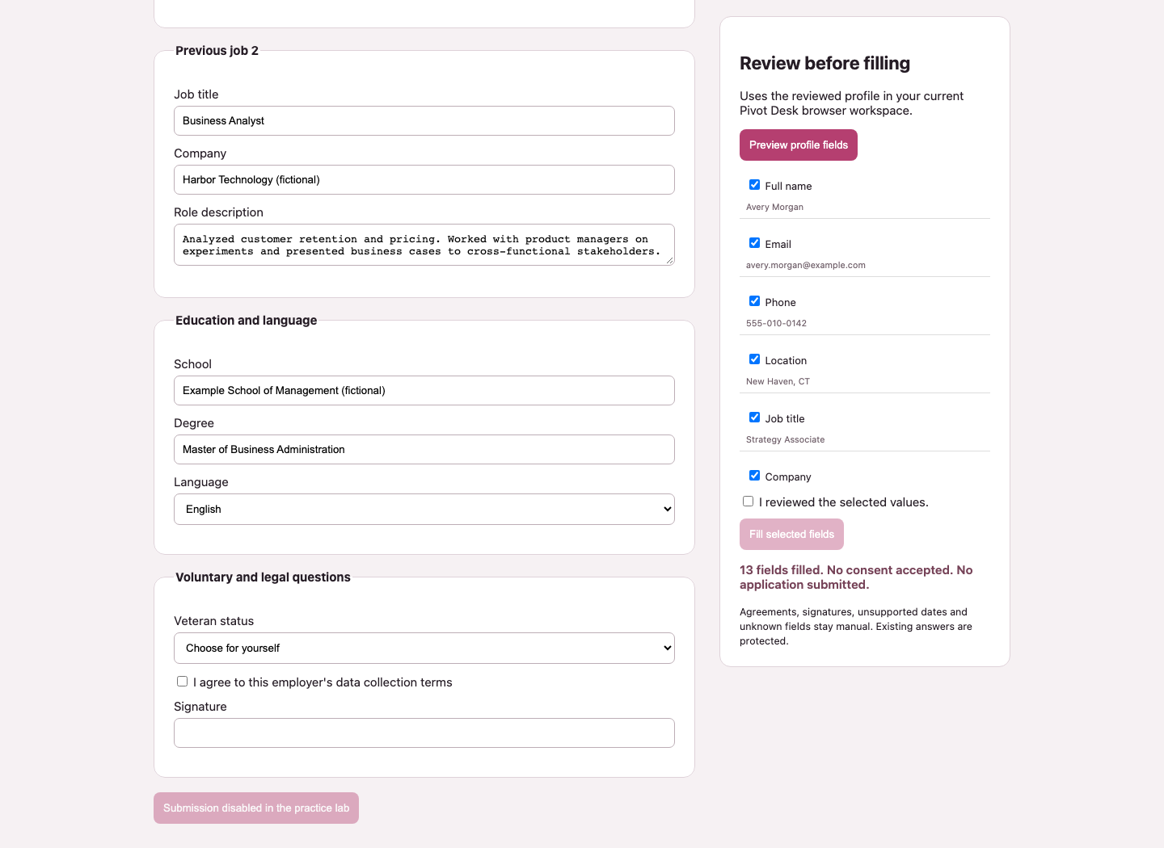
Review is a real boundary
13 fields filled
Fictional demo: contact, work history, education and language.
0 agreements accepted
No signature.
No application submitted.
Unknown dates, legal-name questions, sensitive answers and unsupported controls stay manual.
Notes:
Sources: output/evidence/browser_checks.json, form_regression.json, injection_attempt_1.json and injection_test.json. The image shows the fictional demo, not the owner’s resume. One completed injection case passed; the first provider failure remains inconclusive.

Slide 8
Live test with a real resume
Live run | Input / output | Est. USD
Resume reader | 1,416 / 1,750 | $0.10166
Heartflow marketing (unplanned) | 4,221 / 978 | $0.09111
Heartflow corporate strategy | 4,392 / 1,004 | $0.09412
Stripe strategy / analytics | 3,535 / 926 | $0.08165
13 supported facts. Graduation timing flagged.
The role-selection race is fixed; three repeat reviews hit the cache.
Estimated total: $0.36854, not the provider invoice. Personal details and detailed outputs stay private.
Notes:
Sources: output/evidence/private_resume_live_check.json, search_race_before.json and search_race_regression.json. The owner explicitly allowed AI processing while keeping publication on hold. The reader extracted 13 facts; all exact quotes were validated and the assistant reviewed them. This is not a human usability trial. A search race initially selected a different Heartflow role; that paid review is retained. The request-generation guard and loading interlock now pass a controlled browser regression. No private fact text or contact details are included in this deck.

Slide 9
The next evidence to earn
01 Observe a real applicant and measure the task.
02 Verify one permitted employer form before submission.
03 Improve matching with labeled near-miss roles.
04 Harden privacy and operations before wider deployment.
Public source. Independent user trial still needed.
Astra retained after the owner reported instructor permission to use any model.
Notes:
Sources: docs/user_trial.md, output/submission_checklist.md and README.md. A timed independent human trial and authenticated Workday validation remain uncompleted. The printed brief limits the course key to Luna; the owner subsequently reported that the instructor allowed any model in class and retained Astra. This is attributed to the owner rather than an independently verified announcement. The repository is public; Canvas upload remains a final student step.

