Slide 1
连续竞价市场微观结构
主讲人 韦立坚 博士

Slide 2
要点
了解连续竞价市场微观结构
掌握市场质量的衡量指标
了解资产短期价格的形成机制
掌握连续竞价市场的建模思想

Slide 3
第一部分：基础知识

Slide 4
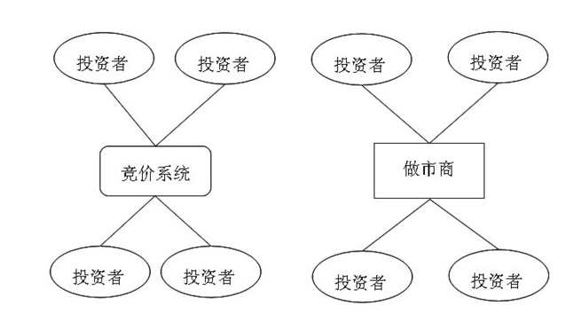
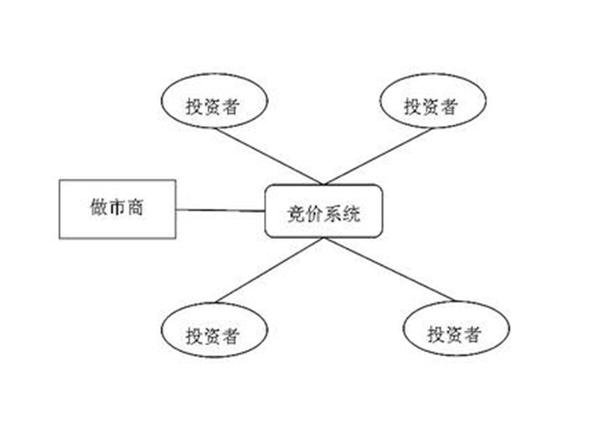
连续竞价市场
连续竞价市场与做市商市场
混合市场
纽交所、纳斯达克

Slide 5
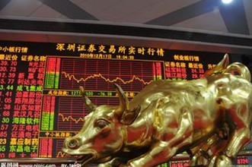


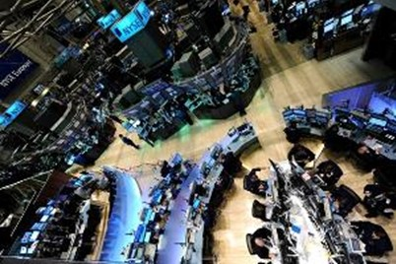

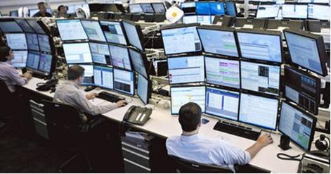
Trading in security markets
information
Trade information
orders
orders
orders
Limit Order Book
orders

Slide 6
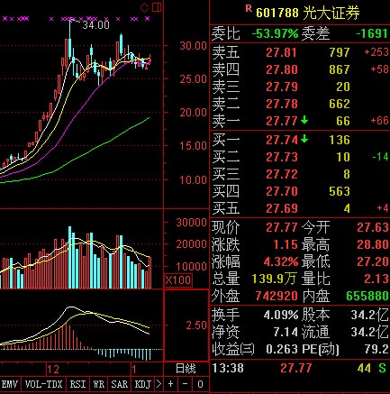
An example of limit order book
The limit order book reports the best 5 asks and the best 5 bids
The bottom reports the transaction happened at 13:38 pm. The trade price is 27.77, the transaction was initiated by a market sell order, the trading volume is 44 .

Slide 7
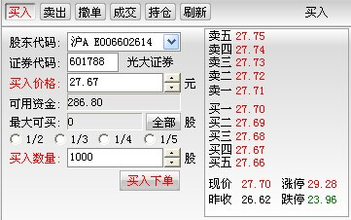
Limit buy order
Buy price
Order size
A limit order gains price-improvement but does NOT result in an immediate matching upon submission, it faces unexecuted risk and has waiting cost.

Slide 8
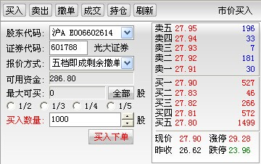
Market buy order
Order size
A market order that results in an immediate matching upon submission
but has more transaction cost than a limit order.

Slide 9
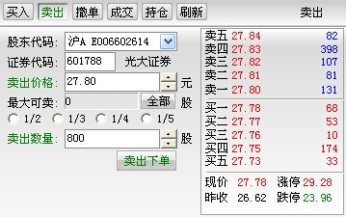
Limit sell order
Sell price
Order size

Slide 10
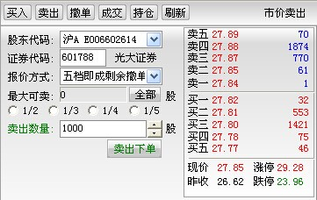
Market sell order
Order size

Slide 11
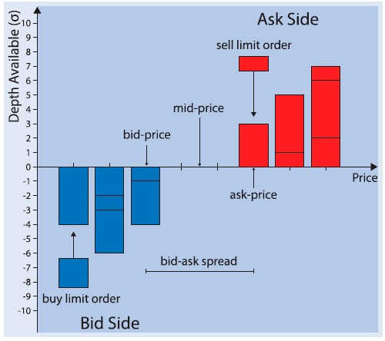
Schematic of limit order book
ALO: aggressive limit order
LOA: limit order at the quote
LOA
ULO: unaggressive limit order
ULO
MO: market order
ALO
MO

Slide 12
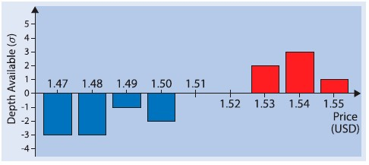
Indicators of limit order book
The best bid
The best ask
The minimize tick size
The mid-price
The bid-ask spread
The relative bid-ask spread

Slide 13
Indicators of order book
Depth of buy side:
where is the order size of limit buy at price
Depth of sell side:

Slide 14
Price-time priority
Most markets use price-time priority, such as Shanghai and Shenzhen stock markets.
X2: 2 shares submitted at 10:02am
X3: 2 shares submitted at 10:03am
X1: 1 share submitted at 10:00am

Slide 15
Transaction initiated by a market order
Market orders
X1: market buy with 1 share
X2: market buy with 3 shares

Slide 16
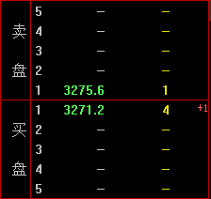
沪深300股指期货IF1509合约的交易
bid-ask spread=4.4 CNY=22 ticks!
Relative bid-ask spread=4.4/3273.4=13.4bps.
Depth of buy side=4
Depth of sell side=1

Slide 17
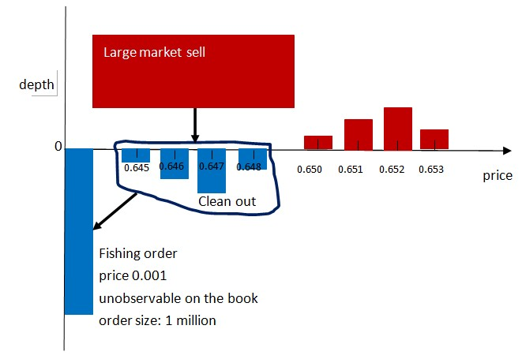
The risk of market orders
“2.28” Fishing Order Incident
On Feb. 28, 2007, Haier Warrant
At 9:15:01 am, a buyer submitted a large limit buy with 1 million shares with price 0.001 (Fishing order).
At 9:30:01 am, a seller submitted a large market sell executed with the Fishing Order for 820 thousands shares!
The fishing order earned about 700-times profit!
Ask side
Bid side
Opening price: 0.650
Closing price: 0.669

Slide 18
Transactions initiated by a marketable limit order
Marketable limit orders
Most traders prefer to use marketable limit orders in Chinese security markets.
X1: limit buy, price 1.54, 8 shares
2
3
3
new limit buy: price 1.54, 3 shares

Slide 19
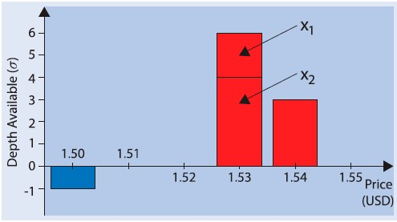
Price-size pro-rata priority
In some futures markets: such as Chicago Mercantile Exchange , EurExchange money market futures.
A market buy with 3 shares
2 shares submitted at 10: 02 am
1
4 shares submitted at 10: 00 am
2
f1=X1/(X1+X2)=1/3
f2=X2/(X1+X2)=2/3

Slide 20
Transaction cost of market order
Limit orders supply liquidity.
Market orders consume liquidity, they pay the bid-ask spread to obtain the trade immediacy.
Effective bid-ask spread: two times of the distance of the trade price to the mid-price :
Relatively effective bid-ask spread:
The effective bid-ask spread measures the transaction cost of market orders. A larger effective bid-ask spread indicates a larger transaction cost.

Slide 21
Order choice is a key issue in limit order markets
Order types: market order, aggressive limit order, limit order at the quote, unaggressive limit order.
Market order gets the trade immediacy but pays more transaction cost; limit order gains price improvement but faces unexecuted risk and has waiting cost.
A key issue is that how traders determine their order choice according to the conditions of limit order book.
If you have private information, how do you maximize your trading profit?
If you need to trade (buy or sell) large amount shares, how do you minimize your transaction cost?

Slide 22
连续竞价市场流动性
流动性（Liquidity)指标
流动性就是市场的一切（O’Hara, 1995)
价格冲击指数：即买卖一定金额股票所产生的反向价格变化的平均成本
流动性指数：指使价格上涨 1%所需要的买入金额和使价格下跌1%所需要的卖出金额的均值
买卖价差
订单簿深度 (order book depth)

Slide 23
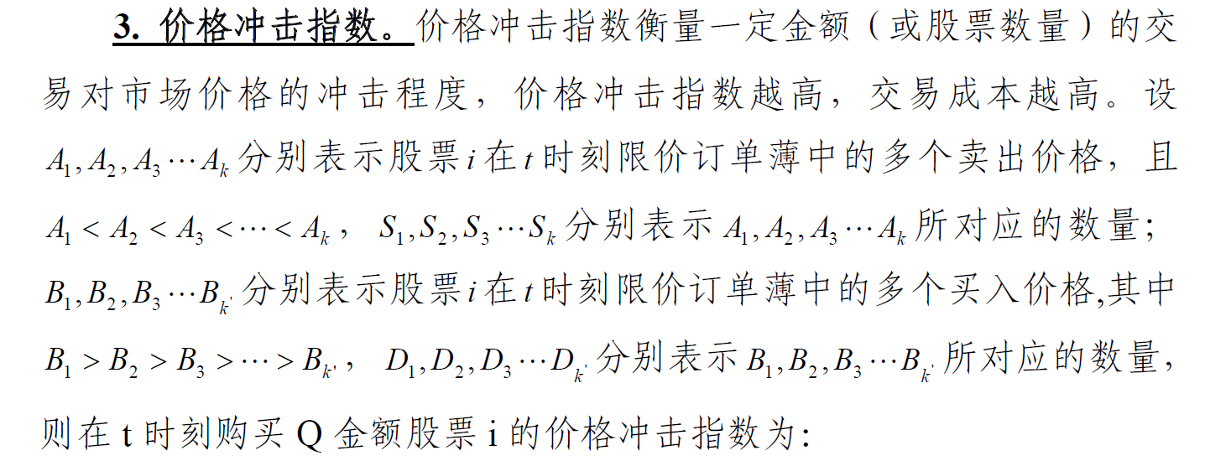
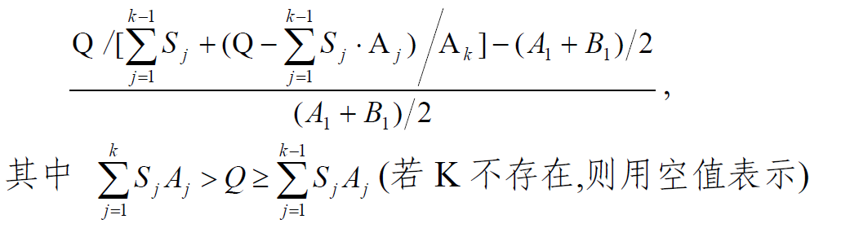
市场价格冲击指数

Slide 24
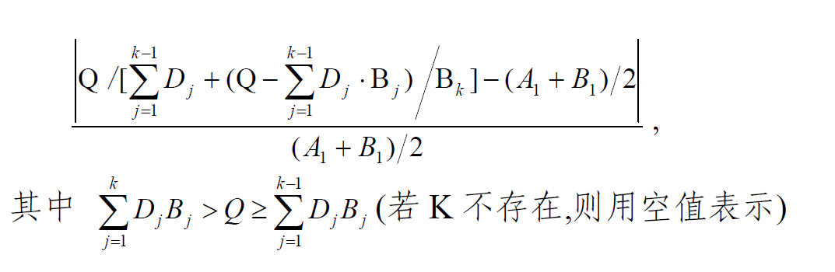
价格冲击指数
卖出价格冲击指数
市场价格冲击指数等于买入和卖出冲击指数的均值。

Slide 25
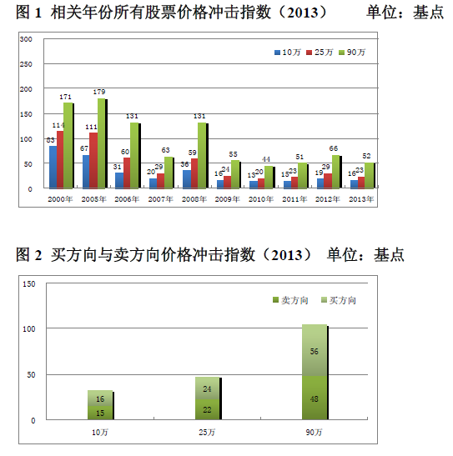
上海证券交易所的价格冲击指数
购买10万金额

Slide 26
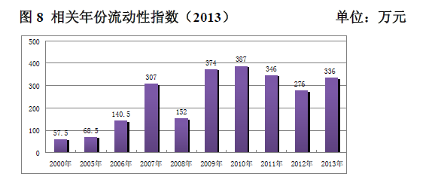
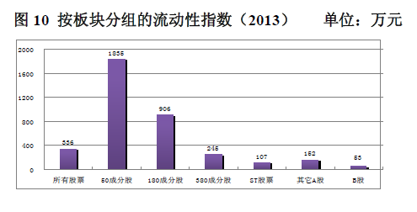
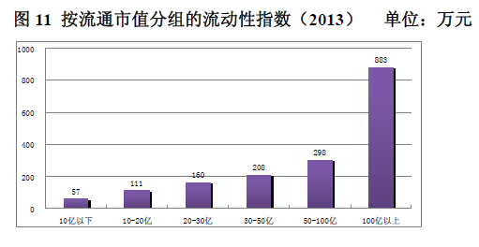
上交所的流动性指数
价格变动1%所需要的金额

Slide 27
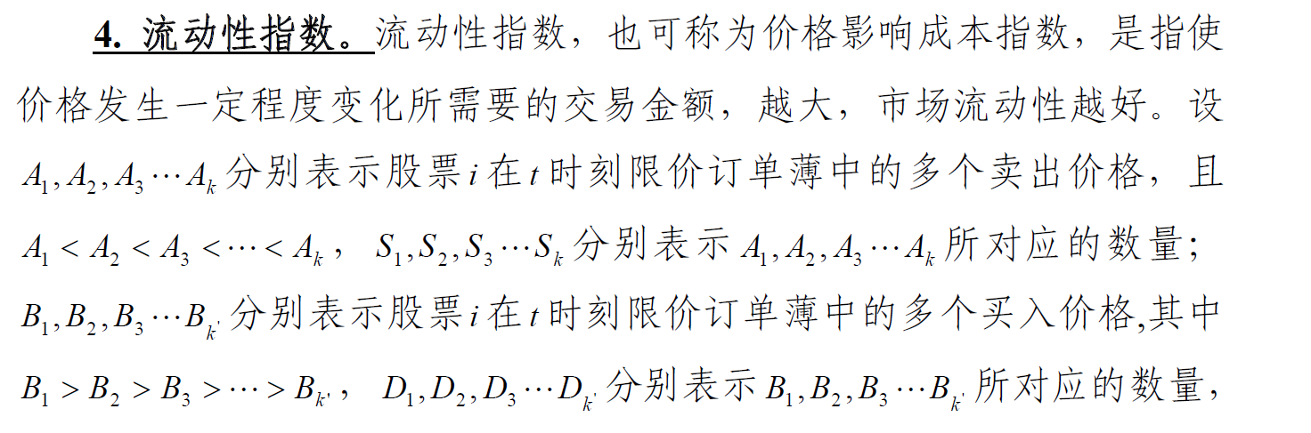
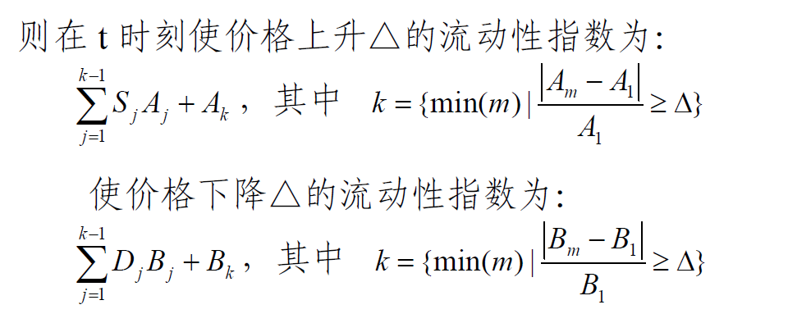
流动性指数
市场流动性指数是上升和下降指数的平均值

Slide 28
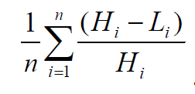
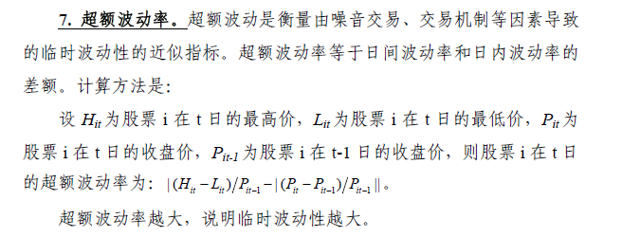
市场波动性
波动性指标
方差/标准差（一般采用5分钟收益率的标准差）
日内波动率

Slide 29
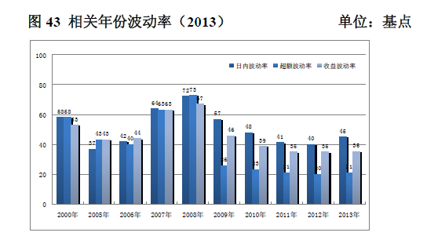
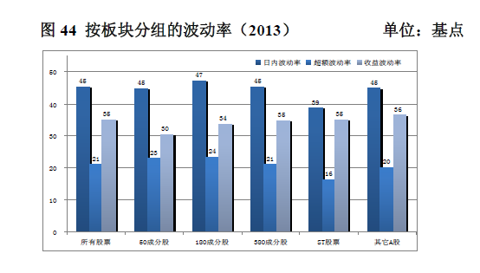
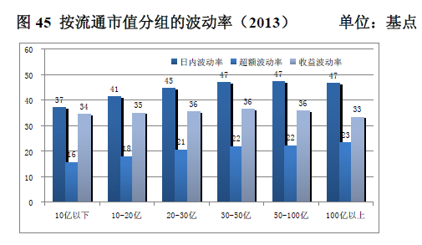

Slide 30
第二部分：理论分析基础与实践
请自行学习有关文献和上交所、深交所的市场质量报告

Slide 31
资产价格短期形成机制
图1-1 资产短期价格形成逻辑过程

Slide 32
Information, Trading & Learning in Limit Order Markets
Goettler R. L. ,Parlour, C. A.andRajan U. Informed traders and limit order markets. Journal of Financial Economics. 2009.93 (1). 67–87.
Chiarella C., He, X. and Wei, L. Learning, information processing and order submission in limit order Markets，Journal of Economic Dynamics and Control. 2015. 61，245-268
Gould, M., Porter, M., Williams, S., Fenn, D. and Howison, S. D. Limit order books. Quantitative Finance. 2013.13(11), 1709-1742.
Rosu, I. Order Choice and Information in Limit Order Markets. inMarket Microstructure: Confronting Many Viewpoints, Eds. Abergel, F. and Bouchaud, J. and Foucault, T. and Lehalle, C.A. and Rosenbaum, M., Wiley. 2012. 41–60.
Chiarella, C., Iori, G. and Perello, J. The impact of heterogeneous trading rules on the limit order book and order flows. Journal of Economic Dynamics and Control. 2009. 33(3), 525 –537.

