Slide 1
Punch-through fits (Fermi function)
Previous fit
Central Pixel fit

Slide 2
Some examples (V->MeV calibrations with several data sets
+ proton punch through).
Comparisons of the two methods.

Slide 3
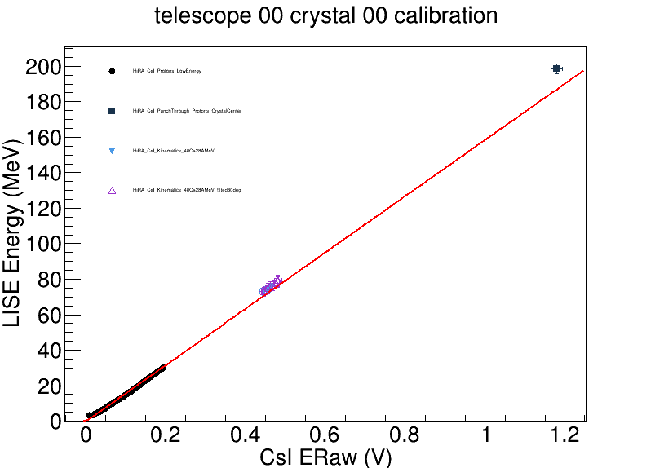
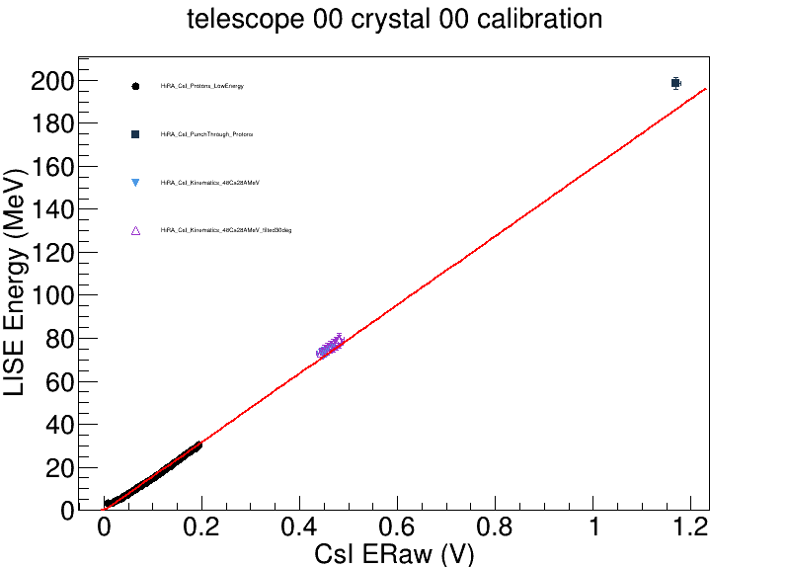
Central Pixel
Previous Fit

Slide 4
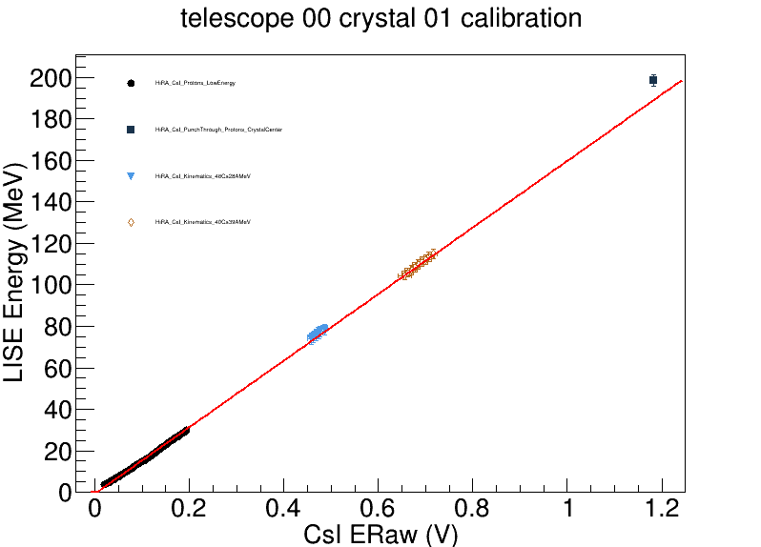
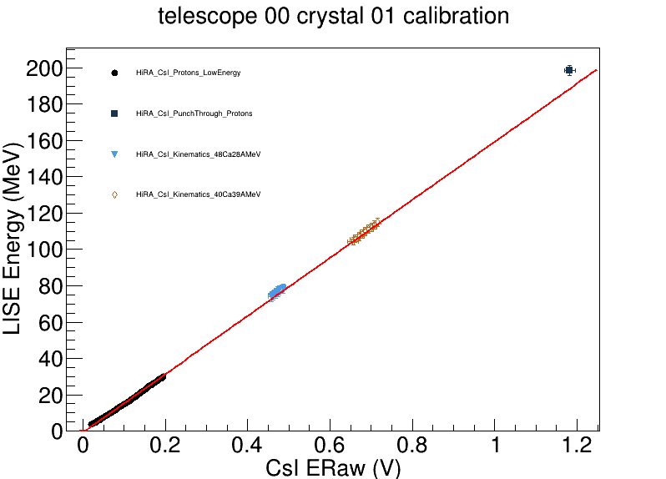
Central Pixel
Previous Fit

Slide 5
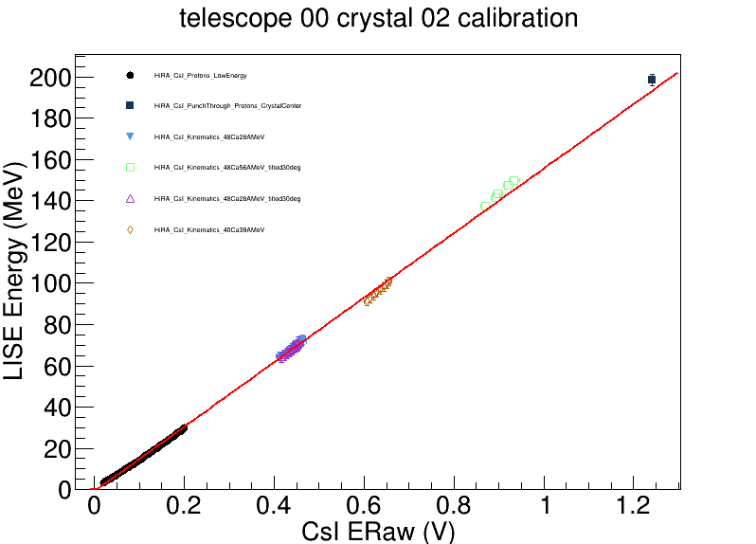
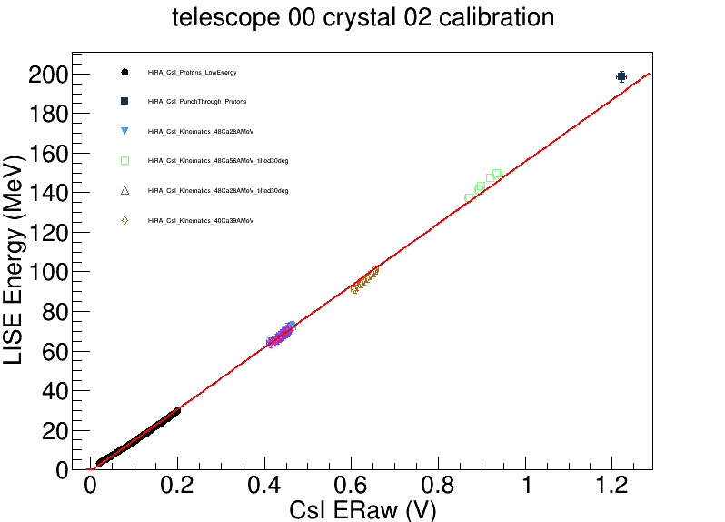
Central Pixel
Previous Fit

Slide 6
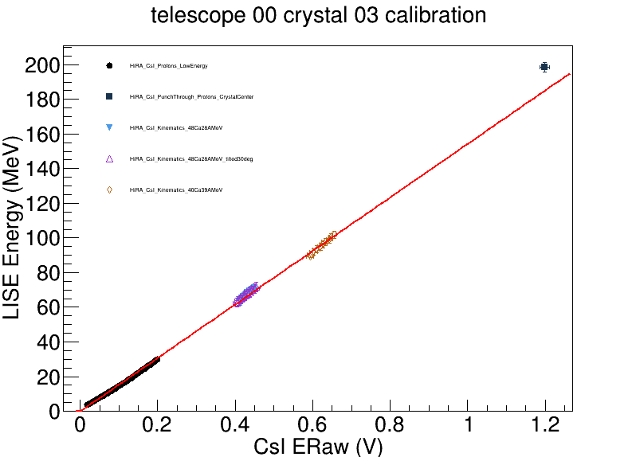
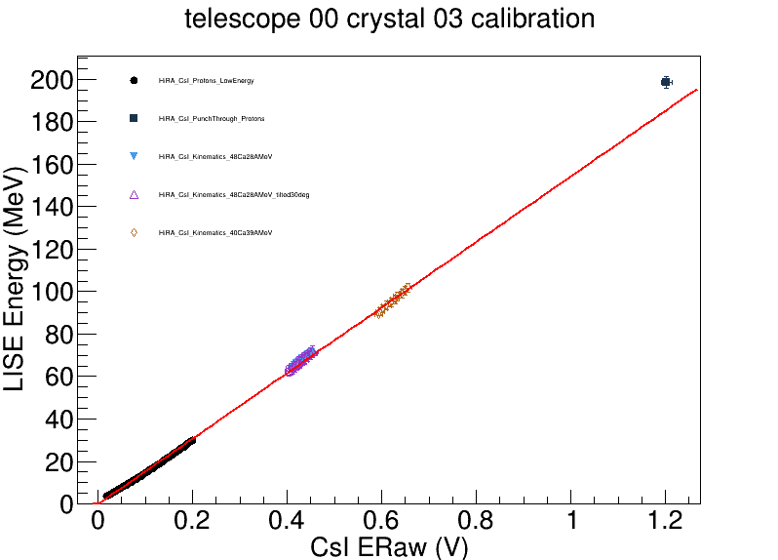
Central Pixel
Previous Fit

Slide 7
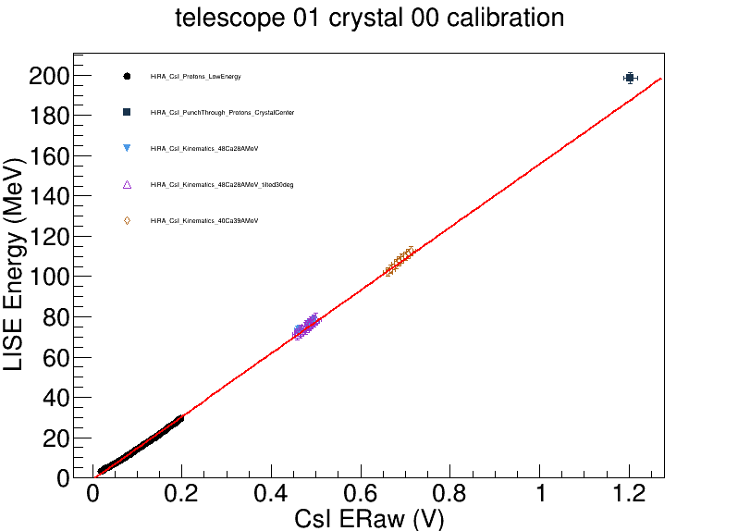
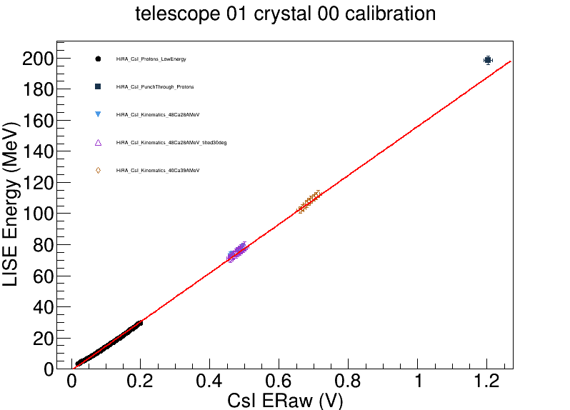
Central Pixel
Previous Fit

Slide 8


Central Pixel
Previous Fit

Slide 9
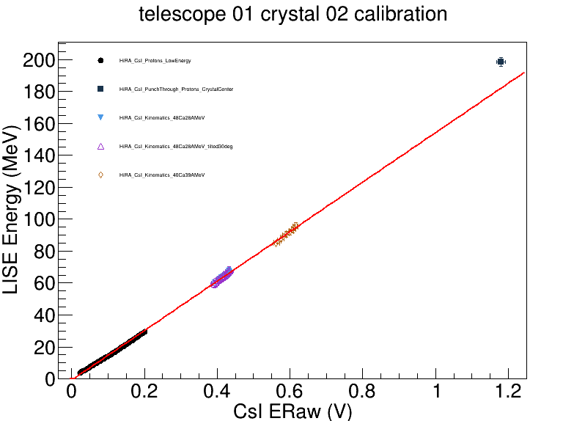

Central Pixel
Previous Fit

Slide 10
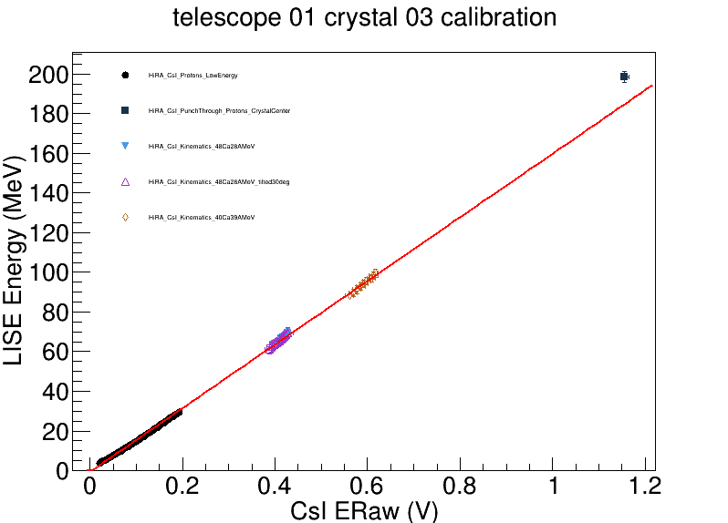

Central Pixel
Previous Fit

Slide 11
Linear extrapolation of the calibration curve at low energy.
Current punch through point
Prediction via exrapolation

