Slide 1
HiRA CsICalibrations
Oct 2nd , 2018
Guan

Slide 2
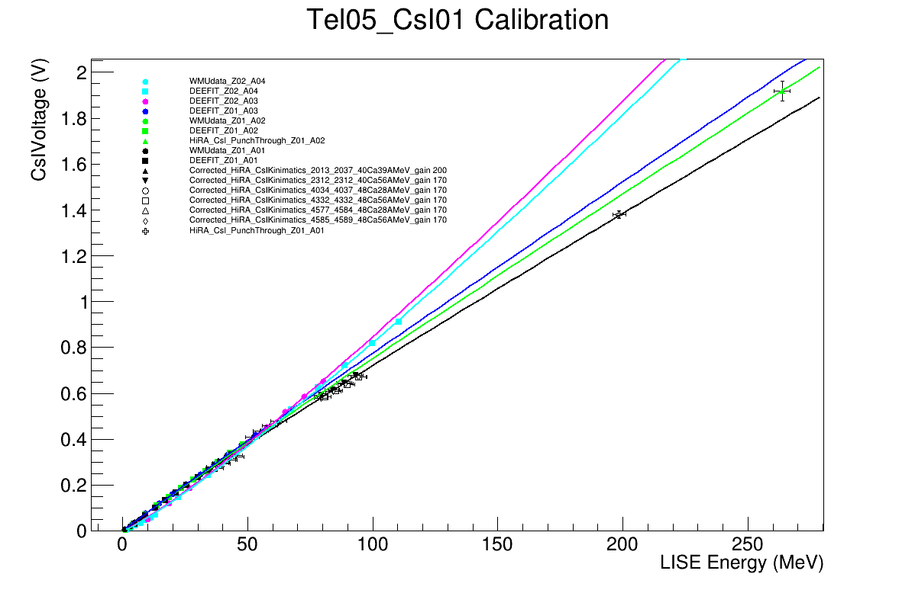
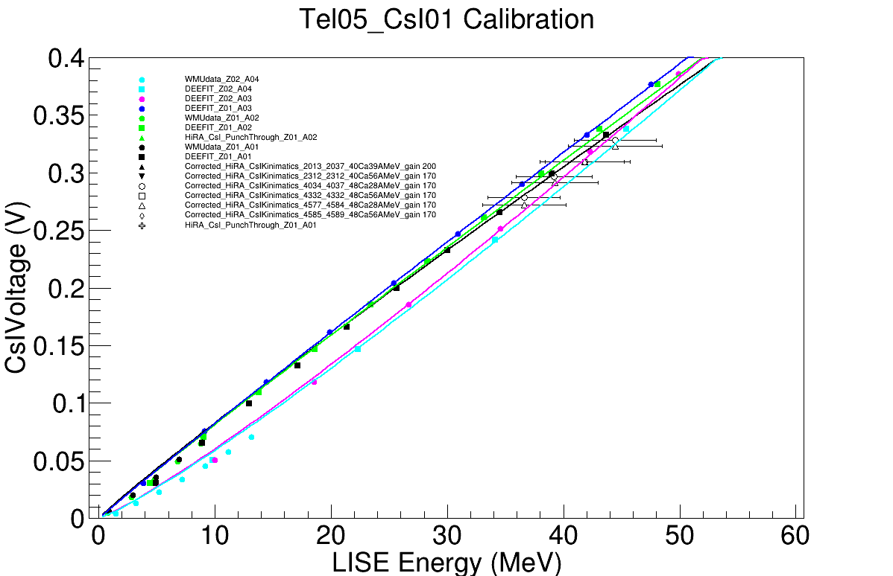

Slide 3
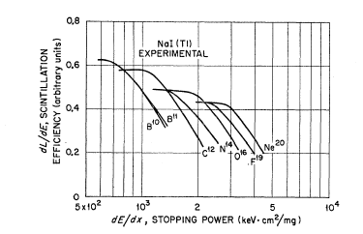
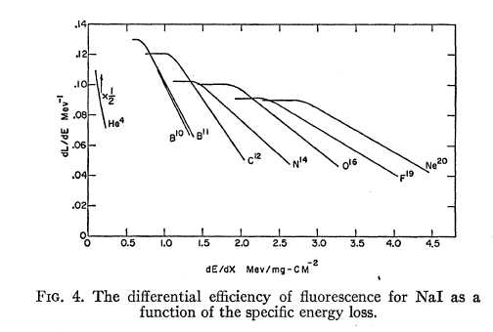
Axel Meyer and R. B. Murray
Phys. Rev. 128(1962) 98
E. Newman and F. E. Steigert
Phys. Rev. 118(1960) 1575

Slide 4
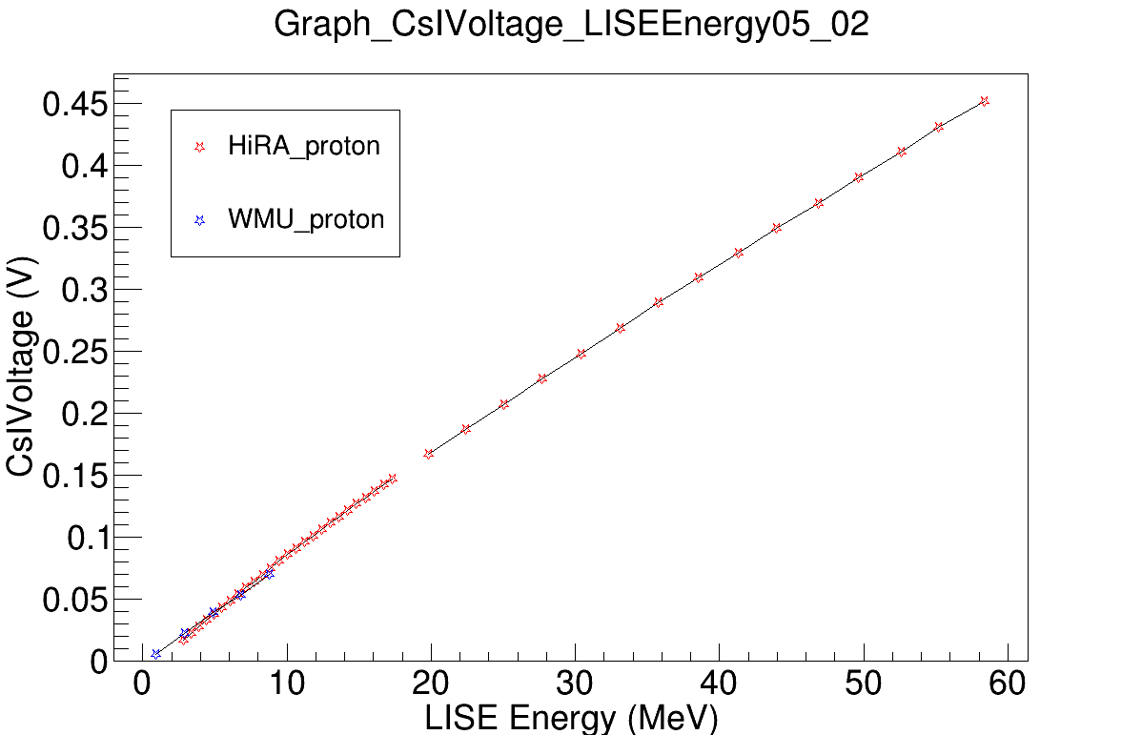

Slide 5
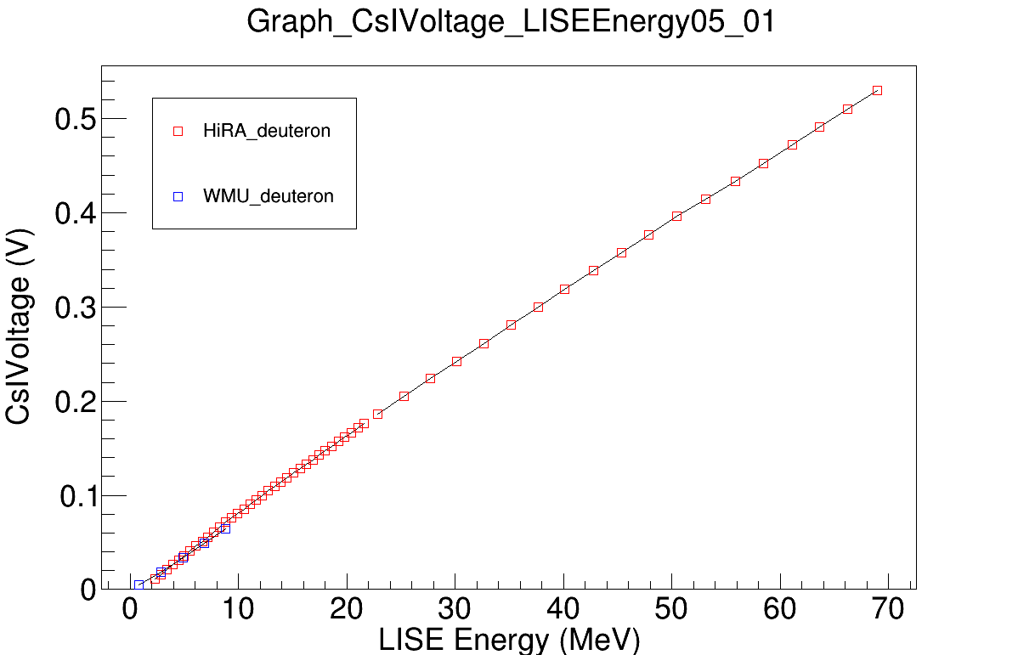

Slide 6
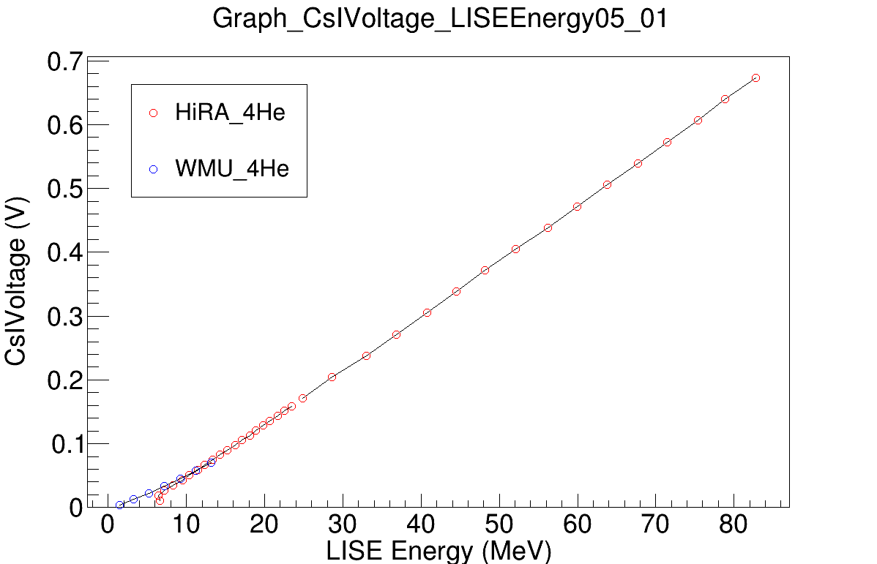

Slide 7
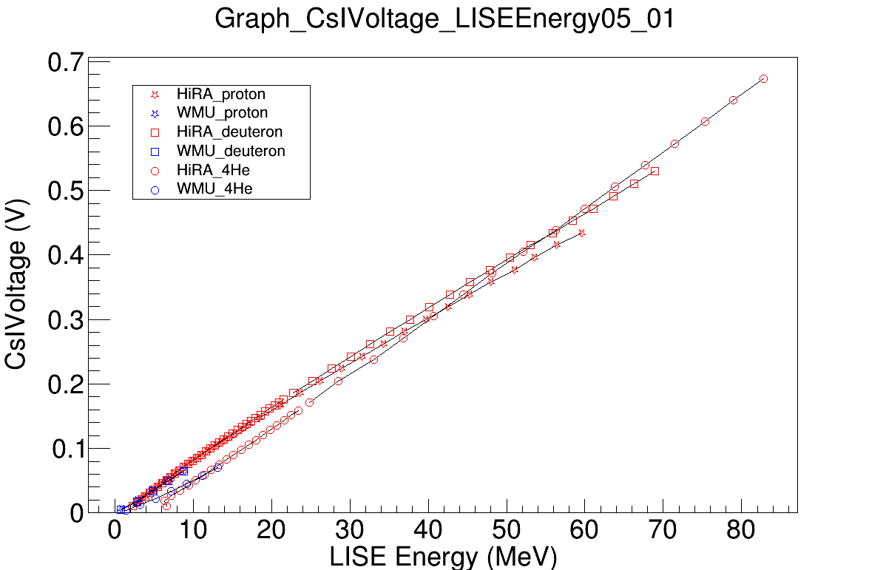

Slide 8
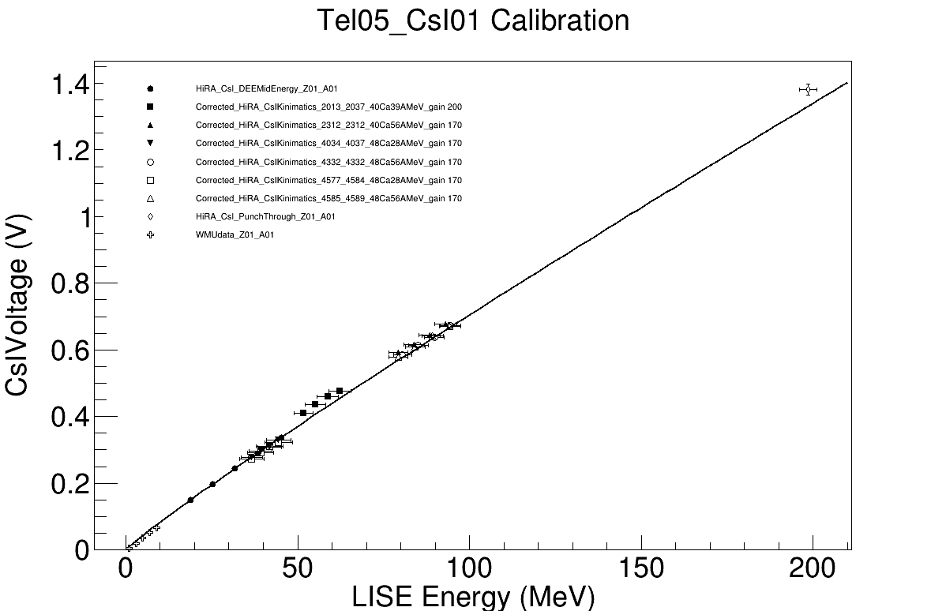
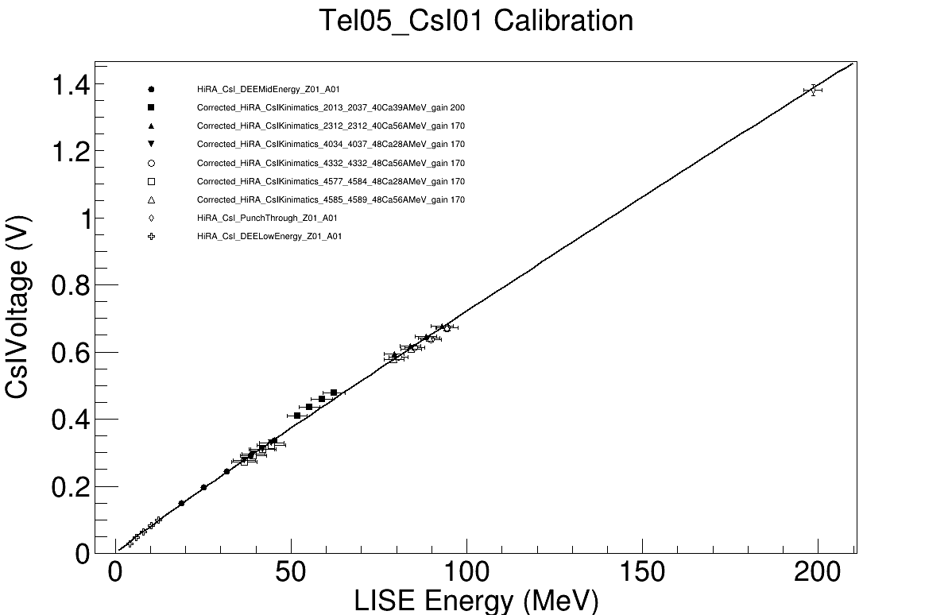
Low Energy points not included !
proton
WMU points not included !
proton

Slide 9
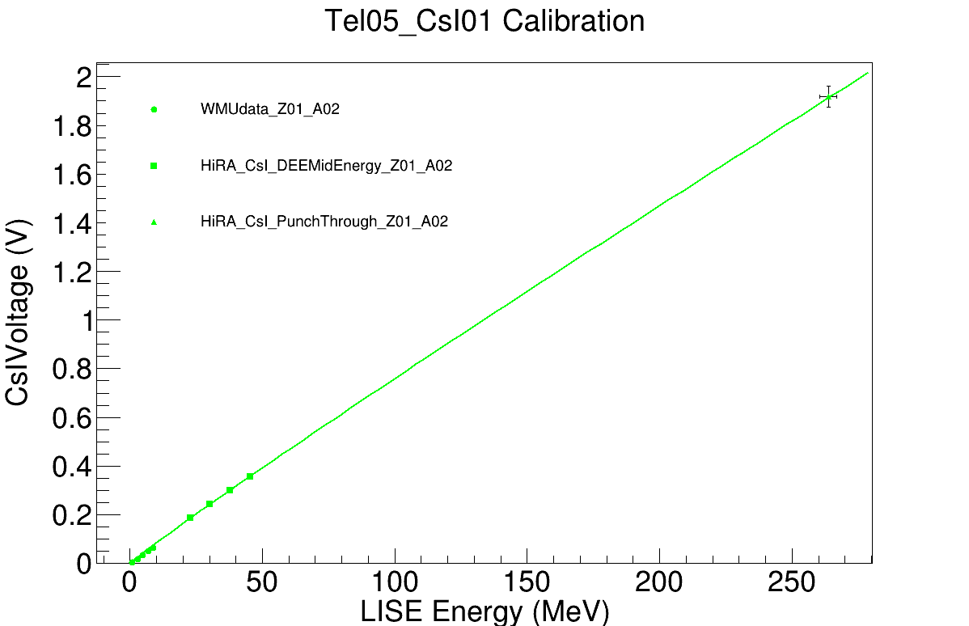
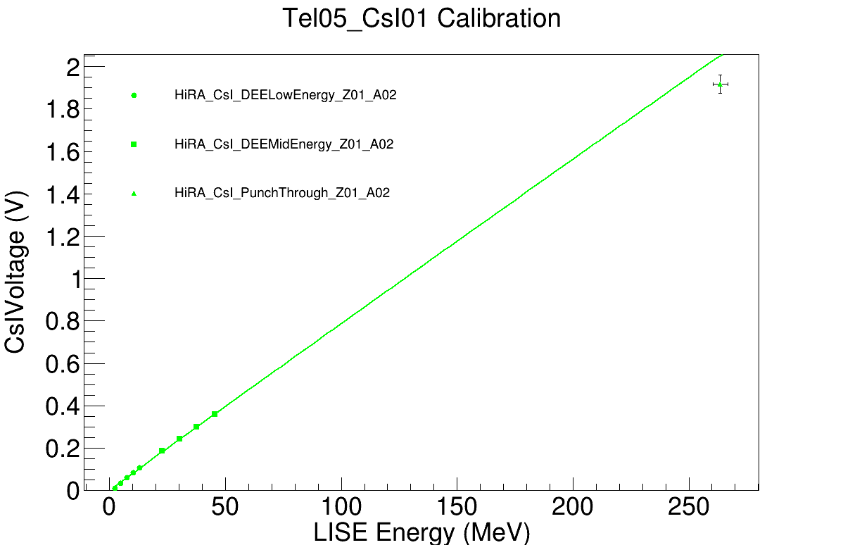
Low Energy points not included !
deuteron
WMU points not included !
deuteron

