Slide 2
Punch-through fits (Fermi function)
Previous fit
Central Pixel fit

Slide 3
Some examples (V->MeV calibrations with several data sets
+ proton punch through).
Comparisons of the two methods.

Slide 4
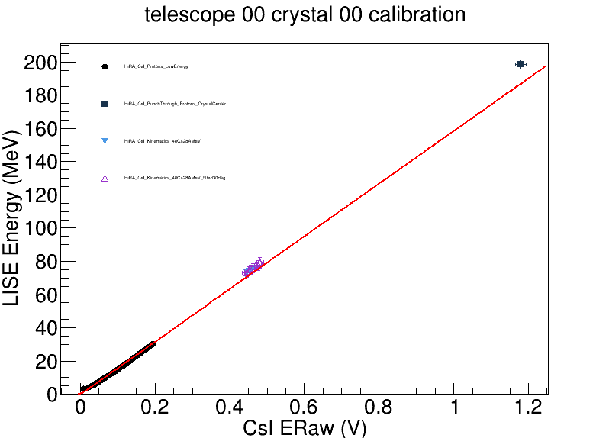
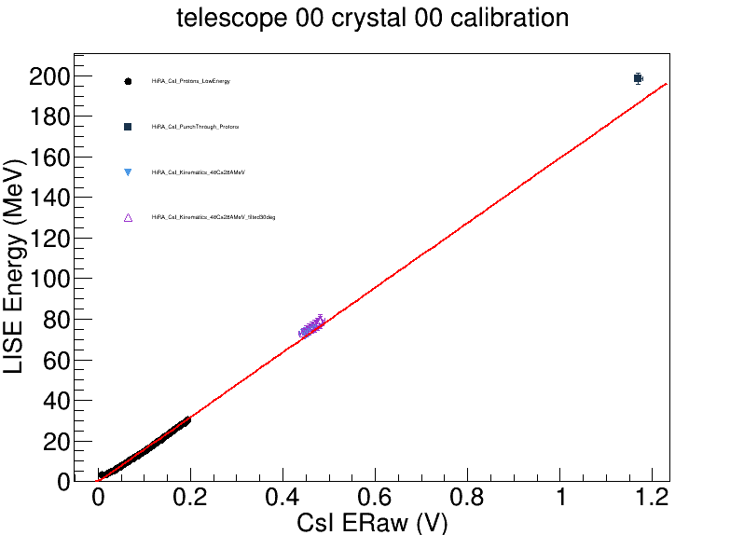
Central Pixel
Previous Fit

Slide 5
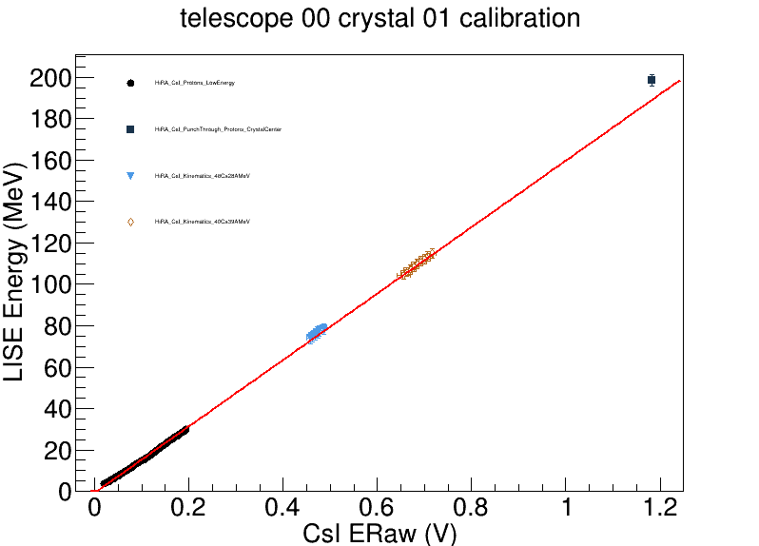
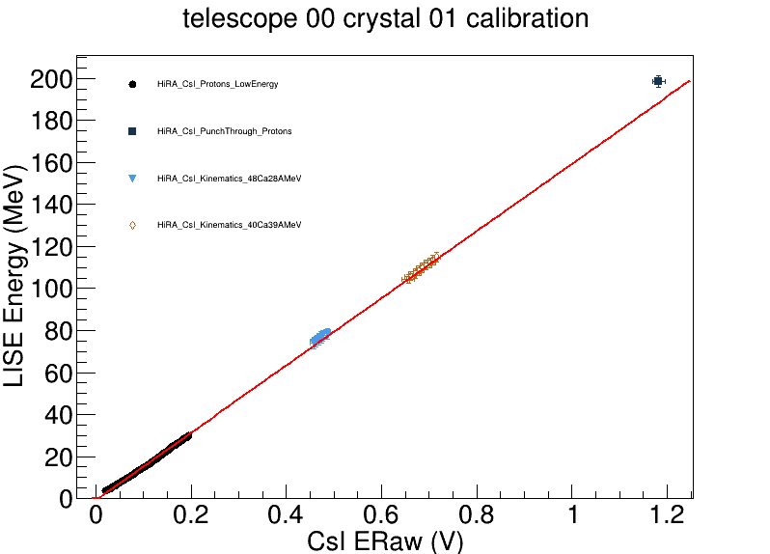
Central Pixel
Previous Fit

Slide 6
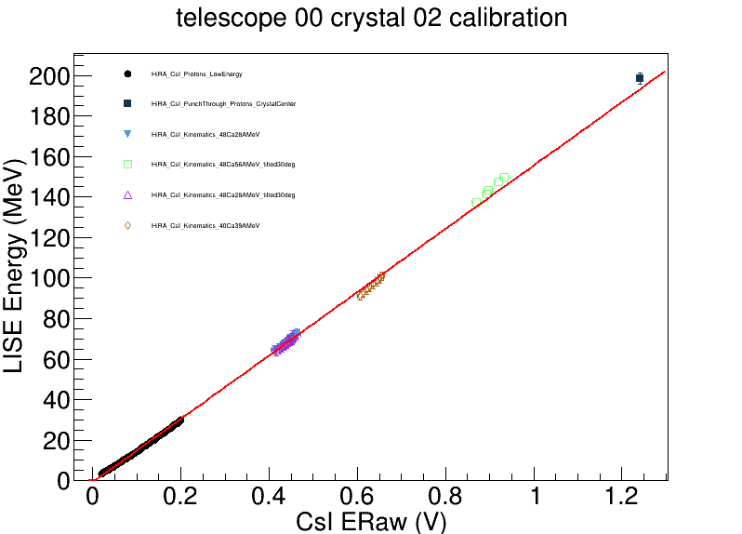
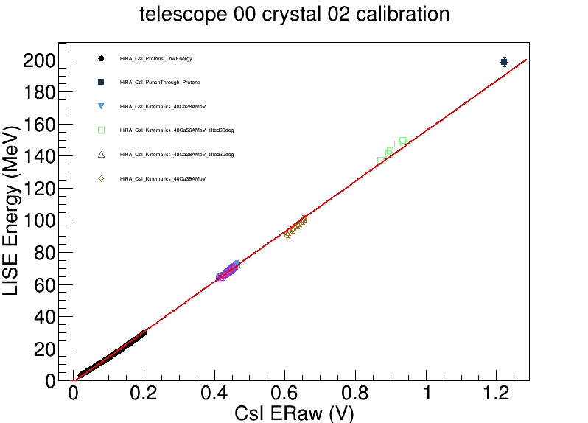
Central Pixel
Previous Fit

Slide 7
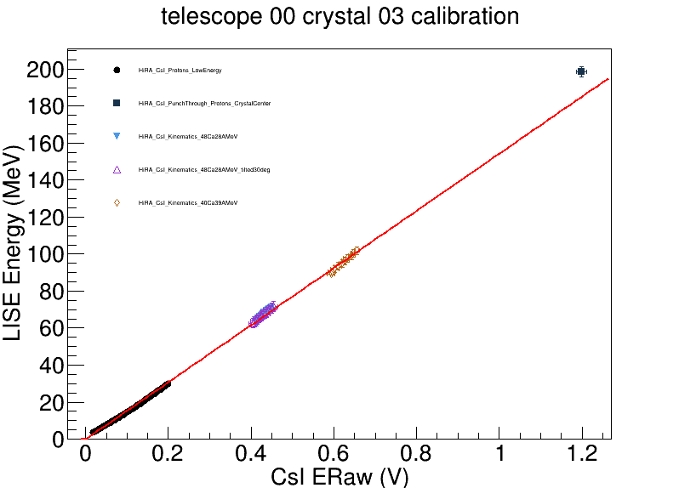
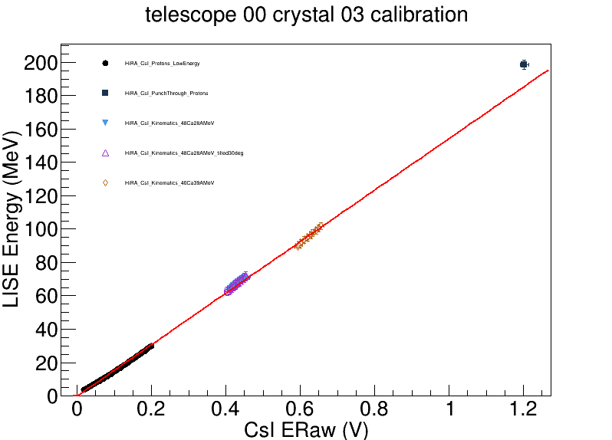
Central Pixel
Previous Fit

Slide 8
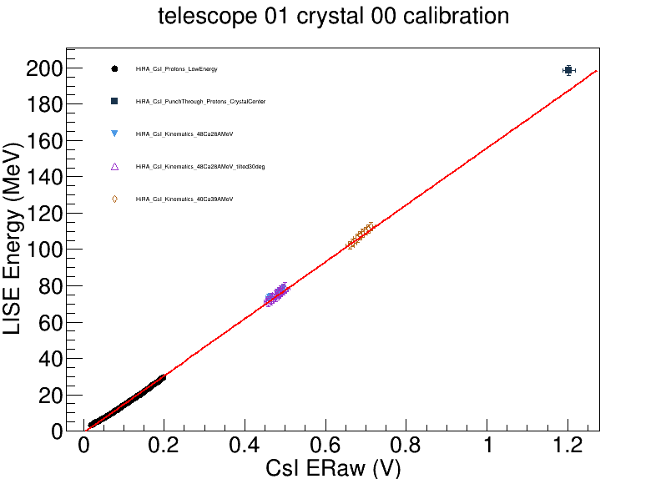
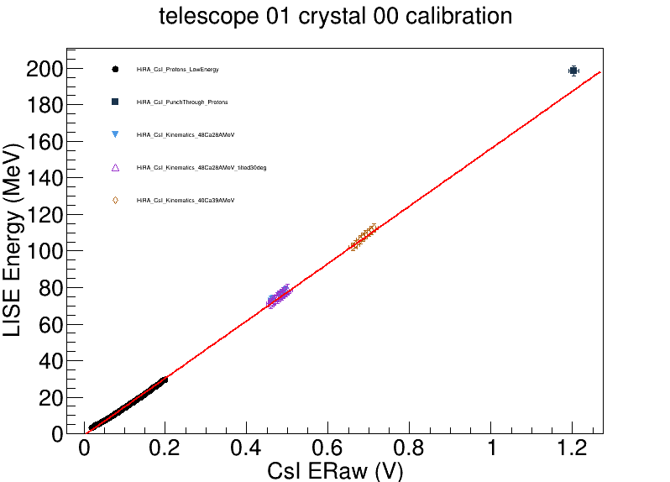
Central Pixel
Previous Fit

Slide 9


Central Pixel
Previous Fit

Slide 10
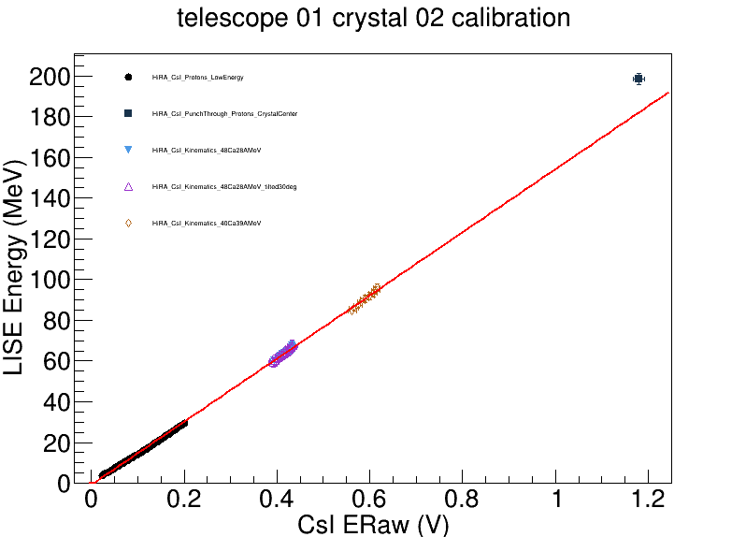

Central Pixel
Previous Fit

Slide 11
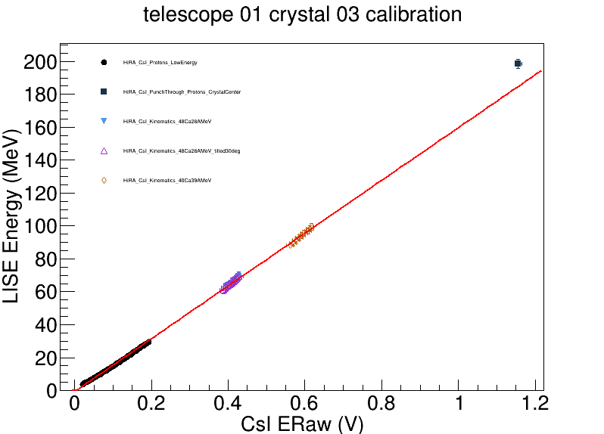

Central Pixel
Previous Fit

Slide 12
Linear extrapolation of the calibration curve at low energy.
Current punch through point
Prediction via exrapolation

Slide 13
HiRA CsI Calibration for protons
(Low Energy DEE points + punch through)

Slide 14
Data from runs:
2570 – 2573
2620 – 2630
2575 – 2578
2592 – 2611
Zoom on
punch through points
DE-E plots for each individual CsI with strip front/CsI matching condition.
example from telescope 0 CsI 1

Slide 15
Fits for punch through points determination

Slide 16
Calibration fits for telescope 0 (linear assumption)
punch-through
Low energy points
from DE-E

Slide 17
DE-E with all CsI merged in the same plot
for each telescope
Forward telescope
Backward telescope

Slide 18
Calibration problems at low energy
DE-E line theoretically predicted for
1537 um Silicon
0.29 mg/cm2 Mylar (2.076 um)
10 cm CsI
The CsI energy at low channel values is under-estimate (shift of 5MeV for a Si energy of 11.3 MeV).

