Slide 1
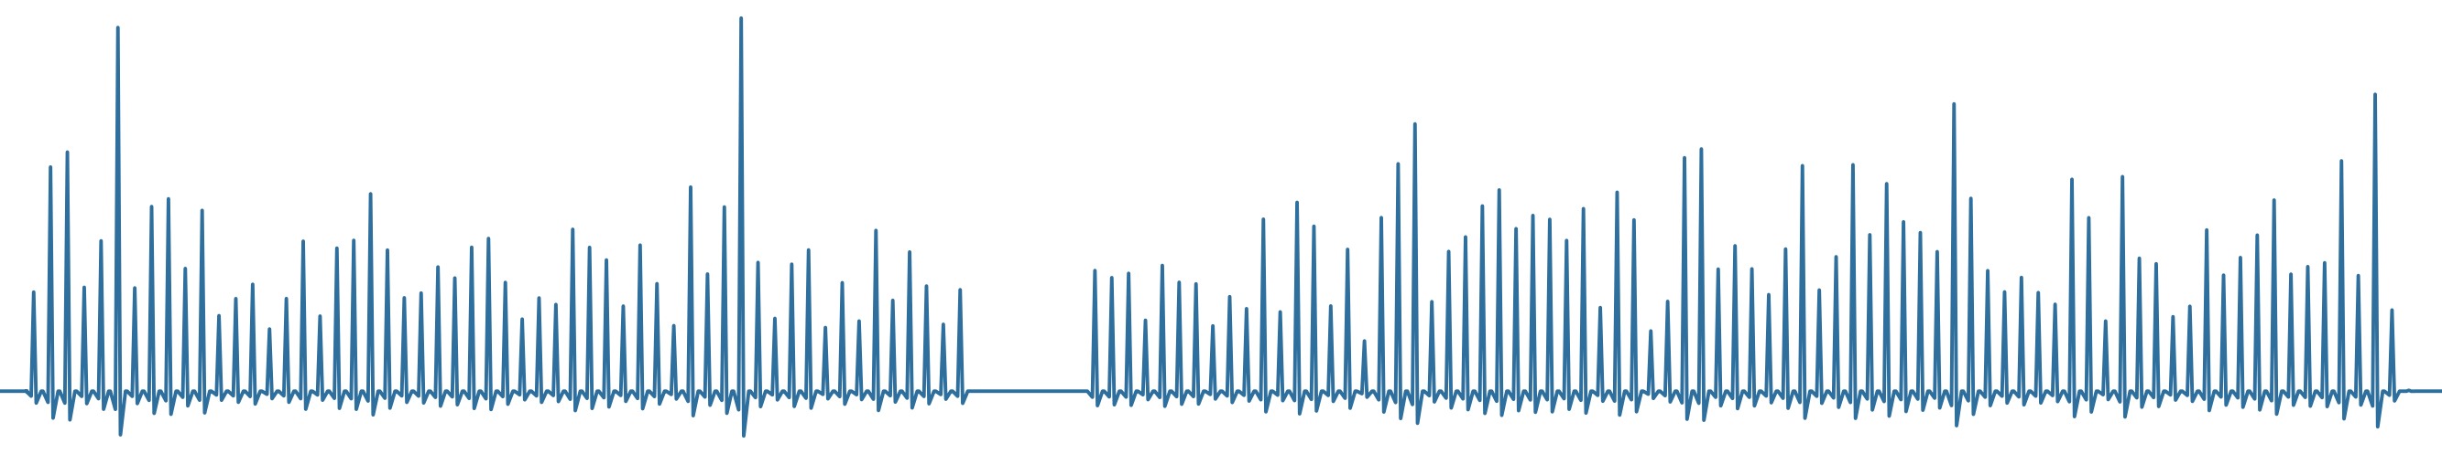
Noéa
Reading water as rhythm, memory and mood
Affective computing for water systems · Meeting of Waters, Geneva
Annual peak daily rainfall, Hong Kong, 1884–2025, drawn as a pulse. The flat stretch is 1940–46, missing from the record.
Notes:
Noéa translates long hydrological records into something people can experience. The pulse below is real data: Hong Kong's annual peak daily rainfall, 1884 to 2025.

Slide 2
Data can show that a river is changing. It rarely makes anyone feel it.
Detect
The missing layer
Respond
Stations now measure rainfall, rivers and glaciers at scale.
Turning measurement into meaning people can experience.
Decisions stall between knowing and acting.
Noéa works in the middle.
Noéa · Meeting of Waters, Geneva
2
Notes:
More stations measure more rain and more rivers every year. The data can tell us a river is changing. What it rarely does is make anyone feel it, and without that, decisions stall.

Slide 3
It reads a record the way a cardiologist reads an ECG
A long record
Diagnostics
Two affective values
XR and sound
Daily rainfall or river discharge, covering decades to centuries.
Peaks and the gaps between them, return periods, flow duration, recession, the seasonal cycle.
Valence: pleasant ↔ distressing.
Arousal: calm ↔ activated.
Plus four physical readouts: size, glow, texture, tempo.
Designed to feed immersive and sonic experiences. The output format is still provisional.
Noéa · Meeting of Waters, Geneva
3
Notes:
Noéa reads a rainfall or river record the way a cardiologist reads an ECG, looking for rhythm, memory and shock. From that it derives two affective values, valence and arousal: how pleasant or distressing, and how activated. Those are designed to feed an XR and sound experience.

Slide 4
Two layers, kept deliberately apart
Science layer
Curatorial layer
OBJECTIVE
DESIGNED
Hong Kong rainfall, 1884–2025: annual peaks, the gaps between them, return periods.
Rhine and alpine rivers, 8 stations: flow duration, recession, the seasonal cycle.
Never changes for artistic reasons.
How a drought or a flood should feel.
Decided in one place, so it can change without touching the science.
Its output: valence and arousal.
Noéa · Meeting of Waters, Geneva
4
Notes:
There are two layers, kept deliberately apart. The first is plain science: for Hong Kong, over a century of daily rainfall from the Observatory; for the Rhine and its alpine tributaries, eight stations of discharge. The second layer is curatorial. How a drought or a flood should feel is decided in one place, so it can change without touching the science.

Slide 5
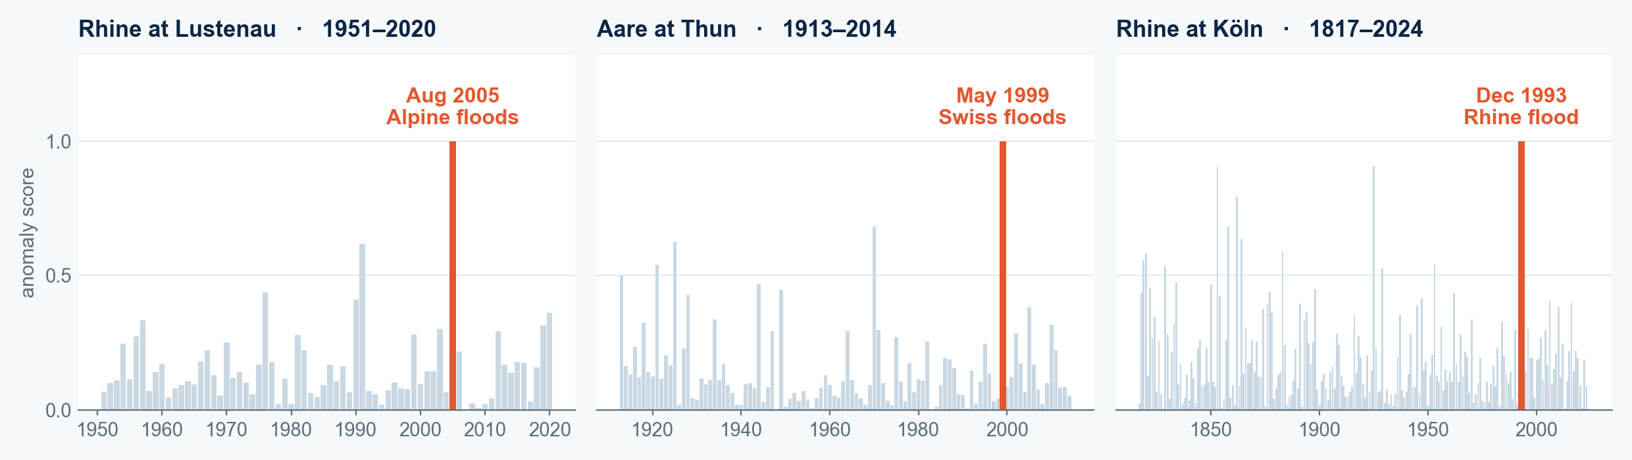
Machine learning finds unusual years
Its one job so far: for each record, an unsupervised model learns what a typical year looks like, then scores how badly each year fails to fit.
The highlighted bar is each station's highest-scoring year. The model was never told these events existed.
Method: PCA reconstruction error, fit separately per station on its own years. Events: Aug 2005 Alpine floods (22–23 Aug), May 1999 Swiss floods (Thun, 15 May), Christmas 1993 Rhine flood (Köln, 24 Dec).
Noéa · Meeting of Waters, Geneva
5
Notes:
Machine learning has one job so far: finding unusual years. For each record, an unsupervised model learns what a typical year looks like, then scores how badly each year fails to fit. On the Rhine, its highest-scoring years include the August 2005 Alpine flood, the May 1999 Swiss flood, and the Christmas 1993 flood. It was never told those events existed.

Slide 6
Built to travel
Each record fits its own model on its own history. Another rainfall or river record can go through the same pipeline.
Hong Kong rainfall
Rhine and alpine rivers
The next record
HONG KONG OBSERVATORY
GRDC · FOEN
NOT YET RUN
Daily, 1884–2025
One model, fit on 134 years
Daily, 8 stations
One model per station, 62–208 years each
Another long rainfall or river series.
Tested on two records so far.
Noéa · Meeting of Waters, Geneva
6
Notes:
The method isn't specific to these places. Each record fits its own model on its own history, so another rainfall or river record can go through the same pipeline. Hong Kong and the Rhine are the two I've tested.

Slide 7
What it doesn't do yet
1
It misses droughts.
The model flags unusual combinations of features, not extremes along the wet–dry axis.
2
The step from anomaly to emotion is designed by hand.
It is not yet learned from people.
3
Nobody has tested whether viewers feel what it intends.
Next: learn the mapping from human responses, and test it with the people who make water decisions.
github.com/qintheory/noea
7
Notes:
What it doesn't do yet: it misses droughts. And most importantly, nobody has tested whether people feel what the system intends. That is the research: learning the mapping from human responses, and testing it with the people who have to decide.

