Slide 1
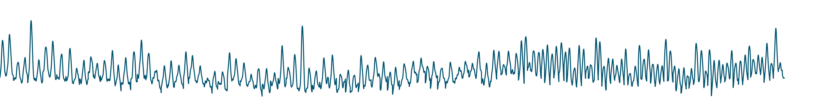

Noéa
Reading water as rhythm, memory and mood
Affective computing for water systems
Hong Kong, 1884–2025: one beat per year. Height is the year's peak daily rainfall; spacing is the time since the previous peak.
Notes:
Noéa translates long hydrological records into something people can experience. The ECG below is real data: Hong Kong's annual peak daily rainfall, 1884 to 2025, one beat per year.

Slide 2
Data can show that a river is changing. It rarely makes anyone feel it.
Noéa works in the missing layer: turning measurement into meaning people can experience.
2
Notes:
More stations measure more rain and more rivers every year. The data can tell us a river is changing. What it rarely does is make anyone feel it, and without that, decisions stall.

Slide 3
It reads a record the way a cardiologist reads an ECG
01
02
03
04
A long record
Diagnostics
Two affective values
XR experience
Daily rainfall or river discharge, covering decades to centuries.
Peaks and the gaps between them, return periods, flow duration, recession, the seasonal cycle.
Valence: pleasant to distressing.
Arousal: calm to activated.
Alongside four physical readouts: size, glow, texture, tempo.
Designed to feed an immersive XR experience. The output format is still provisional.
3
Notes:
Noéa translates hydrological records into something people can experience. It reads a rainfall or river record the way a cardiologist reads an ECG, looking for rhythm, memory and shock. From that it derives two affective values, valence and arousal: how pleasant or distressing, and how activated. Those are designed to feed into an XR experience.

Slide 4
Built to be universal
Each record fits its own model on its own history. Another rainfall or river record can go through the same pipeline.
Hong Kong rainfall
Public record, Hong Kong Observatory. Daily, 1884–2025.
Rhine and alpine rivers
Public records, GRDC and FOEN. Daily, 8 stations.
The next record
Not yet run. Tested on two records so far.
4
Notes:
Our method is built to be universal, where each record fits its own model on its own history. Public records of Hong Kong and the Rhine are the two we've tested. And another rainfall or river record can go through the same pipeline.

Slide 5
Two layers, kept deliberately apart
Diagnostic layer
Curatorial layer
PLAIN SCIENCE
DESIGNED
Hong Kong rainfall, 1884–2025: annual peaks, the gaps between them, return periods.
Rhine and alpine rivers, 8 stations: flow duration, recession, the seasonal cycle.
Measures what happened, and is never adjusted for artistic reasons.
Decides how the results should feel: how alarming, how heavy.
Currently kept separate from the measurements, so the feeling could be redesigned without changing any of the science.
Its output: valence and arousal.
5
Notes:
There are two layers, kept deliberately apart. The first diagnostic layer is plain science: for Hong Kong, over a century of daily rainfall; for the Rhine and its alpine tributaries, eight stations of discharge. The second layer is curatorial, which is currently kept separate from the measurements, so the feeling would be redesigned without changing any of the science.

Slide 6
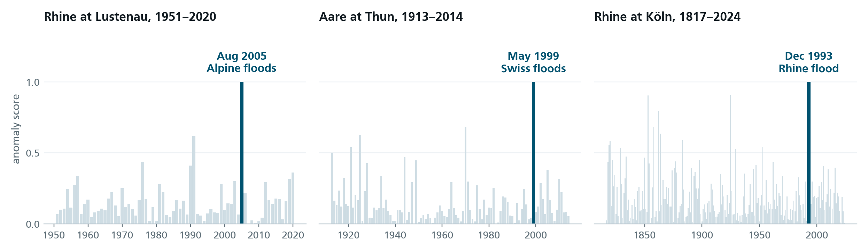
Machine learning finds unusual years
Its one job so far, unsupervised: learn what a typical year looks like, then score how badly each year fits.
The highlighted bar is each station's highest-scoring year. The model was never told these events existed.
Method: PCA reconstruction error, fit separately per station on its own years. Events: Aug 2005 Alpine floods (22–23 Aug), May 1999 Swiss floods (Thun, 15 May), Christmas 1993 Rhine flood (Köln, 24 Dec).
6
Notes:
Machine learning has one job so far: finding unusual years. For each record, an unsupervised model learns what a typical year looks like, then scores how badly each year fails to fit.

Slide 7
The end result is how people respond
Noéa connects machine intelligence to natural intelligence: a model learns the rhythm of a river or rainfall record and flags when it breaks.
How people respond to that now has to be tested in human labs, with HCI methods. That is the research.
meetingofwaters.org/noea
7
Notes:
Noéa connects machine intelligence to natural intelligence: a model learns the rhythm of a river or rainfall record and flags when it breaks. How people respond to that now has to be tested in human labs, with HCI methods. That is the research.

