Slide 1
Be a Morning Person
Luo, Xiaomei

Slide 2


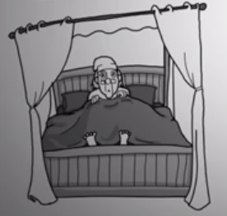
Early to bed and early to rise makes a man healthy,
wealthy and wise

Slide 3
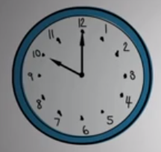




1. The Gradual Method
Start by waking up 15 mins earlier until you feel used to it

Slide 4
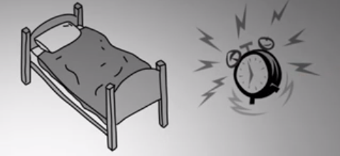

2. Go To Sleep Earlier
Set a bedtime of 7-8.5 hours before you want to wake up
It can be really helpful to set another alarm, one that reminds you when it’s time to go bed.

Slide 5



3. Have a Compelling Reason
If you want to wake up early just for the sake of it, you will fail miserably.

Slide 6
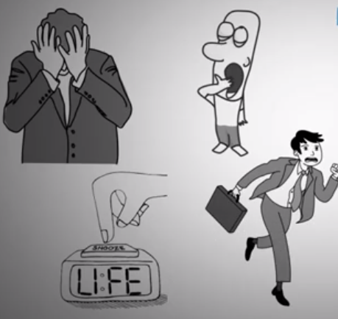
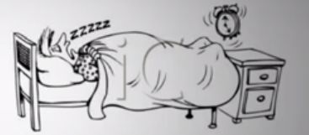
4. Do Not Snooze
You don’t get restful
REM sleep while snoozing
Put alarm
across the room

Slide 7


Common Issues
Super tired
in the morning
Not a
morning person
It’s not that you’re no a morning person.
It’s just that you tried to make a change too quickly.

Slide 8
Thanks
Luo, Xiaomei
2018/12/13

