Slide 1
Introduction to SAS Programming
RBWM CCS Training Material
Feb 2020

Slide 2
What is SAS?
SAS - Statistical Analysis System
Collection of modules that are used to process and analyze data, with statistical algorithms in place
Developed in the early 1970s at North Carolina State University
Originally intended for management and analysis of agricultural field experiments
Now the most widely used statistical software across a wide range of industries

Slide 3
Various Industries Use SAS
Casinos
Communications
Education
Financial Services
Government
Health Insurance
Health Care
Hotels
Insurance
Life Sciences
Manufacturing
Media
Oil & Gas
Retail
Travel & Transportation
Utilities

Slide 4



Major Competitors
Financial & Medical Industry
Academic Society
Internet Companies

Slide 5
Key Applications
Predicting what will be the right segment for a marketing campaign – Decision Trees
Predicting the loan repay capacity of a customer – Logistic Regression
Forecasting the revenue numbers for a product – ARIMA
Identifying fraud claims in healthcare insurance – Cluster Analysis
The recommendation engine that predicts the best product that interests the user - Neural networks
Predicting the sales numbers based on macro economic data – Regression analysis

Slide 6
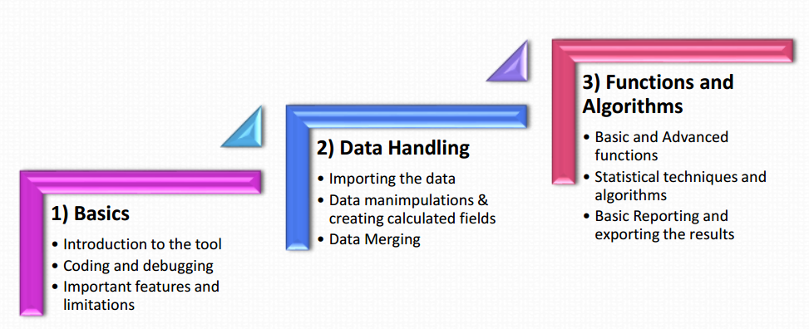
Phases of Learning SAS

Slide 7
SAS Windows Environment
How does it look like

Slide 8
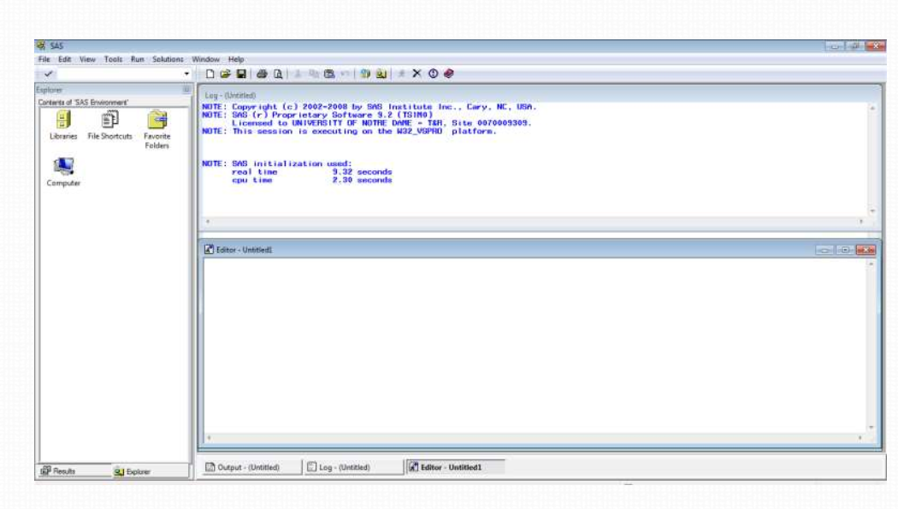
The SAS EG Screen

Slide 9
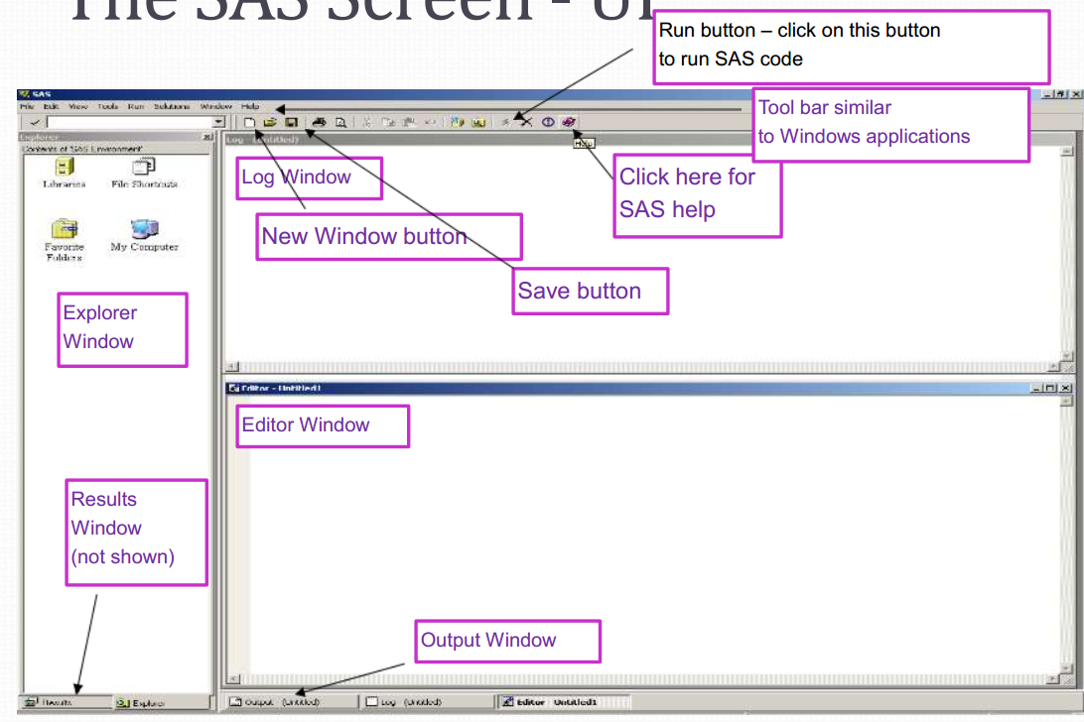
The SAS EG Screen - UI

Slide 10
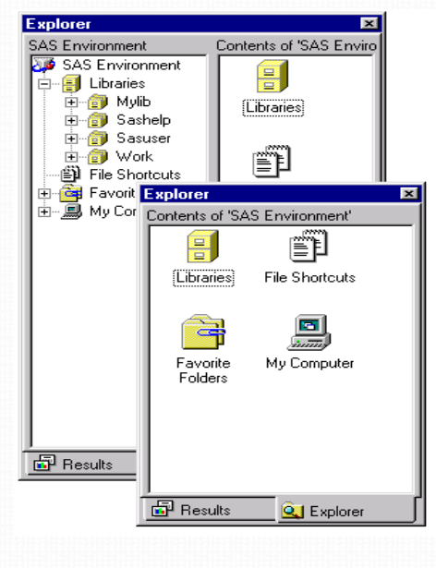
Explorer
Where is Explorer in SAS? What do you see in your SAS Explorer? 1. View and manage SAS files stored in SAS data libraries 2. Create new libraries and SAS files Open SAS files 3. File management tasks such as moving, adding , deleting files 4. Create shortcuts to files Details later

Slide 11
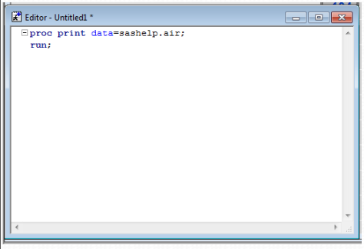
Editor Window
Where is editor in SAS? 1. Opening SAS program 2. Entering, editing and submitting SAS programs 3. Using the command line or menus 4. Clearing the contents 5. Support for keyboard shortcuts 6. Color coding and syntax checking of SAS language Write this script in editor; proc print data=sashelp.air; run;

Slide 12
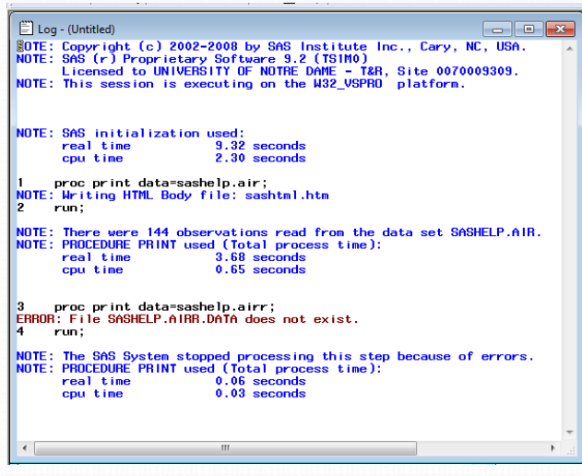
Log Window
Where is log window in SAS? 1. The Debug window 2. Displays the messages about SAS session and the program that is submitted. Write this script in editor and see the log file; proc print data=sashelp.airr; run;

Slide 13
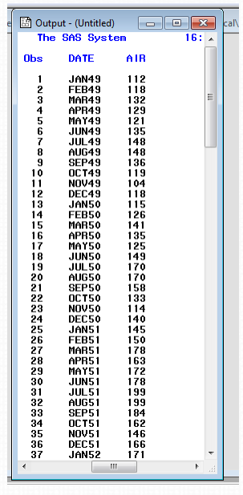
Output Window
1. Displays the listing output in the output window 2. It automatically opens or moves to the front of display when output is created. Write this script in editor and see output file; proc print data=sashelp.air; run;

Slide 14
Give it a try: my first SAS program
• My first SAS program– “Hello world” proc print data=sashelp.air; run; • Submit the program • Write this SAS script in your editor data income_data; Input income expenses; Cards; 1200 1000 9000 600 ; run; Proc print data=income_data; Run

Slide 15
SAS Libraries
• By defining a library, you indicate the location of your SAS files to SAS • Collection of SAS files such as SAS data sets and catalogs • To access a library, you need to assign it a name (also known as a libref, or library reference) • After assigning a library name you'll work with SAS data sets in a library • In the Windows and Unix environments, SAS library is typically a group of SAS files in the same folder or directory. • How to define a library? • Using Interactive window • Libname Statement

Slide 16
Temporary and permanent libraries
Temp Library ◻ Storing files temporarily – If you don't specify a library name when you create a file or – If you specify the library name WORK – Then the file is stored in the temporary SAS data library ◻ Last only for the current SAS session
Permanent library ◻ Storing files permanently – Specify a library name other than the default library name Work ◻ Available during subsequent SAS sessions

Slide 17
Defining a library
Write a statement in a editor window
Syntax LIBNAME libref 'SAS-library‘ ;
Example: LIBNAME sales 'c:\salesdata\sas\2020’;
• Create a library named ‘mylib2’ using the above syntax • Create a library named ‘2mylib’ using the above syntax • Create a library named ‘mylib2mylib’ using the above syntax • Create a library named ‘$mylib2’ using the above syntax

Slide 18
Referencing files in SAS Libraries
As we know, to reference a SAS file we need to assign a libref (library reference) to the SAS library in which the file is stored. • Referencing files from permanent library: • To reference permanent SAS data set, you use two-level name. libref.filename • The libref is name of the SAS data library that contains the file. The filename is the name of the file itself. • A period separates the libref and filename. • Example: libref.filename • Referencing files from temporary library: • Specify default libref WORK, a period and the filename. e.g. work.ecg1 • Alternatively, you can use one level name- the filename only. e.g. ecg1

Slide 19
SAS default libraries
Following libraries are automatically assigned each time you start SAS Sashelp: – Permanent library – Contains sample data and other files that control how SAS works at our site. – This is a read-only library Sasuser: – Permanent library – Contains SAS files that store personal settings/ our own files Work: – Temporary library – Last only for the current SAS session

Slide 20
SAS Datasets
Examining the structure of SAS Datasets

Slide 21
SAS Program
• Sequence of statements executed in order
• Used to access, manage, analyze and present the data
• Contains statements, expressions, functions and CALLroutines, options, formats, and informats
• Simplified programming with built in programs known as SAS Procedures (pre written codes)
• PROC REG, PROC PRINT,PROC ARIMA etc.,
• All programs are already written in SAS, we just need to call the right procedure
• There are a few rules to follow when writing SAS programs

Slide 22
SAS Data Set Terminology
Variables – columns in a SAS data set.
Observations – rows in a SAS data set.
Numeric Data – values that are treated as numeric and may include 8 bytes of floating storage for 16 to 17 significant digits.
Character Data – non numeric data values such as letters, numbers, special characters, and blanks. May be stores with a length of 1 to 32, 767 bytes. One byte is equal to one character.

Slide 23
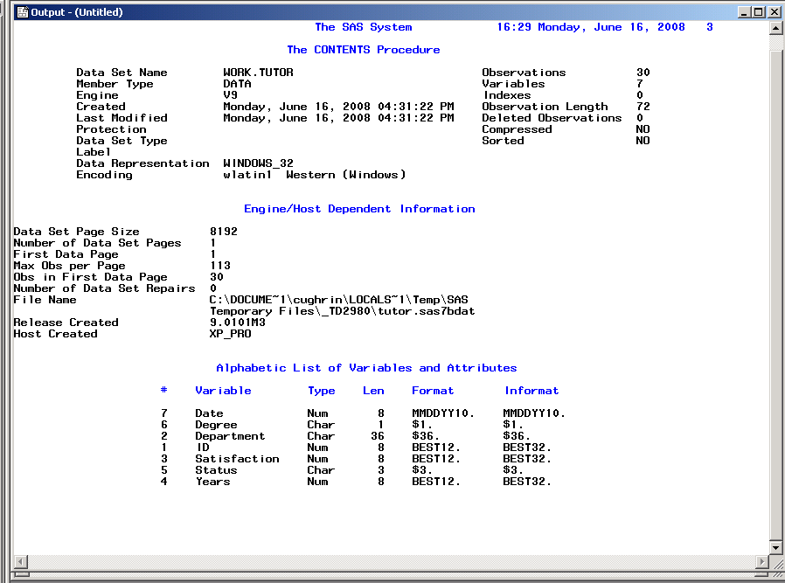
Data Set Descriptor Section

Slide 24
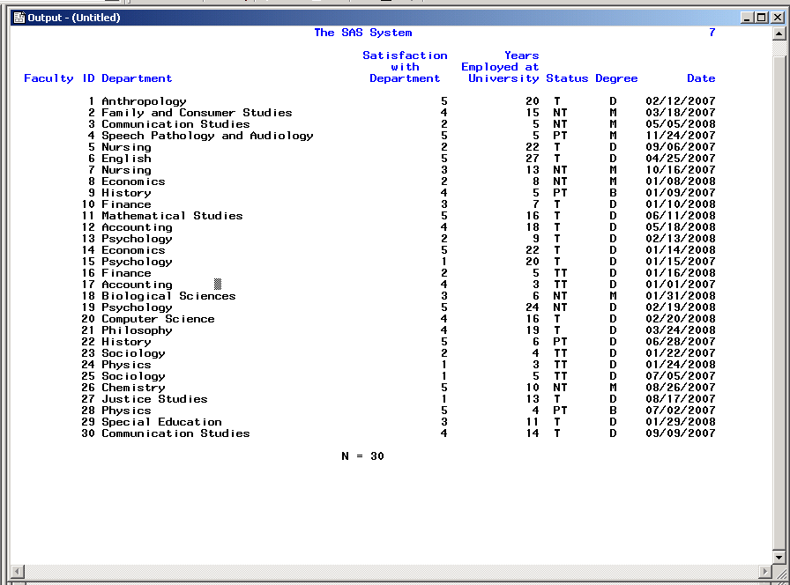
SAS Data Section

Slide 25
Attributes of Variables
Name
e.g. Status
Type
Numeric or Character
e.g. Status in this example is character (T, TT, PT, or NTT) and Satisfaction is numeric (1 to 5).

Slide 26
SAS Data Set and Variable Name Criteria
Can be 32 characters long.
Can be uppercase, lowercase, or a mixture of the cases.
Are not case sensitive
Cannot start with number and cannot contain special characters or blanks.
Must start with a letter or underscore(_).

Slide 27
SAS Dates
Dates are treated as special kind of numeric data.
They are the number of days since January 1st, 1960. January 1st 1960 is the 0 point. SAS dates can go back to 1582 (Gregorian Calendar) and forward to the year 20000.
Dates are displayed using a format. There are a number of different date formats supported by SAS.
Time is scored as the number of seconds since midnight. SAS date time is the number of seconds since January 1st, 1960.

Slide 28
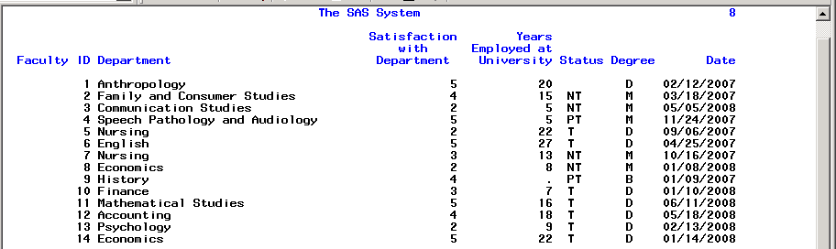
Missing Data in SAS
Missing values are valid values.
For character data, missing values are displayed as blanks.
For numeric data, missing values are displayed as periods.

Slide 29
SAS Syntax

Slide 30
SAS Syntax
Statements in SAS are like sentences. The punctuation though is a semicolon( ; )rather than a period ( . )
Most Statements (but not all) start with an identifying key word (e.g. proc, data, label, options, format…)
Statements are strung together into sections similar to paragraphs. These paragraphs in a Windows OS are ended with the word “run” and a semicolon.

Slide 31
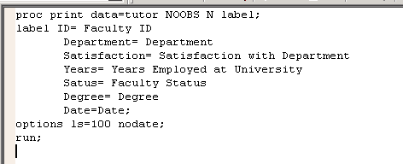
Example of SAS Syntax

Slide 32
SAS Syntax Rules
SAS statements are format free.
One or more blanks or special characters are used to separate words.
They can begin and end in any column.
A single statement can span multiple lines.
Several statements can be on the same line.

Slide 33
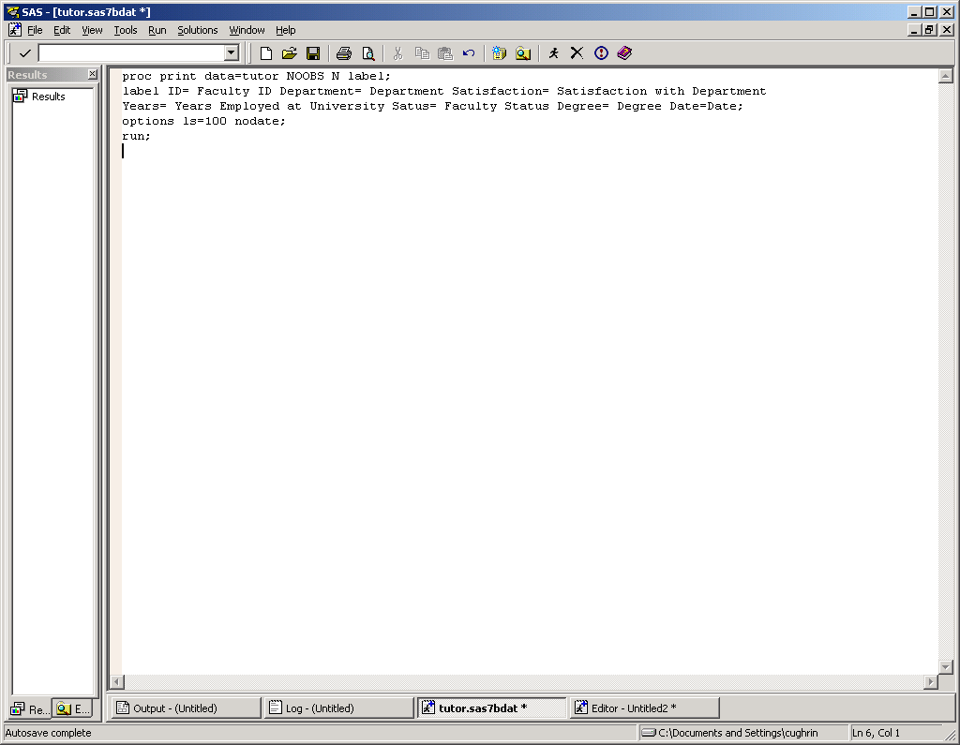
Example of SAS Free Format
Using the free-format Syntax
rules of SAS though can make it difficult for others (or you) to read your
program. This is akin to
writing a page of text with little attention to line breaks. You may still have
Capital letters and periods, but where a sentence begins and ends may be a bit confusing.

Slide 34

Example of SAS Formatted
Using the free-format Syntax rules of SAS though can make it difficult for others (or you) to read your program. This is akin to writing a page of text with little attention to line breaks. You may still have capital letters and periods, but where a sentence begins and ends may be a bit confusing. Isn’t this paragraph a bit easier to read?

Slide 35
SAS Comments
Type /* to begin a comment.
Type your comment text.
Type */ to end the comment.
Or, type an * at the beginning of a line. Everything between the * and the ; will be commented.
e.g. *infile ‘tutor.dat’;
Alternatively, highlight the text that you would like to comment and use the keys Ctrl / to comment the line. To uncomment a line, highlight and use the Ctrl Shift / keys.

Slide 36
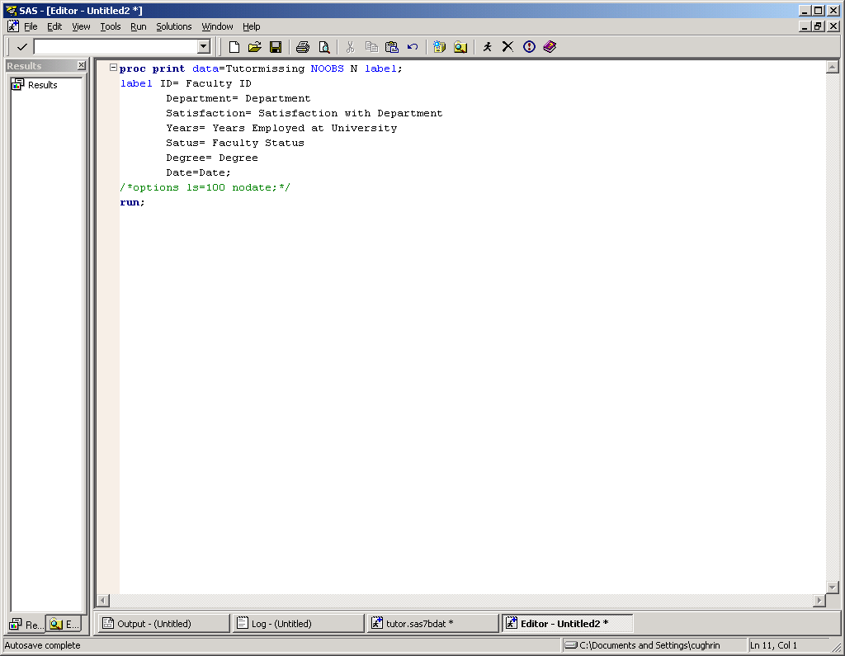
SAS Comments

Slide 37
SAS Windows

Slide 38
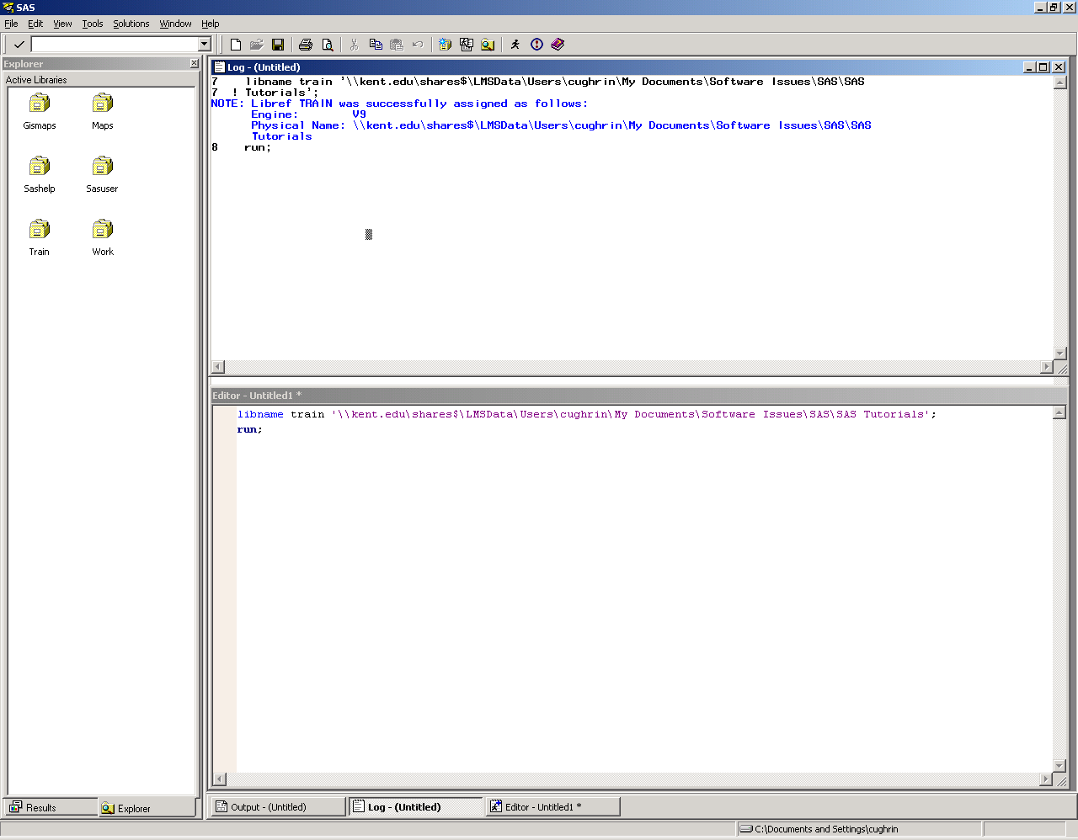
SAS Windows
Explorer
Log
Editor

Slide 39
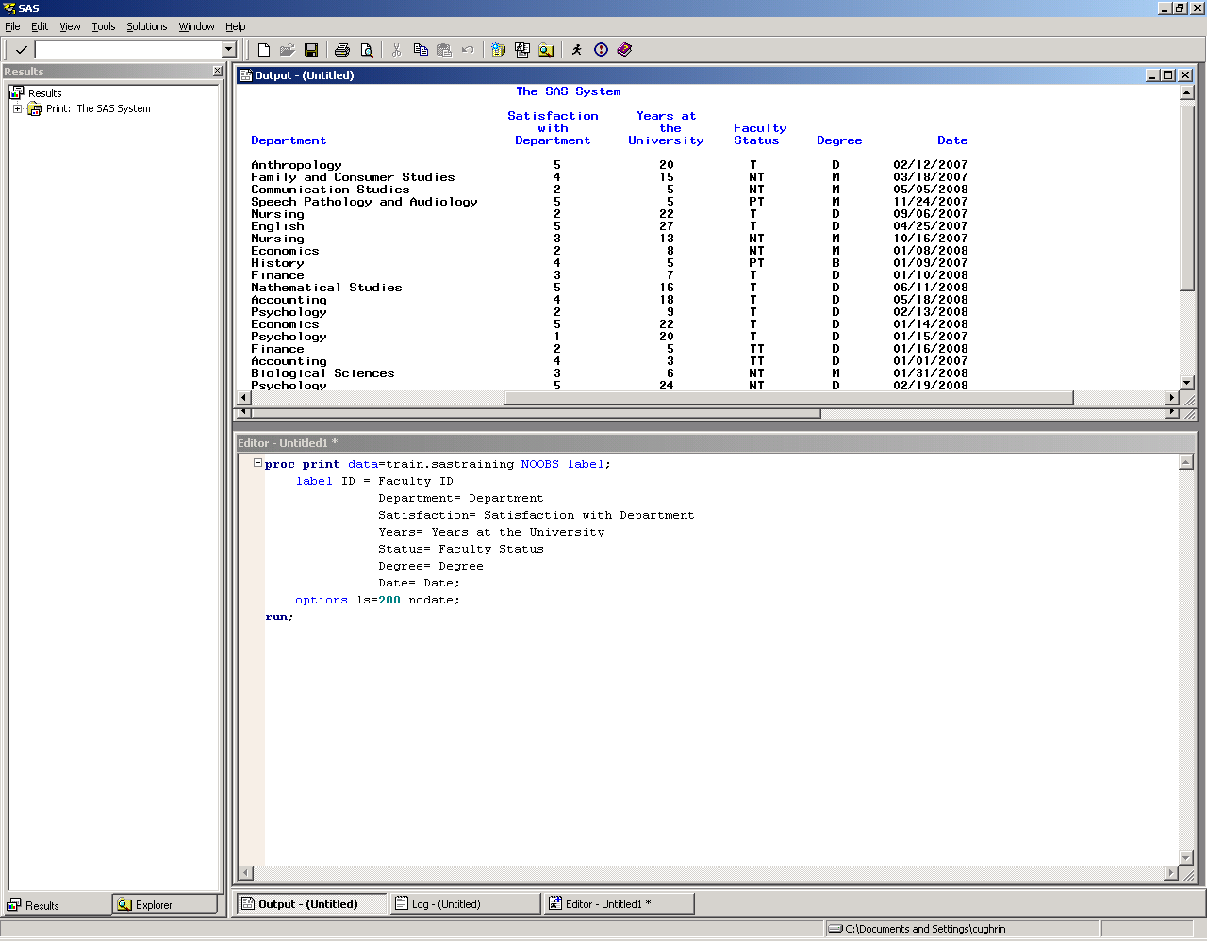
Enhanced Editor Window
Output
Enhanced Editor
Your program script appears in this window.
You can either bring it in from a file or type the program right into the window.
Once the program is in the window, you can Click Submit (or the running guy).

Slide 40
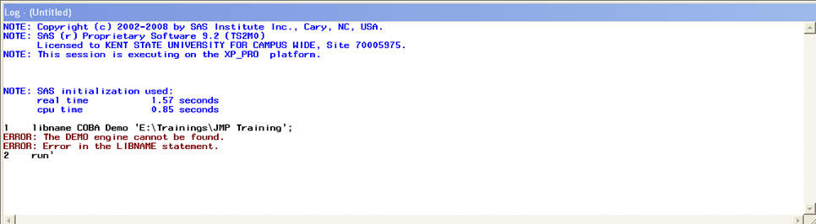
SAS Log
SAS Log provides a “blow by blow” account of the execution of your program. It includes how many observations were read and output, as well as, errors and notes.
Note the errors in red.

Slide 41
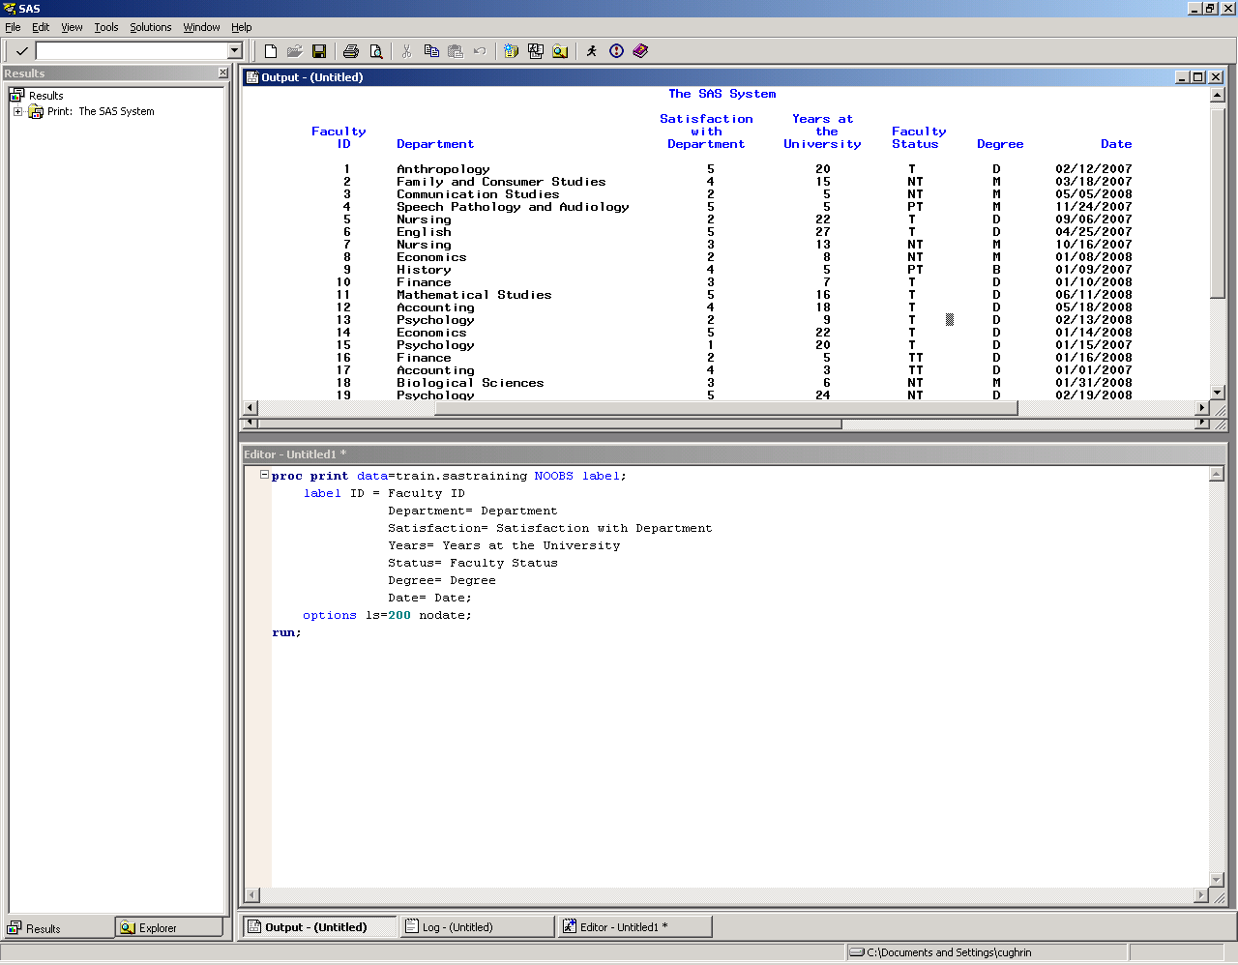
Output Window

Slide 42
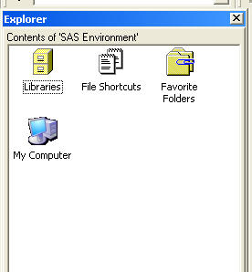
SAS Library
SAS Data Libraries are like drawers in a filing cabinet. The SAS data sets are files within those drawers. Note the icons for the SAS library match that metaphor.
In order to assign a “drawer”, you assign a library reference name (libref).
There are two drawers already in your library: work (temporary) and sasuser (permanent).
You can also create your own libraries (drawers) using the libname statement.

Slide 43
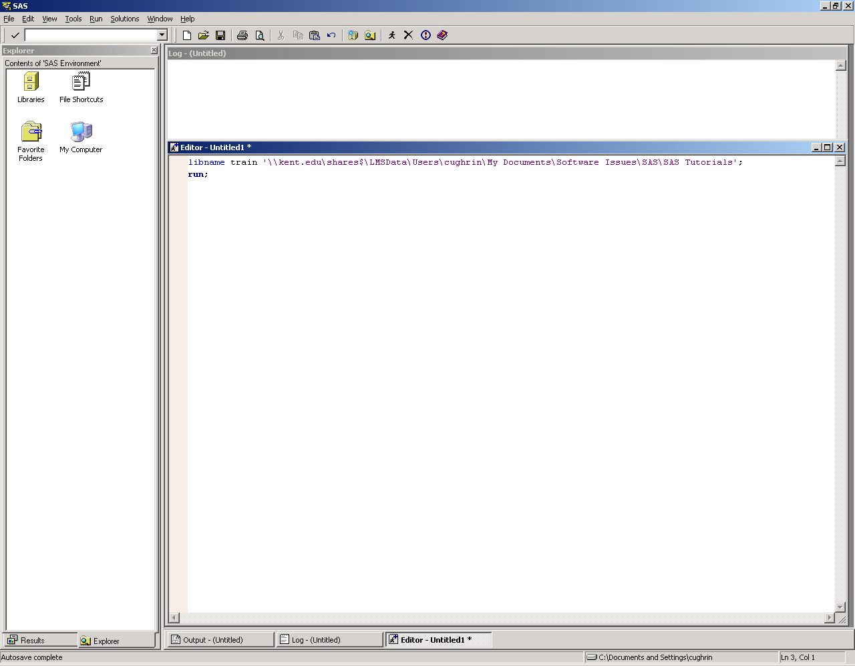
Establishing the libname
Type the libname command in the Enhanced Editor. Click on the running icon
libname Tina ‘E:\Trainings\JMP Training’;
run;

Slide 44
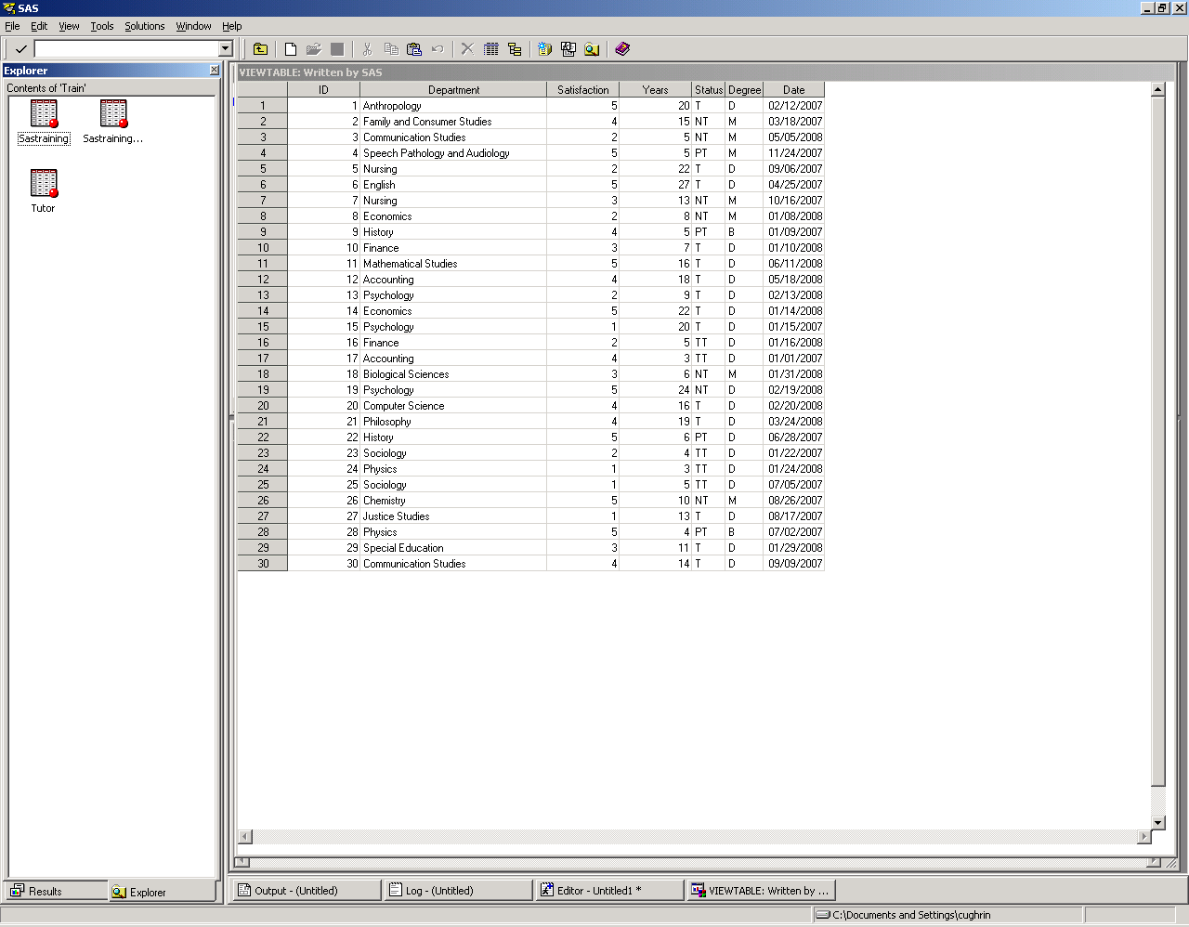
Viewtable Window

Slide 45
Proc Univariate
Proc Univariate

Slide 46
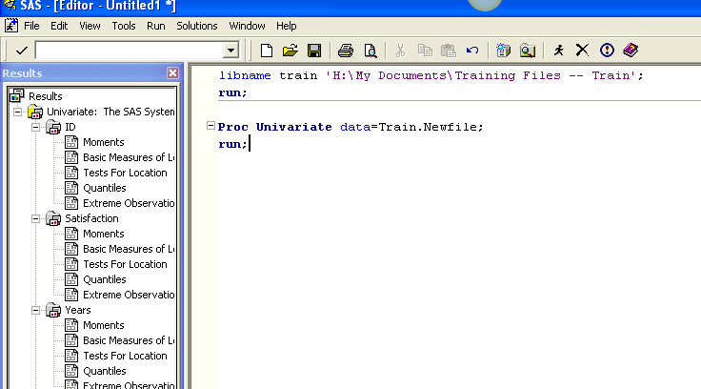
Proc Univariate

Slide 47
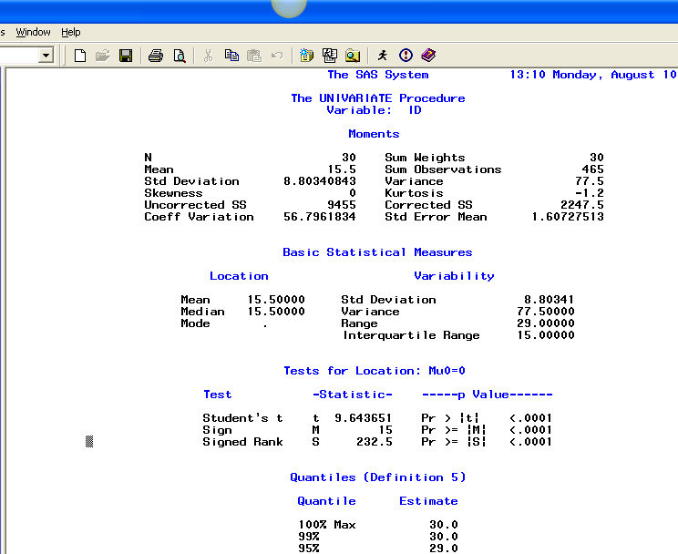
Proc Univariate

