Slide 1
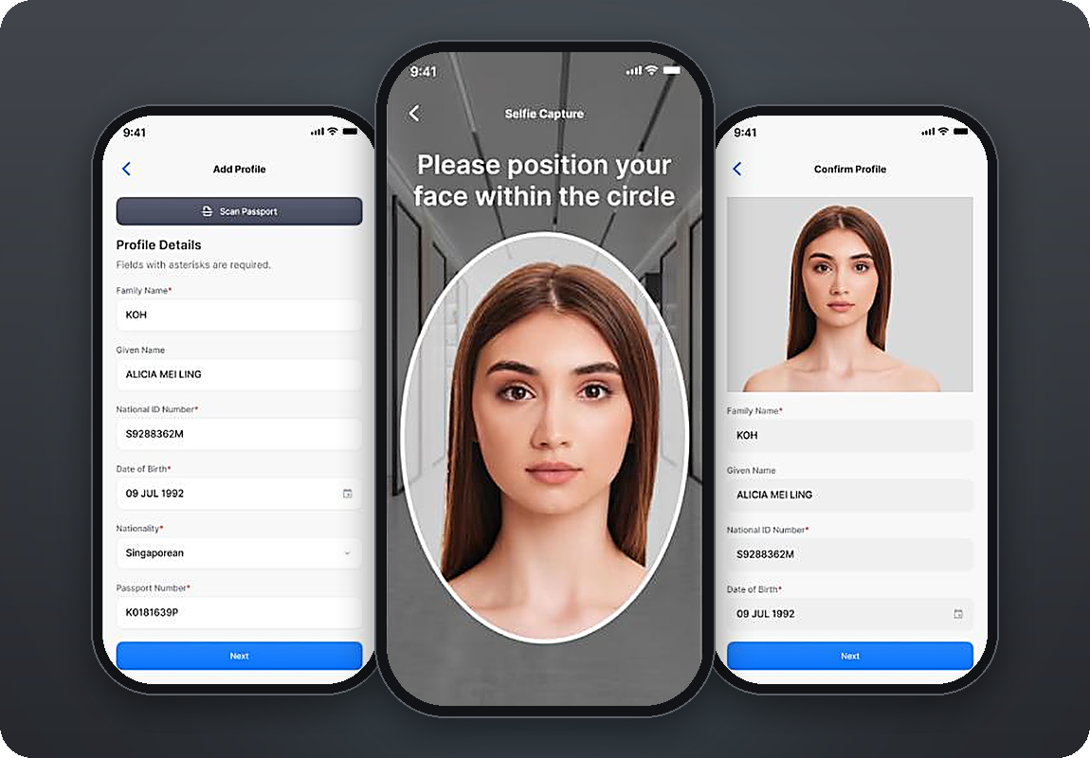
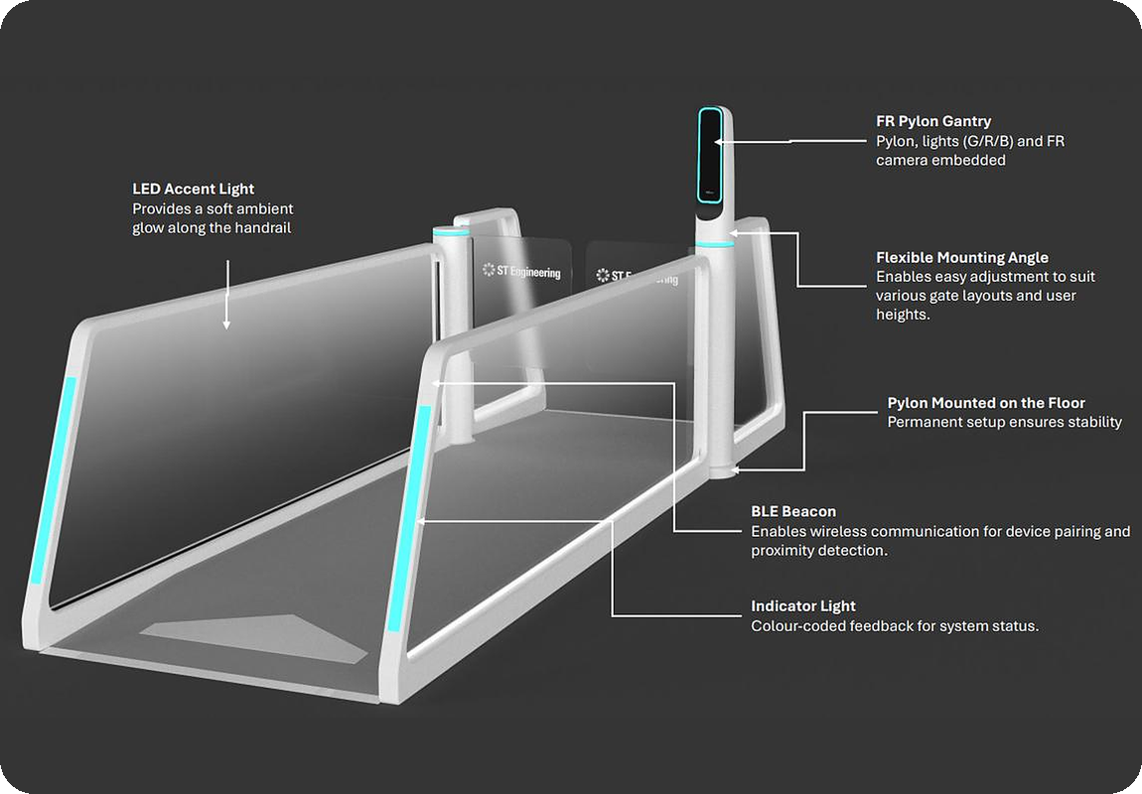
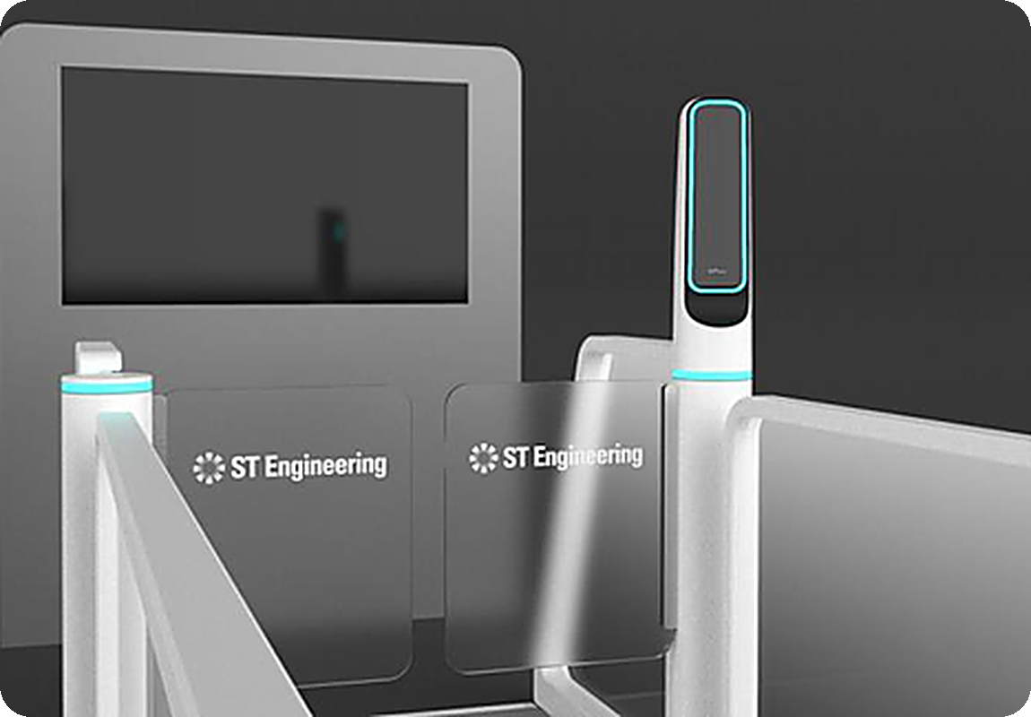







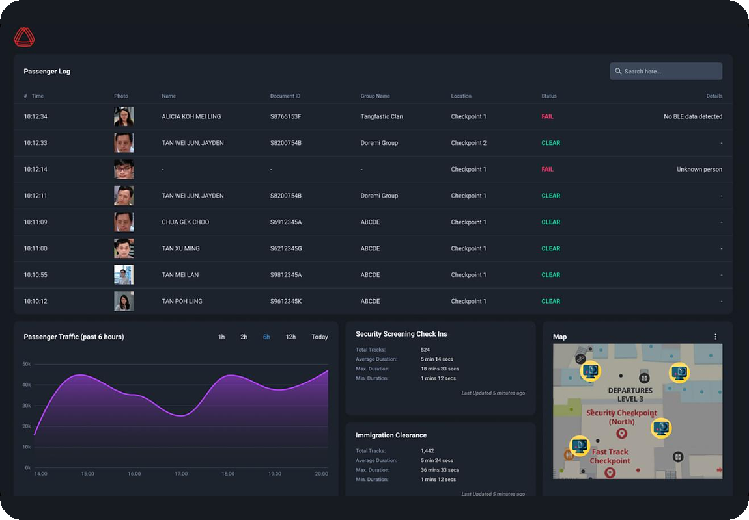



One identity, from curb to gate
FastPass Solution – Curb to Gate
Six touchpoints. One verified credential. No stops for eligible travellers.
1
2
3
4
5
Status TV: CLEARED
Enrol at home
Approach
Walk through
Pre-screen
Board
FastPass Mobile App
BLE lane pairing
Biometric E-Gate
Profile Check reader
Smart Boarding Kiosk
6
Oversee
Live passenger log
AGIL® Secure ISMP
Flow by zone
Every step in one view. Officers act only on exceptions.
Exception alerts
|
Notes:
OPTION 1 — Static storyboard. One page; every real product is visible at once. Best for the PDF handout and for judges reading later.
One. At home, the traveller enrols once in the FastPass app: a passport scan and a selfie. The credential stays safely on the phone.
Two. As they walk up to the lane, the phone connects to it by Bluetooth. It stays in the pocket.
Three. They walk through the e-gate. The camera matches the face to the phone, without stopping. The screen next to the gate shows their name and a green "Cleared".
Four. Before security screening, a profile check confirms it is the same person.
Five. At the gate, the boarding kiosk clears them by face. No passport. No boarding pass.
Six. And the control room sees every step. Officers step in only when something needs attention.

Slide 2

One identity, from curb to gate
FastPass Solution – Curb to Gate
Six touchpoints. One verified credential. No stops for eligible travellers.
1
Enrol at home
2
Approach
3
Walk through
4
Pre-screen
5
Board
FastPass App
BLE lane pairing
Biometric E-Gate
Profile Check
Smart Boarding Kiosk
TAN M. Y.
3
SQ 322 · B12
CLEARED
STATUS TV
4
2
1
5
6
Oversee
6
AGIL® Secure ISMP
|
Notes:
OPTION 2 — Click-to-zoom. Click any step card or numbered badge to zoom into that product; click the same step, the product image or × to zoom out. With a clicker, just press Next: 1 → 6, then back to this overview. Needs PowerPoint 2019 / Microsoft 365 (Morph); older versions fade instead.
So how does it work? Please follow the blue line.

Slide 3


One identity, from curb to gate
FastPass Solution – Curb to Gate
Six touchpoints. One verified credential. No stops for eligible travellers.
1
Enrol at home
2
Approach
3
Walk through
4
Pre-screen
5
Board
6
Oversee
STEP 1 OF 6 · ENROL AT HOME
3
FastPass Mobile App
Scan the passport and take a selfie, once. The credential stays encrypted on the phone.
4
2
1
5
Passport scan + selfie
6
Credential stays on the device
|
Notes:
One. At home, the traveller enrols once in the FastPass app: a passport scan and a selfie. The credential stays safely on the phone.

Slide 4

One identity, from curb to gate
FastPass Solution – Curb to Gate
Six touchpoints. One verified credential. No stops for eligible travellers.
1
Enrol at home
2
Approach
3
Walk through
4
Pre-screen
5
Board
6
Oversee
STEP 2 OF 6 · APPROACH
3
FastPass Lane with BLE beacon
4
2
As the traveller walks up, the lane’s BLE beacon pairs with their phone.
1
5
Hands-free pairing
6
Phone stays in the pocket
|
Notes:
Two. As they walk up to the lane, the phone connects to it by Bluetooth. It stays in the pocket.

Slide 5

One identity, from curb to gate
FastPass Solution – Curb to Gate
Six touchpoints. One verified credential. No stops for eligible travellers.
1
Enrol at home
2
Approach
3
Walk through
4
Pre-screen
5
Board
6
Oversee
STEP 3 OF 6 · WALK THROUGH
3
FastPass Biometric E-Gate
The FR pylon matches face to phone on the move. The status TV shows the traveller “Cleared”.
4
2
1
TAN M. Y.
5
SQ 322 · B12
Two factors: face + phone
6
CLEARED
Status TV feedback
|
Notes:
Three. They walk through the e-gate. The camera matches the face to the phone, without stopping. The screen next to the gate shows their name and a green "Cleared".

Slide 6


One identity, from curb to gate
FastPass Solution – Curb to Gate
Six touchpoints. One verified credential. No stops for eligible travellers.
1
Enrol at home
2
Approach
3
Walk through
4
Pre-screen
5
Board
6
Oversee
STEP 4 OF 6 · PRE-SCREEN
3
Pre-Screening Profile Check
Before bags reach X-ray, the Nova Plus reader confirms identity and retrieves the clearance profile.
4
2
1
5
Same person, confirmed
6
Exceptions flagged to officers
|
Notes:
Four. Before security screening, a profile check confirms it is the same person.

Slide 7

One identity, from curb to gate
FastPass Solution – Curb to Gate
Six touchpoints. One verified credential. No stops for eligible travellers.
1
Enrol at home
2
Approach
3
Walk through
4
Pre-screen
5
Board
6
Oversee
STEP 5 OF 6 · BOARD
3
FastPass Smart Boarding Kiosk
4
2
Face plus phone clears boarding. No passport, no boarding pass.
1
5
Touch-free boarding
6
No documents to show
|
Notes:
Five. At the gate, the boarding kiosk clears them by face. No passport. No boarding pass.

Slide 8

One identity, from curb to gate
FastPass Solution – Curb to Gate
Six touchpoints. One verified credential. No stops for eligible travellers.
1
Enrol at home
2
Approach
3
Walk through
4
Pre-screen
5
Board
6
Oversee
STEP 6 OF 6 · OVERSEE
3
AGIL® Secure ISMP
Every touchpoint in one command view. Officers act only on exceptions.
4
2
1
5
Live passenger log
6
Exception alerts
|
Notes:
Six. And the control room sees every step. Officers step in only when something needs attention.

Slide 9
One identity, from curb to gate
FastPass Solution – Curb to Gate
Six touchpoints. One verified credential. No stops for eligible travellers.
1
Enrol at home
2
Approach
3
Walk through
4
Pre-screen
5
Board
FastPass App
BLE lane pairing
Biometric E-Gate
Profile Check
Smart Boarding Kiosk
TAN M. Y.
3
SQ 322 · B12
CLEARED
STATUS TV
4
2
1
5
6
Oversee
6
AGIL® Secure ISMP
|
Notes:
Back to the overview: one identity, six touchpoints, every product connected by AGIL® Secure ISMP.

Slide 10

One identity, from curb to gate
FastPass Solution – Curb to Gate
Six touchpoints. One verified credential. No stops for eligible travellers.
1
Enrol at home
2
Approach
3
Walk through
4
Pre-screen
5
Board
FastPass App
BLE lane pairing
Biometric E-Gate
Profile Check
Smart Boarding Kiosk
TAN M. Y.
3
SQ 322 · B12
CLEARED
STATUS TV
4
2
1
5
6
Oversee
6
AGIL® Secure ISMP
|
Notes:
OPTION 3 — Guided camera tour. Press Next and the camera flies into the airport, step by step, with the real product beside it. Click a step card to jump; click the progress bars to move between steps. Needs PowerPoint 2019 / Microsoft 365 (Morph).
So how does it work? Please follow the blue line.

Slide 11

One identity, from curb to gate
FastPass Solution – Curb to Gate
3
Six touchpoints. One verified credential. No stops for eligible travellers.
4
2
1
5
6
STEP 1 OF 6 · ENROL AT HOME
FastPass Mobile App
Passport scan and selfie, once. Encrypted on the phone.
|
Notes:
One. At home, the traveller enrols once in the FastPass app: a passport scan and a selfie. The credential stays safely on the phone.

Slide 12
One identity, from curb to gate
FastPass Solution – Curb to Gate
Six touchpoints. One verified credential. No stops for eligible travellers.
3
4
2
1
STEP 2 OF 6 · APPROACH
FastPass Lane with BLE beacon
5
The lane’s BLE beacon pairs with the phone on approach.
|
6
Notes:
Two. As they walk up to the lane, the phone connects to it by Bluetooth. It stays in the pocket.

Slide 13
One identity, from curb to gate
FastPass Solution – Curb to Gate
Six touchpoints. One verified credential. No stops for eligible travellers.
3
TAN M. Y.
SQ 322 · B12
4
CLEARED
STEP 3 OF 6 · WALK THROUGH
2
FastPass Biometric E-Gate
Face matched on the move. Status TV shows “Cleared”.
|
1
5
6
Notes:
Three. They walk through the e-gate. The camera matches the face to the phone, without stopping. The screen next to the gate shows their name and a green "Cleared".

Slide 14
One identity, from curb to gate
FastPass Solution – Curb to Gate
Six touchpoints. One verified credential. No stops for eligible travellers.
3
4
2
STEP 4 OF 6 · PRE-SCREEN
Pre-Screening Profile Check
1
The Nova Plus reader confirms identity before X-ray.
|
5
6
Notes:
Four. Before security screening, a profile check confirms it is the same person.

Slide 15
One identity, from curb to gate
FastPass Solution – Curb to Gate
3
Six touchpoints. One verified credential. No stops for eligible travellers.
4
2
1
5
6
STEP 5 OF 6 · BOARD
FastPass Smart Boarding Kiosk
Face plus phone clears boarding. No documents to show.
|
Notes:
Five. At the gate, the boarding kiosk clears them by face. No passport. No boarding pass.

Slide 16
One identity, from curb to gate
3
FastPass Solution – Curb to Gate
4
Six touchpoints. One verified credential. No stops for eligible travellers.
2
1
5
6
STEP 6 OF 6 · OVERSEE
AGIL® Secure ISMP
Every step in one view. Officers act only on exceptions.
|
Notes:
Six. And the control room sees every step. Officers step in only when something needs attention.

Slide 17
One identity, from curb to gate
FastPass Solution – Curb to Gate
Six touchpoints. One verified credential. No stops for eligible travellers.
1
Enrol at home
2
Approach
3
Walk through
4
Pre-screen
5
Board
FastPass App
BLE lane pairing
Biometric E-Gate
Profile Check
Smart Boarding Kiosk
TAN M. Y.
3
SQ 322 · B12
CLEARED
STATUS TV
4
2
1
5
6
Oversee
6
AGIL® Secure ISMP
|
Notes:
Back to the full journey: one identity, six touchpoints, every product connected by AGIL® Secure ISMP.

