Slide 1
AGIL® Secure FastPass
InnoChamp 2026 | Product Category
Curb to gate on one verified identity.
TWO-FACTOR · PRIVACY-FIRST · MODULAR
Smart Security & Automation
Smart Utilities & Infrastructure
Urban Solutions
Notes:
[0:00–0:10] AGIL® Secure FastPass — curb to gate on one verified identity. Two-factor, privacy-first, modular.
TIME PLAN (8-min slot): 1 Cover 0:10 · 2 Needs 0:45 · 3 Market 0:50 · 4 Journey 1:10 · 5 ISMP 0:35 · 6 Innovation 0:50 · 7 Impact 0:40 · 8 Go-to-market 0:50 · 9 Collaboration & barriers 0:45 · 10 Ready & ask 0:40 · 11 Close 0:05 ≈ 7:20.

Slide 2












More passengers. More checks. Limited capacity.
Market Needs
Every departure is split into four identity checks — each a stop, a queue and a staffed desk.
Check-in
Immigration
Security screening
Boarding gate
4
≥1
2×
2030s
identity checks per departure
officer staffing every touchpoint
air travel demand by 2040
before Changi’s next terminal opens
Sources: IATA Global Outlook for Air Transport (Dec 2023); Singapore MOT, Changi T5 update (2025). Staffing per touchpoint: airport expert calls. See References.
Notes:
[0:10–0:55] The departure journey is fragmented: check-in, immigration, security screening and boarding each ask for identity again — the icons show the documents each stop needs.
• 4 identity checks per departure; each is a stop and a queue.
• At least one officer staffs every touchpoint, so capacity is tied to routine checks.
• Demand doubles by 2040 (IATA, Dec 2023: 7.8 bn passengers).
• New capacity takes a decade: Changi's Terminal 5 broke ground in 2025 and opens in the mid-2030s.
Change from draft: the "48% of airports by 2027" figure is replaced — it could not be traced to SITA's published reports.

Slide 3

A focused market in high-growth airport regions
Market Potential
Brownfield airports in the Middle East and Southeast Asia, where growth outpaces capacity.
US$5.0B global ABC market by 2030
SERVICEABLE MARKET · 2026–30
US$500–700M
≈83% at airports
≈ US$100–140M a year, hardware to services
10–15% Middle East + SE Asia
≈25% FastPass addressable share
7 in 10
~78%
airlines adopting biometric ID by 2026
of ME/SEA airport projects are brownfield
US$2.56B (2025) → US$5.03B (2030) · 14.4% CAGR
Sources: MarketsandMarkets, Automated Border Control Market 2025–2030; SITA Air Transport IT Insights 2024. Regional and serviceable shares: URS estimate. See References.
Notes:
[0:55–1:45] Bottom-up sizing: automated border control US$2.56B (2025) → US$5.03B (2030), 14.4% a year (MarketsandMarkets); airports are ~83% of it; ME + SEA ~10–15%; FastPass can address about a quarter → US$500–700M over 2026–30, ≈ US$100–140M a year.
Demand signals: 7 in 10 airlines adopting biometric ID by 2026 (SITA 2024); ~78% of ME/SEA projects are brownfield — where an infrastructure-light lane wins.
Correction from draft: CAGR is 14.4% (MarketsandMarkets), not ~14.5%.

Slide 4






One identity, from curb to gate
FastPass Solution
Six touchpoints. One verified credential. No stops for eligible travellers.
1
Enrol at home
2
Approach
3
Walk through
4
Pre-screen
5
Board
FastPass App
BLE lane pairing
Biometric E-Gate
Profile Check
Smart Boarding Kiosk
TAN M. L.
3
SQ 322 · B12
CLEARED
STATUS TV
4
2
1
5
6
6
Oversee
AGIL® Secure ISMP
Notes:
[1:45–2:55] One slide, the whole journey. Follow the cyan line:
1 Enrol at home — passport + selfie in the FastPass Mobile App (or the airport/airline app via SDK); the credential stays encrypted on the phone.
2 Approach — BLE pairs the phone to the lane as the traveller walks up.
3 Walk through immigration — the Biometric E-Gate's FR pylon matches face to phone on the move; the status TV beside the pylon flashes the traveller's name and a green CLEARED.
4 Pre-screen — the Pre-Screening Profile Check reader confirms identity before bags reach X-ray.
5 Board — face + phone clears the Smart Boarding Kiosk; no passport, no boarding pass.
6 Oversee — AGIL® Secure ISMP sees every step; amber exceptions go to an officer's tablet.

Slide 5
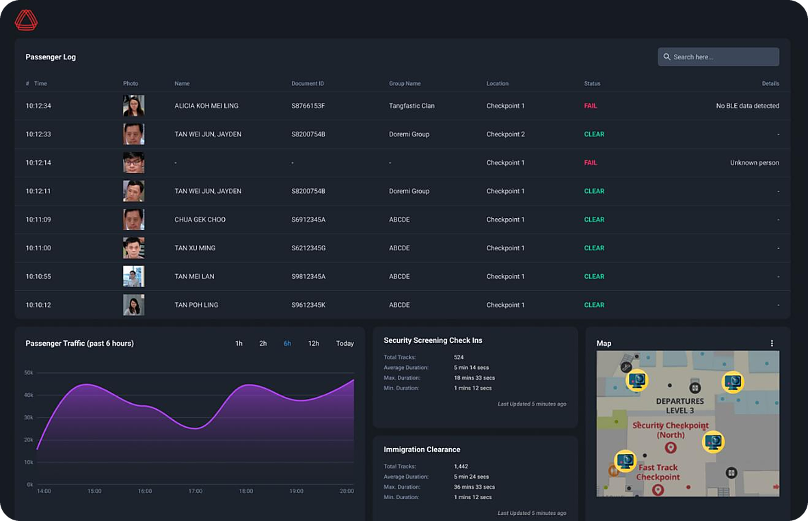







One command environment for every touchpoint
FastPass Solution · AGIL® Secure ISMP
AGIL® Secure ISMP is the operational backbone behind FastPass.
Traveller transactions
Physical security
Lane & gate control
AGIL® Secure ISMP
One command layer
3D operational view
Exception management
Assistive AI
Passenger log
Flow by zone
Exceptions
Notes:
[2:55–3:30] Behind the journey is AGIL® Secure ISMP — one command environment: traveller transactions, lane and gate control, exception management, assistive AI, a 3D operational view and physical security (CCTV, access, intrusion).
The screen is the live product: passenger log with clear/fail status, traffic, and the departures map. [Swap in the incident-management / digital-twin screenshot from the airshow build if available.]

Slide 6




The innovation is the credential, not the gate
Innovativeness
Two factors, on the move: the phone proves the credential, the face proves the person.
TWO FACTORS, ONE STRIDE
Privacy by design
Credentials stay encrypted on the phone
+
=
Plugs into existing apps
SDK for airport and airline channels
Device credential
via BLE
Live face
on the move
Cleared
lane stays open
Converged with security ops
Clearances beside CCTV, access and incidents
Typical walk-through face only (1FA)
AI in the product and the build
FastPass face + phone (2FA), on the move
On-the-move FR and alert triage; ~50% less front-end effort
Notes:
[3:30–4:20] "The magic is the clearance method, not the turnstile" (CEO).
Two factors on the move — the phone credential via BLE plus the live face. Most walk-through lanes we benchmarked verify the face only.
• Privacy by design: passport and face template stay encrypted on the phone; the airport holds no biometric database.
• Plugs into existing apps: an SDK for airport and airline channels — the app is an enabler.
• Converged: every clearance sits beside CCTV, access control and incidents in ISMP.
• AI in the offering and the build: on-the-move facial recognition, assistive alert triage; AI-assisted engineering cut selected front-end effort ~50%.

Slide 7
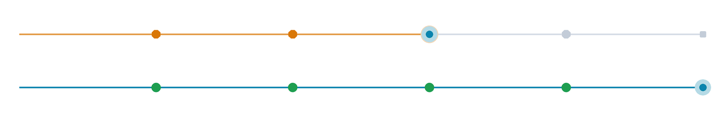

Measurable impact for every stakeholder
Business Impact
Today’s traveller stops four times. With FastPass, eligible travellers keep moving.
Check-in
Immigration
Screening
Boarding
Today
4 stops · officer at each
With FastPass
0 stops · exceptions only
PASSENGERS
OPERATORS
SECURITY
0 stops
4 of 4
1 view
Curb to gate in 8–11 min (target)
Touchpoints automated
Every lane, clearance and incident
Curb-to-gate time is a target, to be validated at the airport demonstration. ROI is anchored on officer hours and capacity gained without new terminal space.
Notes:
[4:20–5:00] Productivity and ROI (Market Potential & Business Impact criterion).
Watch the loop: today's traveller stops at every checkpoint; the FastPass traveller glides through.
• Passengers: zero intentional stops; curb to gate in 8–11 minutes (target, validated at the airport demo).
• Operators: four touchpoints automated — officers move from routine checks to exceptions. The ROI case is officer hours plus capacity without new terminal space.
• Security: one view of every lane, clearance and incident in ISMP.

Slide 8







A clear buyer, model and path to scale
Time to Market
Land one lane in a brownfield terminal, then expand as value is proven.
Buyer ecosystem
Commercial model
How we scale
Primary buyer
Lane hardware
1
Prove
Tier-2 airports, ME & SE Asia
One-off: e-gate, reader, kiosk
One pilot lane
Co-decides
ISMP licence
2
Expand
Immigration and border agencies
Recurring, by deployment scope
More lanes and enrolment
Enabler
Integration
3
Connect
Airlines, via their own apps
Project: configure and deploy
All touchpoints via ISMP
End user
Support
4
Scale
Travellers, enrolled once in the app
Annual maintenance and SLA
Terminals and portfolios
Notes:
[5:00–5:50] Who buys: Tier-2 international airports in the Middle East and Southeast Asia; immigration and border agencies co-decide; airlines enable adoption through their digital channels.
What they pay for: lane hardware (one-off), ISMP licence (recurring, by scope), integration (project), annual support and SLA. [Insert target price points after the Sales sync.]
How we scale: prove one pilot lane → expand lanes and enrolment → connect every touchpoint via ISMP → scale across terminals and portfolios. Reusing the live ISMP core keeps development fast.

Slide 9






Built across BAs. Scaled through the Group.
Collaboration & Entry Barriers
Cross-BA know-how and Group reach form a barrier that point-solution vendors cannot copy.
ENTRY BARRIERS
Owned IP
Deep know-how
Smart Security & Automation
Smart Utilities & Infrastructure
App, lane logic and ISMP
35+ years, mission-critical
Specialised set-up
Sales network
FastPass
Converged security operations
Group reach in ME & SE Asia
SCALING FAST
Cross-sell through Group BUs in other countries
Urban Solutions
Regional sales and integration partners in ME & SE Asia
One product team, from biometrics to Sales
International needs built in: privacy, governance, manual fallback
Notes:
[5:50–6:35] MARKET POTENTIAL — "collaborative initiative across BAs" is 30% of that score — and ENTRY BARRIERS (strong IP, deep know-how, specialised set-up, strong sales network) plus "effort to scale fast".
Collaboration: one product team across Smart Security & Automation, Smart Utilities & Infrastructure and Urban Solutions — product, mobile, biometrics, e-gate, the ISMP platform team — with Group Sales engaged. [Confirm each BA's named contribution.]
Barriers: owned IP across the app, lane logic and ISMP; 35+ years of mission-critical delivery; a specialised set-up that converges clearance with security operations; the Group's sales reach in ME & SE Asia.
Scaling fast: cross-sell through Group BUs in other countries; regional sales and integration partners; international requirements already built in (privacy rules, airport governance models, manual-lane fallback). [Name the countries/BUs with Group Sales before 22 Oct.]
If asked about Idemia: they lead on portfolio breadth; we lead on two-factor clearance and converged security operations.

Slide 10





Ready to pilot, with a clear path to market
Conclusion
Four reasons to back FastPass now.
Clear operational need
Path to market
Demand is outgrowing terminals and staffing
FEB 2026
Focused market
Prototype live at Singapore Airshow
US$100–140M a year in ME and SE Asia
OCT 2026
InnoChamp 2026
Working product
Q4 2026
Integrated prototype, Singapore Airshow 2026
Live demo with airport stakeholders
APR 2027
Defensible edge
Passenger Terminal World, Amsterdam
2027
Two-factor credential, converged security ops
First customer pilot (target)
Productisation funding
Launch customer via Group Sales
Showcase at PT World 2027
OUR ASK
Notes:
[6:35–7:15] Four reasons, in order: a clear operational need; a focused US$100–140M-a-year market; a working, integrated product shown at Singapore Airshow 2026; and a defensible edge — the two-factor credential converged with security operations.
Path: live demo with airport stakeholders this quarter → PT World Amsterdam in April → first customer pilot in 2027.
Our ask (CEO: "what do we need STMG to support — money, resource"): productisation funding for offline mode, redundancy and back-end integration [insert amount]; a launch customer through Group Sales; and the PT World 2027 showcase.

Slide 11
Thank you
AGIL® Secure FastPass
Curb to gate on one verified identity.
Notes:
[7:15–7:20] Thank you — happy to take questions. References and Q&A backup follow.

Slide 12
External sources
Appendix · References
Public sources behind every market and industry figure. Checked 15 Oct 2026.
What the slide says | Source | Status
Passengers double by 2040 (7.8 bn, +4.2% a year) | IATA, Global Outlook for Air Transport, Dec 2023 https://www.iata.org/en/iata-repository/publications/economic-reports/global-outlook-for-air-transport---december-2023---report/ | Verified
Changi T5: ground broken 2025, opens mid-2030s | Singapore MOT, Update on Changi Airport T5 https://www.mot.gov.sg/news-resources/newsroom/update-on-development-plans-for-changi-airport-terminal-5/ | Verified
ABC market US$2.56B → 5.03B (2025–30), 14.4% CAGR | MarketsandMarkets press release, Jul 2025 https://www.marketsandmarkets.com/PressReleases/automated-border-control.asp | Verified
Airports ≈83% of the ABC market (83.1%, 2025) | MarketsandMarkets, ABC market size insight https://www.marketsandmarkets.com/ResearchInsight/automated-border-control-market-size.asp | Verified
7 in 10 airlines adopting biometric ID by 2026 | SITA, Air Transport IT Insights 2024 https://www.sita.aero/resources/surveys-reports/air-transport-it-insights-2024/ | Verified
Asia-Pacific (≈4.8% a year) and Middle East lead growth | SCMP on IATA 20-year outlook https://www.scmp.com/news/world/middle-east/article/3271055/global-airline-traffic-forecast-double-20-years-led-asia-middle-east | Secondary
Removed: “48% of airports plan cross-silo data sharing by 2027” — not found in SITA’s published reports.

Slide 13
Internal evidence register
Appendix · References
Our own estimates and targets, with the evidence behind each one.
Claim on slide | Evidence / owner | Status
≥1 officer staffing every touchpoint | Airport expert calls (Invent); lane staffing worksheet | Internal estimate
ME + SEA ≈10–15%; FastPass addressable ≈25% | URS analysis on MarketsandMarkets data | Internal estimate
~78% of ME/SEA airport projects are brownfield | URS market analysis (submission §7) | Internal estimate
Curb to gate in 8–11 minutes | Sales review 14 Oct; validate at airport demo | Target
Integrated prototype at Singapore Airshow 2026 | Airshow demo records | Verified
~50% less front-end effort (AI-assisted engineering) | Engineering metrics (submission §6) | Internal measure
35+ years of mission-critical delivery | Corporate record | Verified
Most walk-through lanes verify face only (1FA) | PT Asia benchmarking; Idemia PaXpress brochure (12/2025) | Market observation
Group reach in ME & SE Asia; cross-sell via BUs | Confirm countries and contacts with Group Sales | To confirm
Target price points | Pending Sales sync | Open

Slide 14


Hard questions, short answers
Appendix · Q&A
Agreed positions for the questions judges and Excos are most likely to ask.
Where is biometric data stored?
Do you replace immigration?
Encrypted on the traveller’s phone; shared just-in-time for the match. The airport keeps no biometric database.
No. FastPass is modular and works alongside immigration, linking where local policy allows.
Who owns the app?
What if there is no internet?
The airport or airline: FastPass ships as an SDK inside their app.
Credentials download in advance; offline clearance is the first productisation priority.
What happens when a match fails?
How do you compare with Idemia?
The lane closes, an officer is alerted, and manual counters stay open for exceptions.
They lead on portfolio breadth; we lead on two-factor clearance and converged security ops.

Slide 15
How we compare with Idemia
Appendix · Benchmark
Where Idemia PaXpress SmartLane is strong, and where FastPass differs (per Idemia brochure, 12/2025).
 | AGIL® Secure FastPass | Idemia PaXpress SmartLane
Verification | Two factors: phone credential (BLE) + live face | Facial recognition on the move with camera tracking
Identity | Credential encrypted on the traveller’s phone | Digital ID via SDK or kiosk; Authorizer platform
Operations | Converged with CCTV, access, intrusion and incidents | Supervision screens and tablets for exceptions
Traveller feedback | Pylon light and status TV; AI assistant on roadmap | AI-powered guidance displays
Proof and scale | Integrated prototype; pilot-ready | 1.5 bn+ travellers a year; 350+ ports
Compete on two-factor clearance and converged security operations at a modular entry price, not on portfolio breadth.

