Slide 1
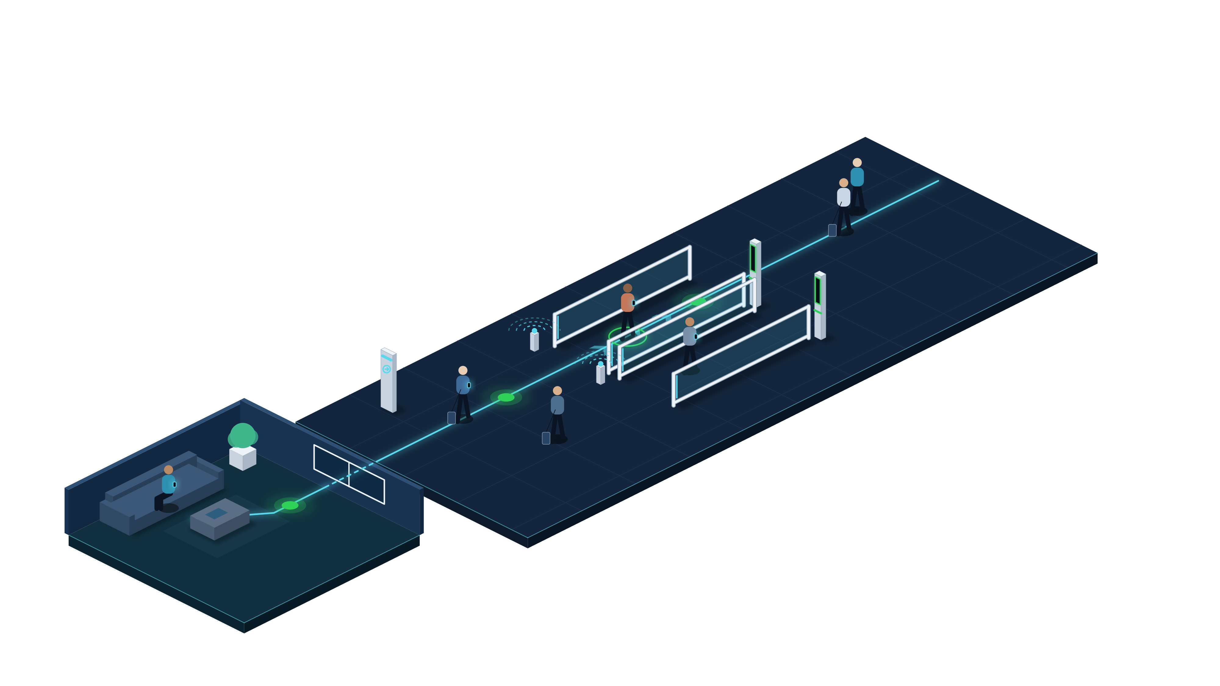
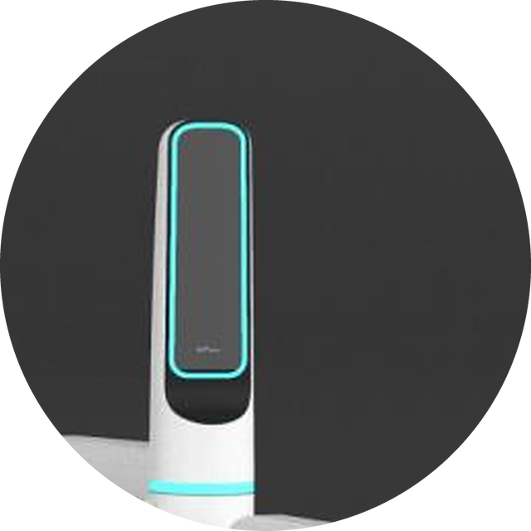
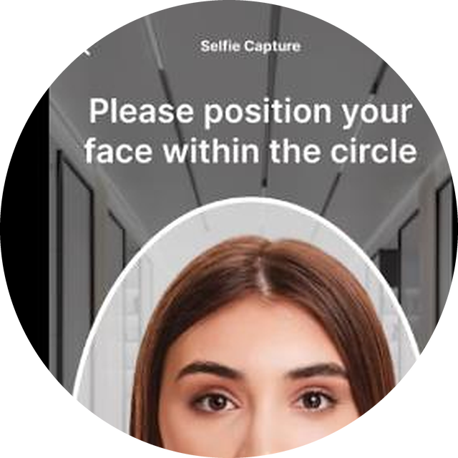
Enrol at home. Walk through immigration
USER JOURNEY · PART 1 OF 2
Create the credential on the phone once, then walk through without stopping.
1
Enrol at home
Scan the passport and a selfie in the FastPass app. The credential stays encrypted on the phone.
BLE beacon
3
2
3
Walk through
1
The FR pylon matches face to phone on the move. Green means go; exceptions alert an officer.
2
Approach the lane
A BLE beacon pairs the phone to the lane as it nears.
Notes:
USER JOURNEY 1/2 — from home to airside.
1. Enrol at home: the traveller scans the passport MRZ and takes a selfie in the FastPass app. The credential (passport data + face template) is encrypted at rest on the phone — nothing is stored centrally.
2. Approach: a BLE beacon at the lane entrance pairs the phone with the lane as the traveller walks up. No tapping, no queue.
3. Walk-through clearance: the FR pylon matches the live face to the phone's template on the move (two-factor). The pylon light turns green and the lane stays open; on an exception the lane closes and an officer is alerted.
The cyan line is the FastPass flow; green nodes are verified touchpoints.

Slide 2
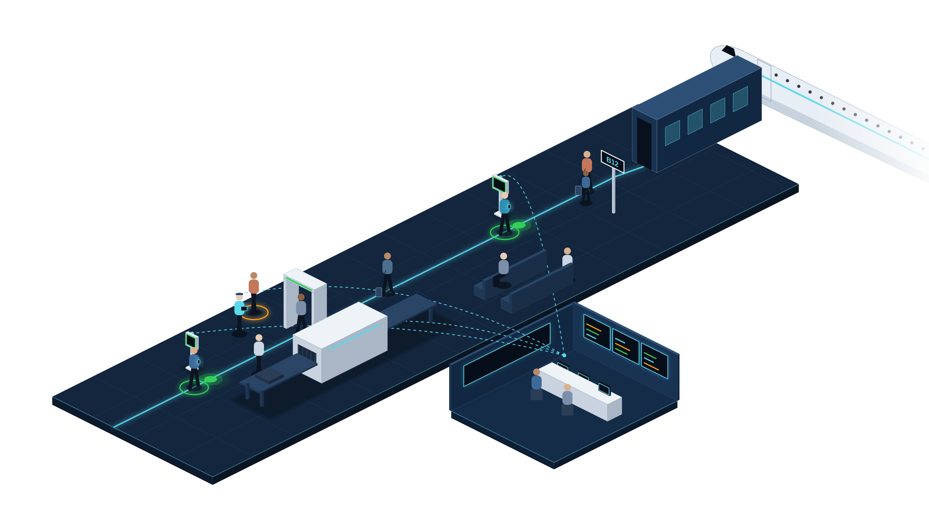
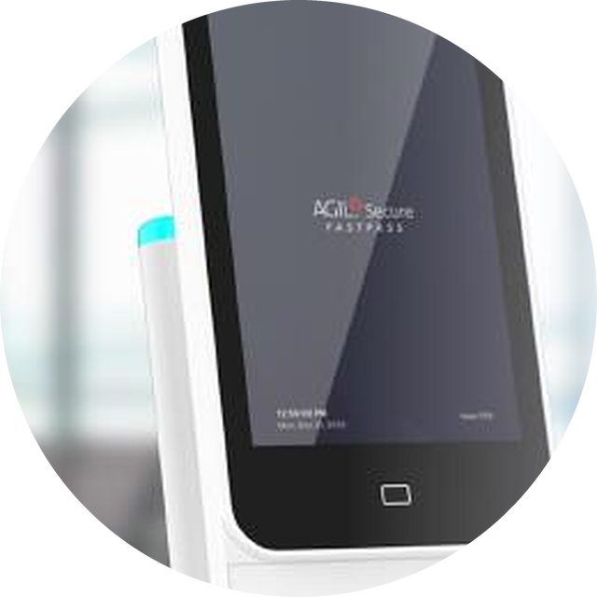
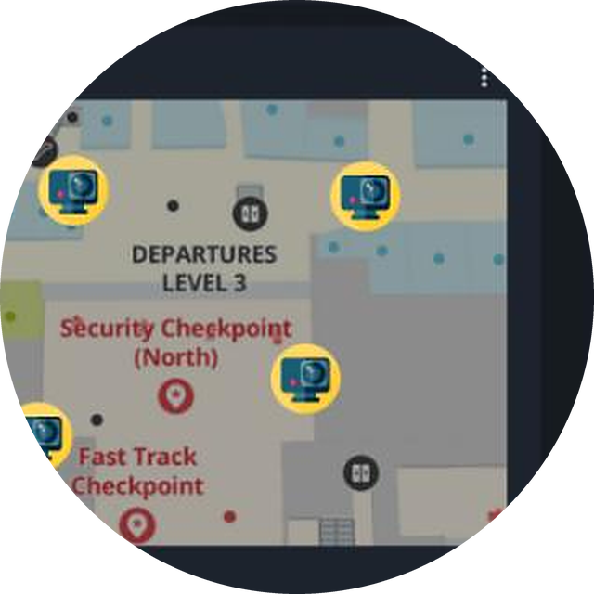
Screened, boarded, always supervised
USER JOURNEY · PART 2 OF 2
One identity clears screening and boarding while ISMP watches every step.
4
Pre-screening check
Before bags reach X-ray, the Nova+ reader confirms identity and pulls the clearance profile.
5
Exception: officer alerted
5
Smart boarding
Face plus phone clears the boarding kiosk. No passport, no boarding pass.
4
6
6
Live oversight
ISMP tracks every touchpoint and routes exceptions to officer tablets.
Notes:
USER JOURNEY 2/2 — screening, boarding and supervision.
4. Pre-screening check: before baggage enters X-ray, the Nova+ reader verifies the traveller and retrieves the relevant clearance profile, so exceptions are flagged early.
5. Smart boarding: the Smart Boarding Kiosk pairs facial recognition with the FastPass app — no passport scan, no boarding pass.
6. Supervise and resolve: AGIL® Secure ISMP tracks every touchpoint in real time. The dashed lines show the command layer reaching every device. When a check fails (amber), the alert goes to an officer's tablet; officers keep authority over every unsuccessful case.

Slide 3











One platform behind every touchpoint
USER JOURNEY · THE PLATFORM
ISMP links traveller clearance and airport security in one command layer.
Passenger log
Every clearance, live
TOUCHPOINTS
Physical security
CCTV, access, intrusion
Lane & gate control
Status, open, close
FastPass Mobile App
Biometric E-Gate
Nova+ pre-screening reader
AGIL® Secure ISMP
Smart Boarding Kiosk
One command layer
CONNECTS TO YOUR SYSTEMS
Airline DCS · Border control · Airport operations
3D digital twin
Passenger flow by zone
Exception workflow
Alerts to officer tablets
Assistive AI
Alert triage, suggestions
Biometrics stay on the phone. ISMP keeps events only.
Notes:
THE PLATFORM — AGIL® Secure ISMP sits behind every touchpoint in the journey.
Inputs: FastPass app, Biometric E-Gate, Nova+ pre-screening reader, Smart Boarding Kiosk.
Modules: live passenger log, lane & gate control, exception workflow with officer-tablet alerts, assistive AI triage, 3D digital-twin flow, and physical security (CCTV, access control, intrusion).
Integrates with airline DCS, border control and airport operations systems.
Privacy: biometric and passport credentials stay on the traveller's phone; ISMP holds clearance events, not a biometric database.

