Slide 1
INVESTOR PITCH · [DATE]
AGIL® Secure FastPass
Departure capacity without building a terminal.
[Name], Chief Product Officer · [Name], Chief Marketing Officer
Raising [US$X M] · lane live [Qx 2027] · paid order [Qx 2028]

Slide 2



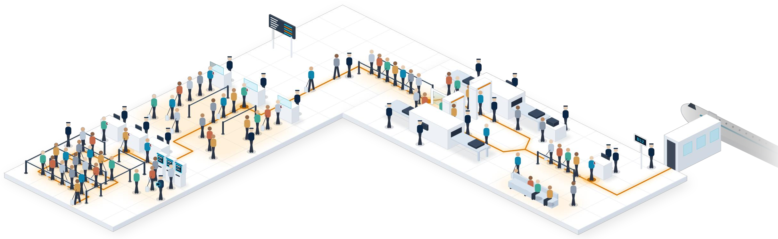



Problem
Up to four ID checks per departure, most staffed.
Airports are running out of space; border agencies, out of people.
1
Check-in
2
Immigration
3
Security screening
4
Boarding gate
Illustrative
≥4 staff per checkpoint workflow (internal estimate)
2
3
4
1
AIRPORT
BORDER AGENCY
~1.5×
8–10 yrs
“ICA's manpower cannot keep growing indefinitely.”
Manila: 52M passengers through terminals built for ~35M
to add a terminal: Changi T5 and Dubai DWC
Singapore Home Affairs Minister, 2025
2 |
GMA News (Jan 2026) · Singapore MOT (Jan 2025) · Dubai Media Office (Apr 2024) & WAM (Jun 2026) · MHA, ICA Workplan Seminar 2025 · Staff count: internal estimate
Notes:
SOURCES
DEM11 · GMA News, 'NAIA hits record-high 52M passenger volume in 2025' (Jan 2026) · https://www.gmanetwork.com/news/topstories/nation/971370/naia-hits-record-high-52m-passenger-volume-in-2025/story/
DEM10 · Singapore Ministry of Transport, 'Update on Development Plans for Changi Airport Terminal 5' (8 Jan 2025) · https://www.mot.gov.sg/news-resources/newsroom/update-on-development-plans-for-changi-airport-terminal-5/
FAC14 · Prime Minister's Office Singapore, 'PM Lawrence Wong at the Changi Airport Terminal 5 Groundbreaking Ceremony' (14 May 2025) · https://www.pmo.gov.sg/Newsroom/PM-Lawrence-Wong-at-the-Changi-Airport-Terminal-5-Groundbreaking-Ceremony
DEM9 · Dubai Media Office, 'Mohammed bin Rashid approves designs of new passenger terminal at Al Maktoum International Airport' (28 Apr 2024) · https://mediaoffice.ae/en/news/2024/april/28-04/al-maktoum-international-airport
DEM9B · WAM, 'Al Maktoum International Airport development project achieves significant milestones' (15 Jun 2026) · https://www.wam.ae/en/article/c0qknce-maktoum-international-airport-development-project
DEM13 · Singapore Ministry of Home Affairs, 'ICA Workplan Seminar 2025' (speech by Minister K Shanmugam) · https://www.mha.gov.sg/media-room/newsroom/ica-workplan-seminar-2025/

Slide 3



Why now
Borders went biometric; passports are going mobile.
Buyers, travellers and standards moved in 2024–26.
54%
today
→ 83%
79%
~127M
surveyed airports with biometric borders (2028, expected)
of passengers surveyed ready for a phone passport
passport-less clearances in Singapore, 2025
Sep 2024 · Changi passport-less,
all terminals
Apr 2026 · ICAO drafts
phone-credential standards
Nov 2025 · Indonesia
walk-through corridors
2027 · FastPass pilot (target)
3 |
SITA Air Transport IT Insights 2025 (Apr 2026) · SITA Passenger IT Insights 2025 (Oct 2025) · ICA (Oct 2024; 2025 statistics) · Amadeus (Nov 2025) · ICAO FALP/14-WP/21 (proposed, not adopted)
Notes:
SOURCES
FAC4 · SITA press release, 'SITA research finds aviation's record technology investment hinges on one thing: data coordination' (Air Transport IT Insights 2025, 16 Apr 2026) · https://www.sita.aero/about-us/pressroom/news-releases/sita-research-finds-aviations-record-technology-investment-hinges-on-one-thing-data-coordination/
WHY10 · SITA Passenger IT Insights 2025, 'Passengers Are Already Digital. This Is a Big Opportunity for Aviation' (GlobeNewswire, 7 Oct 2025) · https://www.globenewswire.com/news-release/2025/10/07/3162210/0/en/Passengers-Are-Already-Digital-This-Is-a-Big-Opportunity-for-Aviation.html
WHY12 · ICA Annual Statistics Report 2025 · https://www.ica.gov.sg/docs/default-source/ica/stats/annual-stats-report/ica-annual-statistics-report-2025.pdf
WHY11 · ICA media release, 'Passport-less clearance fully rolled out at Changi Airport' (24 Oct 2024) · https://www.ica.gov.sg/news-and-publications/newsroom/media-release/passport-less-clearance-fully-rolled-out-at-changi-airport
COM2 · Amadeus press release, 'Indonesia replaces immigration barriers with Amadeus Seamless Corridors' (Nov 2025) · https://amadeus.com/en/newsroom/press-releases/indonesia-replaces-immigration-barriers-with-amadeus-seamless-corridors
WHY6 · ICAO FALP/14-WP/21, 'Revised definitions and proposed standards and recommended practices for ICAO Digital Travel Credentials' (Apr 2026) · https://www.icao.int/sites/default/files/Meetings/FALP14/Working%20Papers/WP%2021%20-%20Revised%20definitions%20and%20proposed%20standards%20and%20recommended%20practices%20for%20ICAO%20Digital%20Travel%20Credentials/FALP14-WP-21.E.pdf

Slide 4



Our insight
Phone in the pocket + face in stride = cleared.
Corridors match a stored face. We add the phone you carry.
+
=
Device credential
Live face
Cleared
Up to 4 → 0
document stops at full rollout (target)
pilot lane: 1 → 0
Two factors by design; independent tests at M2.
Our bet, tested at M1: a second factor opens walk-through to more travellers.
4 |
Walk-through example: Dubai Red Carpet corridor, pre-registered, face only (GDRFA via International Airport Review, 2026) · Eligibility limits today: ICA (Oct 2024)
Notes:
SOURCES
WHY13 · International Airport Review, 'Dubai's biometric Red Carpet processes more than 439,000 travellers in six months' (2026) · https://www.internationalairportreview.com/dubais-biometric-red-carpet-processes-more-than-439000-travellers-in-six-months/2136321.article
WHY11 · ICA media release, 'Passport-less clearance fully rolled out at Changi Airport' (24 Oct 2024) · https://www.ica.gov.sg/news-and-publications/newsroom/media-release/passport-less-clearance-fully-rolled-out-at-changi-airport

Slide 5



Product walkthrough
One traveller, four checks, no documents shown.
Illustrated walkthrough of the prototype shown at Singapore Airshow, Feb 2026.
Check-in → enrol in app [+ airline online check-in]
Immigration → Bluetooth (BLE) lane + e-gate
Security ID → Nova Plus reader; bags still X-rayed
Boarding → kiosk: face + phone
2
Walk through
1
Enrol at home
3
Pre-screen + board
4
Behind every step: AGIL® Secure Platform
Illustration
5 |
Illustration of the prototype; controlled demo conditions. Eligibility set by each border agency. Traveller data synthetic; app screens are specimens.

Slide 6

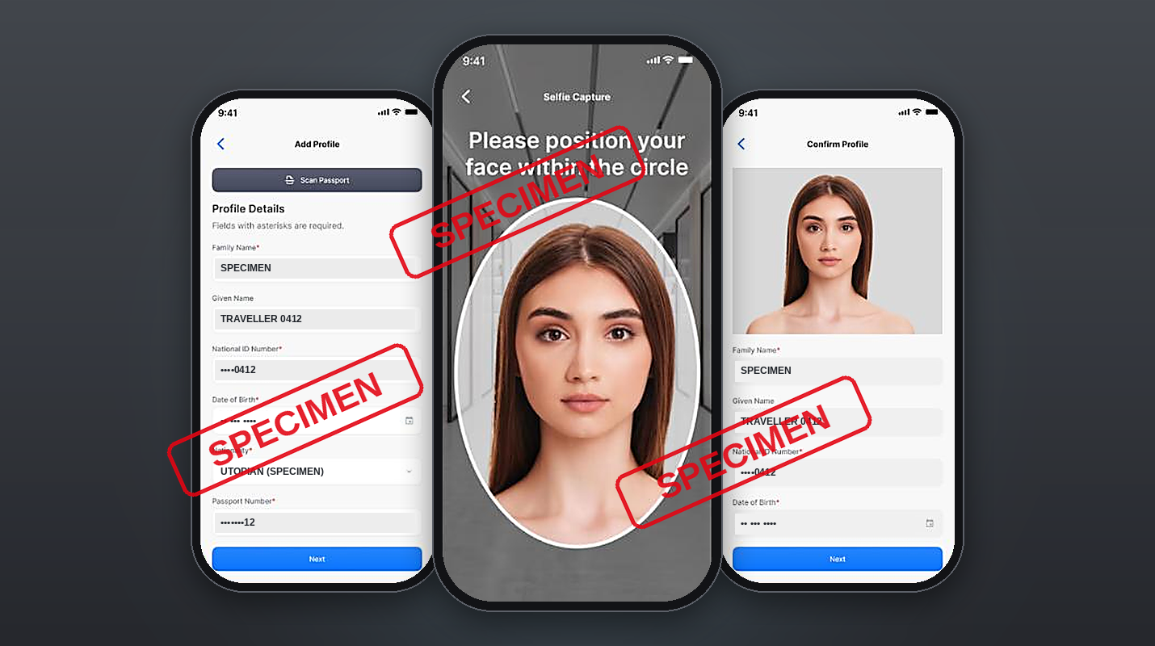
Product walkthrough
1 · Enrol once, at home
2
1
3
Passport scan and selfie, once. Encrypted on the phone; SDK for airline apps.
4
Illustration
5 |
Illustration of the prototype; controlled demo conditions. Eligibility set by each border agency. Traveller data synthetic; app screens are specimens.

Slide 7
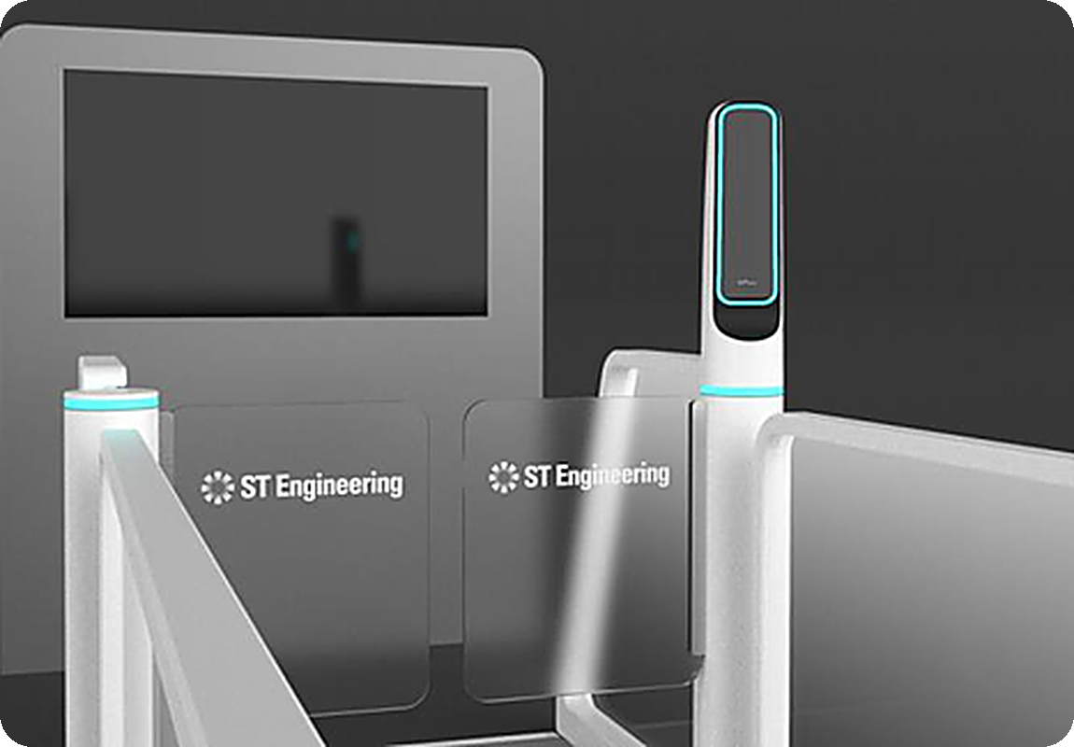

Product walkthrough
2 · Walk through: phone + face = cleared
STATUS TV
[Photo / Render]
#0412 · CLEARED
2
BLE pairing, phone in pocket
[X] s per traveller, prototype, controlled conditions [measure or delete]
Illustration
5 |
Illustration of the prototype; controlled demo conditions. Eligibility set by each border agency. Traveller data synthetic; app screens are specimens.
1
3
4

Slide 8
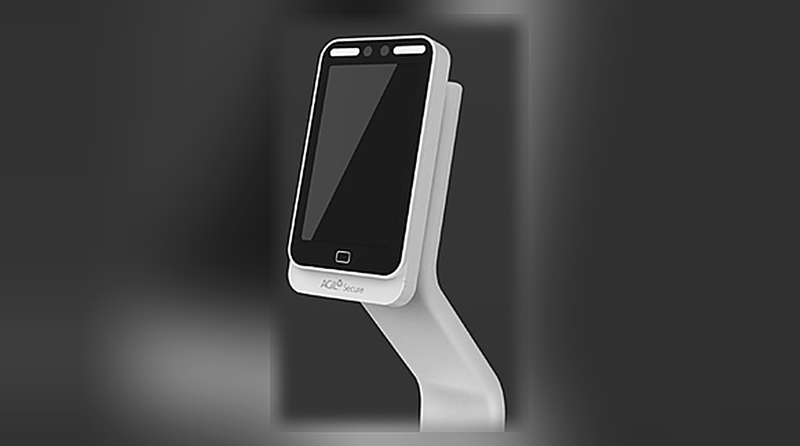

Product walkthrough
3 · Pre-screen and board by face + phone
2
Smart Boarding Kiosk
1
3
Nova Plus reader
4
Nova Plus re-confirms identity before X-ray. Boarding needs airline departure-control integration.
Illustration
5 |
Illustration of the prototype; controlled demo conditions. Eligibility set by each border agency. Traveller data synthetic; app screens are specimens.

Slide 9

2
Product walkthrough
4 · Officers act only on exceptions
Time
Traveller
ID
Lane
Status
10:12:41
TRAVELLER 0413
••••0413
1
EXCEPTION
No BLE credential
Officer review
mock-up
1
10:12:34
TRAVELLER 0412
••••0412
1
CLEARED
10:12:31
TRAVELLER 0411
••••0411
2
3
CLEARED
10:12:27
TRAVELLER 0410
••••0410
1
CLEARED
4
10:12:22
TRAVELLER 0409
••••0409
2
CLEARED
10:12:18
TRAVELLER 0408
••••0408
1
CLEARED
Clearance events sit beside CCTV, access control and incidents.
Illustration
5 |
Illustration of the prototype; controlled demo conditions. Eligibility set by each border agency. Traveller data synthetic; app screens are specimens.

Slide 10
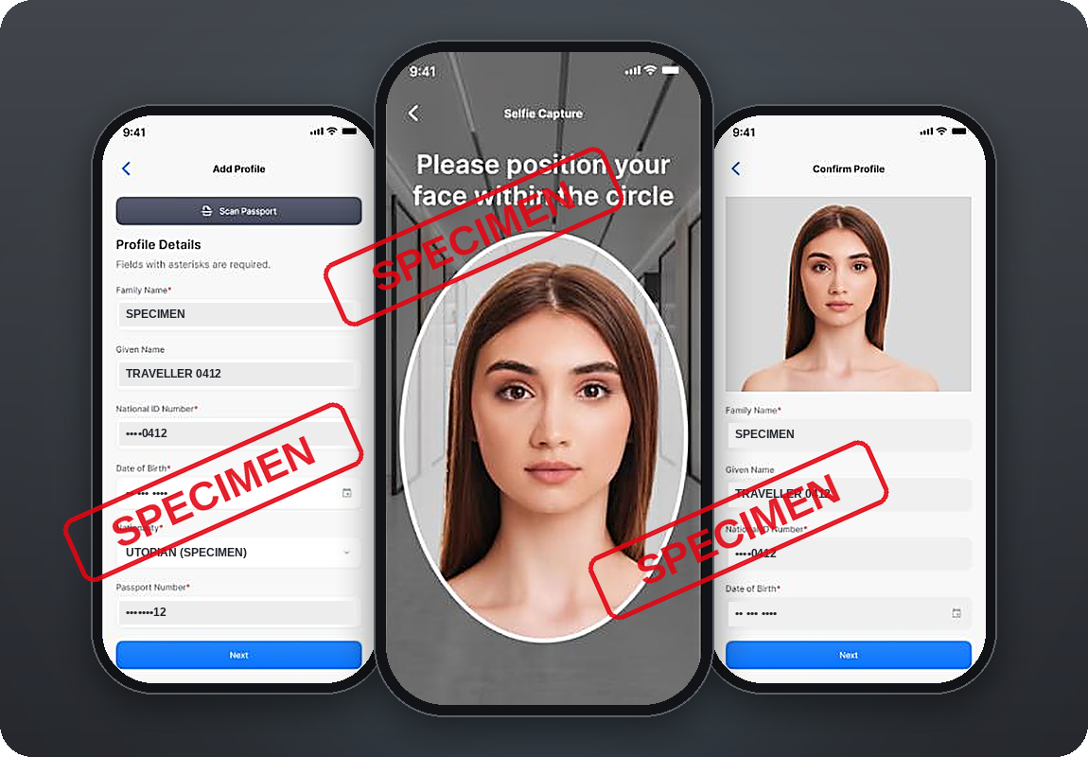

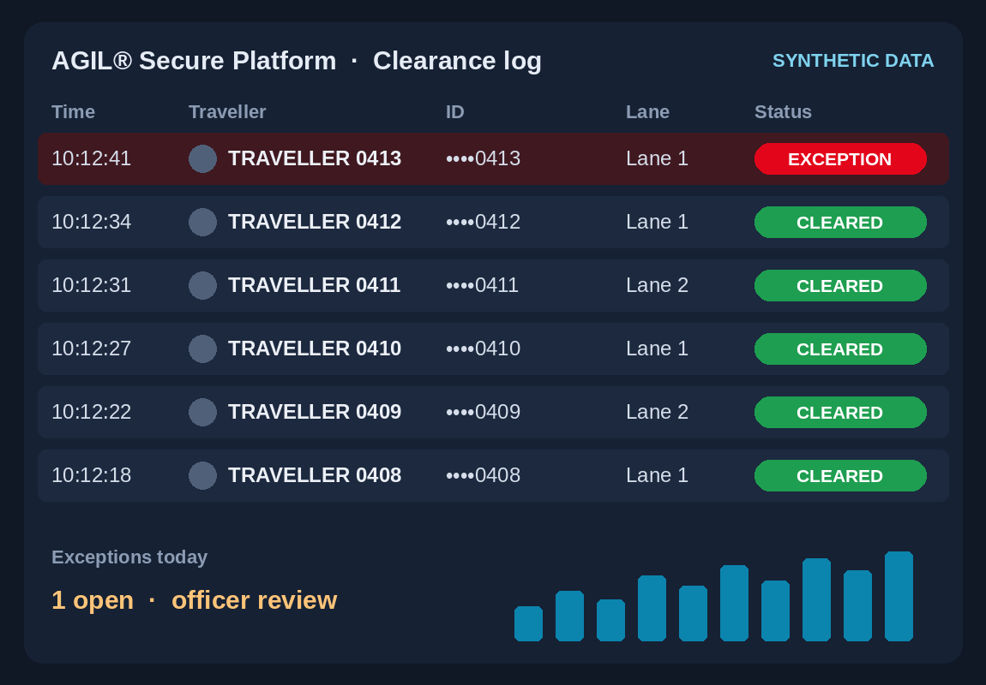

Traction & learning
Built and shown live. Next proof: one airport lane.
Pre-revenue; no pilot or letter of intent signed yet.
Specimen
[Photo / Render]
[Photo / Render]
[Photo / Render]
Mock-up
App
E-gate + BLE
Nova Plus
Kiosk
Platform
[N]
Pilot scorecard, agreed before go-live
Throughput vs e-gate
Officer minutes
False accepts / rejects
Enrolment
Kerb-to-gate (full-rollout target −20–30%)
airports and border agencies in pilot talks
Staffed fallback lane and officer override
6 |
Tiles: product images [photo / render, confirm], specimen and mock-up screens · Company record: Singapore Airshow, Feb 2026 · Full scorecard, baseline and go/no-go: A7

Slide 11

Competition
Others match faces in stride. We add the phone.
Our wedge: two factors, nothing taken out, plus the security control room.
ABC e-gates
FastPass
SITA/Indicio (Aruba)
immigration lane, prototype
Our wedge
(to prove in the pilot)
Smart-Trust (EU pilot, 2018–20)
Two factors, nothing taken out, in stride
Stored face only → Face + a credential you carry
SITA Smart Path
IDEMIA MFace
Clearance events in the security control room
Thales Fly to Gate
Amadeus corridors
Starts with one lane in an existing terminal
NEC (after kiosk step)
Stop and present → Clear in stride
7 |
Placement from public sources; 'not found' ≠ 'cannot'. IDEMIA · SITA · PhocusWire · Singapore EDB · Amadeus · NEC · CORDIS 778571 · Detail: A4
Notes:
SOURCES
COM5 · IDEMIA MFace brochure (Oct 2025) · https://www.idemia.com/wp-content/uploads/2025/10/mface-brochure-idemia-22102025.pdf
COM2 · Amadeus press release, 'Indonesia replaces immigration barriers with Amadeus Seamless Corridors' (Nov 2025) · https://amadeus.com/en/newsroom/press-releases/indonesia-replaces-immigration-barriers-with-amadeus-seamless-corridors
COM9 · NEC press release, walkthrough gates ordered by Japan's Immigration Services Agency (25 Mar 2025) · https://www.nec.com/en/press/202503/global_20250325_02.html
COM8 · PhocusWire, 'Aruba preps full launch of passport-free arrivals process' · https://www.phocuswire.com/aruba-preps-full-launch-passport-free-arrivals-process
COM7 · SITA Smart Path product page · https://www.sita.aero/smartpath
COM10 · Singapore EDB, 'Thales redefines the airport journey with AI-powered biometrics' · https://www.edb.gov.sg/en/business-insights/insights/thales-redefines-the-airport-journey-with-ai-powered-biometrics.html
COM3 · CORDIS, project 778571 Smart-Trust (2018–2020) · https://cordis.europa.eu/project/id/778571
COM1 · Amadeus press release, 'Vision-Box biometrics acquisition complete' (Apr 2024) · https://amadeus.com/en/newsroom/press-releases/vision-box-biometrics-acquisition-complete
COM14 · SITA press release, 'SITA becomes leader in airport solutions following Materna IPS acquisition' (Jul 2024) · https://www.sita.aero/pressroom/news-releases/sita-becomes-leader-in-airport-solutions-following-materna-ips-acquisition/
WHY14 · Hamad International Airport, 'Hamad International Airport rolls out biometric travel across more than 700 touchpoints' (Jul 2026) · https://dohahamadairport.com/press-releases/news/hamad-international-airport-rolls-out-biometric-travel-across-more-700

Slide 12
Market
US$42–94M a year by 2030, and lanes are only the wedge.
Deliberately narrow: e-gate and kiosk spend only, two regions.
US$4.18B
airport ABC market, 2030
Not to scale
× 10–15% Middle East + SE Asia
est.
US$0.42–0.63B
× 10–15% FastPass-serviceable
est.
US$42–94M
≈ 1–2.25% of the airport market
Where it grows (hypothesis)
ME + SEA lanes
Every touchpoint
Airports worldwide
Other borders [confirm]
8 |
Per year, 2030: US$5.03B × 83.1% = US$4.18B; × 10–15% × 10–15% = US$42–94M (midpoint ~US$65M at 12.5% × 12.5%). Shares: internal team estimates.
ABC = e-gates and kiosks, mostly one-off hardware; 83.1% is the 2025 airport share applied to 2030. MarketsandMarkets, Automated Border Control Market to 2030.
Notes:
SOURCES
FAC6 · MarketsandMarkets, 'Automated Border Control Market – Global Forecast to 2030' · https://www.marketsandmarkets.com/Market-Reports/automated-border-control-market-24899883.html
FAC7 · MarketsandMarkets, 'Automated Border Control Market' key takeaways (same report) · https://www.marketsandmarkets.com/Market-Reports/automated-border-control-market-24899883.html
FAC8 · Derived calculation from FAC6/FAC7 and the team's URS share estimates · https://www.marketsandmarkets.com/Market-Reports/automated-border-control-market-24899883.html
DEM2 · ACI World, 'Global airport passenger traffic reaches record 9.8 billion in 2025' (23 Sep 2026) · https://aci.aero/2026/09/23/global-airport-passenger-traffic-reaches-record-9-8-billion-in-2025-airports-council-international-world-reports/

Slide 13
Business model
Land one lane. Hardware once, software every year.
One standard product core, reused across airports, is how margins grow.
1
2
3
4
Pilot lane
Terminal
Airport
Portfolio
1 lane, 1 group
[paid / co-funded]
more lanes + platform licence
every touchpoint, one platform
more airports, one core
Revenue per lane (illustrative, not a forecast)
One-off: hardware + implementation
Yearly: software + SLA support
Y1
Y2
Y3
Y4
Y5
9 |
Revenue lines from the team's commercial model · Tender price anchors (Riga, Aena) and margin comparables: A11
Notes:
SOURCES
ROI8 · Information Centre of the Ministry of the Interior of Latvia, 'Installation of ABC gate at Riga International Airport' (No. VRS/IDF/2018/4) · https://www.ic.iem.gov.lv/en/projects/installation-abc-gate-riga-international-airport-no-vrsidf20184
ROI9 · Aena press release, 'Aena adjudica por 90 millones de euros un acuerdo marco para el suministro de equipos automáticos de control de fronteras' (Dec 2017) · https://www.aena.es/es/prensa/aena-adjudica-por-90-millones-de-euros-un-acuerdo-marco-para-el---suministro-de-equipos-automaticos-de-control-de-fronteras-en-sus---aeropuertos.html

Slide 14




Buyer case & go-to-market
Airport buys capacity. Agency gains officer time.
Payback is agreed per payer, before go-live.
BUYS
APPROVES
Airport operator
Border agency
Airline
Traveller
more departures per lane
officers on exceptions only
enrolment in its app
enrols once, no documents
E-gate benchmark, not FastPass
1 officer :
4–10 e-gates
E-gate · up to 180/hr
Staffed booth · 60–70/hr
FastPass: [X]/hr target, vs this baseline
10 |
Riga Airport / State Border Guard of Latvia (AviationPros) · UK Border Force Aviation Forum minutes (Feb 2018) · Payback per payer: A11 · Target filter: A3
Notes:
SOURCES
ROI5 · AviationPros (Riga Airport / State Border Guard of Latvia), 'New ABC Gates Make Border Crossing at Riga Airport Faster and More Convenient' · https://www.aviationpros.com/airports/airport-technology/press-release/21166019/riga-airport-new-abc-gates-make-border-crossing-at-riga-airport-faster-and-more-convenient
ROI6 · UK Home Office, Border Force Aviation Forum minutes (Feb 2018) · https://assets.publishing.service.gov.uk/government/uploads/system/uploads/attachment_data/file/707604/Aviation-Forum-minutes-Feb-2018.pdf
FAC13 · IATA press release, '2025 Global Passenger Survey: mobile and digital ID are the future of travel' (5 Nov 2025) · https://www.iata.org/en/pressroom/2025-releases/2025-11-05-02/

Slide 15







Team
The team that built and demoed the prototype.
Three ST Engineering business areas; venture-built via STEV / In.Vent [structure TBC].
[Name]
[Name]
[Name]
What an investor would own
[FT / PT]
[FT / PT]
[FT / PT]
Structure: [NewCo / internal venture, TBC]
[Venture lead / GM]
Product (CPO)
Marketing (CMO)
[proof, ≤5 words]
[proof]
[proof]
IP and platform owner: [TBC]
[Name]
Group supply on arm's-length terms [TBC]
Open role
Advisors
[FT / PT]
[Technology: biometrics, BLE, platform]
Hiring now:
commercial lead
+ certification & privacy lead (this round)
[border-agency official]
[airport operations executive]
35+ years of secure delivery (company claim)
[proof]
full-time
11 |
Business areas: Smart Security & Automation · Smart Utilities & Infrastructure · Urban Solutions

Slide 16

THE ASK
[US$X M] from first lane to first paid order by [2028].
[N] months of runway; each milestone retires a named risk.
M1 · [Qx 2027]
M2 · [Qx 2027]
M3 · [Qx 2028]
M4 · [Qx 2028]
Pilot signed: airport + agency
Lane live, independent tests passed
KPIs read out; miss → stop or redesign
First paid multi-lane order
Risk retired: agency
Risk retired: technical
Risk retired: operational
Risk retired: commercial
Today we ask for
The trusted identity layer for every checkpoint.
1 [A US$X M round, [instrument]]
2 [Help hiring a commercial lead]
12 |
[Structure: NewCo · IP assigned / licensed · ST Engineering as shareholder / supplier] · [Name, role, email]

Slide 17
Appendix
Appendix: backup for diligence and Q&A
Click a row to open it. Every external figure is mapped to a source in A1.
A1
Source map
A9
Regulatory and standards path
A2
Full journey, hardware and the BLE lane
A10
Risks and the milestone that retires each
A3
Market maths, segment and regional context
A11
Unit economics, payback per payer and plan
A4
Competitor matrix, evidence and moat
A12
Team detail and what an investor would own
A5
Category exits and consolidation
A13
Assumptions register
A6
AGIL® Secure Platform detail
A14
Investor FAQ: ten questions we expect
A7
Pilot design and full scorecard
A15
Roadmap and vision options
A8
Trust, privacy and security
Back to the ask

Slide 18
Appendix · A1 Source map
Every external number maps to one source.
Short tags on slides; this slide's notes list all 78 sources (id · title · URL).
Main deck
Appendix and Q&A
S2 · DEM11, DEM10, FAC14, DEM9, DEM9B, DEM13
S3 · FAC4, WHY10, WHY12, WHY11, COM2, WHY6
S4 · WHY13, WHY11
S7 · COM5, COM2, COM9, COM8, COM7, COM10, COM3, COM1, COM14, WHY14
S8 · FAC6, FAC7, FAC8, DEM2
S9 · ROI8, ROI9
S10 · ROI5, ROI6, FAC13
A3 · FAC5, FAC6–FAC9, FAC10/DEM6, DEM2–DEM5, DEM8, DEM9, DEM9B, DEM11, DEM12, DEM12B
A4 · COM1–COM12, COM5B, COM14, FAC12, FAC15, WHY11, WHY13, WHY13B, WHY14
A5 · COM1, COM13, COM14, COM14B, COM14C, COM15, COM15B
A7 · ROI2, ROI4, ROI5 | A8 · WHY9
A9 · WHY1, WHY1B, WHY2–WHY8, WHY15, WHY16
A10 · DEM2–DEM4, DEM9, DEM9B, FAC4, WHY2, WHY7, WHY14, FAC13
A11 · FAC2, ROI1, ROI2, ROI4, ROI5, ROI8, ROI9, ROI11–ROI16, ROI14B
A13 · DEM6 | A14 · DEM2, DEM9, DEM9B, WHY14, ROI8, ROI9, ROI11
How sources are handled: each slide carries short source tags and its notes hold the full entries; where sources conflict we use the conservative value (NAIA 35M; IATA about three in four; Dubai 3.4 s, GDRFA); internal estimates are labelled as such (A13). Click-checked against primary pages: [dd mmm 2026].
A1 |
Appendix index
Notes:
SOURCES
DEM11 · GMA News, 'NAIA hits record-high 52M passenger volume in 2025' (Jan 2026) · https://www.gmanetwork.com/news/topstories/nation/971370/naia-hits-record-high-52m-passenger-volume-in-2025/story/
DEM10 · Singapore Ministry of Transport, 'Update on Development Plans for Changi Airport Terminal 5' (8 Jan 2025) · https://www.mot.gov.sg/news-resources/newsroom/update-on-development-plans-for-changi-airport-terminal-5/
FAC14 · Prime Minister's Office Singapore, 'PM Lawrence Wong at the Changi Airport Terminal 5 Groundbreaking Ceremony' (14 May 2025) · https://www.pmo.gov.sg/Newsroom/PM-Lawrence-Wong-at-the-Changi-Airport-Terminal-5-Groundbreaking-Ceremony
DEM9 · Dubai Media Office, 'Mohammed bin Rashid approves designs of new passenger terminal at Al Maktoum International Airport' (28 Apr 2024) · https://mediaoffice.ae/en/news/2024/april/28-04/al-maktoum-international-airport
DEM9B · WAM, 'Al Maktoum International Airport development project achieves significant milestones' (15 Jun 2026) · https://www.wam.ae/en/article/c0qknce-maktoum-international-airport-development-project
DEM13 · Singapore Ministry of Home Affairs, 'ICA Workplan Seminar 2025' (speech by Minister K Shanmugam) · https://www.mha.gov.sg/media-room/newsroom/ica-workplan-seminar-2025/
FAC4 · SITA press release, 'SITA research finds aviation's record technology investment hinges on one thing: data coordination' (Air Transport IT Insights 2025, 16 Apr 2026) · https://www.sita.aero/about-us/pressroom/news-releases/sita-research-finds-aviations-record-technology-investment-hinges-on-one-thing-data-coordination/
WHY10 · SITA Passenger IT Insights 2025, 'Passengers Are Already Digital. This Is a Big Opportunity for Aviation' (GlobeNewswire, 7 Oct 2025) · https://www.globenewswire.com/news-release/2025/10/07/3162210/0/en/Passengers-Are-Already-Digital-This-Is-a-Big-Opportunity-for-Aviation.html
WHY12 · ICA Annual Statistics Report 2025 · https://www.ica.gov.sg/docs/default-source/ica/stats/annual-stats-report/ica-annual-statistics-report-2025.pdf
WHY11 · ICA media release, 'Passport-less clearance fully rolled out at Changi Airport' (24 Oct 2024) · https://www.ica.gov.sg/news-and-publications/newsroom/media-release/passport-less-clearance-fully-rolled-out-at-changi-airport
COM2 · Amadeus press release, 'Indonesia replaces immigration barriers with Amadeus Seamless Corridors' (Nov 2025) · https://amadeus.com/en/newsroom/press-releases/indonesia-replaces-immigration-barriers-with-amadeus-seamless-corridors
WHY6 · ICAO FALP/14-WP/21, 'Revised definitions and proposed standards and recommended practices for ICAO Digital Travel Credentials' (Apr 2026) · https://www.icao.int/sites/default/files/Meetings/FALP14/Working%20Papers/WP%2021%20-%20Revised%20definitions%20and%20proposed%20standards%20and%20recommended%20practices%20for%20ICAO%20Digital%20Travel%20Credentials/FALP14-WP-21.E.pdf
WHY13 · International Airport Review, 'Dubai's biometric Red Carpet processes more than 439,000 travellers in six months' (2026) · https://www.internationalairportreview.com/dubais-biometric-red-carpet-processes-more-than-439000-travellers-in-six-months/2136321.article
WHY13B · Gulf News, 'Dubai's biometric Red-Carpet processes 745,188 travellers in eight months of 2026' · https://gulfnews.com/uae/dubais-biometric-red-carpet-processes-745188-travellers-in-eight-months-of-2026-1.500666738
FAC12 · Paravision, 'Paravision collaborates with Emaratech to power Red Carpet Smart Corridor at Dubai International Airport' (Sep 2025) · https://www.paravision.ai/news/paravision-collaborates-with-emaratech-to-power-red-carpet-smart-corridor-at-dubai-international-airport/
COM5 · IDEMIA MFace brochure (Oct 2025) · https://www.idemia.com/wp-content/uploads/2025/10/mface-brochure-idemia-22102025.pdf
COM5B · IDEMIA press release, 'Zayed International Airport revolutionizes passenger experience: IDEMIA's biometric solutions, over 1 million passengers processed' (6 Mar 2024) · https://www.idemia.com/press-release/zayed-international-airport-revolutionizes-passenger-experience-idemias-biometric-solutions-over-1-million-passengers-processed-2024-03-06
COM4 · IDEMIA press release, 'IDEMIA selected to supply Automated Border Control System' (9 May 2023) · https://idemia.com/press-release/idemia-selected-supply-automated-border-control-system-2023-05-09
COM6 · IDEMIA, ID2Travel / Digital Travel Credential page · https://idemia.com/id2travel
COM9 · NEC press release, walkthrough gates ordered by Japan's Immigration Services Agency (25 Mar 2025) · https://www.nec.com/en/press/202503/global_20250325_02.html
COM8 · PhocusWire, 'Aruba preps full launch of passport-free arrivals process' · https://www.phocuswire.com/aruba-preps-full-launch-passport-free-arrivals-process
COM7 · SITA Smart Path product page · https://www.sita.aero/smartpath
COM10 · Singapore EDB, 'Thales redefines the airport journey with AI-powered biometrics' · https://www.edb.gov.sg/en/business-insights/insights/thales-redefines-the-airport-journey-with-ai-powered-biometrics.html
COM3 · CORDIS, project 778571 Smart-Trust (2018–2020) · https://cordis.europa.eu/project/id/778571
COM1 · Amadeus press release, 'Vision-Box biometrics acquisition complete' (Apr 2024) · https://amadeus.com/en/newsroom/press-releases/vision-box-biometrics-acquisition-complete
COM14 · SITA press release, 'SITA becomes leader in airport solutions following Materna IPS acquisition' (Jul 2024) · https://www.sita.aero/pressroom/news-releases/sita-becomes-leader-in-airport-solutions-following-materna-ips-acquisition/
COM14B · IN Groupe, 'IN Groupe successfully completes the acquisition of IDEMIA Smart Identity' (1 Jul 2025) · https://ingroupe.com/news/in-groupe-successfully-completes-the-acquisition-of-idemia-smart-identity-to-become-the-global-leader-in-secure-identity-solutions/
COM14C · Thales press release, 'Thales completes acquisition of Gemalto' (Apr 2019) · https://www.thalesgroup.com/en/news-centre/press-releases/thales-completes-acquisition-gemalto-become-global-leader-digital
WHY14 · Hamad International Airport, 'Hamad International Airport rolls out biometric travel across more than 700 touchpoints' (Jul 2026) · https://dohahamadairport.com/press-releases/news/hamad-international-airport-rolls-out-biometric-travel-across-more-700
FAC6 · MarketsandMarkets, 'Automated Border Control Market – Global Forecast to 2030' · https://www.marketsandmarkets.com/Market-Reports/automated-border-control-market-24899883.html
FAC7 · MarketsandMarkets, 'Automated Border Control Market' key takeaways (same report) · https://www.marketsandmarkets.com/Market-Reports/automated-border-control-market-24899883.html
FAC8 · Derived calculation from FAC6/FAC7 and the team's URS share estimates · https://www.marketsandmarkets.com/Market-Reports/automated-border-control-market-24899883.html
FAC9 · Research and Markets (Mordor Intelligence), 'Automated Border Control Market Share Analysis'; Lucintel ABC market · https://www.researchandmarkets.com/reports/5026050/automated-border-control-market-share
DEM2 · ACI World, 'Global airport passenger traffic reaches record 9.8 billion in 2025' (23 Sep 2026) · https://aci.aero/2026/09/23/global-airport-passenger-traffic-reaches-record-9-8-billion-in-2025-airports-council-international-world-reports/
DEM3 · IATA press release, 'Air Passenger Demand Slips 0.8% in August' (30 Sep 2026); see also the 29 Apr 2026 release for March · https://www.iata.org/en/pressroom/2026-releases/09-30-air-passenger-demand-slips-august/
DEM4 · IATA, 'Middle East Disruptions and High Fuel Prices Halve Airline Industry Profitability' (7 Jun 2026) · https://www.iata.org/en/pressroom/2026-releases/06-07-middle-east-disruptions-high-fuel-prices-halve-airline-industry-profitability/
DEM5 · ACI Asia-Pacific & Middle East, 'Asia-Pacific and Middle East airports set for strong growth in passenger traffic' (Short-Term Forecast 2025–2028, c. Dec 2025) · https://www.aci-asiapac.aero/media-centre/news/asia-pacific-and-middle-east-airports-set-for-strong-growth-in-passenger-traffic
DEM6 · ACI Asia-Pacific & Middle East, 'Airports in Asia-Pacific & Middle East to see US$240 billion investment in infrastructure expansion' (16 Apr 2025) · https://www.aci-asiapac.aero/media-centre/news/airports-in-asia-pacific-and-middle-east-to-see-ususd240-billion-investment-in-infrastructure-expansion
FAC10 · International Airport Review, 'Airports in Asia-Pacific and Middle East to invest $240 billion in expansion by 2035' · https://www.internationalairportreview.com/news/259618/airports-in-asia-pacific-and-middle-east-to-invest-240-billion-in-expansion-by-2035/
FAC5 · Airport World, 'Data co-ordination key to success of IT investment in aviation' (SITA Air Transport IT Insights 2025, Apr 2026) · https://airport-world.com/data-co-ordination-key-to-success-of-it-investment-in-aviation/
DEM8 · Argaam, 'Saudi airport traffic rises to 140.9M passengers in 2025: GACA' · https://www.argaam.com/en/article/articledetail/id/1876411
DEM12 · Khaosod English, 'Suvarnabhumi to open Auto Gates to 31 more nationalities' (17 Aug 2026) · https://www.khaosodenglish.com/featured/2026/08/17/suvarnabhumi-to-open-auto-gates-to-31-more-nationalities/
DEM12B · Nation Thailand, Suvarnabhumi East Expansion targeted for 2030 (Sep 2025) · https://www.nationthailand.com/business/corporate/40055094
ROI8 · Information Centre of the Ministry of the Interior of Latvia, 'Installation of ABC gate at Riga International Airport' (No. VRS/IDF/2018/4) · https://www.ic.iem.gov.lv/en/projects/installation-abc-gate-riga-international-airport-no-vrsidf20184
ROI9 · Aena press release, 'Aena adjudica por 90 millones de euros un acuerdo marco para el suministro de equipos automáticos de control de fronteras' (Dec 2017) · https://www.aena.es/es/prensa/aena-adjudica-por-90-millones-de-euros-un-acuerdo-marco-para-el---suministro-de-equipos-automaticos-de-control-de-fronteras-en-sus---aeropuertos.html
ROI5 · AviationPros (Riga Airport / State Border Guard of Latvia), 'New ABC Gates Make Border Crossing at Riga Airport Faster and More Convenient' · https://www.aviationpros.com/airports/airport-technology/press-release/21166019/riga-airport-new-abc-gates-make-border-crossing-at-riga-airport-faster-and-more-convenient
ROI6 · UK Home Office, Border Force Aviation Forum minutes (Feb 2018) · https://assets.publishing.service.gov.uk/government/uploads/system/uploads/attachment_data/file/707604/Aviation-Forum-minutes-Feb-2018.pdf
FAC13 · IATA press release, '2025 Global Passenger Survey: mobile and digital ID are the future of travel' (5 Nov 2025) · https://www.iata.org/en/pressroom/2025-releases/2025-11-05-02/
WHY9 · IATA 2025 Global Passenger Survey (same release as FAC13) · https://www.iata.org/en/pressroom/2025-releases/2025-11-05-02/
ROI12 · World Bank PPP Resource Center summary of ACI World Airport Economics Report (2021 edition, FY2019 data) · https://ppp.worldbank.org/node/6996
ROI13 · ACI EUROPE, 'About ACI EUROPE' · https://www.aci-europe.org/about/
ROI1 · Delta, 'Delta Expands Optional Facial Recognition Boarding to New Airports and More Customers' (Jun 2019) · https://pro.delta.com/content/corporate/us/en/news/news-archive/2019/june-2019/delta-expands-optional-facial-recognition-boarding-to-new-airpor.html
ROI2 · Future Travel Experience, 'Biometric trial at Istanbul Airport reduces boarding times by 30%' (Apr 2021) · https://www.futuretravelexperience.com/2021/04/biometric-trial-at-istanbul-airport-reduces-boarding-times-by-30/
ROI4 · Malay Mail, 'Passport-less clearance fully available at Changi Airport, average immigration clearance time of 10 seconds' (24 Oct 2024) · https://www.malaymail.com/news/singapore/2024/10/24/passport-less-clearance-fully-available-at-changi-airport-average-immigration-clearance-time-of-10-seconds/154699
ROI11 · Welsh Government, 'Welsh Government invests £1m to improve border efficiency at Cardiff Airport' (Mar 2019) · https://www.gov.wales/welsh-government-invests-ps1m-improve-border-efficiency-cardiff-airport
ROI14 · Axon Enterprise, Form 10-K FY2025 (SEC) · https://www.sec.gov/Archives/edgar/data/1069183/000162828026011360/axon-20251231.htm
ROI14B · Axon press release, 'Axon reports Q3 2025 revenue of $711 million, up 31% year over year' (4 Nov 2025), via Axon investor relations · https://investor.axon.com/
ROI15 · Evolv Technologies Holdings, Form 10-K FY2025 (SEC) · https://www.sec.gov/Archives/edgar/data/1805385/000180538526000012/evlv-20251231.htm
ROI16 · Motorola Solutions, Form 10-K FY2025 (SEC) · https://www.sec.gov/Archives/edgar/data/68505/000006850526000010/msi-20251231.htm
FAC15 · ABI Research, 'IDEMIA, Thales, and Vision-Box Take the Lead in ABI Research's Automated Border Control System Competitive Ranking' (Jul 2023) · https://abiresearch.com/press//idemia-thales-and-vision-box-take-the-lead-in-abi-researchs-automated-border-control-system-competitive-ranking?hsLang=en
COM11 · Collins Aerospace newsroom, 'Collins deploys biometrics solution at Tokyo Haneda Airport' (Jul 2021) · https://www.collinsaerospace.com/newsroom/News/2021/07/Collins-deploys-biometrics-solution-Tokyo-Haneda-Airport
COM12 · Indra press release, ABC systems for Aena (10 Dec 2018) · https://www.indracompany.com/sites/default/files/181210pr_abcs_aena.pdf
COM13 · BigBear.ai newsroom, 'BigBear.ai completes Pangiam acquisition' · https://bigbear.ai/newsroom/bigbear-ai-completes-pangiam-acquisition/
COM15 · FinTech Futures, 'US identity platform Persona hits $2bn valuation after $200m Series D' (Apr 2025) · https://www.fintechfutures.com/venture-capital-funding/us-identity-platform-persona-hits-2bn-valuation-after-200m-series-d
COM15B · Renaissance Capital, 'Identity verification service Clear Secure prices IPO above the range at $31' (Jun 2021) · https://www.renaissancecapital.com/IPO-Center/News/83419/identity-verification-service-clear-secure-prices-ipo-above-the-range-at-31
WHY1 · European Commission (DG HOME), 'Commission set launch date of the Entry/Exit System to 12 October 2025' (30 Jul 2025) · https://home-affairs.ec.europa.eu/news/commission-set-launch-date-entryexit-system-12-october-2025-2025-07-30_en
WHY1B · European Commission, Entry/Exit System policy page (Smart Borders) · https://home-affairs.ec.europa.eu/policies/schengen-borders-and-visa/smart-borders/entry-exit-system_en
WHY2 · The Local, 'Mayhem and chaos: Europe's airports demand urgent review of new border system' (18 Dec 2025) · https://www.thelocal.com/20251218/mayhem-and-chaos-europes-airports-demand-urgent-review-of-new-border-system
WHY3 · European Commission, 'Commission proposes digital passports and ID cards for easier travel' (8 Oct 2024) · https://commission.europa.eu/news-and-media/news/commission-proposes-digital-passports-and-id-cards-easier-travel-2024-10-08-0_en
WHY4 · European Commission, 'European Digital Identity (EUDI) Regulation' · https://digital-strategy.ec.europa.eu/en/policies/eudi-regulation
WHY5 · ICAO TRIP Guide on the Digital Travel Credential, Part 1 (v1.0, Sep 2025) · https://www.icao.int/sites/default/files/TRIP/Publications/GM-ICAOTRIPGuide_DTC_p1.pdf
WHY7 · Keesing Platform, 'Finland's Digital Travel Credential pilot program results' · https://platform.keesingtechnologies.com/finlands-digital-travel-credential-pilot-program-results/
WHY8 · IATA press release, 'Fully Digital Travel Experience Closer to Reality' (30 Oct 2024) · https://www.iata.org/en/pressroom/2024-releases/2024-10-30-03/
WHY15 · Federal Register 2025-19655, 'Collection of Biometric Data From Aliens Upon Entry to and Departure From the United States' (27 Oct 2025) · https://www.federalregister.gov/documents/2025/10/27/2025-19655/collection-of-biometric-data-from-aliens-upon-entry-to-and-departure-from-the-united-states
WHY16 · Skift, 'New Apple Feature Stores Passport Info in Digital Wallet' (12 Nov 2025) · https://skift.com/2025/11/12/apple-digital-passport-id-tsa-travel/
FAC2 · IATA press release, 'Air Travel Demand Will More Than Double by 2050' (17 Mar 2026) · https://www.iata.org/en/pressroom/2026-releases/2026-03-17-01/
FAC1 · IATA, 'Global Outlook for Air Transport: A local sweet spot' (Dec 2023) · https://www.iata.org/en/iata-repository/publications/economic-reports/global-outlook-for-air-transport---december-2023---report/
FAC3 · SITA press release, 'Aviation industry doubles down on cybersecurity as IT spend climbs to new highs' (Feb 2025) · https://www.sita.aero/about-us/pressroom/news-releases/aviation-industry-doubles-down-on-cybersecurity-as-it-spend-climbs-to-new-highs/

Slide 19
Appendix · A2 Full journey and hardware
Six steps, five modules, one platform.
Every step and module, with live status per module [to confirm].
1 · Enrol
2–3 · Approach, walk
4 · Pre-screen
5 · Board
6 · Oversee
FastPass Mobile App
BLE lane + biometric e‑gate
Nova Plus check; X-ray still applies
Smart Boarding Kiosk
AGIL® Secure Platform
[Shown live / concept]
[Shown live / concept]
[Shown live / concept]
[Shown live / concept]
[Shown live / concept]
What travellers carry
Check-in coverage
Counts reconciled
No documents shown at checkpoints for enrolled, eligible travellers
The passport is still carried as required (ICAO DTC Type 1)
No module is a check-in or bag-drop device
Check-in = app enrolment + airline online check-in [confirm]; bag drop out of scope
4 checks · 5 modules · 6 steps · 1 platform
Walkthrough 1–4 = steps 1 · 2–3 · 4–5 · 6
AI luggage scanning: roadmap (A15)
A2 |
All demo screens show specimen or synthetic data · Image types [photo / render] to confirm
Appendix index

Slide 20
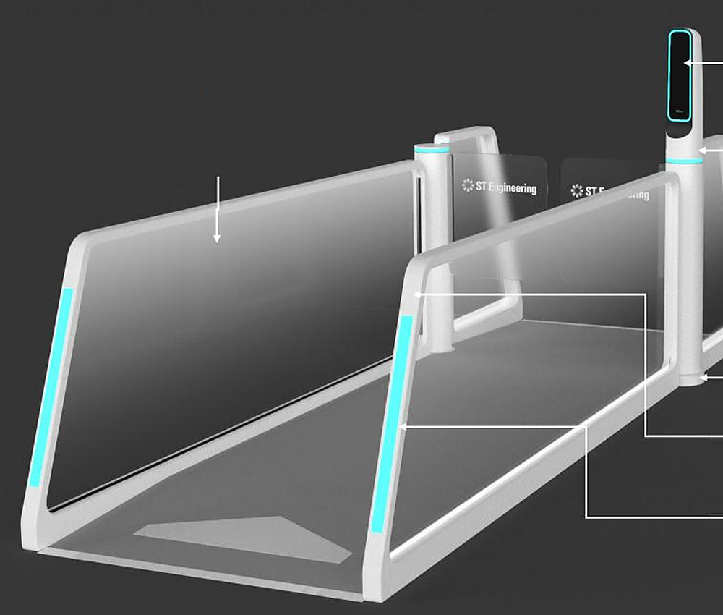
Appendix · A2 BLE lane
The FastPass lane: BLE beacon plus a face camera.
Prototype lane hardware. Image type [photo / render] to confirm.
FR pylon gantry
Pylon, G/R/B lights and face camera
Design intent [CTO to confirm]
LED accent light
soft glow along the handrail
Flexible mounting angle
Adjusts to gate layouts and user heights
The lane challenges the credential on the paired phone, not just a beacon.
The live face must match that credential.
Wrong pairing → exception to an officer, never a false accept.
Officers see the exception in AGIL® Secure Platform.
Pylon mounted on the floor
Permanent setup for stability
BLE beacon
Pairs with the phone; proximity detection
Indicator light
Colour-coded system status
A2 |
Appendix index

Slide 21
Appendix · A3 Market maths
Recompute the beachhead: US$42–94M a year in 2030.
Every input and step, plus what the figure does not cover.
Funnel, per year in 2030
Other readings
Scope caveat
US$5,030M × 83.1% = US$4,180M
× 10–15% = US$418–627M
× 10–15% = US$41.8–94.0M
Midpoint at 12.5% × 12.5% = US$65.3M (mean of the range: US$68M)
To scale: 0.8–1.9% of global ABC, 1.0–2.25% of airport ABC (hence 'Not to scale')
Cumulative 2026–30 (US$19.5B path): US$162–365M
2025 base (US$2.56B): US$21–48M a year
Each 1-point change in either share: ≈ US$4.2–6.3M a year
Independent estimates: ABC US$5.0–5.4B by 2030 (low confidence)
ABC = border e-gates and kiosks, mostly one-off hardware
FastPass software, check-in, pre-screen, boarding and the platform sit outside it
So the beachhead understates scope, but it is not a software market
Bottom-up cross-check
Input labels
[N] airports × [N] lanes × US$[X] one-off + US$[Y]/yr = US$[Z]M a year; must reconcile with the top-down
83.1% = 2025 airport share, applied to 2030
Asia-Pacific 32.6% (2024) includes China, Japan, India: not a proxy for SEA
A3 |
MarketsandMarkets, Automated Border Control Market to 2030 · Research and Markets / Mordor; Lucintel · Shares: internal team estimates
Appendix index
Notes:
SOURCES
FAC6 · MarketsandMarkets, 'Automated Border Control Market – Global Forecast to 2030' · https://www.marketsandmarkets.com/Market-Reports/automated-border-control-market-24899883.html
FAC7 · MarketsandMarkets, 'Automated Border Control Market' key takeaways (same report) · https://www.marketsandmarkets.com/Market-Reports/automated-border-control-market-24899883.html
FAC8 · Derived calculation from FAC6/FAC7 and the team's URS share estimates · https://www.marketsandmarkets.com/Market-Reports/automated-border-control-market-24899883.html
FAC9 · Research and Markets (Mordor Intelligence), 'Automated Border Control Market Share Analysis'; Lucintel ABC market · https://www.researchandmarkets.com/reports/5026050/automated-border-control-market-share

Slide 22
Appendix · A3 Segment and region
Who we target first, and the 2026 headwind.
Proposed first segment; regional data behind the pilot-market choice.
Segment (proposed)
Brownfield
2026 regional context
'Congested international gateways that cannot add a terminal soon'
Filter: brownfield · at or above design capacity at peak · no incumbent end-to-end biometric programme (not Changi, DXB, Doha) · Group relationship · regulator open to pilots
Test NAIA-type gateways (~50M passengers). First three: [A] · [B] · [C]
~78% of ME/SEA airport projects are brownfield: internal team figure [state whether it counts projects]
ACI APAC & MID: 57% of US$240B capex 2025–2035 goes to brownfield, by value
Different metrics: never merge them
ME airport traffic −21% in H1 2026 (ACI); ME carriers −14.2% YoY in Aug (IATA)
IATA: ME demand −11.4% for 2026; ACI +5.4%/yr (2025–28) is pre-war
Saudi: 140.9M passengers in 2025; Jeddah ~107% of design capacity [verify]
Bangkok: 47% still need an officer; East Expansion slipped to 2030
Dubai DWC phase 1 opens 2032
Wider pool, not TAM
Airports spent US$14.8B on IT in 2025, 7.3% of revenue (SITA)
So
Sell efficiency, not growth; SEA or dual-region pilot as the hedge
A3 |
ACI World · ACI APAC & MID · IATA (Jun, Sep 2026) · Argaam / GACA · Khaosod English · Nation Thailand · Dubai Media Office · WAM · SITA · ~78%: internal team figure
Appendix index
Notes:
SOURCES
DEM11 · GMA News, 'NAIA hits record-high 52M passenger volume in 2025' (Jan 2026) · https://www.gmanetwork.com/news/topstories/nation/971370/naia-hits-record-high-52m-passenger-volume-in-2025/story/
FAC5 · Airport World, 'Data co-ordination key to success of IT investment in aviation' (SITA Air Transport IT Insights 2025, Apr 2026) · https://airport-world.com/data-co-ordination-key-to-success-of-it-investment-in-aviation/
FAC10 · International Airport Review, 'Airports in Asia-Pacific and Middle East to invest $240 billion in expansion by 2035' · https://www.internationalairportreview.com/news/259618/airports-in-asia-pacific-and-middle-east-to-invest-240-billion-in-expansion-by-2035/
DEM6 · ACI Asia-Pacific & Middle East, 'Airports in Asia-Pacific & Middle East to see US$240 billion investment in infrastructure expansion' (16 Apr 2025) · https://www.aci-asiapac.aero/media-centre/news/airports-in-asia-pacific-and-middle-east-to-see-ususd240-billion-investment-in-infrastructure-expansion
DEM2 · ACI World, 'Global airport passenger traffic reaches record 9.8 billion in 2025' (23 Sep 2026) · https://aci.aero/2026/09/23/global-airport-passenger-traffic-reaches-record-9-8-billion-in-2025-airports-council-international-world-reports/
DEM3 · IATA press release, 'Air Passenger Demand Slips 0.8% in August' (30 Sep 2026); see also the 29 Apr 2026 release for March · https://www.iata.org/en/pressroom/2026-releases/09-30-air-passenger-demand-slips-august/
DEM4 · IATA, 'Middle East Disruptions and High Fuel Prices Halve Airline Industry Profitability' (7 Jun 2026) · https://www.iata.org/en/pressroom/2026-releases/06-07-middle-east-disruptions-high-fuel-prices-halve-airline-industry-profitability/
DEM5 · ACI Asia-Pacific & Middle East, 'Asia-Pacific and Middle East airports set for strong growth in passenger traffic' (Short-Term Forecast 2025–2028, c. Dec 2025) · https://www.aci-asiapac.aero/media-centre/news/asia-pacific-and-middle-east-airports-set-for-strong-growth-in-passenger-traffic
DEM8 · Argaam, 'Saudi airport traffic rises to 140.9M passengers in 2025: GACA' · https://www.argaam.com/en/article/articledetail/id/1876411
DEM9 · Dubai Media Office, 'Mohammed bin Rashid approves designs of new passenger terminal at Al Maktoum International Airport' (28 Apr 2024) · https://mediaoffice.ae/en/news/2024/april/28-04/al-maktoum-international-airport
DEM9B · WAM, 'Al Maktoum International Airport development project achieves significant milestones' (15 Jun 2026) · https://www.wam.ae/en/article/c0qknce-maktoum-international-airport-development-project
DEM12 · Khaosod English, 'Suvarnabhumi to open Auto Gates to 31 more nationalities' (17 Aug 2026) · https://www.khaosodenglish.com/featured/2026/08/17/suvarnabhumi-to-open-auto-gates-to-31-more-nationalities/
DEM12B · Nation Thailand, Suvarnabhumi East Expansion targeted for 2030 (Sep 2025) · https://www.nationthailand.com/business/corporate/40055094

Slide 23
Appendix · A4 Competitor matrix
Competitor matrix behind the slide-7 map.
Public sources only; 'not found in public sources' ≠ 'cannot'.
Vendor | Face in stride | Credential in lane | Stays in pocket | Ops platform | Notable deployments
IDEMIA | Yes (MFace) | Yes, e-gate (stop) | Not found [verify] | [verify] | Singapore ABCS (May 2023); Zayed >1M (vendor); ID2Travel app
SITA | No (stop-and-look) | Yes, Aruba (tap, stop) | No (tap) | [verify] | Smart Path on NEC at Frankfurt; Hamad 'Fast Pass' (Jul 2026)
Amadeus / Vision-Box | Yes (corridors) | Pilot only (Smart-Trust, 2018–20) | [verify] | Yes (Orchestra) | Indonesia: >30/min per corridor (vendor); DXB T3 (2020); Smart-Trust EU pilot
NEC | Yes (after kiosk step) | None found | No | [verify] | Japan ISA: Kansai, Narita, Haneda (Apr 2025)
Thales | No (pod, stop) | Not in lane [verify] | No [verify] | [verify] | Fly to Gate: 600+ touchpoints, 7 Adani airports (vendor)
Collins · Indra | No (stop-and-look) | Yes, document (stop) | No | [verify] | SelfPass, Haneda (2021); Indra ABC at Aena (2018)
FastPass | Yes (prototype) | Yes, phone credential | By design (BLE) [CTO] | Yes, AGIL® Secure Platform | Prototype shown Feb 2026; no deployments yet
A4 |
IDEMIA · SITA · PhocusWire · Amadeus · NEC · Singapore EDB (Thales) · Collins · Indra · CORDIS 778571 · Hamad International · ABI Research (Jul 2023)
Appendix index
Notes:
SOURCES
COM1 · Amadeus press release, 'Vision-Box biometrics acquisition complete' (Apr 2024) · https://amadeus.com/en/newsroom/press-releases/vision-box-biometrics-acquisition-complete
COM2 · Amadeus press release, 'Indonesia replaces immigration barriers with Amadeus Seamless Corridors' (Nov 2025) · https://amadeus.com/en/newsroom/press-releases/indonesia-replaces-immigration-barriers-with-amadeus-seamless-corridors
COM3 · CORDIS, project 778571 Smart-Trust (2018–2020) · https://cordis.europa.eu/project/id/778571
COM4 · IDEMIA press release, 'IDEMIA selected to supply Automated Border Control System' (9 May 2023) · https://idemia.com/press-release/idemia-selected-supply-automated-border-control-system-2023-05-09
COM5 · IDEMIA MFace brochure (Oct 2025) · https://www.idemia.com/wp-content/uploads/2025/10/mface-brochure-idemia-22102025.pdf
COM5B · IDEMIA press release, 'Zayed International Airport revolutionizes passenger experience: IDEMIA's biometric solutions, over 1 million passengers processed' (6 Mar 2024) · https://www.idemia.com/press-release/zayed-international-airport-revolutionizes-passenger-experience-idemias-biometric-solutions-over-1-million-passengers-processed-2024-03-06
COM6 · IDEMIA, ID2Travel / Digital Travel Credential page · https://idemia.com/id2travel
COM7 · SITA Smart Path product page · https://www.sita.aero/smartpath
COM8 · PhocusWire, 'Aruba preps full launch of passport-free arrivals process' · https://www.phocuswire.com/aruba-preps-full-launch-passport-free-arrivals-process
COM9 · NEC press release, walkthrough gates ordered by Japan's Immigration Services Agency (25 Mar 2025) · https://www.nec.com/en/press/202503/global_20250325_02.html
COM10 · Singapore EDB, 'Thales redefines the airport journey with AI-powered biometrics' · https://www.edb.gov.sg/en/business-insights/insights/thales-redefines-the-airport-journey-with-ai-powered-biometrics.html
COM11 · Collins Aerospace newsroom, 'Collins deploys biometrics solution at Tokyo Haneda Airport' (Jul 2021) · https://www.collinsaerospace.com/newsroom/News/2021/07/Collins-deploys-biometrics-solution-Tokyo-Haneda-Airport
COM12 · Indra press release, ABC systems for Aena (10 Dec 2018) · https://www.indracompany.com/sites/default/files/181210pr_abcs_aena.pdf
COM14 · SITA press release, 'SITA becomes leader in airport solutions following Materna IPS acquisition' (Jul 2024) · https://www.sita.aero/pressroom/news-releases/sita-becomes-leader-in-airport-solutions-following-materna-ips-acquisition/
FAC15 · ABI Research, 'IDEMIA, Thales, and Vision-Box Take the Lead in ABI Research's Automated Border Control System Competitive Ranking' (Jul 2023) · https://abiresearch.com/press//idemia-thales-and-vision-box-take-the-lead-in-abi-researchs-automated-border-control-system-competitive-ranking?hsLang=en
WHY14 · Hamad International Airport, 'Hamad International Airport rolls out biometric travel across more than 700 touchpoints' (Jul 2026) · https://dohahamadairport.com/press-releases/news/hamad-international-airport-rolls-out-biometric-travel-across-more-700

Slide 24
Appendix · A4 Evidence and moat
Market evidence and the moat to build.
Agencies and airports are possible buyers, so they are not plotted as rivals.
Market evidence (not plotted)
Moat to build (honest)
Dubai GDRFA Red Carpet: 745,188 travellers Jan–Aug 2026; 3.4 s vs 12.5 s (GDRFA; Paravision ~14 s); face only
Hamad 'Fast Pass' (Qatar Airways + SITA): 700+ touchpoints, app enrolment
Changi ICA passport-less: 25 s → 10 s; foreign visitors on departure only
ICA and HTX are not partners; Changi is market evidence only
Leaders by ranking: IDEMIA, Thales, Vision-Box (ABI Research, Jul 2023)
Accreditation earned in the pilot
Control-room integration: a switching cost only where security ops run on AGIL® Secure Platform
Government-grade delivery in ME/SEA
IP: [state the actual status]
Why not copied in 12 months: [team answer]
A4 |
Gulf News (2026) · International Airport Review (2026) · Paravision · Hamad International / SITA (Jul 2026) · ICA (Oct 2024) · ABI Research (Jul 2023)
Appendix index
Notes:
SOURCES
WHY11 · ICA media release, 'Passport-less clearance fully rolled out at Changi Airport' (24 Oct 2024) · https://www.ica.gov.sg/news-and-publications/newsroom/media-release/passport-less-clearance-fully-rolled-out-at-changi-airport
WHY13 · International Airport Review, 'Dubai's biometric Red Carpet processes more than 439,000 travellers in six months' (2026) · https://www.internationalairportreview.com/dubais-biometric-red-carpet-processes-more-than-439000-travellers-in-six-months/2136321.article
WHY13B · Gulf News, 'Dubai's biometric Red-Carpet processes 745,188 travellers in eight months of 2026' · https://gulfnews.com/uae/dubais-biometric-red-carpet-processes-745188-travellers-in-eight-months-of-2026-1.500666738
FAC12 · Paravision, 'Paravision collaborates with Emaratech to power Red Carpet Smart Corridor at Dubai International Airport' (Sep 2025) · https://www.paravision.ai/news/paravision-collaborates-with-emaratech-to-power-red-carpet-smart-corridor-at-dubai-international-airport/
WHY14 · Hamad International Airport, 'Hamad International Airport rolls out biometric travel across more than 700 touchpoints' (Jul 2026) · https://dohahamadairport.com/press-releases/news/hamad-international-airport-rolls-out-biometric-travel-across-more-700
FAC15 · ABI Research, 'IDEMIA, Thales, and Vision-Box Take the Lead in ABI Research's Automated Border Control System Competitive Ranking' (Jul 2023) · https://abiresearch.com/press//idemia-thales-and-vision-box-take-the-lead-in-abi-researchs-automated-border-control-system-competitive-ranking?hsLang=en

Slide 25
Appendix · A5 Category exits
The identity layer produces real outcomes.
Comps for context, not a valuation of FastPass.
Deal | Value | Detail | Date
Amadeus–Vision-Box | ~€320M EV | ~16× 2023 normalised EBITDA (per The Corner); ~€70M expected 2023 revenue (~4.6×, derived); ~470 staff | Apr 2024
BigBear.ai–Pangiam | ~US$70M, all-stock | Announced Nov 2023 | Early 2024
SITA–Materna IPS | Not disclosed | Airport solutions | 2024
IN Groupe–IDEMIA Smart Identity | Not disclosed | — | Jul 2025
Thales–Gemalto | €4.8B | — | Apr 2019
Persona Series D | US$200M at US$2B | Co-led by Founders Fund and Ribbit | Apr 2025
CLEAR Secure IPO | US$409M raised at US$31 | 38 airports at IPO | Jun 2021
These are comps for the category, not a valuation of FastPass.
A5 |
Amadeus (Apr 2024) · The Corner (EBITDA multiple) · BigBear.ai (2024) · SITA (Jul 2024) · IN Groupe (Jul 2025) · Thales (Apr 2019) · FinTech Futures (Apr 2025) · Renaissance Capital (Jun 2021)
Appendix index
Notes:
SOURCES
COM1 · Amadeus press release, 'Vision-Box biometrics acquisition complete' (Apr 2024) · https://amadeus.com/en/newsroom/press-releases/vision-box-biometrics-acquisition-complete
COM13 · BigBear.ai newsroom, 'BigBear.ai completes Pangiam acquisition' · https://bigbear.ai/newsroom/bigbear-ai-completes-pangiam-acquisition/
COM14 · SITA press release, 'SITA becomes leader in airport solutions following Materna IPS acquisition' (Jul 2024) · https://www.sita.aero/pressroom/news-releases/sita-becomes-leader-in-airport-solutions-following-materna-ips-acquisition/
COM14B · IN Groupe, 'IN Groupe successfully completes the acquisition of IDEMIA Smart Identity' (1 Jul 2025) · https://ingroupe.com/news/in-groupe-successfully-completes-the-acquisition-of-idemia-smart-identity-to-become-the-global-leader-in-secure-identity-solutions/
COM14C · Thales press release, 'Thales completes acquisition of Gemalto' (Apr 2019) · https://www.thalesgroup.com/en/news-centre/press-releases/thales-completes-acquisition-gemalto-become-global-leader-digital
COM15 · FinTech Futures, 'US identity platform Persona hits $2bn valuation after $200m Series D' (Apr 2025) · https://www.fintechfutures.com/venture-capital-funding/us-identity-platform-persona-hits-2bn-valuation-after-200m-series-d
COM15B · Renaissance Capital, 'Identity verification service Clear Secure prices IPO above the range at $31' (Jun 2021) · https://www.renaissancecapital.com/IPO-Center/News/83419/identity-verification-service-clear-secure-prices-ipo-above-the-range-at-31

Slide 26






Appendix · A6 Platform
AGIL® Secure Platform: the command layer behind every step.
Six capabilities. The AI recommends; the officer decides [confirm].
Traveller transactions
Video analytics
Lane & gate control
AGIL Secure
Platform
Human in the loop: the AI recommends, the officer decides, every decision logged [confirm]
Integrations: CCTV, access control, incident management [list systems, confirm]
Third-party gates via open interfaces [confirm]: decides whether biometric-border airports are an installed base to upgrade
Demo screens use synthetic data only
3D operational view
Exception management
Assistive AI
A6 |
Appendix index

Slide 27
Appendix · A7 Pilot design
Pilot design: one airport, one group, one lane.
Scope, fallback and the exits that define M2 and M3. Full scorecard: A7b.
Scope
Fallback and officer control
Milestone exits and trigger
One airport [name], one traveller group [set by the border agency], one lane, [N] months
[Paid / co-funded]
Payer and procurement route [to validate]
Converts a lane or adds one; floor space [agree]
Baseline on the existing lane for [N] weeks; scorecard signed by airport and agency
Staffed lane beside every FastPass lane; documents accepted anywhere; nobody forced into biometrics
Covers dead phone, BLE congestion, wrong phone paired, face no-match, tailgating, outage
Children without phones, wheelchair users, assisted travellers: [design]
Exception → officer review → manual clearance or referral; logged
M2 exit: lane live + independent ISO/IEC 19795 and 30107-3 tests + BLE relay and mis-pairing tests
M3 exit: KPIs met
KPIs met → airport decides on [N] lanes for US$[X] within [N] months [if in the agreement]
KPIs missed → stop or redesign
Prototype to date: match [X s] · false-reject [X%] · [X/lane/hr] · BLE pairing [X%], or scripted demo
A7 |
Appendix index

Slide 28
Appendix · A7 Pilot scorecard
Pilot scorecard: targets set now, measured live.
Baseline, target and go / no-go agreed with the airport and agency before go-live.
Measure | Baseline | Target | Go / no-go
Throughput (travellers / lane / hr) vs measured e-gate | [measure] | [X] | [X]
Immigration seconds per traveller | [measure] | [X] | [X]
Kerb-to-gate minutes (full-rollout team target −20–30%) | [measure] | [X] | [X]
False-accept (impostor) rate | [measure] | [X] | [X]
False-reject rate | [measure] | [X] | [X]
BLE pairing, phone locked or backgrounded (iOS, Android) | [measure] | [X] | [X]
Mis-pairing rate in a crowded lane | [measure] | [X] | [X]
Exceptions per 100 | [measure] | [X] | [X]
Officer minutes per 100 | [measure] | [X] | [X]
Enrolment vs break-even uptake per lane [X%] | [measure] | [X] | [X]
Lane availability | [measure] | [X] | [X]
Traveller satisfaction | [measure] | [X] | [X]
Custom-engineering days (margin proxy) | [measure] | [X] | [X]
Benchmarks, not FastPass claims: e-gate 180/hr vs booth 60–70 (Riga) · Changi 25 s → 10 s · boarding −30% (SITA / Turkish trial)
A7 |
AviationPros (Riga Airport / State Border Guard of Latvia) · Malay Mail (Oct 2024) · Future Travel Experience (Apr 2021)
Appendix index
Notes:
SOURCES
ROI2 · Future Travel Experience, 'Biometric trial at Istanbul Airport reduces boarding times by 30%' (Apr 2021) · https://www.futuretravelexperience.com/2021/04/biometric-trial-at-istanbul-airport-reduces-boarding-times-by-30/
ROI4 · Malay Mail, 'Passport-less clearance fully available at Changi Airport, average immigration clearance time of 10 seconds' (24 Oct 2024) · https://www.malaymail.com/news/singapore/2024/10/24/passport-less-clearance-fully-available-at-changi-airport-average-immigration-clearance-time-of-10-seconds/154699
ROI5 · AviationPros (Riga Airport / State Border Guard of Latvia), 'New ABC Gates Make Border Crossing at Riga Airport Faster and More Convenient' · https://www.aviationpros.com/airports/airport-technology/press-release/21166019/riga-airport-new-abc-gates-make-border-crossing-at-riga-airport-faster-and-more-convenient

Slide 29
Appendix · A8 Trust, privacy and security
Trust, privacy and security: design intent and test plan.
Design intent, test plan and data protection. Bracketed items await CTO sign-off.
Second-factor binding [CTO]
Enrolment and testing
Privacy and trust
The lane challenges the credential on the paired phone, not just a beacon
The live face must match that credential
Wrong pairing → exception to an officer, never a false accept
Where the face match runs and what crosses the BLE link [confirm]
Passport chip read with ICAO 9303 passive authentication, or data-page OCR [confirm]
Liveness selfie; credential encrypted on the device [enclave / keystore]
Tests [plan]: ISO/IEC 30107-3, ISO/IEC 19795, demographic accuracy
Face algorithm [own / licensed] and NIST FRTE standing [confirm]
BLE threats: wrong phone, relay, spoofed beacons, tailgating
Opt-in at enrolment; retention; data controller per deployment
PDPA (SG), PDPL (UAE, Saudi), PDPA (MY, TH), PDP Law (ID), GDPR [verify]
Public displays: sequence number + CLEARED only
42% of hesitant travellers would reconsider if data protection were guaranteed (IATA GPS 2025)
Design principles: Trusted by design · Easy to adopt (SDK) · Connected ecosystem · AI-assisted decisions
A8 |
IATA Global Passenger Survey 2025 · ICAO Doc 9303 · ISO/IEC 30107-3 · ISO/IEC 19795 · NIST FRTE
Appendix index
Notes:
SOURCES
WHY9 · IATA 2025 Global Passenger Survey (same release as FAC13) · https://www.iata.org/en/pressroom/2025-releases/2025-11-05-02/

Slide 30
Appendix · A9 Regulatory path
How an agency could accept a phone-held credential.
Standards status, precedents and the certification plan per country.
ICAO Digital Travel Credential
EU and US
Precedents and our plan
Type 1 (passport still carried): specs endorsed 2020; State implementation guide v1.0, Sep 2025
Annex 9 SARPs proposed at FALP/14, Apr 2026: not adopted; to the Air Transport Committee, fall 2026
Types 2 and 3: not ready
EES: progressive from 12 Oct 2025; fully operational 10 Apr 2026
ACI Europe: ~70% longer processing (Commission disputes)
EU Digital Travel app ~2030; EUDI wallets end-2026 (identity, not passports)
US: CBP may require face biometrics from non-citizens on entry and exit (from 26 Dec 2025)
Apple Digital ID: TSA beta, 250+ airports, domestic only
Finland border-guard DTC pilot: 355 checks, ~8 s; 90% would reuse
IATA One ID wallet + biometrics proof of concept, Hong Kong–Narita (Oct 2024)
Who approves on-the-move clearance per country: [agency, process, owner]
Certification roadmap and launch eligibility: [per country]
A9 |
ICAO (FALP/14; DTC guide) · European Commission · The Local / ACI Europe · Federal Register · Skift · Keesing · IATA (Oct 2024)
Appendix index
Notes:
SOURCES
WHY1 · European Commission (DG HOME), 'Commission set launch date of the Entry/Exit System to 12 October 2025' (30 Jul 2025) · https://home-affairs.ec.europa.eu/news/commission-set-launch-date-entryexit-system-12-october-2025-2025-07-30_en
WHY1B · European Commission, Entry/Exit System policy page (Smart Borders) · https://home-affairs.ec.europa.eu/policies/schengen-borders-and-visa/smart-borders/entry-exit-system_en
WHY2 · The Local, 'Mayhem and chaos: Europe's airports demand urgent review of new border system' (18 Dec 2025) · https://www.thelocal.com/20251218/mayhem-and-chaos-europes-airports-demand-urgent-review-of-new-border-system
WHY3 · European Commission, 'Commission proposes digital passports and ID cards for easier travel' (8 Oct 2024) · https://commission.europa.eu/news-and-media/news/commission-proposes-digital-passports-and-id-cards-easier-travel-2024-10-08-0_en
WHY4 · European Commission, 'European Digital Identity (EUDI) Regulation' · https://digital-strategy.ec.europa.eu/en/policies/eudi-regulation
WHY5 · ICAO TRIP Guide on the Digital Travel Credential, Part 1 (v1.0, Sep 2025) · https://www.icao.int/sites/default/files/TRIP/Publications/GM-ICAOTRIPGuide_DTC_p1.pdf
WHY6 · ICAO FALP/14-WP/21, 'Revised definitions and proposed standards and recommended practices for ICAO Digital Travel Credentials' (Apr 2026) · https://www.icao.int/sites/default/files/Meetings/FALP14/Working%20Papers/WP%2021%20-%20Revised%20definitions%20and%20proposed%20standards%20and%20recommended%20practices%20for%20ICAO%20Digital%20Travel%20Credentials/FALP14-WP-21.E.pdf
WHY7 · Keesing Platform, 'Finland's Digital Travel Credential pilot program results' · https://platform.keesingtechnologies.com/finlands-digital-travel-credential-pilot-program-results/
WHY8 · IATA press release, 'Fully Digital Travel Experience Closer to Reality' (30 Oct 2024) · https://www.iata.org/en/pressroom/2024-releases/2024-10-30-03/
WHY15 · Federal Register 2025-19655, 'Collection of Biometric Data From Aliens Upon Entry to and Departure From the United States' (27 Oct 2025) · https://www.federalregister.gov/documents/2025/10/27/2025-19655/collection-of-biometric-data-from-aliens-upon-entry-to-and-departure-from-the-united-states
WHY16 · Skift, 'New Apple Feature Stores Passport Info in Digital Wallet' (12 Nov 2025) · https://skift.com/2025/11/12/apple-digital-passport-id-tsa-travel/

Slide 31
Appendix · A10 Risks
Risks you will raise, and the milestone that retires each.
Agency, technical, privacy, adoption, payer, market and flow risks.
Risk | Mitigation | Retired at
Agency declines the phone credential, or sees no value in a second factor | Co-design the pilot with the agency; align to ICAO DTC Type 1; Finland DTC precedent. No value → stop or redesign | M1
Accuracy, spoofing, wrong-phone pairing, relay attack | Independent ISO/IEC 19795 and 30107-3 tests; BLE mis-pairing and relay tests; face must match the paired credential | M2 exit
Privacy and data protection | Credential encrypted on the phone; opt-in; controller and retention per country [legal review]; no personal data on displays | M1
Enrolment cold start | Airline-app SDK; eligible segments; enrolment is an M3 KPI vs break-even uptake [X%]; ~3 in 4 travellers willing (IATA) | M3
Payer mismatch: airport buys, agency saves officer time | Payback split per payer and budget holder; procurement route per country; co-funding at M1 | M1
Middle East 2026 traffic shock (airports −21% H1; carriers −14.2% Aug; IATA −11.4% for 2026) | SEA or dual-region pilot; sell efficiency, not growth; long-cycle builds continue (DWC 2032) | M1 market
Flow failure like EES (~70% longer, per ACI Europe; disputed) | Redesign the flow, not just the gate; staffed fallback lane | M2
A10 |
ACI World (Sep 2026) · IATA (Jun, Sep 2026) · The Local / ACI Europe (Dec 2025) · Keesing (Finland DTC) · IATA GPS 2025 · Dubai Media Office · WAM (Jun 2026)
Appendix index
Notes:
SOURCES
DEM2 · ACI World, 'Global airport passenger traffic reaches record 9.8 billion in 2025' (23 Sep 2026) · https://aci.aero/2026/09/23/global-airport-passenger-traffic-reaches-record-9-8-billion-in-2025-airports-council-international-world-reports/
DEM3 · IATA press release, 'Air Passenger Demand Slips 0.8% in August' (30 Sep 2026); see also the 29 Apr 2026 release for March · https://www.iata.org/en/pressroom/2026-releases/09-30-air-passenger-demand-slips-august/
DEM4 · IATA, 'Middle East Disruptions and High Fuel Prices Halve Airline Industry Profitability' (7 Jun 2026) · https://www.iata.org/en/pressroom/2026-releases/06-07-middle-east-disruptions-high-fuel-prices-halve-airline-industry-profitability/
DEM9 · Dubai Media Office, 'Mohammed bin Rashid approves designs of new passenger terminal at Al Maktoum International Airport' (28 Apr 2024) · https://mediaoffice.ae/en/news/2024/april/28-04/al-maktoum-international-airport
DEM9B · WAM, 'Al Maktoum International Airport development project achieves significant milestones' (15 Jun 2026) · https://www.wam.ae/en/article/c0qknce-maktoum-international-airport-development-project
WHY2 · The Local, 'Mayhem and chaos: Europe's airports demand urgent review of new border system' (18 Dec 2025) · https://www.thelocal.com/20251218/mayhem-and-chaos-europes-airports-demand-urgent-review-of-new-border-system
WHY7 · Keesing Platform, 'Finland's Digital Travel Credential pilot program results' · https://platform.keesingtechnologies.com/finlands-digital-travel-credential-pilot-program-results/
FAC13 · IATA press release, '2025 Global Passenger Survey: mobile and digital ID are the future of travel' (5 Nov 2025) · https://www.iata.org/en/pressroom/2025-releases/2025-11-05-02/

Slide 32
Appendix · A10 Risks
Risks you will raise, and the milestone that retires each.
Competitive, procurement, brand, IP and delivery risks.
Risk | Mitigation | Retired at
Incumbents win the replacement cycle first (SITA: 83% of surveyed airports biometric by 2028) | Retrofit onto installed third-party gates [CTO to confirm]; else target the replacement cycle | M1–M2
Incumbents copy the device factor | Accreditation earned in the pilot; control-room integration; [IP] | M3–M4
Procurement cycle longer than runway | Innovation-pilot route; Group channel; runway sized to [X–Y] months | M1
Brand: Hamad / Qatar Airways / SITA 'Fast Pass' (Jul 2026) | Trademark and naming check in ME/SEA classes; fallback names ready | Before launch
Freedom to operate on the BLE lane | Patent / FTO review before any 'proprietary' claim | Before launch
Matching bias · cyber attack · airline DCS integration delay | [mitigation for each] | [TBC]
A10 |
SITA (Apr 2026) · Hamad International (Jul 2026)
Appendix index
Notes:
SOURCES
FAC4 · SITA press release, 'SITA research finds aviation's record technology investment hinges on one thing: data coordination' (Air Transport IT Insights 2025, 16 Apr 2026) · https://www.sita.aero/about-us/pressroom/news-releases/sita-research-finds-aviations-record-technology-investment-hinges-on-one-thing-data-coordination/
WHY14 · Hamad International Airport, 'Hamad International Airport rolls out biometric travel across more than 700 touchpoints' (Jul 2026) · https://dohahamadairport.com/press-releases/news/hamad-international-airport-rolls-out-biometric-travel-across-more-700

Slide 33
Appendix · A11 Unit economics
Unit economics and payback per payer (placeholders).
FastPass values stay bracketed until a pilot prices them and Finance validates them.
Per lane
Payback per payer
Who pays: precedents
Hardware US$[X] one-off
Implementation [X%]
Software US$[Y] / lane / yr
SLA support US$[Z] / yr
Gross margin per line [X%]
Recurring share by year 3 [X%]
Blended gross margin [X%]
Airport: added departures / lane / hr × [value per departure] + airport-staff hours redeployed, vs lane cost US$[X] = [N] months
Agency: officer-hours redeployed [N] × loaded cost [US$/hr] = [N] months
Stated as incremental over the existing e-gate baseline
Where the agency gains, co-funding is part of M1
Aena (airport operator) ran an ABC framework
Riga: Interior Ministry and an EU fund
Cardiff: up to £1M from the Welsh Government (Border Force funds e-gates only above 2M inbound)
Route per target country: [to validate]
A11 |
Aena (Dec 2017) · Latvian Ministry of the Interior (Riga) · Welsh Government (Mar 2019) · Payback inputs: [Finance]
Appendix index
Notes:
SOURCES
ROI8 · Information Centre of the Ministry of the Interior of Latvia, 'Installation of ABC gate at Riga International Airport' (No. VRS/IDF/2018/4) · https://www.ic.iem.gov.lv/en/projects/installation-abc-gate-riga-international-airport-no-vrsidf20184
ROI9 · Aena press release, 'Aena adjudica por 90 millones de euros un acuerdo marco para el suministro de equipos automáticos de control de fronteras' (Dec 2017) · https://www.aena.es/es/prensa/aena-adjudica-por-90-millones-de-euros-un-acuerdo-marco-para-el---suministro-de-equipos-automaticos-de-control-de-fronteras-en-sus---aeropuertos.html
ROI11 · Welsh Government, 'Welsh Government invests £1m to improve border efficiency at Cardiff Airport' (Mar 2019) · https://www.gov.wales/welsh-government-invests-ps1m-improve-border-efficiency-cardiff-airport
ROI5 · AviationPros (Riga Airport / State Border Guard of Latvia), 'New ABC Gates Make Border Crossing at Riga Airport Faster and More Convenient' · https://www.aviationpros.com/airports/airport-technology/press-release/21166019/riga-airport-new-abc-gates-make-border-crossing-at-riga-airport-faster-and-more-convenient

Slide 34
Appendix · A11 Benchmarks and plan
Cost anchors, margin comparables and the 5-year plan.
Public anchors and large-company comparables: context only, not FastPass prices.
Public cost anchors
Buyer ROI context
5-year plan and demand
~€140–235k per unit (2017–18 tenders)
Aena: EUR 90M ÷ 652 max units ≈ €138k (incl. kiosks)
Riga: EUR 1.87M ÷ 8 gates ≈ €234k
~60% of airport opex is staff and contracted services (ACI FY2019; not all labour)
~20% of opex is security-related (ACI Europe)
Changi 25 s → 10 s; −30% boarding (SITA / IST); ~9 min per wide-body boarding (Delta)
Illustrative: 1 officer × 4 gates × 180/hr ≈ 720 pax/hr, vs 60–70 at a booth (not a FastPass claim)
5-year plan (internal estimate; Finance to validate): lanes, revenue, recurring %, gross margin, burn, break-even year
The ask derives from a bottom-up cost of M1–M4
IATA (Mar 2026): air travel demand more than doubles by 2050 (3.1% CAGR)
Margin and mix (context)
Axon: software & services ~74% GM (Q3 2025) vs 59.7% blended (FY2025)
Evolv: subscription 56% GM, hardware bundled: a caution
Motorola Solutions: software & services 38% of revenue
A11 |
Aena · Riga · Axon (Q3 2025; FY2025) · Evolv · Motorola · ACI (via World Bank) · ACI Europe · Malay Mail · FTE · Delta · IATA (Mar 2026)
Appendix index
Notes:
SOURCES
FAC2 · IATA press release, 'Air Travel Demand Will More Than Double by 2050' (17 Mar 2026) · https://www.iata.org/en/pressroom/2026-releases/2026-03-17-01/
ROI1 · Delta, 'Delta Expands Optional Facial Recognition Boarding to New Airports and More Customers' (Jun 2019) · https://pro.delta.com/content/corporate/us/en/news/news-archive/2019/june-2019/delta-expands-optional-facial-recognition-boarding-to-new-airpor.html
ROI2 · Future Travel Experience, 'Biometric trial at Istanbul Airport reduces boarding times by 30%' (Apr 2021) · https://www.futuretravelexperience.com/2021/04/biometric-trial-at-istanbul-airport-reduces-boarding-times-by-30/
ROI4 · Malay Mail, 'Passport-less clearance fully available at Changi Airport, average immigration clearance time of 10 seconds' (24 Oct 2024) · https://www.malaymail.com/news/singapore/2024/10/24/passport-less-clearance-fully-available-at-changi-airport-average-immigration-clearance-time-of-10-seconds/154699
ROI12 · World Bank PPP Resource Center summary of ACI World Airport Economics Report (2021 edition, FY2019 data) · https://ppp.worldbank.org/node/6996
ROI13 · ACI EUROPE, 'About ACI EUROPE' · https://www.aci-europe.org/about/
ROI14 · Axon Enterprise, Form 10-K FY2025 (SEC) · https://www.sec.gov/Archives/edgar/data/1069183/000162828026011360/axon-20251231.htm
ROI14B · Axon press release, 'Axon reports Q3 2025 revenue of $711 million, up 31% year over year' (4 Nov 2025), via Axon investor relations · https://investor.axon.com/
ROI15 · Evolv Technologies Holdings, Form 10-K FY2025 (SEC) · https://www.sec.gov/Archives/edgar/data/1805385/000180538526000012/evlv-20251231.htm
ROI16 · Motorola Solutions, Form 10-K FY2025 (SEC) · https://www.sec.gov/Archives/edgar/data/68505/000006850526000010/msi-20251231.htm

Slide 35
Appendix · A12 Team and structure
Team detail and what an investor would own.
Who is full-time, how the venture is set up, and what an investor owns.
Team
Why a venture
What an investor would own
Bios: [name, role, track record, full-time status, equity] × 4 leads
Advisors: [names]
Hires this round: commercial lead (airport / border-agency sales); certification & privacy lead
Concept to Airshow prototype: [N] months
Drawn from Smart Security & Automation, Smart Utilities & Infrastructure and Urban Solutions
[Rationale]
Structure: [NewCo spin-out or internal venture via STEV / In.Vent]
IP and platform rights: [assigned or exclusively licensed]
Cap table: [placeholder]; ST Engineering as [shareholder / supplier / channel]
Group supply on arm's-length terms; no parent veto on an exit [TBC]
Face-matching algorithm: [own / licensed, confirm]
Channel conflict [TBC]
Can FastPass sell through non-ST integrators?
And into airports where other ST Engineering units compete?
How are related-party sales handled?
A12 |
Appendix index

Slide 36
Appendix · A13 Assumptions register
Every internal number, labelled and owned.
Every internal estimate, with its label, owner and validation plan.
Assumption | Label | Validation · owner
Up to 4 document checks per departure | Process framing (domestic: no immigration) | [CPO]
Up to 4 → 0 at full rollout | Design target; pilot is 1 → 0 at immigration | [CPO]
≥4 staff per checkpoint workflow | Internal estimate | Pilot baseline · [COO]
10–15% ME + SEA share of airport ABC | Internal team estimate | Method [to document] · [CMO]
10–15% FastPass-serviceable share | Internal team estimate | Method [to document] · [CMO]
20–30% less kerb-to-gate time | Team target, unvalidated (full rollout) | Pilot baseline · [CPO]
~78% brownfield (team figure) | Unsourced; shown beside ACI's 57% (by value) | [CMO]
35+ years of secure delivery | Company claim | —
Prototype shown end to end, Feb 2026 | Company record; live status per module | [CTO]
Every [X] price, margin, KPI, date, count | Placeholder until confirmed | [owner]
A13 |
ACI Asia-Pacific & Middle East (57% brownfield, by value) · All other rows: internal
Appendix index
Notes:
SOURCES
DEM6 · ACI Asia-Pacific & Middle East, 'Airports in Asia-Pacific & Middle East to see US$240 billion investment in infrastructure expansion' (16 Apr 2025) · https://www.aci-asiapac.aero/media-centre/news/airports-in-asia-pacific-and-middle-east-to-see-ususd240-billion-investment-in-infrastructure-expansion

Slide 37
Appendix · A14 Investor FAQ
Ten questions we expect, answered plainly.
Ownership, scale, demand, payer and measured gain.
Question | Short answer
What would I own? | Not decided yet. For outside money we expect a NewCo, IP assigned or exclusively licensed, full-time leads with equity and arm's-length Group supply (A12). Structure and IP terms are fixed before any outside close [TBC].
Is this venture-scale? | The US$42–94M is a deliberately narrow beachhead: ABC e-gates and kiosks in two regions. The path to US$100M+ (every touchpoint, software, other airports and borders) is a hypothesis the pilot must open.
Which agency has asked for a second factor? | None yet. That is the bet M1 tests, and if agencies don't value it we stop or redesign.
Who pays: airport or agency? | It differs by country (Aena, Riga, Cardiff precedents). We compute payback per payer and structure the pilot with the budget holder (A11).
What's your measured gain over an e-gate? | Not measured yet. The pilot measures throughput against the existing e-gate baseline, with a go / no-go agreed in advance.
A14 |
Appendix index
Notes:
SOURCES
ROI8 · Information Centre of the Ministry of the Interior of Latvia, 'Installation of ABC gate at Riga International Airport' (No. VRS/IDF/2018/4) · https://www.ic.iem.gov.lv/en/projects/installation-abc-gate-riga-international-airport-no-vrsidf20184
ROI9 · Aena press release, 'Aena adjudica por 90 millones de euros un acuerdo marco para el suministro de equipos automáticos de control de fronteras' (Dec 2017) · https://www.aena.es/es/prensa/aena-adjudica-por-90-millones-de-euros-un-acuerdo-marco-para-el---suministro-de-equipos-automaticos-de-control-de-fronteras-en-sus---aeropuertos.html
ROI11 · Welsh Government, 'Welsh Government invests £1m to improve border efficiency at Cardiff Airport' (Mar 2019) · https://www.gov.wales/welsh-government-invests-ps1m-improve-border-efficiency-cardiff-airport

Slide 38
Appendix · A14 Investor FAQ
Ten questions we expect, answered plainly.
Demo, security, brand, market and the ask.
Question | Short answer
Was the demo real? | It is an illustrated walkthrough of the prototype demonstrated end to end at the Airshow. Real footage: [show / none]. Measured: [figures / none yet].
How is Bluetooth a second factor? Relay or mis-pairing? | Design intent: a cryptographic challenge to the paired phone's credential, plus a face match to that credential [CTO]. Independent tests are M2's exit criteria.
Can you use the name 'Fast Pass'? | Hamad, Qatar Airways and SITA launched it in Jul 2026. Our trademark review is [status], and fallback names are ready.
Why lead with the Middle East after −21% in H1 2026? | We sell efficiency, not growth; an SEA or dual-region pilot is the hedge; build-outs like DWC 2032 continue.
How much, and what's true at the end? | [US$X M] over [N] months buys M1–M4. In 12 months: a signed pilot and a live lane (M1–M2); the KPI readout (M3) follows by [Qx 2028]. Not revenue.
A14 |
Appendix index
Notes:
SOURCES
DEM2 · ACI World, 'Global airport passenger traffic reaches record 9.8 billion in 2025' (23 Sep 2026) · https://aci.aero/2026/09/23/global-airport-passenger-traffic-reaches-record-9-8-billion-in-2025-airports-council-international-world-reports/
DEM9 · Dubai Media Office, 'Mohammed bin Rashid approves designs of new passenger terminal at Al Maktoum International Airport' (28 Apr 2024) · https://mediaoffice.ae/en/news/2024/april/28-04/al-maktoum-international-airport
DEM9B · WAM, 'Al Maktoum International Airport development project achieves significant milestones' (15 Jun 2026) · https://www.wam.ae/en/article/c0qknce-maktoum-international-airport-development-project
WHY14 · Hamad International Airport, 'Hamad International Airport rolls out biometric travel across more than 700 touchpoints' (Jul 2026) · https://dohahamadairport.com/press-releases/news/hamad-international-airport-rolls-out-biometric-travel-across-more-700

Slide 39
Appendix · A15 Roadmap and vision
The trusted identity layer for every checkpoint.
Future options, kept out of the main pitch. Airports first.
Vision: no documents shown at any checkpoint a person crosses. Airports first.
Next capabilities
Technology options
New markets, in order
Accept airline-issued, ICAO DTC and EUDI wallet credentials as the device factor via the SDK [CTO to confirm]
Arrivals and transit
Lounge
LiDAR
Iris
E-concierge
AI luggage scanning ('FastPass AI Scanning')
1 → Congested airports worldwide
2 → Seaports, cruise and land borders
3 → Secure campuses [to confirm]
A15 |
Appendix index

