Slide 1

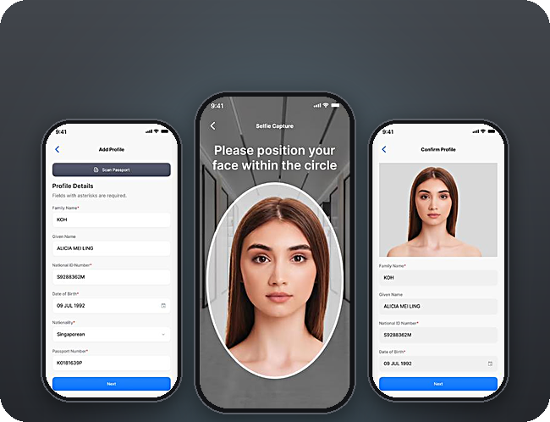
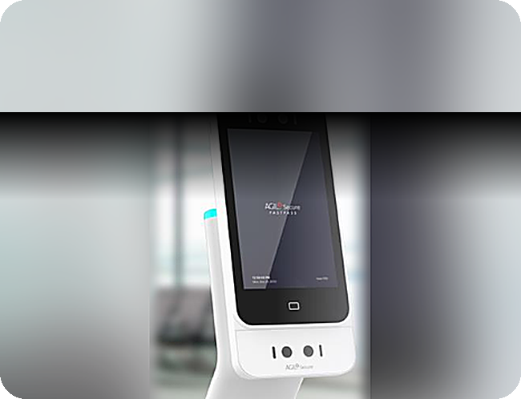


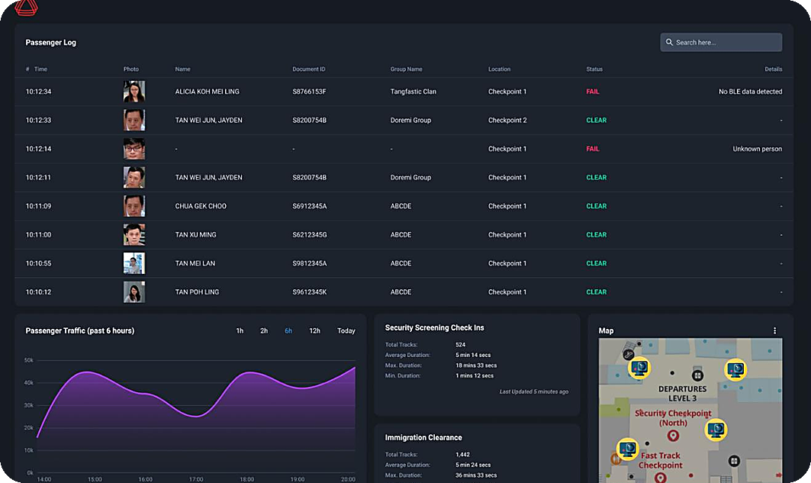


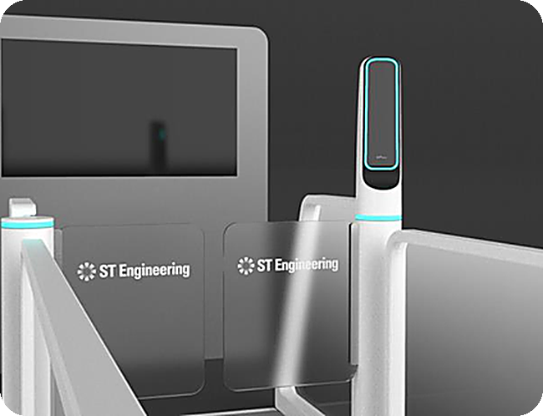
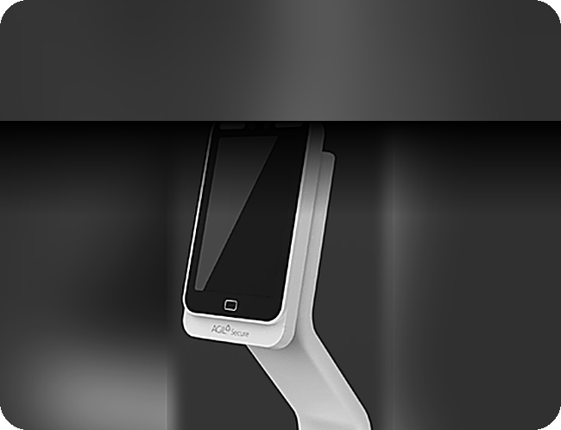

One identity, from curb to gate
FastPass Solution – Curb to Gate
1
Enrol before travel
Traveller path
ISMP oversight
4
Pre-screen
FastPass Mobile App
3
Profile Check reader
4
2
1
5
6
6
Oversee
BEHIND EVERY STEP
AGIL® Secure ISMP
2
Approach BLE pairing
5
Board
3
Walk through Biometric E-Gate
Smart Boarding Kiosk
STATUS TV
TAN M. Y.
SQ 322 · B12
CLEARED
Notes:
LAYOUT A · Centre stage. Map in the middle, the traveller’s products on both sides, AGIL® Secure ISMP at the heart.
[1:45–2:45] So how does it work? Please follow the numbers.
One. Before travel, the traveller enrols once in the FastPass app: a passport scan and a selfie. The credential stays safely on the phone.
Two and three. As they walk up to the lane, the phone pairs with it by Bluetooth. Then they walk through the e-gate. The camera matches the face to the phone, without stopping, and the status TV shows their name and a green "Cleared".
Four. Before security screening, the profile check reader confirms it is the same person.
Five. At the gate, the boarding kiosk clears them by face. No passport. No boarding pass.
And six, behind every step, AGIL Secure ISMP sees the whole journey. Officers step in only when something needs attention.

Slide 2
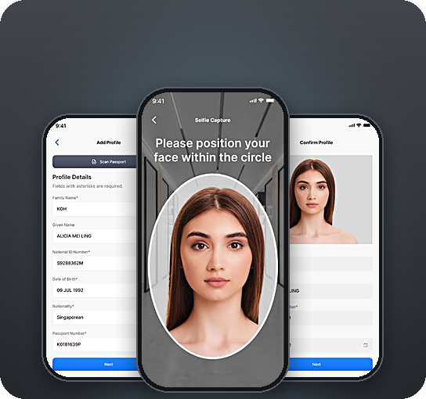
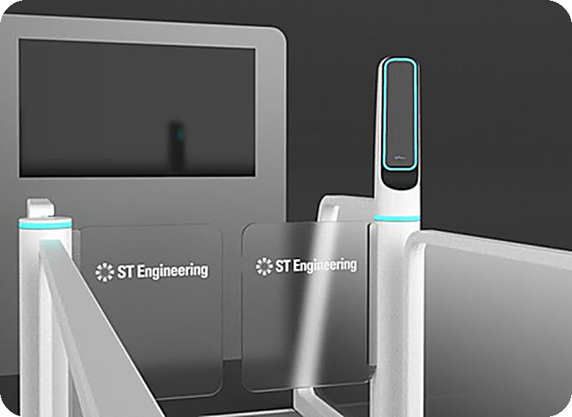
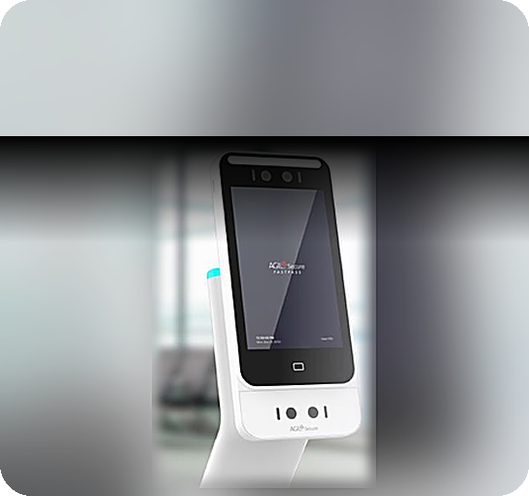
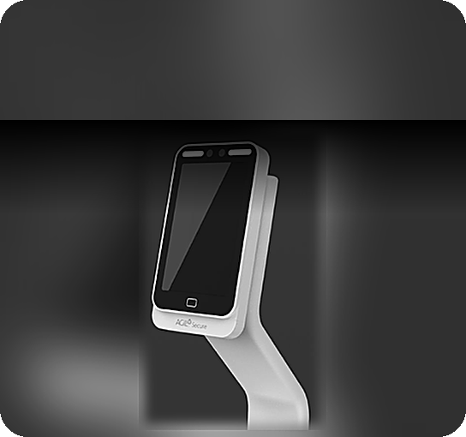

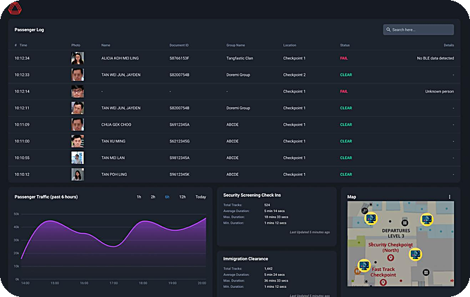



One identity, from curb to gate
FastPass Solution – Curb to Gate
1
Enrol before travel
2
Approach BLE pairing
4
Pre-screen
5
Board
FastPass Mobile App
3
Walk through Biometric E-Gate
Profile Check reader
Smart Boarding Kiosk
STATUS TV
TAN M. Y.
SQ 322 · B12
CLEARED
BEHIND EVERY STEP
3D OPERATIONAL VIEW
6
Oversee
3
AGIL® Secure ISMP
4
2
Live passenger log
1
5
Flow by zone
6
Exception alerts
Notes:
LAYOUT B · Two layers. Top: what the traveller uses, in order. Bottom: what operators see — the ISMP dashboard and the 3D operational view of every touchpoint.
[1:45–2:45] So how does it work? Please follow the numbers.
One. Before travel, the traveller enrols once in the FastPass app: a passport scan and a selfie. The credential stays safely on the phone.
Two and three. As they walk up to the lane, the phone pairs with it by Bluetooth. Then they walk through the e-gate. The camera matches the face to the phone, without stopping, and the status TV shows their name and a green "Cleared".
Four. Before security screening, the profile check reader confirms it is the same person.
Five. At the gate, the boarding kiosk clears them by face. No passport. No boarding pass.
And six, behind every step, AGIL Secure ISMP sees the whole journey. Officers step in only when something needs attention.

Slide 3
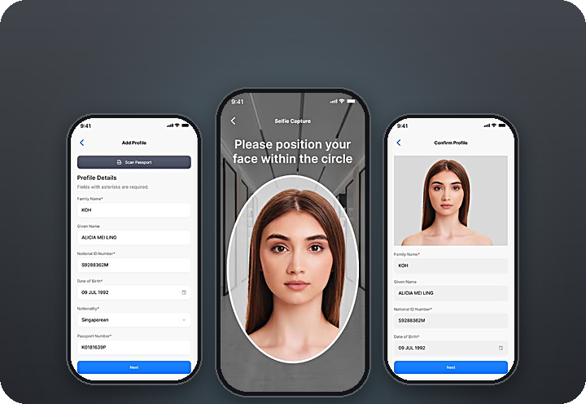
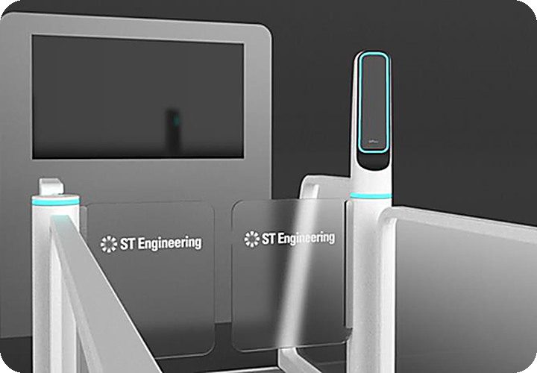
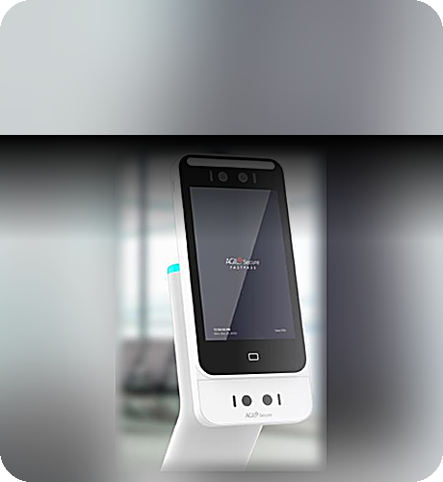
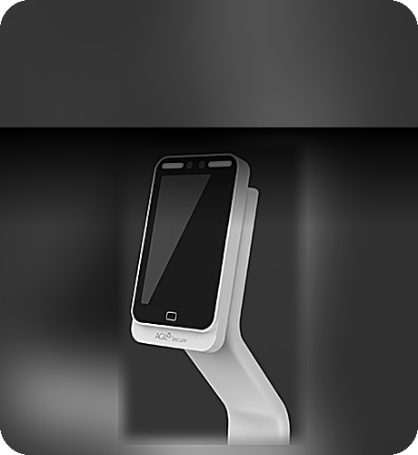
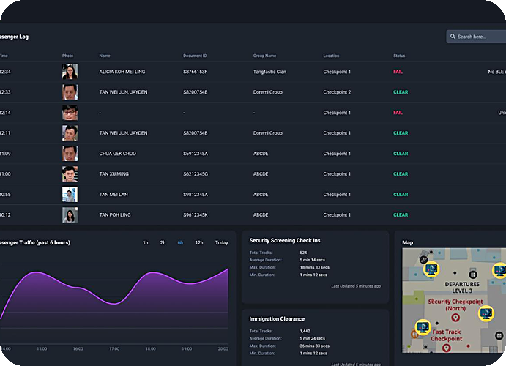
One identity, from curb to gate
FastPass Solution – Curb to Gate
1
Enrol before travel
Traveller path
ISMP oversight
FastPass Mobile App
3
4
2
1
5
6
2
Approach BLE pairing
4
Pre-screen
5
Board
6
Oversee
3
Walk through Biometric E-Gate
Profile Check reader
Smart Boarding Kiosk
AGIL® Secure ISMP
STATUS TV
TAN M. Y.
SQ 322 · B12
BEHIND EVERY STEP
CLEARED
Notes:
LAYOUT C · Bento. Full-bleed product tiles in one grid; the journey map is the wide hero tile.
[1:45–2:45] So how does it work? Please follow the numbers.
One. Before travel, the traveller enrols once in the FastPass app: a passport scan and a selfie. The credential stays safely on the phone.
Two and three. As they walk up to the lane, the phone pairs with it by Bluetooth. Then they walk through the e-gate. The camera matches the face to the phone, without stopping, and the status TV shows their name and a green "Cleared".
Four. Before security screening, the profile check reader confirms it is the same person.
Five. At the gate, the boarding kiosk clears them by face. No passport. No boarding pass.
And six, behind every step, AGIL Secure ISMP sees the whole journey. Officers step in only when something needs attention.

