Slide 1
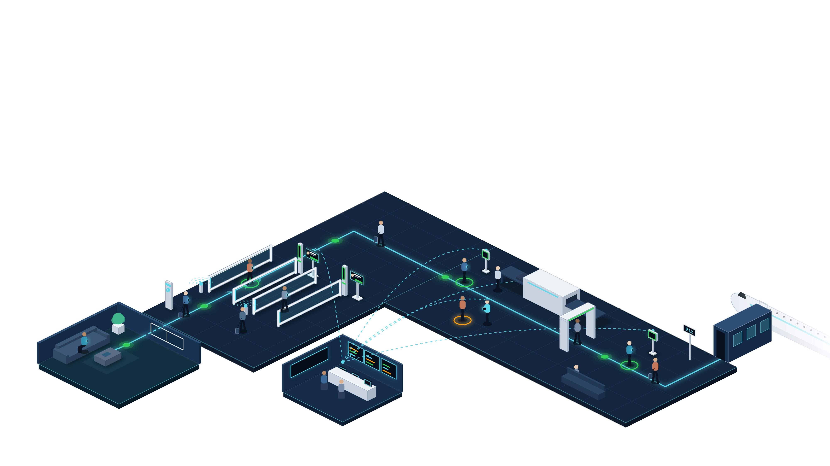
Curb to gate in six steps, on one identity
THE SOLUTION · CURB TO GATE
Enrol once at home, then walk through immigration, screening and boarding without stopping.
1
Enrol at home
2
Approach
3
Walk through
4
Pre-screen
5
Board
Passport + selfie in the app; kept on the phone
BLE pairs the phone to the lane as it nears
Face matched on the move; the TV shows your status
Nova+ confirms identity before bags reach X-ray
Face + phone clears the kiosk; no boarding pass
TAN M. L.
3
SQ 322 · B12
CLEARED
STATUS TV
4
2
1
5
6
6
Live oversight
One view in ISMP; exceptions go to officers
Notes:
[1:55–3:10] THE SOLUTION — the whole curb-to-gate journey on one slide (replaces the two journey slides; saves ~15 s).
Walk the path left to right:
1. Enrol at home — passport MRZ + selfie in the app (or inside the airport/airline app via our SDK). The credential is encrypted at rest on the phone.
2. Approach — a BLE beacon pairs the phone to the lane as the traveller walks up. No tapping.
3. Walk through immigration — the FR pylon matches the live face to the phone's template on the move: two factors. The status TV beside the pylon flashes the traveller's name and a green CLEARED, so they keep walking with confidence (CEO feedback: show the feedback loop).
4. Pre-screen — before bags reach X-ray, the Nova+ reader confirms identity and pulls the clearance profile.
5. Board — face plus phone clears the boarding kiosk; no passport, no boarding pass. Straight down the jet bridge.
6. Live oversight — AGIL® Secure ISMP sees every step (dashed links). An amber exception goes to an officer's tablet; 2–3 manual counters remain for edge cases.
Bridge: "So what is genuinely new here?"

