Slide 1


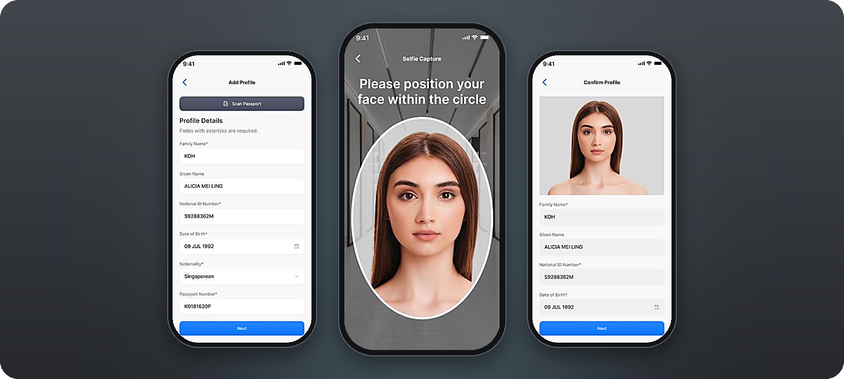






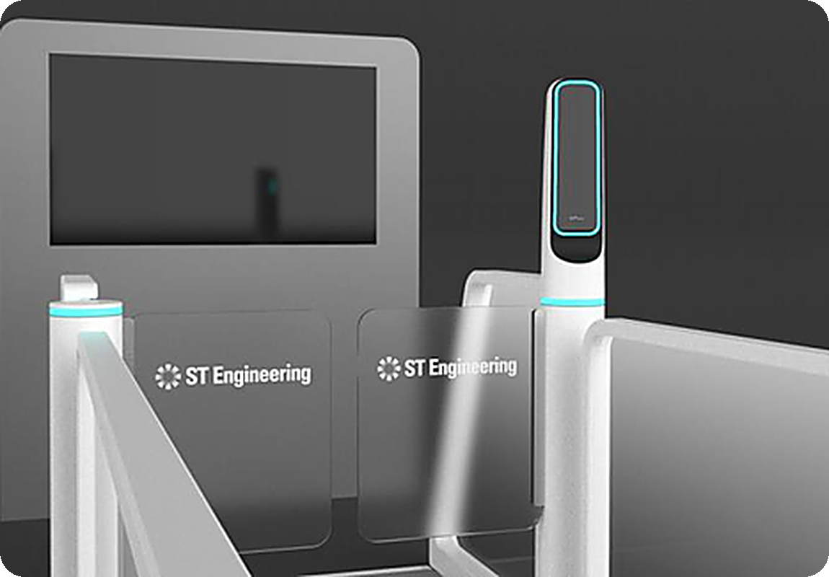


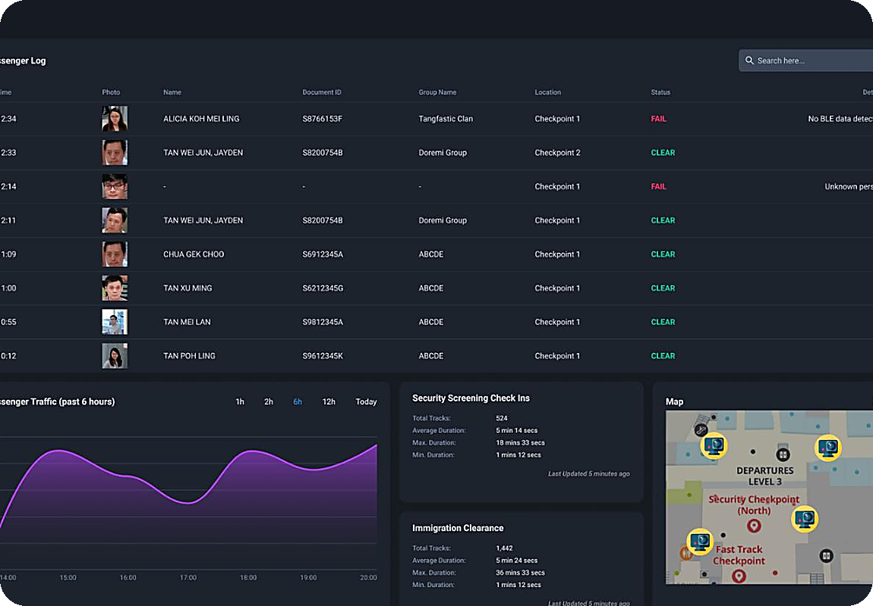

One identity, from curb to gate
FastPass Solution – Curb to Gate
3
1
Enrol before travel
4
FastPass Mobile App
2
1
5
6
BEHIND EVERY STEP
2
Approach
3
Walk through
4
Pre-screen
5
Board
6
Oversee
BLE pairing
Biometric E-Gate
Profile Check reader
Smart Boarding Kiosk
AGIL® Secure ISMP
STATUS TV
TAN M. Y.
SQ 322 · B12
CLEARED
Notes:
[1:45–2:45] So how does it work? Please follow the numbers.
One. Before travel, the traveller enrols once in the FastPass app: a passport scan and a selfie. The credential stays safely on the phone.
Two and three. As they walk up to the lane, the phone pairs with it by Bluetooth. Then they walk through the e-gate. The camera matches the face to the phone, without stopping, and the status TV shows their name and a green "Cleared".
Four. Before security screening, the profile check reader confirms it is the same person.
Five. At the gate, the boarding kiosk clears them by face. No passport. No boarding pass.
And six, behind every step, AGIL Secure ISMP sees the whole journey. Officers step in only when something needs attention.

