Slide 1
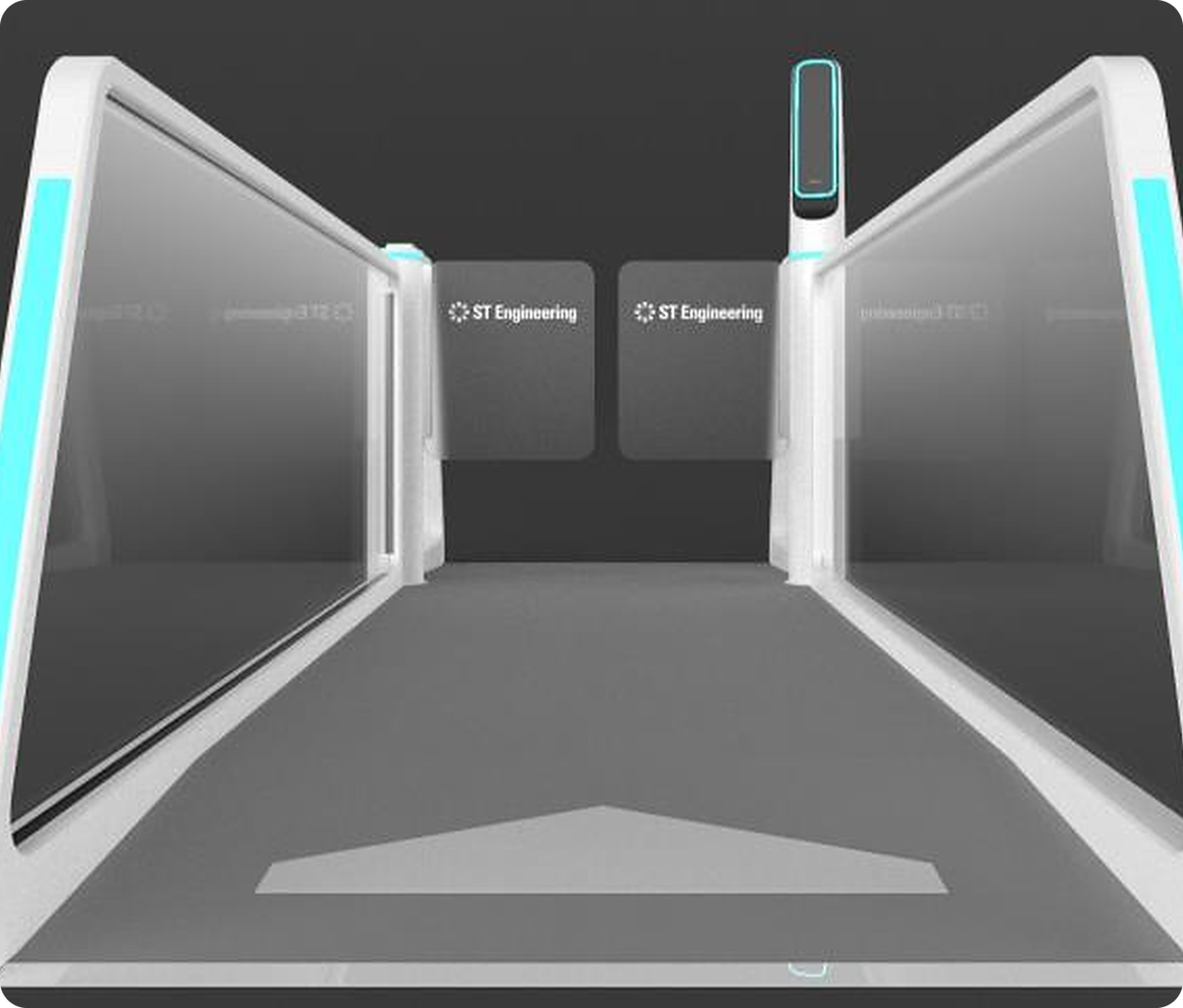
AGIL® Secure
FastPass
INNOCHAMP 2026 · PRODUCT CATEGORY
Curb to gate on one verified identity.
Two-factor
Privacy-first
Modular
Smart Security & Automation · Smart Utilities & Infrastructure · Urban Solutions
Notes:
[0:00–0:10] AGIL® Secure FastPass: curb to gate on one verified identity — two-factor, privacy-first, modular.
TIME PLAN (8-min slot, last on agenda): 1 Title 0:10 · 2 Problem 0:50 · 3 Market 0:55 · 4 Journey 1 0:45 · 5 Journey 2 0:45 · 6 Innovation 0:50 · 7 Impact 0:40 · 8 GTM 0:55 · 9 Collaboration & barriers 0:50 · 10 Ask 0:40 · 11 Close 0:05 ≈ 7:25. Suggested split: presenter A slides 1–6, presenter B slides 7–11.
Judges (division heads) score 4 × 10 points: Innovativeness · Market potential & business impact (cross-BA collaboration = 30% of it) · Time to market · Entry barriers. Every slide's eyebrow names the criterion it earns.

Slide 2







Demand doubles. Terminals take a decade
MARKET NEEDS
Every departure still means four stops, and airports cannot build their way out.
Check-in
Immigration
Security screening
Boarding gate
Document check
Passport + officer
ID + boarding pass
Passport + boarding pass
2×
2030s
~3
None
passengers by 2040
before Changi’s next terminal opens
staff per manned lane
of the biometric data airports want to keep
7.8 bn a year, growing 4.2% annually
T5: ground broken 2025, opens mid-2030s
On routine ID checks at every stop
Data-protection rules make storing it a liability
Sources: R1 IATA Global Outlook (Dec 2023) · R2 Singapore MOT, Changi T5 update · I1, I10 internal (ops assessment, Invent interviews). See References.
Notes:
[0:10–1:00] PAIN FIRST (CEO feedback: articulate the service-delivery pain, not industry stats).
• Demand: passengers double by 2040 — 7.8 bn, +4.2% a year (IATA, Dec 2023) [R1].
• Supply: airports cannot build fast enough. Changi's T5 broke ground in 2025 and opens in the mid-2030s — a decade for new capacity [R2]. (CMO framing: throughput rises faster than terminals and runways can be built.)
• Today a departing passenger stops four times — check-in, immigration, screening, boarding — and every manned lane ties up ~3 staff on routine checks [I1].
• Data: airports do not want to hold passenger biometrics; data-protection rules make it a liability [I10, Invent interviews].
Line to land: "The only way to add capacity this decade is to make every existing lane work harder — without adding people or data risk."
Q&A: IATA's newer forecasts (2025–26) keep long-term growth but over longer horizons; the 2040 figure is the Dec 2023 release.

Slide 3



A focused US$100–140M a year market
MARKET POTENTIAL
We target the Middle East and Southeast Asia: fastest growth, lower privacy resistance.
US$5.0B global ABC market by 2030
SERVICEABLE MARKET · 2026–2030
US$500–700M
83% of it at airports
≈ US$100–140M addressable every year
10–15% Middle East + SE Asia
Lanes, platform software, integration and services
≈25% FastPass share
WHO BUYS DEPENDS ON GOVERNANCE
Operator-led airports
e.g. Changi, Narita: the operator buys
Airline-led hubs
Gulf hubs: embed in the airline app
ABC market: US$2.56B (2025) → US$5.03B (2030), 14.4% a year
Demand signal: ~70% of airlines plan biometric ID by 2026; Asia-Pacific leads passenger growth
Private concessions
e.g. Philippines: the concessionaire buys
Sources: R3–R4 MarketsandMarkets (2025) · R5 SITA IT Insights (2024) · R6 IATA regional outlook. ME+SEA and FastPass shares: I2 URS estimate. See References.
Notes:
[1:00–1:55] MARKET (CEO: which market, which customers, what revenue; CMO: shift from features to market and sales).
• Target: Middle East and Southeast Asia — highest airport growth and lower privacy resistance. Europe and the US are deliberately out of scope for now (privacy resistance, strict data laws).
• Sizing, bottom-up: automated border control US$2.56B (2025) → US$5.03B (2030), 14.4% a year [R3]; airports are 83.1% of it [R4]; ME + SEA ≈ 10–15% and FastPass can address ~¼ of that [I2] → US$500–700M over 2026–30, ≈ US$100–140M a year.
• Demand signal: ~70% of airlines plan biometric ID management by 2026 [R5]; Asia-Pacific leads passenger growth (≈4.8% a year to 2043) [R6].
• Who buys depends on governance: operator-led airports (Changi, Narita) buy directly; at airline-led Gulf hubs we embed in the airline app; private concessions (e.g. Philippines) buy through the concessionaire.
NOT on slide: the US$40B e-gate TAM — source still unverified (Riley).

Slide 4
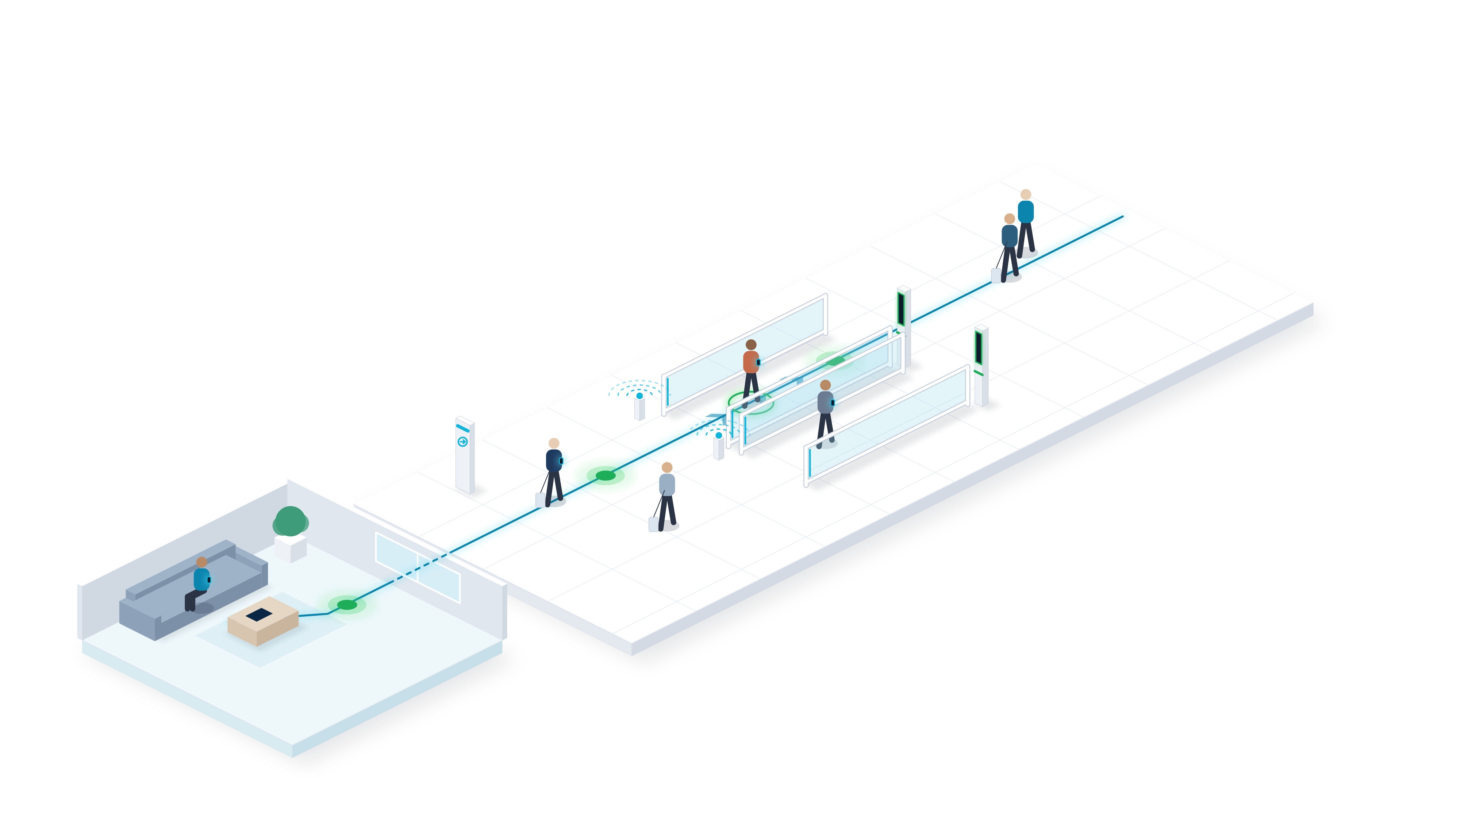
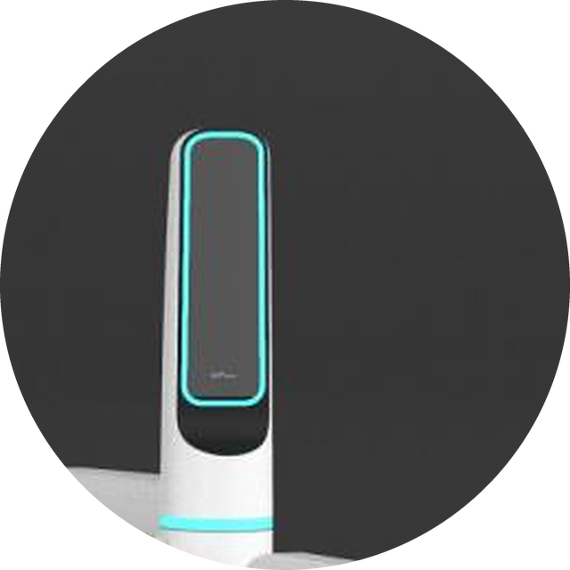
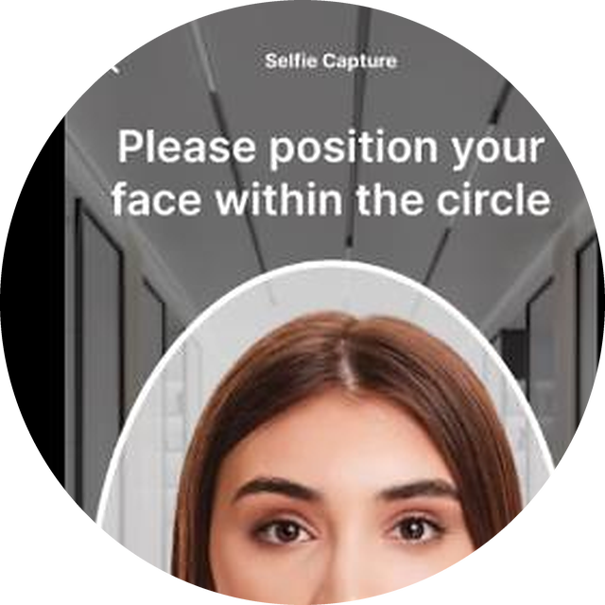
Enrol at home. Walk through immigration
THE SOLUTION · CURB TO GATE 1 OF 2
Create the credential on the phone once, then walk through without stopping.
1
Enrol at home
Scan the passport and a selfie in the app. The credential stays encrypted on the phone.
BLE beacon
3
2
3
Walk through
1
The FR pylon matches face to phone on the move. Green means go; exceptions alert an officer.
2
Approach the lane
A BLE beacon pairs the phone to the lane as it nears.
Notes:
[1:55–2:40] THE JOURNEY (CEO + CMO: show the physical airport journey, not app screens).
1. Enrol at home — passport MRZ + selfie in the app (or inside the airport/airline app via our SDK). The credential is encrypted at rest on the phone.
2. Approach — a BLE beacon pairs the phone to the lane as the traveller walks up. No tapping.
3. Walk through — the FR pylon matches the live face to the phone's template on the move: two factors. Green light, lane stays open; on an exception the lane closes and an officer is alerted.
Keep it to the three numbers — the picture explains the rest.

Slide 5
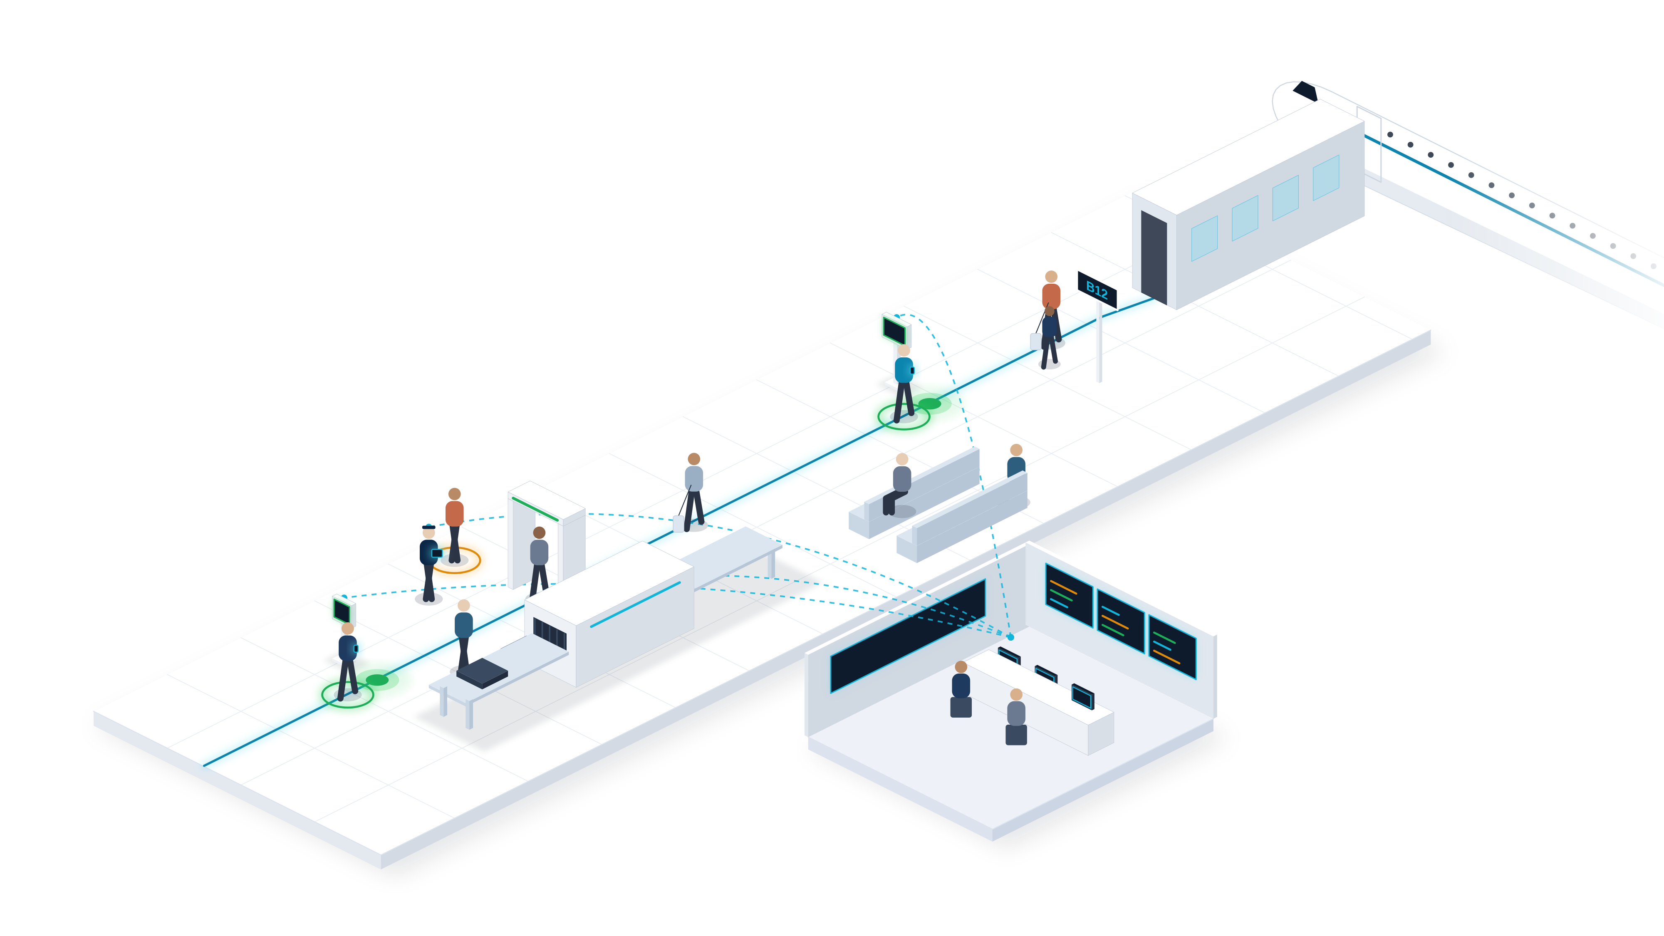
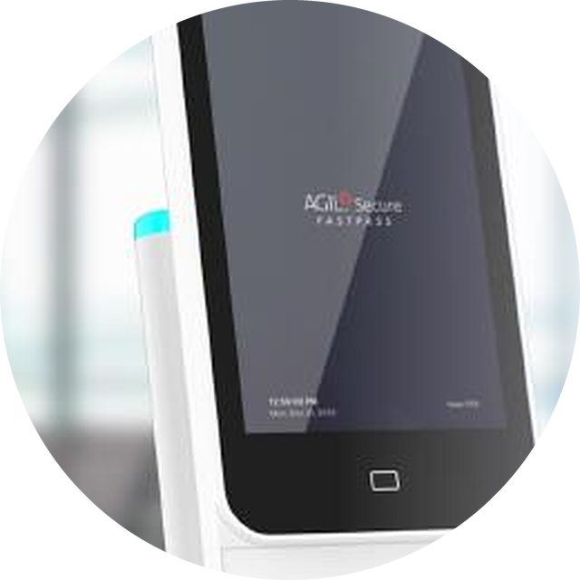
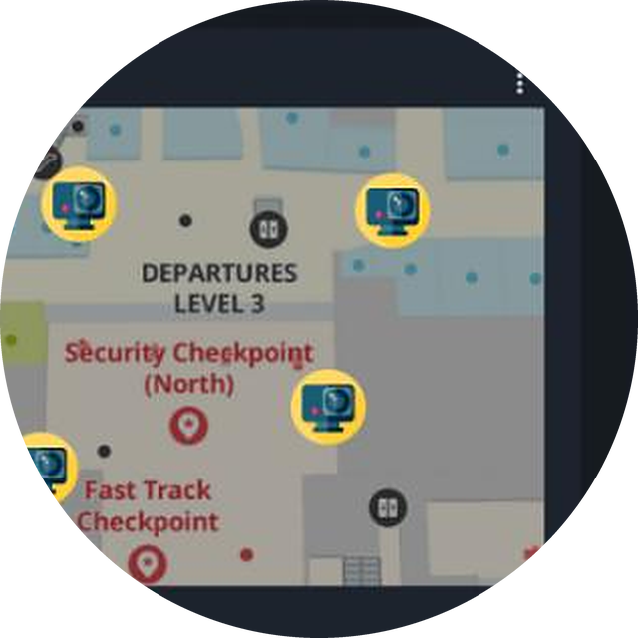
Screened, boarded, always supervised
THE SOLUTION · CURB TO GATE 2 OF 2
One identity clears screening and boarding while ISMP watches every step.
4
Pre-screening check
Before bags reach X-ray, the Nova+ reader confirms identity and pulls the clearance profile.
5
Exception: officer alerted
5
Smart boarding
Face plus phone clears the boarding kiosk. No passport, no boarding pass.
4
6
6
Live oversight
ISMP tracks every touchpoint and routes exceptions to officer tablets.
Notes:
[2:40–3:25] 4. Pre-screening — the Nova+ reader verifies identity and retrieves the clearance profile before bags enter X-ray, so exceptions surface early.
5. Smart boarding — face plus phone clears the kiosk; no passport scan, no boarding pass.
6. Live oversight — AGIL® Secure ISMP is one pane of glass across lanes, incidents, CCTV and passenger flow. Exceptions go to officer tablets; 2–3 manual counters remain for edge cases.
Bridge: "So what is genuinely new here?"

Slide 6







The magic is the credential, not the gate
INNOVATIVENESS
A two-factor mobile biometric credential that airports deploy without holding biometric data.
No biometric liability
TWO FACTORS, ONE STRIDE
Credentials stay encrypted on the phone; the airport keeps none.
+
=
Plugs into existing apps
SDK inside the airport or airline app; links to immigration only where policy allows.
Device credential
via BLE
Live face
on the move
Cleared
lane stays open
Converged with security ops
Clearance events sit beside CCTV, access control and incident data in ISMP.
Typical walk-through face only (1FA)
AI in the product and the build
FastPass face + phone (2FA), on the move
Face recognition on the move, an AI co-pilot for alarms, ~50% less front-end effort.
Sources: I9 peer benchmark (PT Asia, R8 Idemia brochure) · I7 AI engineering efficiency (internal) · I11 ISMP AI co-pilot (in design). See References.
Notes:
[3:25–4:15] INNOVATIVENESS (10 pts). CEO: "Everybody knows the turnstile is not the magic. The magic is the clearance method."
• Two factors on the move: the phone credential (BLE) plus the live face. Peers we saw at PT Asia mostly do face-only (1FA) [I9]. That is our unique point.
• No biometric liability: passport and face template stay encrypted on the traveller's phone; the airport stores no biometric database. This answers "who owns the data" — the airport doesn't have to.
• Plugs into existing apps: we ship an SDK so the airport or airline owns the app (the app is an enabler, not the product). Modular — links to immigration only where local policy allows; never "standalone vs immigration".
• Converged: every clearance sits beside CCTV, access control and incidents in ISMP.
• AI in the offering and in development: face recognition on the move, ISMP AI co-pilot that correlates related alarms and guides SOPs [I11]; AI-assisted engineering cut selected front-end effort ~50% [I7].

Slide 7
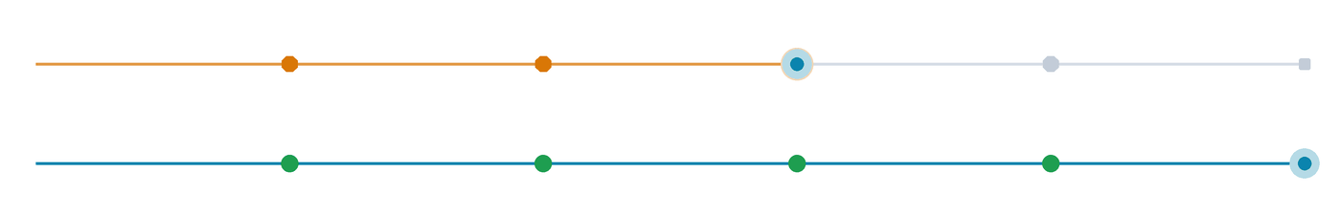



Three fewer staff per lane. Zero stops
BUSINESS IMPACT
Watch the loop: today’s traveller stops four times; the FastPass traveller keeps walking.
Check-in
Immigration
Screening
Boarding
Today
4 stops · ~3 staff per lane
With FastPass
0 stops · exceptions only
PASSENGERS
OPERATORS
SECURITY
8–11 min
3 fewer
1 view
curb to gate (target)
staff per lane
of every lane and incident
No queues, no passport at each stop
More capacity without new terminal space
One pane of glass in AGIL® Secure ISMP
Sources: I1 staffing estimate (ops assessment, Singapore Airshow feedback) · I4 curb-to-gate target (Sales review, to validate at airport demo). See References.
Notes:
[4:15–4:55] BUSINESS IMPACT — three stakeholders (CMO), one memorable number (Gareth's own takeaway at the Airshow: "I reduce three men").
• Passengers: curb to gate in 8–11 minutes (target — we validate it at the airport demo) [I4]. No queue, no passport at each stop.
• Operators: automating the four touchpoints frees ~3 staff per lane [I1] and adds capacity without new terminal space — the productivity and ROI story.
• Security: one pane of glass in ISMP across every lane and incident.
Keep 3–6 s passage and 30–50% throughput for Q&A only (design targets, not yet field-measured).

Slide 8



From demo to paid pilot in 12 months
TIME TO MARKET
Who buys, how we sell and what ships next, built on the live AGIL® Secure ISMP core.
How we win the first customers
Next 12 months
WHO BUYS
Q4 2026
Live airport demonstration
Airport operators first; hub airlines where they lead
HOW WE SELL
Q1 2027
Productise: offline, redundancy, back-end
SDK in their app, via Group Sales and partners in ME & SEA
Apr 2027
Passenger Terminal World, Amsterdam
WHAT THEY PAY
Lanes (one-off), ISMP licence (recurring), integration, support
H1 2027
First paid pilot in ME/SEA with Group Sales
PRICE ANCHOR
Against the ~3 staff each lane saves
H2 2027
Add lanes, screening and boarding modules
Built for international buyers: regional data-protection rules, airport governance models, 2–3 manual counters for exceptions
Notes:
[4:55–5:50] TIME TO MARKET (10 pts) + "effort to scale fast" (plans for the next 12 months, international requirements, sales network).
CEO: "After 12 months we still have no pilot" — so this slide commits to one.
WHO BUYS: airport operators first; hub airlines where they lead (governance, slide 3). HOW WE SELL: an SDK inside their app, sold via Group Sales and local partners in ME & SEA (confirm named contacts with Riley/William — Gareth will ask whether Sales is involved). WHAT THEY PAY: lanes one-off, ISMP licence recurring, integration, lifecycle support — priced against the ~3 staff each lane saves.
[ACTION: insert target price points after the Sales sync.]
NEXT 12 MONTHS: Q4 2026 airport demo (AGIL® Secure software) → Q1 2027 productise — offline credentials, redundancy, back-end integration (CEO: "still a demo") → Apr 2027 PT World Amsterdam (target) → H1 2027 first paid pilot with Group Sales → H2 2027 add lanes plus screening and boarding modules.
Speed comes from reusing the live ISMP core.

Slide 9



One cross-unit team. Hard to copy
COLLABORATION · BARRIERS TO ENTRY
Three business units and Group Sales built FastPass; that depth is what rivals lack.
ENTRY BARRIERS
Smart Security & Automation
Smart Utilities & Infrastructure
Owned IP
Credential workflow, lane logic and ISMP are Group-owned
Deep know-how
FastPass
35+ years of government-grade, mission-critical delivery
Specialised set-up
Clearance converged with CCTV, access control and intrusion
Sales network
Urban Solutions
Group Sales in ME & SEA, plus ISMP accounts to cross-sell
Joint team: product, mobile, biometrics, e-gate, ISMP, Sales
vs Idemia: they lead on portfolio; we lead on 2FA and converged ops
Sources: I8 corporate record · R8 Idemia PaXpress SmartLane brochure (12/2025) · I12 sales network (confirm with Group Sales). See References.
Notes:
[5:50–6:40] MARKET POTENTIAL — collaborative initiative across BAs is 30% of that 10-point criterion — plus ENTRY BARRIERS (10 pts).
COLLABORATION: one product team across Smart Security & Automation, Smart Utilities & Infrastructure and Urban Solutions — product management, mobile engineering, biometric integration, e-gate engineering, the ISMP platform team — with Group Sales now in the loop. [Confirm each unit's named contribution before the pitch; this is where the 30% weighting is earned.]
BARRIERS: owned IP across the credential workflow, lane logic and ISMP; 35+ years of government-grade delivery; a specialised set-up that converges clearance with CCTV, access control and intrusion; and the Group's sales reach in ME & SEA with existing ISMP accounts to cross-sell.
EXCO QUESTION "How do we benchmark against Idemia?": they lead on portfolio breadth (baggage, concierge, clearance, big install base); we lead on two-factor clearance and converged security operations, at a modular entry price. Detail in Appendix B2.

Slide 10
Ready to pilot. Here is what we need
CONCLUSION
Four reasons to back FastPass, and three asks to reach a paying customer.
01
Real pain
OUR ASK
Demand doubles by 2040; new terminals take a decade
1
Productisation funding
02
Focused market
Offline mode, redundancy and back-end integration
US$100–140M a year serviceable in ME and Southeast Asia
2
A launch customer
03
Proven product
Group Sales to co-own a paid ME/SEA pilot in 2027
Working prototype, shown at Singapore Airshow 2026
3
A global stage
04
Hard to copy
Showcase at Passenger Terminal World 2027
Two-factor, privacy-first, converged with security ops
Notes:
[6:40–7:20] CEO: "Summary must be a sequence: product is ready, clear go-to-market, enhancements, price point — and what do we need STMG to support? Money, resource."
Recap: real pain · focused US$100–140M a year market · working prototype shown at Singapore Airshow 2026 · hard to copy (two-factor, privacy-first, converged).
ASKS: (1) productisation funding to turn the demo into an operational product — offline mode, redundancy, back-end integration [insert S$ amount]; (2) a launch customer — Group Sales to co-own a paid ME/SEA pilot in 2027; (3) a global stage — PT World Amsterdam, April 2027.
Close: "FastPass is ready to pilot. With your support, our first paying airport is within 12 months."

Slide 11
Thank you
Questions welcome
AGIL® SECURE FASTPASS
Curb to gate on one verified identity.
Smart Security & Automation · Smart Utilities & Infrastructure · Urban Solutions
Notes:
[7:20–7:25] Thank you. References and Q&A backup follow (R1–R2, B1–B7).

Slide 12
Appendix
R1 External sources and URLs
R2 Internal evidence register
REFERENCES & Q&A BACKUP
B1 Hard questions, short answers
B2 Benchmark: FastPass vs Idemia
B3 ISMP: one platform behind every touchpoint
Every number in the pitch, traced to its source.
B4 Product roadmap and adjacencies
B5 Market sizing method
B6 E-Gate design and engineering
B7 AI in the product and the build
Notes:
Appendix for Q&A. R1–R2 trace every figure in the pitch to a URL or an internal owner. Footers on each pitch slide cite these codes.

Slide 13
External sources
R1 · REFERENCES
Public sources behind every market and industry figure. Checked 15 Oct 2026.
Ref | What the slide says | Source | Status
R1 | Passengers double by 2040 (7.8 bn, +4.2% a year) | IATA, Global Outlook for Air Transport, Dec 2023 https://www.iata.org/en/iata-repository/publications/economic-reports/global-outlook-for-air-transport---december-2023---report/ | Verified
R2 | Changi T5: ground broken 2025, opens mid-2030s | Singapore MOT, Update on Changi Airport T5 https://www.mot.gov.sg/news-resources/newsroom/update-on-development-plans-for-changi-airport-terminal-5/ | Verified
R3 | ABC market US$2.56B → 5.03B (2025–30), 14.4% CAGR | MarketsandMarkets press release, Jul 2025 https://www.marketsandmarkets.com/PressReleases/automated-border-control.asp | Verified
R4 | Airports 83.1% of ABC market; Asia-Pacific 32.6% | MarketsandMarkets, ABC market size insight https://www.marketsandmarkets.com/ResearchInsight/automated-border-control-market-size.asp | Verified
R5 | ~70% of airlines plan biometric ID by 2026 | SITA, Air Transport IT Insights 2024 https://www.sita.aero/resources/surveys-reports/air-transport-it-insights-2024/ | Verified
R6 | Asia-Pacific (≈4.8% a year) and Middle East lead growth | SCMP on IATA 20-year outlook https://www.scmp.com/news/world/middle-east/article/3271055/global-airline-traffic-forecast-double-20-years-led-asia-middle-east | Secondary
R7 | Airports’ IT spend US$14.8B; 89% prioritise data | SITA, Air Transport IT Insights 2025 https://www.sita.aero/resources/surveys-reports/air-transport-it-insights-2025/airports/ | Verified
R8 | Competitor benchmark: Idemia PaXpress SmartLane | Idemia brochure EXT-Brochure-PaXpress-SmartLane-EN (12/2025) https://na.idemia.com | On file
Removed from v1.3: “48% of airports plan cross-silo data sharing by 2027” could not be traced to SITA. Not used: US$40B e-gate TAM (source pending).
Notes:
Q&A notes on external sources:
R1 IATA's Dec 2023 outlook: 7.8 bn passengers by 2040. IATA has since published newer forecasts (Aug 2025: 3.9% a year to 2034; Mar 2026: more than double by 2050). If challenged: "the direction is the same — demand outgrows capacity."
R3/R4 MarketsandMarkets editions differ slightly (US$2.56B→5.03B vs 2.57B→5.04B). Mordor Intelligence sizes 2025 at US$2.36B. We use the conservative press-release figures.
R2 Changi T5: works resumed 2022 after a two-year pandemic pause; groundbreaking May 2025; opening mid-2030s.
REMOVED: the 48% cross-silo statistic from v1.3 — not found in SITA's published material. NOT USED: the US$40B e-gate TAM (from a Sales chart; source to be confirmed with Riley).

Slide 14
Internal evidence register
R2 · REFERENCES
Our own estimates and targets, with the evidence and owner behind each one.
Ref | Claim on slide | Evidence / owner | Status
I1 | ~3 staff freed per lane when 4 touchpoints are automated | CEO review 14 Oct; Singapore Airshow 2026 feedback (Gareth). Build a lane-staffing worksheet. | Internal estimate
I2 | ME + SEA ≈10–15% of ABC demand; FastPass can address ≈25% | URS analysis (submission §5) on R3–R4 data | Internal estimate
I4 | Curb to gate in 8–11 minutes | Sales review 14 Oct; validate at the airport demo | Target
I5 | 3–6 s passage; 30–50% throughput (Q&A only) | v1.3 product design targets | Target
I6 | Working prototype shown at Singapore Airshow 2026 | Submission §1; Airshow demo records | Verified
I7 | ~50% less front-end effort; ~40% better delivery efficiency | Submission §6; engineering metrics | Internal measure
I8 | 35+ years of government-grade delivery | Corporate record (submission §8) | Verified
I9 | Peers mostly verify face only (1FA) | PT Asia observations (CEO); Idemia brochure (R8) | Market observation
I10 | Airports reluctant to hold biometrics; ME/SEA less privacy-resistant than EU/US | Invent customer interviews; Sales review 14 Oct | Customer insight
I11 | ISMP AI co-pilot correlates related alarms, guides SOPs | Operator console UI review, 14 Oct (in design) | In design
I12 | Group Sales and partners in ME & SEA | Confirm named contacts and countries with Group Sales (Riley, William) | To confirm
— | Target price points | Pending Sales sync | Open
Notes:
Use this register to answer "where does that number come from?". Anything marked Target or Internal estimate should be framed as such when challenged. Close the two amber items before 22 Oct.

Slide 15
Hard questions, short answers
B1 · Q&A BACKUP
Agreed positions for the questions division heads and Excos are most likely to ask.
Where is biometric data stored?
Do you replace immigration?
Encrypted on the traveller’s phone. Shared just-in-time over BLE for the 2FA match; the airport keeps no biometric database.
No. FastPass is modular and works alongside immigration, linking to its systems where local policy allows.
Who owns the app?
What if there is no internet?
The airport or airline. FastPass ships as an SDK inside their app; our own app is the reference design.
Credentials download in advance. Offline clearance and redundancy are the first productisation priority.
What happens when a match fails?
Why not Europe or the US?
The lane closes, an officer is alerted on a tablet, and 2–3 manual counters stay open for exceptions.
Highest privacy resistance today. ME & SEA combine growth with readiness; privacy-by-design keeps the door open.
How do you compare with Idemia?
What about UWB or palm-vein?
They lead on portfolio breadth. We lead on two-factor clearance and converged security operations (B2).
Both are on the roadmap: UWB wallet for passive clearance on newer phones, palm-vein as an alternative biometric.
Notes:
Positions agreed in the 14 Oct reviews:
• Never say "standalone" vs immigration. Position: open and modular — compatible with immigration integration depending on localised policy; link at enrolment where agreed.
• Singapore is unique (tight ICA–airport integration). Elsewhere, airports don't want to own passport/biometric data — that is the problem the on-phone credential solves.
• Offline, redundancy and back-end linkage are acknowledged gaps (CEO); answer with the productisation plan, not a claim.
• Identity validation: FastPass can support QR/2FA validation against airline (IATA) data and watchlists via the airport or airline app (Sales review).

Slide 16
How we compare with Idemia
B2 · BENCHMARK
An honest view: where Idemia PaXpress SmartLane is strong, and where FastPass differs.
 | AGIL® Secure FastPass | Idemia PaXpress SmartLane (per brochure)
Verification | Two factors: phone credential (BLE) + live face | Facial recognition on the move, with IP-camera tracking
Identity | Credential encrypted on the traveller’s phone | Digital ID via Capture SDK or kiosk; Authorizer platform; “no personal data is stored”
Operations | Converged with CCTV, access control, intrusion and incidents in ISMP | Supervision screens and tablets for clearance and exceptions
Guidance | Pylon status light; backboard screen and AI assistant on roadmap | AI-powered guidance displays for travellers
Groups | Linked travellers under one group profile | Multiple travellers processed at once
Proof and scale | Working prototype (Singapore Airshow 2026); pilot-ready | 1.5 bn+ travellers a year; 350+ ports equipped
Takeaway: compete on two-factor clearance and converged security operations at a modular entry price, not on portfolio breadth.
Notes:
Source: Idemia PaXpress SmartLane brochure (12/2025), pages 4, 6, 8–10. Idemia also claims privacy by design, so lead with two-factor and converged operations rather than privacy alone. CEO context: Idemia has already integrated with immigration (ICA) for ABC gates and offers baggage, concierge and clearance — Exco has asked how we benchmark against them.

Slide 17








One platform behind every touchpoint
B3 · THE PLATFORM
ISMP links traveller clearance and airport security in one command layer.
Passenger log
Every clearance, live
TOUCHPOINTS
Physical security
CCTV, access, intrusion
Lane & gate control
Status, open, close
FastPass app or SDK
Biometric E-Gate
Nova+ pre-screening reader
AGIL® Secure ISMP
Smart Boarding Kiosk
One command layer
CONNECTS TO YOUR SYSTEMS
Airline DCS · Border control · Airport operations
3D digital twin
Passenger flow by zone
Exception workflow
Alerts to officer tablets
AI co-pilot
Correlates related alarms
Biometrics stay on the phone. ISMP keeps events only.
Notes:
ISMP is the operational backbone: passenger log, lane control, exception workflow, AI co-pilot (in design), 3D digital twin and physical security. Swap in the incident-management and digital-twin screenshots from the airshow build when available (CEO request).

Slide 18
From demo to operational product
B4 · ROADMAP
What exists today, what we harden next, and where the platform extends.
NOW
NEXT · 2027
LATER
Working prototype
Operational product
Platform extensions
Mobile enrolment and credential
Offline credentials and redundancy
Face + iris multimodal (Iris SecureFlow)
BLE lane association, 2FA on the move
Back-end, airline and watchlist links
UWB wallet and palm-vein options
Biometric E-Gate, Nova+, boarding kiosk
Backboard status screen at the lane
Front-to-back baggage partners
ISMP monitoring and exceptions
AI lane assistant; onboard-processing LiDAR
Seaports and land checkpoints
Notes:
CEO: "Still a demo — offline, mobile, redundancy and back-end linkage are not considered yet." This slide shows the plan. LiDAR feedback: move to onboard-processing units that send insights to the back end. Feedback loop: backboard screen showing identity/clearance (airshow build) and an AI assistant screen for corrective prompts (e.g. remove glasses). Adjacencies from Invent: front-to-back baggage (e.g. Veovo-style partners), rail (UWB/palm), seaports.

Slide 19
How we sized the market
B5 · MARKET SIZING
Conservative, bottom-up and traceable to published sources.
Step | Figure | Basis
Global automated border control market | US$2.56B (2025) → US$5.03B (2030), 14.4% CAGR | R3 MarketsandMarkets
Airport share of demand | 83.1% (2025) | R4 MarketsandMarkets
Middle East + Southeast Asia share | ≈10–15% | I2 URS analysis (APAC is 32.6%, R4)
FastPass initial addressable share | ≈25% of the regional market | I2 URS estimate
Serviceable market, 2026–2030 | ≈US$500–700M (≈US$100–140M a year) | Derived
Sanity check: Asia-Pacific alone is 32.6% of the market (R4), so a 10–15% share for ME + SEA is conservative.
Notes:
If asked about the US$40B e-gate figure from the Sales chart: not used until the source is confirmed. Our serviceable market is deliberately conservative and fully traceable.

Slide 20
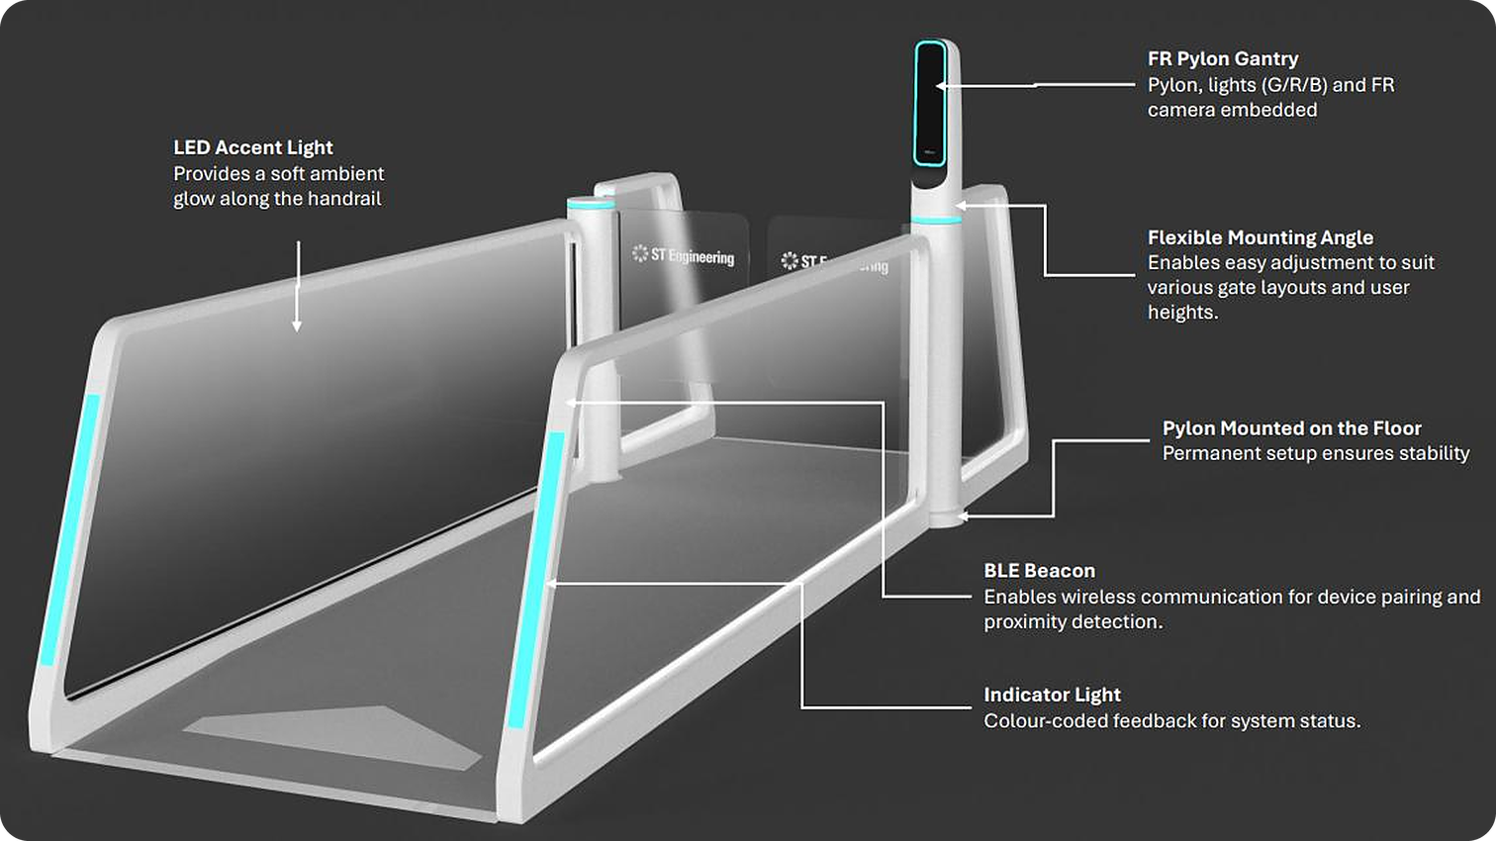


Built for travellers and borders
B6 · DESIGN & ENGINEERING
A gantry-free, infrastructure-light lane with integrated FR camera, BLE beacon and status lighting.
Human-factor design
Soft-white matte finish: a calm, approachable presence
Self-service by default
FR camera, RGB guidance and status light in a slim pylon
Brownfield-ready
Light footprint cuts civil works in existing terminals
Secure to the core
Zero-trust, multi-tier, cloud-ready, hardened APIs
Notes:
Hardware is the enabler, not the pitch (CEO). Use this only if asked about the lane. Camera note: test higher-resolution, lens-flexible cameras for on-the-move capture.

Slide 21


AI in the product and in how we build it
B7 · AI ADOPTION
InnoChamp scores AI adoption in both the offering and its development.
IN THE PRODUCT
IN ENGINEERING
Face recognition engine
Reliable verification on the move
~50%
AI co-pilot
Correlates related alarms, guides SOPs
less effort in selected front-end activities
~40%
Behaviour analytics
Unusual-pattern and tailgating detection
better delivery-pipeline efficiency
Flow prediction
Congestion forecasting across zones
AI-assisted engineering and CI/CD with integrated security testing
Predictive maintenance
Device and network health monitoring
Notes:
Sources: I7 (engineering metrics, submission §6) and I11 (ISMP AI co-pilot in design: tailgating triggers co-pilot notifications and downstream door locking; up to four related alarms correlated into one SOP-guided incident).

