Slide 1
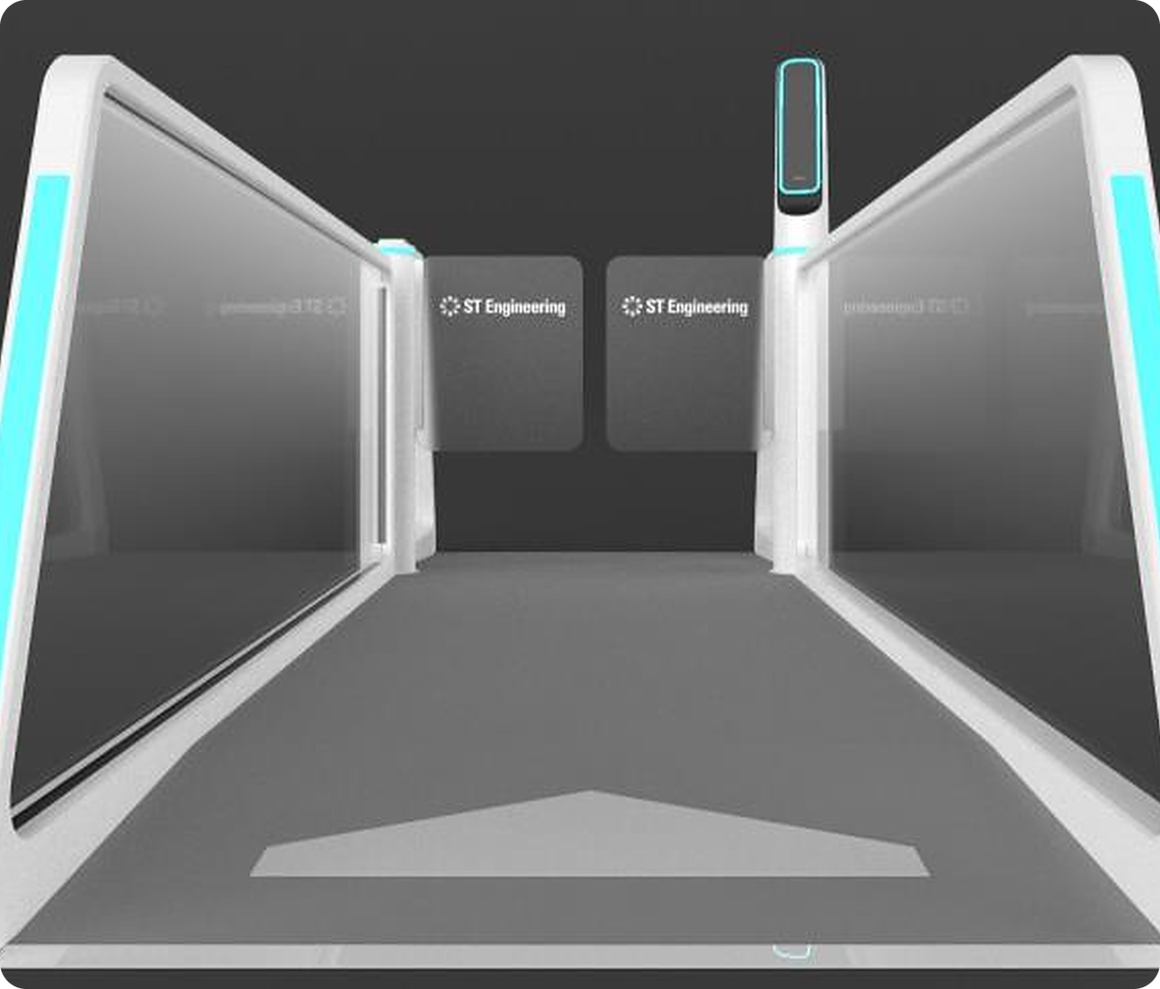
AGIL® Secure
FastPass
INNOCHAMP 2026 · PRODUCT CATEGORY
One verified identity. A journey designed to keep moving.
Privacy-first
Modular
Walk-through
Smart Security & Automation · Smart Utilities & Infrastructure · Urban Solutions
Notes:
[0:00–0:15] Good afternoon. We're presenting AGIL® Secure FastPass — a privacy-first, modular, walk-through clearance product that lets a verified traveller move from immigration to the boarding gate without stopping.
Positioning (from 14 Oct review): privacy-preserving, modular, and removes checkpoint staffing overhead. Say this in one breath, then move on — 8-minute slot, we are last on the agenda.

Slide 2







Every passenger stops four times
MARKET NEEDS
Departure is split across identity, immigration, screening and boarding. Each stop costs staff, space and time.
Check-in
Immigration
Security screening
Boarding gate
Document check
Passport + officer
ID + boarding pass
Passport + boarding pass
4
~3
2×
48%
stops per departure
staff per manned lane
air travel demand by 2040
of airports plan data sharing by 2027
Each one a queue and an identity check
Tied up on routine identity checks
Terminals and headcount can't double
Today operators lack one cross-silo view
Sources: IATA Global Outlook for Air Transport (Dec 2023); SITA Air Transport IT Insights 2024 & 2025. Staffing per lane: URS operational assessment.
Notes:
[0:15–1:05] The problem isn't a lack of technology — it's fragmentation.
• A departing passenger stops four times: check-in, immigration, screening, boarding. Each is a queue and an identity check.
• Every manned lane ties up around three staff on routine checks — at a time when airports in our region face staffing shortages.
• Demand nearly doubles by 2040 (IATA), but terminals and headcount can't double.
• 48% of airports plan cross-silo data sharing by 2027 (SITA) — today operators lack one view across passenger processing and physical security.
The forced trade-off: move people faster, or inspect them more securely. FastPass removes that trade-off.
Reviewer guidance: concrete pain points, not broad industry statistics. Keep background data for Q&A.

Slide 3
A US$100–140M a year opportunity
MARKET POTENTIAL
Sized from the automated border control market down to the lanes FastPass can win in the Middle East and SE Asia.
US$5.0B global ABC market by 2030
SERVICEABLE MARKET · 2026–2030
US$500–700M
≈83% of it at airports
≈ US$100–140M addressable every year
10–15% Middle East + SE Asia
Hardware, platform software, integration and services
7 in 10
~78%
≈25% FastPass share
airlines adopting biometric ID by 2026
of ME/SEA airport projects are brownfield
Global market grows from US$2.56B (2025): ~14.5% CAGR
Sources: MarketsandMarkets, Automated Border Control Market 2025–2030; SITA Air Transport IT Insights 2024. Regional and serviceable shares: URS estimate (method in appendix).
Notes:
[1:05–1:55] We sized this bottom-up, not with a headline TAM.
• Global automated border control: US$2.56B in 2025 growing to US$5.03B by 2030 (MarketsandMarkets) — about 14.5% CAGR.
• Airports are ~83% of that demand; the Middle East and Southeast Asia are ~10–15%.
• FastPass can initially address about a quarter of the regional market → US$500–700M over 2026–2030, roughly US$100–140M a year in e-gates, kiosks, platform software, integration and lifecycle services.
• Demand signal: 7 in 10 airlines are adopting biometric ID management (SITA). ~78% of anticipated ME/SEA projects are brownfield — exactly where an infrastructure-light lane wins.
NOTE: The US$40B e-Gate TAM figure discussed on 14 Oct is NOT on this slide — add only after Riley verifies the source URL.

Slide 4
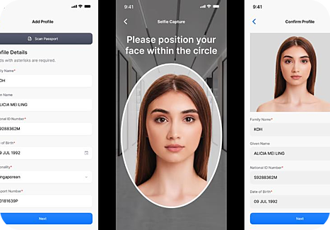

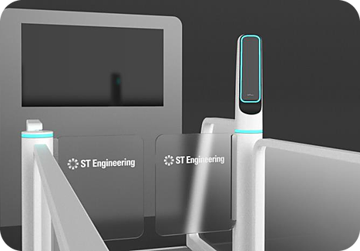





One identity. Every touchpoint. No stops
INNOVATIVENESS
The traveller's phone becomes a verified credential that carries them from home to gate.
01 ENROL
02 APPROACH
03 CLEAR
04 SCREEN
05 BOARD
At home
Lane entry
Immigration
Security
Gate
Scan passport and face once. Encrypted on the phone.
Bluetooth pairs the phone to the lane while walking.
Face matched on the move. The gate stays open.
Identity confirmed before baggage X-ray.
Kiosk clears boarding. No passport, no boarding pass.
AGIL® Secure ISMP one command layer for transactions, lane status, security events and exceptions
Notes:
[1:55–2:55] Here is the whole journey on one line — this replaces the old component-by-component slide.
1. Enrol at home: scan the passport MRZ and a selfie in the FastPass app. The credential is encrypted on the phone; raw documents never go to airport systems.
2. Approach: Bluetooth pairs the phone with the lane as the traveller walks up — no tapping.
3. Clear immigration: facial recognition matches the live face to the phone's template on the move. The gate stays open; it only closes on an exception, and an officer is alerted.
4. Screen: the Nova reader confirms identity and pulls the clearance profile before baggage enters X-ray.
5. Board: the smart kiosk clears boarding — no passport, no boarding pass.
Underneath it all, AGIL® Secure ISMP gives operators one command layer.
The animated line loops every ~3 seconds in slideshow (reviewer asked for a 2–3 s loop for passenger flow).

Slide 5




Your identity stays on your phone
INNOVATIVENESS
Passport and biometric data are encrypted on the device and shared only at the moment of verification.
BLE · 2FA
Result
Traveller's phone
FastPass lane
AGIL® Secure ISMP
just-in-time
clear or alert
Passport + face template, encrypted at rest in the FastPass SDK
Live face matched on the move to the phone's template: two-factor
Receives the clearance result and events, not a biometric database
Strict privacy regimes
Centralised regimes
Modular by policy
Rules like the EU GDPR restrict central biometric storage. FastPass needs none.
Where national data sharing exists (e.g. ICA–airport in Singapore), FastPass plugs in.
No compulsory national-database integration. Configure each checkpoint to local rules.
Notes:
[2:55–3:45] This is our answer to the PDPA / GDPR question every airport asks.
• Passport and biometric data stay encrypted at rest on the traveller's phone inside the FastPass SDK — not in an airport database.
• At the lane, Bluetooth hands over the template just in time; the lane matches it to the live face — two factors: device + face.
• ISMP receives the clearance result and events — not a central biometric store.
Why it matters commercially: one product fits both regulatory models. Strict regimes like Europe restrict operators from holding biometrics — we don't need to. Centralised models like Singapore's ICA-to-airport sharing — we plug in. And it runs at any checkpoint without compulsory national-database integration.

Slide 6
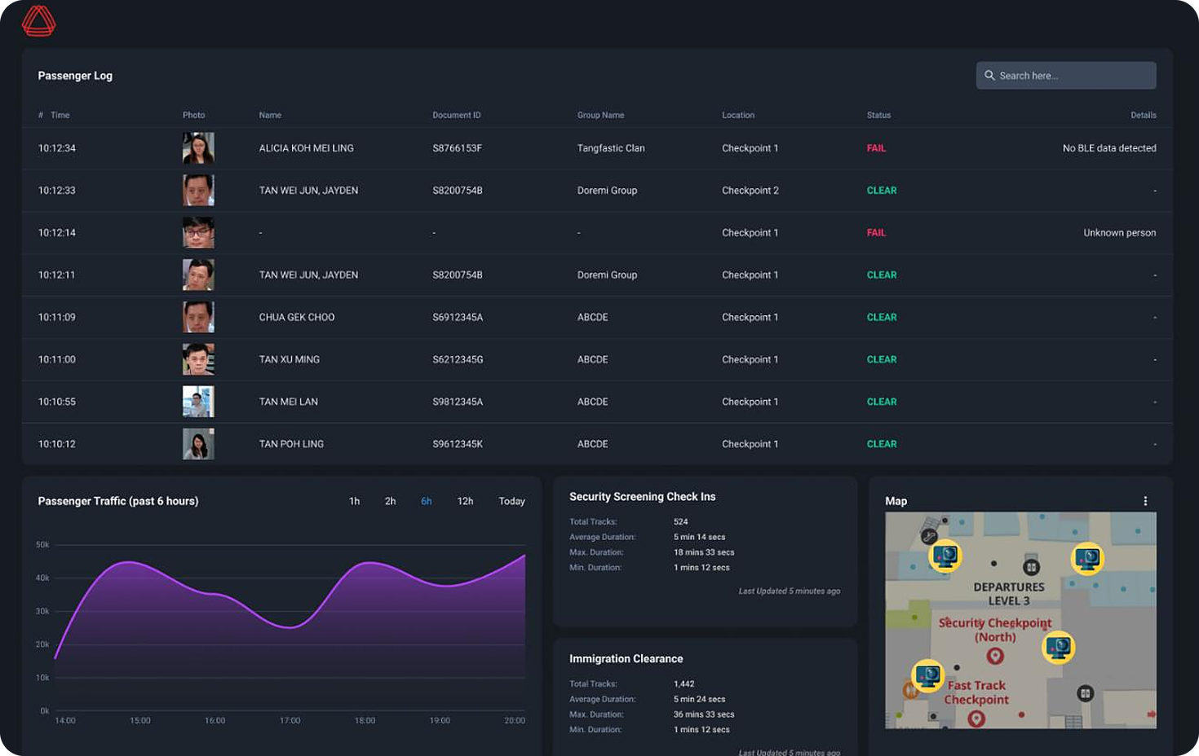
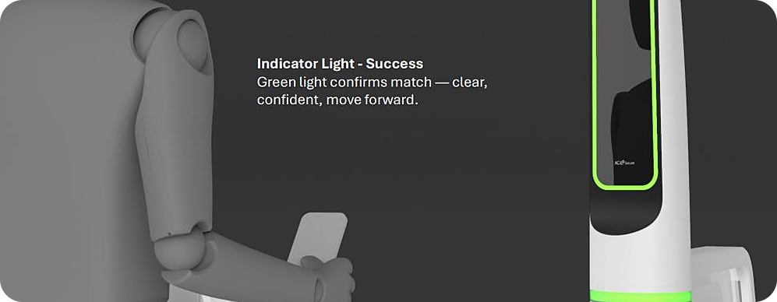




One command view for every lane
VALUE PROPOSITION
AGIL® Secure ISMP fuses traveller clearance with CCTV, access control and incident management.
Lane feedback: green means go
Live passenger log
Every clearance, by traveller and lane
Exceptions to officers
A mismatch closes the lane, alerts staff
3D digital-twin flow
Flow by zone to pre-empt congestion
Assistive AI
Triages alerts, suggests responses
Notes:
[3:45–4:30] For operators, FastPass is not another silo.
• ISMP is the live passenger log — every clearance by traveller, group and checkpoint, next to CCTV, access control and incident management.
• Exceptions go to officers: a failed match or tailgating closes the lane and raises an alert; officers keep authority over every unsuccessful case.
• Digital-twin view of passenger flow across zones helps pre-empt congestion. [Swap in the 3D airport digital-twin screenshot here when available.]
• Assistive AI triages alerts and recommends responses for operator review.
• At the lane, the feedback loop is instant: the pylon light turns green; rear display boards can show status; future versions add on-lane guidance (e.g. "please remove glasses").

Slide 7
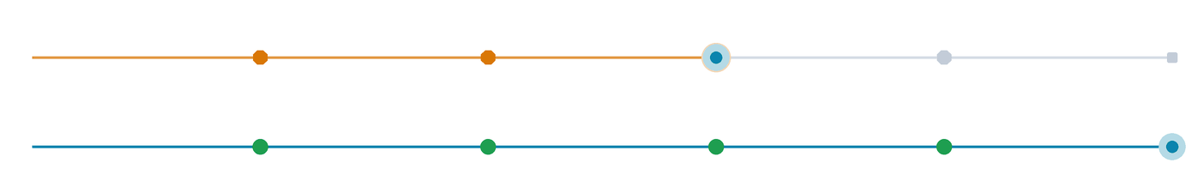
Three fewer staff per lane. Zero stops
BUSINESS IMPACT
Automating four touchpoints turns a stop-and-check process into continuous flow.
Check-in
Immigration
Screening
Boarding
Today
4 stops · ~3 staff per lane
With FastPass
0 stops · exceptions only
3
3–6 s
30–50%
100%
fewer staff per lane
walk-through passage
more throughput
auditable events
Officers redeployed to exceptions
No intentional stop at the gate
Per lane, without more floor space
Every clearance logged in ISMP
Notes:
[4:30–5:15] This is the business case in one picture. Watch the two dots: today's traveller stops at every checkpoint; the FastPass traveller glides through.
• Automating the four passenger touchpoints removes around three staff per lane — they are redeployed to exceptions, not routine checks.
• 3–6 second walk-through passage, no intentional stop.
• 30–50% more throughput per lane without more floor space.
• 100% of clearance events auditable in ISMP.
Speak to these four numbers only; detailed derivations stay for Q&A. (Validate the 30–50% and 3–6 s basis before the pitch — carried over from v1.3.)

Slide 8



Who buys, what they pay, how we land
TIME TO MARKET
Land with one lane in a brownfield terminal, then expand across touchpoints as value is proven.
Who buys
What they pay for
How we land
PRIMARY BUYER
ONE-OFF
Lane hardware: e-gate, reader, kiosk
1
Prove
Tier-2 international airports in the Middle East and SE Asia
A single pilot lane
RECURRING
ISMP platform licence per checkpoint
2
Expand
CO-DECIDES
More lanes and enrolment
Immigration and border agencies: sovereignty, compliance
PROJECT
Systems integration
ANNUAL
Lifecycle support and SLA
3
Connect
ENABLERS
All touchpoints via ISMP
Airlines: drive app enrolment and boarding adoption
Priced against the ~3 staff it saves per lane
4
Scale
Terminals and portfolios
Notes:
[5:15–6:05] Go-to-market — concrete, not a generic four-step rollout.
WHO BUYS: Primary buyer is the Tier-2 international airport in the Middle East and Southeast Asia, modernising brownfield terminals. Immigration and border agencies co-decide (sovereignty, compliance). Airlines enable adoption through enrolment and boarding.
WHAT THEY PAY FOR: one-off lane hardware; a recurring ISMP platform licence per checkpoint; integration as a project; annual lifecycle support. The price anchor is labour: each automated lane saves ~3 staff.
[ACTION before 22 Oct: insert target price points per lane / per checkpoint after the GTM sync with Riley.]
HOW WE LAND: prove with one pilot lane; expand lanes and enrolment; connect screening, boarding and security through ISMP; scale across terminals and portfolios. Because we reuse the live ISMP core, the path to first revenue is short.

Slide 9



Why we win, and how we stay ahead
BARRIERS TO ENTRY
Idemia and SITA lead on ecosystem breadth. FastPass wins where security, privacy and modularity converge.
OUR EDGE
ENTRY BARRIERS → OUR MITIGATION
Converged with security ops
Incumbent ecosystems
Interoperate via open APIs; land at a single checkpoint
Clearance events sit beside CCTV, access control and intrusion in ISMP
Privacy-first architecture
Divergent privacy rules
On-device credentials, configurable data flows
On-device credentials deploy under strict data regimes
Traveller app adoption
Airline co-enrolment, group profiles, standard-lane fallback
Modular and infrastructure-light
Start with one lane; no national-database tie-in; minimal civil works
Sensor robustness
Onboard-processing LiDAR, iris roadmap, lane guidance
Government-grade delivery
35+ years of mission-critical systems, cybersecurity and airport support
Each new lane and integration deepens the moat
Notes:
[6:05–6:50] Competitors like Idemia and SITA — with Amadeus behind them — are strong on ecosystem breadth and practical operational design (e.g. overhead angled screens). We don't try to out-ecosystem them.
OUR EDGE: (1) clearance converged with physical-security operations in ISMP; (2) privacy-first, on-device architecture; (3) modular and infrastructure-light — one lane, no national-database tie-in, minimal civil works; (4) 35+ years of government-grade delivery.
ENTRY BARRIERS WE FACE, AND MITIGATION:
• Incumbent ecosystems → interoperate via open APIs; land at a single checkpoint rather than rip-and-replace.
• Divergent privacy rules → on-device credentials, configurable data flows per jurisdiction.
• App adoption → airline co-enrolment, group profiles; standard lanes remain as fallback.
• Sensor robustness → onboard-processing LiDAR (per prototype feedback), multimodal iris roadmap, on-lane guidance.
And the moat compounds: every lane, workflow and integration adds reusable interfaces and know-how.

Slide 10
Ready to pilot. Built to win
CONCLUSION
Four reasons FastPass should scale, and a clear path to first revenue.
01
Real pain
Path to market
4 stops, ~3 staff per lane, demand doubling by 2040
FEB 2026
02
Focused market
Prototype live at Singapore Airshow
US$100–140M a year serviceable in ME and Southeast Asia
OCT 2026
InnoChamp 2026
03
Proven product
Q4 2026
Live airport demonstration
Working prototype, demonstrated at Singapore Airshow 2026
APR 2027
04
Passenger Terminal World, Amsterdam
Defensible edge
Privacy-first, converged with security ops, modular from one lane
2027
First customer pilot lanes (target)
Notes:
[6:50–7:35] Four takeaways, in order:
1. Real pain — four stops per passenger, ~three staff per lane, and demand doubling by 2040.
2. Focused market — US$100–140M a year that we can serve in the Middle East and Southeast Asia.
3. Proven product — an end-to-end working prototype, demonstrated at Singapore Airshow 2026.
4. Defensible edge — privacy-first, converged with security operations, modular from a single lane.
Readiness: live airport demonstration this quarter, Passenger Terminal World in Amsterdam in April, and first customer pilot lanes in 2027.
Close: "FastPass is ready to pilot — and built to win." Then go to the thank-you slide.

Slide 11
Thank you
Questions welcome
AGIL® SECURE FASTPASS
One verified identity. A journey designed to keep moving.
Smart Security & Automation · Smart Utilities & Infrastructure · Urban Solutions
Notes:
[7:35–7:45] Thank you. Happy to take questions — backup slides follow for market sizing, design, app, ISMP, AI and roadmap.

Slide 12
Appendix
A1 Value for every stakeholder
A2 E-Gate design and engineering
BACKUP FOR Q&A
A3 Mobile app: enrolment and groups
A4 ISMP journey and exception views
Detail behind the pitch, ready for judges’ questions.
A5 AI in the product and the build
A6 Roadmap and adjacencies
A7 Market sizing method
Notes:
Appendix — use only in Q&A.

Slide 13




Value for every stakeholder
A1 · VALUE PROPOSITION
One platform, five beneficiaries across the airport ecosystem.
Travellers
Security officers
Screening checkpoints
Control-room operators
Airport authorities
Passport-free journey with fewer stops. Groups clear together under one profile.
Less repetitive checking. Attention goes to the exceptions that need judgement.
Biometric profile check before X-ray flags exceptions early.
One dashboard for clearances, lanes, security events and exceptions.
Fewer standalone systems for IT. Capacity grows without more space or staff.
Zero stops
Exceptions only
Earlier flags
One live view
Capacity, not headcount
Notes:
Backup: value proposition by stakeholder (submission §4).

Slide 14
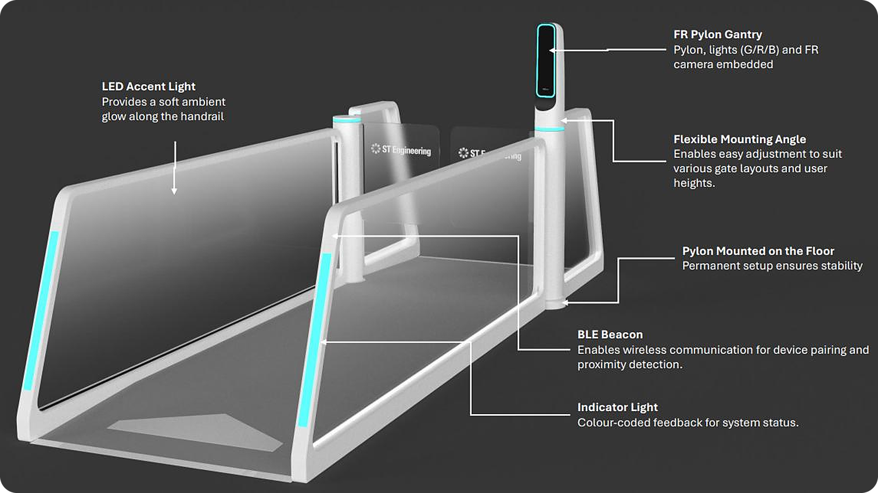



Built for travellers and borders
A2 · DESIGN & ENGINEERING
A gantry-free, infrastructure-light lane with integrated FR camera, BLE beacon and status lighting.
Human-factor design
Soft-white matte finish: a calm, approachable presence
Self-service by default
FR camera, RGB guidance and status light in a slim pylon
Brownfield-ready
Light footprint cuts civil works in existing terminals
Secure to the core
Zero-trust, multi-tier, cloud-ready, hardened APIs
Notes:
Backup: E-Gate design (v1.3 slide 6, submission Annex B).

Slide 15
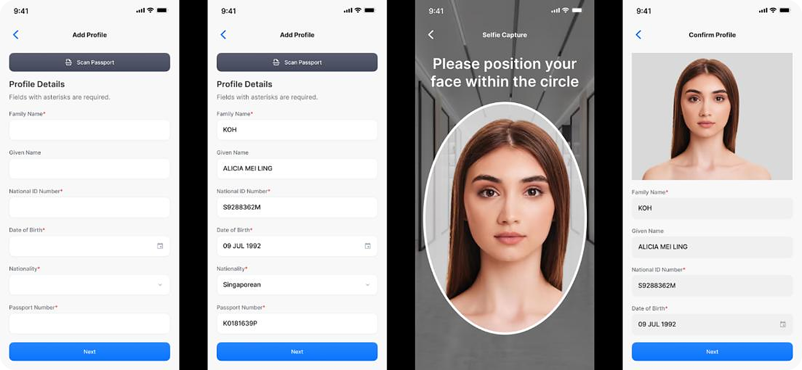
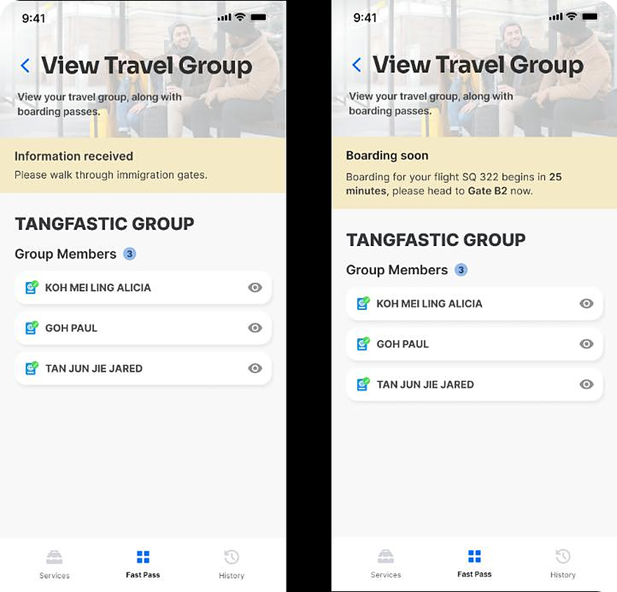
Enrol once. Travel as a group
A3 · MOBILE APP
Self-enrolment at home via passport MRZ and selfie; linked travellers clear individually under one group.
Enrolment Add profile → passport scan fills details → selfie → confirm
No raw identity documents are sent to airport systems; verification uses two factors.
Group view live status from immigration to boarding
Notes:
Backup: app flows (submission Annex A). NUS team lessons on app design and Bluetooth to be folded in.

Slide 16
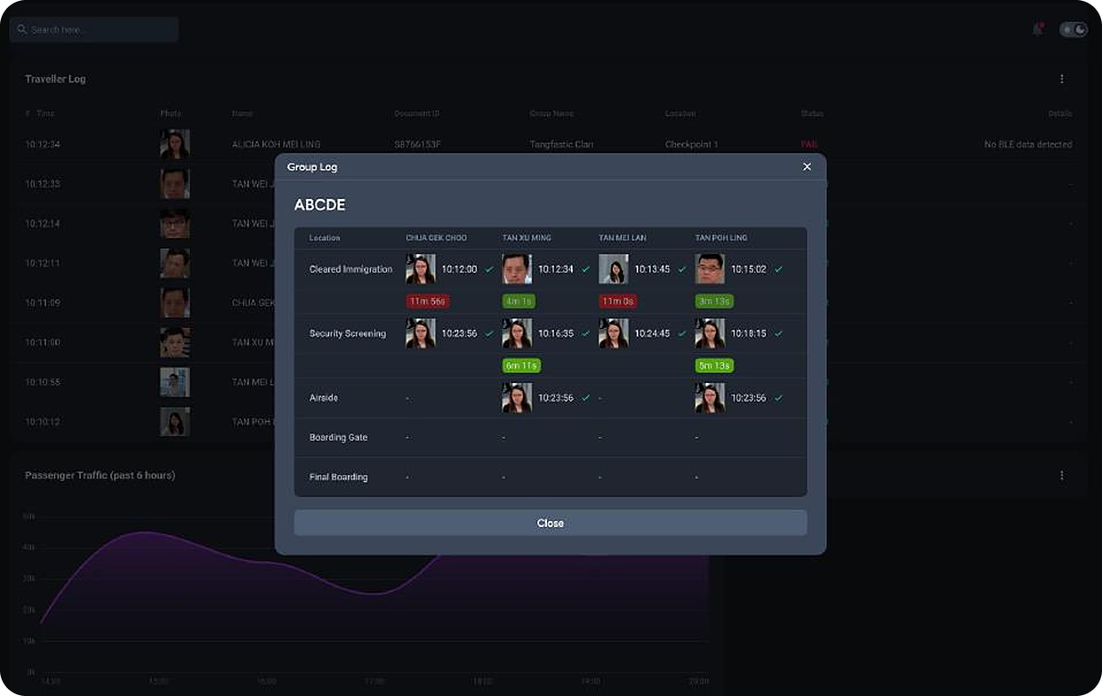
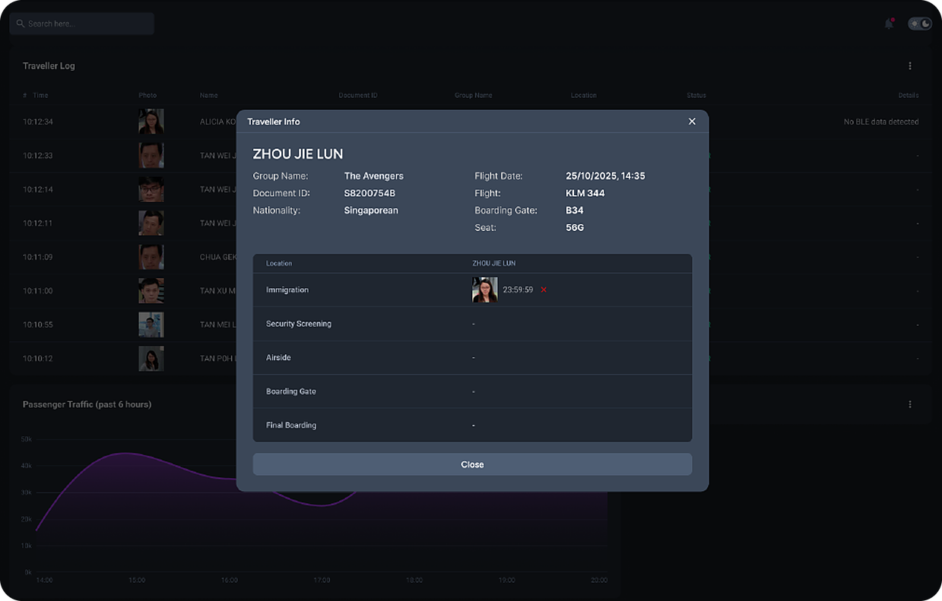
Follow every journey, every exception
A4 · AGIL® SECURE ISMP
Group and individual views trace each traveller across immigration, screening and boarding.
Group log each member's status at every touchpoint
Traveller view flight, gate and verified touchpoints
Notes:
Backup: ISMP views (v1.3 slide 4, submission Annex D).

Slide 17


AI in the product and in how we build it
A5 · AI ADOPTION
Aligned with InnoChamp 2026's theme of AI-driven collaborative innovation.
IN THE PRODUCT
IN ENGINEERING
Facial recognition engine
Reliable verification on the move
~50%
Alert triage
Context-aware alarm prioritisation
less effort in selected front-end activities
~40%
Behaviour analytics
Unusual-pattern detection
better delivery-pipeline efficiency
Flow prediction
Congestion forecasting across zones
AI-assisted engineering and CI/CD with integrated security testing
Predictive maintenance
Device and network health monitoring
Notes:
Backup: AI adoption (submission §3 and §6).

Slide 18
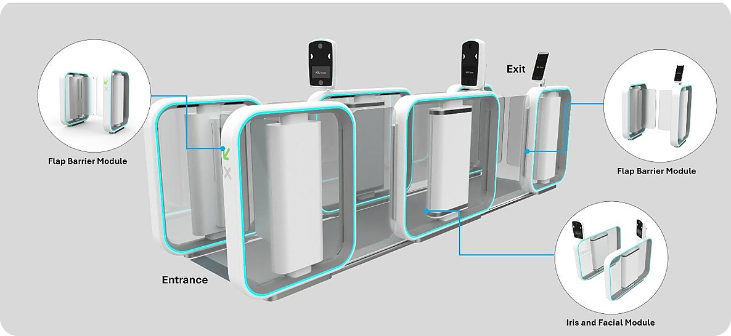




Built to extend: next modes and markets
A6 · ROADMAP
A common lane and platform foundation lets airports add capabilities without replacing what they own.
NEXT MODES
Face + iris multimodal
Assurance when masks, eyewear or lighting degrade capture
UWB wallet clearance
Passive walk-through without opening the app
Palm-vein option
Iris SecureFlow modular face + iris lane for higher assurance
Alternative biometric for specific security postures
NEXT MARKETS
Onboard-processing LiDAR
Kerbside & check-in
Baggage
Seaports
Land checkpoints
Edge insights straight to ISMP, less post-processing
Stadiums
Critical sites
Notes:
Backup: roadmap (submission §5 New Capabilities, Annex E; 14 Oct discussion on UWB, palm-vein, LiDAR and baggage adjacencies such as Veovo-style front-to-back solutions).

Slide 19
How we sized the market
A7 · MARKET SIZING
Conservative, bottom-up and traceable to published sources.
Step | Figure | Basis
Global automated border control market | US$2.56B (2025) → US$5.03B (2030) | MarketsandMarkets
Airport share of demand | ≈83% | MarketsandMarkets
Middle East + Southeast Asia share | ≈10–15% | URS analysis of regional data
FastPass initial addressable share | ≈25% of regional market | URS estimate
Serviceable market, 2026–2030 | ≈US$500–700M (≈US$100–140M a year) | Derived
SOURCES
marketsandmarkets.com/Market-Reports/automated-border-control-market-24899883.html
iata.org — Global Outlook for Air Transport, December 2023
sita.aero — Air Transport IT Insights 2024; Air Transport IT Insights 2025 (Airports)
Notes:
Backup: market sizing (submission §5 Market Potential). The US$40B e-Gate TAM mentioned on 14 Oct is pending source verification with Riley — not shown.

