Slide 1
InnoChamp 2026 | Product Category
AGIL® Secure FastPass
Smart, secure, seamless airport journeys
A mobile-first, biometric solution for fast, contactless and secure journeys, from kerb to gate
Smart Security & Automation,
Smart Utilities & Infrastructure,
Urban Solutions
Notes:
[0:00–0:15] Good morning. I'm [Name]. With colleagues across Smart Security & Automation, Smart Utilities & Infrastructure and Urban Solutions, we built AGIL Secure FastPass: a mobile-first, biometric solution for fast, contactless and secure journeys, from kerb to gate.

Slide 2














Market Needs
More passengers. More checks. Limited capacity.
Every departure is split into four identity checks. Airports must balance speed, capacity and security as volumes rise.
Check-in
Immigration
Security screening
Boarding gate
~ 4
≥2
2×
48%
identity touchpoints per departure
officer or staff member per touchpoint
air travel demand by 2040
of airports plan cross-silo data sharing by 2027
Sources: IATA Global Outlook for Air Transport (Dec 2023); SITA Air Transport IT Insights 2024 & 2025.
2 |
Notes:
[0:15–0:55] Think about your last flight. Passport at check-in. Again at immigration. Again at security. Again at the gate. Four checks, four stops, four queues, and at least two staff at every one.
The pressure keeps growing: demand doubles by 2040. And half of airports say they will break their data silos by 2027. Airports must balance speed, capacity and security with the terminals and staff they already have.

Slide 3


Market Potential
A focused market in high-growth airport regions
Brownfield airports in the Middle East and Southeast Asia, where growth outpaces capacity.
US$5.0B global ABC market by 2030
SERVICEABLE MARKET · 2026–2030
US$500–700M
≈83% of it at airports
≈ US$100–140M a year, hardware to services
10–15% Middle East + SE Asia
7 in 10
~78%
≈25% FastPass addressable share
airlines adopting biometric ID by 2026
of ME/SEA airport projects are brownfield
Global market grows from US$2.56B (2025): ~14.5% CAGR
Sources: MarketsandMarkets, Automated Border Control Market 2025–2030; SITA Air Transport IT Insights 2024. Regional and serviceable shares: URS estimate
3 |
Notes:
[0:55–1:45] This is a large, growing market. Automated border control reaches about US$5 billion by 2030, growing about 14% a year; most of it is at airports.
We focus on the Middle East and Southeast Asia, where traffic grows fastest: a serviceable market of US$500–700 million over five years, about 100–140 million a year.
The timing is right: 7 in 10 airlines are adopting biometric ID by 2026, and almost 80% of airport projects in these regions upgrade existing terminals. That is exactly where FastPass fits.

Slide 4

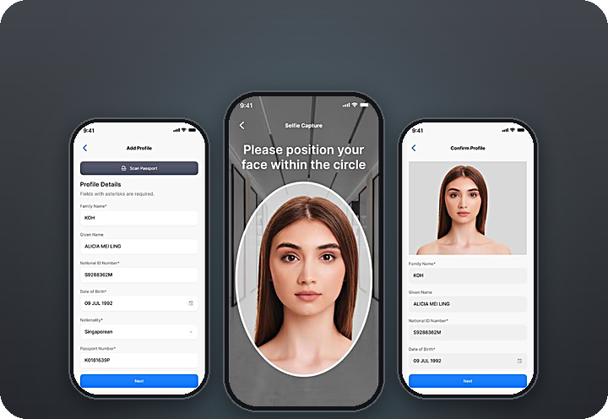

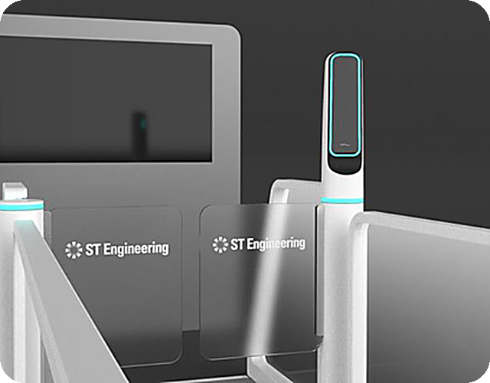
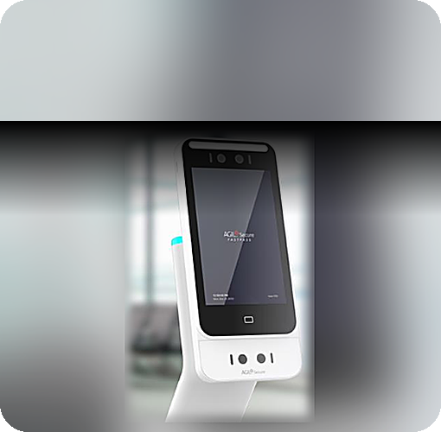

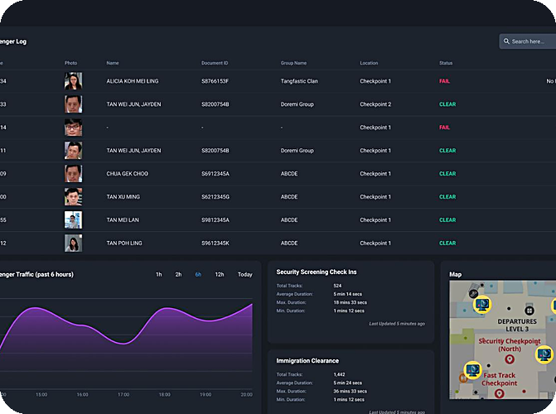

FastPass Solution – Kerb to Gate
One identity, from kerb to gate
1
Enrol before travel
Traveller path
ISMP oversight
FastPass Mobile App
2
Traveller enrolment & digital identity
3
1
4
5
2
Clear immigration
3
Pre-screen
4
Board
5
Oversee
BLE pairing → Biometric E-Gate
Nova Plus + AI Scanning
Smart Boarding Kiosk
AGIL® Secure ISMP
On-the-move immigration clearance
AI-assisted pre-screening
Facial recognition boarding
Unified command & control
STATUS TV
TAN M. Y.
SQ 322 · B12
BEHIND EVERY STEP
CLEARED
3 |
Notes:
[1:45–2:45] So how does it work? Follow the numbers.
One. Before travel, the traveller enrols once in the FastPass app: a passport scan and a selfie. The credential stays encrypted on the phone.
Two. At immigration, the lane pairs with the phone by Bluetooth as they walk up, the camera matches the face to the phone without stopping, and the status TV shows a green Cleared.
Three. Before screening, the Nova Plus reader confirms it is the same person, and AI scanning flags threats in the bags.
Four. At the gate, the boarding kiosk clears them by face. No passport, no boarding pass.
Five. Behind every step, AGIL Secure ISMP sees the whole journey. All components are integrated to support whole-of-airport operations.

Slide 5
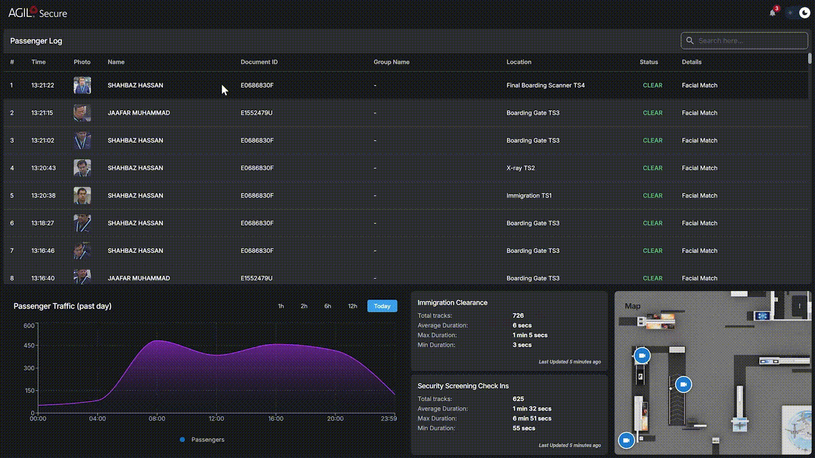






FastPass Solution - AGIL® Secure ISMP
One command environment across every FastPass touchpoint
AGIL® Secure ISMP is the operational backbone behind FastPass: unified command and control for whole-of-airport operations.
Traveller transactions
Physical security
Lane & gate control
AGIL® Secure ISMP
One command layer
3D operational view
Exception management
Assistive AI
5 |
Notes:
[2:45–3:15] That command layer is AGIL Secure ISMP, our existing platform: traveller transactions, lane and gate control, exception management, assistive AI, a 3D operational view and physical security in one environment. On the right is the live product: the passenger log, flow by zone, exceptions flagged for action.

Slide 6
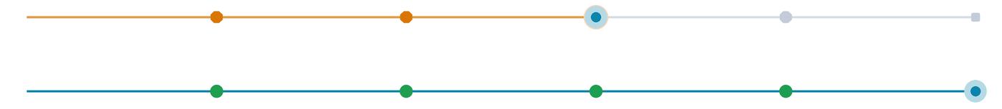






Innovativeness
The innovation is the verified credential, not another gate.
Today
Check-in
Immigration
Screening
Boarding
4 stops · an officer at each
With FastPass
0 stops · officers on exceptions only
Privacy by design
Credentials stay encrypted on the phone
Plugs into airline and airport apps
+
=
Ships as an SDK inside the channels travellers already use
Converged with security ops
Device credential
via BLE
Live face
on the move
Cleared
lane stays open
Clearance events sit beside CCTV, access control and incident data in ISMP.
AI-assisted verification and operations
Face matching on the move, AI-powered luggage threat detection, and assistive AI that helps operators triage alerts.
6 |
Notes:
[3:15–4:00] So where is the innovation? Not another gate. The credential.
Most walk-through lanes check one thing: your face. FastPass checks two things at once, while you walk: the phone proves the credential, the face proves the person.
It is built differently too: data stays encrypted on the phone; it plugs into the apps airports and airlines already have; it is converged with security operations; and AI runs in the product, for face matching, luggage threat detection and alert triage.

Slide 7






Business Impact
Smarter operations, stronger security, better journeys
What FastPass changes for travellers, airports and agencies, at scale.
FOR TRAVELLERS
FOR AIRPORTS & AIRLINES
FOR IMMIGRATION & SECURITY
0 stops
4 of 4
1 view
Kerb to gate in 8–11 min for eligible travellers (target)
Identity touchpoints automated
Every lane, clearance and incident in ISMP
Faster, frictionless, passport-free journey
Increased throughput without added manpower
Unified monitoring, analytics and faster incident response
Contactless, with less waiting
Reduced human error through automation and AI
Officers focus on exceptions, not routine checks
Consistent security from check-in to boarding
Scalable, infrastructure-light and future-ready
Two factors on the move: phone credential + live face
Kerb-to-gate time is a target, to be validated at the airport demonstration. ROI is anchored on officer hours and capacity gained without new terminal space.
3 |
Notes:
[4:00–4:35] What changes for each stakeholder?
Travellers: zero stops; our target is kerb to gate in 8 to 11 minutes. A faster, frictionless, passport-free journey.
Airports and airlines: all four identity touchpoints automated, so throughput grows without added manpower, with less human error.
Immigration and security: one view of every lane, clearance and incident, and officers focused on exceptions. That is the ROI: officer hours and capacity, without new terminal space.

Slide 8





Time to Market
A clear buyer, commercial model and path to scale
Land with one lane in a brownfield terminal, then expand across touchpoints as value is proven.
Buyer ecosystem
Commercial model
How we scale
Primary buyer
Lane hardware
1
Prove
Tier-2 international airports in the Middle East and SE Asia
One-off: e-gate, reader, kiosk
Deploy and validate a single pilot lane
Co-decides
ISMP licence
2
Expand
Immigration and border agencies
Recurring, by deployment scope
More lanes and enrolment capacity
Enabler
Integration
3
Connect
Airlines via their own existing digital channels
Project: configure and deploy
Integrate configured touchpoints through AGIL® Secure ISMP
End user
Support
4
Scale
Travellers, enrolled once in the app
Annual maintenance and SLA
Extend across terminals and airport portfolios
7 |
Notes:
[4:35–5:20] Who buys: Tier-2 international airports in the Middle East and Southeast Asia; immigration agencies co-decide; airlines enable adoption through their own apps.
What they pay for: lane hardware once, the ISMP licence recurring, integration as a project, and annual support.
How we scale: prove one pilot lane, expand lanes and enrolment, connect every touchpoint through ISMP, then scale across terminals and portfolios. Because ISMP already runs, we move fast.

Slide 9


Collaboration and entry barriers
Why FastPass is differentiated, and how its advantage scales
Cross-BA know-how and Group reach create a unique competitive edge.
Urban Solutions
STEV
(Venture Building)
OUR DIFFERENTIATION & ENTRY BARRIERS
FastPass
Integrated with security operations
Traveller-clearance events are unified with video, access control and incident management through AGIL® Secure ISMP.
Modular and infrastructure-light
SCALING FAST
Airports can start with a single lane, integrate through open interfaces and scale with minimal civil works.
Cross-market access through Group business units
Government-grade delivery
Regional sales and integration partners in ME and SE Asia
Over 35 years of experience delivering secure, mission-critical systems, backed by cybersecurity and airport-domain expertise.
Built for international deployment: privacy, governance, manual fallback
8 |
Notes:
[5:20–6:05] FastPass is built across business areas as one product team.
That is also what makes it hard to copy: it is integrated with security operations, modular and infrastructure-light, and delivered by a team with 35 years of government-grade, mission-critical systems.
To scale fast we cross-sell through Group business units in other countries, work with regional sales and integration partners, and we have built in international needs: privacy, governance and manual fallback.

Slide 10





Conclusion
Conclusion and path to market
FastPass brings together a clear operational need, a focused market and a differentiated product architecture, with a phased path towards customer deployment.
Clear operational need
Path to market
Demand and customer expectations are outgrowing terminals and staffing
FEB 2026
Focused market opportunity
Prototype live at Singapore Airshow
US$100–140M a year in ME and SE Asia
OCT 2026
InnoChamp 2026
Working product foundation
Q4 2026
Integrated prototype, Singapore Airshow 2026
Live demo with airport stakeholders
APR 2027
Defensible differentiation
Passenger Terminal World, Amsterdam
2027
Two-factor credential, converged security ops
First customer pilot (target)
Productisation funding
Launch customer via Group Sales
Showcase at PT World 2027
OUR ASK
9 |
Notes:
[6:05–6:50] Four reasons to back FastPass now: a clear need, a focused market, a working product shown live at the Singapore Airshow, and a defensible edge.
Next: a live demo with airport stakeholders this quarter, Passenger Terminal World in Amsterdam in April, and our first customer pilot in 2027.
Our ask: productisation funding of [amount] for offline mode, redundancy and back-end integration; a launch customer through Group Sales; and the PT World 2027 showcase.

Slide 11
Thank You
AGIL® Secure FastPass
Move travellers faster, smarter and more securely, at scale.
Notes:
[6:50–7:00] One identity, from kerb to gate. Move travellers faster, smarter and more securely, at scale. Thank you; happy to take questions.

Slide 12
Appendix

Slide 13
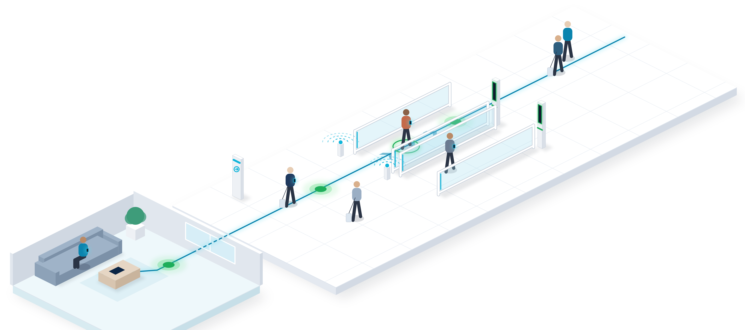

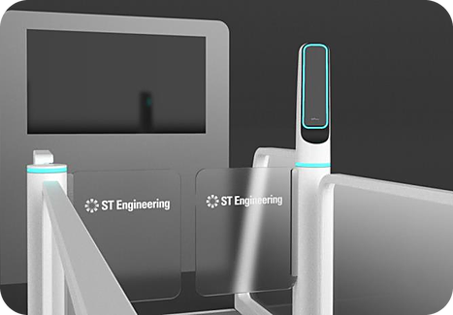
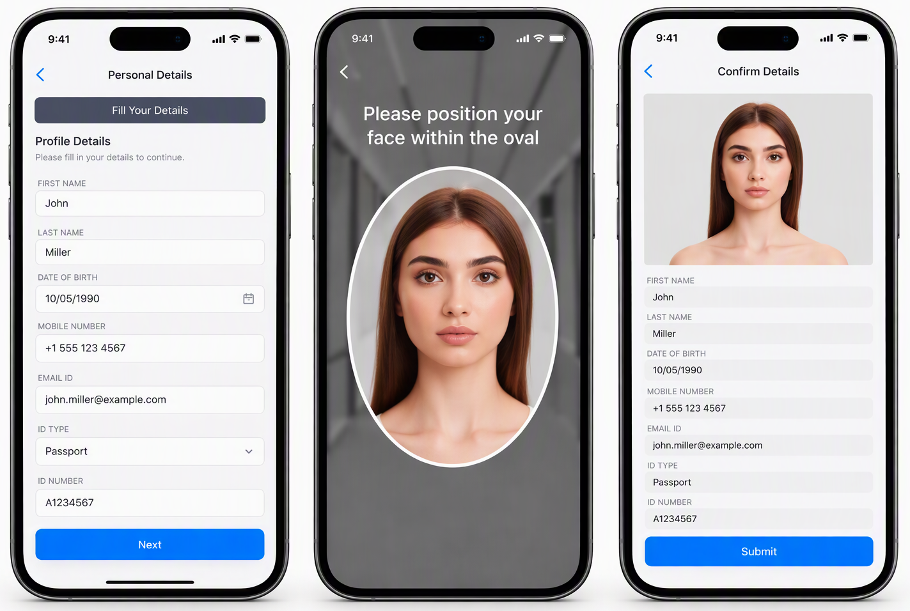


FastPass Solution – Enrolment to immigration
Enrol once. Keep moving through immigration.
Create the credential on the phone once, then walk through without stopping.
FastPass Mobile App
1
Enrol before travel
Scan the passport and a selfie in the FastPass app. The credential stays encrypted on the phone.
BLE beacon
3
FastPass Biometric E-Gate
2
3
Clear Immigration
1
Face matched on the move. Eligible travelers continue through; exceptions alert an officer.
2
Approach the lane
A BLE beacon pairs the phone to the lane as it nears.
12 |
Notes:
Middle east & SEA

Slide 14
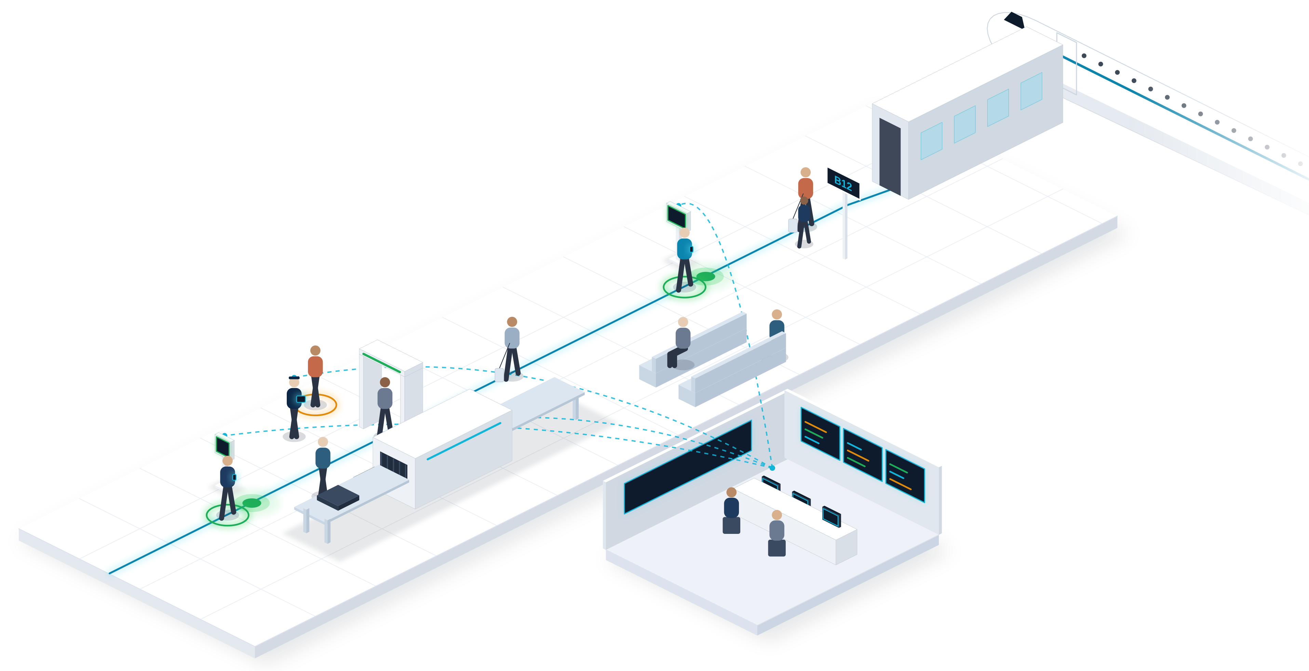


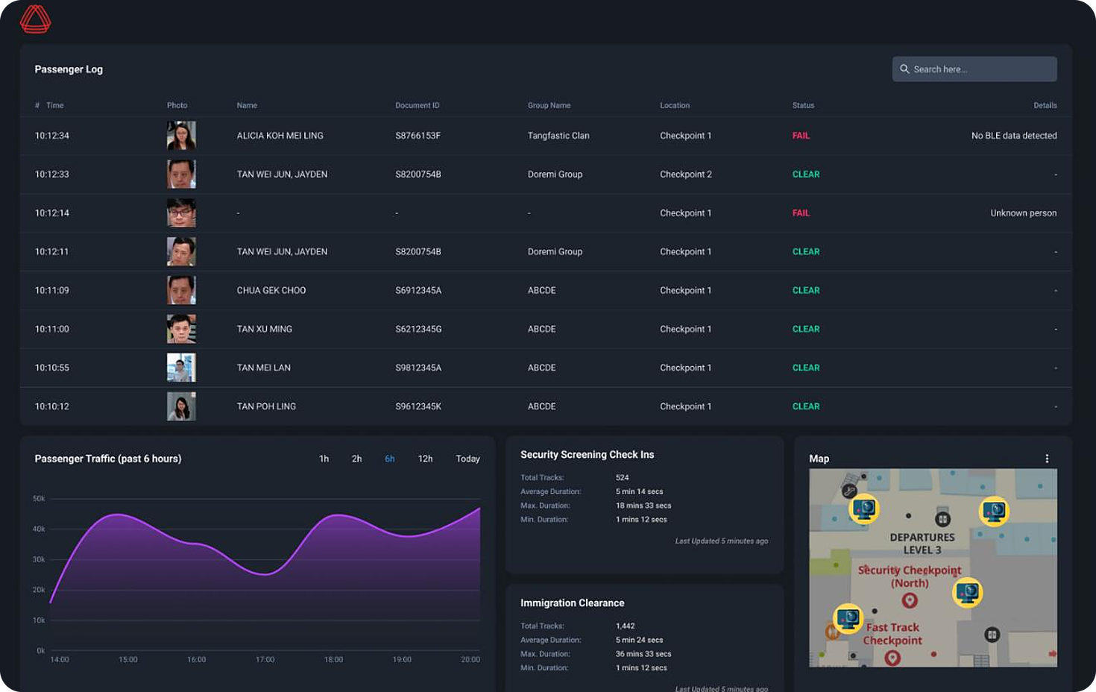
FastPass Solution – Screening to boarding
The journey continues, with operators in control.
The verified mobile credential continues across configured touchpoints, while AGIL® Secure ISMP provides real-time operational visibility and exception management.
4
FastPass Pre-Screening Profile Check
Before bags reach X-ray, the Nova Plus reader confirms identity and retrieves the clearance profile.
5
Exception detected | Officer notified
5
FastPass Smart Boarding Kiosk
Face plus phone clears the boarding kiosk. No passport, no boarding pass.
4
6
6
Maintain operational oversight
AGIL® Secure ISMP connects transactions, touchpoint status and relevant security events, routing exceptions to the appropriate officer workflow.
13 |
AGIL® Secure ISMP
Notes:
Middle east & SEA

Slide 15
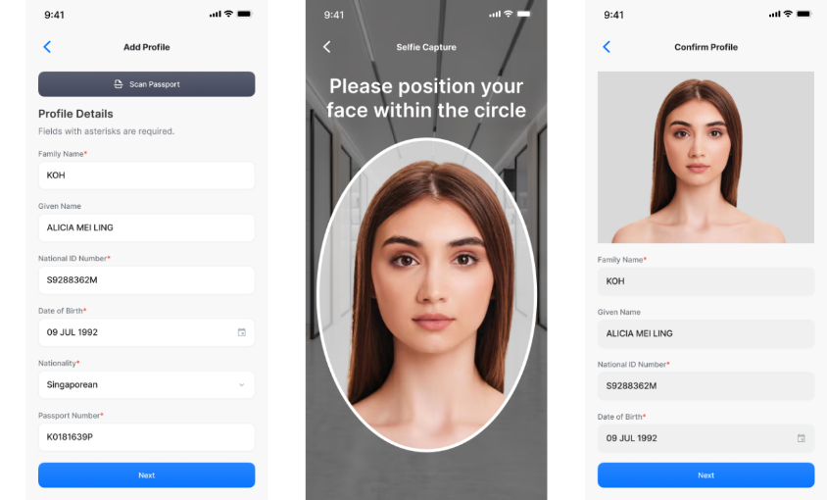
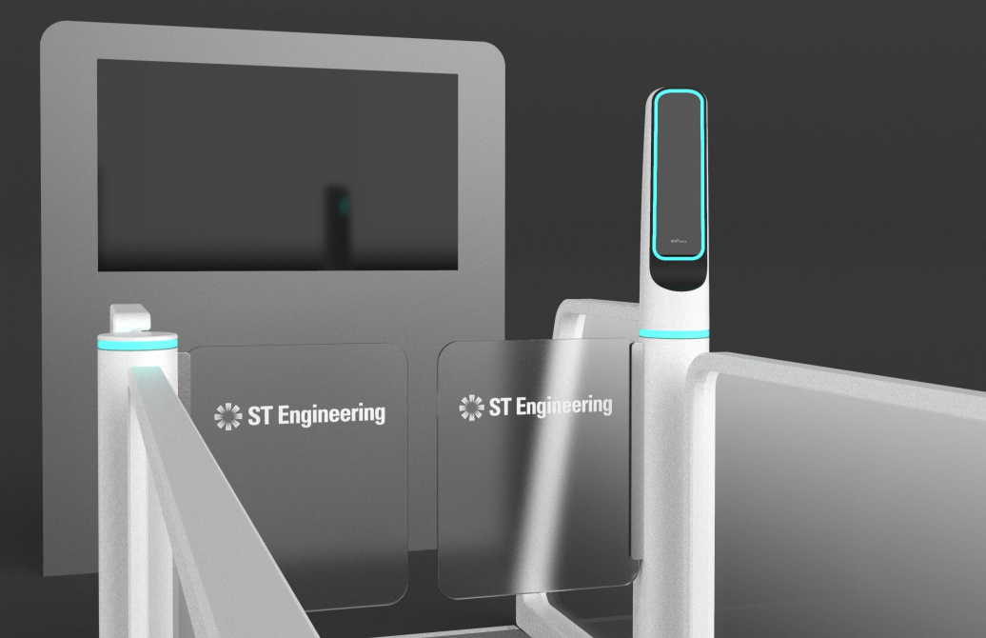
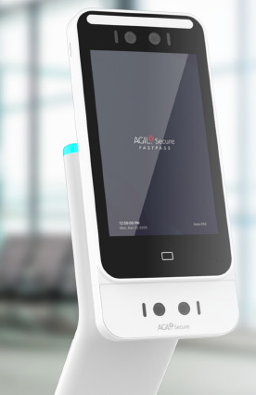
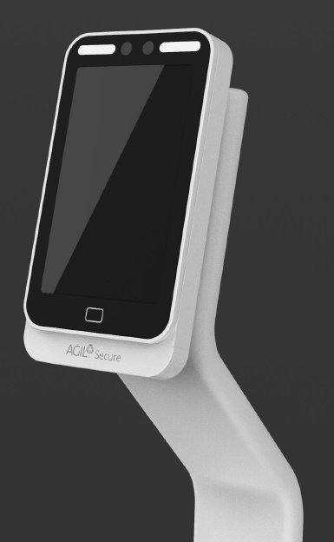


Innovativeness - Product Overview
One identity. Every integrated touchpoint.
FastPass is among the industry’s pioneering solutions, turning the traveller’s phone into a verified mobile credential—connecting enrolment, immigration, pre-screening and boarding through AGIL® Secure ISMP.
FastPass Mobile App
FastPass Biometric E-Gate
FastPass Pre-Screening Profile Check
FastPass Smart Boarding Kiosk
The digital companion — travellers enrol through their phone, capturing the identity, biometric and travel information needed to create a verified mobile credential.
Facial recognition detects and verifies an approaching traveller within the configured operating range, enabling eligible travellers to clear the lane without presenting a passport at the gate or making an intentional stop.
Before baggage screening, the FastPass biometric reader verifies the traveller and retrieves the relevant clearance profile, helping operators identify exceptions before the screening transaction begins.
Facial verification and the verified mobile credential support contactless self-clearance at configured boarding touchpoints.
14 |

Slide 16
Appendix · References
External sources and internal estimates
Every market and industry figure on the slides, with its source. Checked 18 Oct 2026.
What the slide says | Source | Status
Air travel demand doubles by 2040 (7.8 bn journeys, +4.2% a year) | IATA, Global Outlook for Air Transport, Dec 2023 https://www.iata.org/en/iata-repository/publications/economic-reports/global-outlook-for-air-transport---december-2023---report/ | Verified
48% of airports plan cross-silo data sharing or synchronisation by 2027 | SITA, Air Transport IT Insights 2025 (airports) https://www.sita.aero/resources/surveys-reports/air-transport-it-insights-2025/airports/ | Verified
7 in 10 airlines adopting biometric ID by 2026 | SITA, Air Transport IT Insights 2024 https://www.sita.aero/resources/surveys-reports/air-transport-it-insights-2024/ | Verified
ABC market US$2.56B (2025) → US$5.03B (2030); 14.4% CAGR (≈14.5% from the endpoints) | MarketsandMarkets press release, Jul 2025 https://www.marketsandmarkets.com/PressReleases/automated-border-control.asp | Verified
Airports ≈83% of the ABC market (83.1%, 2025) | MarketsandMarkets, ABC market size insight https://www.marketsandmarkets.com/ResearchInsight/automated-border-control-market-size.asp | Verified
9.8 bn airport passengers in 2025 (+3.7%); ACI counts airport passengers, IATA counts journeys | ACI World, World Airport Traffic Report, Sep 2025 (via CAPA) https://centreforaviation.com/news/aci-world-forecasts-global-passenger-traffic-to-reach-99bn-in-2025-up-48-1313729 | Context
ME + SEA ≈10–15% of market; FastPass addressable ≈25%; ~78% brownfield; ≥2 staff per touchpoint | URS analysis on MarketsandMarkets data; airport expert calls; submission §7 | Internal estimate
Kerb to gate in 8–11 minutes; first customer pilot in 2027 | Sales review 14 Oct 2026; programme plan. Validate at the Q4 2026 live demo | Target
3 |

Slide 17

Appendix · Q&A
Hard questions, short answers
Product and security questions judges and Excos are likely to ask.
Where is biometric data stored?
Do you replace immigration?
Encrypted on the traveller’s phone and released only to a paired lane. The airport keeps no central biometric database.
No. FastPass works alongside immigration systems and links to them where local policy allows.
Who owns the app?
What if there is no internet?
The airport or airline. FastPass ships as an SDK inside the channels travellers already use.
Credentials and lane policies are cached locally; full offline clearance is in the productisation scope.
What happens when a match fails?
Can a photo or video fool it?
The lane closes, an officer is alerted in ISMP, and manual counters stay open for exceptions.
A face alone cannot pass: the lane also needs the paired phone credential, and the camera applies liveness checks.
3 |

Slide 18



Appendix · Q&A
Hard questions, short answers
Business and delivery questions.
How do you compare with Idemia?
What is the ROI for an airport?
They lead on portfolio breadth; we lead on two-factor clearance and converged security operations.
Officer hours move from routine checks to exceptions, and throughput grows without new terminal space. Quantified per site in the pilot.
What is not productised yet?
Why the Middle East and Southeast Asia first?
Offline mode, redundancy and back-end integration with airport and immigration systems. That is the funding ask.
Fastest growth, most brownfield projects and Group presence: a lower cost of entry than markets with incumbent frameworks.
What do you need from the Group?
How fast can a first lane go live?
Productisation funding, a launch customer through Group Sales, and the Passenger Terminal World 2027 showcase.
A pilot lane fits a brownfield terminal with minimal civil works. The ISMP core already exists, so integration, not development, sets the pace.
3 |

Slide 19
Q&A
 | AGIL® Secure FastPass | Idemia PaXpress SmartLane
Verification | Two factors: phone credential (BLE / UWB) + live face | Facial recognition on the move with camera tracking
Identity | Credential encrypted on the traveller’s phone | Digital ID via SDK or kiosk;
Operations | Converged with CCTV, access, intrusion and incidents | Supervision screens and tablets for exceptions
Traveller feedback | Pylon light and status TV; AI assistant on roadmap | AI-powered guidance displays
Proof and scale | Integrated prototype; pilot-ready | 1.5 bn+ travellers a year; 350+ ports
Compete on two-factor clearance and converged security operations at a modular entry price, not on portfolio breadth.
Notes:
Middle east & SEA

Slide 20
FastPass Solution – Kerb to Gate
Kerb to gate in six steps, on one identity
Enroll once at home, then walk through immigration, screening and boarding without stopping.
1
Enrol on the GO
2
Approach
3
Walk through
4
Pre-screen
5
Board
Passport + selfie in the app; kept on the phone
BLE / UWB pairs the phone to the lane as it nears
Face matched on the move; the TV shows your status
Nova Plus confirms identity before bags reach X-ray
Face + phone clears the kiosk; no boarding pass
TAN M. Y.
3
SQ 322 · B12
CLEARED
STATUS TV
4
2
1
5
6
6
Live oversight
One view in ISMP; exceptions go to officers
Notes:
Middle east & SEA

Slide 21
Previous Submitted Slide Version

Slide 22



Market Potential
Air Travel is Evolving
Passenger volumes continue to rise, yet the airport journey remains fragmented across identity, immigration, screening and boarding.
Travellers face repeated stops, while operators lack a unified view across passenger-processing and physical-security systems.
Airports are asked to deliver more capacity, stronger security and a better experience—all at the same time.
Air travel demand is projected to nearly double by 2040.
About 7 in 10 airlines plan to adopt biometric identity management by 2026.
48% of airports plan to implement cross-silo data sharing or synchronisation by 2027
Source:
https://www.iata.org/en/iata-repository/publications/economic-reports/global-outlook-for-air-transport---december-2023---report/
https://www.sita.aero/resources/surveys-reports/air-transport-it-insights-2024/
https://www.sita.aero/resources/surveys-reports/air-transport-it-insights-2025/airports/
20 |

Slide 23
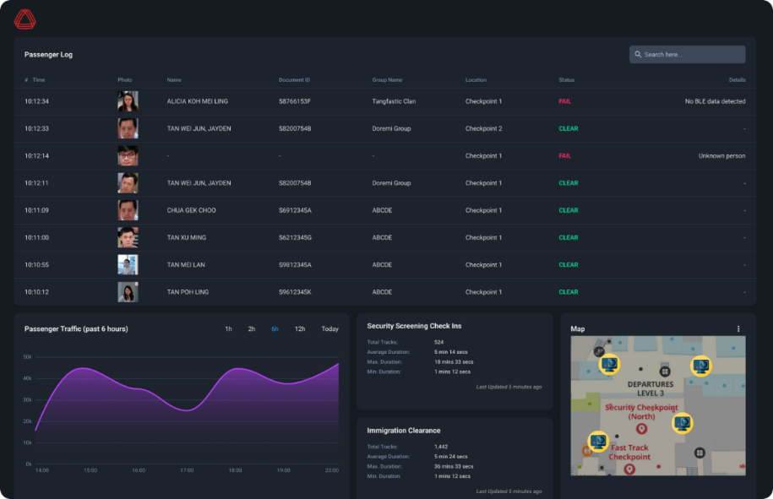
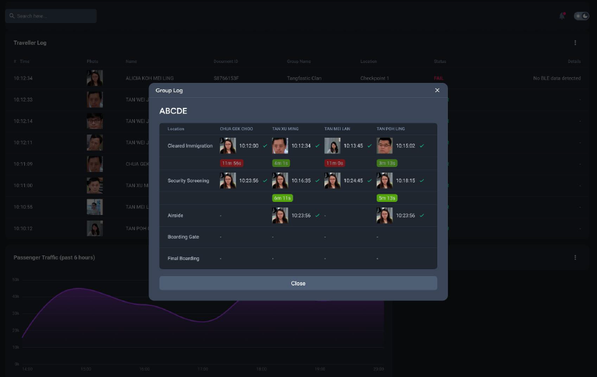

Product Overview
AGIL® SECURE INTEGRATED SECURITY MANAGEMENT PLATFORM
AGIL® Secure ISMP is the operational backbone of FastPass—bringing transaction monitoring, lane status, security events and exception handling into one command environment.
21 |

Slide 24
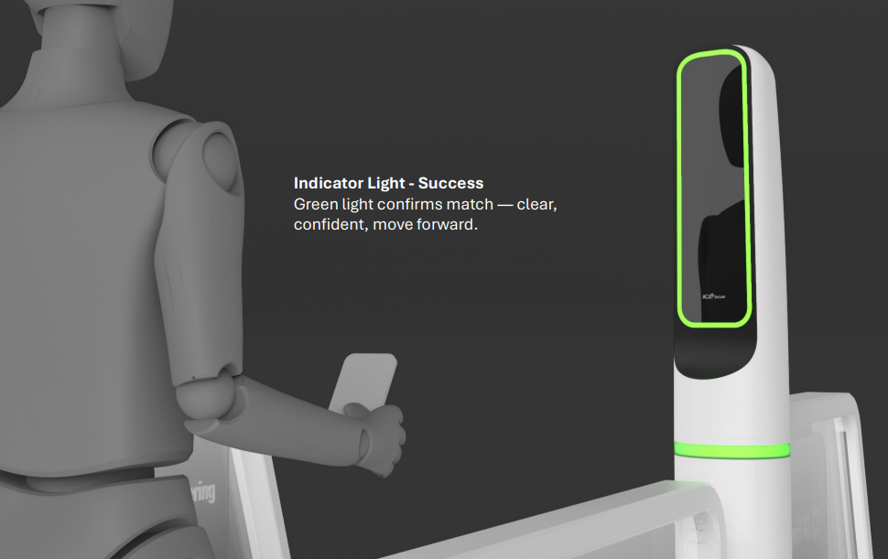





The Product – How It Works and Why It Is Innovative
One Credential. Seamless Flow.
1 · Enrol Once
On the traveller's own phone — identity, biometrics and travel profile become a verified mobile credential.
2 · Approach the Lane
A BLE-enabled lane association links the approaching mobile credential to the designated lane.
3 · Keep Moving
Facial recognition verifies the approaching traveller on the move, allowing eligible travellers to clear the lane without touching a reader or presenting a passport at the gate.
4 · Clear Securely
Operators see the journey
The lane remains open for successful clearance and closes when identity, lane-association or policy checks require intervention. Tailgating controls and exception workflows keep officers in control.
AGIL® Secure ISMP connects every touchpoint—giving operators real-time visibility of each traveller’s latest verified touchpoint, clearance status and relevant physical-security events across the airport.
ONE CREDENTIAL. THE JOURNEY CONTINUES.
Screening checkpoint — profile check at the Nova reader
Boarding — contactless self-clearance at configured FastPass touchpoints
22 |

Slide 25

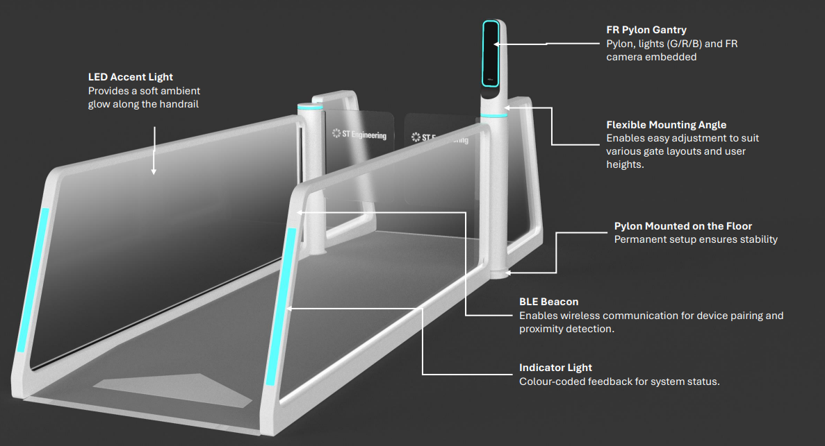



The Product – Design & Engineering
Designed for travellers. Engineered for borders.
Human-factor design
Soft-white matte CMF creates a clean, approachable and professional presence within the security environment.
Self-service approach
Facial-recognition camera, RGB guidance lighting and status indication are integrated into a slim and compact design.
Brownfield deployment
An infrastructure-light footprint reduces the need for extensive civil works in suitable terminal environments.
Secure to the core
Zero-trust, multi-tier, cloud-ready ISMP with hardened APIs; assistive AI for alert triage and operator-reviewed response recommendations.
Lane system — product overview
23 |

Slide 26





Time to Market – Entry Barriers - Roadmap
Start with one lane. Scale to an airport.
LAND & EXPAND
FASTPASS KEY DIFFERENTIATION
1
Converged with airport security operations
Prove
Deploy a mobile pilot lane
Passenger-clearance events feed into AGIL® Secure ISMP alongside CCTV, access control, intrusion detection and other physical-security systems—giving operators visibility of each traveller’s latest verified touchpoint and clearance status within the airport’s wider security picture.
2
Expand
Expand lanes and enrolment capacity
Integrated product architecture
A tightly integrated architecture spanning mobile credential workflows, biometric lane control and ISMP orchestration reduces the integration burden for customers.
3
Connect immigration, pre-screening, boarding and physical-security operations through ISMP.
Deep know-how
Connect
Built on more than 35 years of experience in government-grade, mission-critical deployments.
4
Scale
Extend across terminals and airport portfolios
Designed for lifecycle scale
Airport engineering, systems integration and support within one delivery model.
FUTURE OPTION Enhance multimodal biometrics, including iris recognition, for higher-assurance use cases.
24 |

Slide 27
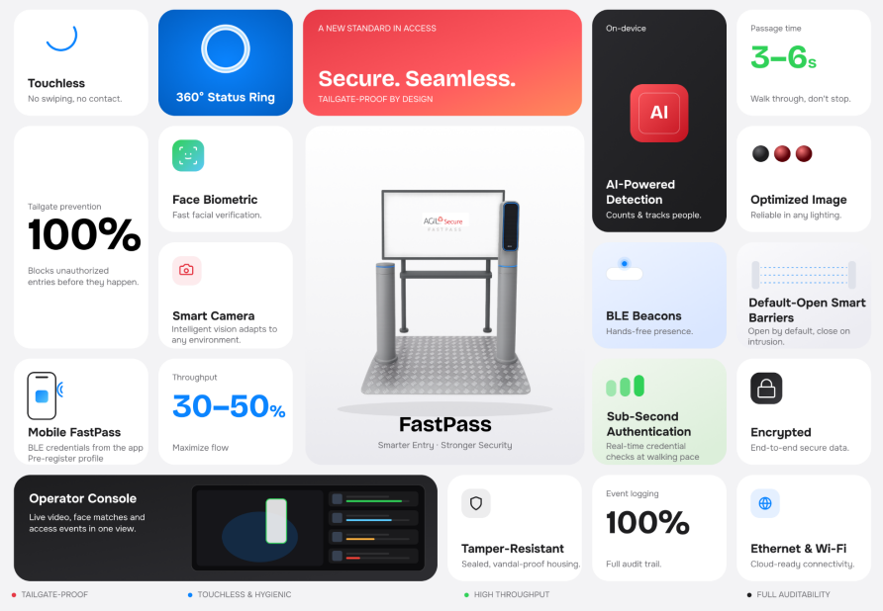
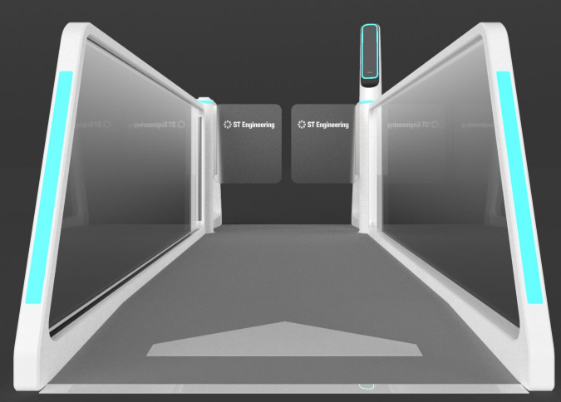
Conclusion
The future of trusted travel should feel effortless.
Fewer intentional stops for eligible travellers.
Real-time visibility and control for operators.
Improved passenger flow without compromising required security controls.
25 |

