Slide 1


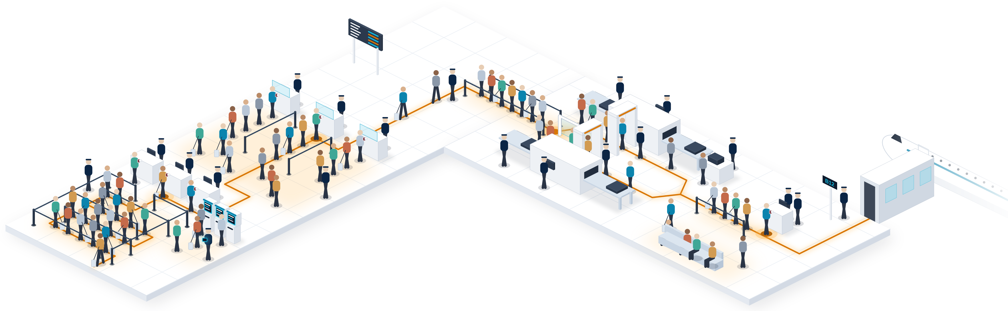






Market Needs
More passengers. More checks. Limited capacity.
Today, every departure stops four times, each with its own queue, its own document check and its own staff.
1
Check-in
2
Immigration
3
Security screening
4
Boarding gate
Kiosks and staffed counters
Manual passport check
Two lanes: bags and body scan
Documents checked again
5 staff
Queue
4 staff
Queue
8 staff
Queue
3 staff
Queue
2
3
1
4
Traveller path and stops
Staff / officer
Queue
~4
identity checks per departure
≥2
staff at every touchpoint
2×
air travel demand by 2040
48%
of airports plan cross-silo data sharing by 2027
Sources: IATA Global Outlook for Air Transport (Dec 2023); SITA Air Transport IT Insights 2025 (airports). Staff per touchpoint: URS estimate from airport expert calls. Scene and staff counts are illustrative.
3 |
Notes:
[0:15–0:55] Think about your last flight. Passport at check-in. Again at immigration. Again at security. Again at the gate. Four checks, four stops, four queues, and staff at every one of them.
Follow the amber line: every stop is a queue, a document check and a desk to staff. The pressure keeps growing: air travel demand doubles by 2040, and half of airports plan to break their data silos by 2027. Airports must move more people with the terminals and staff they already have.

