Slide 1
Examples

Slide 2
Patterns in Data

Slide 3
1
0
Light brown represents 1
Blue represents 0
Data stream is a sequence of 0 or 1s

Slide 4
1
0
5*5 matrix of ‘0’s

Slide 5
1
0
5*5 matrix
What is the pattern?

Slide 6
1
0
5*5 matrix
What is the pattern?

Slide 7
1
0
5*5 matrix
What is the pattern?

Slide 8
1
0
5*5 matrix
Random 0s and 1s

Slide 9
1
0
6*6 matrix
Add one row and one column on the previous 5*5 matrix

Slide 10
1
0
6*6 matrix
Secretly swift one color to another color.
What happens?
Can computer recognize the change?

Slide 11
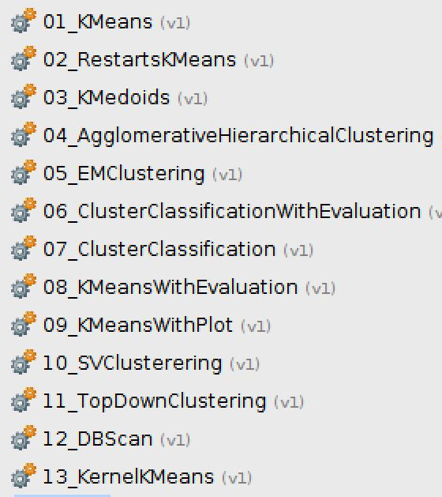
Finding Insights
Global property analysis
Network analysis
Clustering
…..

Slide 12
Which Factors Affect Life Expectancy?
A. High-income people live longer
B. Low-income people live longer
C. Middle-income people live longer
D. People in a big country live longer
E. People in a small country live longer
F. Asia people live longer
G. Africa people live longer
H. Europe people live longer
I. America people live longer

Slide 13
Data of Incomes and Life Expectancy in the World (2012)
4 dimensions
Country name | GDP per capita | Lifespan | Population | Region
Brazil | 12157.31 | 73.84 | 202401 | America
France | 40850.35 | 81.97 | 63561 | Europe
Greece | 22242.68 | 80.63 | 11109 | Europe
Greenland | 41471.66 | 71.31 | 56 | Europe
Haiti | 766.87 | 62.03 | 10288 | America
Iceland | 44258.84 | 82.92 | 323 | Europe
India | 1449.66 | 67.29 | 1263589 | Asia
…...
Russian Federation | 14078.83 | 70.37 | 143287 | Europe
United Kingdom | 41294.51 | 80.90 | 63573 | Europe
United States | 51456.66 | 78.74 | 314799 | America
Zambia | 1686.62 | 58.36 | 14786 | Africa
161
countries
Notes:
https://developers.google.com/chart/interactive/docs/gallery/bubblechart#overview
Explain each row, how many rows

Slide 14
Data of Incomes and Life Expectancy in the World (2012)
Data sources:
Incomes: http://data.worldbank.org/indicator/NY.GDP.PCAP.CD
Population : http://esa.un.org/unpd/wpp/Download/Standard/Population/
Life expectation: http://esa.un.org/unpd/wpp/Download/Standard/ASCII/
Notes:
https://developers.google.com/chart/interactive/docs/gallery/bubblechart#overview
Explain each row, how many rows

Slide 15
Bubble chart
Definition
Bubble chart: a variation of scatter plot
A bubble chart is used to visualize a data set with two to four dimensions, all of which will be shown in a chart.
In bubble chart, each data point is visualized as a bubble.
The first two dimensions of a data point are visualized as coordinates or location of a bubble, the third as color of a bubble and the fourth as size of a bubble.
Notes:
https://developers.google.com/chart/interactive/docs/gallery/bubblechart#overview

Slide 16
Bubble chart: visualizing all four dimensions in a chart
80
This chart shows income and lifespan of 161 countries. Each bubble is a country.
70
Lifespan
60
50
Income
$500
$5 000
$50 000
(2012)
Adapted from http://www.gapminder.org/

Slide 17
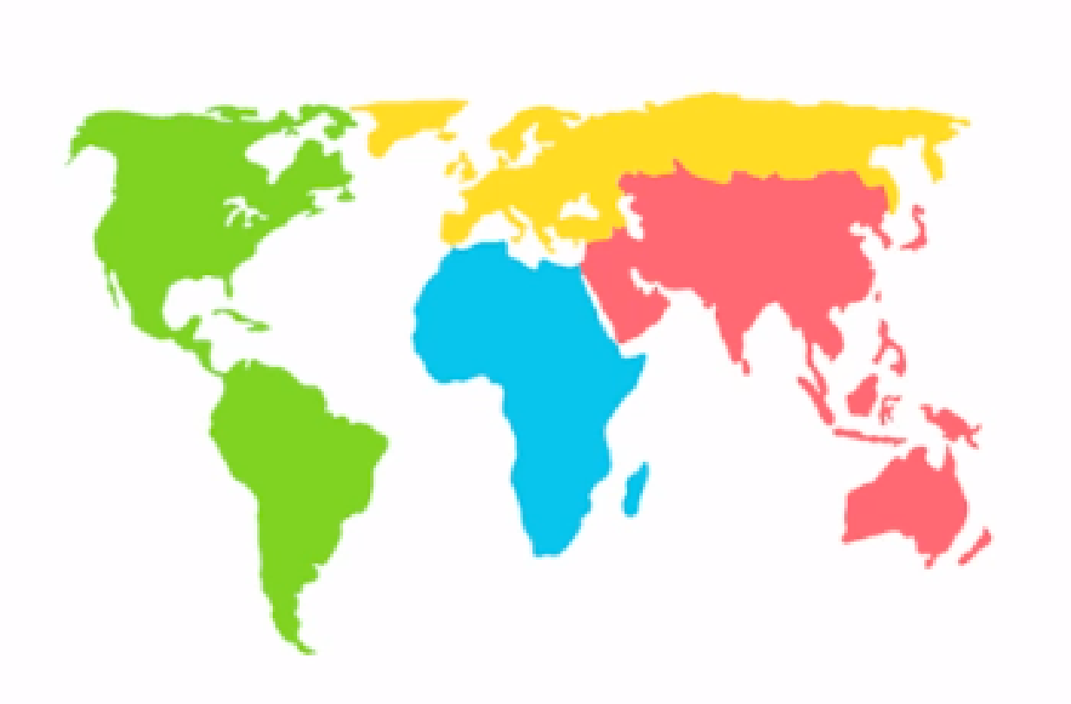
Bubble chart: visualizing all four dimensions in a chart
80
70
Color shows country region.
Lifespan
60
50
Income
$500
$5 000
$50 000
Adapted from http://www.gapminder.org/

Slide 18
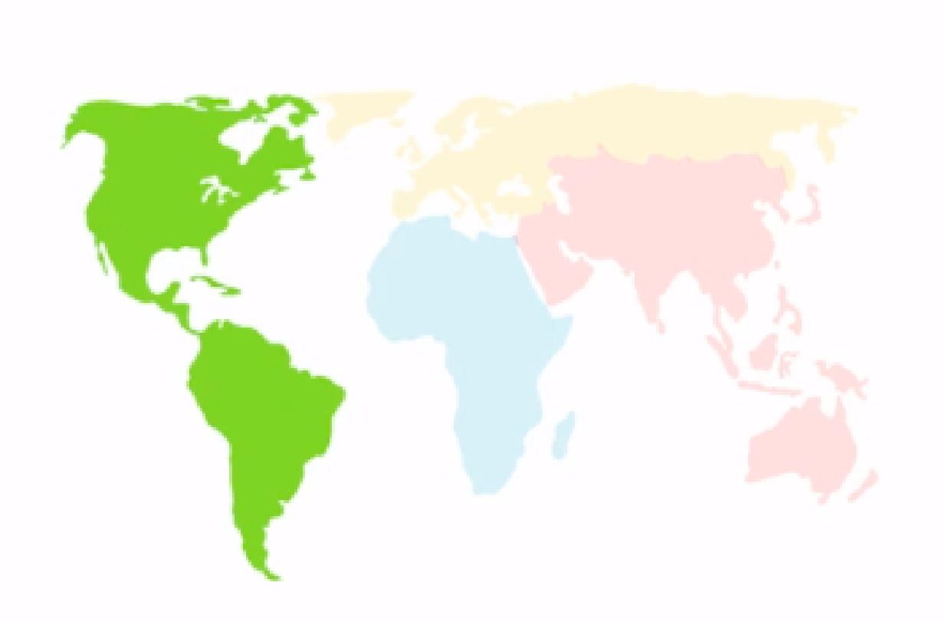
Bubble chart: visualizing all four dimensions in a chart
80
Americas
70
Lifespan
60
50
Income
$500
$5 000
$50 000
Adapted from http://www.gapminder.org/

Slide 19
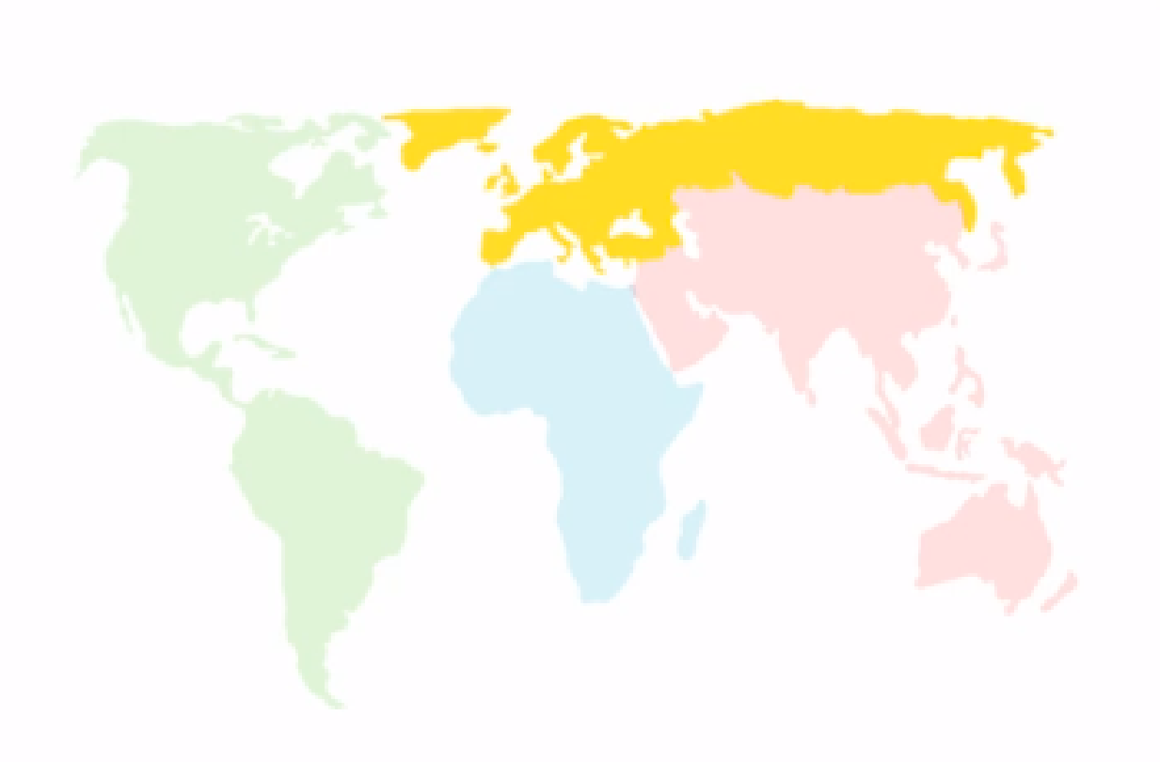
Bubble chart: visualizing all four dimensions in a chart
80
Europe
70
Lifespan
60
50
Income
$500
$5 000
$50 000
Adapted from http://www.gapminder.org/

Slide 20
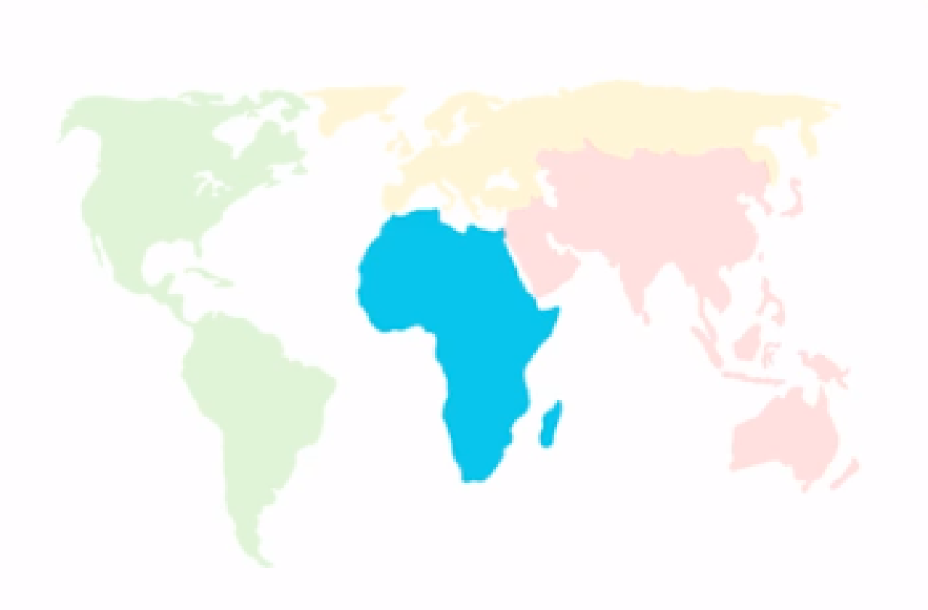
Bubble chart: visualizing all four dimensions in a chart
80
70
Lifespan
Africa
60
50
Income
$500
$5 000
$50 000
Adapted from http://www.gapminder.org/

Slide 21
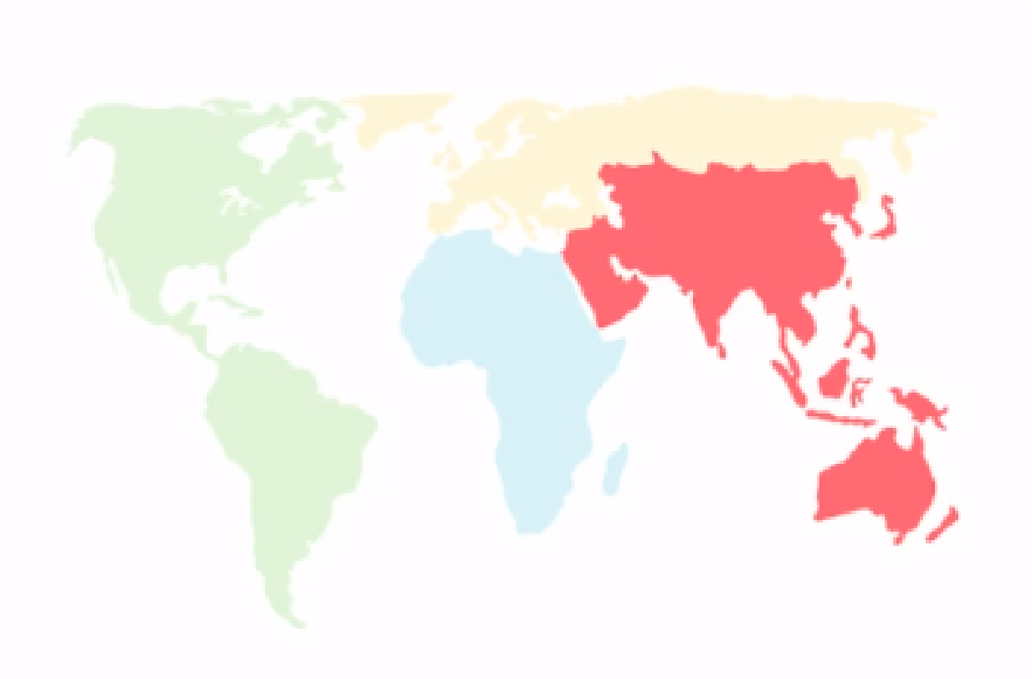
Bubble chart: visualizing all four dimensions in a chart
80
Asia
70
Lifespan
60
50
Income
$500
$5 000
$50 000
Adapted from http://www.gapminder.org/

Slide 22
Bubble chart: visualizing all four dimensions in a chart
80
The size of the bubble represents the country population.
70
Lifespan
60
50
Income
$500
$5 000
$50 000
(2012)
Adapted from http://www.gapminder.org/

Slide 23
Bubble chart: visualizing all four dimensions in a chart
80
70
This is India (~1.2 billion people ).
Lifespan
60
50
Income
$500
$5 000
$50 000
(2012)
Adapted from http://www.gapminder.org/

Slide 24
Bubble chart: visualizing all four dimensions in a chart
And this is USA
(~314 million
people ).
80
70
Lifespan
60
50
Income
$500
$5 000
$50 000
(2012)
Adapted from http://www.gapminder.org/

Slide 25
Bubble chart: visualizing all four dimensions in a chart
Lifespan
80
70
The Income axis represents GDP per capita from $500 all the way to $50 000 per person and year.
60
50
Income
$500
$5 000
$50 000
(2012)
Adapted from http://www.gapminder.org/

Slide 26
Bubble chart: visualizing all four dimensions in a chart
80
The Lifespan axis shows life expectancy in years.
70
Lifespan
60
50
Income
$500
$5 000
$50 000
(2012)
Adapted from http://www.gapminder.org/

Slide 27
Bubble chart: visualizing all four dimensions in a chart
80
There are countries of all levels of income and lifespan.
70
Lifespan
60
50
Income
$500
$5 000
$50 000
(2012)
Adapted from http://www.gapminder.org/

Slide 28
Bubble chart: visualizing all four dimensions in a chart
80
70
Lifespan
These countries have the lowest income and the shortest life expectancy.
60
Income
$500
$5 000
$50 000
(2012)
Adapted from http://www.gapminder.org/

Slide 29
Bubble chart: visualizing all four dimensions in a chart
80
70
These countries have the highest income and the longest life expectancy.
Lifespan
60
50
Income
$500
$5 000
$50 000
(2012)
Adapted from http://www.gapminder.org/

Slide 30
Data Visualization through Bubble chart
Lifespan
80
74
70
There are no countries here. On this high income, there are no countries with life expectancy below 74.
60
50
Income
$500
$5 000
$50 000
(2012)
Adapted from http://www.gapminder.org/

Slide 31
Data Visualization through Bubble chart
Lifespan
80
There’s no country here. On this low income, there’s no country with life expectancy above 64.
70
64
60
50
Income
$500
$5 000
$50 000
(2012)
Adapted from http://www.gapminder.org/

Slide 32
Data Visualization through Bubble chart
Most people live in middle income countries.
80
70
Lifespan
60
50
Income
$500
$5 000
$50 000
Adapted from http://www.gapminder.org/
(2012)

Slide 33
Bubble chart: visualizing all four dimensions in a chart
80
On the same income level there are huge differences in lifespan from 50 all the way up to 75 years.
70
Lifespan
60
50
Income
$500
$5 000
$50 000
Adapted from http://www.gapminder.org/
(2012)

Slide 34
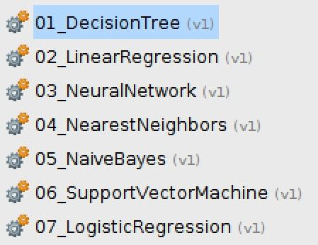
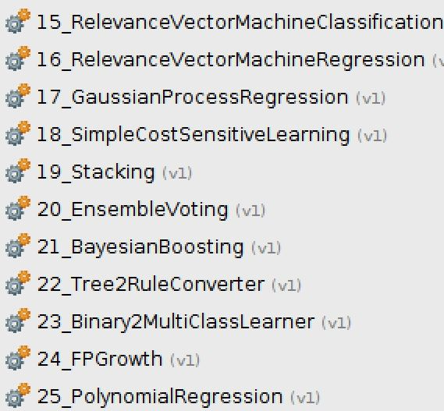
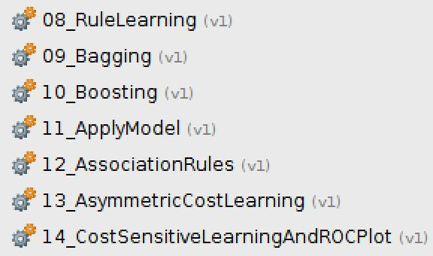
Predictive Analytics
Deep learning
Fuzzy logic
….. (Machine Learning, Artificial Intelligence)

Slide 35

An Example of Predictive Analytics
Would you survive in Titanic ship?

Slide 36
An Example of Predictive Analytics
Would you survive in Titanic ship?
1,503 people total died, including passengers and crew
Here the data that we have show that 349 survivals out of 916 passengers

Slide 37
An Example of Predictive Analytics
Would you survive in Titanic ship?

Slide 38
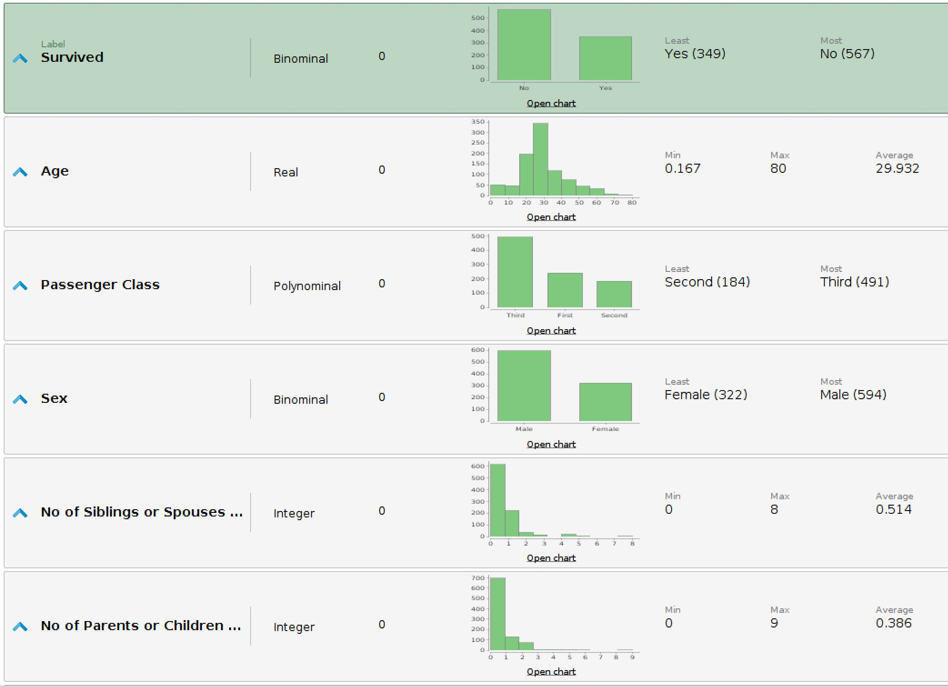

Slide 39
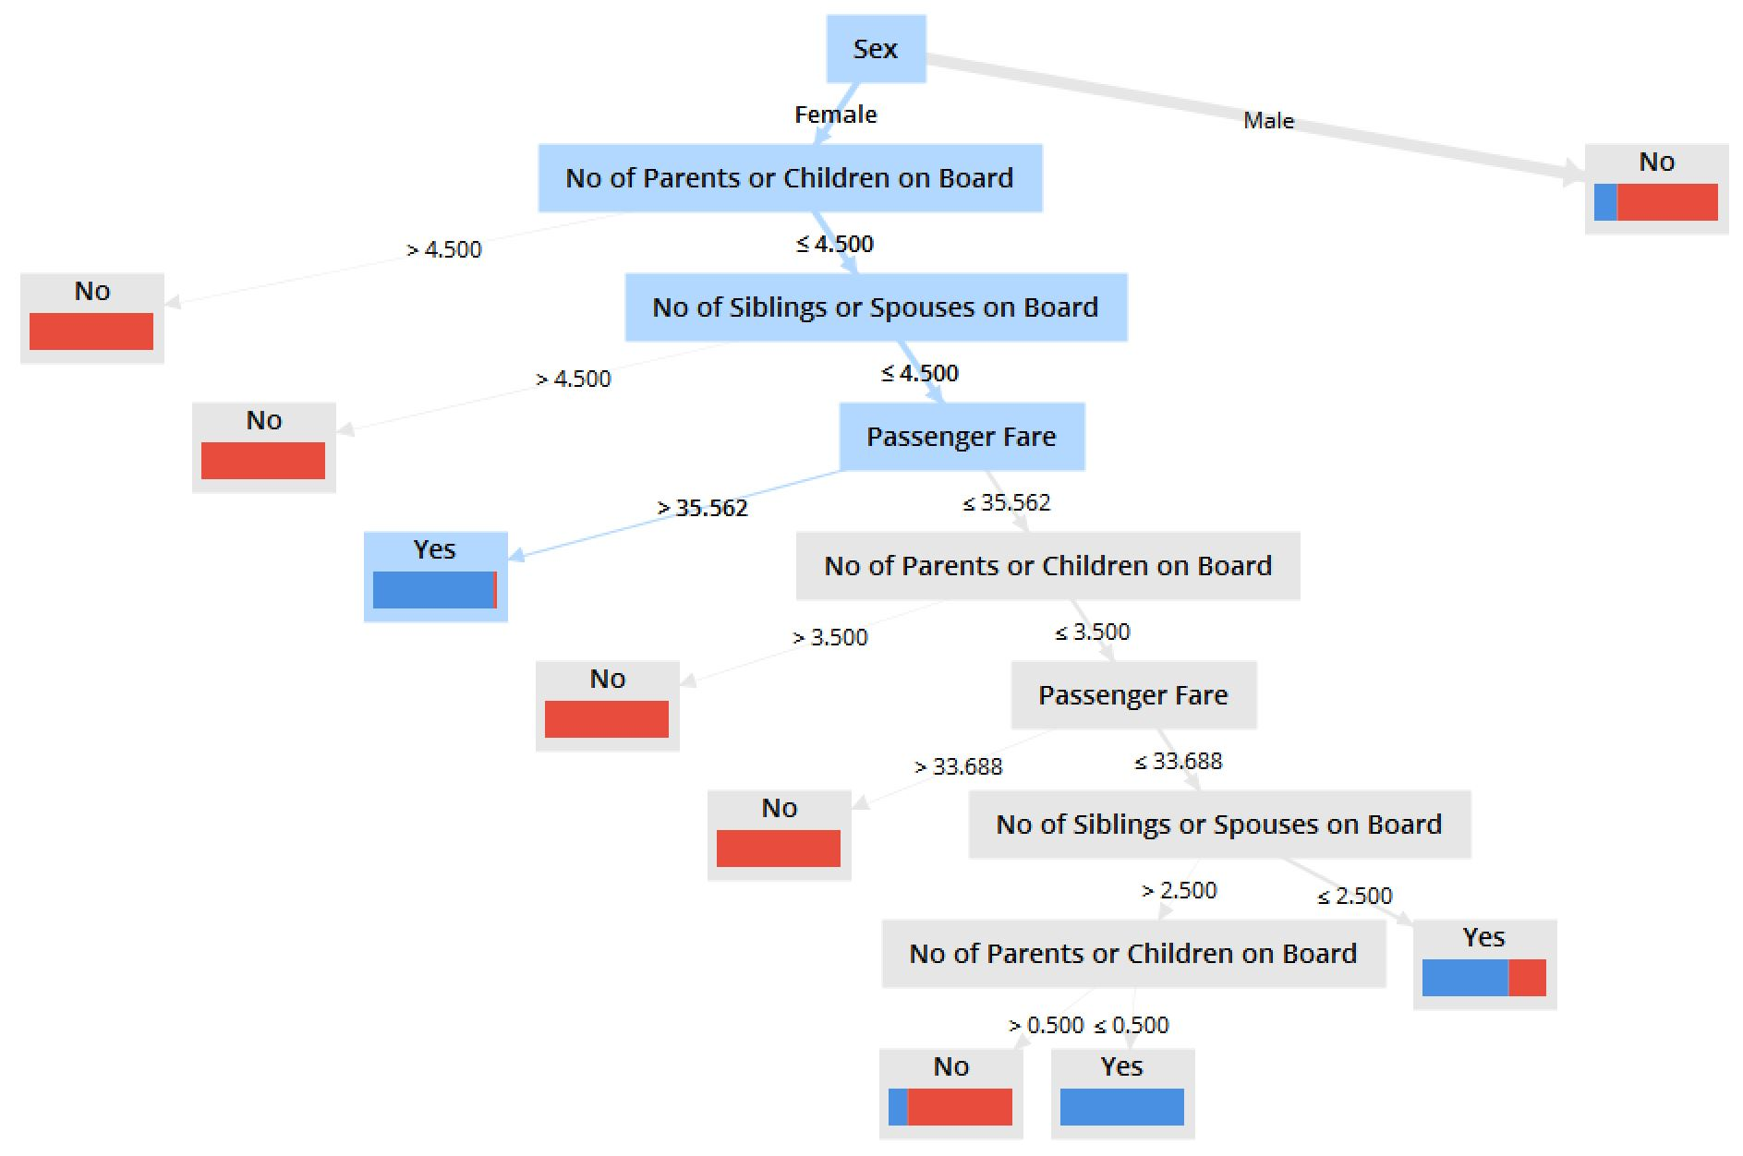
An Example of Predictive Analytics

