Slide 1
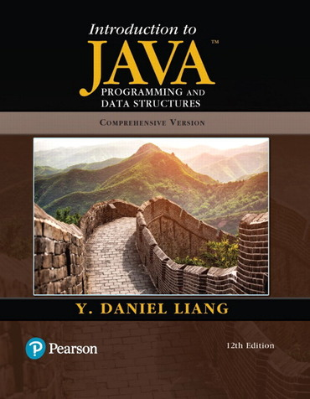

Object-Oriented Programming
1
Week 11 (Lecture-1)
Chapter 9
Objects and Classes
Aneeka Azmat
Lecturer
Zhejiang Normal University
aneekaazmat89@gmail.com
Aneeka Azmat

Slide 2
Todays Agenda
Learning Objectives:
Introduction
Defining Classes for Objects
Constructing Objects Using Constructors
Accessing Objects via Reference Variables
Using Classes from the Java Library
Static Variables, Constants, and Methods
Exercise
Aneeka Azmat

Slide 3
Introduction
Aneeka Azmat

Slide 4
Motivations
In the preceding chapters, you are able to solve many programming problems using
Selections
Loops
Methods
Arrays
However, these Java features are not sufficient for developing graphical user interfaces and large-scale software systems.
Aneeka Azmat

Slide 5
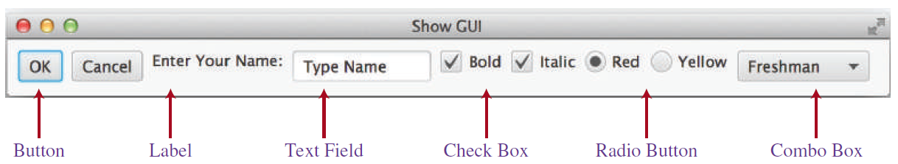
Motivations
Suppose you want to develop a graphical user interface as shown below. How do you program it?
This chapter introduces object-oriented programming, which you can use to develop GUI and large-scale software systems.
Aneeka Azmat

Slide 6
Defining Classes for Objects
Aneeka Azmat

Slide 7




OO Programming Concepts
Object-oriented programming (OOP) involves programming using objects.
An object represents an entity in the real world that can be distinctly identified.
For example,
Student
Desk
Button
Circle
Aneeka Azmat

Slide 8
Objects
An object has a state and behavior.
State
Defines attributes or properties of an object (represented by data field).
For example, a circle object has a data field radius, which is the property that characterizes a circle.
Behavior
Defines what the object does (defined by methods).
For example, you may define methods named getArea() and getPerimeter() for circle objects.
Aneeka Azmat

Slide 9
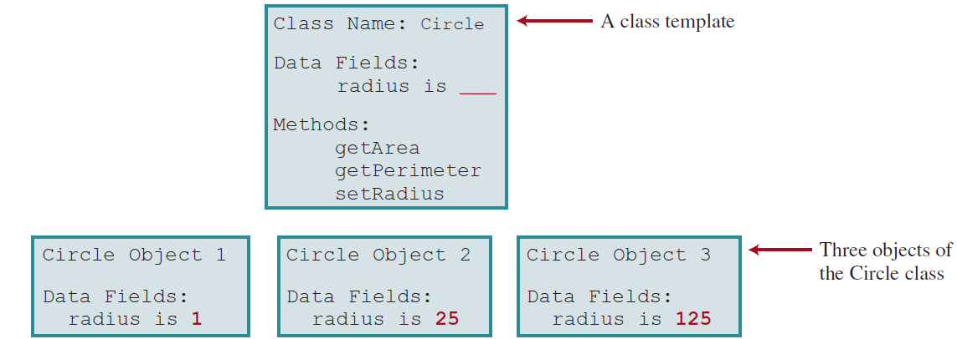
Classes
Objects of the same type are defined using a common class.
For example, a class named Circle and its three objects are shown below.
Aneeka Azmat

Slide 10
Classes
A Java class uses variables to define data fields and methods to define actions.
In addition, a class provides methods of a special type, known as constructors, which are used to create a new object.
Aneeka Azmat

Slide 11
UML Class Diagram
Aneeka Azmat

Slide 12
Example 9.1: Circle Class (Alternative 1)
Example 9.1 is a program that defines the Circle class and uses it to create objects.
The program constructs three circle objects with radius 1, 25, and 125 and displays the radius and area of each of the three circles.
It then changes the radius of the second object to 100 and displays its new radius and area.
Aneeka Azmat

Slide 13
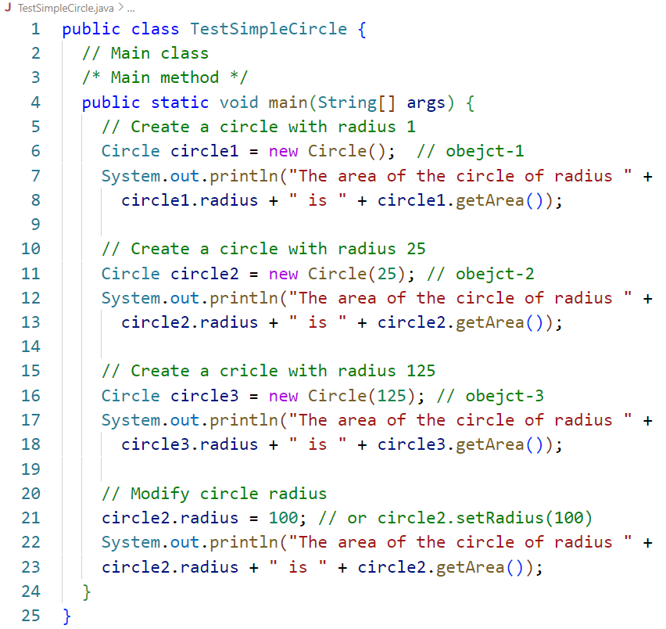
Example 9.1: Circle Class (Alternative 1)
(1 of 2)
Aneeka Azmat

Slide 14
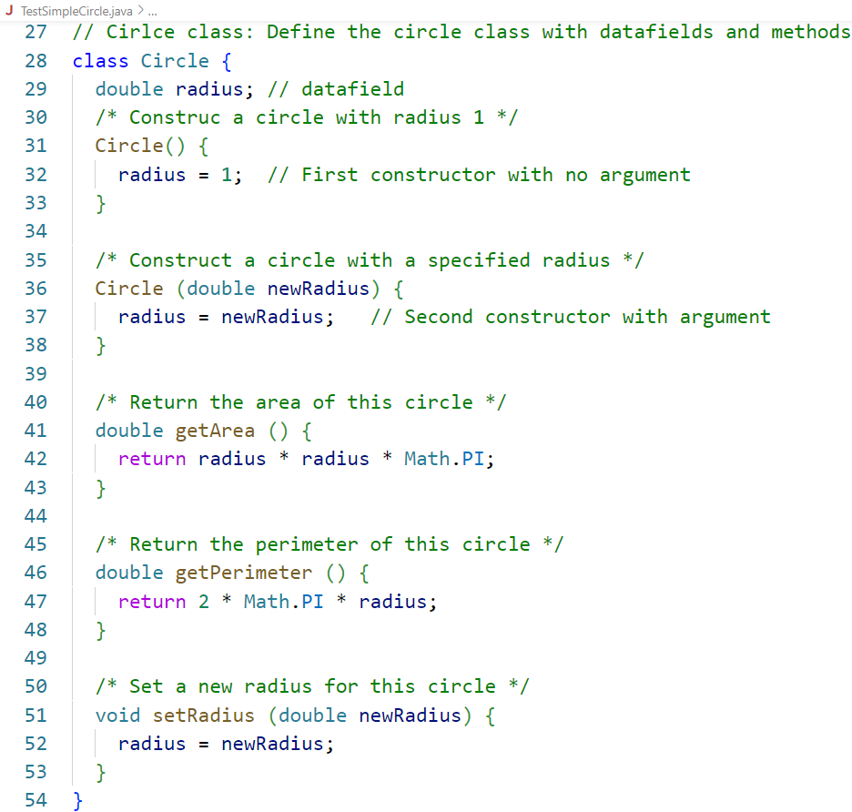
Example 9.1: Circle Class (Alternative 1)
(2 of 2)
Aneeka Azmat

Slide 15
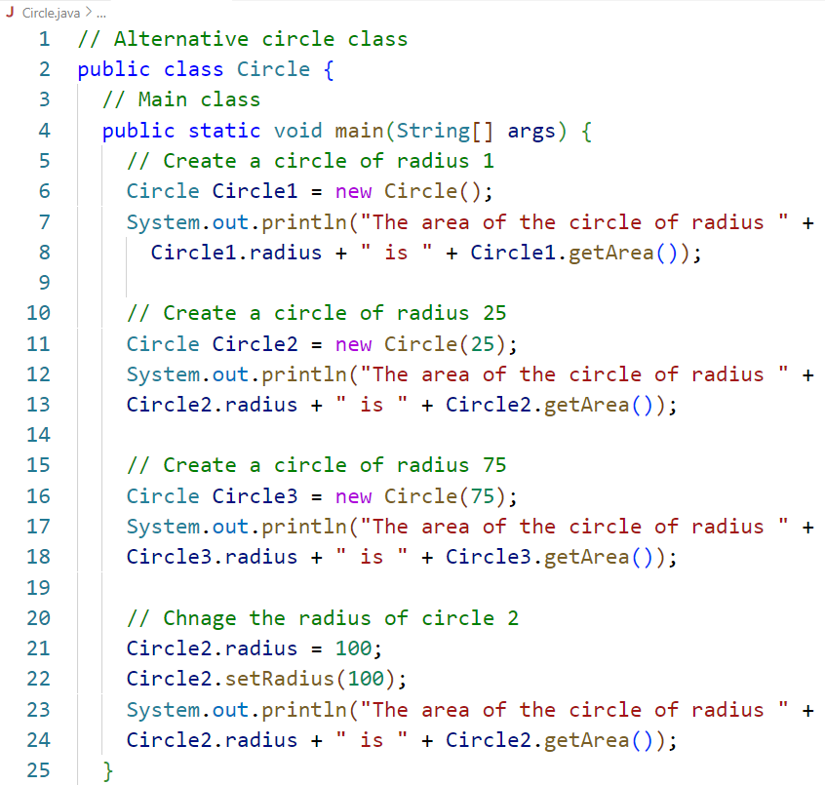
Example 9.2: Circle Class (Alternative 2)
Combine two classes in Example 9.1 into one class
(1 of 2)
Aneeka Azmat

Slide 16
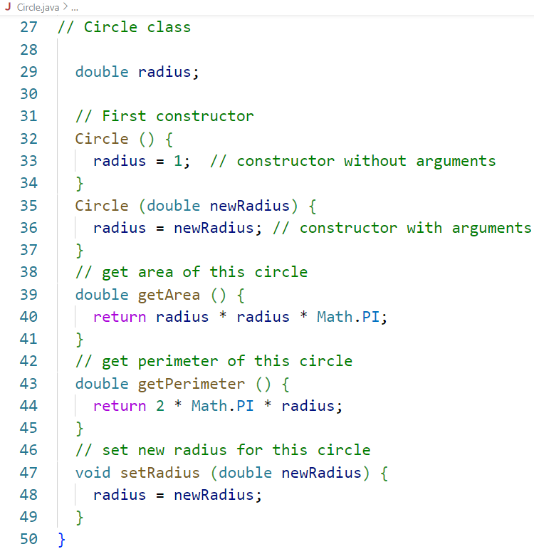
Example 9.2: Circle Class (Alternative 2)
(2 of 2)
Aneeka Azmat

Slide 17
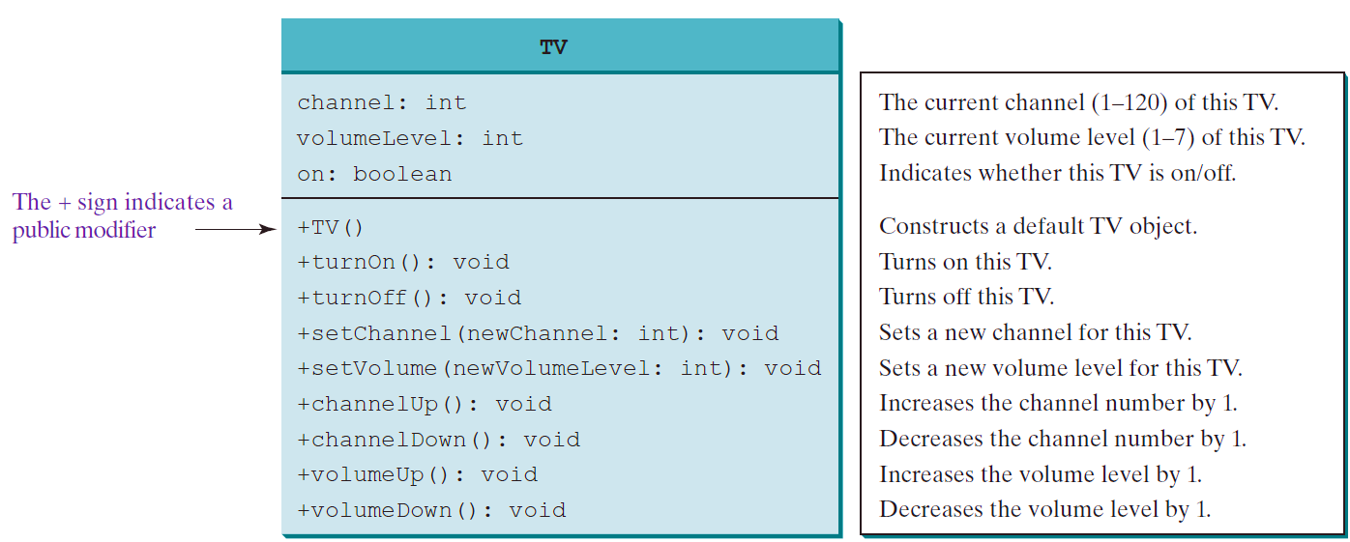
Example 9.3: Television Sets (Alternative 3)
Each TV is an object with states (current channel, current volume level, and power on or off) and behaviors (change channels, adjust volume, and turn on/off).
The UML diagram for the TV class
Aneeka Azmat

Slide 18
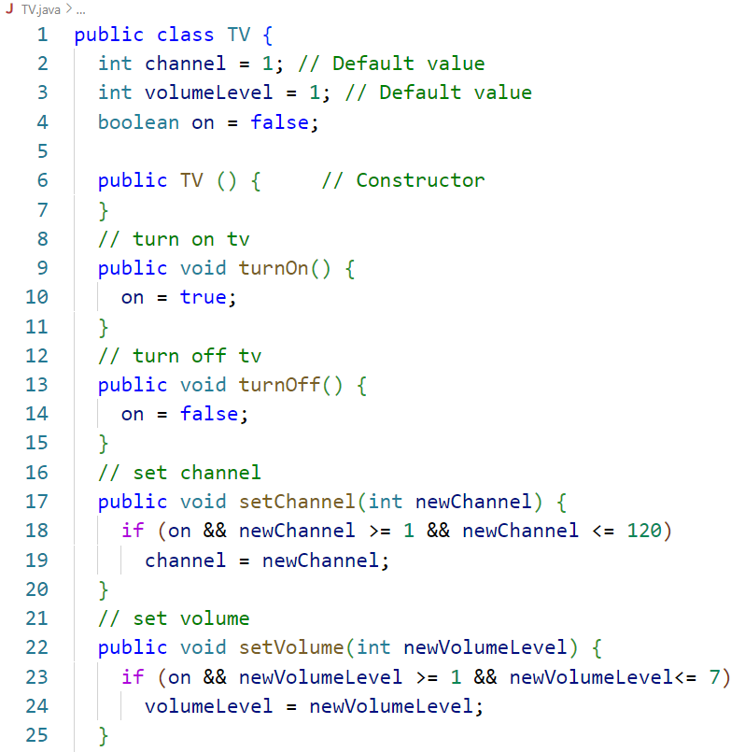
Example 9.3: Television Sets (Alternative 3)
(1 of 2)
Aneeka Azmat

Slide 19
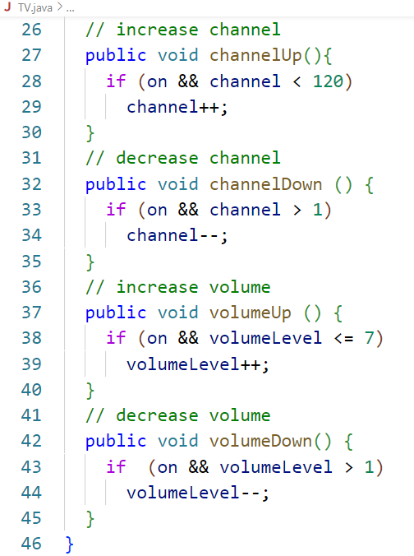
Example 9.3: Television Sets (Alternative 3)
(2 of 2)
Aneeka Azmat

Slide 20
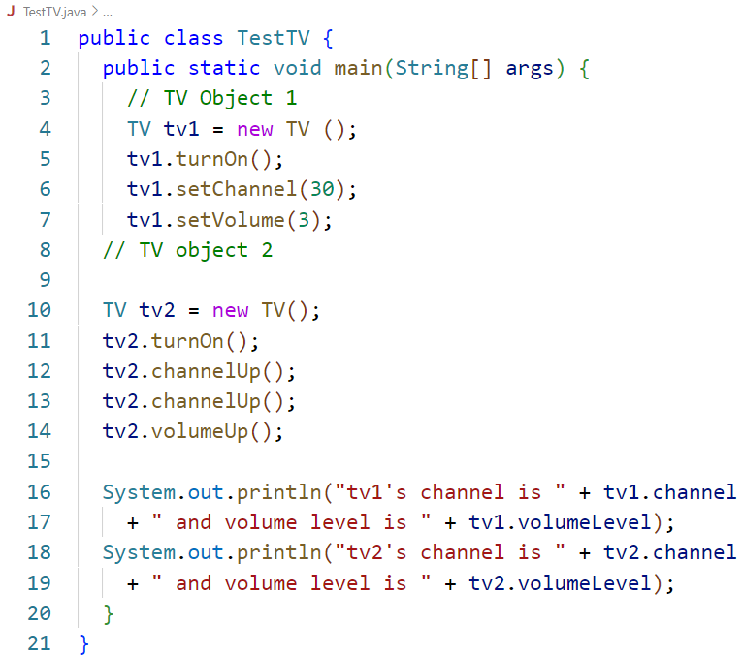
Example 9.3: Television Sets (Alternative 3)
Create a separate TestTV class to create two TV objects using TV class.
Aneeka Azmat

Slide 21
Constructing Objects Using Constructors
Aneeka Azmat

Slide 22
Constructors
Constructors are a special kind of methods that are invoked to construct objects.
Circle() {
}
Circle(double newRadius) {
radius = newRadius;
}
Example:
new Circle();
new Circle(5.0);
Aneeka Azmat

Slide 23
Constructors
A constructor with no parameters is referred to as a no-arg constructor.
Constructors must have the same name as the class itself.
Constructors do not have a return type—not even void.
Constructors are invoked using the new operator when an object is created.
Aneeka Azmat

Slide 24
Default Constructor
A class may be defined without constructors.
In this case, a no-arg constructor with an empty body is implicitly defined in the class.
This constructor, called a default constructor, is provided automatically only if no constructors are explicitly defined in the class.
Aneeka Azmat

Slide 25
Declaring/Creating Objects in a Single Step
You can declare and create an object of a class using the following syntax:
ClassName objectRefVar = new ClassName();
Example:
Circle myCircle = new Circle();
Aneeka Azmat

Slide 26
Accessing Objects via Reference Variables
Aneeka Azmat

Slide 27
Accessing Object’s Data and Methods
Referencing the object’s data:
Referencing the object’s data:
objectRefVar.data
myCircle.radius
objectRefVar.methodName(arguments)
myCircle.getArea()
Aneeka Azmat

Slide 28
Trace Code
Declare myCircle
Circle myCircle = new Circle(5.0);
Circle yourCircle = new Circle();
yourCircle.radius = 100;
myCircle
no value
Aneeka Azmat

Slide 29
Trace Code
Circle myCircle = new Circle(5.0);
Circle yourCircle = new Circle();
yourCircle.radius = 100;
myCircle
no value
Create a circle
Aneeka Azmat

Slide 30
Trace Code
Circle myCircle = new Circle(5.0);
Circle yourCircle = new Circle();
yourCircle.radius = 100;
myCircle
reference value
Assign object reference to myCircle
Aneeka Azmat

Slide 31
Trace Code
Circle myCircle = new Circle(5.0);
Circle yourCircle = new Circle();
yourCircle.radius = 100;
myCircle
reference value
yourCircle
no value
Declare yourCircle
Aneeka Azmat

Slide 32
Trace Code
Circle myCircle = new Circle(5.0);
Circle yourCircle = new Circle();
yourCircle.radius = 100;
myCircle
reference value
yourCircle
no value
Create a new Circle object
Aneeka Azmat

Slide 33
Trace Code
Circle myCircle = new Circle(5.0);
Circle yourCircle = new Circle();
yourCircle.radius = 100;
myCircle
reference value
yourCircle
reference value
Assign object reference to yourCircle
Aneeka Azmat

Slide 34
Trace Code
Circle myCircle = new Circle(5.0);
Circle yourCircle = new Circle();
yourCircle.radius = 100;
myCircle
reference value
yourCircle
reference value
Change radius in yourCircle
Aneeka Azmat

Slide 35
Caution
Recall that you use
to invoke a method in the Math class. Can you invoke getArea() using SimpleCircle.getArea()? The answer is no. All the methods used before this chapter are static methods, which are defined using the static keyword. However, getArea() is non-static. It must be invoked from an object using
Math.methodName(arguments)
(e.g., Math.pow(3, 2.5))
objectRefVar.methodName(arguments)
(e.g., myCircle.getArea()).
Aneeka Azmat

Slide 36
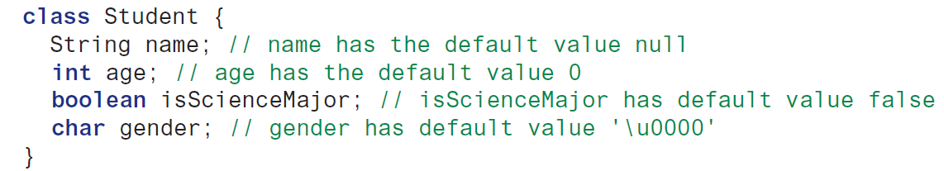
Reference Data Fields and The Null Value
The data fields can be of reference types. For example, the following Student class contains a data field name of the String type.
If a data field of a reference type does not reference any object, the data field holds a special literal value, null.
Aneeka Azmat

Slide 37
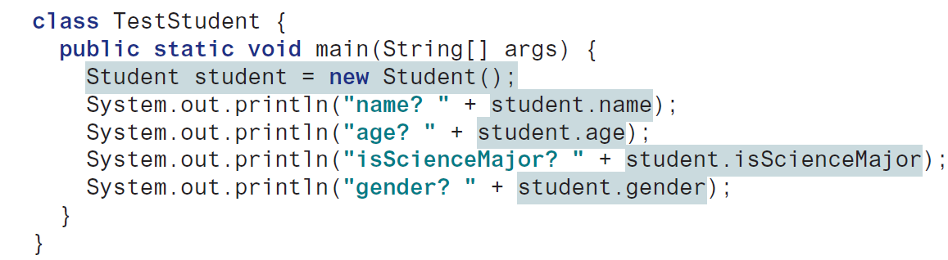
Reference Data Fields and The Null Value
The default value of a data field is null for a reference type.
0 for a numeric type, false for a boolean type, and '\u0000' for a char type.
However, Java assigns no default value to a local variable inside a method.
Aneeka Azmat

Slide 38
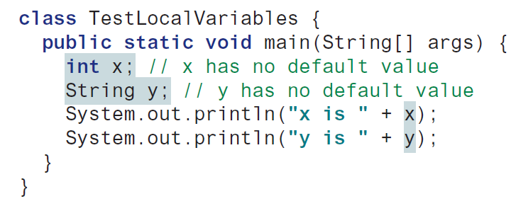
Reference Data Fields and The Null Value
Java assigns no default value to a local variable inside a method.
Aneeka Azmat

Slide 39
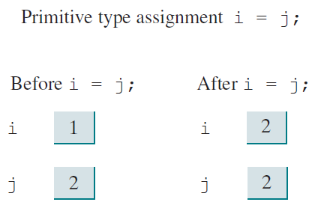
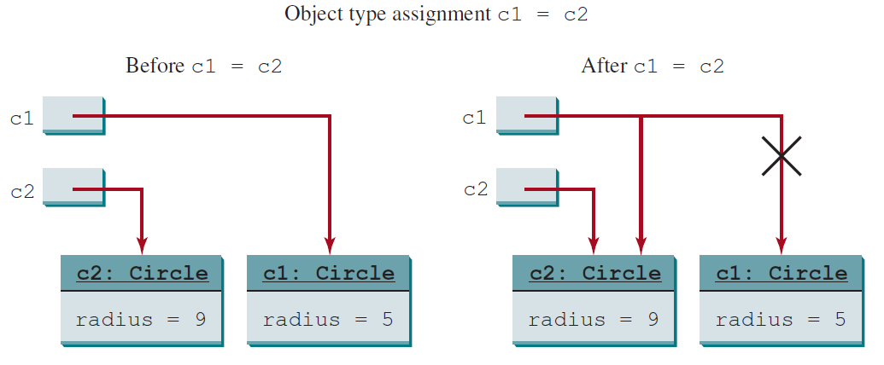
Differences between Variables of Primitive Data Types and Object Types
Aneeka Azmat

Slide 40
Using Classes from the Java Library
Aneeka Azmat

Slide 41
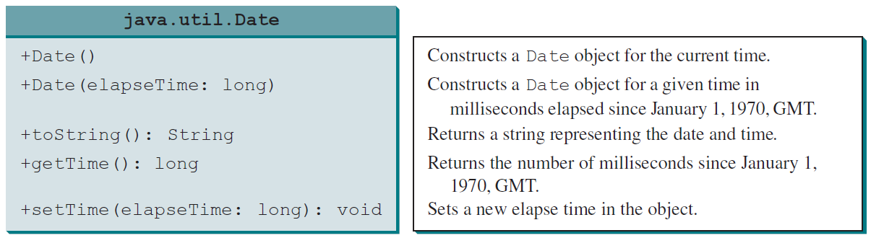
The Date Class
Java provides a system-independent encapsulation of date and time in the java.util.Date class.
You can use the Date class to create an instance for the current date and time and use its toString method to return the date and time as a string.
Aneeka Azmat

Slide 42
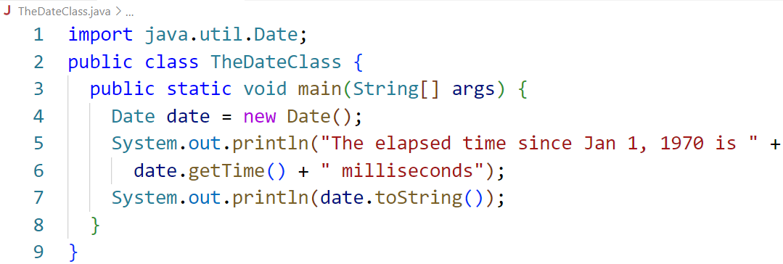
The Date Class (Example 9.4)
Aneeka Azmat

Slide 43
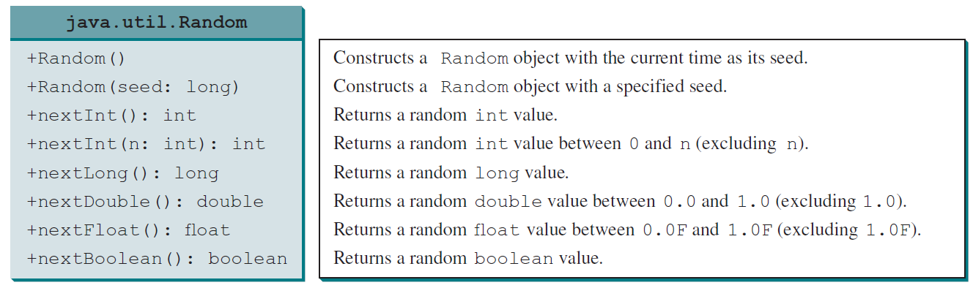
The Random Class
You have used Math.random() to obtain a random double value between 0.0 and 1.0 (excluding 1.0).
A more useful random number generator is provided in the java.util.Random class.
Aneeka Azmat

Slide 44
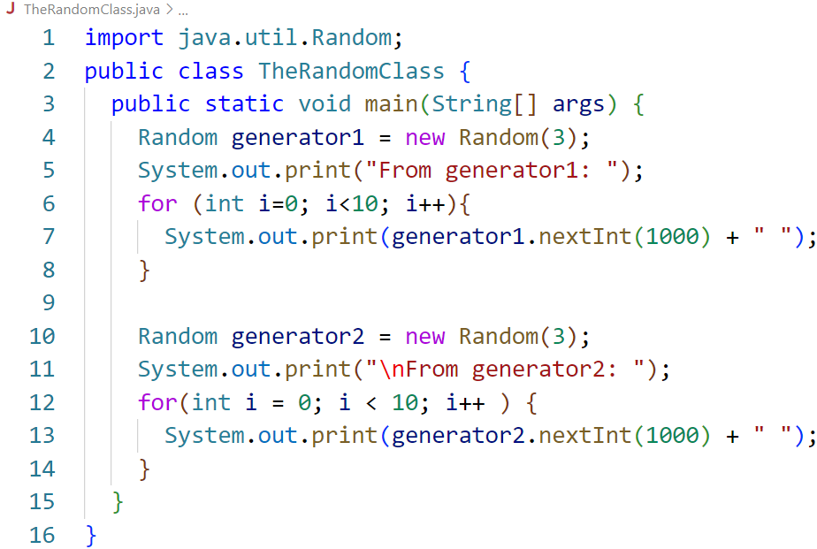
The Random Class (Example 9.5)
If two Random objects have the same seed, they will generate identical sequences of numbers. For example, the following code creates two Random objects with the same seed 3.
Aneeka Azmat

Slide 45
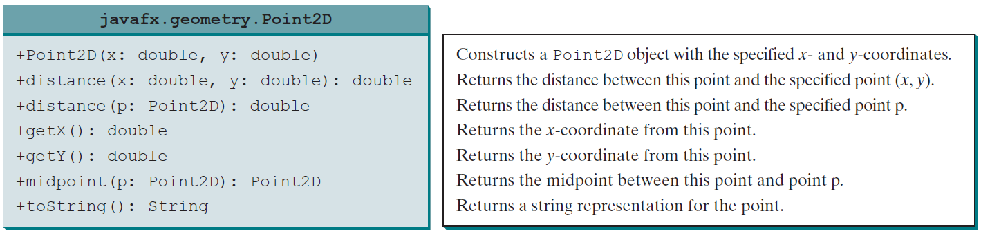
The Point2D Class
Java API has a convenient Point2D class in the javafx.geometry package for representing a point in a two-dimensional plane.
Aneeka Azmat

Slide 46
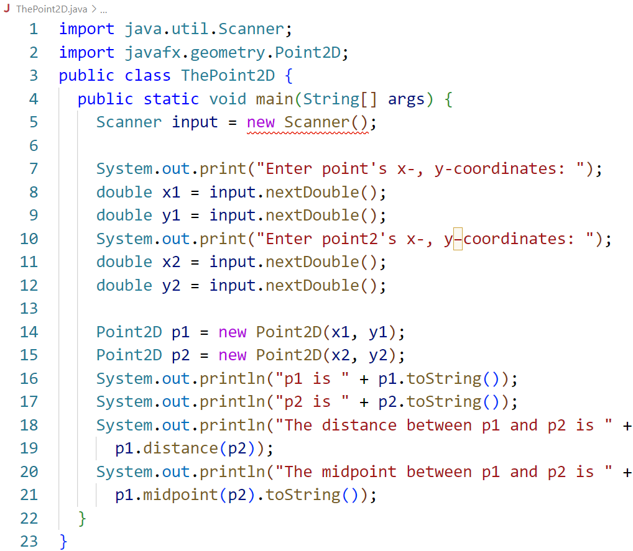
The Point2D Class (Example 9.6)
Aneeka Azmat

Slide 47
Static Variables, Constants, and Methods
Aneeka Azmat

Slide 48

Instance Variables and Methods
An instance variable is tied to a specific instance of the class; it is not shared among objects of the same class.
For example, suppose that you create the following objects:
The radius in circle1 is independent of the radius in circle2 and is stored in a different memory location.
Changes made to circle1’s radius do not affect circle2’s radius, and vice versa.
Aneeka Azmat

Slide 49
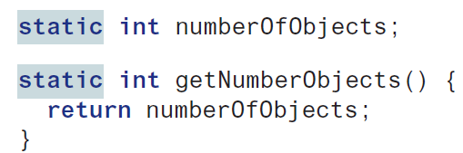
Static Variables, Constants, and Methods
Static variables are shared by all the instances of the class.
Static methods are not tied to a specific object.
Static constants are final variables shared by all the instances of the class.
For declaration, put the modifier static in the variable or method declaration.
Aneeka Azmat

Slide 50
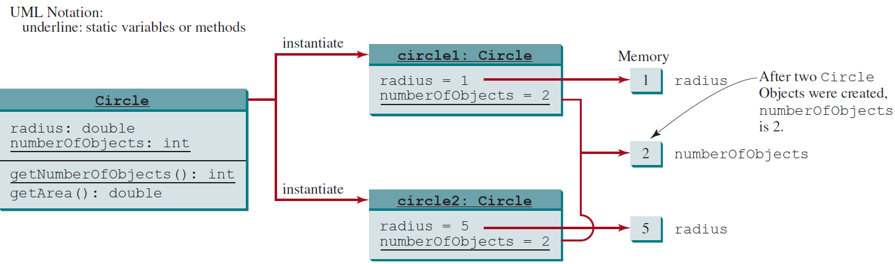
Static Variables, Constants, and Methods
Circle class is modified by adding a static variable numberOfObjects to count the number of circle objects created.
The new circle class is defined in Example 9.7.
Aneeka Azmat

Slide 51
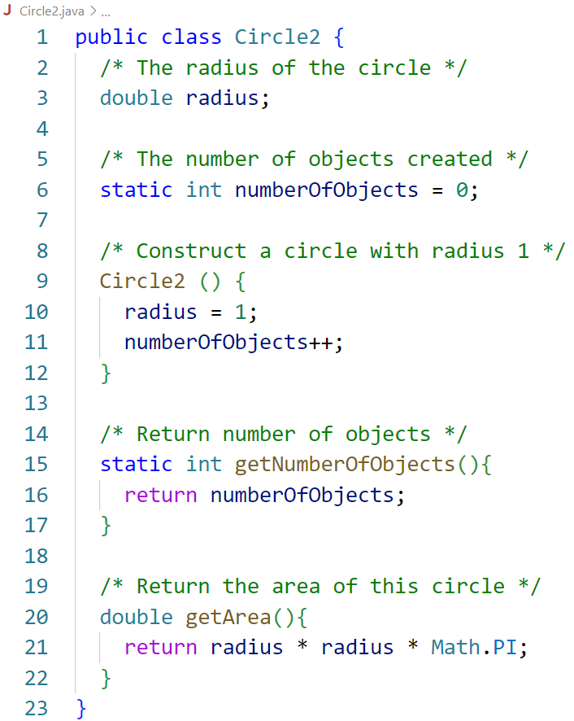
Static Variables, Constants, and Methods
(Example 9.7)
Aneeka Azmat

Slide 52
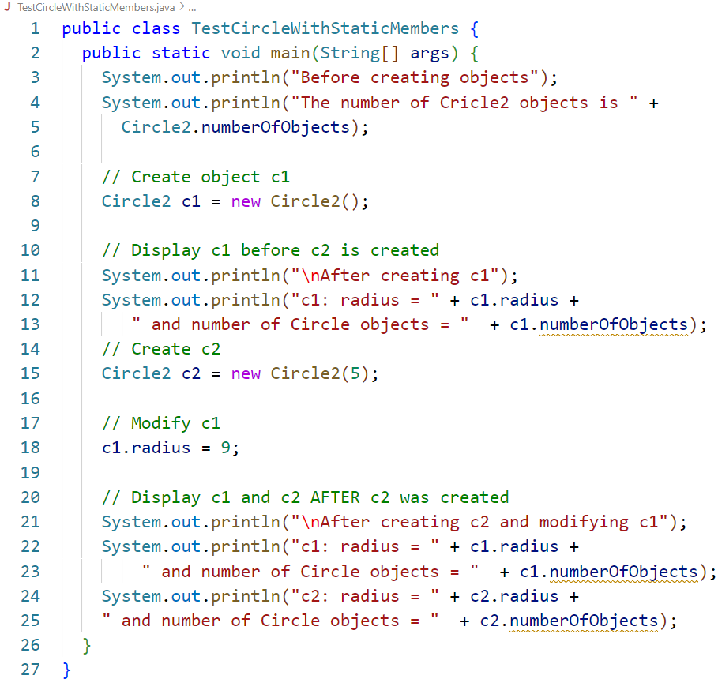
Static Variables, Constants, and Methods
(Example 9.7)
Aneeka Azmat

Slide 53
Exercises
Aneeka Azmat

Slide 54
Exercise 9.1
(The Rectangle class) Following the example of the Circle class, design a class named Rectangle to represent a rectangle. The class contains:
Two double data fields named width and height that specify the width and height of the rectangle. The default values are 1 for both width and height.
A no-arg constructor that creates a default rectangle.
A constructor that creates a rectangle with the specified width and height.
A method named getArea() that returns the area of this rectangle.
A method named getPerimeter() that returns the perimeter.
Aneeka Azmat

Slide 55
Exercise 9.1
Draw the UML diagram for the class then implement the class.
Write a test program that creates two Rectangle objects—one with width 4 and height 40, and the other with width 3.5 and height 35.9.
Display the width, height, area, and perimeter of each rectangle in this order.
Aneeka Azmat

Slide 56
Exercise 9.2
(The Stock class) Following the example of the Circle class, design a class named Stock that contains:
A string data field named symbol for the stock’s symbol.
A string data field named name for the stock’s name.
A double data field named previousClosingPrice that stores the stock price for the previous day.
A double data field named currentPrice that stores the stock price for the current time.
A constructor that creates a stock with the specified symbol and name.
A method named getChangePercent() that returns the percentage changed from previousClosingPrice to currentPrice.
Aneeka Azmat

Slide 57
Exercise 9.2
Draw the UML diagram for the class then implement the class.
Write a test program that creates a Stock object with the stock symbol ORCL, the name Oracle Corporation, and the previous closing price of 34.5.
Set a new current price to 34.35 and display the price-change percentage.
Aneeka Azmat

