Slide 1
MDP 第二部分

Slide 2
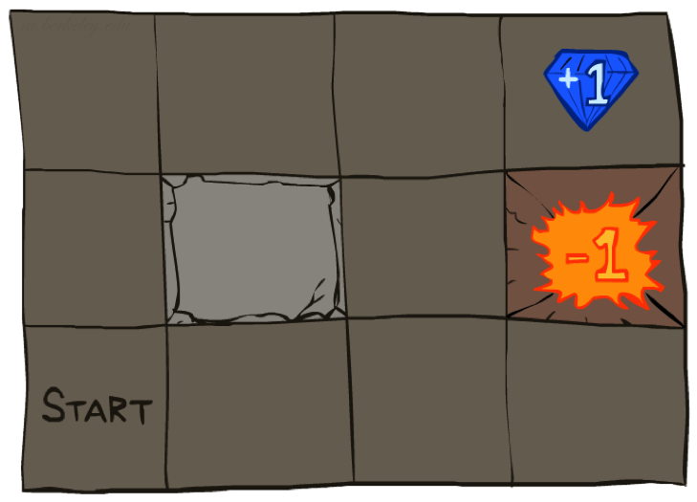




Example: Grid World
A maze-like problem
The agent lives in a grid
Walls block the agent’s path
Noisy movement: actions do not always go as planned
80% of the time,
the action North takes the agent North
10% of the time, North takes the agent West; 10% East
If there is a wall in the direction the agent would have been taken, the agent stays put
The agent receives rewards each time step
Small “living” reward each step (can be negative)
Big rewards come at the end (good or bad)
Goal: maximize sum of (discounted) rewards
Notes:
[cut demo of moving around in grid world program]
A MDP example.

Slide 3
Recap: MDPs
Markov decision processes:
States S
Actions A
Transitions P(s’|s,a) (or T(s,a,s’))
Rewards R(s,a,s’) (and discount γ)
Start state s₀
Quantities:
Policy = map of states to actions
Utility = sum of discounted rewards
Values = expected future utility from a state (max node)
Q-Values = expected future utility from a q-state (chance node)
s
a
s, a
s,a,s’
s’
Notes:
Pick the best action, a.

Slide 4
Recap: Optimal Quantities
The value (utility) of a state s:
V*(s) = expected utility starting in s and acting optimally
The value (utility) of a q-state (s,a):
Q*(s,a) = expected utility starting out having taken action a from state s and (thereafter) acting optimally
The optimal policy:
π*(s) = optimal action from state s
s
s is a state
a
(s, a) is a q-state
s, a
s,a,s’
(s,a,s’) is a transition
s’
[Demo: gridworld values (L9D1)]
Notes:
Demo just shows V and Q values, snapshots on next slides.

Slide 5
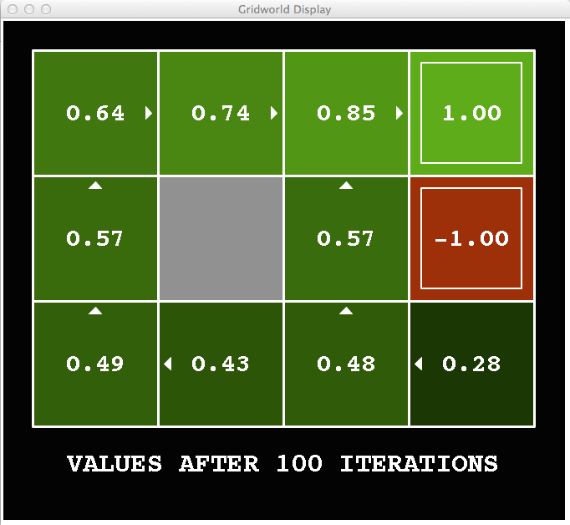
Snapshot of Gridworld - V Values
Noise = 0.2
Discount = 0.9
Living reward = 0
Notes:
Optimal value of state.
Arrows converges much earlier.

Slide 6
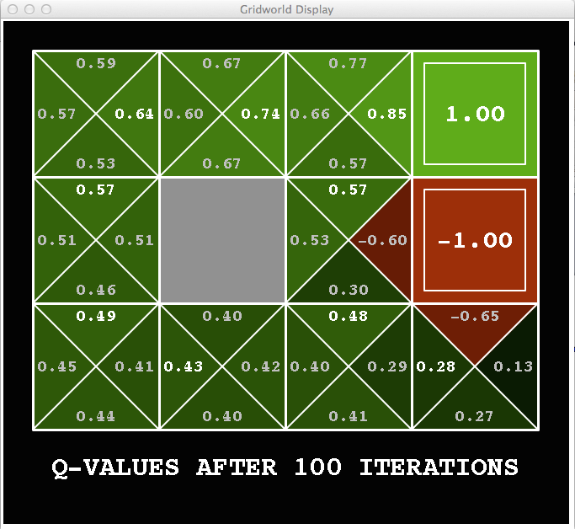
Snapshot of Gridworld - Q Values
Noise = 0.2
Discount = 0.9
Living reward = 0
Notes:
Q-state values.
Q values each state position with four actions (going four directions).
From here we can actually infer the current optimal policy (optimal action for each state at current step).
Optimal policy shown by the arrows.

Slide 7

The Bellman Equations
How to be optimal:
Step 1: Take correct first action
Step 2: Keep being optimal

Slide 8

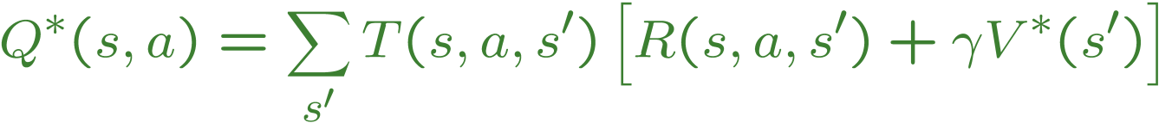
The Bellman Equations
Definition of “optimal utility” via expectimax recurrence gives a simple one-step lookahead relationship amongst optimal utility values
These are the Bellman equations, and they characterize optimal values in a way we’ll use over and over
s
a
s, a
s,a,s’
s’
Notes:
One-step lookahead refers to the third equation.
Let’s start by equations that characterize these quantities through mutual recursions. [step through this by writing on slide, one step at a time]
Recursive characterization of V* in terms of V*; not necessarily helpful; but it is a characterization.
Note: this is a set of equations that needs to be satisfied; but it could have multiple solutions (it does not, but at this stage of our knowledge it could).

Slide 9
Recap: Value Iteration (值迭代)
Bellman equations characterize the optimal values:
Value iteration computes them:
Value iteration is just a fixed point solution method
… though the V_{k} vectors are also interpretable as time-limited values
V(s)
a
s, a
s,a,s’
V(s’)
Notes:
Discuss computational complexity: S * A * S times number of iterations
Note: updates not in place [if in place, it means something else and not even clear what it means]

Slide 10
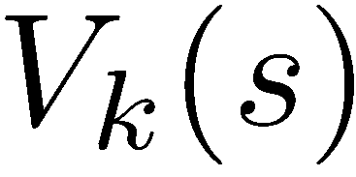
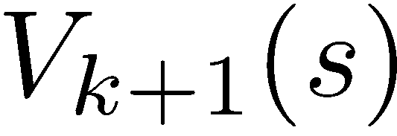
Convergence* （收敛）
How do we know the V_{k} vectors are going to converge?
Case 1: If the tree has maximum depth M, then V_{M} holds the actual untruncated values
Case 2: If the discount is less than 1
Sketch: For any state V_{k} and V_{k+1} can be viewed as depth k+1 expectimax results in nearly identical search trees
The difference is that on the bottom layer, V_{k+1} has actual rewards while V_{k} has zeros
That last layer is at best all R_{MAX}
It is at worst R_{MIN}
But everything is discounted by γ^{k} that far out
So V_{k} and V_{k+1} are at most γ^{k} max|R| different
So as k increases, the values converge

Slide 11
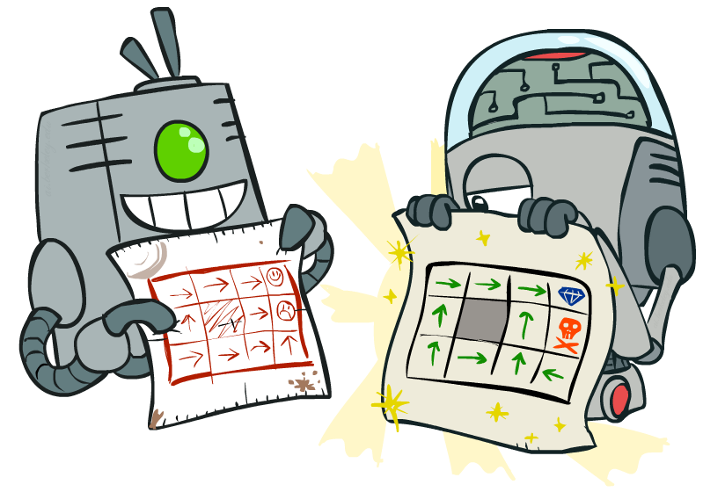
基于策略的求解MDP方法 Policy Methods
Notes:
Value iteration can be very slow.
If gamma = 1, V values can’t converge.

Slide 12
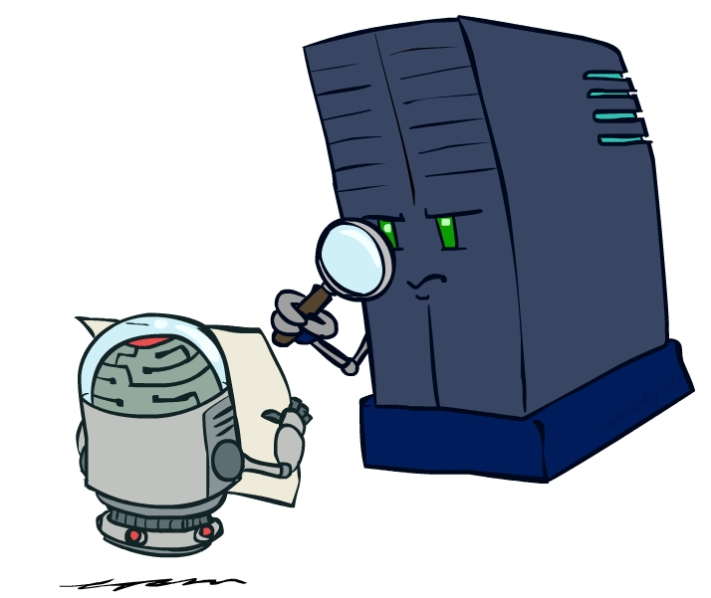
策略评价
Notes:
Given a policy, evaluate how good the policy is.

Slide 13
固定的策略
采取最优行动
按照策略 π 选择行动
s
s
a
π(s)
s, a
s, π(s)
s,a,s’
s, π(s),s’
s’
s’
期望最大值搜索树在所有行动分支里选择最大功效值
如果使用一个给定的策略 π(s), 那么这个搜索树变得比以前要简单 – 每个状态节点只有一个分支
… 所以搜索树的状态节点值的计算将取决于我们所固定（使用）的那个策略

Slide 14
用来评价一个固定的策略的功效值
当给定一个策略（通常不是最优的）时，如何计算一个状态 s 的功效值
给定策略 π 下，定义一个状态 s 的功效值为:
V^{π}(s) = 从状态 s 开始，按照策略 π 执行，所获得的期望折扣奖赏值的总计
迭代关系 (基于 Bellman 公式的一步计算):
s
π(s)
s, π(s)
s, π(s),s’
s’
Notes:
The bigger V values, the better policy is.
Linear equations to solve the V(s).

Slide 15
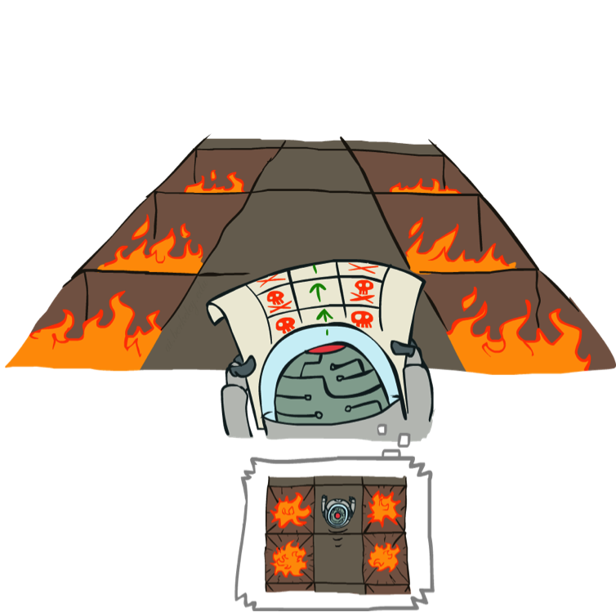
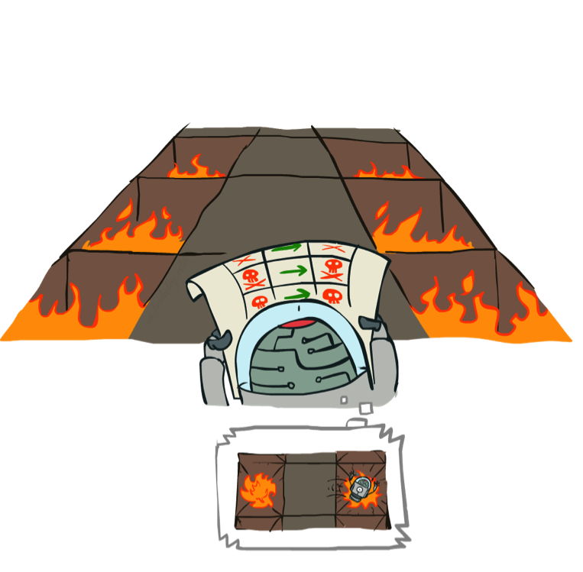
举例: 策略评价
Always Go Right
Always Go Forward

Slide 16
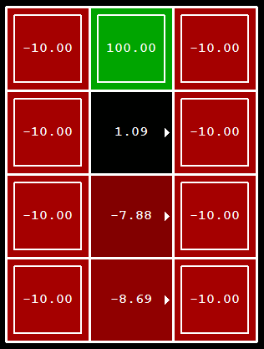
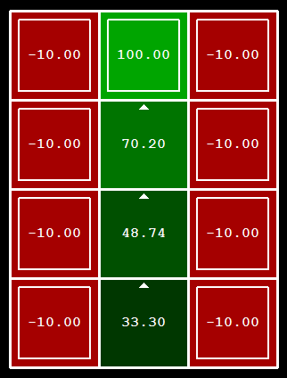
举例: 策略评价
Always Go Right
Always Go Forward
Notes:
Don’t worry about the numbers (how to calculate them) right now.
You can think of the policies as something you can search of.

Slide 17

策略评价
给定一个策略π，如何计算 V-值?
思路 1: 基于 Bellman 方程的赋值迭代更新
效率: O(S²) 每步迭代
思路 2: 由于没有了“最大符号”, Bellman 方程变为了 一个线性系统
s
π(s)
s, π(s)
s, π(s),s’
s’
Notes:
Just like a value iteration without the max symbol.
思路 2: 由于没有了“最大符号”, Bellman 方程变为了 一个线性系统
Solve with Matlab (or your favorite linear system solver)

Slide 18
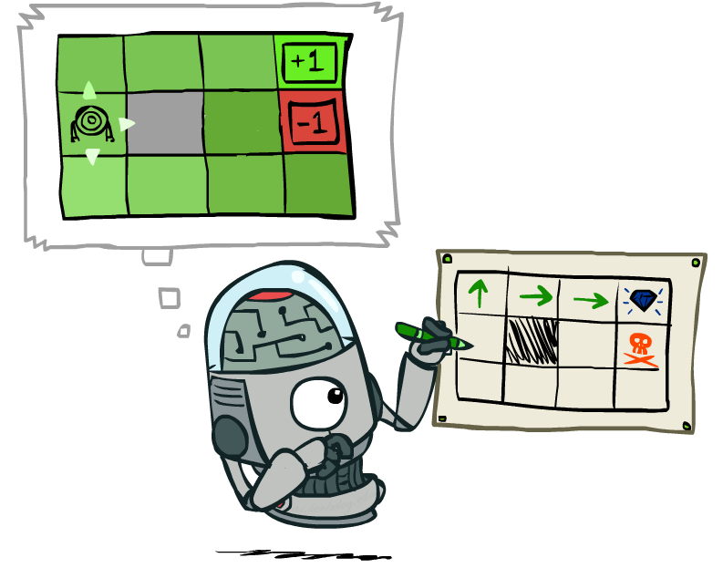
策略提取 Policy Extraction

Slide 19
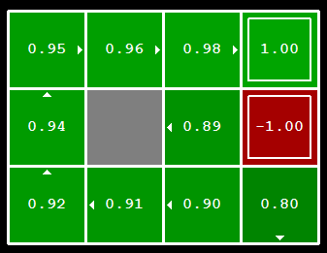

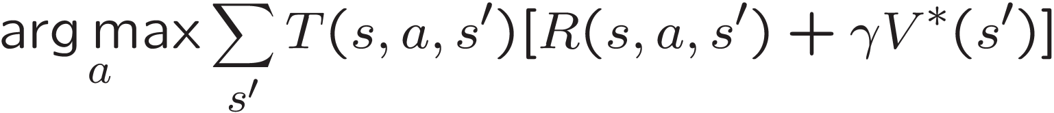
从状态值计算行动
假设我们已有了每个状态的最优值 V*(s)
那么我们如何选择行动?
不是很明显!
需要计算一步长的 mini-expectimax：
这叫做 策略提取, 通过计算期望最大值，间接地获得最优行动选择

Slide 20
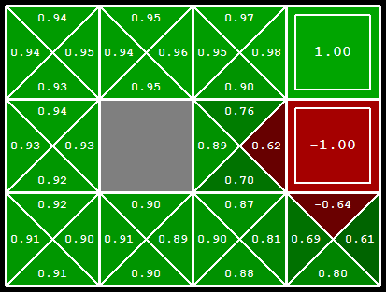
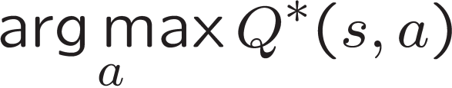
从Q-值计算行动
假设我们已有了最优的 q-values:
现在我们如何挑选行动?
此时变得很简单!
因此: 为每个状态位置选择最优行动从Q-值中比在状态值中更容易!

Slide 21
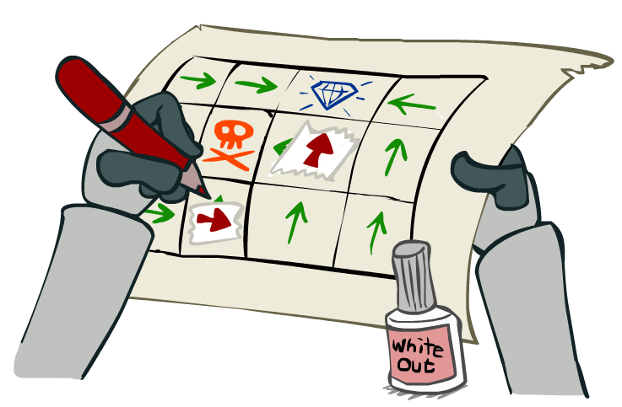
策略迭代法 Policy Iteration

Slide 22
状态赋值迭代方法的缺点
赋值迭代实现的是基于 Bellman 方程的更新公式：
问题 1: 很慢 –每次迭代的复杂度是 O(S²A)
问题 2: 在每个位置（状态）的 “最大”选项很少改变
问题 3: 策略 policy 通常比状态值收敛的更快
s
a
s, a
s,a,s’
s’
Notes:
Demo steps through value iteration; snapshots of values shown on next slides.
Policy looks the max (value) for choosing the best action, that “max” changes less than the V-value changes.

Slide 23
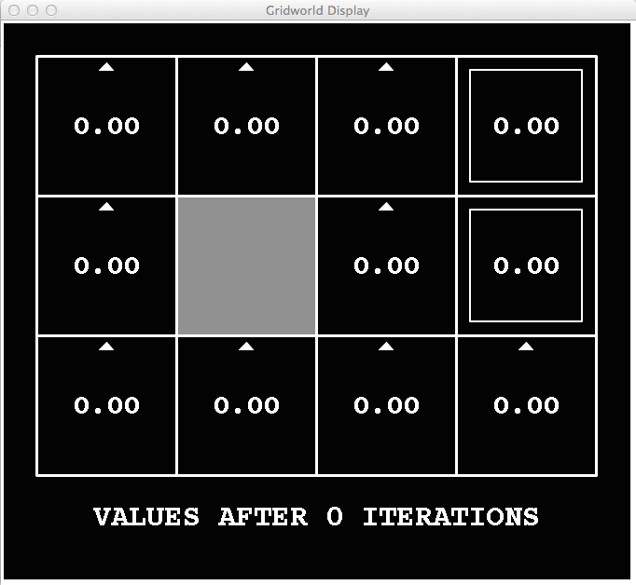
k=0
Noise = 0.2
Discount = 0.9
Living reward = 0
Notes:
Assuming zero living reward

Slide 24
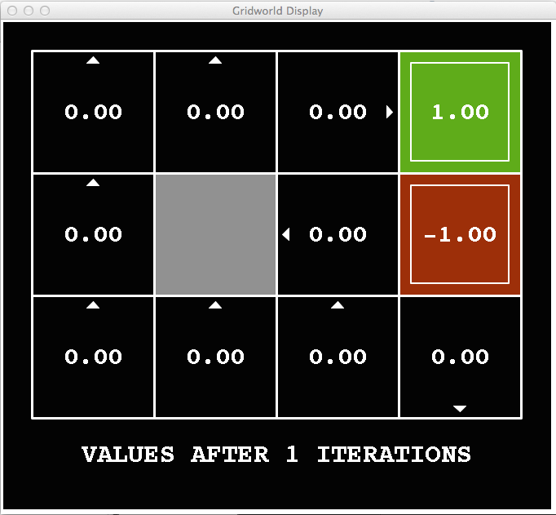
k=1
Noise = 0.2
Discount = 0.9
Living reward = 0
Notes:
Assuming zero living reward

Slide 25
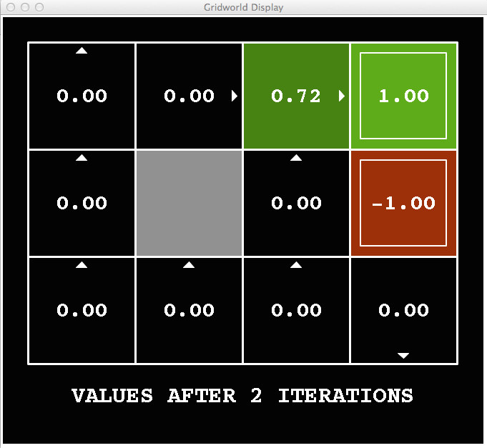
k=2
Noise = 0.2
Discount = 0.9
Living reward = 0
Notes:
Assuming zero living reward

Slide 26
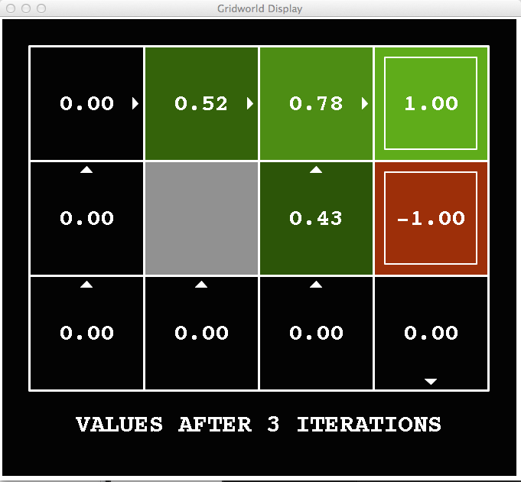
k=3
Noise = 0.2
Discount = 0.9
Living reward = 0
Notes:
Assuming zero living reward

Slide 27
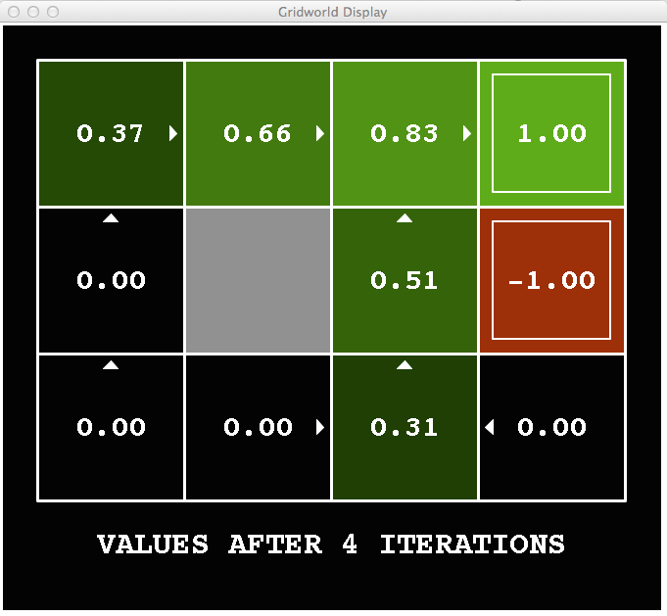
k=4
Noise = 0.2
Discount = 0.9
Living reward = 0
Notes:
Assuming zero living reward

Slide 28
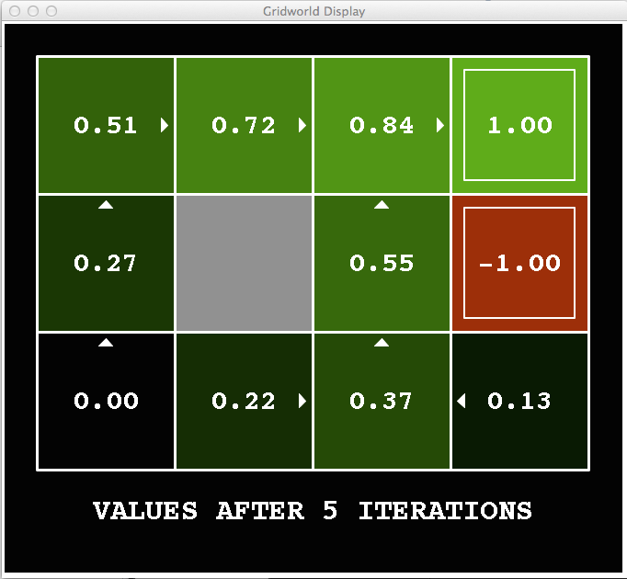
k=5
Noise = 0.2
Discount = 0.9
Living reward = 0
Notes:
Assuming zero living reward

Slide 29
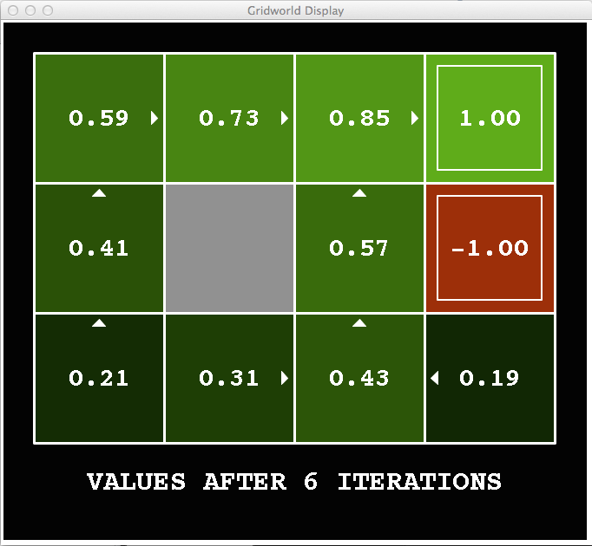
k=6
Noise = 0.2
Discount = 0.9
Living reward = 0
Notes:
Assuming zero living reward

Slide 30
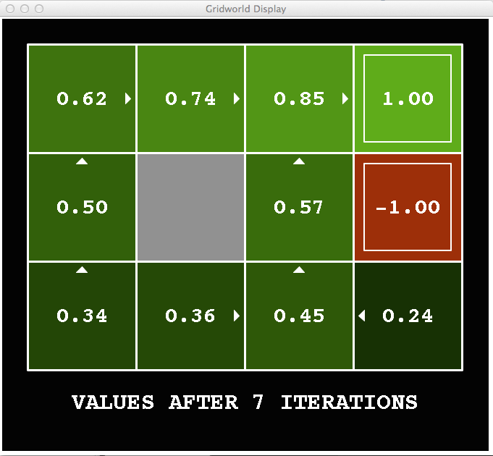
k=7
Noise = 0.2
Discount = 0.9
Living reward = 0
Notes:
Assuming zero living reward

Slide 31
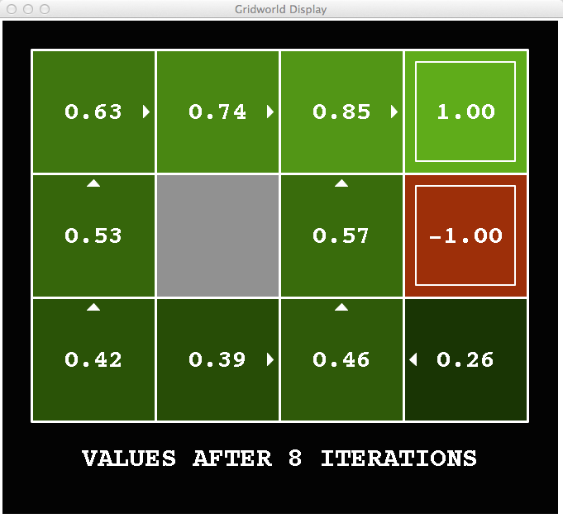
k=8
Noise = 0.2
Discount = 0.9
Living reward = 0
Notes:
Assuming zero living reward

Slide 32
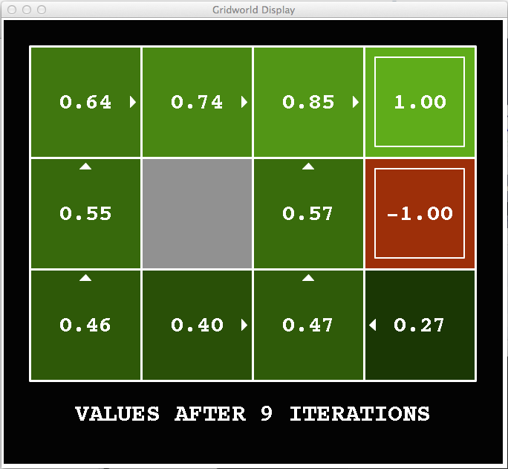
k=9
Noise = 0.2
Discount = 0.9
Living reward = 0
Notes:
Assuming zero living reward

Slide 33

k=10
Noise = 0.2
Discount = 0.9
Living reward = 0
Notes:
Assuming zero living reward

Slide 34

k=11
Noise = 0.2
Discount = 0.9
Living reward = 0
Notes:
Assuming zero living reward

Slide 35

k=12
Noise = 0.2
Discount = 0.9
Living reward = 0
Notes:
Assuming zero living reward

Slide 36

k=100
Noise = 0.2
Discount = 0.9
Living reward = 0
Notes:
Assuming zero living reward

Slide 37
策略迭代法 Policy Iteration
另一种方法求解最优值:
步骤 1: 策略评价: 给定某个固定的行动策略，计算各个状态值 (尽管他们不是代表最优的状态值!) ，迭代计算，直到这个状态值收敛
步骤 2: 策略改进: 更新行动策略，使用向前一步的计算，使用之前迭代计算收敛的 (but not optimal!) 状态值（作为未来的状态值）
重复这两步直到行动策略收敛
Notes:
This is policy iteration
It’s still optimal!
Can converge (much) faster under some conditions

Slide 38
策略迭代法 （Policy iteration）
策略评价: 对于当前的策略 π, 使用策略评价过程计算状态位置的值:
迭代直至V-值收敛
策略改进: 给定计算出来的V-值, 通过策略提取过程，计算获得更好一步的策略
向前 一步的 计算:

Slide 39
比较
状态值迭代和策略迭代方法计算的是同一件事情 (所有状态节点的最优功效值)
在状态赋值迭代里:
每次迭代，更新状态V-值,和策略(隐式地)
没有直接追踪策略, 但是从不同行动分支中获取一个最大值时，实际上隐式地计算了策略
在策略迭代里:
我们在当前固定的策略下，通过几次迭代，更新计算状态的功效值(V-值) (每次迭代很快，因为我们此时只考虑一个行动, 而不是所有的行动分支)
在当前策略评价过程完成以后, 一个新的策略被挑选出来 (这一步较慢，就像状态赋值迭代方法里的一次迭代)
新的策略将会更优化 (否则的话，迭代过程结束)
Both are dynamic programs for solving MDPs

Slide 40
总结: MDP 算法
我们用到的算法：
计算状态节点的最优功效值: 使用状态赋值迭代，或策略迭代方法
给定一个策略，计算状态值: 使用策略评价方法
通过状态值获取一个策略: 使用策略提取方法（向前一步优化）
这些方法看上去都很像!
它们本质上都是基于 Bellman 赋值更新表达式
全都使用了基于期望最大值的向前一步优化计算模块
它们区别只是在于是否固定一个策略，或是在所有行动分支中进行最优挑选（最大化期望功效值的行动）

Slide 41
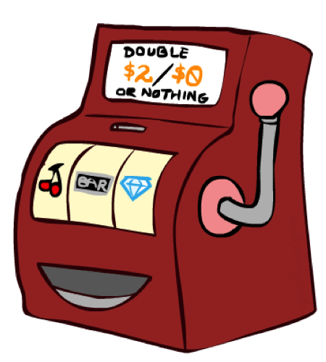
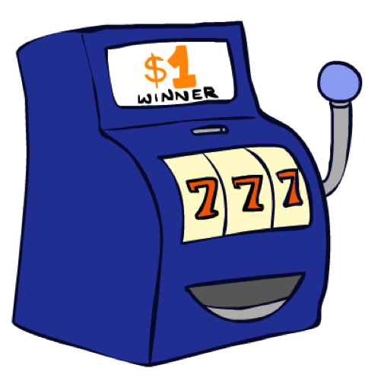

Double Bandits
Notes:
The Blue: it will give you a 1$ every time you pull the lever; The red: it will either give you $0 or $2 ever time you pull the lever.

Slide 42
Double-Bandit MDP
No discount
100 time steps
Both states have the same value
Actions: Blue, Red
States: Win, Lose
0.25 $0
0.75
$2
W
L
0.25
$0
$1
1.0
$1
1.0
0.75 $2
Notes:
What’s the expected values when you play 100 times of blue slot machine, or play 100 times of red slot machine?

Slide 43
Offline Planning
No discount
100 time steps
Both states have the same value
Solving MDPs is offline planning
You determine all quantities through computation
You need to know the details of the MDP
You do not actually play the game!
0.25 $0
Value
0.75
$2
Play Red
W
0.25
$0
150
L
$1
1.0
$1
1.0
Play Blue
0.75 $2
100
Notes:
If MDP structure (model) is known (all parameters are known), then we can do offline computation, and choose the best action.
So choosing action of play red.

Slide 44
Let’s Play!
$2
$2
$0
$2
$2
$2
$2
$0
$0
$0
Notes:
Real time playing the faked game 10 times (choosing play the red machine as we made the decision offline). Outcome is total 12$, not so bad compared with expected $15.

Slide 45
Online Planning
Rules changed! Red’s win chance is different.
?? $0
??
$2
W
L
??
$0
$1
1.0
$1
1.0
?? $2

Slide 46
Let’s Play!
$0
$0
$0
$2
$0
$2
$0
$0
$0
$0
Notes:
How can we figure out the probability parameters? We have to play it.
After the play, asking audience which machine to play then.

Slide 47
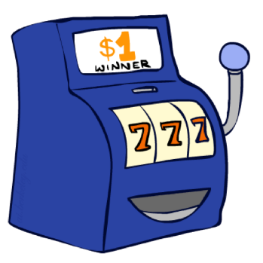
What Just Happened?
That wasn’t planning, it was learning!
Specifically, reinforcement learning (增强学习)
There was an MDP, but you couldn’t solve it with just computation
You needed to actually act to figure it out
Important ideas in reinforcement learning that came up
Exploration （探索）: you have to try unknown actions to get information
Exploitation （利用）: eventually, you have to use what you know
Regret: even if you learn intelligently, you make mistakes
Sampling: because of chance, you have to try things repeatedly
Difficulty: learning can be much harder than solving a known MDP
Notes:
You need to play and take observations (samples), and use its to figure out the parameters of MDP behind the scene.
Regret: Experience can cost.

Slide 48
Next Time: Reinforcement Learning!

Slide 49

Asynchronous Value Iteration*
In value iteration, we update every state in each iteration
Actually, any sequences of Bellman updates will converge if every state is visited infinitely often
In fact, we can update the policy as seldom or often as we like, and we will still converge
Idea: Update states whose value we expect to change:
If is large then update predecessors of s

