Slide 1
A VERY Brief Introduction to Convolutional Neural Network using TensorFlow
李 弘
16081200210002

Slide 2
Agenda
Overview of TensorFlow(mainly stolen from Stanford CS20SI)
A brief introduction to Convolutional neural network

Slide 3
What’s TensorFlow
Open source software library for numerical computation using data flow graphs
Originally developed by Google Brain Team to conduct machine learning and deep neural networks research
General enough to be applicable in a wide variety of other domains as well

Slide 4
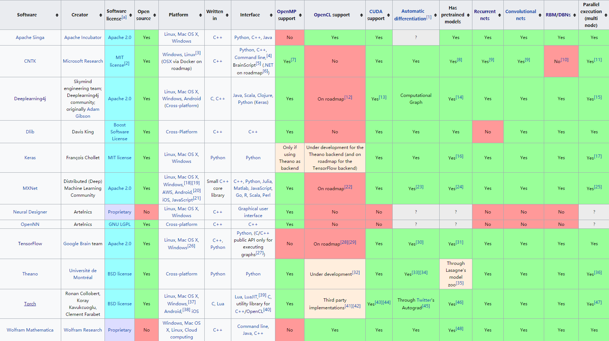
The comparison of deep learning software in Wikipedia

Slide 5
Why TensorFlow
Python API
The ability to run in heterogeneous environments, to easily build models that span multiple GPUs on a single machine, and to train large-scale networks in a distributed fashion
Visualization (TensorBoard)
Checkpoints (for managing experiments)
Large community (> 10,000 commits and > 3000 TF-related repos in 1 year)

Slide 6
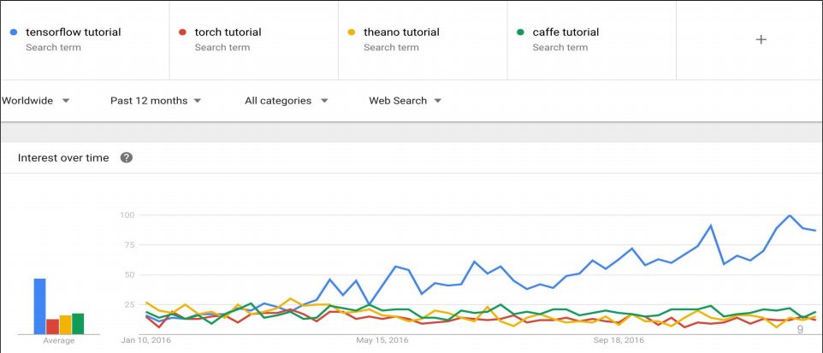

Slide 7
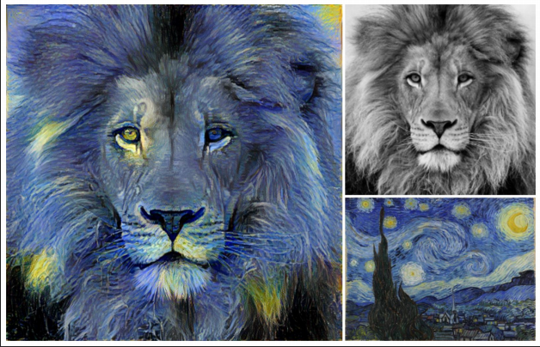
Neural Style Translation
“Image Style Transfer Using Convolutional Neural Networks” by Leon A. Gatys et al. (2016)

Slide 8
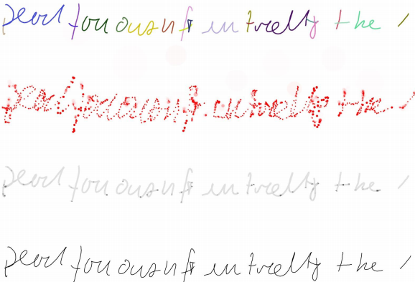
Generative Handwriting
“Generative Handwriting using LSTM Mixture Density Network with TensorFlow” by hardmaru@GitHub (2016)

Slide 9
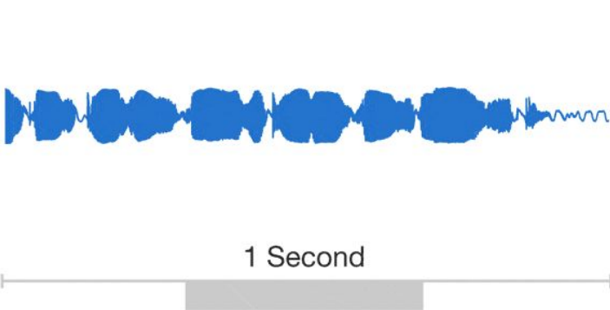
WaveNet: Text to Speech
“Wavenet: A generative model for raw audio” by Aaron van den Oord et al. (2016)

Slide 10
Dataflow Graph
TensorFlow uses a unified dataflow graph to represent both the computation in an algorithm and the state on which the algorithm operates
TensorFlow separates definition of computations from their execution

Slide 11
Dataflow Graph
Nodes in the graph represent mathematical operations, while the graph edges represent the multidimensional data arrays (tensors) communicated between them.

Slide 12
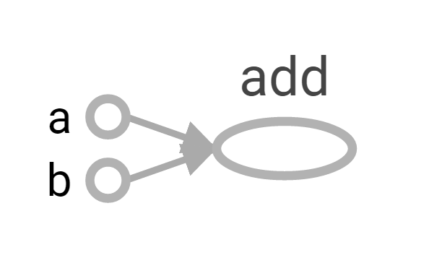
Dataflow Graph
import tensorflow as tf
a = tf.constant(2, name='a')
b = tf.constant(3, name='b')
A = tf.add(a, b, name = 'add')
Nodes: operators, variables and constants
Edges: tensors(n-d arrays)
A

Slide 13
Dataflow Graph
Create a session Within the session, evaluate the graph to fetch the value of the node.
with tf.Session() as sess:
print sess.run(A)
A

Slide 14
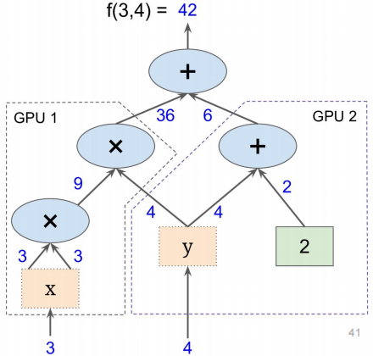
Dataflow Graph
Possible to break graphs into several chunks and run them parallelly across multiple CPUs, GPUs, or devices

Slide 15
Convolutional Neural Network(CNN)
“The origins of convolutional neural networks go back to the 1970s. But the seminal paper establishing the modern subject of convolutional networks was a 1998 paper, ‘Gradient-based learning applied to document recognition’, by Yann LeCun, Léon Bottou, Yoshua Bengio, and Patrick Haffner. ”
http://neuralnetworksanddeeplearning.com/chap6.html

Slide 16
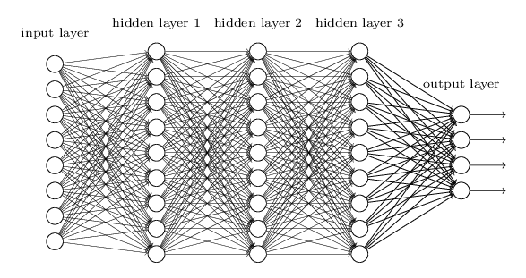
A fully connected neural network

Slide 17
For image classifying, fully connected networks ignore the spatial structure of the images.

Slide 18
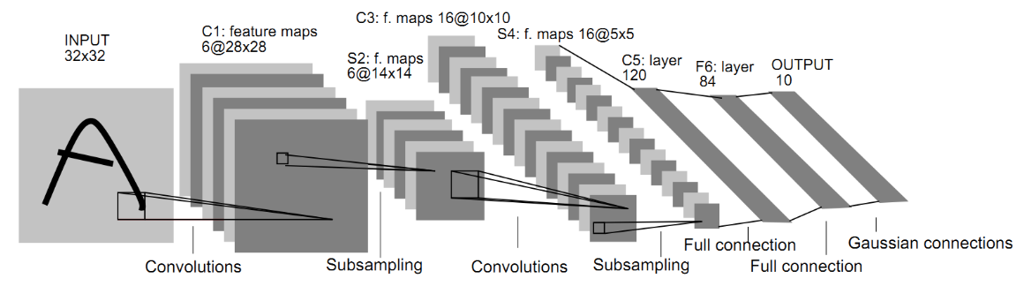
LeNet-5

Slide 19
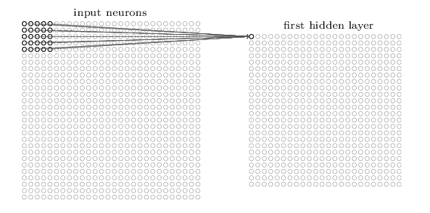
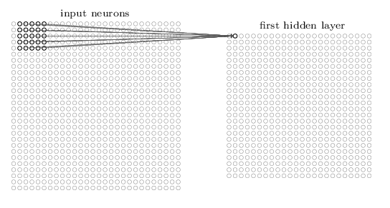
Convolutional layer

Slide 20
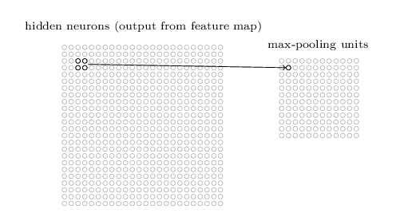
Subsampling layer(pooling layer)

Slide 21
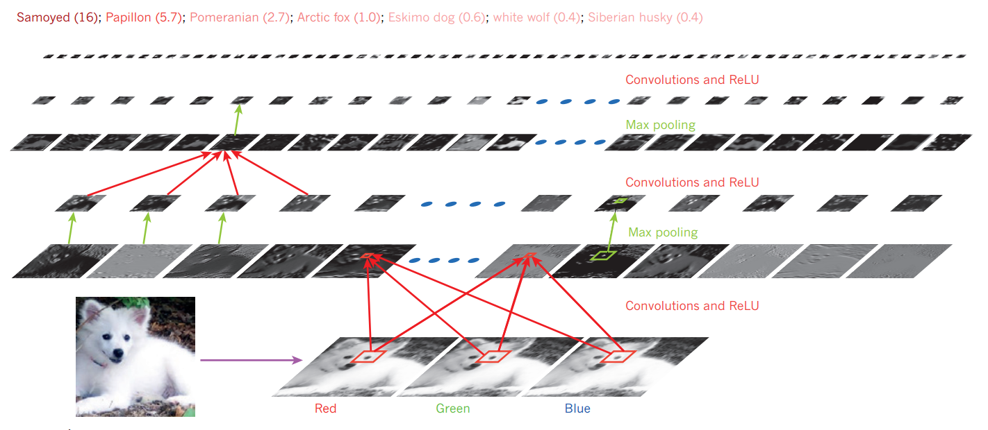

Slide 22
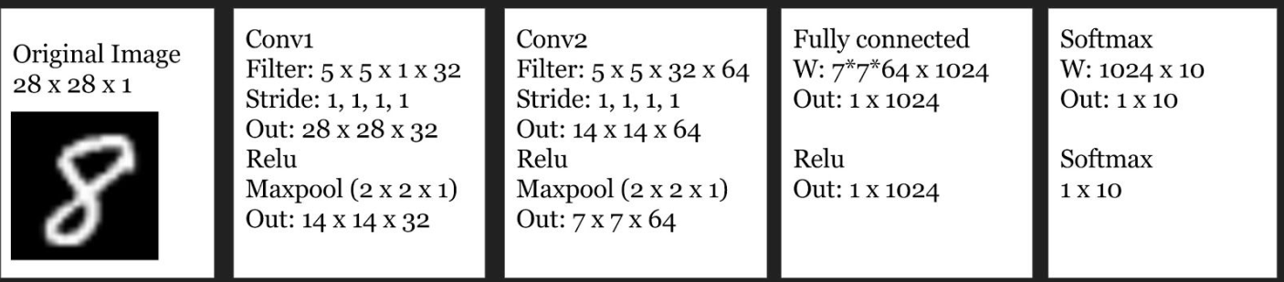
Handwritten digits recognition

Slide 23
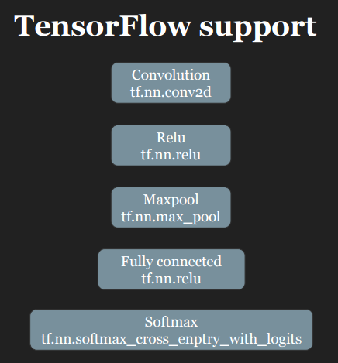
Just Combine them!

Slide 24
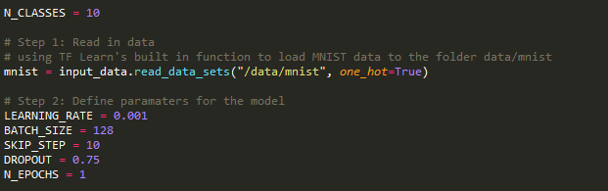

Slide 25
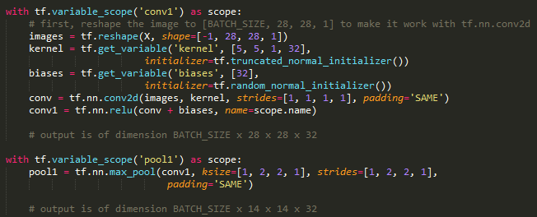

Slide 26

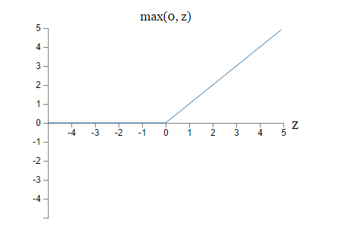
tf.nn.relu

Slide 27
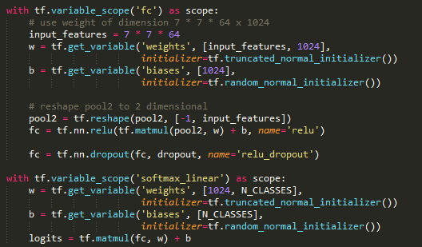

Slide 28
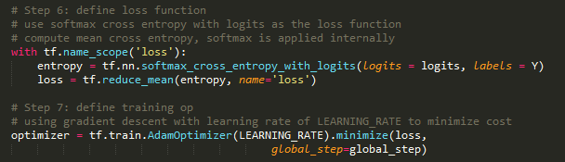

Slide 29

Cost function

Slide 30
Reference
http://neuralnetworksanddeeplearning.com/index.html
Stanford CS20SI

