Slide 1
Fundamentals of databases
A Local Email System
By:
Saleh Alghusson
Sultan Alsehibani
Hassan Shaaban

Slide 2
Introduction
Why an email system?
Why C#?
Why SQL server 2012?

Slide 3
The problem statement
An email system that has:
Users
Email account
Email messages
Attachments
Service providers
Email server

Slide 4
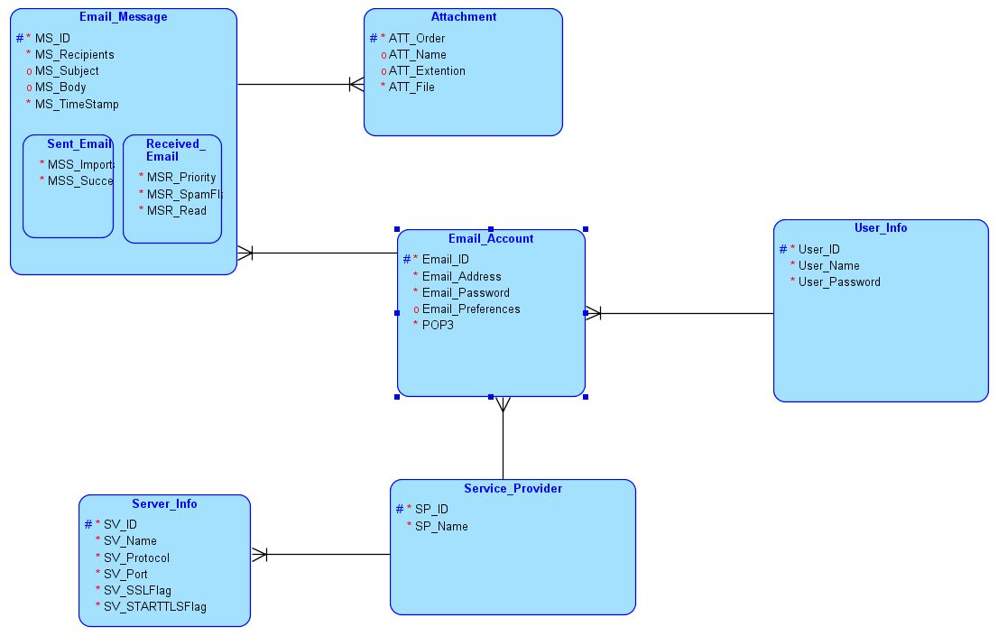
3. Conceptual Design (EER diagram)

Slide 5
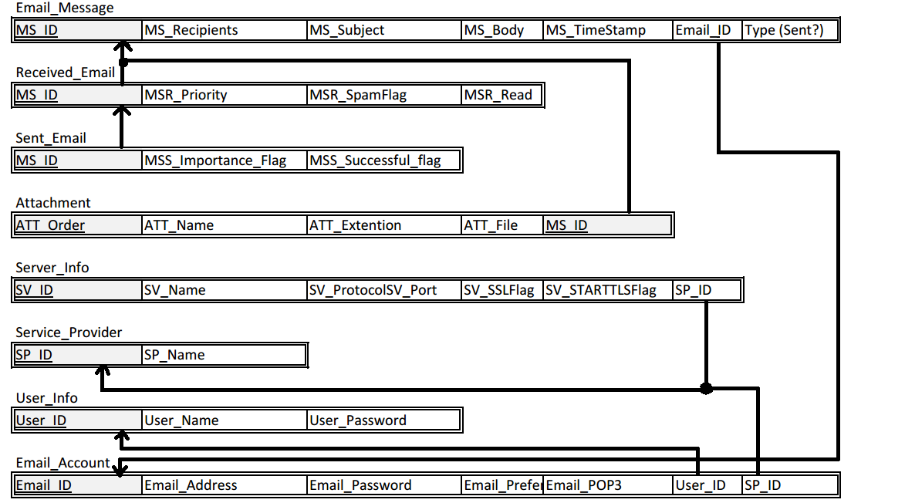
4. Logical Design (The Relational Schema)

Slide 6
Demonstration

