Slide 1
Quantum Courses Progression
Core 1-year Requirement
QM for CS
QM Labs 1
Intro to QIS
QM Labs 2
Quantum Computing Pipeline
Applied Quantum Pipeline
Intro to QC
Quantum Crypto
QKD Labs
Applied QC
Quantum Sensing
Q-Sensing Labs
Quantum Algos
FPGA Intro
FPGA Labs I
Quantum ML
Applied FPGA
FPGA Labs II

Slide 2
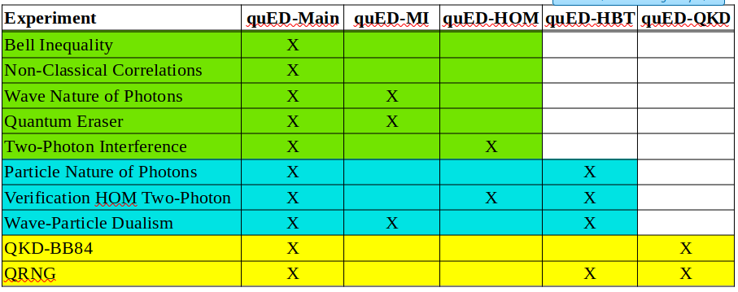
6-course quantum sequence
QM for Computing
QM Labs 1
Intro to QC (QIS)
QM Labs 2
Quant Algos (ML)
QC Programming
Applied Q (Sensing)
Q-Sensing Labs
Quantum Crypto
QKD Labs
Quantum Capstone

Slide 3
6-course quantum sequence
QM for Computing
QM Labs:
Non-Classical Correlations
Bell Inequality
Wave Nature of Photons
Quantum Eraser
Two-photon Interference
Verification HOM 2-photon*
Particle Nature of Photons*
Wave-Particle Dualism*
* Requires quED-HBT module
Intro to QC (QIS)
Quant Algos (ML)
Applied Q (Sensing)
Q-Sensing Labs:
Quantum Magnetometry
Ghost Imaging
Ghost Spectroscopy
Non-Line-of-Sight Imaging
Quantum Squeezing
Quantum Gravimetry Inversion
Quantum Crypto
Quantum Capstone
COSC 210
COSC 215
COSC 310
COSC 315
COSC 410
COSC 415

