Slide 1
DUET
69.5%
DUal Expert Trajectory Utilization
for Agent RLVR
Validation Success Rate
ALFWorld 3B Experiment Analysis
2026.03.30 Qwen2.5-3B-Instruct 4xH100 NeurIPS 2026

Slide 2
Problem & Motivation
Agent RLVR 的挑战
DUET 的核心洞察
Reward Sparsity：Multi-turn环境只有终端奖励(0/1)，探索成功概率极低
GRPO 失效：当group内rollout全部失败时 σ_R=0，零梯度 → 训练plateau在~58%
LUFFY：固定policy shaping无法自适应衰减，后期引入有害梯度
CHORD：SFT路径衰减后退化为纯GRPO，不解决根本问题
核心矛盾：现有方法只利用action-level信息，忽略了state-level信息
信息分解：Expert trajectory 包含两类正交信息
Action-level (策略相关)：expert 选择了什么 action → 需分布修正
State-level (策略无关)：expert 到达了什么 state → 可直接构造进度奖励
Action Channel (DR3)：判别器估计密度比，修正importance weight
State Channel (SC)：Expert Progress Map 提供 dense reward shaping
正交互补：两通道独立工作，效果严格叠加

Slide 3
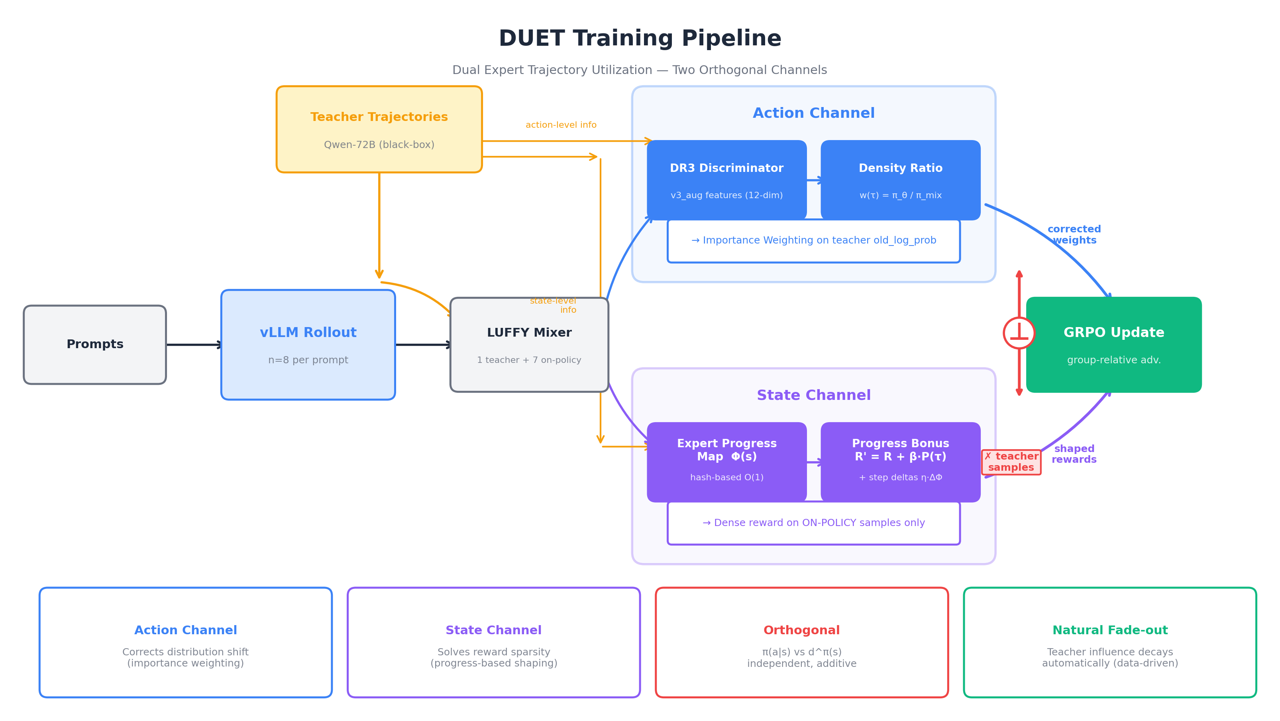
DUET Architecture

Slide 4
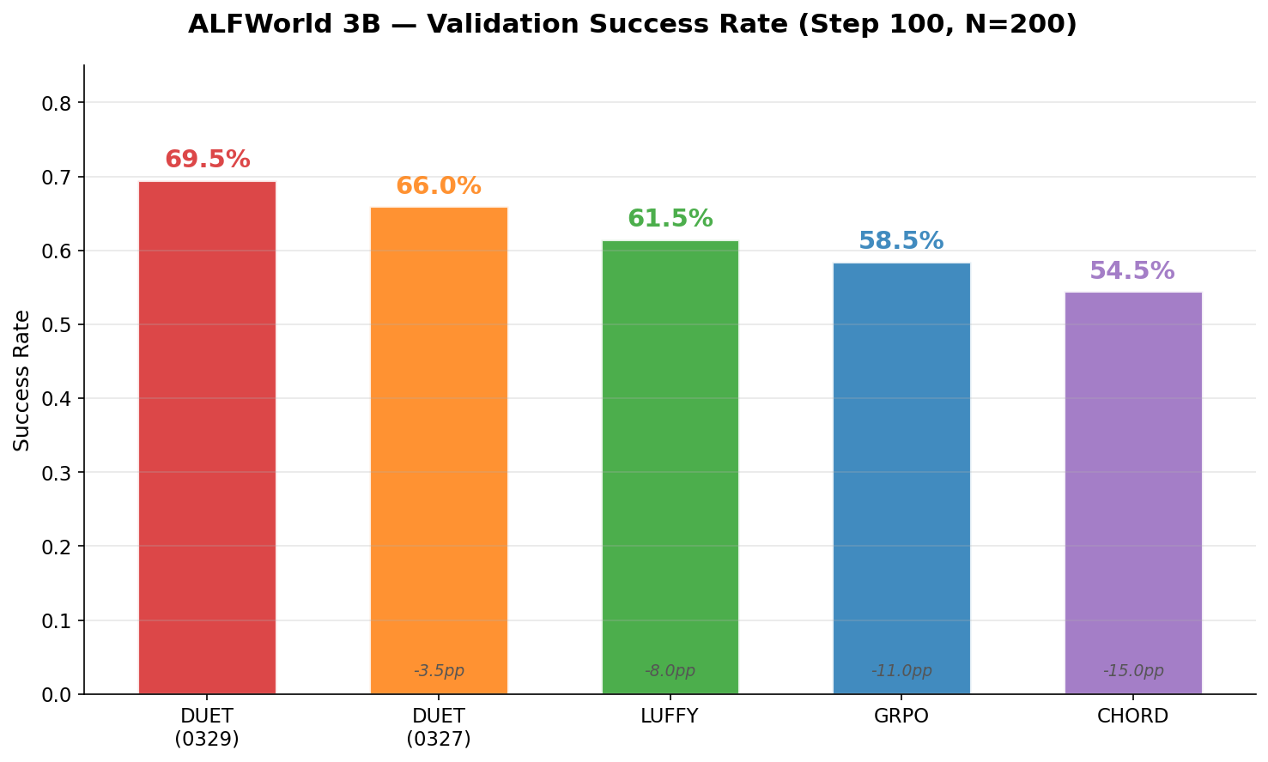
Main Results
Key Findings
DUET 69.5%：ALFWorld 3B best result
vs LUFFY +8.0pp：DR3 density ratio > fixed policy shaping
vs GRPO +11.0pp：dual channels break the on-policy plateau
vs CHORD +15.0pp：PG-based correction > SFT path
后半段加速：Step 50→100 增长 +21.5pp，远超其他方法
响应效率：DUET 3155 tok vs GRPO 8665 tok (-63%)

Slide 5
Detailed Results
Validation Success Rate (N=200)
Analysis
Method | Val@50 | Val@100 | Improvement | vs DUET
DUET (0329) | 48.0% | 69.5% | +21.5pp | —
DUET (0327) | 53.0% | 66.0% | +13.0pp | -3.5pp
LUFFY | 47.5% | 61.5% | +14.0pp | -8.0pp
GRPO | 47.5% | 58.5% | +11.0pp | -11.0pp
CHORD | 42.5% | 54.5% | +12.0pp | -15.0pp
DUET 后半段加速最猛：Step 50→100 +21.5pp，LUFFY仅+14pp
Train@100 = 84.4%：on-policy已接近teacher水平(~85%)
GRPO plateau ~58%：on-policy方法的固有瓶颈
泛化 Gap = 14.9pp (Train 84.4% vs Val 69.5%)：合理范围
CHORD在step50后SFT基本关闭，后续改善缓慢
DUET训练最稳定：无LUFFY的step 80-90回落
Training Success Rate (64 rollouts/step)
Method | Step 10 | Step 30 | Step 50 | Step 70 | Step 100
DUET (0329) | 48.4% | 54.7% | 65.6% | 59.4% | 84.4%
LUFFY | 43.8% | 57.8% | 62.5% | 68.8% | 71.9%
GRPO | 35.9% | 37.5% | 54.7% | 60.9% | 51.6%
CHORD | 43.8% | 45.3% | 54.7% | 65.6% | 64.1%

Slide 6
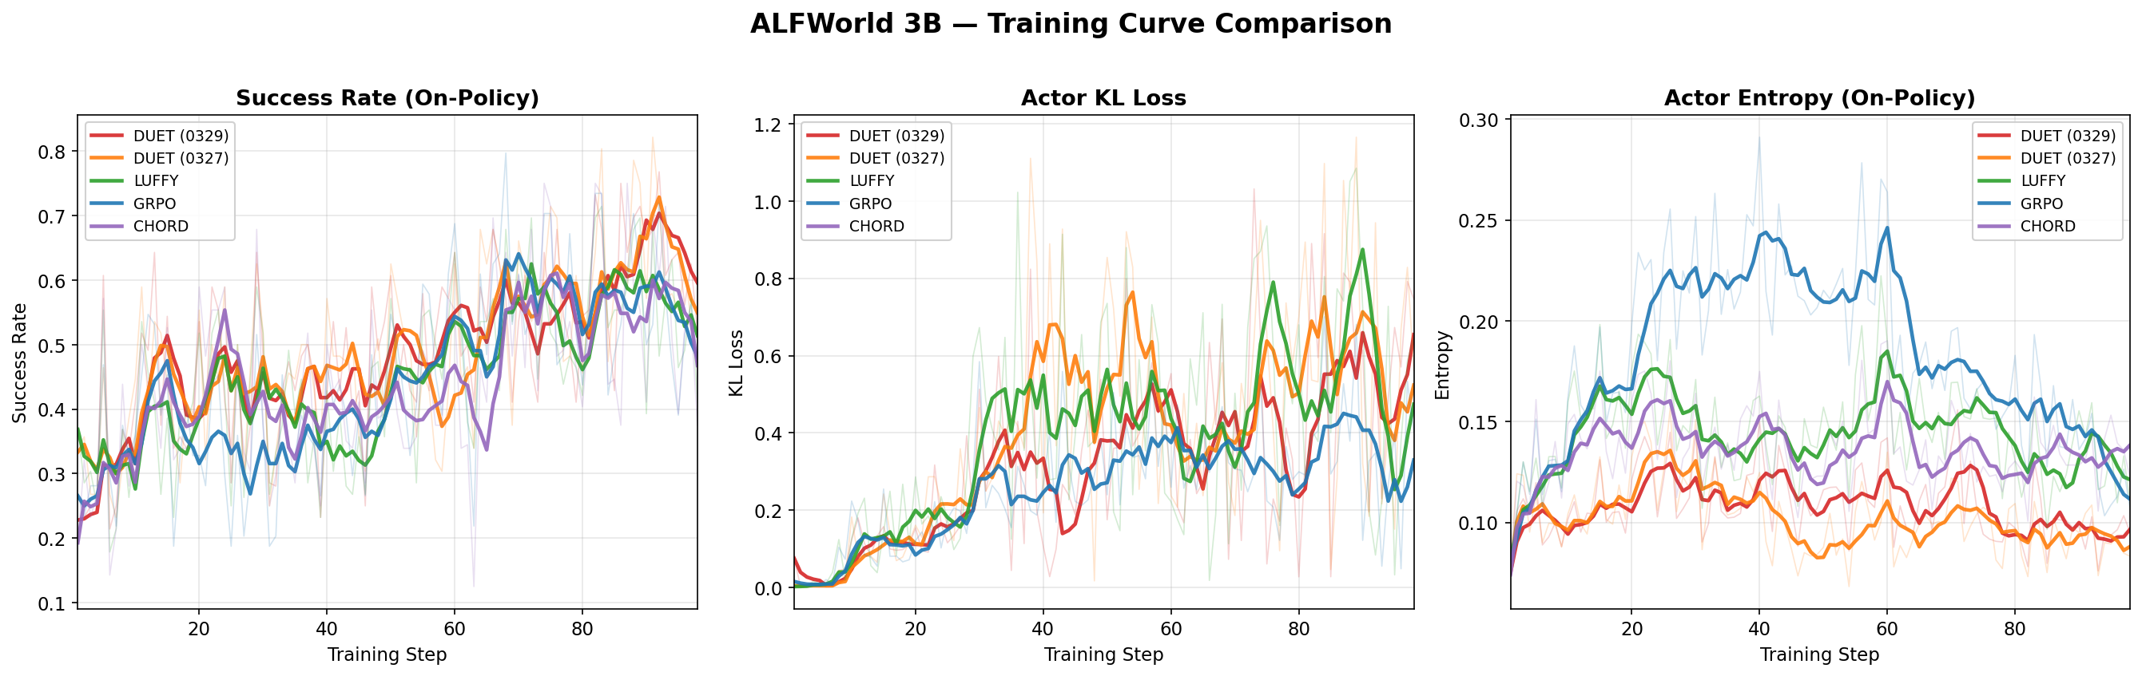
Training Dynamics
Success Rate：DUET(红)在step 70后加速上升并持续领先，GRPO(蓝)在~50-60%水平plateau，LUFFY/CHORD中间振荡
KL Loss：DUET的KL稳定在0.2-0.4，策略更新可控，后期有spike但未发散
Entropy：DUET的entropy渐进平稳下降，exploration→exploitation过渡健康。浅色=raw data，深色=MA(5)

Slide 7
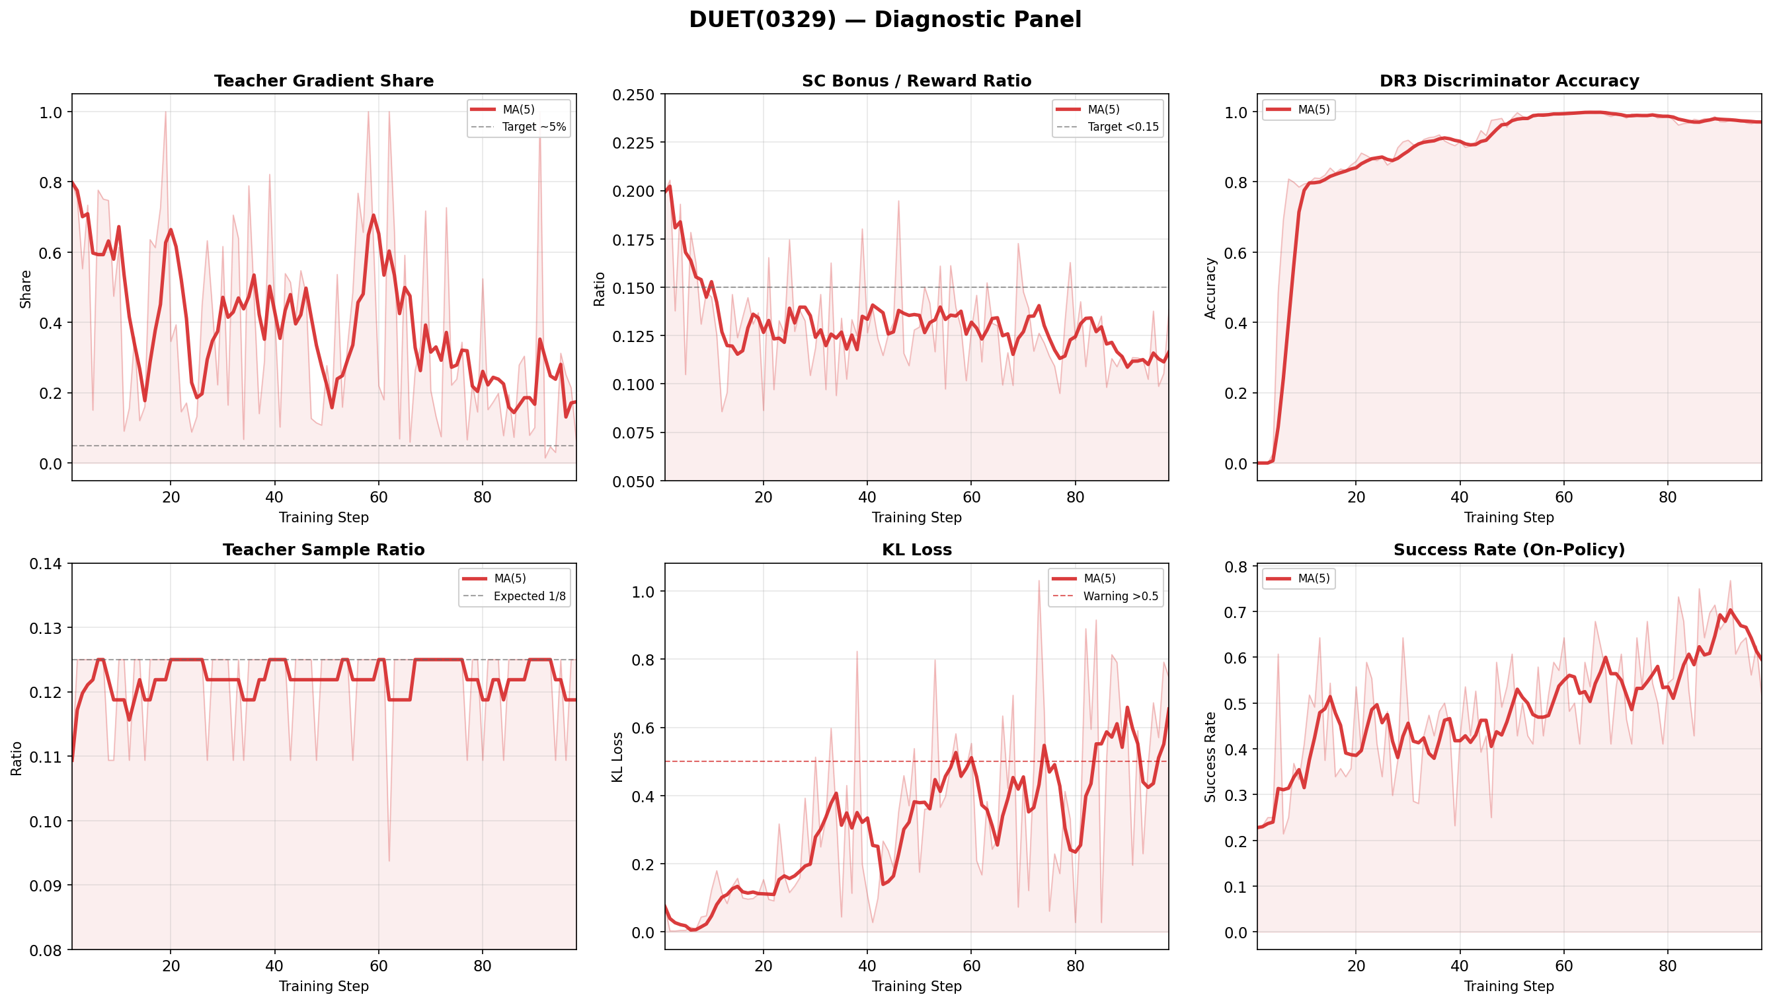
DUET Component Diagnostics
Diagnostic Summary
Teacher Gradient Share：80%→20% ✅ DR3自然课程已验证
SC Bonus/Reward：0.08-0.15 ✅ 未压过task reward
Disc Accuracy：0→0.98+ ✅ 判别器快速收敛
Teacher Ratio：稳定0.125 ✅ 1/8混入比例正确
KL Loss：< 0.5为主 ⚠️ 后期有spike需关注
Success Rate：持续上升 ✅ 训练整体健康

Slide 8
Key Fix: SC Teacher Exclusion
DUET(0327) → DUET(0329)：解决两通道互斗问题
Before: DUET(0327)
After: DUET(0329)
SC bonus同时应用于teacher样本
Teacher reward被抬高：1.0 + 0.2×0.85 = 1.17
Teacher advantage始终为正 (+0.10 at step 100)
SC抬高teacher → 对抗DR3的natural fade-out
Teacher gap停滞在 0.394
exclude_teacher: true — SC bonus仅给on-policy
Teacher reward保持 1.0，不被inflate
Teacher advantage到step 50已为负 (-0.22)
DR3自然衰退恢复正常
Teacher gap收敛至 0.061 (6.5x improvement)
Metric | DUET(0327) | DUET(0329) | Change
Validation@100 | 66.0% | 69.5% | +3.5pp
Teacher Gap | 0.394 | 0.061 | 6.5x better
Training Batch SR | 66.1% | 82.1% | +16pp
Response Length | 4,778 tok | 3,155 tok | -34%

Slide 9
Theoretical Verification
Proposition | Description | Status | Evidence
P1 Non-degeneracy | SC ensures σ_{R'} > 0 | ✅ | GRPO plateau while DUET improves
P3 Direction | SC preserves optimal policy | ✅ | Val SR consistently increases
P4 Curriculum | σ_P → 0 as policy improves | ⚠️ | beta_decay bug; σ_P ≈ 0.24
P9 Orthogonality | Channels additive | ✅ | DUET > LUFFY > CHORD ordering
DR3 Fade-out | teacher_grad_share ↓ | ✅ | 52.8% → 19.8%, final 6.3%
SC Exclusion | No SC bonus on teacher | ✅ | Gap: 0.394 → 0.061
Bug Found & Fix Plan
beta_decay bug：beta_decay_target=0.3 vs per-token reward ~0.0007 — 400x数量级不匹配，β=0.2全程不变
Impact：SC全程活跃实际有益（持续dense signal），但不符合设计意图
Fix (0330)：改用binary success rate作为decay metric (beta_decay_target=0.8)，同时KL coef 0.005→0.001与LUFFY对齐

Slide 10
Next Steps
Immediate
Short-term
Paper Prep
DUET(0330)：beta_decay fix + KL=0.001
Ablation：DR3-only, SC-only 量化各组件贡献
WebShop 实验：验证跨环境泛化能力
多 seed (3-5)：获取 error bars
SciWorld：第三个实验环境
7B 模型：验证 scalability
GiGPO baseline 对比
论文撰写：method + experiments
Publication-quality figures
Reviewer 预演：orthogonality, novelty, baselines
NeurIPS 2026 submission

