Slide 1
Machine Learning Workshop Kickoff
Michael, 2018

Slide 2
Agenda
Data Science Center of Excellence (CoE)
What will cover in this workshop?
Prerequisites
What background knowledge is necessary ?
Why choose python as the primary language ?
Python & related library
Self-learning Resources

Slide 3
Data Science Center of Excellence (CoE)

Slide 4
DSCOE
What is CoE?
“A center of excellence (CoE) is a team, a shared facility or an entity that provides leadership, best practices, research, support and/or training for a focus area. The focus area might be a technology, a business concept, a skill or a broad area of study” – Wikipedia
“A team of people that promote collaboration and using best practices around a specific focus area to drive business or customer-valued results” – JIT Technologies
What is Data Science
“Data science is a "concept to unify statistics, data analysis and their related methods" in order to "understand and analyze actual phenomena" with data. It employs techniques and theories drawn from many fields within the broad areas of mathematics, statistics, information science, and computer science, in particular from the subdomains of machine learning, classification, cluster analysis, data mining, databases, and visualization”
Data Science is not Magic nor Alchemy

Slide 5
AI Journey
0.1
N2C4
Booking shortfall predication
EQPRD
Empty Release/Return Forecast
CX + MSC
Email intent Classification
2.0
MRO
Empty repo optimization
Supply & demand forecast
Vessel utilization forecast
CX
Chatbot
1.0
External recruitment
DS talent program
MSRA engagement
Strategized AI platform
…
Product Team formulation
Embed DSCoE members
Open to internal recruitment
Commodity
HS code classification
2017 Q1
2017 Q2
2017 Q3
2017 Q4
2018 Q1
Onwards
Team Establishment in
HKG & SNT
N2C3
Rail ETA predication
Members exchange to SNT
MSRA phase one
Empty repo optimization
Demand forecast
IoT
Expand to ZHA
Monthly DS talks
MSRA General Training
RoboAdvisor?
Empty repo with RL?
Proforma design?
GVVMC?
…

Slide 6
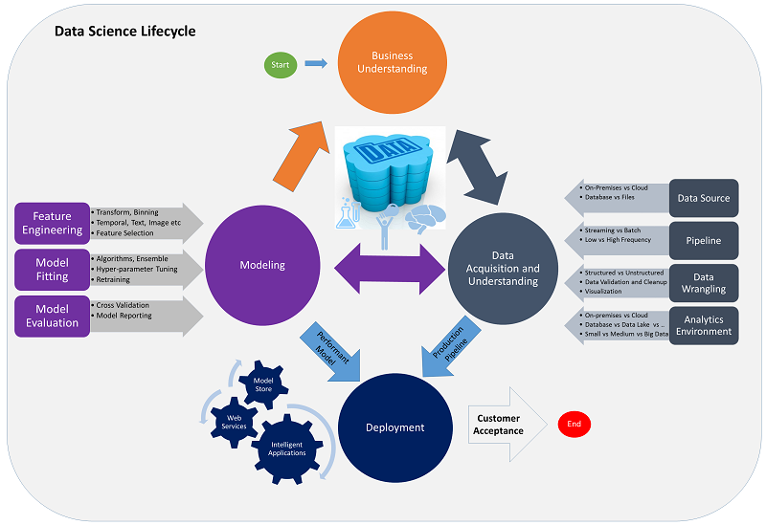
What will cover in this workshop?
Machine learning introduction
Supervised Machine Learning
Unsupervised Machine Learning
Systemic machine learning process

Slide 7
What background knowledge is necessary?
Python programming will be used in this course, I assume you have basic python programming skills.
Work effectively with loops, control flows, data structures, files, functions and OO programming.
Install python library with conda or pip
Python Jupiter Notebook, which will be the primary IDE
PyData libraries
Pandas
Numpy (Recommended)
Matplotlib
Scikit-learn (Recommended)
Mathematics (recommended):
A top-down approach (instead of bottom-Up) in a systematic way to do a machine project will be applied in this course. Even though, it’s good to has the basic knowledge on mathematics.
Statistics & Probability
Linear Algebra
Calculus

Slide 8
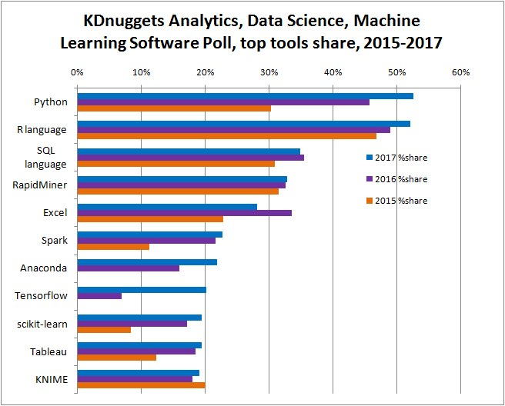
Why Python?
Why choose python as the course language ?

Slide 9
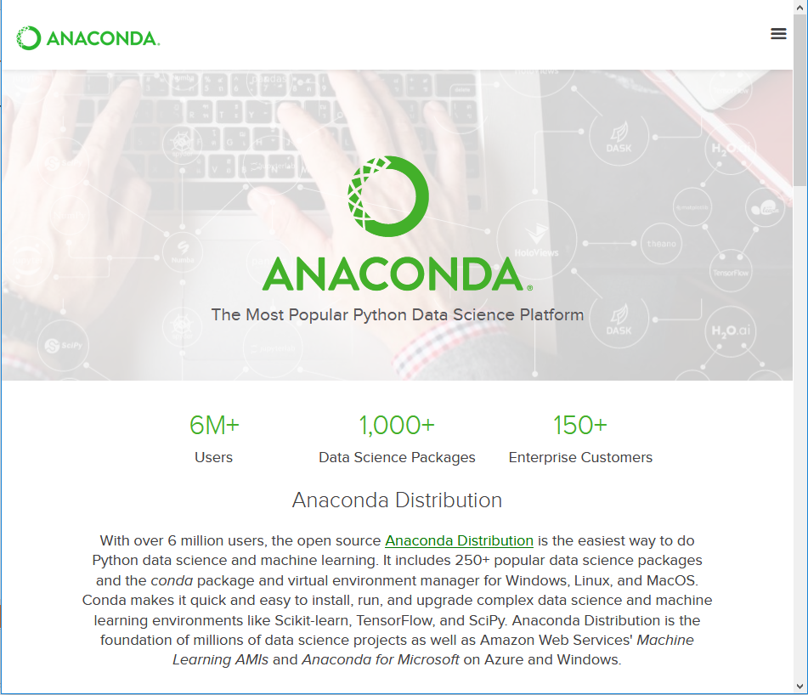
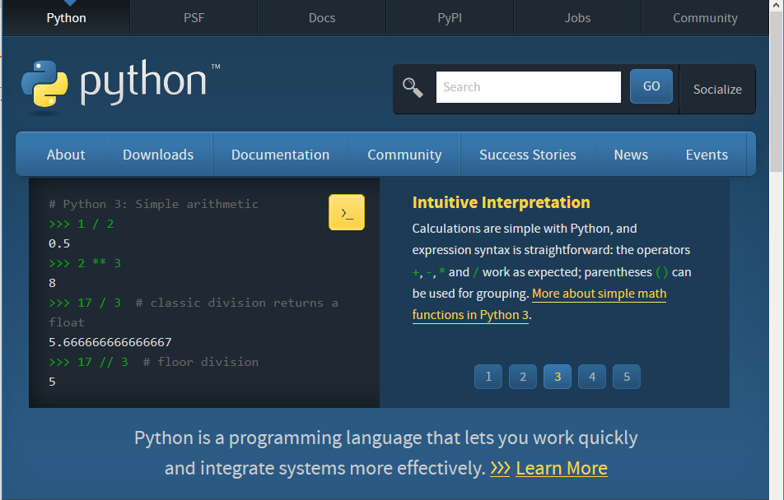
Python & Anaconda
https://www.python.org/
https://www.anaconda.com/what-is-anaconda/

Slide 10
Python & Anaconda cont.
Python Version:
For this cause, all code will use the newest version Python 3.6.x
Tips: there are currently two different supported versions of Python, 2.7 and 3.6, somewhat confusingly, Python 3.0 introduced many backwards-incompatible changes to the language, so code written for 2.7 may not work under 3.6 and vice versa.
Python installation:
Recommend to install python through Anaconda, which contains porting for all the popular python libraries that can be used in data science.
Download links:
https://www.continuum.io/downloads
How to install:
https://docs.continuum.io/anaconda/install/
Jupyter Notebook & other python libraries will be installed along with Anaconda

Slide 11
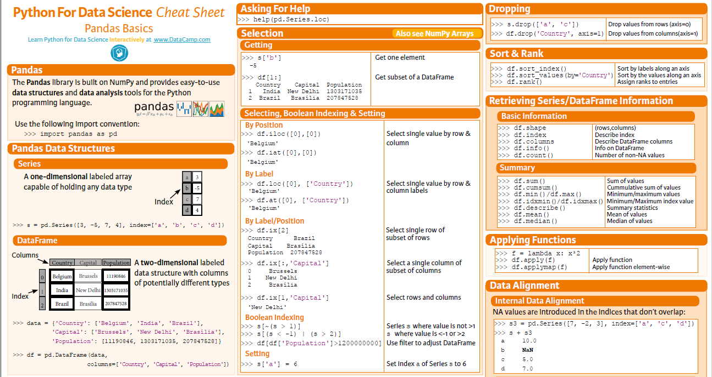
Pandas
http://pandas.pydata.org/pandas-docs/stable/dsintro.html

Slide 12
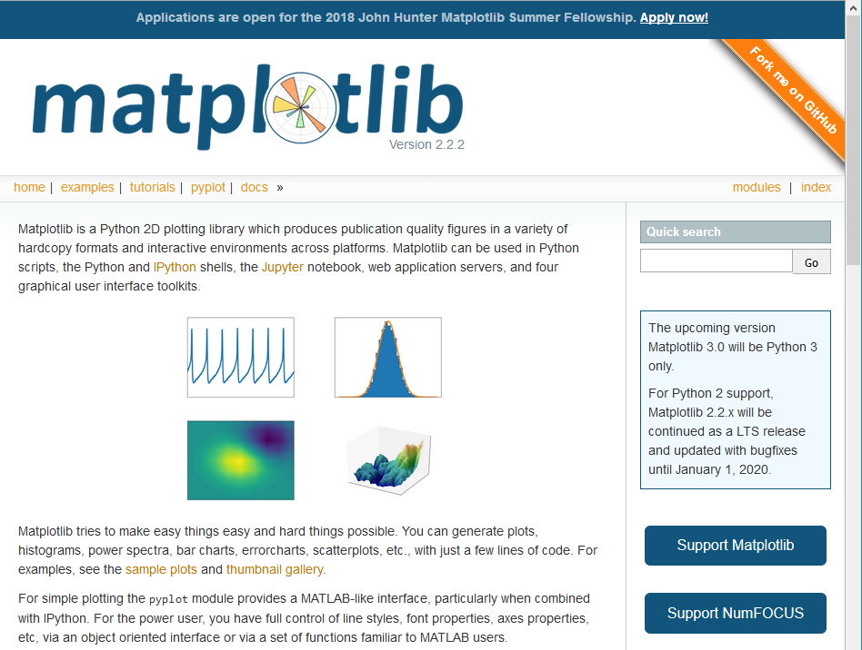
Matplotlib
https://matplotlib.org/

Slide 13
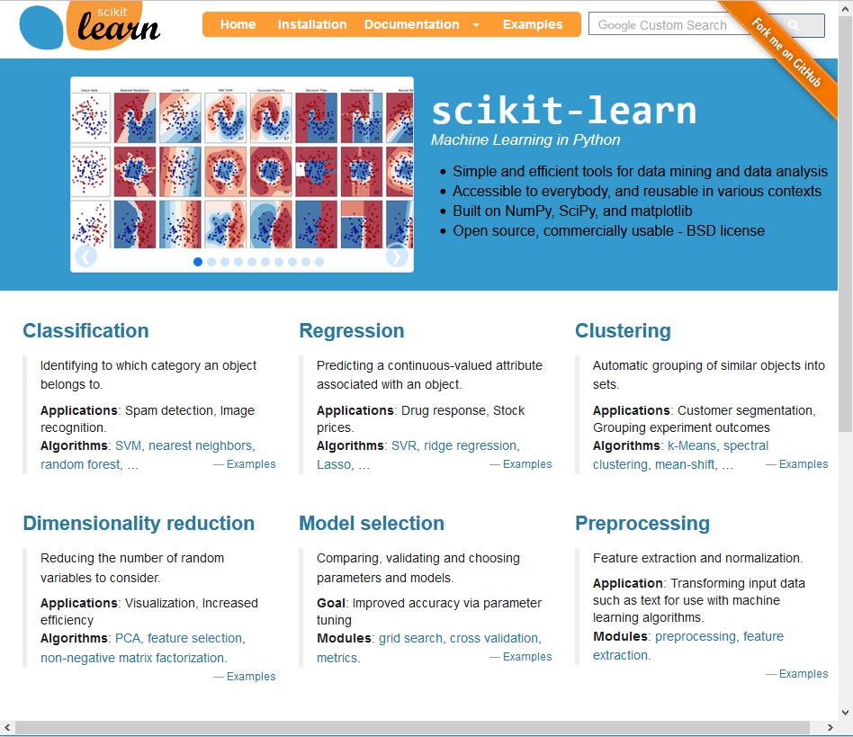
Scikit-learn
http://scikit-learn.org/

Slide 14
Self-learning Resources
Python
https://www.learnpython.org/
Some useful cheat sheets
Numpy_Python_Cheat_Sheet.pdf
PandasPythonForDataScience.pdf
Python_Matplotlib_Cheat_Sheet.pdf
Scikit_Learn_Cheat_Sheet_Python.pdf
PythonForDataScience.pdf
Jupyter notebooks
python-tutorial.ipynb
pandas-tutorial

