Slide 1
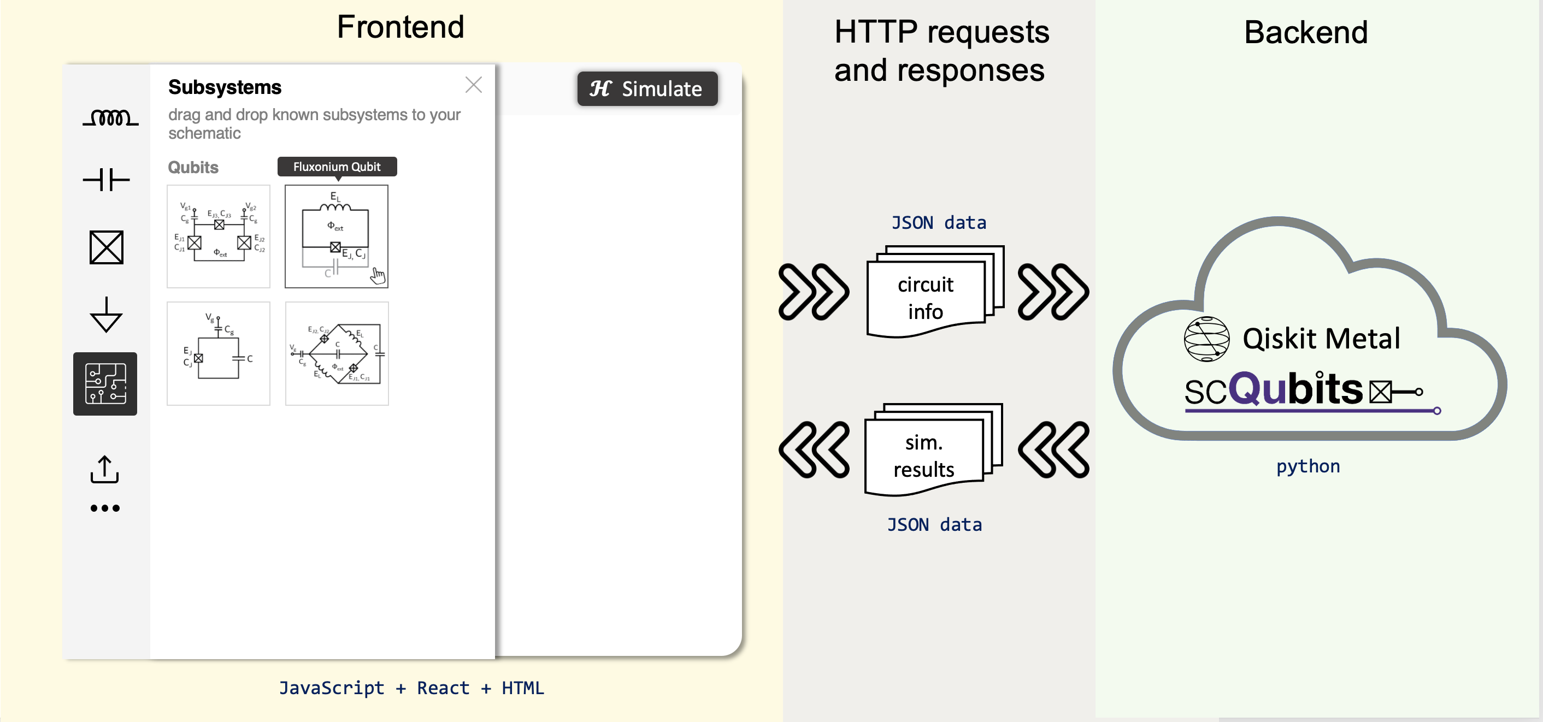
LOM Analysis
Hamiltonian Analysis

Slide 2
Conversion from Circuit Schematic to Weighted Capacitance & Inductance Graph
Stage 1
Stage 2
Stage 3
Stage 4
Stage 5
Implement basic functionalities
Resolve issue with cyclic circuits
Test with more complex circuits
Convert to Javascript
Integrate with Frontend
Example of a cyclic circuit that can be processed now after stage 2
Example of acyclic circuit that could be processed at stage 1
C1
I1
C1
I1
C2
I2
C4
C2
C3
I2
5F
6H
10F
3H

Slide 3
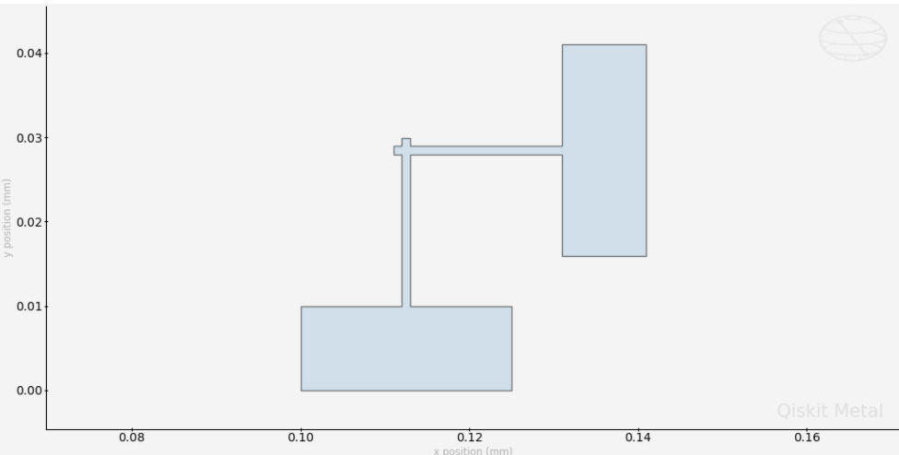
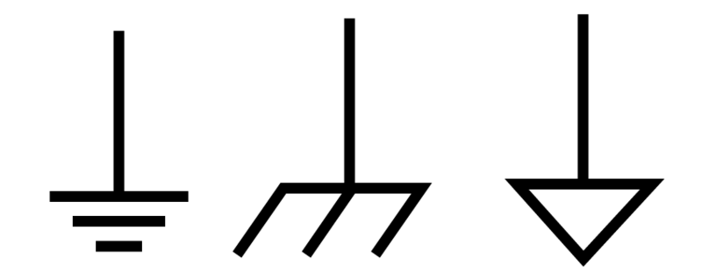
Features in development
Node connected to multiple components
Josephson Junction
Test by sending JSON request to backend
Ground node

