Slide 1
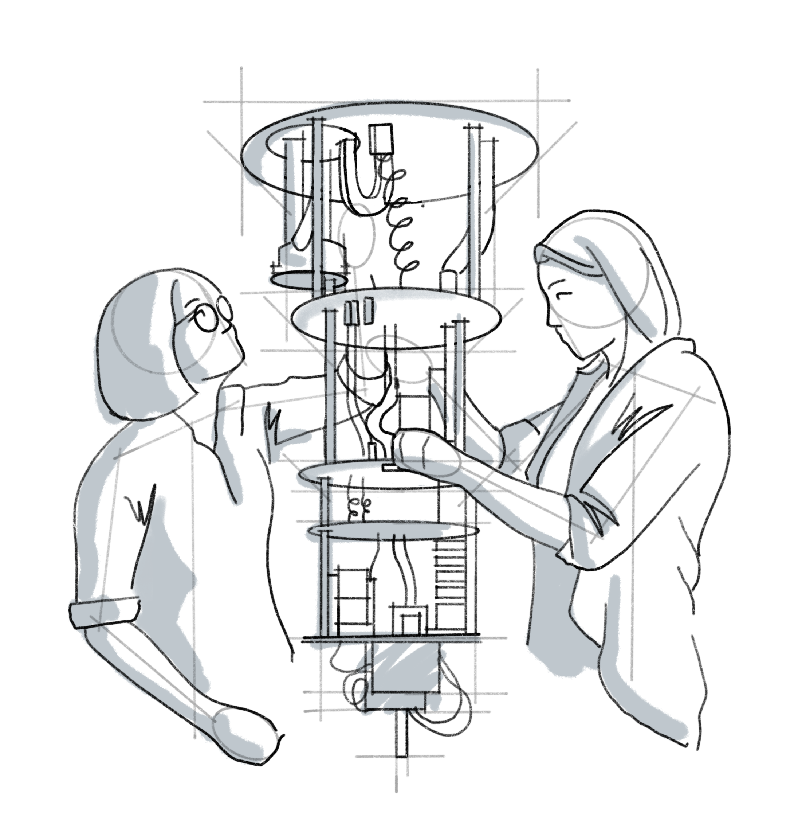
Machine Learning for Classifying Exotic Quantum States of Matter
Mentees: Syed Farhan Ahmad
Mentor: Kunal Sharma, Alireza Seif, Zlatko Minev
As part of QAMP Fall 2022

Slide 2
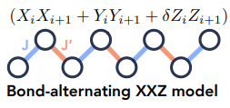
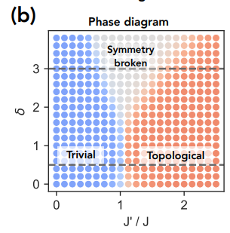
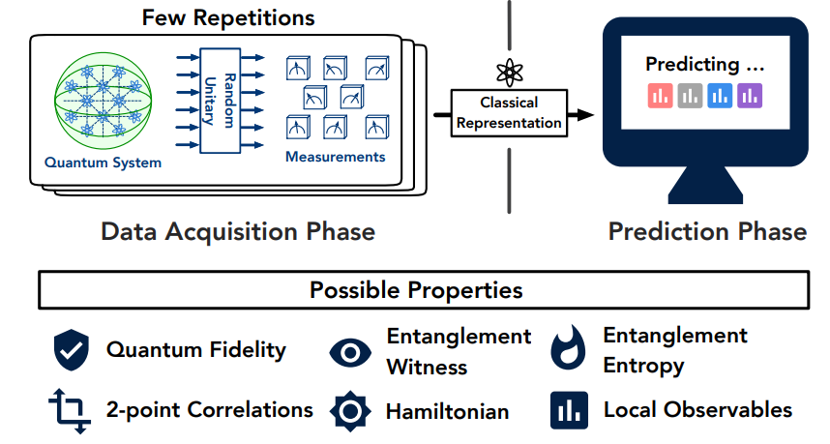
Recap
arXiv: https://arxiv.org/abs/2106.12627
arXiv: https://arxiv.org/pdf/2002.08953.pdf
Notes:
Here’s a recap from checkpoint 1 presentation that took place in October.

Slide 3
Recap: Classical Shadows
Apply a random unitary on the quantum system followed by measurements (similar to Projecting high-dimensional data into classical dimensions)
arXiv: https://arxiv.org/pdf/2002.08953.pdf

Slide 4
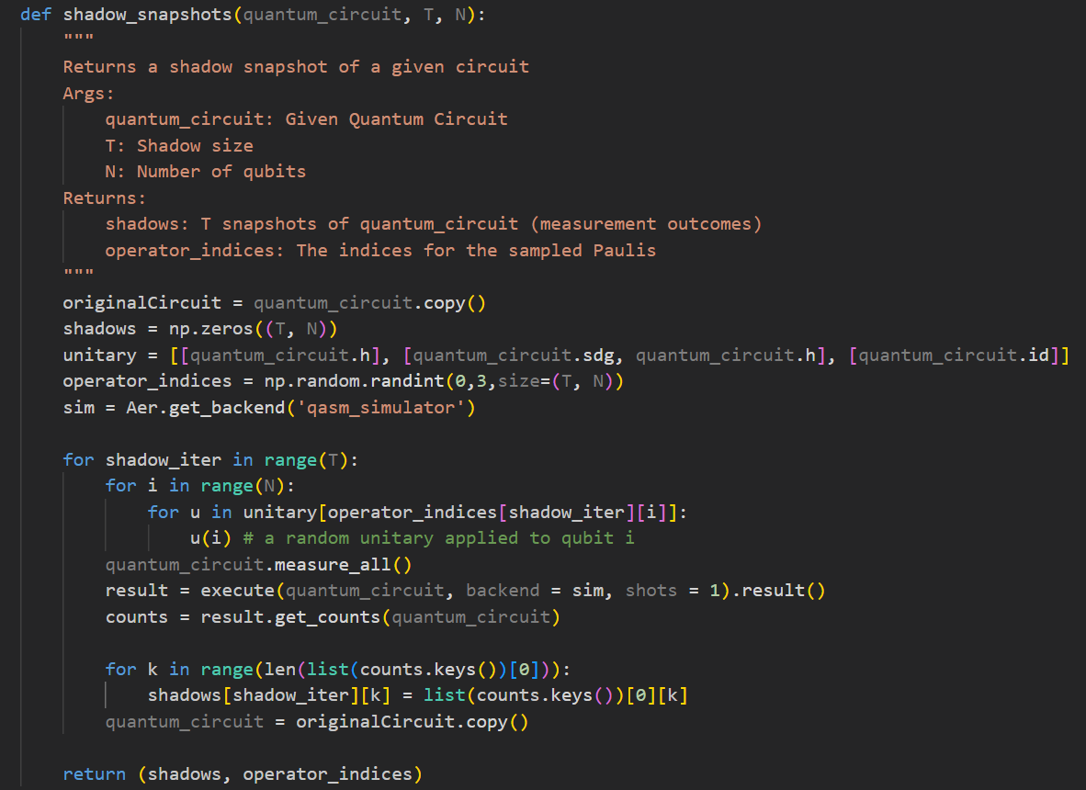
Classical Shadow Implementation in Qiskit
Returns a shadow snapshot of a given circuit
Args:
quantum_circuit: Given Quantum Circuit
T: Shadow size
N: Number of qubits
Returns:
shadows: T snapshots of quantum_circuit (measurement outcomes)
operator_indices: The indices for the sampled Paulis

Slide 5
Shadow State Reconstruction
Shadow State is reconstruction using Eq.(1) given in the paper “ Provably efficient machine learning for quantum many-body problems
arXiv: https://arxiv.org/abs/2106.12627

Slide 6
Hydrogen Hamiltonian
A H2_Hamiltonian was taken as an example to begin with because of its simplicity.
The ground state circuit can be easily obtained using one of the two methods:
Beginning with an initial guess circuit and iteratively updating the wave function using VQE experiment
Calculating eigenvectors using diagonalization and creating the circuit using QuantumCircuit.initialize()
Simple case of a Hydrogen molecule
Image Source: https://www.nationalgrid.com/stories/energy-explained/what-is-hydrogen

Slide 7
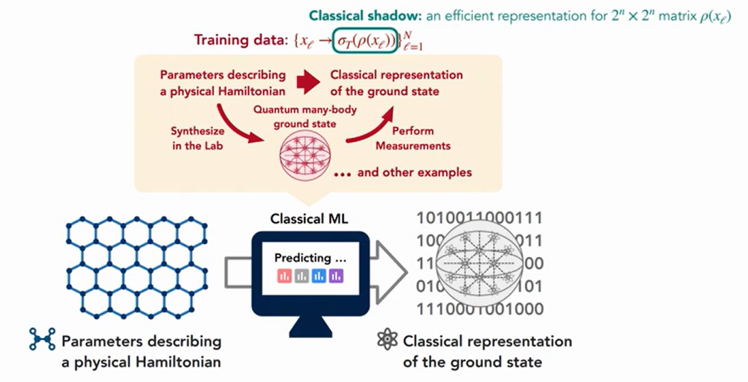
Predicting Ground State using ML
Inputs to ML model: Parameters that describe a Hamiltonian.
Examples: laser intensities, few-body interactions, magnetic fields, etc.
Outputs: classical shadow of ground state
ML Algo: with PCA kernel or NTK kernel
Predicting ground state using shadow formalism
arXiv: https://arxiv.org/abs/2106.12627

Slide 8
Next Steps
Obtain classical shadows of a larger Hamiltonian by varying the Hamiltonian coefficients.
Training ML models with PCA kernel and NTK (Neural Tangent Kernels).
Observing the prediction of the ML model at the phase boundaries

Slide 9
Thank You ☺

