Slide 1
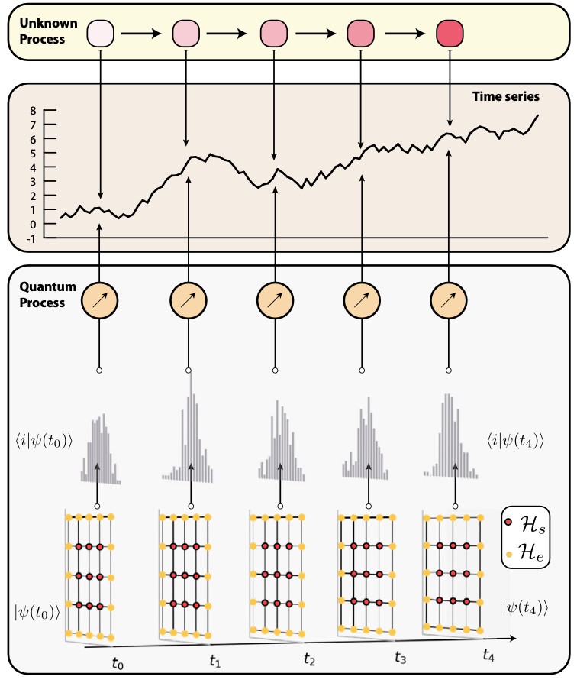
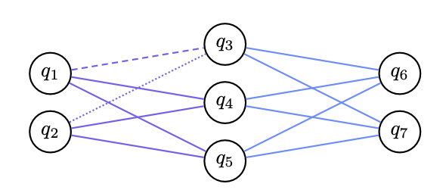
QAMP Fall 22 Project 34: Quantum Machine Learning for reduced order density matrix time propagation
QAMP Team: Das Pemmaraju, Siheon Park, Abhay Kamble, I-Chi Chen
Collaborators: Soham Bopardikar
Aim: Explore quantum machine learning prediction of the dynamics of reduced density matrices of quantum systems
Initial efforts:
Identify existing methods/architectures for QML based predictions of time series
Reproduce literature results
Specialize to physics models of interest with Qiskit
Generative model based on Hamiltonian Learning
Horowitz et al: https://arxiv.org/abs/2204.06150
Dissipative Quantum Neural Networks
Beer et al: https://doi.org/10.1038/s41467-020-14454-2 ,
https://arxiv.org/abs/2104.06081
Model aims to learn quantum channels which reproduce the transition probabilities implied by a given time series.
Architecture implements positive layer-to-layer transition maps

Slide 2
Project#34: Quantum Machine Learning for reduced order density matrix time propagation
Motivation:
System
$$ρ_{s}\left(t\right)=\frac{1}{2}\left(\hat{I}+r_{x}\left(t\right)\hat{X}+r_{y}\left(t\right)\hat{Y}+r_{z}\left(t\right)\hat{Z}\right)$$
Environment
History
Predict
Future
Classical neural network
$$\left(r_{x}\left(t\right),r_{y}\left(t\right),r_{z}\left(t\right)\right)$$
Time series of data
Nelson et al., Rev. B 106, 045402

Slide 3
$$ρ^{out}=Uρ^{in}U^{†}$$
$$ρ^{in}$$
$$ρ^{out}$$
Beer et al., Nat. Commun. 11, 808 (2020).
Cost function $C=\frac{1}{N}\sum_{i}{\left\langle φ_{i}^{out} | ρ_{i}^{out} | φ_{i}^{out}\right\rangle }$
History
$$\left\langle X_{t}\right\rangle , \left\langle Y_{t}\right\rangle , \left\langle Z_{t}\right\rangle$$
Encoding
Output
Future
$$\left\langle X_{t−dt}\right\rangle , \left\langle Y_{t−dt}\right\rangle , \left\langle Z_{t−dt}\right\rangle$$
$$\left\langle X_{t+dt}\right\rangle , \left\langle Y_{t+dt}\right\rangle , \left\langle Z_{t+dt}\right\rangle$$
$$\left\langle X_{t−2dt}\right\rangle , \left\langle Y_{t−2dt}\right\rangle , \left\langle Z_{t−2dt}\right\rangle$$
$$⋮$$
Cost function $C=\frac{1}{N}\sum_{i}{{\left({Y_{P,i}−Y}_{L,i}\right)}^{2}}$

Slide 4
Thank you

Slide 5
QML for reduced density matrix propagation
QAMP 2022 Team #34
Siheon Park, Abhay Kamble, I-Chi Chen (Mentor: Das Pemmaraju)

Slide 6
What we are trying to do
Nelson, J., Coopmans, L., Kells, G., & Sanvito, S. (2022). Data-Driven Time Propagation of Quantum Systems with Neural Networks. arXiv preprint arXiv:2201.11647.
Notes:
Nakajima-Zwanzig equation is non-markovian

Slide 7
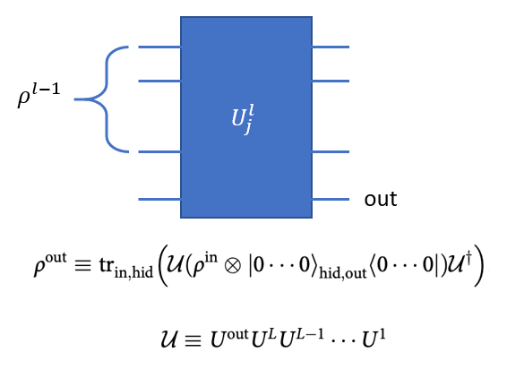
Candidate QML model
Beer, K., Bondarenko, D., Farrelly, T. et al. Training deep quantum neural networks. Nat Commun 11, 808 (2020). https://doi.org/10.1038/s41467-020-14454-2

Slide 8
My (coding) Progress
https://github.com/QAMP-Fall-22-Project34/DQNNforQOS

Slide 9
Thank you

