Slide 1
Project #6 - Quantum fMRI analysis
Mentor: Robert Loredo
Mentees: Adnani Hinde, Hamza Ahmed, Iulia Zidaru, Jody Burks, José Victor, Khadija Challaouy, Louis Chen and Tai Yue Li

Slide 2
Our team
Mentor:
Mentees:

Slide 3
Goals:
Deliverables:
Implementation of different kinds of encoding circuits (FRQI, NEQR, QPIE and others)
Analysis of fMRI images using quantum computing
A working circuit of the project running on both a simulator and physical quantum device.
A presentation describing the work done and outcomes.
A draft for Qiskit tutorial/textbook
GitHub repository:
https://github.com/jvscursulim/qamp_fall22_project

Slide 4
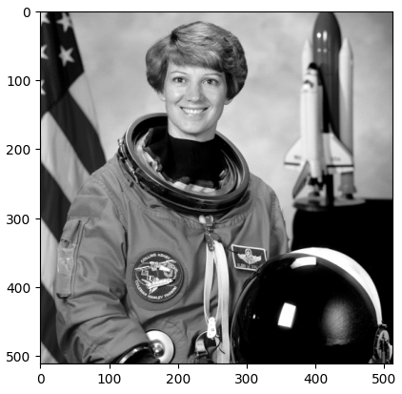
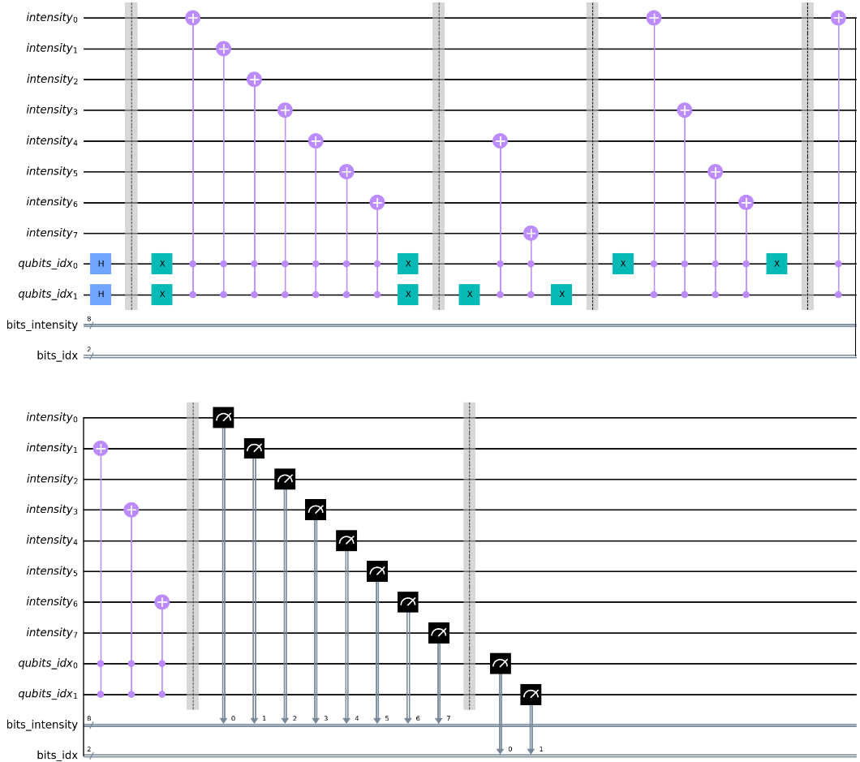
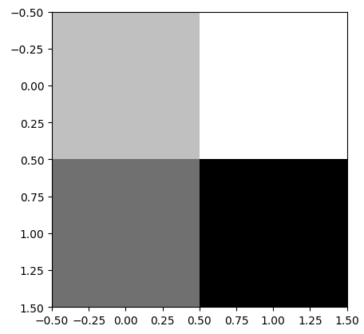
Original Image
Quantum circuit that encodes the image
2x2 Image

Slide 5
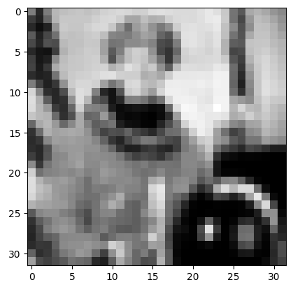
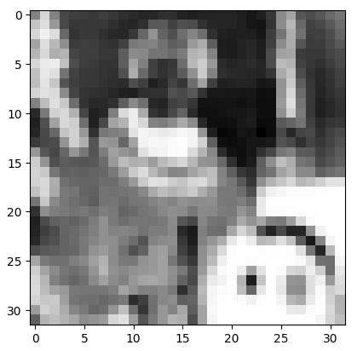
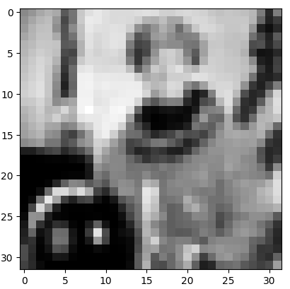
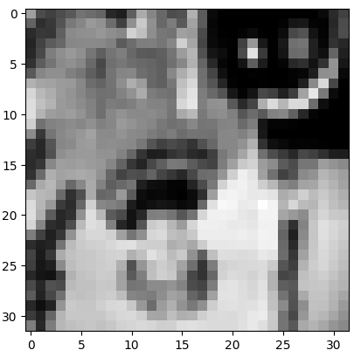
Original image 32x32
Negative of the image 32x32
Mirrored image 1
32x32
Mirrored image 2
32x32
https://github.com/jvscursulim/qamp_fall22_project/blob/master/neqr_example.ipynb

Slide 6
Thank you for your attention!!!

