Slide 1
Health Econometrics I
Lecture 12: Topics in Research Design
December 2, 2022
HAD5744 • Alex Hoagland, Ph.D.
Notes:
Things to add here:
Data cleaning (+ problems on Assignment 1) resources: https://twitter.com/rohanalexander/status/1632751793993023490?s=12&t=hNtLDW9uckouFPGvsGdgsg
Foreshadowing of future topics (and the types of questions they answer)
Repo/guide of publicly available datasets
Ways to integrate this into proposal

Slide 2
Session Outline
Are we estimating what we want to be estimating?
How to pick a research design
Organizing your research project
Communicating your results

Slide 3

Framework: Everything is a Remix
Notes:
Watch part 3 for sure, maybe also part 2?

Slide 4
What are we Estimating?
Notes:
One of the most important things to remember from this course – what is your estimand, and is it useful? How? We need to be good stewards of our data and research, and talk accurately about how our research designs give us causal pathways.

Slide 5
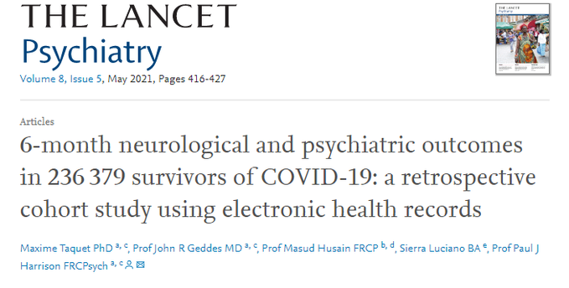
Example: What is Long COVID?
Notes:
Based on this study from the Lancet -- A key point about long COVID (and really, all chronic disease) is to remember that the number of people who have the condition is VERY dependent on how we define it

Slide 6
Example: What is Long COVID?
This study:
Large retrospective study (236,000 people who had COVID)
Looks at psychological/neurological symptoms post-COVID infection
Intracranial haemorrhage
Ischaemic stroke
Parkinsonism
Guillain-Barré syndrome
Dementia
Psychotic, mood, and anxiety disorders
Substance use disorder
Etc.
Notes:
This study is BIG – already cited 890 times with an altmetric score of 13.8k. Also included a control group of non-infected, close to 80 million patients. This is big data

Slide 7
Example: What is Long COVID?
This study:
Large retrospective study (236,000 people who had COVID)
Looks at psychological/neurological symptoms post-COVID infection
Matching study between cohorts
Notes:
Here, let’s start thinkin about threats to causality – what are some of the big things to watch out for when you hear matching? (selection on unobservables, type of matching)

Slide 8
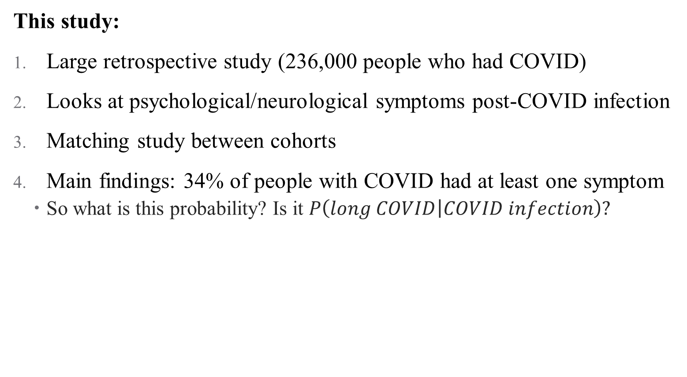
Example: What is Long COVID?
This study:
Large retrospective study (236,000 people who had COVID)
Looks at psychological/neurological symptoms post-COVID infection
Matching study between cohorts
Main findings: 34% of people with COVID had at least one symptom
So what is this probability? Is it $P\left(long COVID | COVID infection\right)?$
Notes:
Why or why not? A lot of people said yes! Even a JAMA article citing this study said that this is true! But it’s not! (Not yet – haven’t dealt with *new* diagnoses, for example)

Slide 9
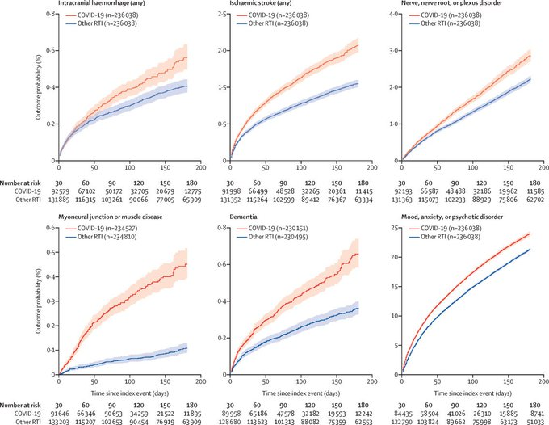
Example: What is Long COVID?
Notes:
What do these effects tell us? Are they economically significant? Are they statistically significant? They sure look bad! But what issues are there? (Publication bais; they’re only showing us 6 here. Plus look at y-axes. And what is the control group here?)

Slide 10
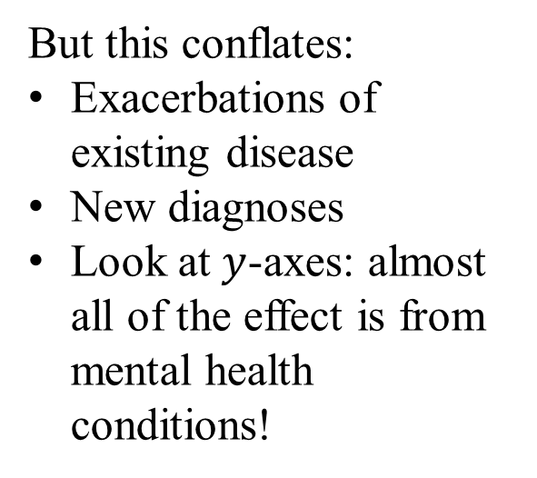
Example: What is Long COVID?
But this conflates:
Exacerbations of existing disease
New diagnoses
Look at $y$-axes: almost all of the effect is from mental health conditions!
Notes:
These include people with an old dx (e.g., depression) who filled a prescription, visited a GP, or went to the hospital for an unrelated issue – is that what we want to capture? The authors answer yes (because we care about flare-ups), but you could also reasonably argue that no, we only care about new onset (or some flareups, but which?)

Slide 11
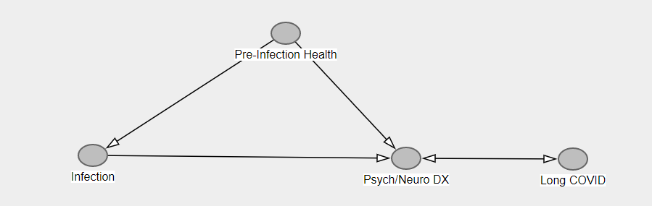
Example: What is Long COVID?
What’s the DAG here?
If we limit to
Notes:
Sample DAG – are we really getting the causal impact of infection to long covid? Maybe, but we haven’t closed back door, nor do we know that these dx’s are long covid (e.g., do we care about insomnia as a problem? Do we care about flare ups)

Slide 12

Example: What is Long COVID?
What’s the DAG here?
If we limit to
If we limit to new diagnoses only, $P\left(new dx | infection\right)=13\%$
But who’s the right control here?
Notes:
This is still matching only to the fully healthy group. But there are 80 million patients, surely we can pick a better match than that?

Slide 13
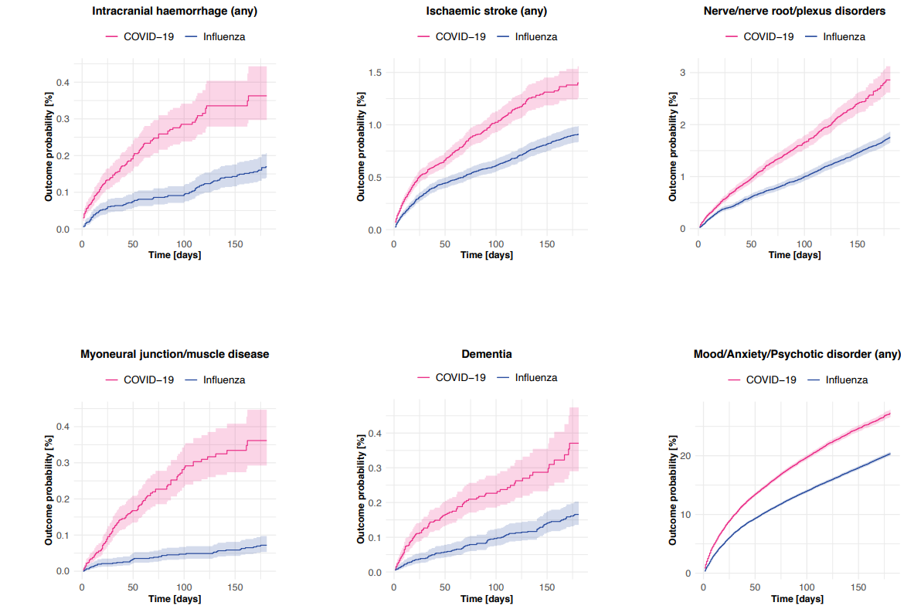
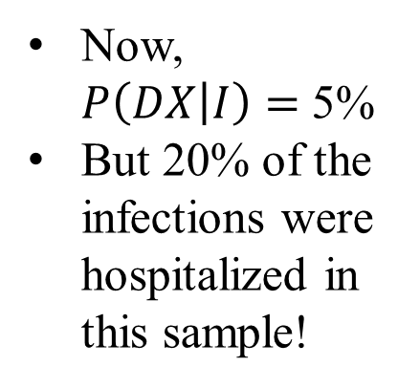
What if you compared to comparable illnesses?
Now, $P\left(DX | I\right)=$ 5%
But 20% of the infections were hospitalized in this sample!
Notes:
Now we’re matching not to the people with no health event, but to people with influenza (or broken bone, etc.). Differences are much smaller! You have to go to the online appendix to even find this! That already says something about the messaging of this article (plus the fact that curves are different, axis are shrunk, etc.). What is the takeaway? About 8% of the control cohorts had any new diagnosis of any of the issues assessed in this paper, compared to around 13% of the people infected with COVID-19.

Slide 14
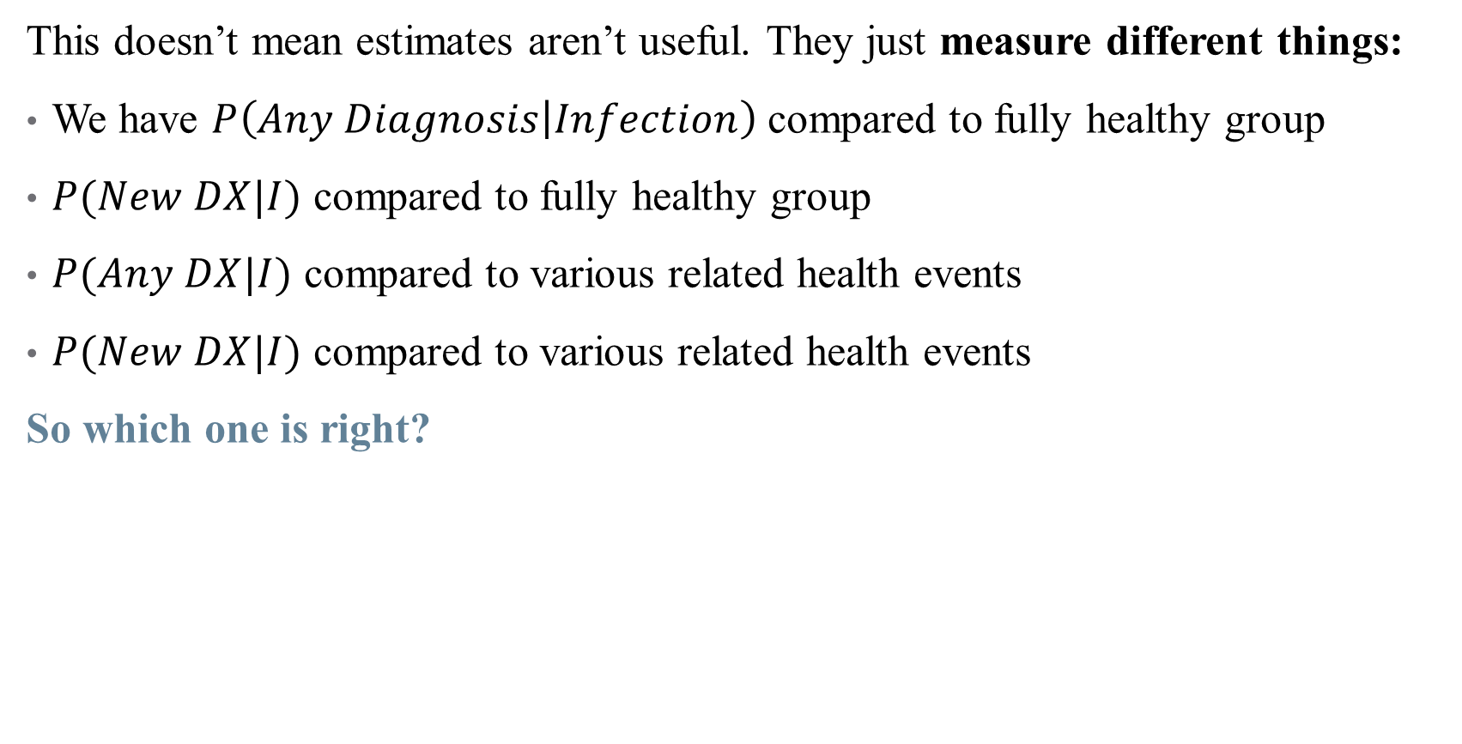
Example: What is Long COVID?
This doesn’t mean estimates aren’t useful. They just measure different things:
We have $P\left(Any Diagnosis | Infection\right)$compared to fully healthy group
$P(New DX|I)$ compared to fully healthy group
$P(Any DX|I)$ compared to various related health events
$P(New DX|I)$ compared to various related health events
So which one is right?
Notes:
They all are! For different things. What’s your policy context? What’s the threshold for economic significance (even 5% is not trivial)?
These are all things you need to think carefully about and be honest about in a paper. Why is your headline figure what it is? Why did you bury that figure in an online appendix? How will other researchers interpret your results when they cite you? How will the media cite you? Is that what you want?

Slide 15
Selecting a Research Design
Notes:
With this framework of remixing and thinking about your estimand in mind, let’s talk about how to pick a research design?

Slide 16
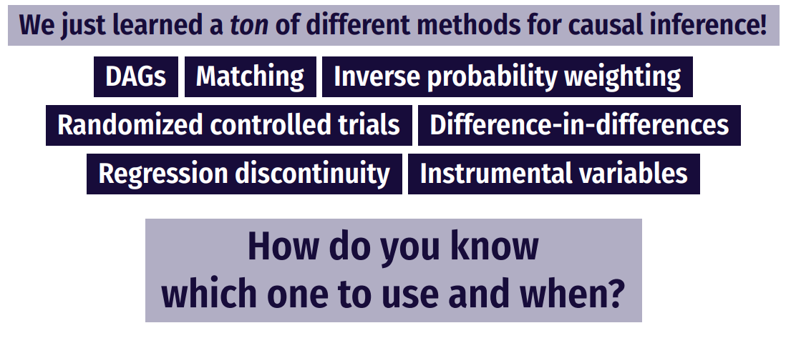
How do you pick a method?

Slide 17
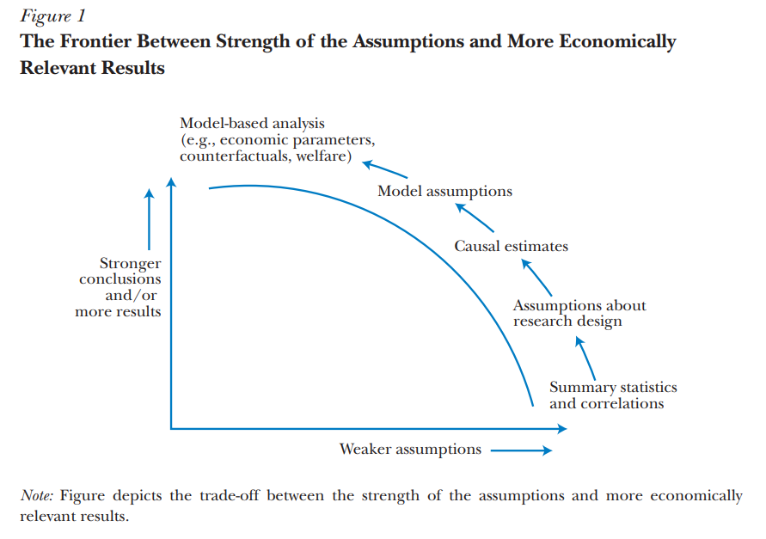
How do you pick a method?
Source: Mahoney (2022)

Slide 18
Model vs. Design-based Approaches
Approaches either rest on you having a DAG (model-based) or a good source of exogenous variation (design-based)
Examples of model-based: matching, controlling, IPW
Requires a big assumption about your DAG (and selection on unobservables)
Examples of design-based: RCT, DID, IV
Need a specific set of data and circumstances (policy change, instrument)

Slide 19
Model vs. Design-based Approaches
Approaches either rest on you having a DAG (model-based) or a good source of exogenous variation (design-based)
Examples of model-based: matching, controlling, IPW
Requires a big assumption about your DAG (and selection on unobservables)
Examples of design-based: RCT, DID, IV
Need a specific set of data and circumstances (policy change, instrument)
Important key: think about what variation you have
Variation across units?
Across time?
Policy changes
Weird policy rules?
Instruments?
Notes:
You’ll develop an intuition for this over time. Talk to lots of people about your thoughts!

Slide 20

Relying on Theoretical Frameworks
Almost all frameworks are theories of change (causal pathways)
But how can a framework motivate a design?
Write your research question as explicitly as possible
Draw a DAG! Take time thinking about open back- and front-doors
Maybe build the DAG into a theoretical model
DAG + model $⇒$ Regressions, assumptions, even identification!
Notes:
Building a model may require some calculus to solve it, but provides useful insights into relative comparative statics, what the real parameter of interest is (hint: usually a first/second derivative). Can embed these even further into a structural approach (more on this in a separate course, if there is demand?)

Slide 21
Choosing an Empirical Strategy
Your empirical strategy consists of two (related) components:
Estimation strategy: what is estimated, how, inference, etc.
Put equations in your papers!
Identification strategy: what allows making a causal statement?
Do you have experimental variation?
Balance?
Is there endogeneity in your design?
(reverse causality, heterogeneity, measurement/omitted error)
Notes:
Don’t be scared of regression equations – in fact, formalizing them will help you see threats to identification and improve your estimation approach.

Slide 22
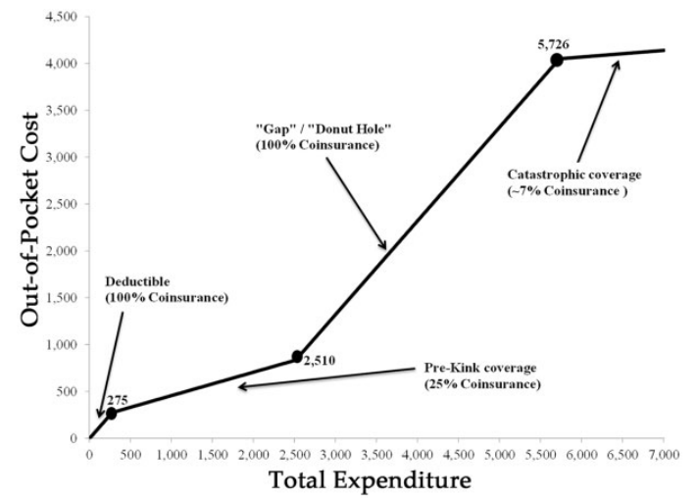
Descriptive Statistics are Your Friend!
1. Tell us something about the “story” you have in mind
Notes:
See “Mere description” in the folder. Even though we’re after a causal pathway, a solid set of descriptive stats (or better, a singl descriptive figure that tells your story) helps you to sell your work before it begins. By descriptives we mean just looking at patterns in the data, not trying to recover causal pathways.
Example: donut hole in Medicare (subsidies before/after a region, but a middle part where you have to pay 100% of expenses) (Einav, Finkelstein, and Schrimpf 2015)

Slide 23
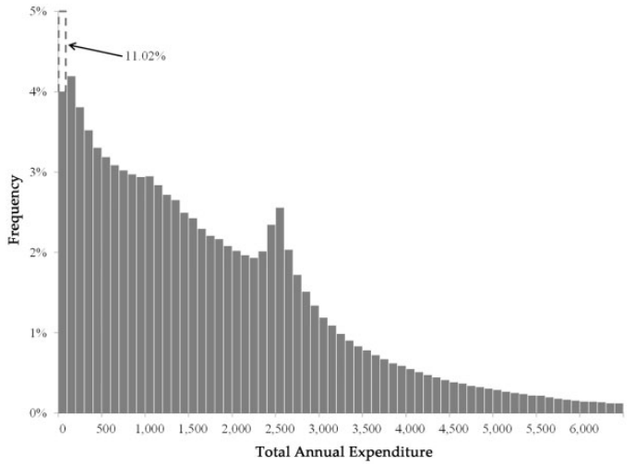
Descriptive Statistics are Your Friend!
Tell us something about the “story” you have in mind
You can argue the variation you’re exploiting in fact exists!
Notes:
In this case, the variation is bunching at the kink of the donut hole

Slide 24
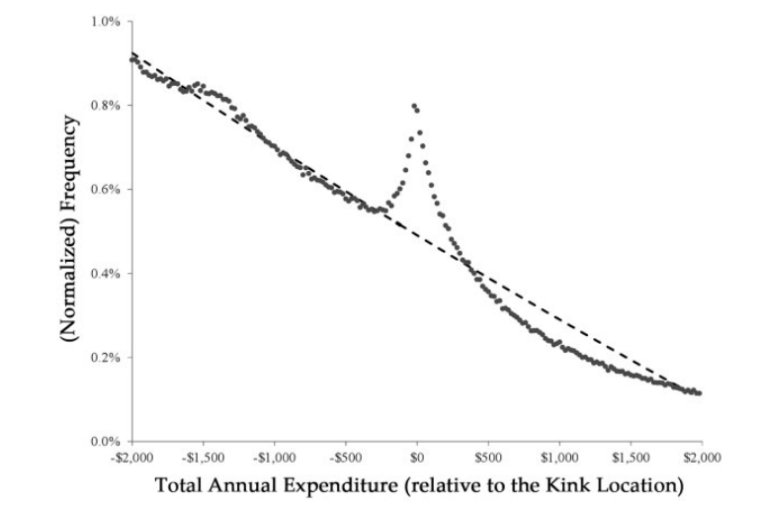
Descriptive Statistics are Your Friend!
Tell us something about the “story” you have in mind
You can argue the variation you’re exploiting in fact exists!
Notes:
In this case, the variation is bunching at the kink of the donut hole

Slide 25
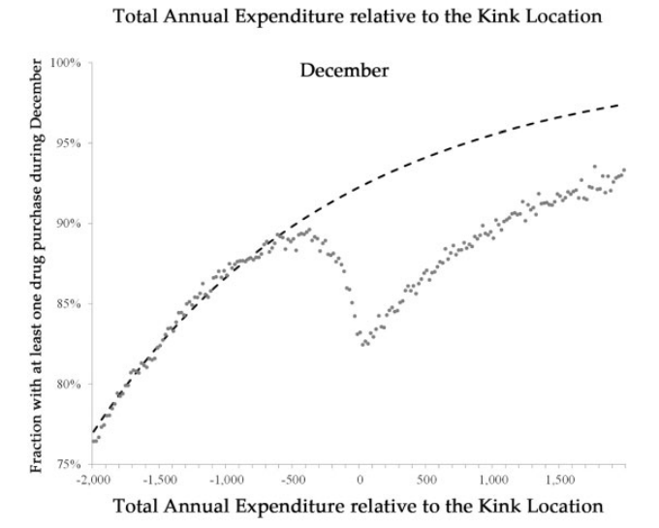
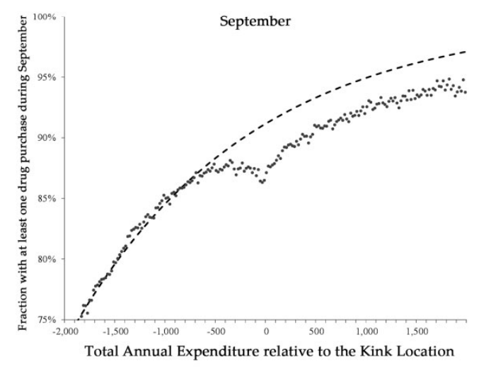
Descriptive Statistics are Your Friend!
Tell us something about the “story” you have in mind
You can argue the variation you’re exploiting in fact exists!
Informs and motivates your model
Notes:
In this case, show that consumers respond before the end of the year, but less than they do at the end of the year (so consumers aren’t fully forward looking). The descriptives provide evidence of a kink, but don’t allow you to quantify it without a causal model – ding ding ding you have a paper!

Slide 26
Descriptive Statistics are Your Friend!
Tell us something about the “story” you have in mind
You can argue the variation you’re exploiting in fact exists!
Informs and motivates your model
Don’t forget to say something about whom your sample is representative
Medicare Part D enrollees
Subject to the donut hole
Close to the kink point (since they are using a bunching strategy)
How does/doesn’t this generalize?
Notes:
Who are we looking at in this case? Seniors with Part D coverage – does that expand to other populations? Maybe, maybe not.

Slide 27
Organizing a Project
Notes:
Some people say synthetic control, but I like the plural – reminds me of the construction of the control group

Slide 28
How do we structure a project?
File organization
Clean code
Robustness checks
Writing!

Slide 29
What is Clean Code?
Code that is easy to understand, easy to modify, and hence easy to debug
Some sources:
The Clean Coder, by Robert C. Martin
Code and Data for the Social Sciences: A Practitioner's Guide, by Gentzkow and Shapiro
Tyler Ransom’s (Oklahoma University) slides: https://raw.githack.com/OU-PhD-Econometrics/fall-2022/master/LectureNotes/01a-CleanCode/01aslides.html#2
Notes:
Clean code saves you and your collaborators time! You will always make a mistake while coding -- what makes good programmers great is their ability to quickly identify and correct mistakes.

Slide 30
Principles of Clean Code
Automation
Version control
Abstraction
Documentation
Time / task management
Test-driven development (unit testing, profiling, refactoring)
Pair programming
Notes:
Clean code saves you and your collaborators time! You will always make a mistake while coding -- what makes good programmers great is their ability to quickly identify and correct mistakes.

Slide 31
Principles of Clean Code
Automation – automate everything (that can be)!
Version control
Abstraction
Documentation
Time / task management
Test-driven development (unit testing, profiling, refactoring)
Pair programming
Notes:
You should have a single script that runs all of your chunks from beginning to end – this is for reproducibility and efficiency (it’s like showing your work)

Slide 32
Principles of Clean Code
Automation
Version control – Github, Dropbox, Overleaf!
Abstraction
Documentation
Time / task management
Test-driven development (unit testing, profiling, refactoring)
Pair programming
Notes:
Use collaborative software that tracks versions of your code! easily undo changes, test out new specifications, and more

Slide 33
Principles of Clean Code
Automation
Version control
Abstraction – use functions to reduce complexity of code!
Documentation
Time / task management
Test-driven development (unit testing, profiling, refactoring)
Pair programming
Notes:
e.g. A dishwasher -- all I need to know is how to put dirty dishes in and which button, not how the electrical wiring works. Define a function once also makes it more reliable if you use it multiple times. You should abstract to eliminate redundancy and improve clarity (but not otherwise – can make code impenetrable!)

Slide 34
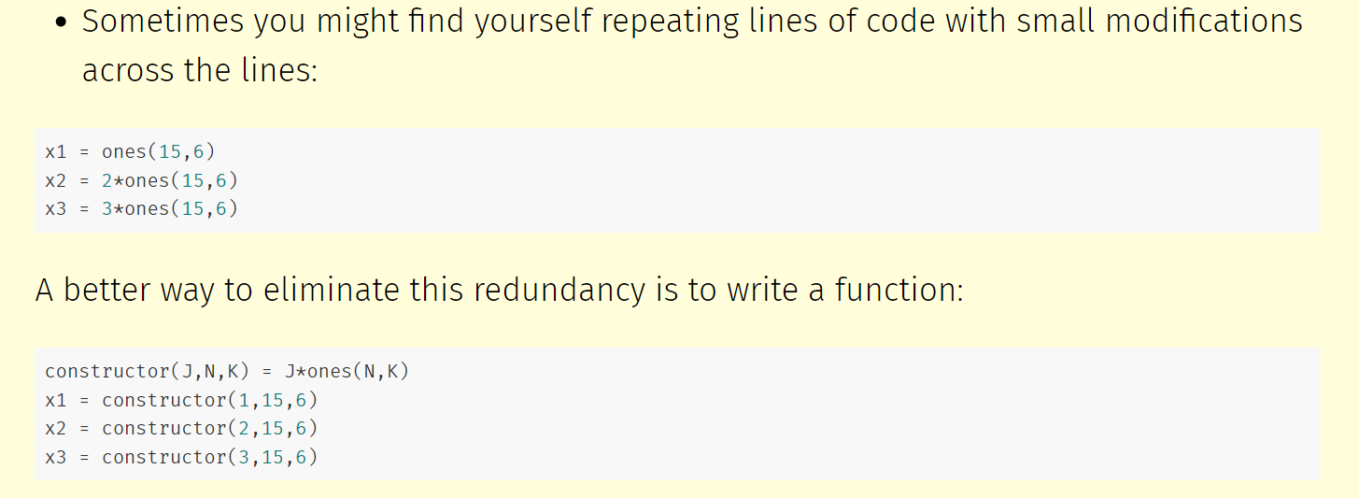
Example of Abstraction
Notes:
Now if I need to adjust the constructor() function, I only have to modify one line of code instead of three. This approach also minimizes typos in copy-pasting lines that are largely similar.

Slide 35
Principles of Clean Code
Automation
Version control
Abstraction
Documentation – make code readable! (Variable names, comments)
Time / task management
Test-driven development (unit testing, profiling, refactoring)
Pair programming
Notes:
Use names that people can understand (make code readable). Of course, don’t document if you aren’t going to update the documentation!

Slide 36
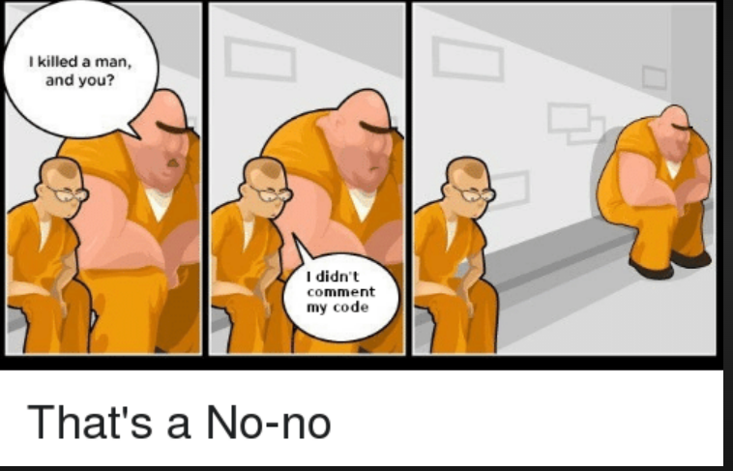
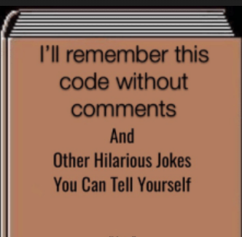
Principles of Clean Code: Comment Your Code!
Automation
Version control
Abstraction
Documentation – make code readable! (Variable names, comments)
Time / task management
Test-driven development (unit testing, profiling, refactoring)
Pair programming

Slide 37
Principles of Clean Code
Automation
Version control
Abstraction
Documentation
Time / task management – think carefully about when you code
Test-driven development (unit testing, profiling, refactoring)
Pair programming
Notes:
Coding is time intensive, and too many breaks or a strained/tired mental state will come back to bite you
Schedule long blocks of time (1.5 hours - 3 hours) to work on coding where you eliminate distractions (email, social media, etc.)
Stop coding when you feel that your focus or energy is dissipating

Slide 38
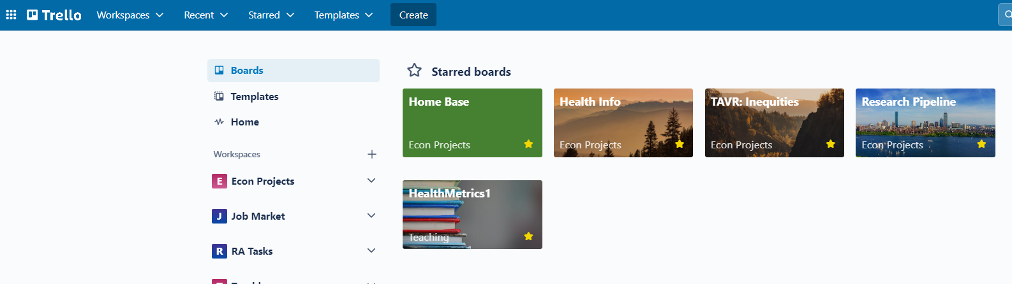
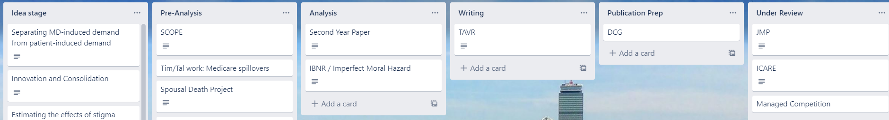
Principles of Clean Code: Task Management Software
Notes:
Trello is a great organizer for tasks. Don’t use email/slack, but rather a shared space just for the project. Another good one is Github Issues.

Slide 39
Principles of Clean Code
Automation
Version control
Abstraction
Documentation
Time / task management
Test-driven development (unit testing, profiling, refactoring) –
The only way to know that your code works is to test it!
Pair programming
Notes:
Test-driven development (TDD) consists of a suite of tools for writing code that can be automatically tested
Unit testing: checking that each piece of code works as you move through the structure. I recommend the testthat package for this
Profiling: how many resources does it take to run my code? Can I speed things up, make it faster, etc.?
Refactoring: can I make the code more readable / less redundant?

Slide 40
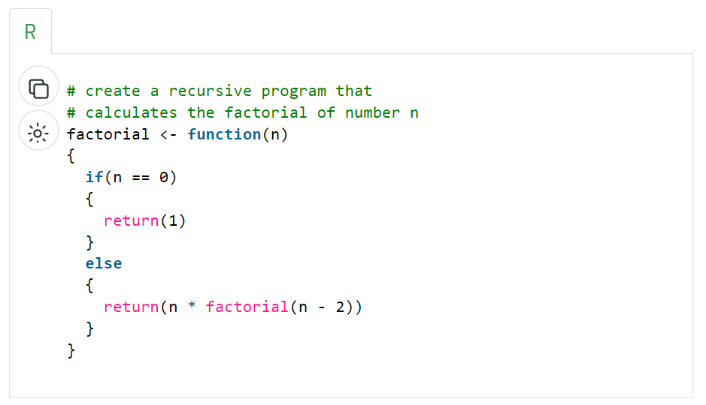
Unit Testing
Notes:
Suppose we have a function like this – we want to make sure that the function works for a set of values

Slide 41
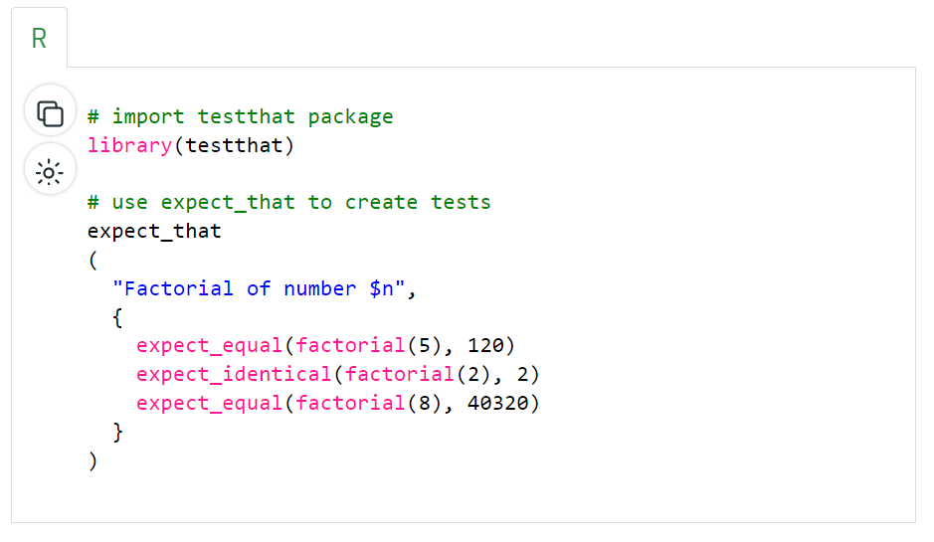
Unit Testing
Notes:
This package will test that!

Slide 42
Principles of Clean Code
Automation
Version control
Abstraction
Documentation
Time / task management
Test-driven development (unit testing, profiling, refactoring)
Pair programming – have people look at your code!
Notes:
Some people literally mean pair programming as in two people writing code together (one writes, another reviews simultaneously). But at any case, more than one set of eyes should look over all code (it’s definitely a learned skill to read code)

Slide 43
Communicating Findings
Notes:
Some people say synthetic control, but I like the plural – reminds me of the construction of the control group

Slide 44
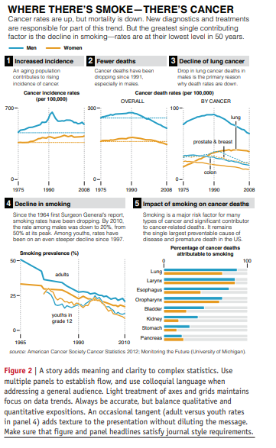
Data Viz
Schwabish (2014):
Show the data
Reduce the clutter
Integrate the text and the graph
See some helpful slides and examples here
Notes:
Figures are the most important thing about a paper – no, really. I think this is why TWFE took off more than anything else – the figures. Read this article in Github repo. How does the data viz stack up to some of these principles

Slide 45
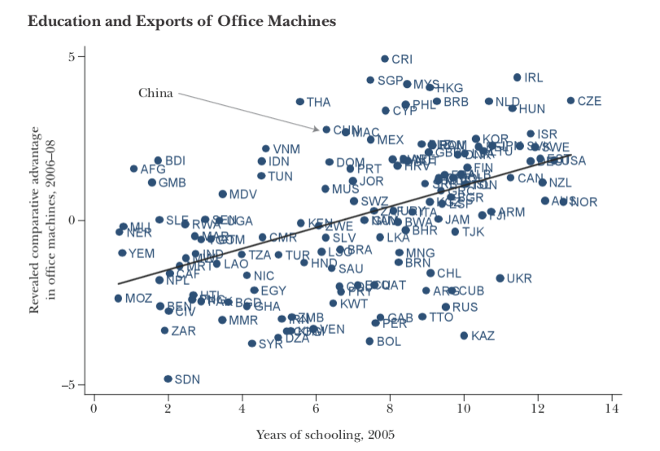
Data Viz: Before (1/2)
Notes:
What are some problems with this? This graph is super easy to make in R – but it pays to take the tmie to clean it up.

Slide 46
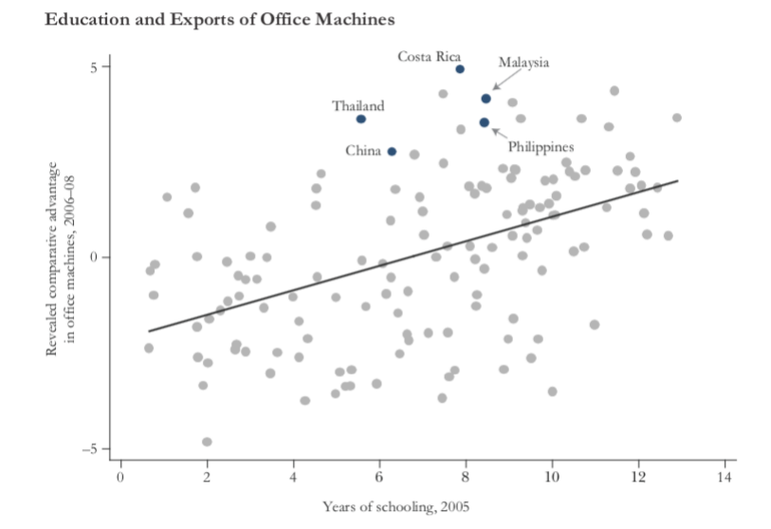
Data Viz: After (1/2)
Notes:
How is this better/ What does it tell us about the paper without reading it?

Slide 47
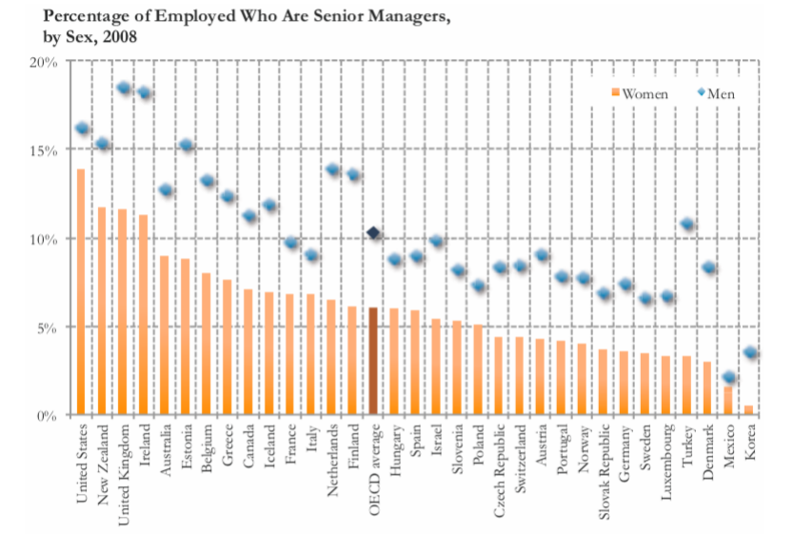
Data Viz: Before (2/2)
Notes:
This chart just doesn’t tell the story we want it to!

Slide 48
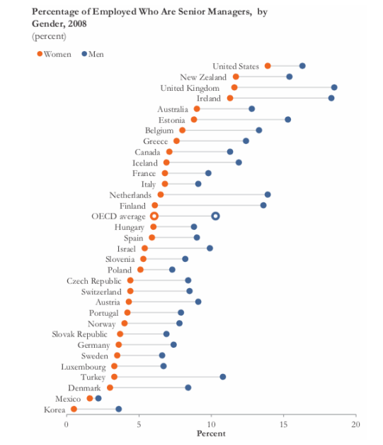
Data Viz: After (2/2)
Notes:
Now what’s the takeaway?

Slide 49

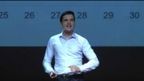
Data Storytelling and Making Good Charts
Notes:
If there’s time, data storytelling ted talks (probably will have to skip). Start with #1 if time.

Slide 50
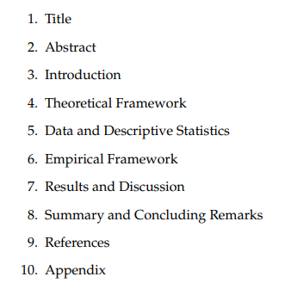
Writing a Paper
Academic writing is formulaic – take advantage of that!
Notes:
Follow the outlines!

Slide 51
Writing a Paper
Academic writing is formulaic – take advantage of that!
Copy good writers
Prioritize good writing – it will make your papers more successful
Some other good sources:
Marc Bellemare “How to Write an Applied Economics Paper”
Neil Mahoney “Principles for Combining Descriptive and Model-Based Analysis in Applied Microeconomics Research”
Notes:
What’s more, just copy structures of papers you think are good (literally – table 1 does X, etc.) This both makes your writing better and makes it easier for reviewers.

Slide 52
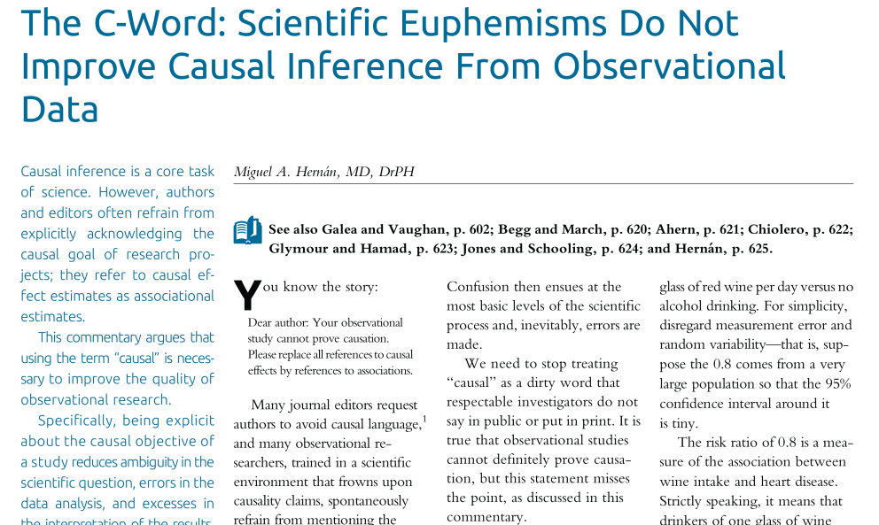
Concluding Thoughts
Don’t be afraid of causal inference!
In particular, don’t go back to saying everything you study is “associations”
Notes:
Fight the power!

Slide 53
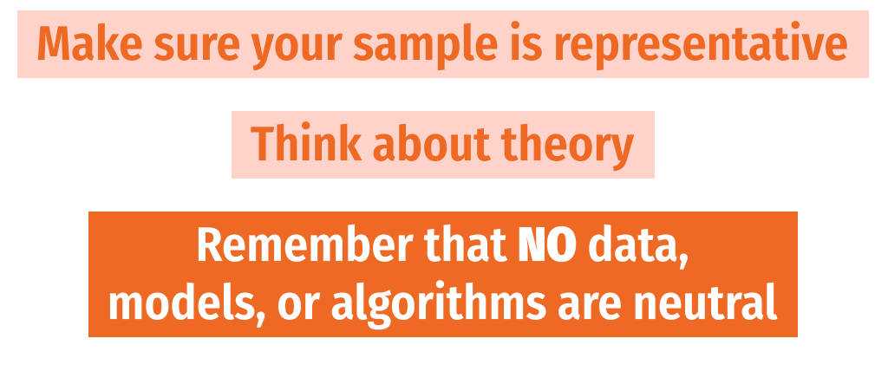
Concluding Thoughts
Don’t be afraid of causal inference!
In particular, don’t go back to saying everything you study is “associations”
And don’t be afraid of R!
Think carefully about your research setting
Notes:
Think carefully about how your results are going into the world. What are the assumptions? Limitations? External validity? What biases are you perhaps missing?

