Slide 1
Health Econometrics I
Lecture 8: Regressions with Limited Dependent Variables
November 4, 2022
HAD5744 • Alex Hoagland, Ph.D.
Notes:
For next semester
When discussing identification, use slides here: https://davidcard.berkeley.edu/lectures/woytinsky.pdf
Take out hurdle models, heckit, multinomial logit
Add in discussion about identification + partial identification + oster bounds

Slide 2
Quick Note on Proposals
Notes:
It’s all good! Just make sure that you focus on causal questions, and then think about how descriptive evidence will play in. I’d say the next big thing for a project is outlining the tables/figures (what do you want to show?) Come talk to me!

Slide 3
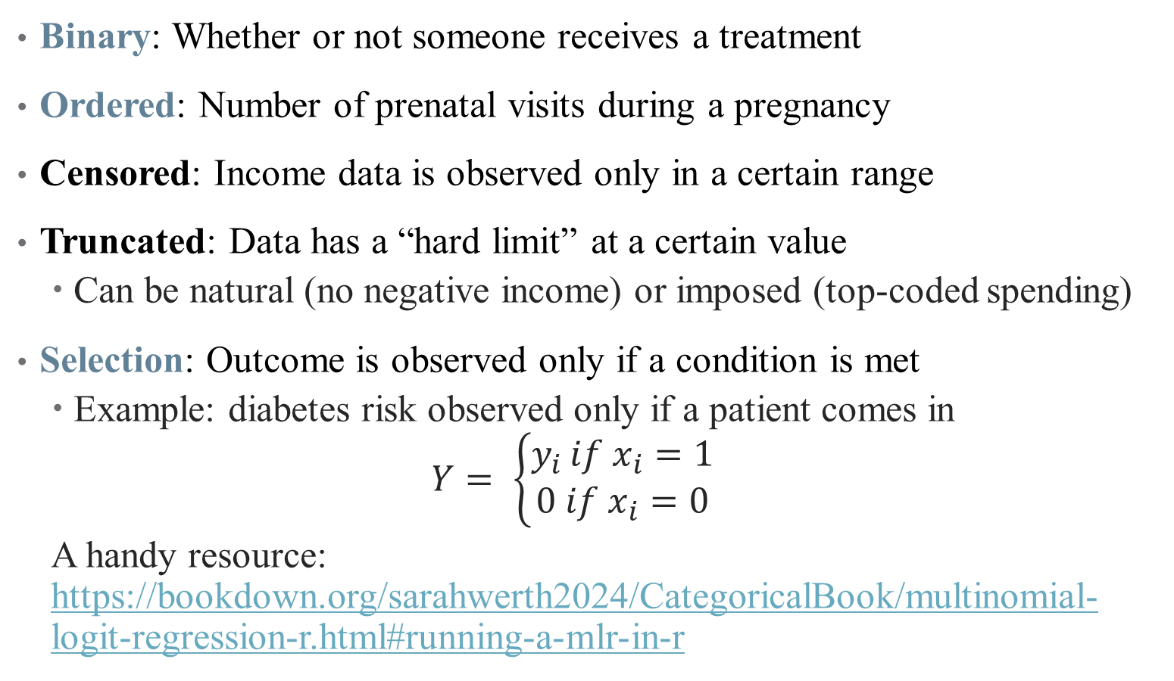
Examples of Limited Dependent Variables
Binary: Whether or not someone receives a treatment
Ordered: Number of prenatal visits during a pregnancy
Censored: Income data is observed only in a certain range
Truncated: Data has a “hard limit” at a certain value
Can be natural (no negative income) or imposed (top-coded spending)
Selection: Outcome is observed only if a condition is met
Example: diabetes risk observed only if a patient comes in
$$Y= \left\{\begin{aligned}y_{i }if x_{i}=1 \\ 0 if x_{i}=0\end{aligned}\right.$$
A handy resource: https://bookdown.org/sarahwerth2024/CategoricalBook/multinomial-logit-regression-r.html#running-a-mlr-in-r
Notes:
Last time we did binary, today we’re doing ordered and selection

Slide 4
Count Data: Poisson Regression

Slide 5
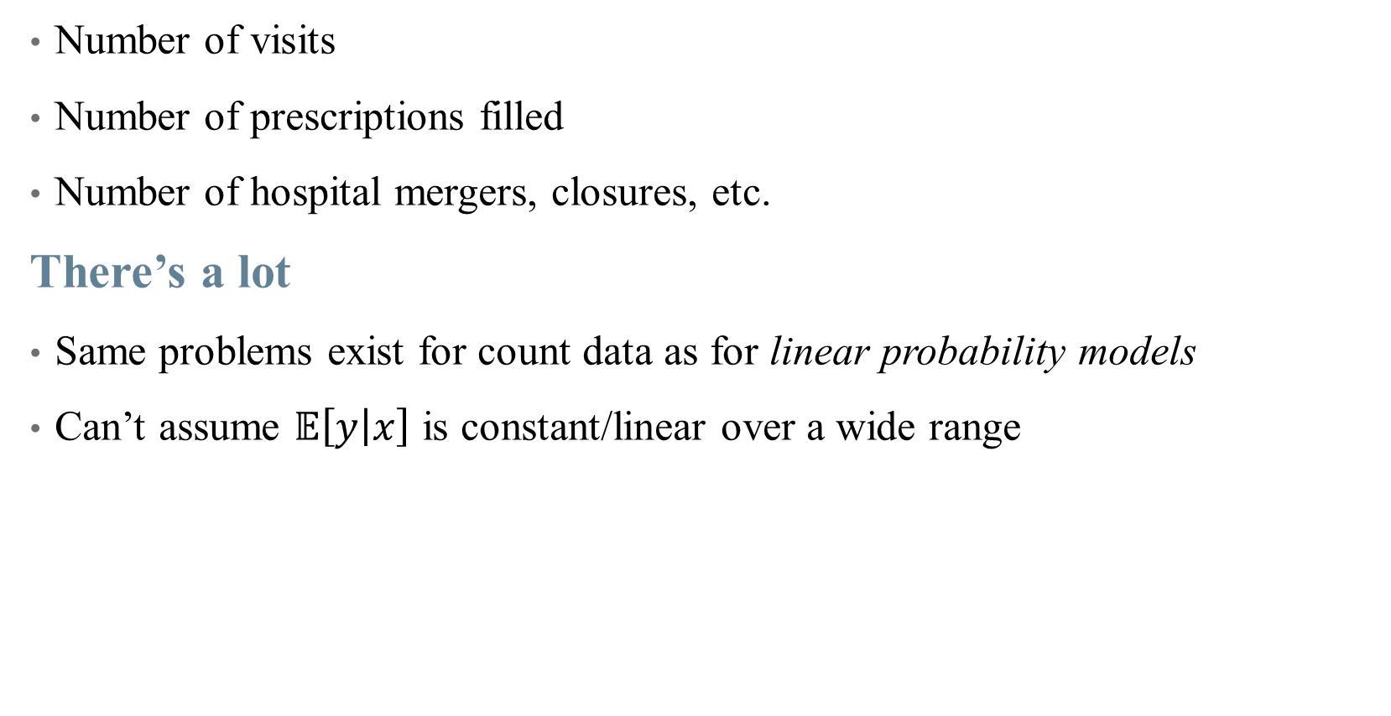
Examples of Count Data in Health Policy
Number of visits
Number of prescriptions filled
Number of hospital mergers, closures, etc.
There’s a lot
Same problems exist for count data as for linear probability models
Can’t assume $𝔼\left[y | x\right]$ is constant/linear over a wide range

Slide 6
Examples of Count Data in Health Policy
Number of visits
Number of prescriptions filled
Number of hospital mergers, closures, etc.
There’s a lot
When an event is relatively rare (counts are small), data tend to be far from normally distributed
We use Poisson regression to handle this

Slide 7
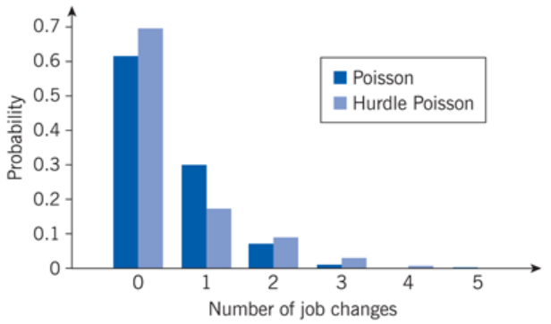
Examples of Count Data: Job Changes
Notes:
Main feature: low counts, far from normal. Hurdle Poisson takes into account the fact that we may not see people with 0 job changes in our data. We’ll get to that.

Slide 8
The Poisson Distribution
We can use GLM again to handle this non-normality
We just need a link function that approximates shape of data
Notes:
Draw Poisson distribution over data in class

Slide 9
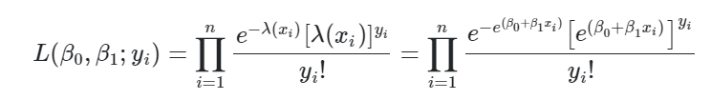
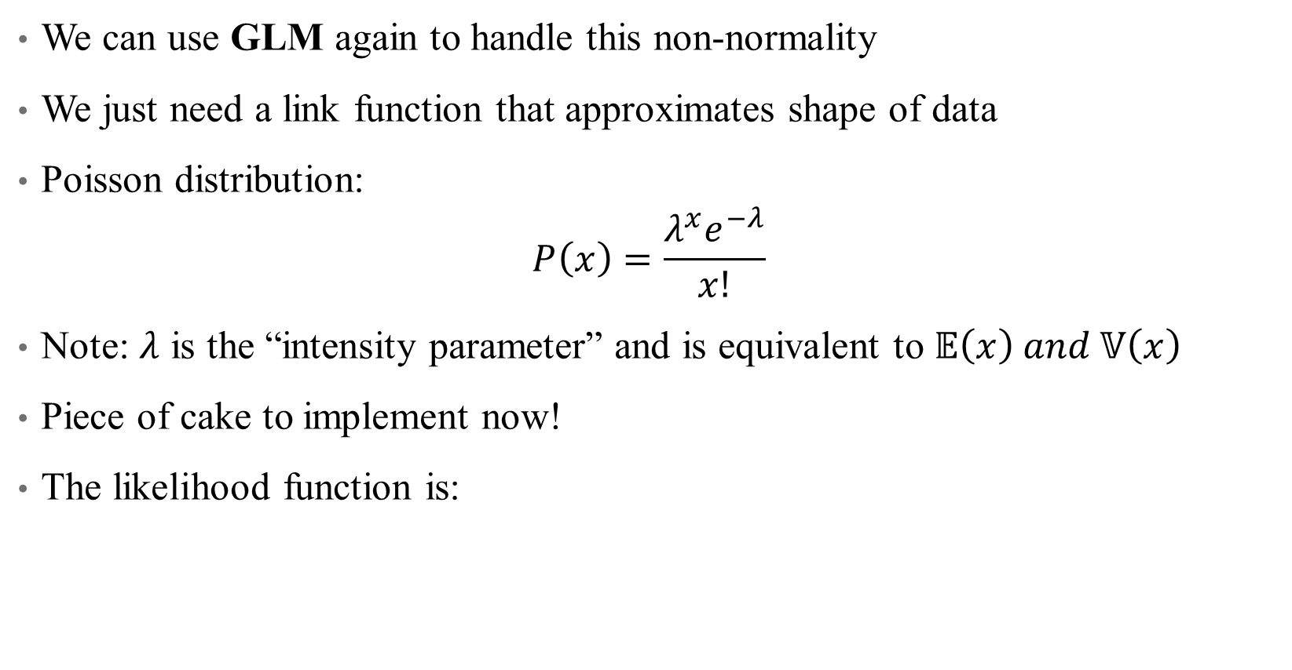
The Poisson Distribution
We can use GLM again to handle this non-normality
We just need a link function that approximates shape of data
Poisson distribution:
$$P\left(x\right)=\frac{λ^{x}e^{−λ}}{x!}$$
Note: $λ$ is the “intensity parameter” and is equivalent to $𝔼\left(x\right) and 𝕍\left(x\right)$
Piece of cake to implement now!
The likelihood function is:
Notes:
Likelihood function looks weird, but remember we just need a linear index function (our regression, bottom right of equation) and a pdf as our link function.

Slide 10



The Poisson Distribution
We can use GLM again to handle this non-normality
We just need a link function that approximates shape of data
Poisson distribution:
$$P\left(x\right)=\frac{λ^{x}e^{−λ}}{x!}$$
Note: $λ$ is the “intensity parameter” and is equivalent to $𝔼\left(x\right) and 𝕍\left(x\right)$
Piece of cake to implement now!
We can take logs as our link function to get:
Notes:
Can drop the last term in maximization – doesn’t matter because it doesn’t depend on beta.

Slide 11
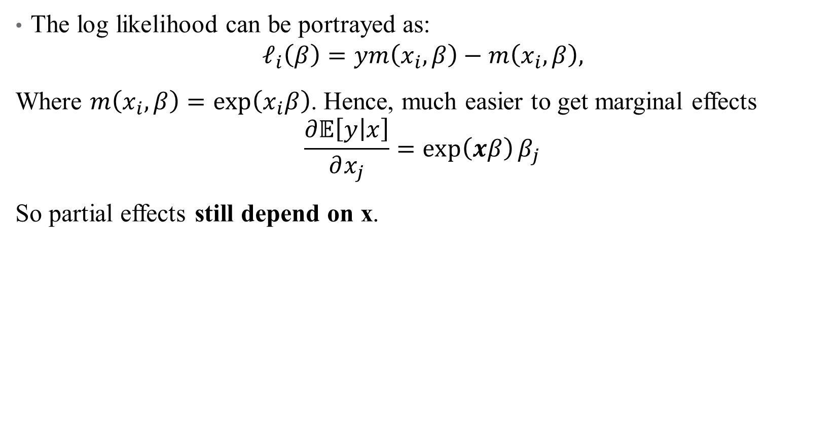
Poisson Regressions in Practice: Interpretation
The log likelihood can be portrayed as:
$$ℓ_{i}\left(β\right)=ym\left(x_{i},β\right)−m\left(x_{i},β\right),$$
Where $m\left(x_{i},β\right)=\exp\left(x_{i}β\right)$. Hence, much easier to get marginal effects
$$\frac{∂𝔼\left[y | x\right]}{∂x_{j}}=\exp\left(xβ\right)β_{j}$$
So partial effects still depend on x.

Slide 12
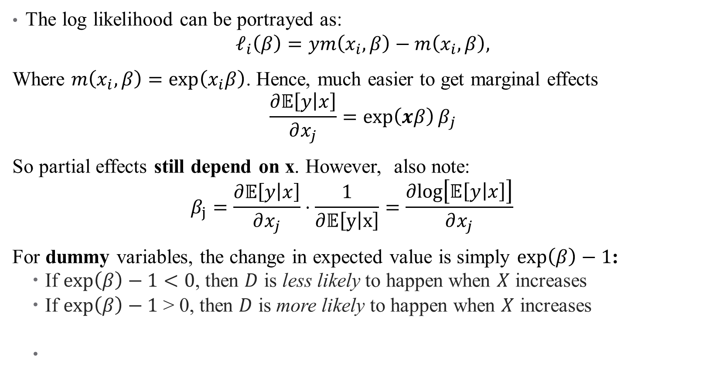
Poisson Regressions in Practice: Interpretation
The log likelihood can be portrayed as:
$$ℓ_{i}\left(β\right)=ym\left(x_{i},β\right)−m\left(x_{i},β\right),$$
Where $m\left(x_{i},β\right)=\exp\left(x_{i}β\right)$. Hence, much easier to get marginal effects
$$\frac{∂𝔼\left[y | x\right]}{∂x_{j}}=\exp\left(xβ\right)β_{j}$$
So partial effects still depend on x. However, also note:
$$β_{j}=\frac{∂𝔼\left[y | x\right]}{∂x_{j}}⋅\frac{1}{∂𝔼\left[y | x\right]}=\frac{∂log\left[𝔼\left[y | x\right]\right]}{∂x_{j}}{}$$
For dummy variables, the change in expected value is simply $\exp\left(β\right)−1$:
If $\exp\left(β\right)−1<0$, then $D$ is less likely to happen when $X$ increases
If $\exp\left(β\right)−1$ > 0, then $D$ is more likely to happen when $X$ increases
Notes:
You’re using the Poisson pdf here, and getting a semi-elasticity! So 100 beta_j is approximately the percentage change. Here it really is percent increase, not percentage points (because this is essentially a log transform)!

Slide 13

Poisson Regressions in Practice: Dispersion
One key assumption in a Poisson model is that $λ=𝔼\left(x\right)=𝕍\left(x\right)$
Essentially, this tests if you chose the right link function
It’s very possible (especially with lots of heterogeneity in your data) that you have overdispersion: $𝕍\left(x\right)>𝔼(x)$
This doesn’t affect bias, but does lead to imprecision in your estimates
Notes:
Overdispersion is likely since we know e(x) is small – otherwise, why would be doing poisson in the first place?

Slide 14
Poisson Regressions in Practice: Advantages
Useful for count data, but also for any case with nonnegative data:
Don’t need additional assumptions about conditional mean (log-transformed data)
Natural way to deal with zeros
Avoids inconsistency when using log-transformed + heteroskedasticity
Not as computationally intensive anymore (ppmlhdfe in Stata, glm in R)
Notes:
See ppmlhdfe help page in Github?

Slide 15
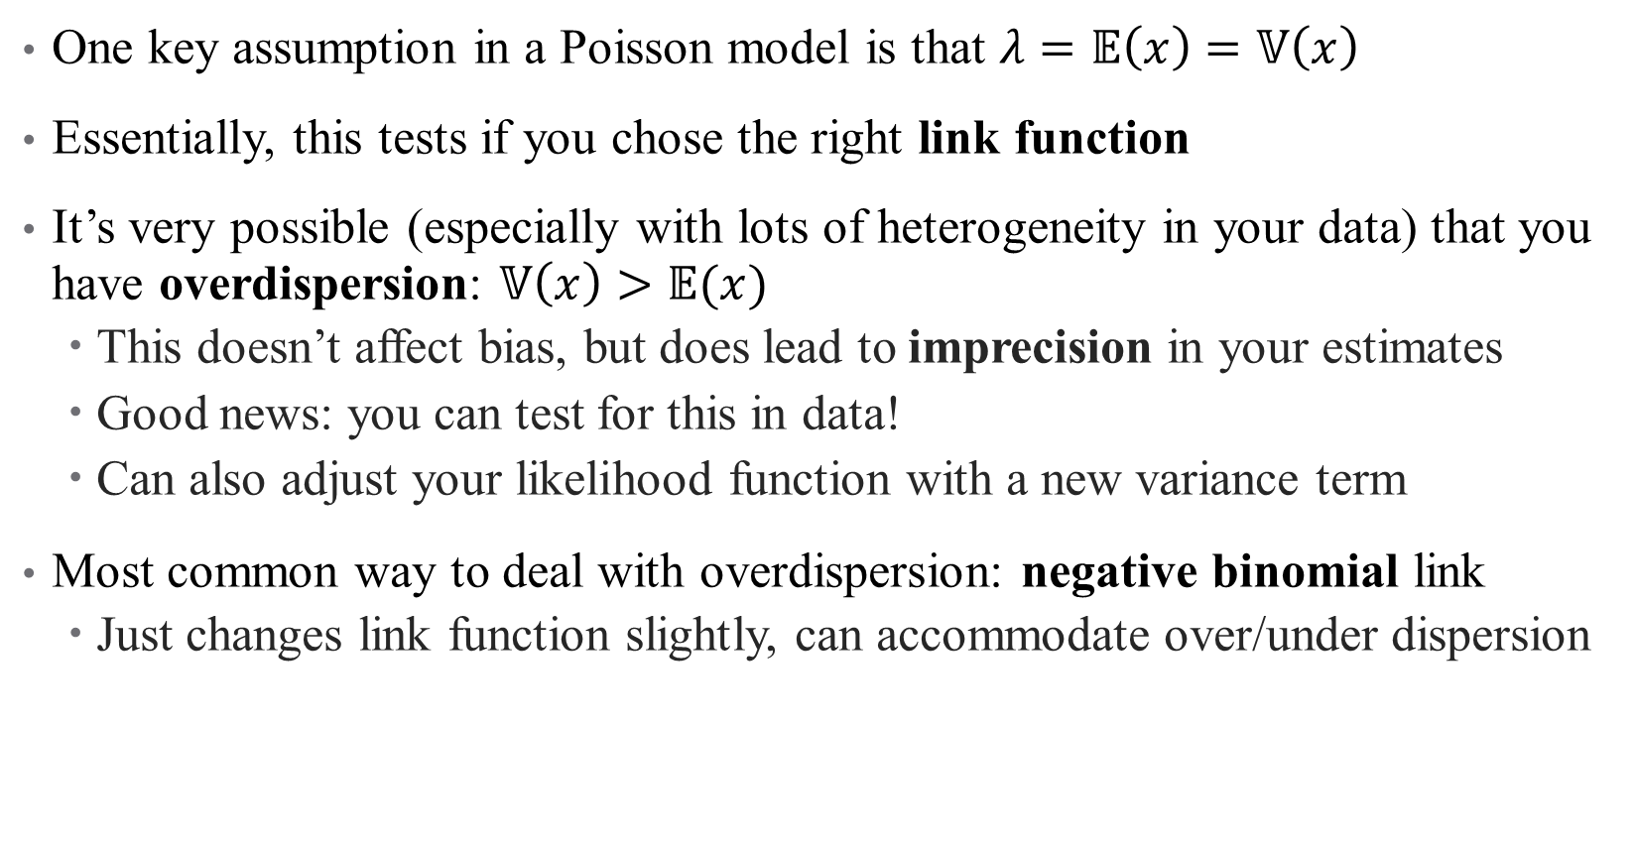
Poisson Regressions in Practice: Dispersion
One key assumption in a Poisson model is that $λ=𝔼\left(x\right)=𝕍\left(x\right)$
Essentially, this tests if you chose the right link function
It’s very possible (especially with lots of heterogeneity in your data) that you have overdispersion: $𝕍\left(x\right)>𝔼(x)$
This doesn’t affect bias, but does lead to imprecision in your estimates
Good news: you can test for this in data!
Can also adjust your likelihood function with a new variance term
Most common way to deal with overdispersion: negative binomial link
Just changes link function slightly, can accommodate over/under dispersion
Notes:
Negative binomial adds an additional variance parameter. Doesn’t really matter unless you are doing a complicated model and need to reduce parameters.

Slide 16
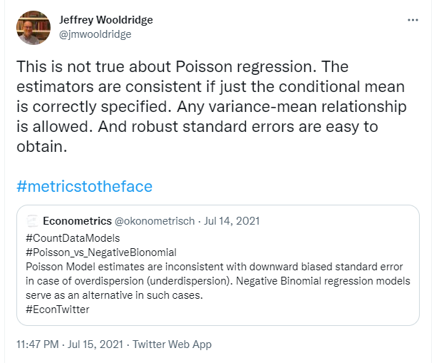
Poisson Regressions in Practice: Dispersion
Notes:
It’s not as big a deal as yo umight have heard. Negative binomial adds an additional variance parameter. Doesn’t really matter unless you are doing a complicated model and need to reduce parameters.

Slide 17
Example: How do hospital closures affect access?
Context: Between 1997 and 2002, Los Angeles County lost roughly 10% of its initial 131 hospitals
9 other “general acute care” hospitals also closed
Notes:
Note: is table 1 a helpful descriptive? How can it be better? Main mechanism is distance! Possible that it could be beneficial if you close low-quality hospitals (average quality increases). They are assuming that hospital closures are exogenous to patients (good assumption or not?)

Slide 18
Example: How do hospital closures affect access?
Context: Between 1997 and 2002, Los Angeles County lost roughly 10% of its initial 131 hospitals
9 other “general acute care” hospitals also closed
Contribution: assessing the impact of hospital closures on:
Perceived access to care
Health care utilization
Health outcomes
What do we think? Valid? Interesting?
What’s the main mechanism? What’s the hypothesis/hypotheses?
Notes:
Note: is table 1 a helpful descriptive? How can it be better? Main mechanism is distance! Possible that it could be beneficial if you close low-quality hospitals (average quality increases). They are assuming that hospital closures are exogenous to patients (good assumption or not?)

Slide 19
Example: How do hospital closures affect access?
Context: Between 1997 and 2002, Los Angeles County lost roughly 10% of its initial 131 hospitals
9 other “general acute care” hospitals also closed
Contribution: “assessing the impact of hospital closures on perceived access to care, health care utilization and health outcomes”
What do we think? Valid? Interesting?
What’s the main mechanism? What’s the hypothesis/hypotheses?
Data: household surveys + administrative zip code level mortality data
How useful is this? What would be better?
Notes:
Note: is table 1 a helpful descriptive? How can it be better? Main mechanism is distance! Possible that it could be beneficial if you close low-quality hospitals (average quality increases). The data seems usefu lin the sense hat it allows to separate out two things: where people are getting care, nd where care might be most valuable (AMI)

Slide 20
Example: How do hospital closures affect access?
Context: Between 1997 and 2002, Los Angeles County lost roughly 10% of its initial 131 hospitals
9 other “general acute care” hospitals also closed
Contribution: “assessing the impact of hospital closures on perceived access to care, health care utilization and health outcomes”
What do we think? Valid? Interesting?
What’s the main mechanism? What’s the hypothesis/hypotheses?
Data: household surveys + administrative zip code level mortality data
How useful is this? What would be better?
Methods: What exogeneity assumption are they resting on?
Do they have a control group? Who?
Notes:
They are assuming that hospital closures are exogenous to patients (good assumption or not – areas might be very different?) Control group is those in areas without closures.

Slide 21
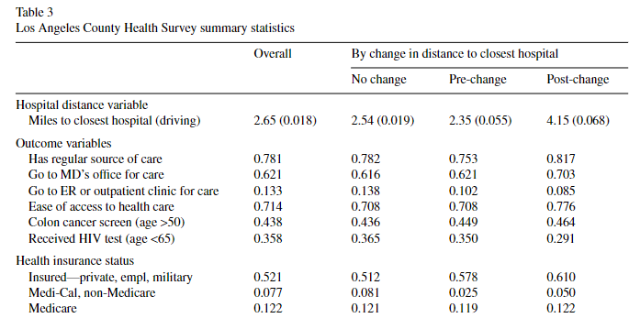
Data: What story are we telling here?
Notes:
How do we interpret these results?

Slide 22
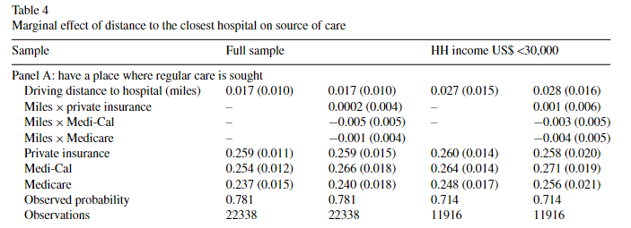
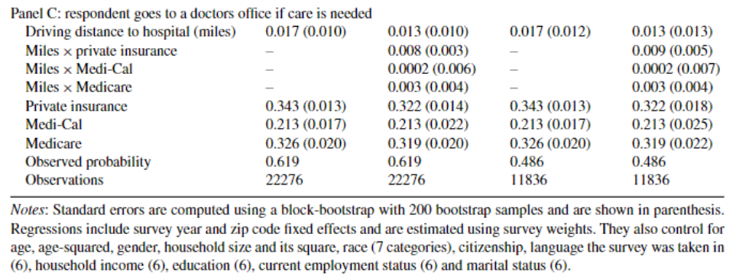
Results: Linear Probability Models
Notes:
How do we interpret these results? (Review; how would these change if we used logit/probit)?

Slide 23
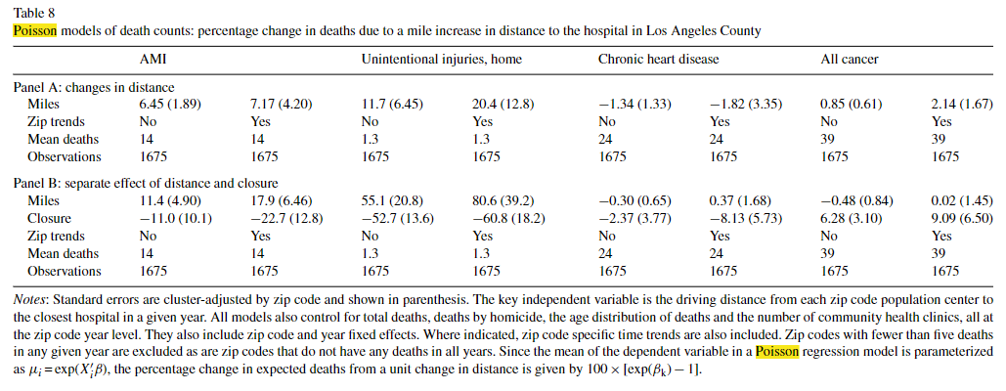
Poisson results: How do hospital closures affect access?
Notes:
How do we interpret these results? Notice the title is helpful here – plus look at that note! But we have very small death counts here, and are the results significant? Not really talking about significance here or in the paper.

Slide 24
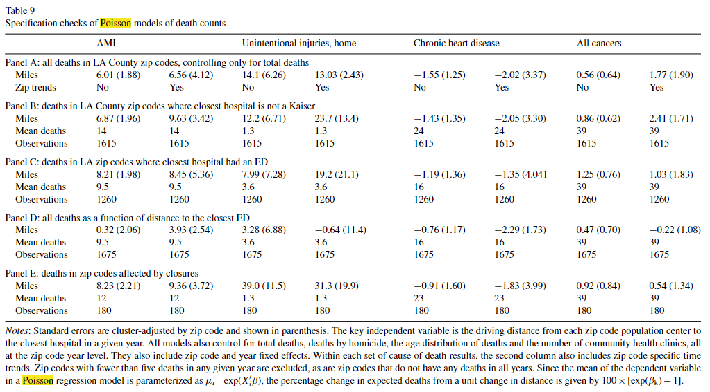
Poisson results: How do hospital closures affect access?
Notes:
How do we interpret these results? Specification/robustness checks: what concerns are we addressing here? Mostly checking the mechanisms – are mortality results driven by lack of ER access. Panel D is the funkiest. What is panel E attempting to do (take into account differences in treated vs. control group)

Slide 25
Mini Referee Report
What do you think about this paper? Any concerns? Anything clever?
Notes:
Some of my concerns – what are these negative trends from the closure? Reporting error? I don’t like the data. Would have liked to see some figures.

Slide 26
Hurdle Models

Slide 27
A unique form of excess dispersion: Zeros
A common violation of Poisson assumptions is having too many 0s in data
Sometimes, you want a different model processes for 0/positive outcome
Notes:
Examples of different processes: have to decide first time whether to go, based on location, lack of relationship, uncertainty about cost, etc. After I go once, number of visits is more related to actual medical needs (and easier due to physician relationship, automatic appointments, etc.). This is an example of censored/corner solution data (Pr(Y=0) > 0)

Slide 28
A unique form of excess dispersion: Zeros
A common violation of Poisson assumptions is having too many 0s in data
Sometimes, you want a different model processes for 0/positive outcome
Can model these separately with a hurdle model, which has 2 steps:
Participation decision: whether number of visits will be positive or 0.
Amount decision: how many visits take place once hurdle is crossed?
Notes:
Examples of different processes: have to decide first time whether to go, based on location, lack of relationship, uncertainty about cost, etc. After I go once, number of visits is more related to actual medical needs (and easier due to physician relationship, automatic appointments, etc.)

Slide 29

Hurdle Models in Theory
Suppose we have data $s∈\{0,1\}$ on whether $y=0$ or $y>0$
Consider a latent variable $w^{∗} such that y={sw}^{∗}$
Notes:
Note that this means that anything could be true for the value of y when we don’t observe it

Slide 30
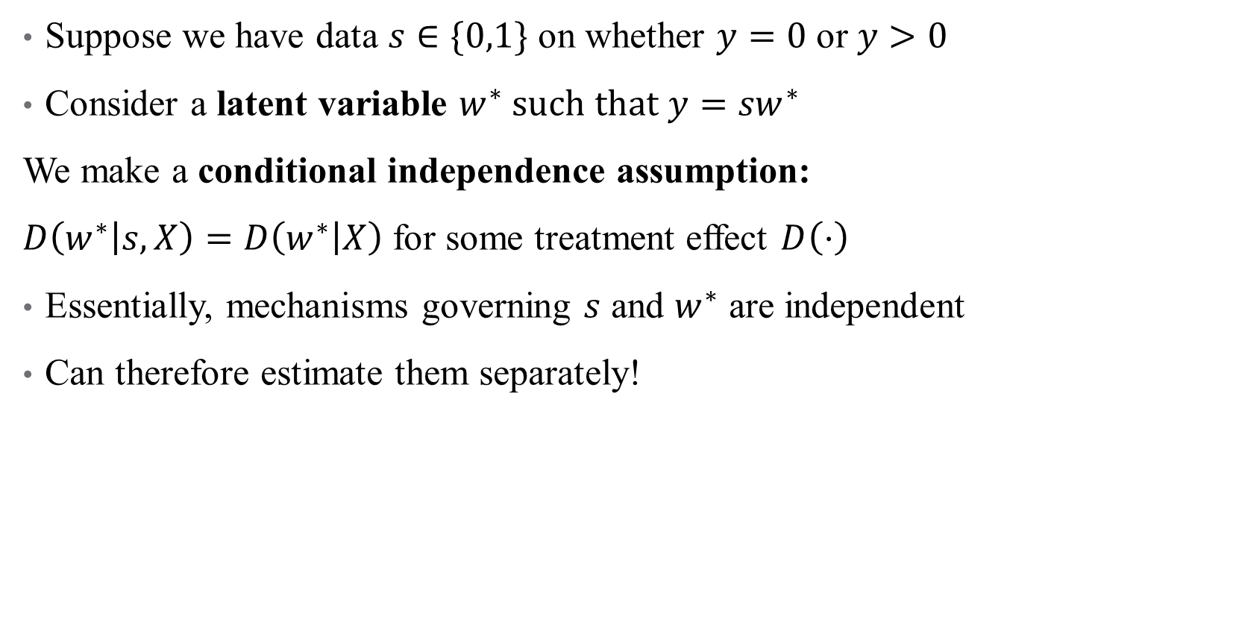
Hurdle Models in Theory
Suppose we have data $s∈\{0,1\}$ on whether $y=0$ or $y>0$
Consider a latent variable $w^{∗} such that y={sw}^{∗}$
We make a conditional independence assumption:
$D\left(w^{∗} | s,X\right)=D\left(w^{∗} | X\right)$ for some treatment effect $D\left(⋅\right)$
Essentially, mechanisms governing $s$ and $w^{∗}$ are independent
Can therefore estimate them separately!

Slide 31
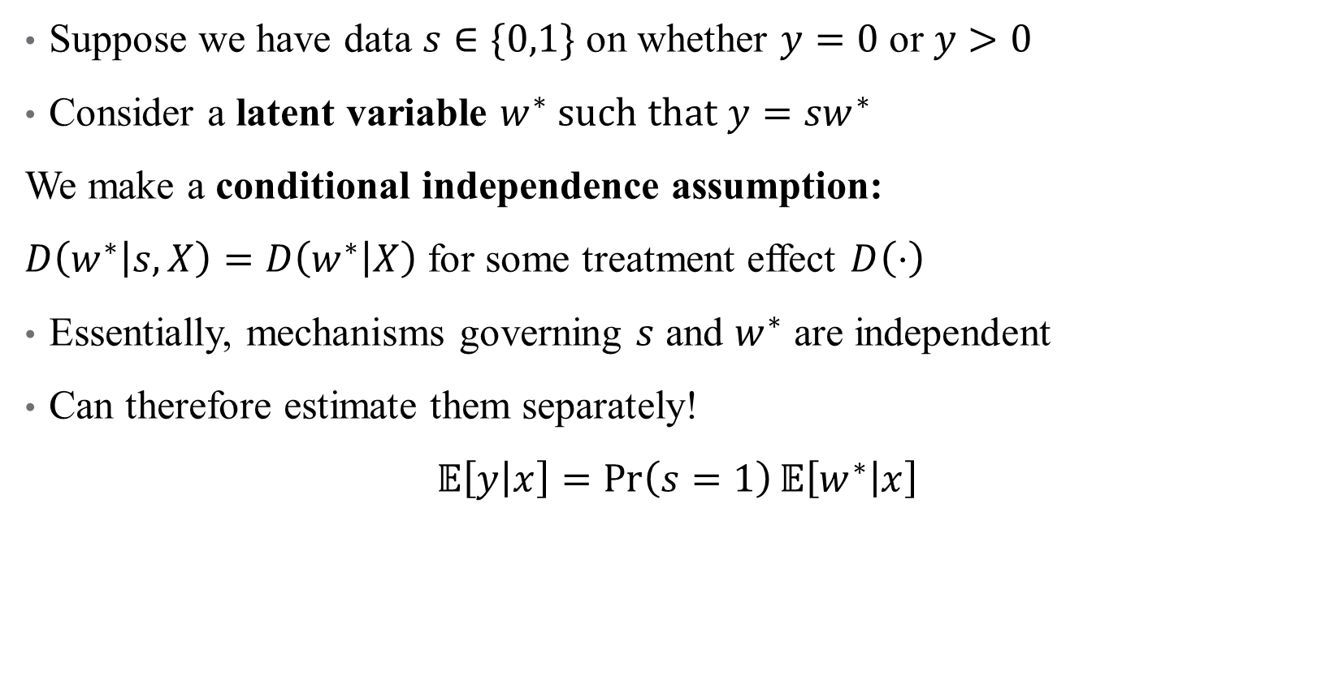
Hurdle Models in Theory
Suppose we have data $s∈\{0,1\}$ on whether $y=0$ or $y>0$
Consider a latent variable $w^{∗} such that y={sw}^{∗}$
We make a conditional independence assumption:
$D\left(w^{∗} | s,X\right)=D\left(w^{∗} | X\right)$ for some treatment effect $D\left(⋅\right)$
Essentially, mechanisms governing $s$ and $w^{∗}$ are independent
Can therefore estimate them separately!
$𝔼\left[y | x\right]=\operatorname{Pr}\left(s=1\right)𝔼\left[w^{∗} | x\right]$
Participation decision
Amount decision

Slide 32
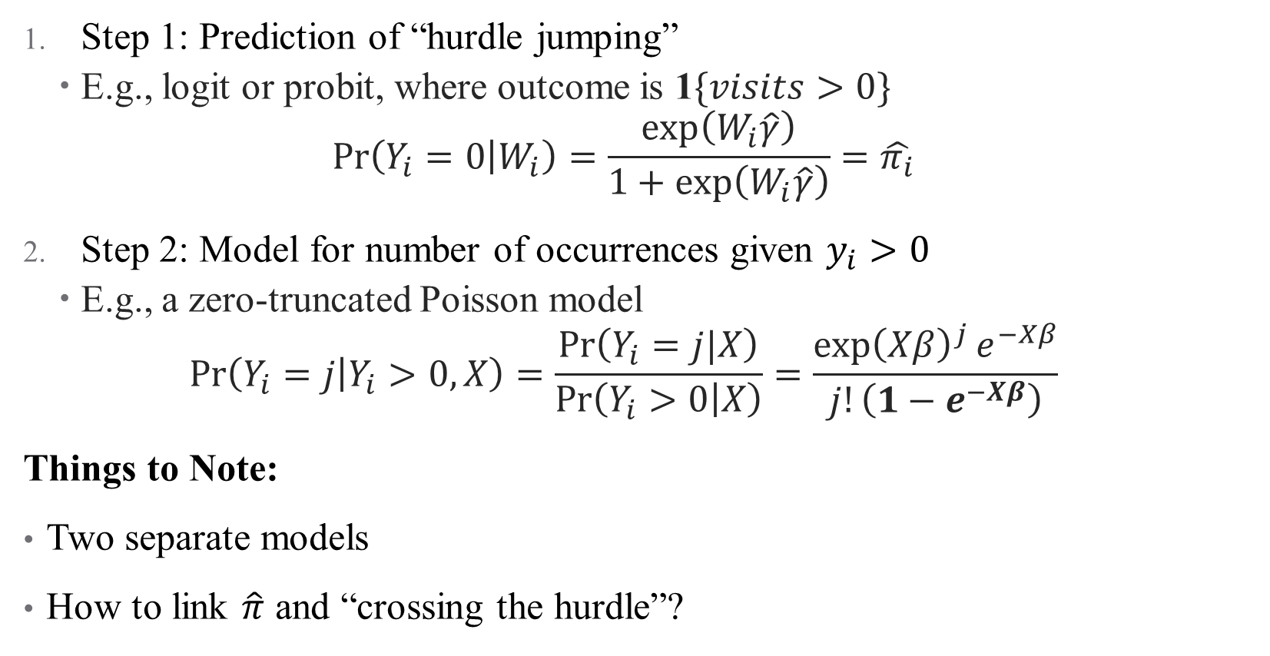
Hurdle Models in Practice
Step 1: Prediction of “hurdle jumping”
E.g., logit or probit, where outcome is 1$\{visits>0\}$
$$\operatorname{Pr}\left(Y_{i}=0 | W_{i}\right)=\frac{\exp\left(W_{i}\hat{γ}\right)}{1+\exp\left(W_{i}\hat{γ}\right)}=\hat{π_{i}}$$
Step 2: Model for number of occurrences given $y_{i}>0$
E.g., a zero-truncated Poisson model
$$\operatorname{Pr}\left(Y_{i}=j | Y_{i}>0,X\right)=\frac{\operatorname{Pr}\left(Y_{i}=j|X\right)}{\operatorname{Pr}\left(Y_{i}>0 | X\right)}=\frac{{\exp\left(Xβ\right)}^{j}e^{−Xβ}}{j!\left(1−e^{−Xβ}\right)}$$
Things to Note:
Two separate models
How to link $\hat{π}$ and “crossing the hurdle”?
Notes:
Notice that W and X have different variables and coefficients—not restricted to be the same. Equation for Poisson is same as pdf, except for bolded part which is 1-f(0) (rescales distribution). Pi is linked to hurdle based on data—hurdle package pins down exact number of 0s at those observed in data (so pi_overbar is a “moment” that matches the data

Slide 33
Is a Hurdle Model Appropriate?
Hurdle models are great if there really are two processes in your data
If the decisions driving one DGP are different from another
Applications to behavioral econ galore!
But hurdle models can’t help you if your problem isn’t a separate DGP:
Selection (we don’t observe data for some people for some reason)
Data are censored/error in measurement
Any reason the 0s in your data aren’t actually 0s
In these cases, a two-part model will be biased
These issues are addressed another way: a technique called Heckit
Notes:
E.g., differences in planned versus realized choice, insurance plan choice verus follow-up years, etc. Heckit is named after James Heckman. I’ll give a brief overview of Heckit but not its implementation—basically if you’re working with crummy data, you’re already losing a big chunk of the battle so best not to focus on this too much.

Slide 34
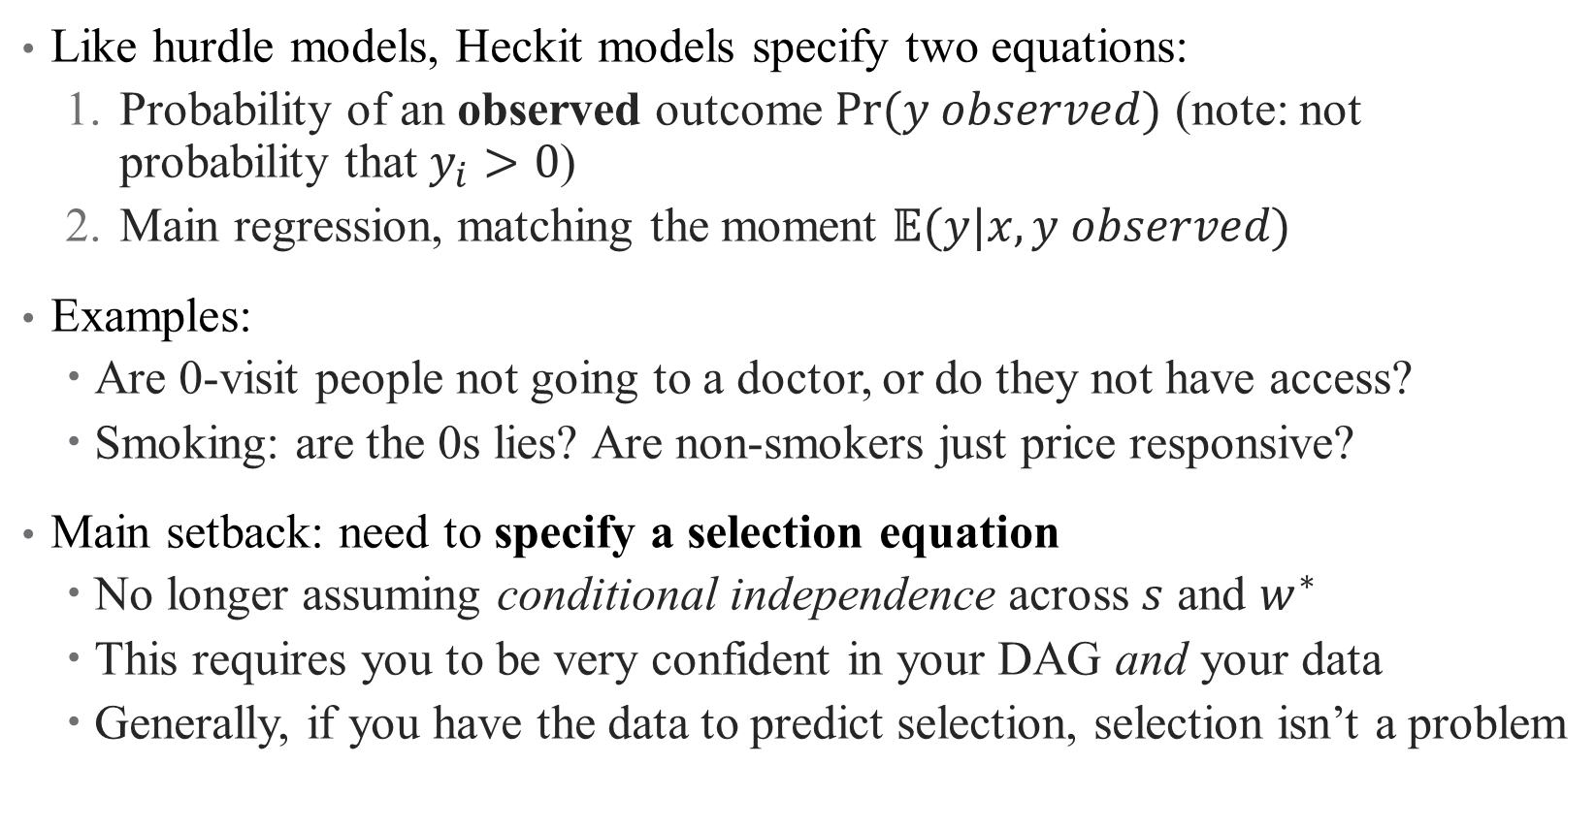
Heckit: A brief overview
Like hurdle models, Heckit models specify two equations:
Probability of an observed outcome $Pr⁡(y observed)$ (note: not probability that $y_{i}>0$)
Main regression, matching the moment $𝔼(y|x,y observed)$
Examples:
Are 0-visit people not going to a doctor, or do they not have access?
Smoking: are the 0s lies? Are non-smokers just price responsive?
Main setback: need to specify a selection equation
No longer assuming conditional independence across $s$ and $w^{∗}$
This requires you to be very confident in your DAG and your data
Generally, if you have the data to predict selection, selection isn’t a problem
Notes:
The main difference between heckit and hurdle is that hurdle deals with 0s in the actual outcome, while heckit deals with potential outcomes (e.g., the potential outcome is latent, so we stick a 0). So in the PCP example, the potential number of visits for some people isn’t observed because they don’t have access – that’s a selection problem (not someone who chose not to go to a doctor they had access to, that’s an actual outcome). The problem is that you have to specify a model predicting who didn’t have access—stronger identification issues.

Slide 35
Example: How can LTC care be expanded affordably?
Context: public subsidization of LTC in Spain (2007)
Universalized and funded access to LTC
One advantage: heterogeneously introduced across regions (identification!)

Slide 36
Example: How can LTC care be expanded affordably?
Context: public subsidization of LTC in Spain (2007)
Universalized and funded access to LTC
One advantage: heterogeneously introduced across regions (identification!)
Contribution: first assessment of causal effects of access to LTC
Outcomes: social/health-related needs, hospital costs
What do we think? Valid? Interesting?

Slide 37
Example: How can LTC care be expanded affordably?
Context: public subsidization of LTC in Spain (2007)
Universalized and funded access to LTC
One advantage: heterogeneously introduced across regions (identification!)
Contribution: first assessment of causal effects of access to LTC
Outcomes: social/health-related needs, hospital costs
What do we think? Valid? Interesting?
Data: Survey panel (2004-2013)
How useful is this? What would be better?

Slide 38
Example: How can LTC care be expanded affordably?
Context: public subsidization of LTC in Spain (2007)
Universalized and funded access to LTC
One advantage: heterogeneously introduced across regions (identification!)
Contribution: first assessment of causal effects of access to LTC
Outcomes: social/health-related needs, hospital costs
What do we think? Valid? Interesting?
Data: Survey panel (2004-2013)
How useful is this? What would be better?
Methods: What identifying assumption are they resting on?
Do they have a control group? Who?
Notes:
Resting on differences across regions – specifically variation in timing

Slide 39
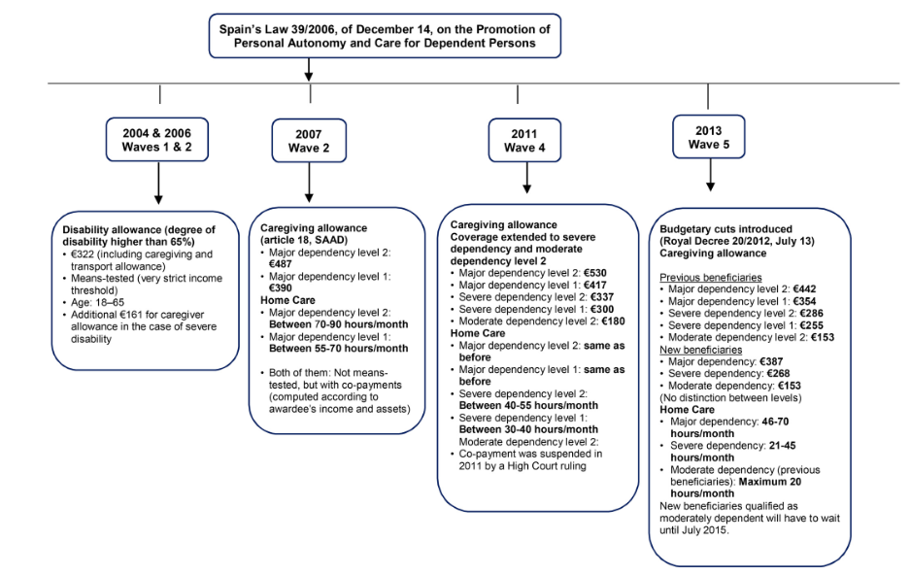
Data: What story are we telling here?
Notes:
Thoughts on this figure?

Slide 40
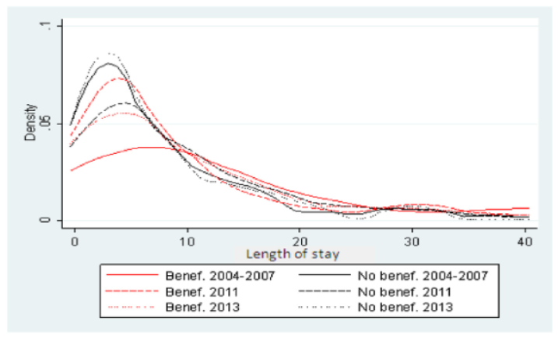
Side Note: Figures
What is this?
Notes:
Don’t do this! What’s wrong with it? Does show shorter length of stay for the black lines? Does it show what we want? What they want is for you to look at time trend within the red/black groups (red LOS is going down, black is going up-ish)

Slide 41
Data: What story are we telling here?
Outcome variables:
Hospital admission (extensive margin)
Hospital utilization/length of stay (intensive margin)
Assumptions to check:
Is there a selection process that needs to be modeled?
Are we observing the zeros?
Notes:
Thoughts on this figure?

Slide 42
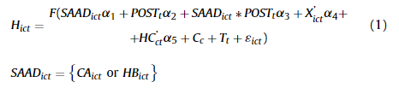
Empirical Strategy: Decision Stage
Decision stage is modeled as a difference-in-differences:
Subsidization meaningfully changes likelihood of admission
Notes:
What do we hypothesize about the coefficient alpha3 (captures the reform’s impact)

Slide 43
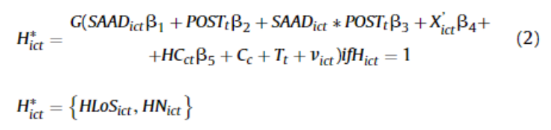
Empirical Strategy: Intensity Stage
Intensity stage is also modeled as a difference-in-differences:
Subsidization meaningfully changes total utilization
Notes:
Which hypothesis is more credible? Do you wish this had been done a different way?

Slide 44
Empirical Strategy: Intensity Stage
Intensity stage is also modeled as a difference-in-differences:
Subsidization meaningfully changes total utilization
Use IV (control function) to deal with endogeneity (with 6 instruments!):
Socialist party support + post interaction
Coverage of public home care prior to policy + post interaction
Proportion of women outside the labor market (why?)
Living in a rural area or not
Notes:
Which variable do they think is endogenous? What do you think about IV validity? Women outside labor market is indicative of providing informal care?

Slide 45
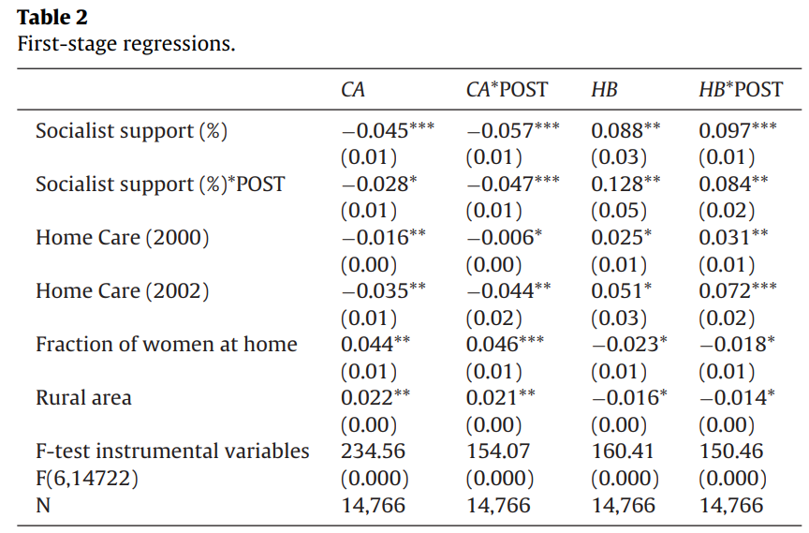
Results: IV First Stage
Notes:
What are the takeaways here?

Slide 46
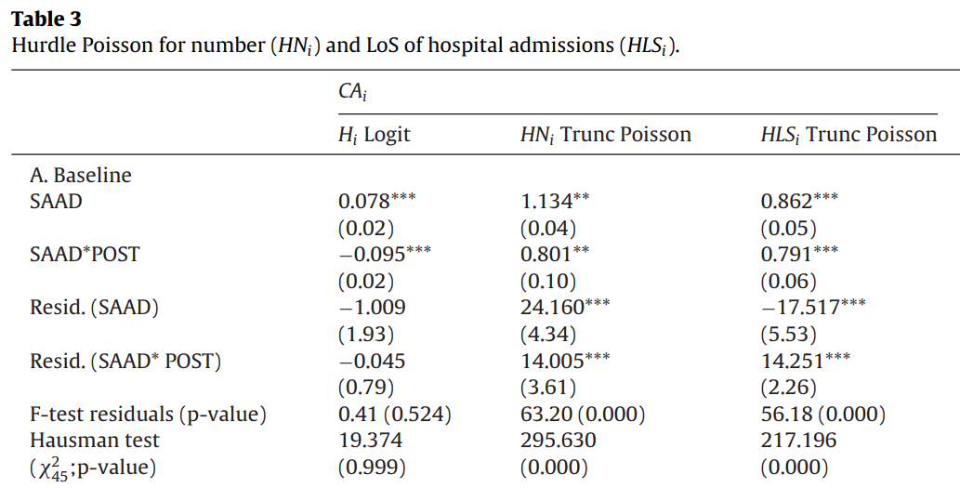
Results: Hurdle Model
Notes:
Note – this ignores a lot of the DDDDDDD structure (we have different types of policies, different budgetary cuts, etc. But what’s the general takeaway here? What coefficient should we be looking at here? How should we interpret (the first column is marginal effects, the second and third are IRRs)

Slide 47
Policy Implications: Hospital Costs
Micro-simulation on how subsidization affected hospital costs:
Compute average cost/day for each admission
Estimate region-level # of beneficiaries of caregiving allowances and home care beneficiaries (who did the policy affect?)
Apply hurdle model coefficients to (1) to obtain change in LoS
Change in LoS * Affected # of people = Savings from program
Notes:
Do you see any problems with this? Obviously doesn’t take into account the cost to the taxpayer, and assumes homogeneous treatment effects. Still, pretty handy.

Slide 48
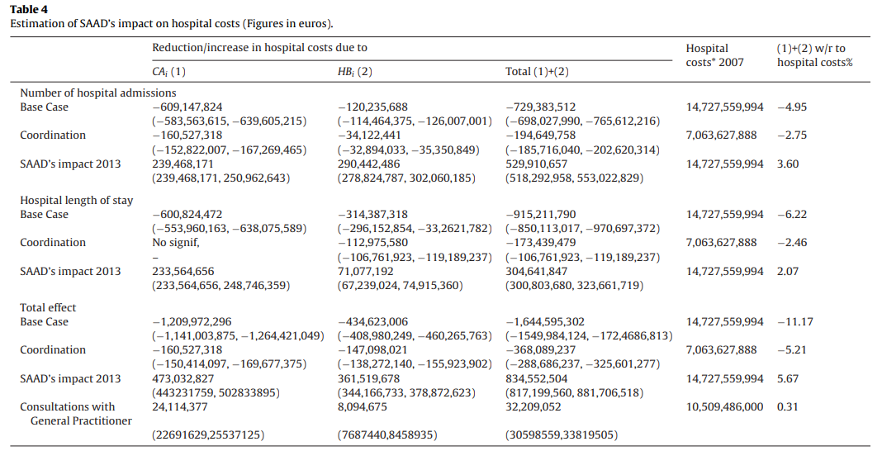
Policy Implications: Hospital Costs
Micro-simulation on how subsidization affected hospital costs:
Compute average cost/day for each admission
Estimate region-level # of beneficiaries of caregiving allowances and home care beneficiaries (who did the policy affect?)
Apply hurdle model coefficients to (1) to obtain change in LoS
Change in LoS * Affected # of people = Savings from program
Notes:
Maybe consider changing units here? Add in euro sign, idk. It’s a lot to look at. Also some lines telling my eyes where totals/cells are would be helpful.

Slide 49
Mini Referee Report
What do you think about this paper? Any concerns? Anything clever?
Notes:
Poor writing quality, bad figures (?) I don’t like imputation of data (wave 4 was missing public home care data)

Slide 50
Multinomial Choice Logit
Notes:
Also called discrete choice models

Slide 51
Multinomial Choice Logit: When Choices Matter (More)
What if our data is on choices between N different options?
E.g., type of insurance coverage, treatment (surgery, medication, etc.)
This is actually more similar to logit than you think!
Notes:
Choice of specialty: choosing to be a surgeon vs. in IM or PCP. We can think about logit as a binary choice – did the patient choose treatment or not? Now we’re extending that, in data speak, to N choices instead of 2.

Slide 52
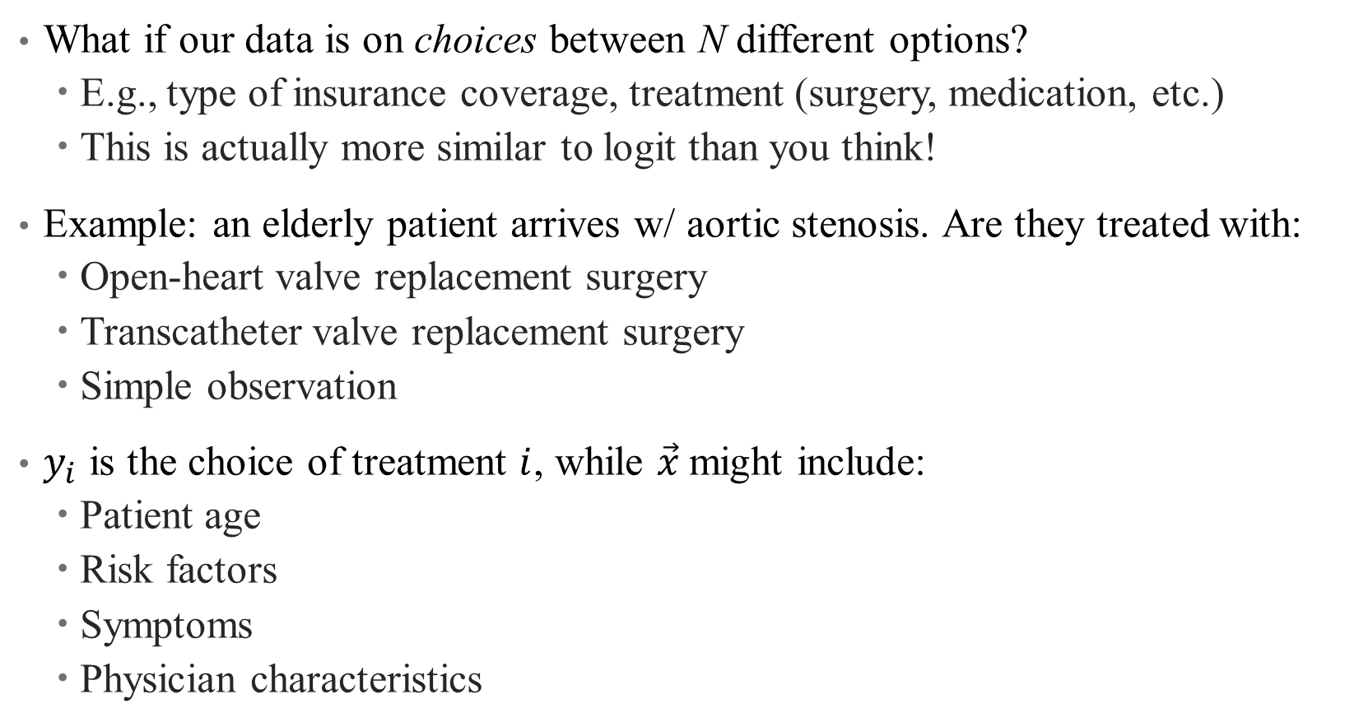
Multinomial Choice Logit: When Choices Matter (More)
What if our data is on choices between N different options?
E.g., type of insurance coverage, treatment (surgery, medication, etc.)
This is actually more similar to logit than you think!
Example: an elderly patient arrives w/ aortic stenosis. Are they treated with:
Open-heart valve replacement surgery
Transcatheter valve replacement surgery
Simple observation
$y_{i}$ is the choice of treatment $i$, while $\vec{x}$might include:
Patient age
Risk factors
Symptoms
Physician characteristics
Notes:
In this example, pretend that these are the only 3 possible choices.

Slide 53
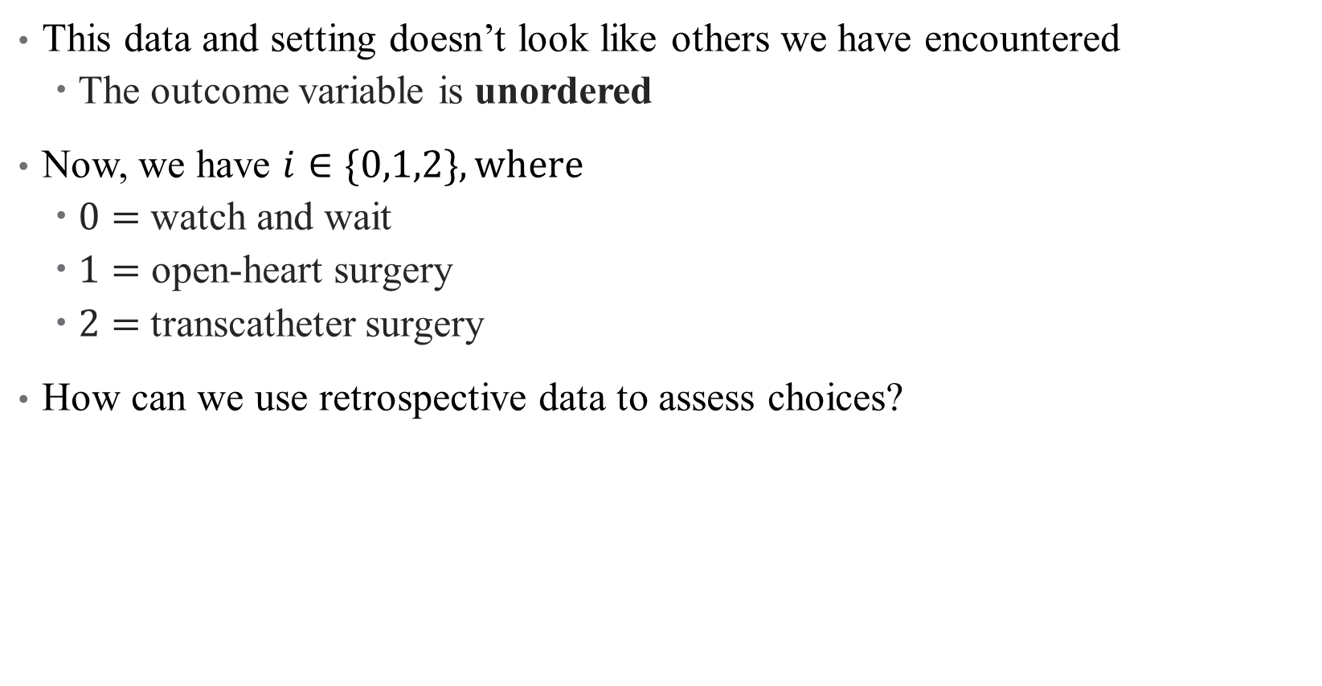
What makes this setting unique?
This data and setting doesn’t look like others we have encountered
The outcome variable is unordered
Now, we have $i∈\{0,1,2\}, where$
$0=$watch and wait
$1=$ open-heart surgery
$2=$transcatheter surgery
How can we use retrospective data to assess choices?
Notes:
How would order surgical choices? If these were RHS variables could just have a lot of dummies but we want one single regression evaluating choice across all alternatives on LHS.

Slide 54
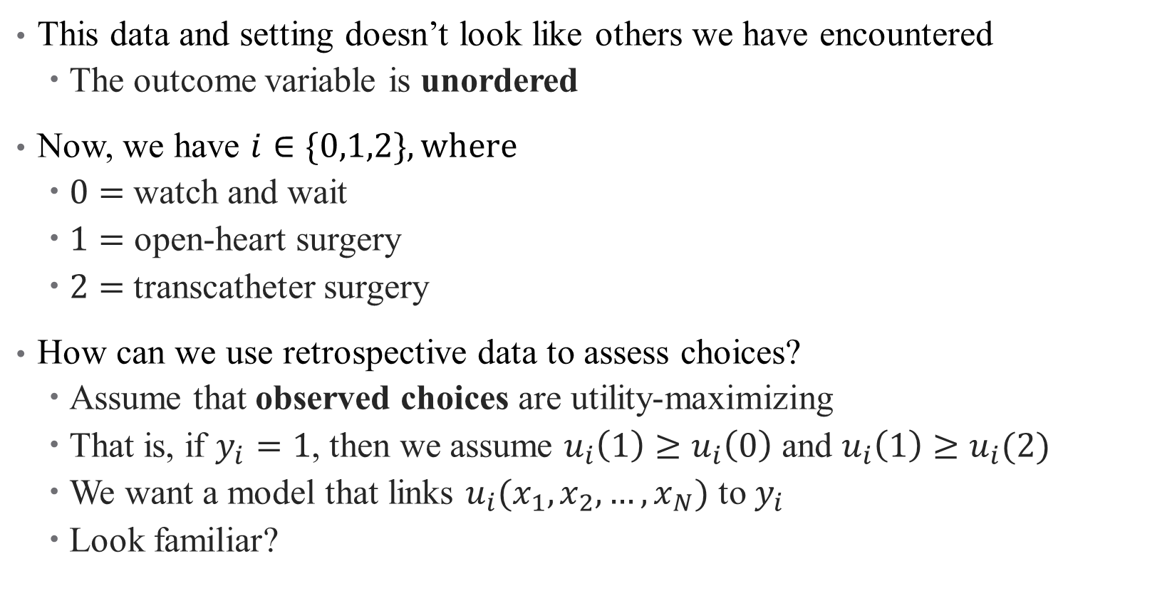
What makes this setting unique?
This data and setting doesn’t look like others we have encountered
The outcome variable is unordered
Now, we have $i∈\{0,1,2\}, where$
$0=$watch and wait
$1=$ open-heart surgery
$2=$transcatheter surgery
How can we use retrospective data to assess choices?
Assume that observed choices are utility-maximizing
That is, if $y_{i}=1$, then we assume $u_{i}\left(1\right)≥u_{i}\left(0\right)$ and $u_{i}\left(1\right)≥u_{i}(2)$
We want a model that links $u_{i}(x_{1},x_{2},…, x_{N})$ to $y_{i}$
Look familiar?
Notes:
We assume a “latent utility-maximizing framework”. Now we have a new link function (utility)! The difference here is that it’s not a known distribution, but rather we are interested in the characteristics of that link function. Talk about ordinal/relative goals on next slide.

Slide 55

Multinomial Logit: Setup
In order to assess this, we need to assign a benchmark outcome
That is, we compare $u(y_{2})$ and $u(y_{1})$ to $u\left(y_{0}\right)$
Why do we need to do this?
Notes:
We need a benchmark because utility is an ordinal concept – it only has meaning as a comparison across states. (40 utils doesn’t get me anywhere).

Slide 56
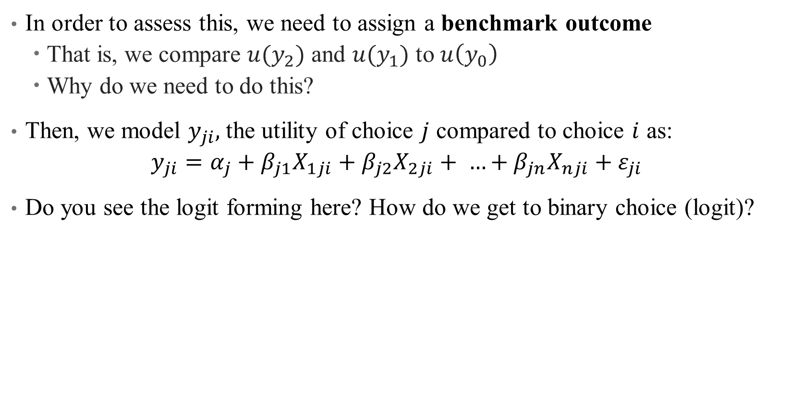
Multinomial Logit: Setup
In order to assess this, we need to assign a benchmark outcome
That is, we compare $u(y_{2})$ and $u(y_{1})$ to $u\left(y_{0}\right)$
Why do we need to do this?
Then, we model $y_{ji},$the utility of choice $j$ compared to choice $i$ as:
$$y_{ji}=α_{j}+β_{j1}X_{1ji}+β_{j2}X_{2ji}+ …+β_{jn}X_{nji}+ε_{ji}$$
Do you see the logit forming here? How do we get to binary choice (logit)?
Notes:
What does it mean if y_ji > 0 verus y_ji < 0? Think about the outside option as set to 0. What is the outcome now? Utility → but can easily be converted into choice as a piecewise link function

Slide 57
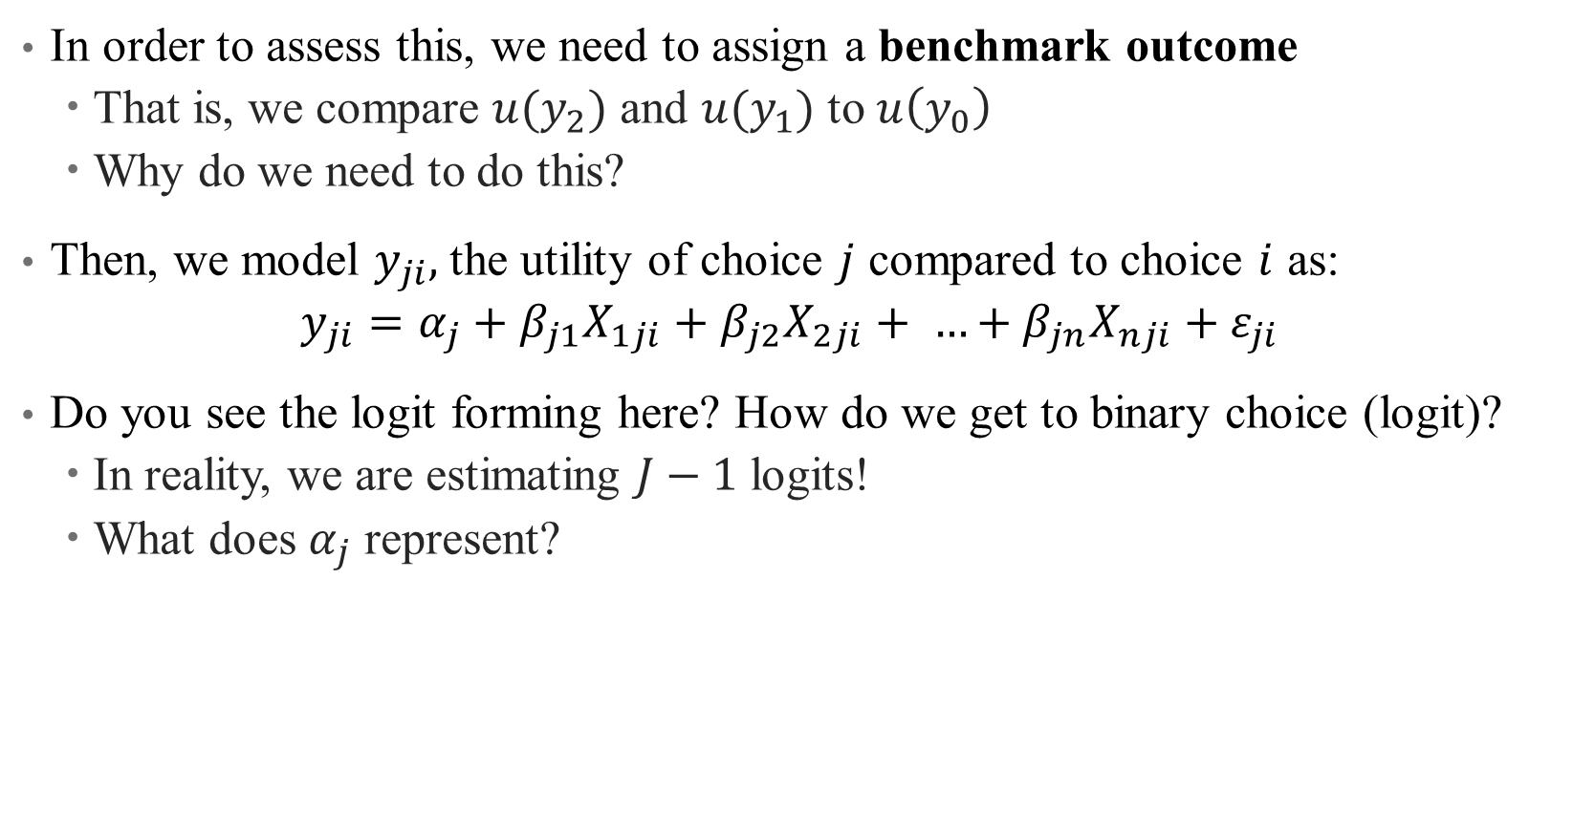
Multinomial Logit: Setup
In order to assess this, we need to assign a benchmark outcome
That is, we compare $u(y_{2})$ and $u(y_{1})$ to $u\left(y_{0}\right)$
Why do we need to do this?
Then, we model $y_{ji},$the utility of choice $j$ compared to choice $i$ as:
$$y_{ji}=α_{j}+β_{j1}X_{1ji}+β_{j2}X_{2ji}+ …+β_{jn}X_{nji}+ε_{ji}$$
Do you see the logit forming here? How do we get to binary choice (logit)?
In reality, we are estimating $J−1$ logits!
What does $α_{j}$ represent?
Notes:
alpha_j represents level differences in utility across options. Note that the notation x_ji helps convey that demographics can vary across choices or individuals (kind of an abuse of notation). Generally, your covariates will not vary in both dimensions at once.

Slide 58
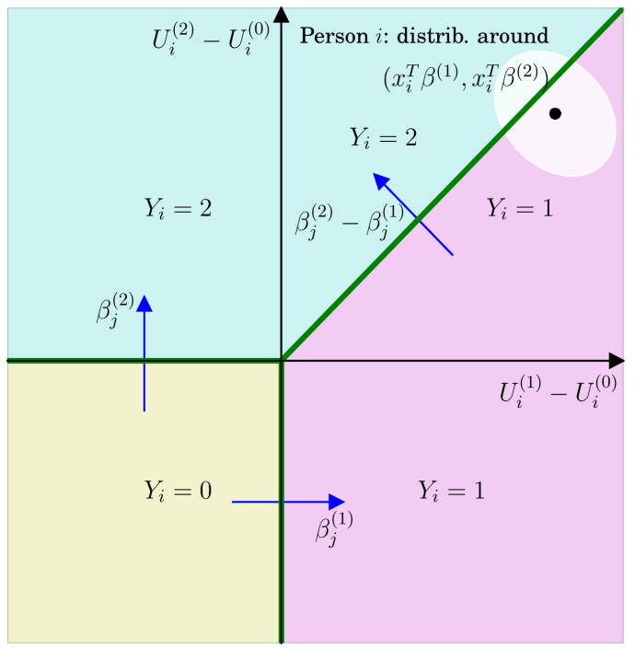
Multinomial Logit: Intuition
Notes:
Here there are 3 choices and 2 determinants of utility (plus level shifts). Regression lines identify the boundaries here. Can you see why we don’t need three regressions, but only 2?

Slide 59
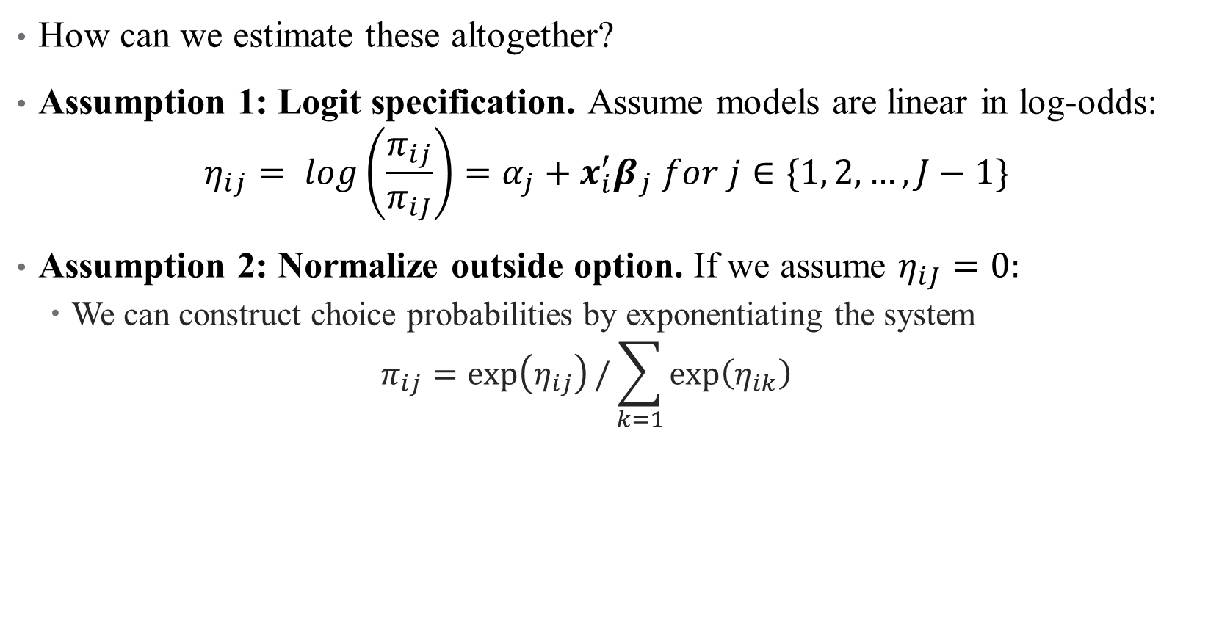
Multinomial Logit: Estimation
How can we estimate these altogether?
Assumption 1: Logit specification. Assume models are linear in log-odds:
$$η_{ij}= log\left(\frac{π_{ij}}{π_{iJ}}\right)=α_{j}+x_{i}^{′}β_{j} for j∈\{1, 2, …, J−1\}$$
Assumption 2: Normalize outside option. If we assume $η_{iJ}=0:$
We can construct choice probabilities by exponentiating the system
$$π_{ij}=\exp\left(η_{ij}\right)/\sum_{k=1}{\exp\left(η_{ik}\right) }$$
Notes:
Exponentiating leads to \pi_ij=\pi_iJ*exp(eta_ij). Do this on the board in a system of 3 equations. After exponentiating, sum up all probabilities to show formula for pi_i3, and then plug that in for the others

Slide 60

Multinomial Logit: Estimation
From choice probabilities we can recover likelihood function
$$\operatorname{Pr}\left(Y_{i1}=y_{i1},Y_{i2}=y_{i2},…, Y_{iJ}=y_{iJ}\right)=\left(\begin{aligned}n_{i} \\ y_{i1},…y_{iJ}\end{aligned}\right)π_{i1}^{y_{i1}}…π_{iJ}^{y_{iJ}}$$
Note that the MLE depends on the parameters $α_{j}, β_{j}$ through each $π_{ij}$
So we get $J−1$ sets of regression parameters!
What are the interpretations here?
Notes:
Interpretations are all relative to outside option

Slide 61
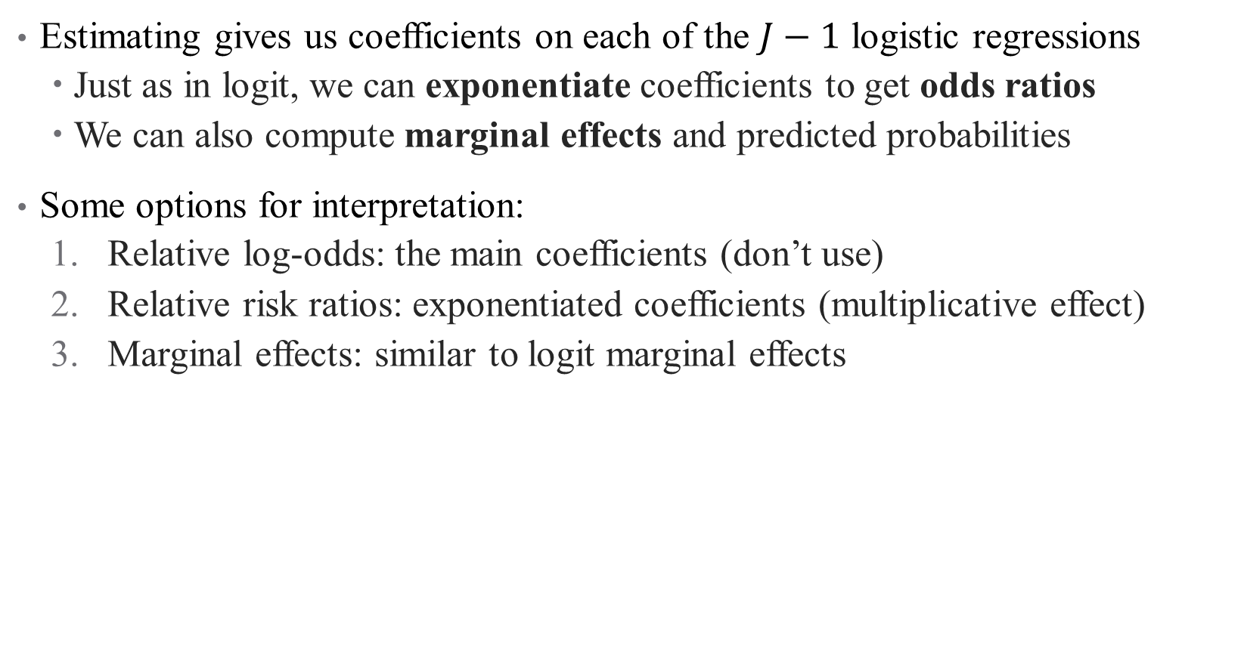
Multinomial Logit: Interpretation
Estimating gives us coefficients on each of the $J−1$ logistic regressions
Just as in logit, we can exponentiate coefficients to get odds ratios
We can also compute marginal effects and predicted probabilities
Some options for interpretation:
Relative log-odds: the main coefficients (don’t use)
Relative risk ratios: exponentiated coefficients (multiplicative effect)
Marginal effects: similar to logit marginal effects
Notes:
A note on relative risk ratios: odds ratios are relative and hence depend on baseline levels (e.g., a 1.5 times increase from 1 is 1.5 but from 100 is 150). This plays a critical role in the economic significance of your results.
Evaluating a complicated model in econometric analysis becomes more and more about story-telling – the more complicated your model is, the more certain your assumptions are wrong. How useful is your model?

Slide 62
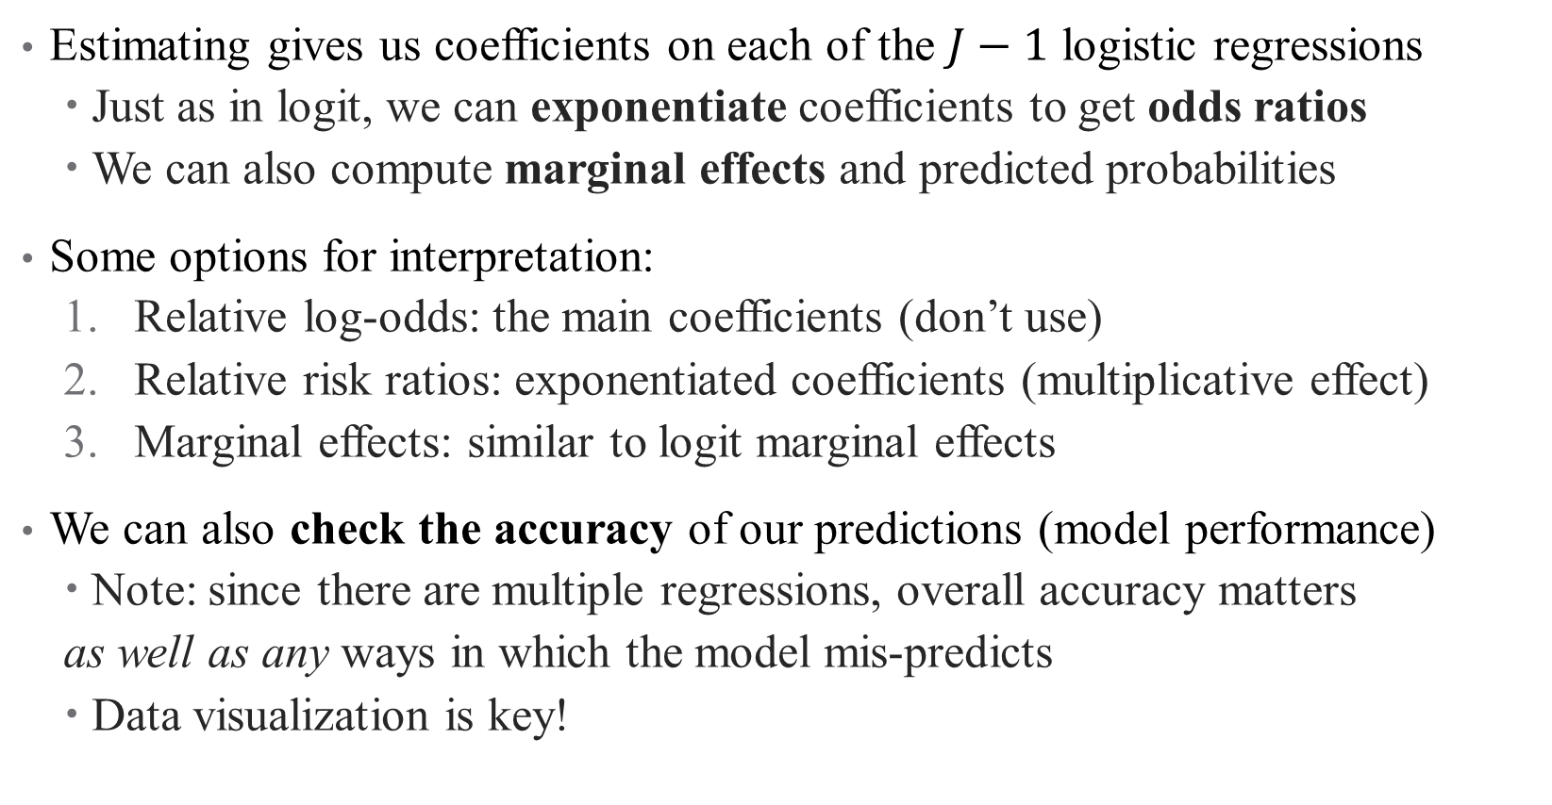
Multinomial Logit: Interpretation
Estimating gives us coefficients on each of the $J−1$ logistic regressions
Just as in logit, we can exponentiate coefficients to get odds ratios
We can also compute marginal effects and predicted probabilities
Some options for interpretation:
Relative log-odds: the main coefficients (don’t use)
Relative risk ratios: exponentiated coefficients (multiplicative effect)
Marginal effects: similar to logit marginal effects
We can also check the accuracy of our predictions (model performance)
Note: since there are multiple regressions, overall accuracy matters
as well as any ways in which the model mis-predicts
Data visualization is key!
Notes:
A note on relative risk ratios: odds ratios are relative and hence depend on baseline levels (e.g., a 1.5 times increase from 1 is 1.5 but from 100 is 150). This plays a critical role in the economic significance of your results.
Evaluating a complicated model in econometric analysis becomes more and more about story-telling – the more complicated your model is, the more certain your assumptions are wrong. How useful is your model?

Slide 63
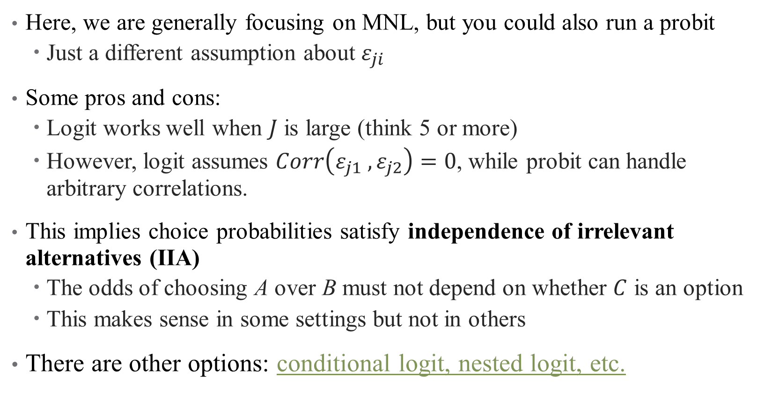
A quick note: multinomial probit versus logit
Here, we are generally focusing on MNL, but you could also run a probit
Just a different assumption about $ε_{ji}$
Some pros and cons:
Logit works well when $J$ is large (think 5 or more)
However, logit assumes $Corr\left(ε_{j1} ,ε_{j2}\right)=0$, while probit can handle arbitrary correlations.
This implies choice probabilities satisfy independence of irrelevant alternatives (IIA)
The odds of choosing A over B must not depend on whether $C$ is an option
This makes sense in some settings but not in others
There are other options: conditional logit, nested logit, etc.
Notes:
If you have a small choice set and care about the correlations in choice, probit may work better.
Example of IIA: if you have car or bus and then add a bike lane, maybe you should pull equally from both (go from 50% and 50% to 40%, 40%, and 20%). But if you have a car and a red bus, and then add a blue bus, you wouldn’t expect this.

Slide 64
Example: How do physicians choose specialties?
Context: Is there an over (under) supply of specialists (general practitioners)?
Notes:
This is an area of research I’m particularly interested in these days

Slide 65
Example: How do physicians choose specialties?
Context: Is there an over (under) supply of specialists (general practitioners)?
Contribution: What (non-pecuniary) factors drive that choice?
What do we think? Valid? Interesting?
What’s the main mechanism? What’s the hypothesis/hypotheses?
Notes:
This is an area of research I’m particularly interested in these days

Slide 66
Example: How do physicians choose specialties?
Context: Is there an over (under) supply of specialists (general practitioners)?
Contribution: What (non-pecuniary) factors drive that choice?
What do we think? Valid? Interesting?
What’s the main mechanism? What’s the hypothesis/hypotheses?
Novel method: choice experiment
Survey + stated preferences between two options
Data: Australian junior doctors who have not yet chosen their specialty.
Advantages: choices are presented exogenously (RCT), each person answers multiple questions (let’s you use a person fixed-effect)
Notes:
This is an area of research I’m particularly interested in these days

Slide 67
Example: How do physicians choose specialties?
Context: Is there an over (under) supply of specialists (general practitioners)?
Contribution: What (non-pecuniary) factors drive that choice?
What do we think? Valid? Interesting?
What’s the main mechanism? What’s the hypothesis/hypotheses?
Novel method: choice experiment
Survey + stated preferences between two options
Data: Australian junior doctors who have not yet chosen their specialty.
Advantages: choices are presented exogenously (RCT), each person answers multiple questions (let’s you use a person fixed-effect)
Assumptions: what features are important for their results?
Notes:
Need to have survey be honest, actually well thought out reponses, etc. Also external valididty (we’re in Australia and only looking at hospital non-generalists; those who are “on the border” between specialists and GPs who have worked without committing one way or another for about 3 yearS)

Slide 68
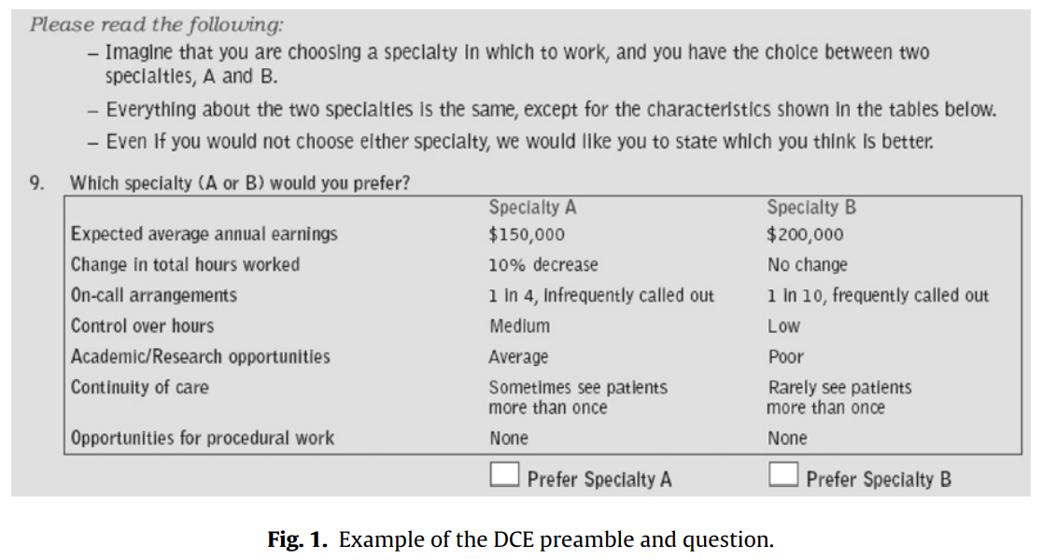
Choice Experiment
Notes:
Some of my concerns – experimental design (i.e. choice between specialty A and B instead of between surgery and generalist?). I thought the authors did well addressing these concerns openly.

Slide 69
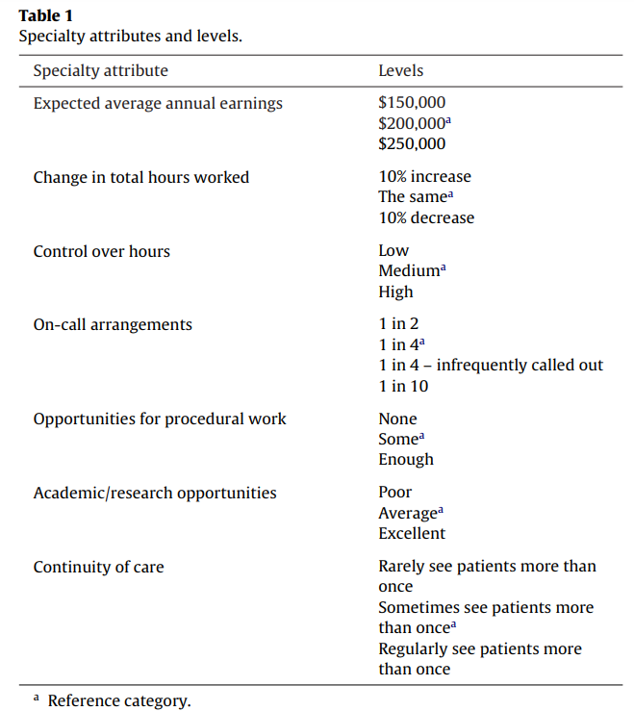
Choice Experiments
Notes:
Each observation in the data is a choice between two of these hypothetical worlds. Given enough choices, can back out importance of each parameter (think of a decision tree) while accounting for individual-level idiosycracy. Of course: 2916 possible choices! For the pilot survey and then for the main survey, we generated a fractional factorial of 36 binary choice sets containing 72 alternatives (4 versions; 9 choices per doctor).

Slide 70
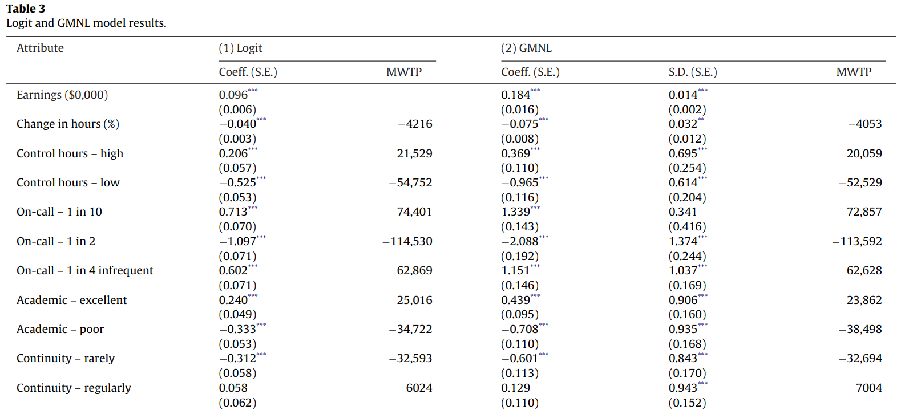
Results: What do MDs Care About?
Notes:
How do we interpret these results? Recall that (2) is like (1) + individual FE. Rather than calculate marginal effects, the coefficients are reported as is (how useful is this) and converted to MWTP -- MWTP for an attribute is the ratio of the coefficient estimate for that attribute and the coefficient estimate for the earnings attribute.

Slide 71
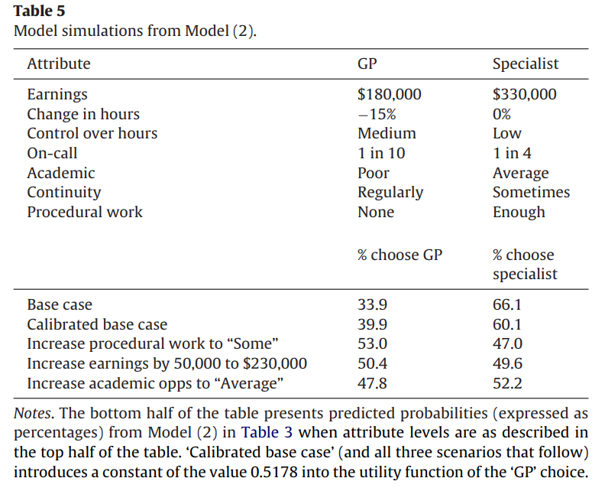
Policy Implications: Simulating Choices
Notes:
Simulation comes from MABEL data for differences between GP and specialists (top half). Then the simulation allows parameters to be matched to WTP (expressed in earnings) and counterfactual simulations. Calibrated base case uses actual Australia market shares.

Slide 72
Mini Referee Report
What do you think about this paper? Any concerns? Anything clever?
Notes:
Some of my concerns – experimental design (i.e. choice between specialty A and B instead of between surgery and generalist?). I thought the authors did well addressing these concerns openly. I really like the simulation here – that’s a big perk of these discrete choice models (plug for structural estimation, which we will do next time)

Slide 73
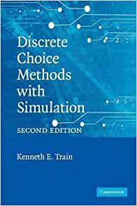
Conclusion: Limited Dependent Variables
Binary: LPM, Logit, Probit
Ordered: Poisson, Negative Binomial
Selection: Hurdle Models, Heckit
Choices: Multinomial Logit models
Notes:
Focusing only on these three for today

