Slide 1



Homa: A Receiver-Driven Low-Latency Transport Protocol Using Network Priorities
Behnam Montazeri
Joint work with: Yilong Li, Mohammad Alizadeh, John Ousterhout

Slide 2
Goals & Key Results
Goal: A datacenter transport for low latency at high load
Close to hardware limit latency for short messages
High network bandwidth utilization
Practical design for commodity fabrics
Key results: 100x faster than best published testbed implementation
15us tail latency (99%ile) for short messages, at 80% load
High bandwidth utilization: more than 90% of available bandwidth
Key idea: Effective use of network priorities
Dynamically assigned priorities by receivers
Receiver-driven packet scheduling
Controlled overcommitment on receiver’s downlink
Notes:
When we started this work, our primary goal was to get very low latency, close to hardware limit, for short messages but we also wanted to achieve that even when network is running at high load and achieve that through a practical design for commodity fabrics.
So we designed Homa and in our testbed, we are able to achieve 15us tail latency for short message at 99%tile, at 80% network load. To best of our knowledge, this level of tail latency is at least 100X better than any published results of a testbed implementation. Homa can also utilize upto 90% of network bandwidth.
The core idea that allows Homa to achieve this level of performance is effective use of network priorities, and as I’ll explain later Homa uses three main mechanisms to realize to this core idea. These mechanisms are dynamic assignment of priorities at the receiver, receiver driven packet scheduling and controlled overcommitment at receivers downlink

Slide 3
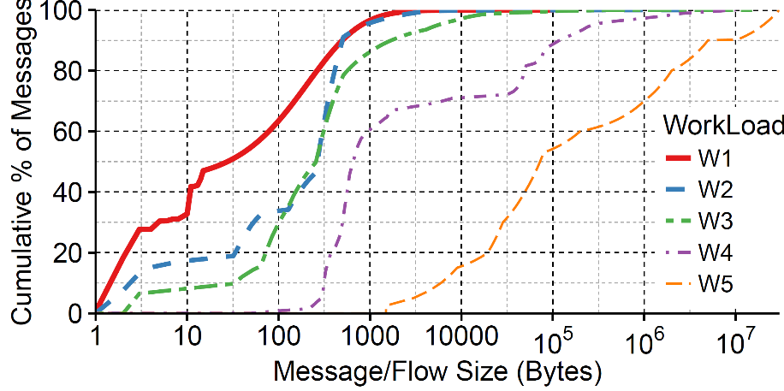
Tiny Messages, Tiny Latency
Short messages dominate workloads
W1, W2: 95% of messages shorter than 1000Bytes
Prior work assumed large messages
W5: 100KB message considered short
A tiny 200Bytes message, one way latency, ~5μs
Prior work “short” messages
Notes:
This space of low latency transports is a very crowded space with many prior works but Homa is different from previous works in two key aspects. One, We're looking at very short message and two very low latency for these messages.
First let me tell you what I mean by short messages. Here we have message size CDF of 5 workloads measured in google, facebook, microsoft datacenters. If you look at this point here on this plot, you can see that more than 95% of messages are shorter than 1000Bytes in W1 and W2. Generally, in workloads 1 to 4, messages smaller than 1000 bytes account for a significant fraction of messages. Workload 5 on the other hand is the workload used by previous works and message less than 100KB are called short in previous works, which are huge by Homa's standards.
Second aspect that sets Homa apart from previous work is the fact that we want super low latency for these short messages. In today low latency datacenter fabric, a tiny 200B message should be completed in 5us.

Slide 4
Near-Hardware Tail Latency is Hard
For tiny messages, small inefficiencies have large impact
8 packets of queueing adds 10μs of latency at 10Gbps → 3x minimum completion time for a 200-byte message
Such queues have minor impact on larger message sizes
A 100KB message takes > 80μs to transmit
Notes:
This level of single digit us latency is really hard for transports especially at high load and what makes it hard is that we need an extremely efficient transports to achieve this latency. Even a few packet extra latency is unacceptable and can significantly increase short messages latency.
For example, imagine a 200B message that could finish in 5us, is blocked by a 8 packets in a queue. 8 packets at 10Gbps, means 10us delay or 3x higher completion time for the message. Even a small inefficiency in the transport mechanism can translate to queuing in the network and large latency overhead for short messages.
An 8 packet queue would have had minimal impact on large messages but unacceptable for short messages. If you really want to achieve micro second level latency for short message, we need have to get rid of the effect of queuing.

Slide 5
Prior Work Low Latency
Reduce buffering:
DCTCP(sigcomm10), HULL(nsdi12), PDQ(sigcomm12), NDP(sigcomm17)
Can’t eliminate buffering, particularly at tail under high load
Use in network priorities:
pHost(conext15), PIAS(nsdi15) , QJump(nsdi15)
Do not use priorities effectively, suffer head of line blocking
pFabric(sigcomm13): near optimal latency, but needs switch modification
Notes:
This queuing is the main issue in previous designs that prevents them from achieving optimal tail latency for short messages.
Among the previous proposals, there’s been various transport design to get around the queuing. Some approaches like DCTCP, HULL, PDQ, and NDP they came up with rate control schemes to limit queuing but they cant really get rid of it the queuing completely. Other proposals like phost, PIAS and QJump started to use network priorities to bypass queuing but as I’ll show later, they only used priorities in limited or ineffective ways. pFabric is the only proposal that achieves perfect queuing bypass for short messages by extensively using priority queues in the network, but unfortunately it requires switch modification.

Slide 6
Some Buffering Is Inevitable
Low latency: senders must blindly transmit at full rate
Multiple blind transmission Induces buffering Increases latency
Buffering also needed for high BW Utilization
Sender 1
Datacenter Network Fabric
Receiver
Sender 2
Notes:
In fact, a little bit of queuing is inevitable if we want low latency. That’s because, for achieving optimal latency in an unloaded network, we have to allow a sender to start blindly transmit at least the first portion of the message at full rate. However when multiple senders each blindly transmit, queuing happens which ironically increases latency of short messages.

Slide 7
Low Latency Requires Priorities
Use hardware provided priority queues
Sender 1
Datacenter Network Fabric
Receiver
Sender 2
Buffered low-priority packets
Notes:
Considering that buffering is inevitable, the only way to achieve optimal latency at high network loads is to allow high priority packets of short messages to bypass queues. If sender 1 packets are high priority, they get to pass through the queue and low priority packets from sender 2 will be buffered.

Slide 8
Best to Choose Priorities at Receiver
Sender 1
Sender N
Datacenter Network Fabric
Multi-path core
fabric: congestion rare
Congestion at TOR-Receiver downlink
TOR-Receiver Downlink
Receiver
Notes:
But how should we assign priorities to bypass queues? It turns out the receiver is best place to assign priorities. And that’s because in todays datacenters, queuing happens primarily at the TOR near the receiver. Todays datacenter networks usually have enough bandwidth in the core and is heavily mulipathed that congestions is rare in the core. But once multiple senders from 1 to N all try to send to the same receiver destination, they can ovesubscribe the link to the receiver and can create congestion at the TOR downlink. Therefore the receiver is the best place to assign priorities.

Slide 9
Priorities, Key To Low Latency
Homa: using priorities effectively to bypass buffering
Schedule messages in shortest-remaining-first order (SRPT)
Near-optimal average latency & good tail latency for short messages
Combine three mechanisms to use priorities effectively
Dynamically assigned network priorities by receivers
Bypass queues for short messages
Receiver-driven packet scheduling
Reduce buffer occupancy & improve latency
Controlled overcommitment on receiver’s downlink
Avoid bandwidth waste, leads to high bandwidth utilization
Notes:
We have to use priorities and Homa is all about how to use priorities to driver down latency. In particular, our goal with priorities is to implement SRPT, which favors messages that are nearest to completion. SRPT is shown to have near optimal average latency and very good tail latency for short messages and that’s why it’s the policy chosen for Homa.
To effectively use priorities and achieve our goals, Homa uses three mechanisms:
The rest of this talk is organized around these key ideas and then evaluation of Homa.
Controlled overcommittment at the receiver downlink by allwoing multiple senders to send at same time the receiver. This is important to achieve high bw util

Slide 10
Receiver Based Packet Scheduling
Basic mechanism like pHost and NDP:
Send RTTBytes Unscheduled packets blindly
RTT=10us, @ 10Gbps RTTBytes=12KB
Receivers schedule remaining packets: one Grant per Scheduled packet
Optimal latency for one sender, one receiver scenario
Message
Unscheduled
Scheduled
1 RTT
Scheduled Data Packets
Sender 1
Receiver/TOR
Unscheduled Data Packets
Grant Packets
Notes:
First mechanism we discuss is the receiver driven packet scheduling. The basic mechanism for packet scheduling is similar to NDP and pHost. Our goal is to give the receiver as much scheduling power as possible while also getting optimal latency. So Each sender divides each message into two parts, the first part is send blindly by the sender and the second part is only transmitted in response to the explicit grants from the receiver. The first part is called unscheduled packets and they’re enough to cover the first RTT time of the message, or we say the first RTTBytes. For every packet that arrives at the receiver, the receiver sends a grant packet that allows transmission of an scheduled packets. This results in optimal latency when we have one sender and one receiver.

Slide 11
Receiver Based Packet Scheduling
Basic mechanism like pHost and NDP:
Send RTTBytes Unscheduled packets blindly
Receivers schedule remaining packets: one Grant per Scheduled packet
Optimal latency for one sender, one receiver scenario
Competing senders, grant only the shortest message(s)
Sender 1
Receiver/TOR
Grant
Sched.
Unsched.
Sender 2
Notes:
The advantage of this packet scheduling is that it gives the receiver control on who’s sending to it. So, when there are competing senders, the receiver can send grants to shorter message . In this example sketch, when receiver realizes that sender two is transmiting a shorter message, stops the grants to sender 1 and sends grant for sender 2 and then resumes sending grants to sender1 when sender is comletely granted. So the receiver can use the packet scheduling to implement SRPT.

Slide 12
Packet Scheduling Not Enough!
Works well for long messages, but problematic for short messages
Buffering creates preemption lag
Short messages scheduling takes at least on RTT to come to full effect
Unscheduled messages (no receiver control)
Sender 1
Receiver/TOR
Grant
Sched.
Unsched.
Sender 2
Notes:
Using packet scheduling to implement SRPT works great when we have long messages but it doesn’t work well for short messages for two reasons. One reason, is what we call preemption lag. The problem is when short message arrives at the receiver, we already sent grants for longer message and the arrival packets from longer message from sender 1 at the TOR queue are gonna delay the short message from sender 2. Second reason, is that the receiver has no control over unscheduled packets and we can’t use packet scheduling to prioritize their transmission.

Slide 13
Using Network Priorities
Goal: set priorities dynamically based on incoming messages
Receiver specifies priorities:
Scheduled packets: adaptive priority in each grant
Unscheduled packets: In-advance priority cutoffs
Assign higher priority levels for unscheduled packets
Cutoff: 2kB < Message Size < 5kB, Unsched. Prio: P6
TOR priority queues
P7
P6
Unscheduled prios
P5
Sender
P4
Receiver
P3
P2
Prio. P1 for sched. Pkt 1
P1
Prio. P2 for Sched. Pkt 2
Scheduled prios
P0
G1
G2
Notes:
Homa uses network priorities to achieve perfect preemption and SRPT. The goal is to dynamically assign packet priorities for the TOR queue, based on the current set of messages at the receiver. The priorities for scheduled packets is easy and can be dynamically and accurately specified in the grant packets. For the unscheduled packets though, because the receiver doesn’t have any control over their transmission, it has to computes priority cutoff sizes and transmit them to the senders. Sender uses those cutoff sizes to assign unscheduled priority for later transmissions. An example of cuttoff size is, the receiver says if the message size is between 2KB and 5KB, use priority P6 for its unscheduled packets. The receiver uses some number of higher priorities for unscheduled packets and the remaining lower priorities for scheduled packets.

Slide 14
Unscheduled Priority Assignment
Goal: distribute traffic evenly among priority levels
Fraction of prios for unscheduled = fraction of incoming bytes unsched.
Pick cut-offs based on CDF of message sizes
Shorter messages, higher unsched. Priority
Equal bytes per priority level
TOR priority queues
P7
Example:
P6
75% bytes unsched.
P5
P4
Receiver
P3
P2
25% bytes sched.
P1
P0
Notes:
For unscheduled packets priorities, the receiver goal is to balance traffic equally among the priority levels. So the receiver frequently measures the incoming traffic. From the measured traffic, first uses the fraction unsched bytes it measured, for number of unscheduled priorities. For example, if 75% of total bytes are received in unscheduled bytes, then 75% of total priorities for usncheduled. The it computes the CDF of message sizes from the measured traffic and uses it to compute the cutoff sizes. The idea is to compute cutoffs such than shorter messages get higher unsched priority and equal bytes are transmitted per periority level. The details are in the paper.

Slide 15
Scheduled Priority Assignment
Allocate adaptively based on incoming messages
Start with lowest priority
Use higher priority for rapid preemption
Initial approach: only grant to higher priority message (like pHost)
New short message arrives
P0
P1
P0
Notes:
For scheduled packets, Homa allocated priorities dynamically based on incoming messages. It starts with the lowest priority, whenever a new shorter message arrives, it elevates priority and use the next higher priority. Our initial approach ..

Slide 16
Problem: Wasted Bandwidth
Senders may not respond promptly to grant
Result: wasted bandwidth at receiver down link
Prefers m2 to m1
S1
m2
m3
S2
m1
Wasted BW
R1
R2
Prefers m1 to m3

Slide 17
Solution: Controlled Overcommitment
Goal: keep links busy while prioritizing short messages
Receiver grants multiple senders simultaneously
Different priority level for each message
Shortest message gets highest priority
Priorities to favor short message, buffering for high BW utilization
Both senders respond
Sender 1 doesn’t respond
m1
m3
m1
m3
S1
S2
S1
S2
P1
P0
P1
P0
m1
R1
R1
m3
Notes:
Priorities ensure prompt delivery of shorter message
Buffering essential to high link utilization

Slide 18
Testbed Implementation
Implemented Homa in RAMCloud storage system
~4000 lines of code
Testbed cluster: 8 clients, 8 servers
Client sends a message of a given size
Server replies with the same message
All nodes in a cluster are connected to a single switch
Cluster configuration:
CloudLab m510 cluster: 8-Core Xeon D1548 @ 2.0 GHz, 10 Gbps network
Local Infiniband cluster: 4-Core Xeon X3470 @ 2.93 GHz, 24 Gbps network

Slide 19
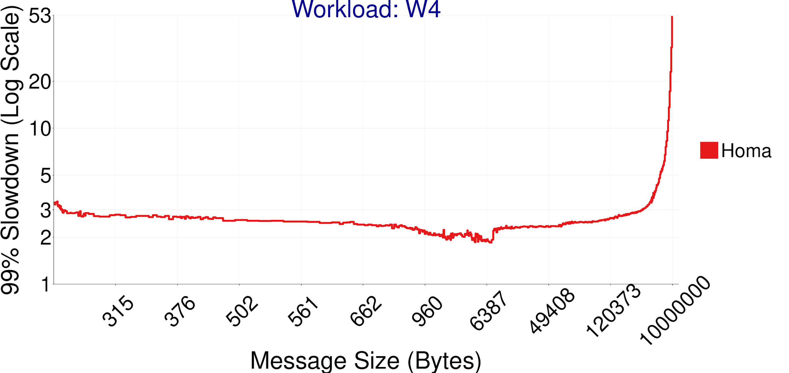
Homa Implementation Results
99%-ile slowdown < 3x at 80% load for most messages
Slowdown = message latency, normalized to latency in unloaded network
Workload: W4
10%
20%
30%
40%
50%
60%
70%
80%
90%
100%
Notes:
Here are the 99%tile slowdown at 80% network load for w4. Let me first take a few moment, and explain how to read this graph.

Slide 20
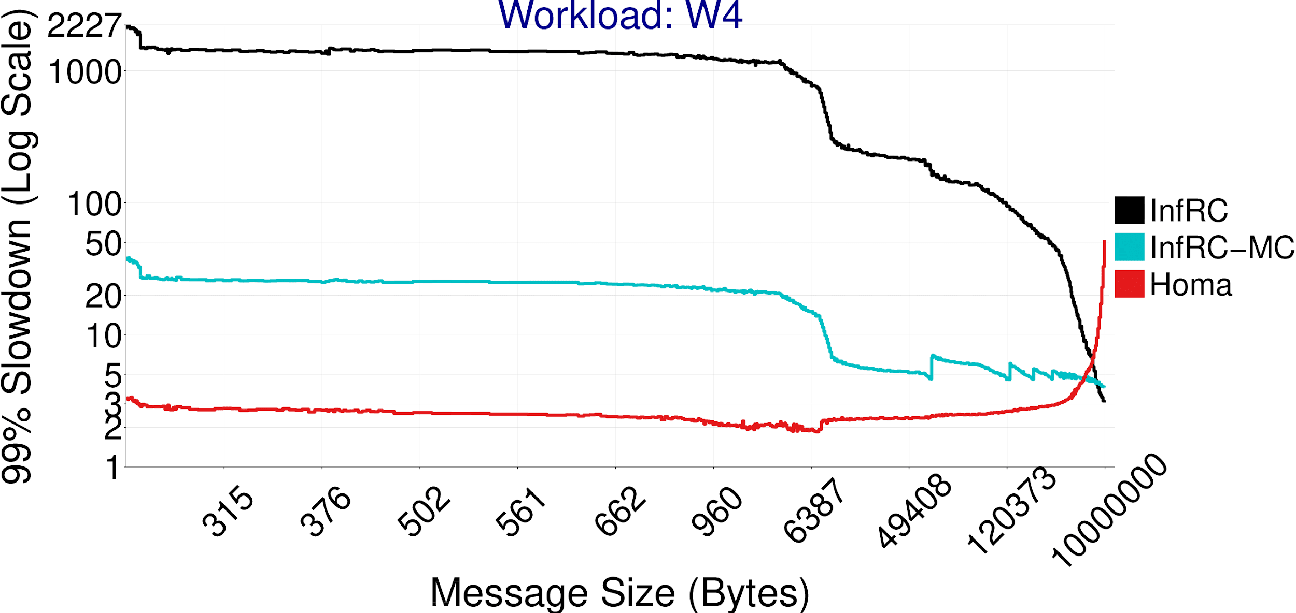
Infiniband VS. Homa
Infiniband suffers severe head of line blocking
Infiniband with multiple connections, performs 20x worse than Homa
Not scalable: can’t afford to keep too much connection state
Workload: W4
10%
20%
30%
40%
50%
60%
70%
80%
90%
100%
Multi Conn.
Reduces HOL
blocking
1000x HOL
blocking
Infiniband
Infiniband Multi Conn.
Homa
Notes:
First, we’d like to compare Homa against commodity low latency transport in today datacenters. So we compared Homa against Infiniband, a streaming RDMA transport. The result was the black graph and the tail latencies of
small messages are 1000x higher than Homa.
By analyzing the packet traces we confirmed that the long delays are caused by
HOL blocking at the senders, where a small message got stuck behind a very large
message to the same destination.
We then modified the benchmark to open multiple connections per client-server
pair. This is the InfRC-MC, the blue curve. Increasing the number of connection
to essentially infinity, reduces the tail latencies of small messages by 100x
but it is still much worse than Homa’s performance because it doesn’t use
Priorities.
.

Slide 21
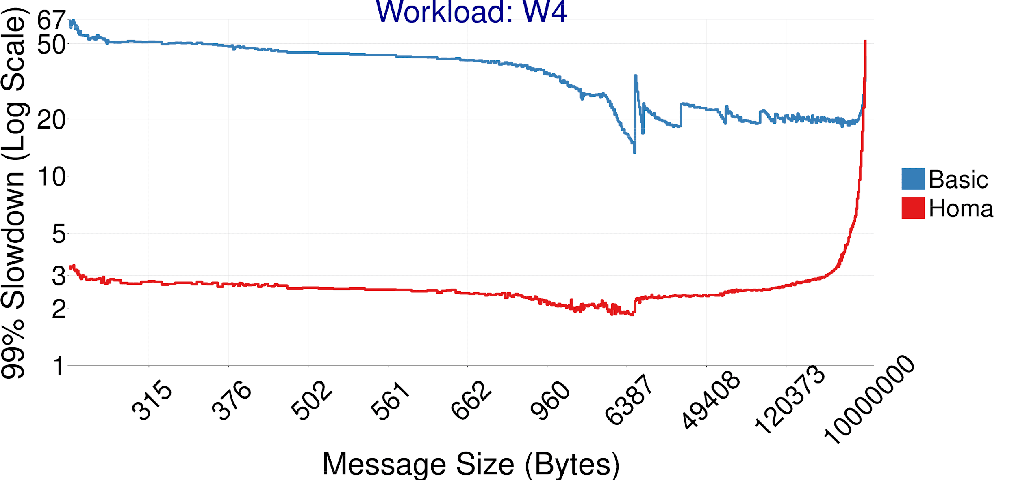
No Prios & Uncontrolled Overcommitt.
Basic: Receiver scheduler, single priority level, infinite overcommitment
Fair share scheduling instead of SRPT
At least 15x difference between Basic and Homa
Workload: W4
10%
20%
30%
40%
50%
60%
70%
80%
90%
100%
Queue Delay at TOR
Notes:
OK, these results are look great but we'd like to dig deeper and understand how
different mechanisms of Homa like overcommitment and pririorities contribute in
achieving these results. First lets take away all of Homa, and go back to one priority level and no limit on overcommitment and see what that looks like. Here Basic is that.
It will be very bad, so much queue
No let’s layer in back Homa, one layer at time. Let’s have controlled overcommitment only.
The figure shows that the tail latency of Basic, the blue graph, which is 10 -
15 times higher than Homa for most of the message sizes. We analyzed the packet
traces and we determined that the high latency is caused by queueing delays at
the receiver’s downlink.

Slide 22
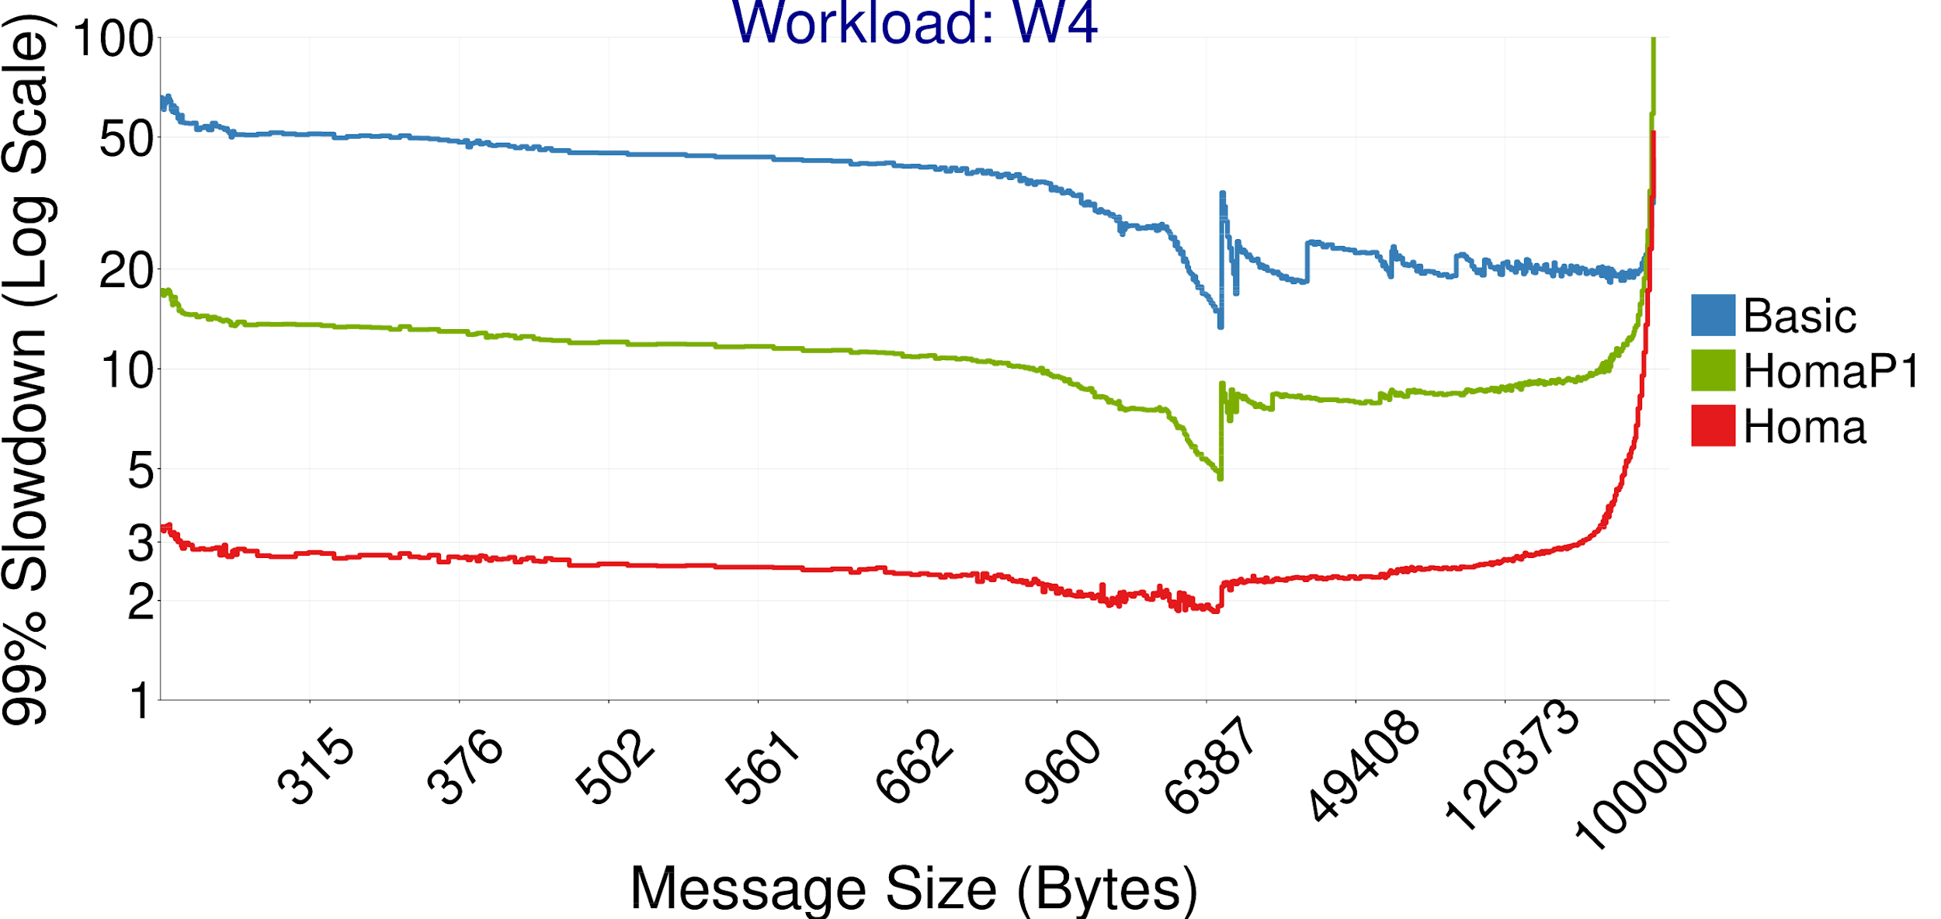
Controlled Overcommittment Effect
HomaP1: Homa with single priority and 7 overcommitment
Controlled Overcommit: shorter queue sizes, less head-of-line blocking
Workload: W4
10%
20%
30%
40%
50%
60%
70%
80%
90%
100%
3x Reduced HOL
blocking
Notes:
Next we turn on the controlled overcommittment mechanism in Homa but not
priorities? So the green graph for HomaP1 is for a version of Homa that limits
the over committment to 8 but only uses one priroity level so all packets are
transmitted on the same priority level. Controlled overcommittment feature
reduces queue sizes and the head of line blocking and allows HomaP1 to achieve 3
times lower tail latency comparing to Basic. But, it's still a factor of 3 to 5
worth than Homa.
By the way we can;t reduce the overcommitment below 4 in this workload. We found that with overcommitment less than 4, there’s too much wasted bw at the recevier downlink because of unresonsive senders and we can’t sustain 80% newtwork load.

Slide 23
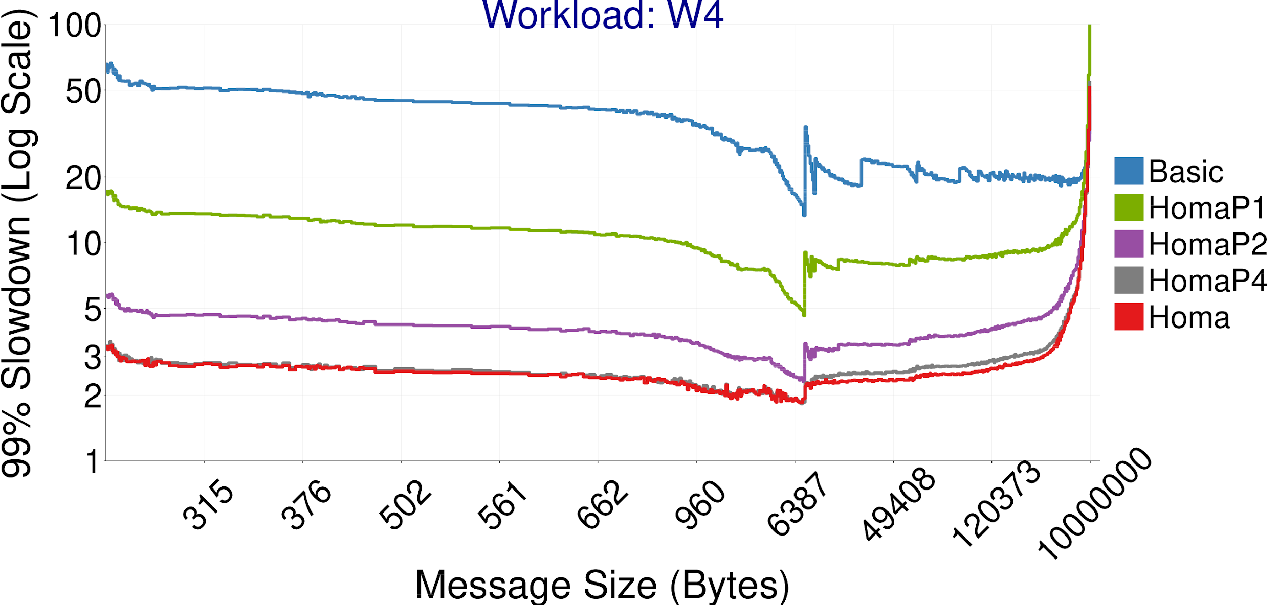
Effect Of Priorities
HomaPi: Homa with i priorities and 7 overcommitment
More priorities, further reduces HOL blocking for short messages
Workload: W4
10%
20%
30%
40%
50%
60%
70%
80%
90%
100%
More priority, less HOL blocking
Notes:
And now we add more priorities to study the effect of more priorities in tail latency.
By default, Homa uses 8 priorities. HomaP4 means Homa with 4 prios. and HomaP2
mean Homa with 2 priroities. The figure shows that with 4 prios, the performance
is almost as good as 8 priorities. But with only 2 prios, the tail latency for
short messages increases quite a bit. Adding more priorities, eliminates the
remaining head of line blocking for short messages and brings the tail slowdown
of short messages to as low 3.

Slide 24
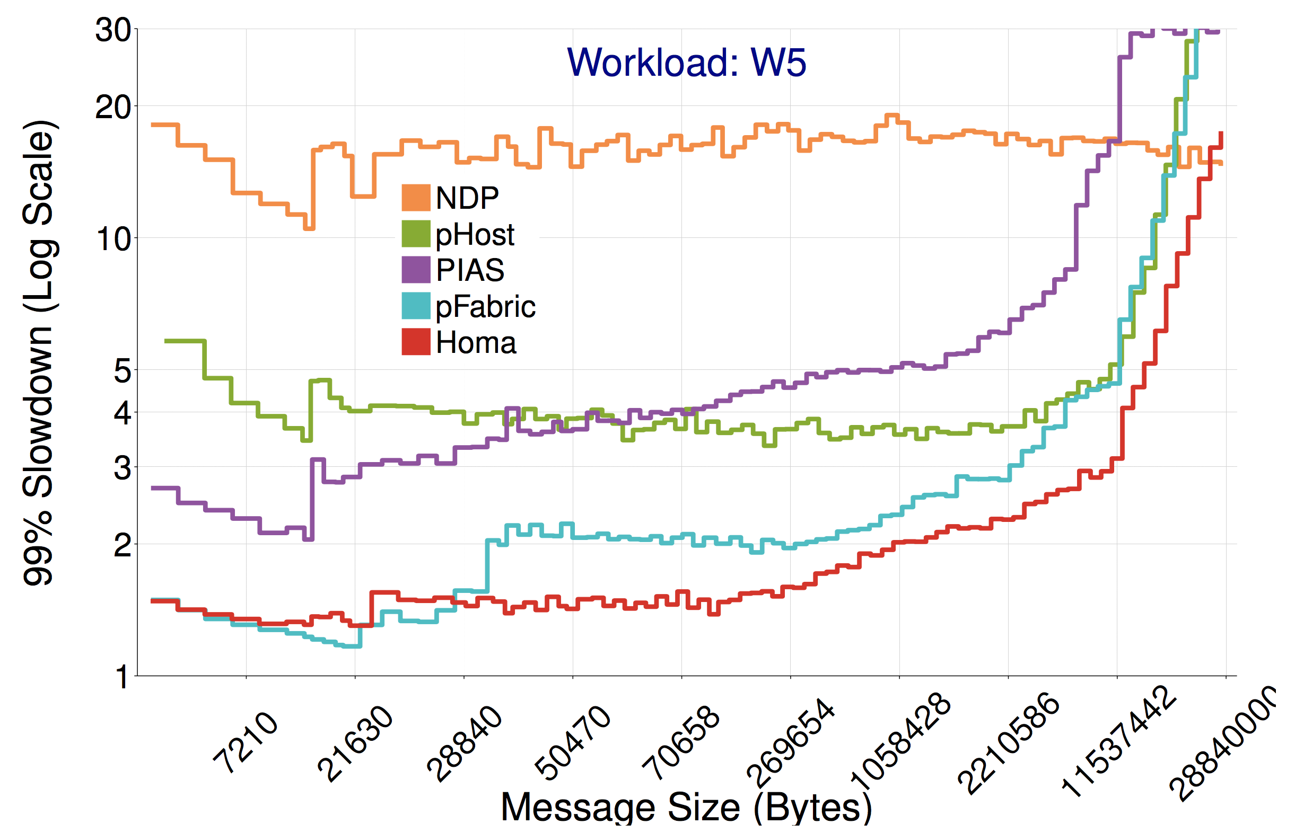
Simulation Evaluation
Homa’s 99%ile tail latency <6us at 80% network load (slowdown < 2x)
10%
20%
30%
40%
50%
60%
70%
80%
90%
100%
Notes:
We also compared against NDP, pHost, Pias and pfabric in simulations. The red graph is Homa and the blue is pFabric on the bottom of the plot. We can see that Homa achieve
tail slowdown for short messages around 1.5. You can see Homa mostly tracks the
near optimal behaviour of pFabric for shorter messages and beats pFabric for
larger messages that's because queue sizes in the network under pFabric are
usually much larger and the large queues hurt large message completion times.
PIAS and pHost are the green and purple lines and they're generally achieve tail
latencies that are 150% to 400% larger than the Homa tail latency. The orange
graph is for NDP and NDP tail latency is higher than the other protocol and that’s mostly
Because NDP is not using priorities and uses fair queuing scheduling policy. We suspect if we add SRPT to NDP, it would achieve similar results to pHost.

Slide 25
Summary
Homa provides low latency at high load
Close to hardware limit latency for short messages
High network bandwidth utilization
Practical design for commodity fabrics
Key results: 100x faster than best published testbed implementation
15us tail latency (99%ile) for short messages, at 80% load
High bandwidth utilization: more than 90% of available bandwidth
Key idea: Effective use of network priorities
Dynamically assigned priorities by receivers
Receiver-driven packet scheduling
Controlled overcommitment on receiver’s downlink

Slide 26
Homa Source Code
Homa Simulator:
https://github.com/PlatformLab/HomaSimulation
Testbed implementation in RAMCloud:
https://github.com/PlatformLab/RAMCloud
Stand alone implementations (under development):
Linux Kernel: https://github.com/PlatformLab/HomaModule
Userspace RPC: https://github.com/PlatformLab/Homa

Slide 27
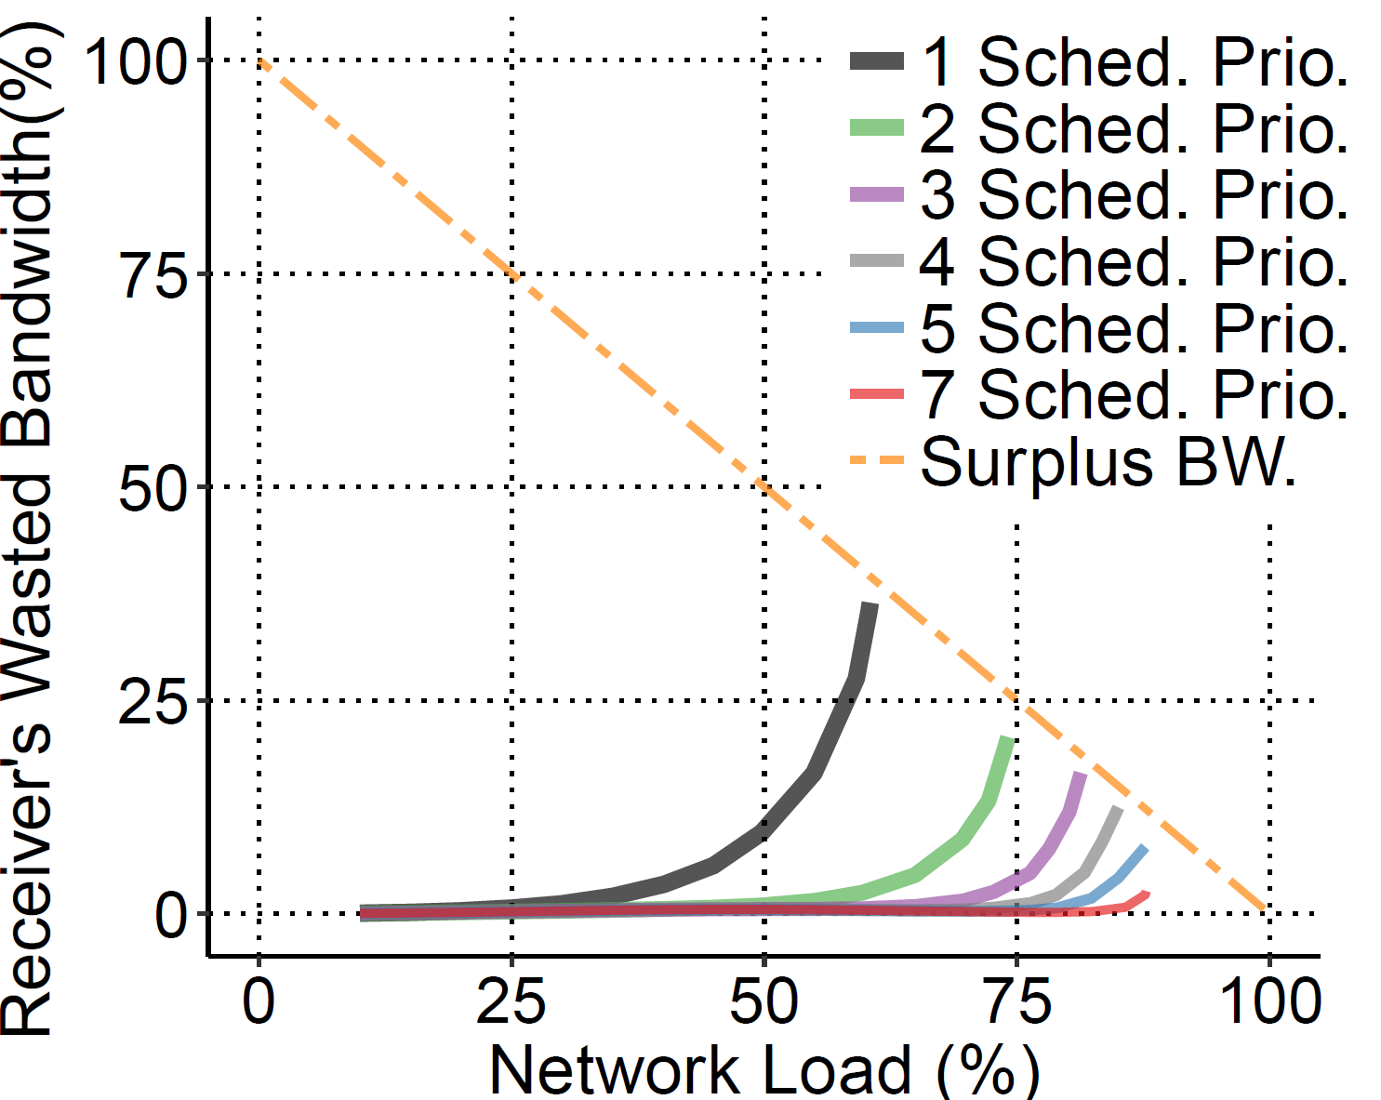
Overcommitment For High BW Util.
More scheduled priorities → More overcommitment → Less wasted bw
92% network bandwidth utilization with 7 scheduled priorities
Notes:
We evaluated the importance of overcommittment on achieving high
bandwidth utilization.
This plot here shows on the y axis Homa's wasted bandwidth versus the offered
network load on the x axis for different levels of overcommittment. In Homa,
bandwidth is wasted if a receiver has messages to receive, but none of the
messages are sending and receiver link remains idle.
For example take the black graph for overcommittment 0 meaning that receiver is
not overcommitting at all and only grants one sender at time. When the offer
load increases, the wasted bandwidth increases. The yellow 100-100 line show the
maximum badnwidth we have available to waste at a specific network load. For
example if offered load is 75%, we can't waste more than 25% of bandwidth. With
overcommitment 0, Homa can utilize upto 63% of available bandwidth before
hitting the yellow line. As we increase the overcommittment, we can utilize more
and more bandwidht before the graph hit the yellow line. With overcommittment of
6, meaning granting to 7 senders at a time at 7 different priority levels, Homa
can utilize about 92% of network bandwidth. The more scheduled priority levels
we have, the higher degree of overcommitment, and less bandwidth wasted. But at
the same time, we don't really need more than 7 scheduled priority levels.

