Slide 1

Flowtune
Flowlet Control for
Datacenter Networks
Jonathan Perry, Hari Balakrishnan and Devavrat Shah

Slide 2
Software in the Datacenter
Response Time: Productivity, Revenue, Reputation
microservices → develop → network is central deploy scale

Slide 3


Traditional approach is packet-centric
Switch Mechanisms
Server Mechanisms
Implicit
Allocation
Several RTT to converge
Changes many components

Slide 4
Traditional approach is packet-centric
Switch Mechanisms
Allocate network resources
Explicitly (maximize utility)
Quickly, Consitently
Flexibly (in software)
Server Mechanisms
Implicit
Allocation
Several RTT to converge
Changes many components

Slide 5
Flowtune’s approach
1. Flowlet control
send() ↔ flowlet
2. Logically centralized
Reduce RTT dependence

Slide 6
Example
Hadoop on Server A has data for B:
A → Allocator | “Hadoop on A has data for B”
Allocator | Assign rates
Allocator → A | “Send at 40Gbps”
R1
R2
Allocator
B
C
A

Slide 7
Example
Now say ad_server on Server C has data for B:
C → Allocator | “ad_server on C has data for B”
Allocator | Assign rates
Allocator → A | “Send at 5Gbps”
Allocator → C | “Send at 35Gbps”
R1
R2
Allocator
B
C
A

Slide 8
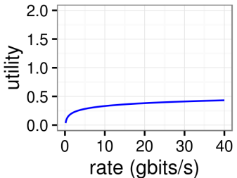
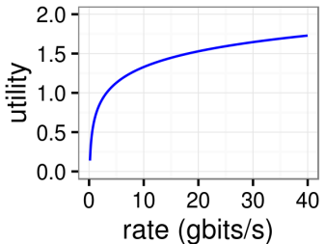
Network Utility Maximization (NUM)
Hadoop flowlet:
Ads flowlet:
Hadoop flowlet rate 2x → $0.05
Ads flowlet rate 2x → $0.20
Kelly et al., Journal of the Operational Research Society, 1998

Slide 9
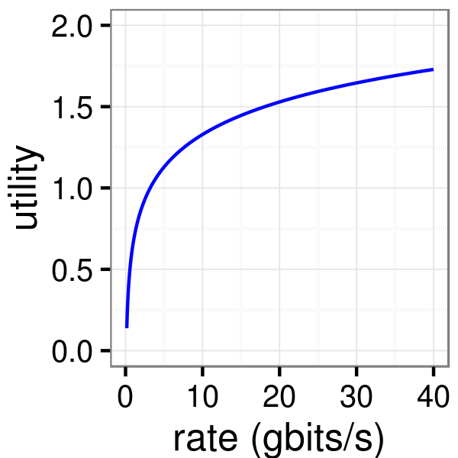
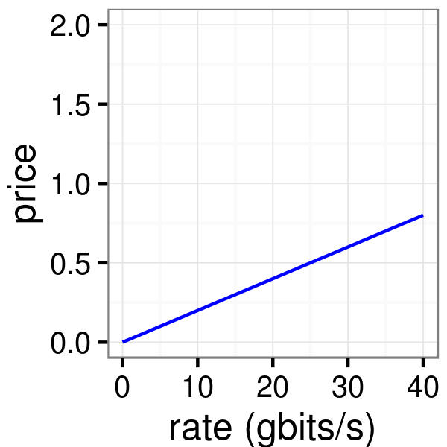
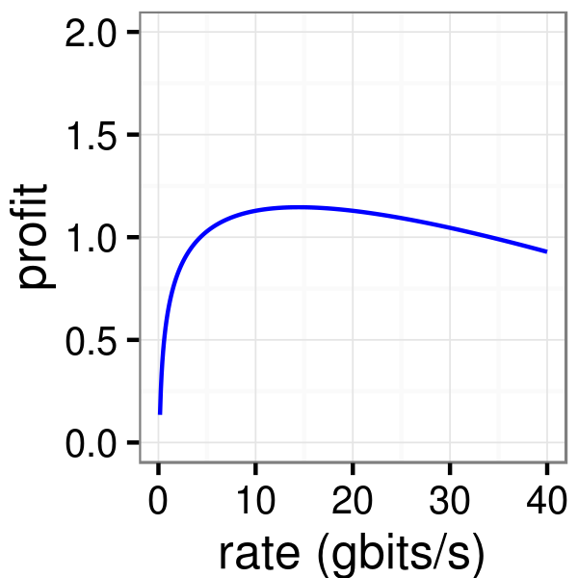
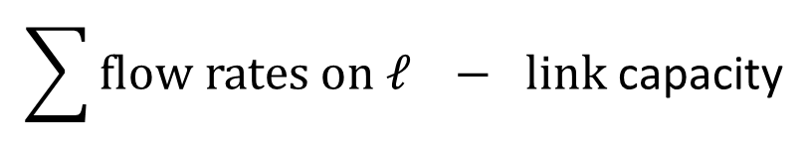
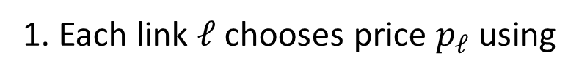
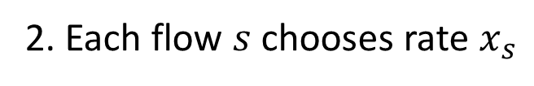
NUM Iterative Optimizer
$$\sum{\text{flow} \text{rates} \text{on} ℓ} − \text{link} \text{capacity}$$
1. Each link $ℓ$ chooses price $p_{ℓ}$ using
Demand
Supply
2. Each flow $s$ chooses rate $x_{s}$
-
=
×
3. Goto 1

Slide 10
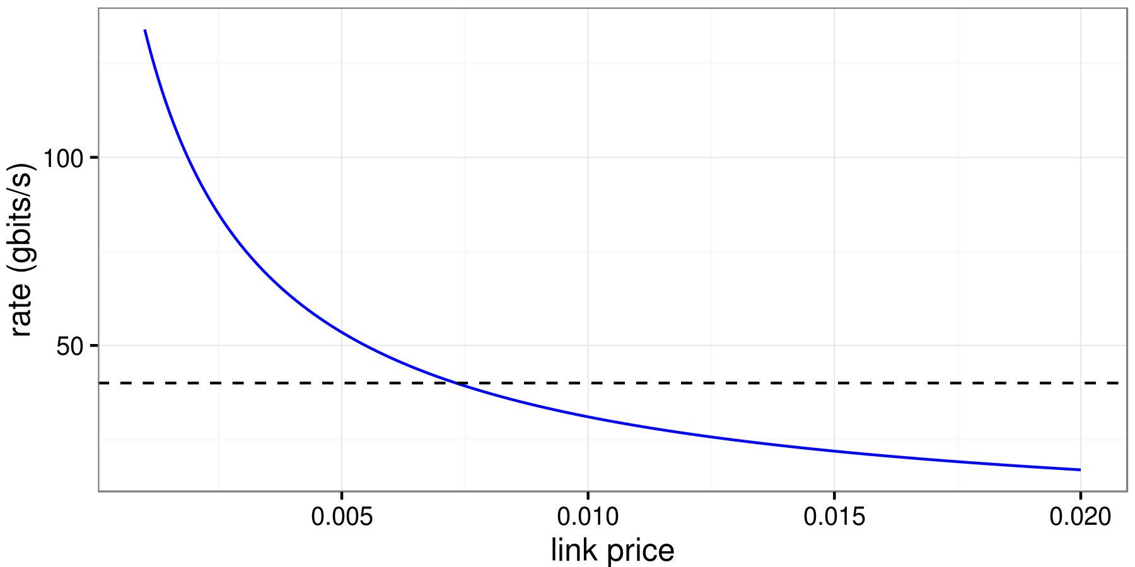
Adjusting prices

Slide 11
Adjusting prices
Newton
Exact
Diagonal
(NED)

Slide 12
Increasing responsiveness
Update inputs
Run 100 iterations
Output rates
Solution 1:
Solution 2:
Solution 3:
But: too slow!
Update inputs
Run 1 iteration
Output rates
But: queueing, packet drops!
Update inputs
Run 1 iteration
Normalize rates
Output rates
$0.05
$0.01
$0.09

Slide 13
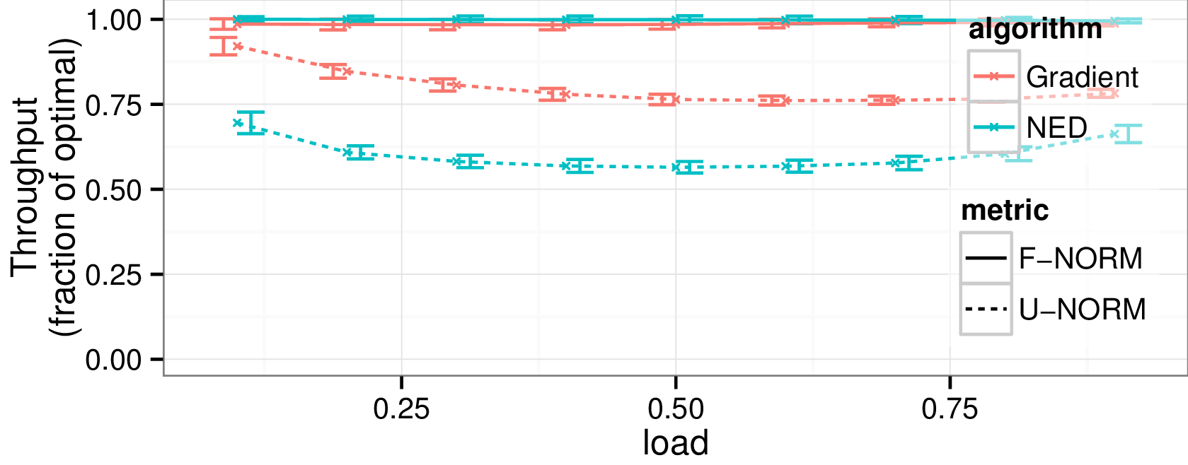
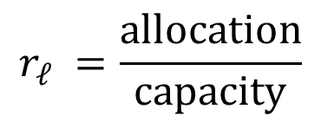
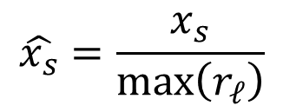
Flowtune normalizes rates
$$r_{ℓ} =\frac{\text{allocation}}{\text{capacity}}$$
102%
93%
99.7% of
optimal throughput
$$\hat{x_{s}}=\frac{x_{s}}{\max\left(r_{ℓ}\right)}$$
110%
87%

Slide 14
Architecture
Optimizer
flowlet
start/end
rates
normalized rates
Endpoints
Normalizer
Allocator

Slide 15
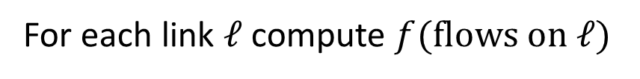
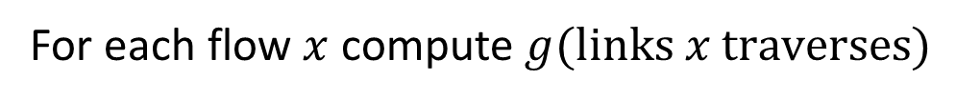
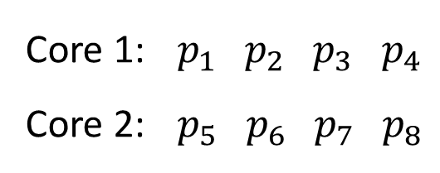
Multicore
6
7
5
8
Core 1: ${ p}_{1} { p}_{2}{ p}_{3} p_{4}$
Core 2: ${ p}_{5} { p}_{6}{ p}_{7} p_{8}$
1
2
3
4
For each link $ℓ$ compute $f(\text{flows} \text{on} ℓ)$
For each flow $x$ compute $g(\text{links} x \text{traverses}\text{)}$

Slide 16
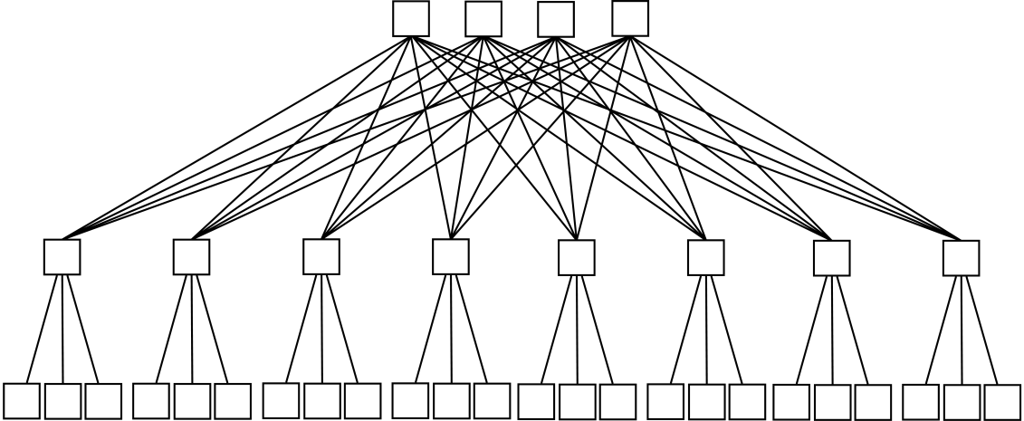
Multicore
Source | Block 1 | core 0 | core 1 | core 2 | core 3
 | Block 2 | core 4 | core 5 | core 6 | core 7
 | Block 3 | core 8 | core 9 | core 10 | core 11
 | Block 4 | core 12 | core 13 | core 14 | core 15
 |  | Block 1 | Block 2 | Block 3 | Block 4
 |  | Destination
Block 1
Block 2
Block 3
Block 4

Slide 17
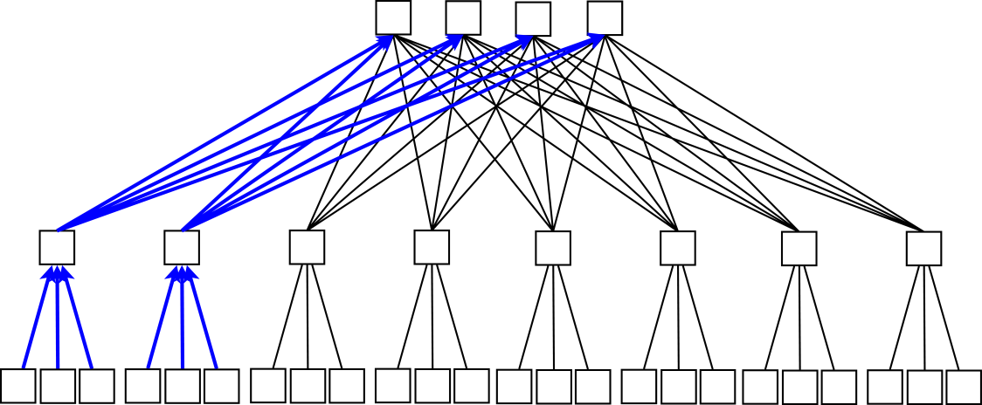
Multicore
Source | Block 1 | core 0 | core 1 | core 2 | core 3
 | Block 2 | core 4 | core 5 | core 6 | core 7
 | Block 3 | core 8 | core 9 | core 10 | core 11
 | Block 4 | core 12 | core 13 | core 14 | core 15
 |  | Block 1 | Block 2 | Block 3 | Block 4
 |  | Destination
Block 1
Block 2
Block 3
Block 4

Slide 18
Multicore
Source | Block 1 | core 0 | core 1 | core 2 | core 3
 | Block 2 | core 4 | core 5 | core 6 | core 7
 | Block 3 | core 8 | core 9 | core 10 | core 11
 | Block 4 | core 12 | core 13 | core 14 | core 15
 |  | Block 1 | Block 2 | Block 3 | Block 4
 |  | Destination
Block 1
Block 2
Block 3
Block 4

Slide 19
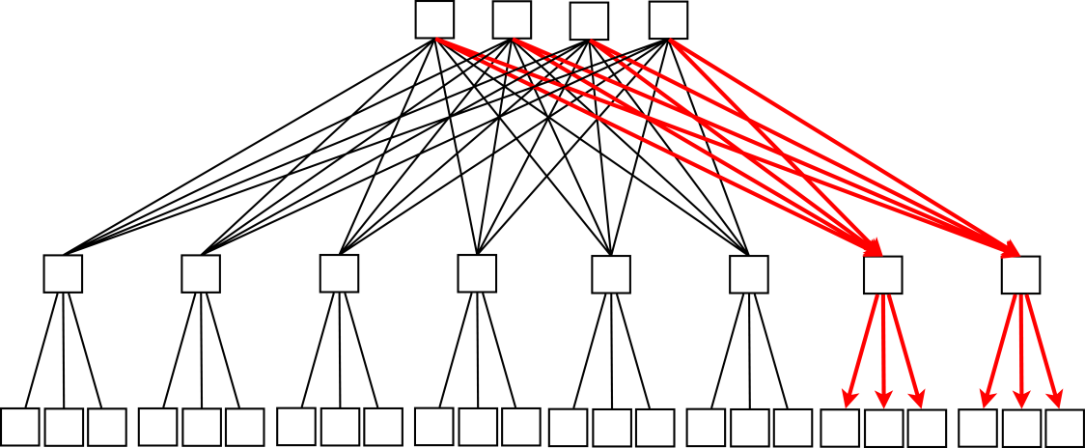
Multicore
Source | Block 1 | core 0 | core 1 | core 2 | core 3
 | Block 2 | core 4 | core 5 | core 6 | core 7
 | Block 3 | core 8 | core 9 | core 10 | core 11
 | Block 4 | core 12 | core 13 | core 14 | core 15
 |  | Block 1 | Block 2 | Block 3 | Block 4
 |  | Destination
Block 1
Block 2
Block 3
Block 4

Slide 20
Multicore
Source | Block 1 | core 0 | core 1 | core 2 | core 3
 | Block 2 | core 4 | core 5 | core 6 | core 7
 | Block 3 | core 8 | core 9 | core 10 | core 11
 | Block 4 | core 12 | core 13 | core 14 | core 15
 |  | Block 1 | Block 2 | Block 3 | Block 4
 |  | Destination
Block 1
Block 2
Block 3
Block 4

Slide 21
Multicore
Source | Block 1 | core 0 | core 1 | core 2 | core 3
 | Block 2 | core 4 | core 5 | core 6 | core 7
 | Block 3 | core 8 | core 9 | core 10 | core 11
 | Block 4 | core 12 | core 13 | core 14 | core 15
 |  | Block 1 | Block 2 | Block 3 | Block 4
 |  | Destination
Block 1
Block 2
Block 3
Block 4

Slide 22
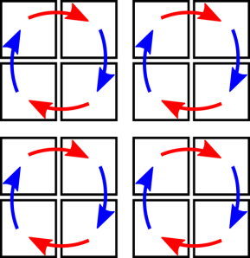
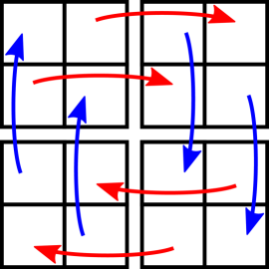


In the paper…
core 0 | core 1 | core 2 | core 3
core 4 | core 5 | core 6 | core 7
core 8 | core 9 | core 10 | core 11
core 12 | core 13 | core 14 | core 15
core 0 | core 1 |  | core 2 | core 3
core 4 | core 5 |  | core 6 | core 7
core 8 | core 9 |  | core 10 | core 11
core 12 | core 13 |  | core 14 | core 15
core 0 | core 1 | core 2 | core 3
core 4 | core 5 | core 6 | core 7
core 8 | core 9 | core 10 | core 11
core 12 | core 13 | core 14 | core 15
Flow view
Link view

Slide 23
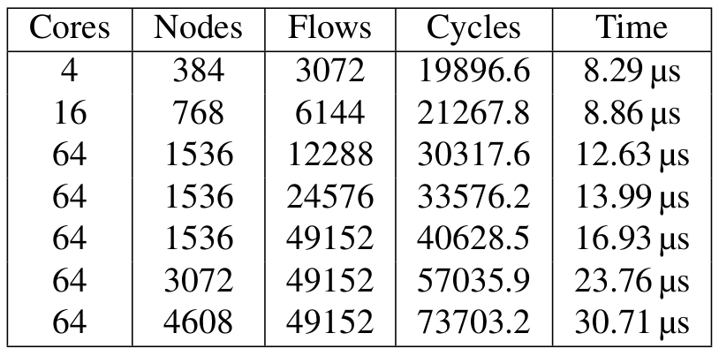

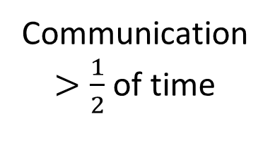
4608 servers in < 31$μs$
Communication
$>\frac{1}{2}$ of time

Slide 24

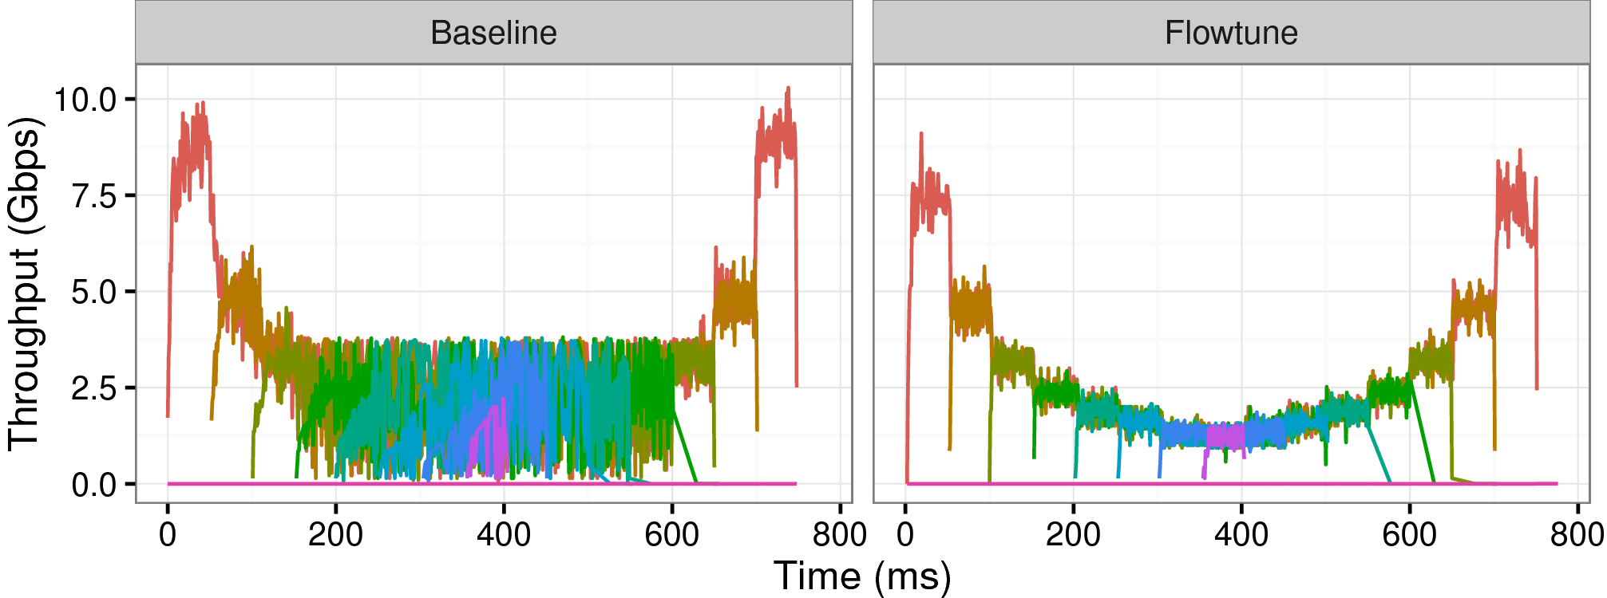
EC2: Resource Allocation
8 senders, every 50 milliseconds
receiver
senders

Slide 25

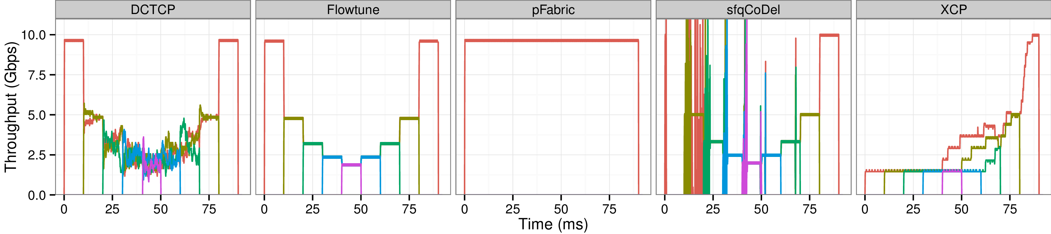
Ns-2: Flowtune converges quickly to a fair allocation
Every 10 milliseconds:
receiver
senders

Slide 26
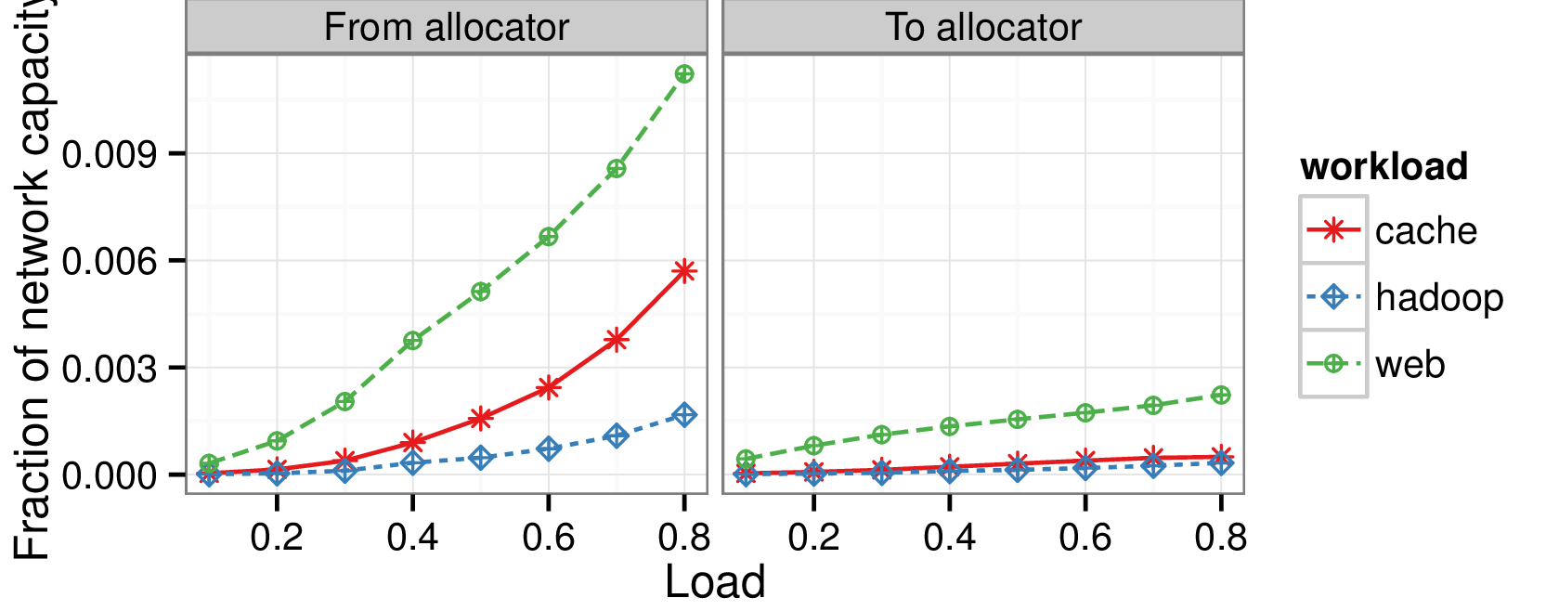
Overhead is low
99% of links
< 10% utilized
Fraction of network capacity
Inside the Social Network’s (Datacenter) Network, Roy et al., SIGCOMM’15

Slide 27
Open Questions
Handling mice
Bypass the allocator? Fastpass?
External traffic
Measure & react?
Deadlines, Co-flow
Market?
Multicore: 3-tier Clos, WAN

Slide 28
Flowtune
Application
Developers
Network Engineers
Explicit Policy
Give application developers
control over network transport

Slide 30
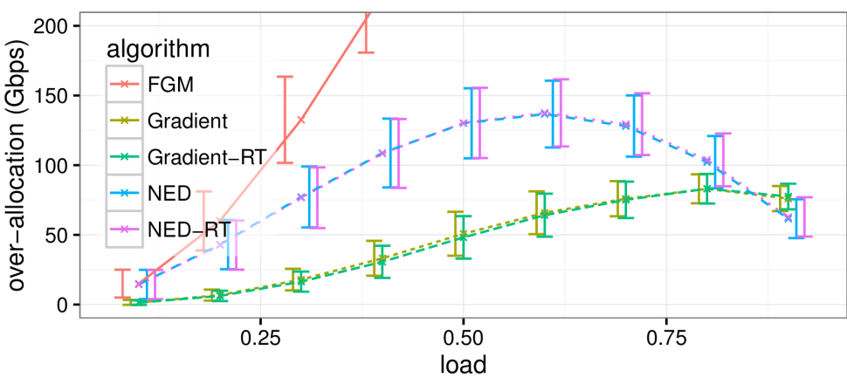
Over-allocation

Slide 31
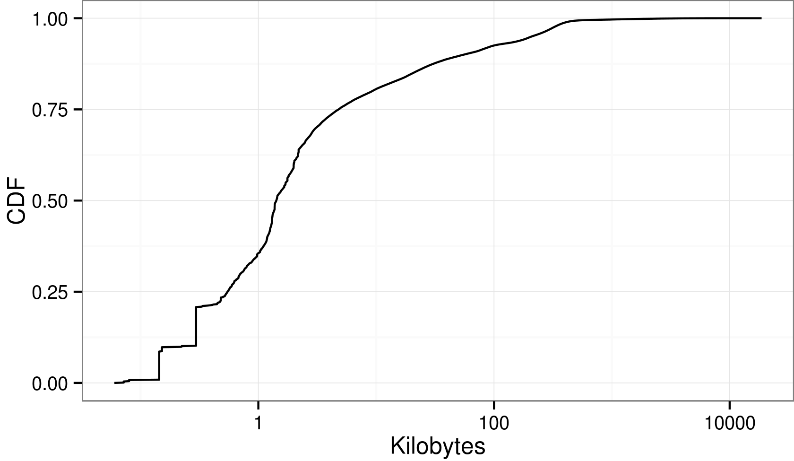
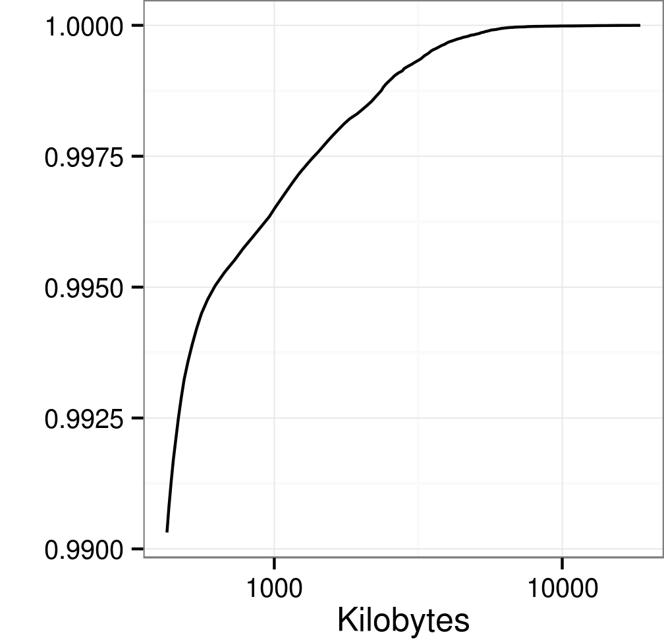




Setup
Inside the Social Network’s (Datacenter) Network, Roy et al., SIGCOMM’15
4 spines
40 Gbits/s
9 racks
…
10 Gbits/s
16 servers/rack
…
…
…
…
pFabric, Alizade et al., SIGCOMM’13

Slide 32
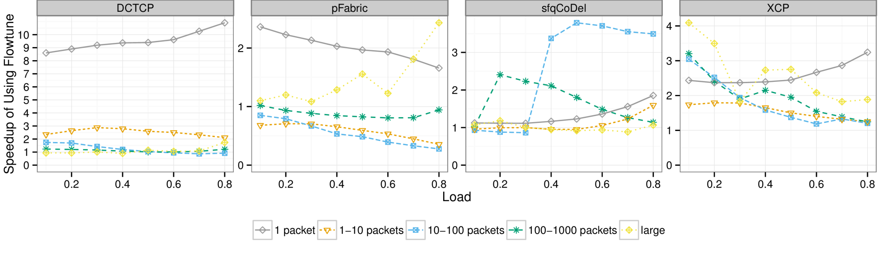
Flowtune reduces p99 FCT

Slide 33
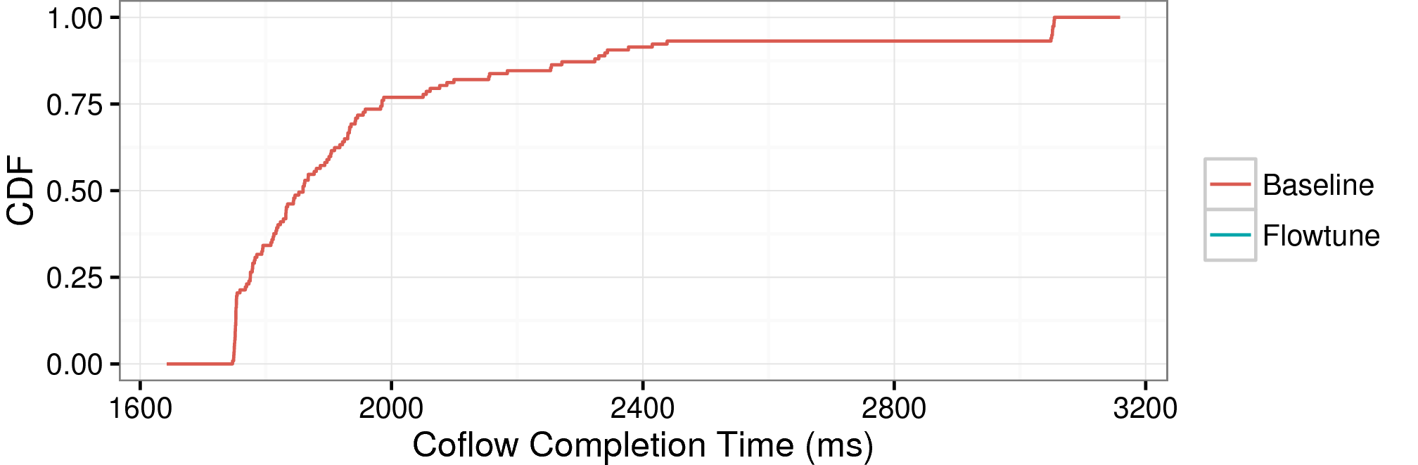
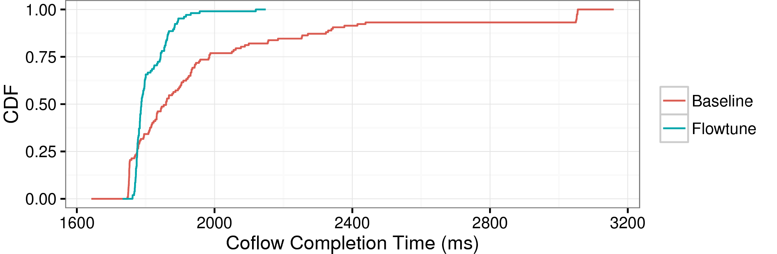
EC2: Response Time is Reduced
receiver
senders
1.61x p95

Slide 34
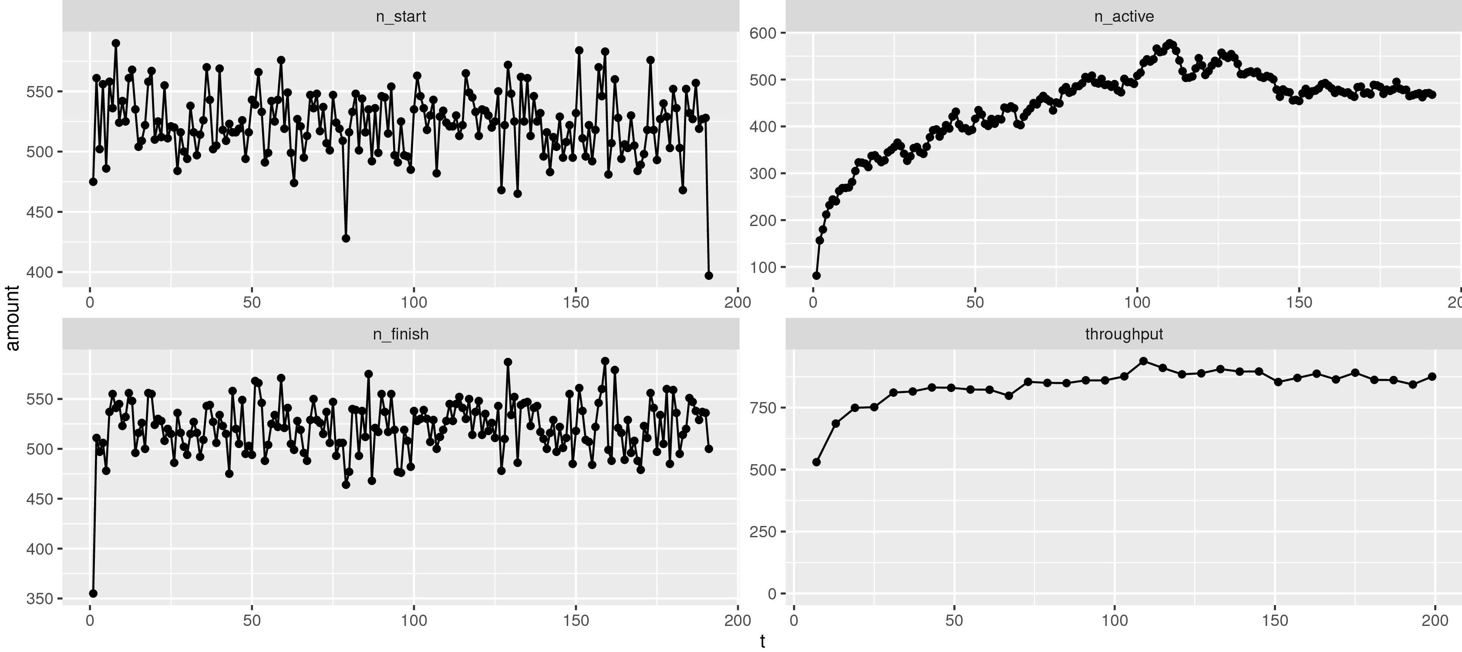
Flowtune, 0.6 load, web

Slide 35
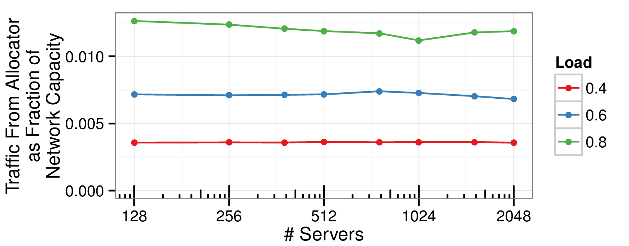
Overhead is constant with scale

Slide 36
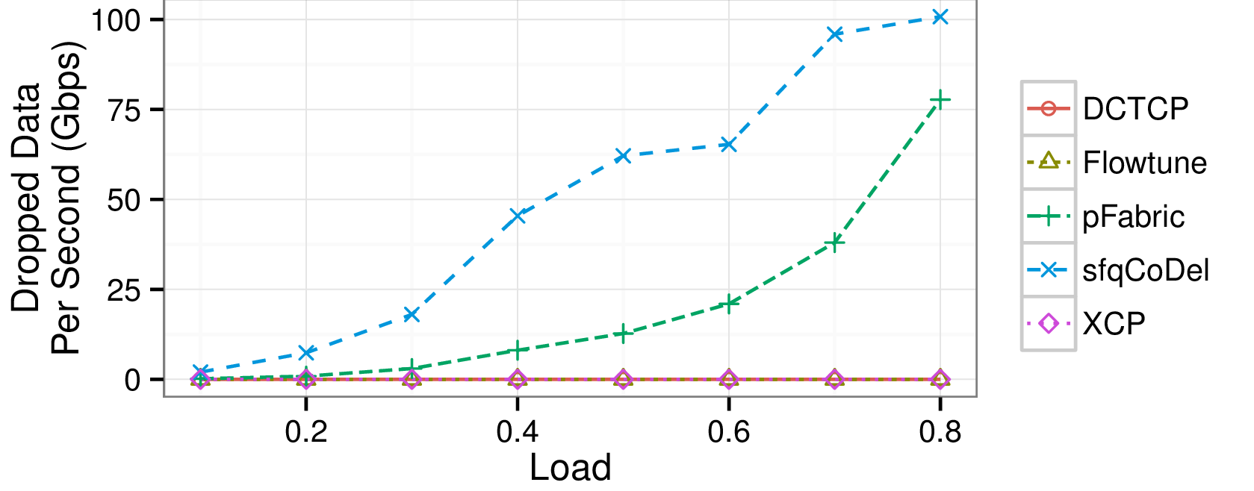
Flowtune achieves low drop rate

Slide 37
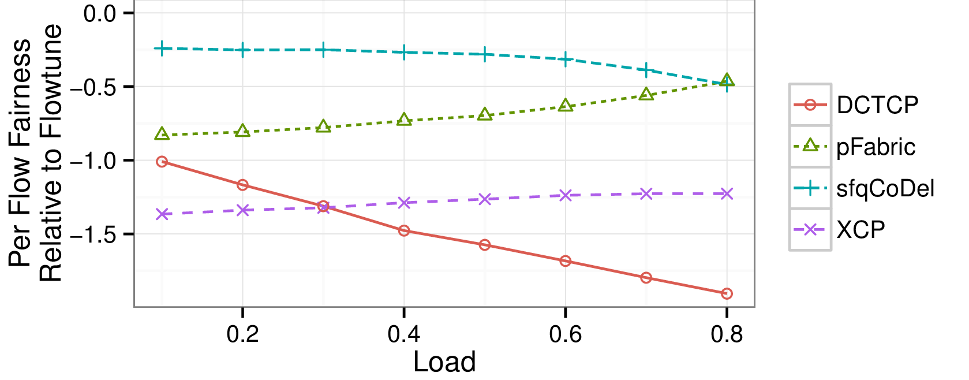
Flowtune is more fair to flows

Slide 38
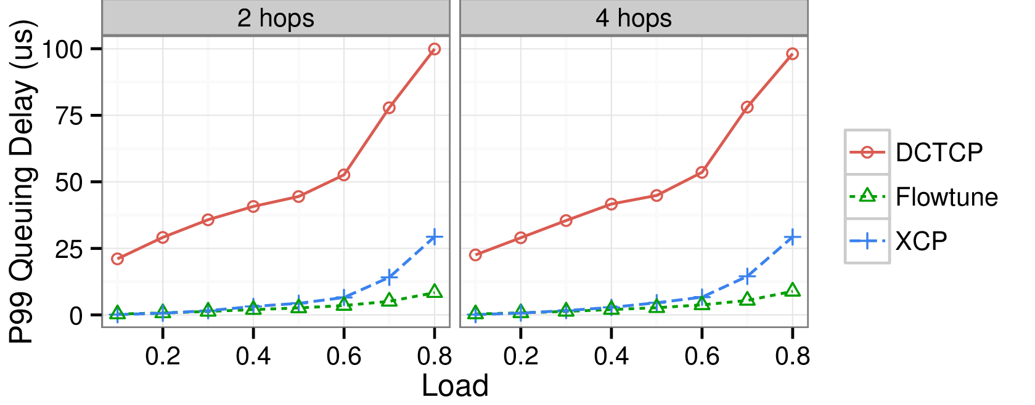
Flowtune has low (p99) queuing delay

Slide 39
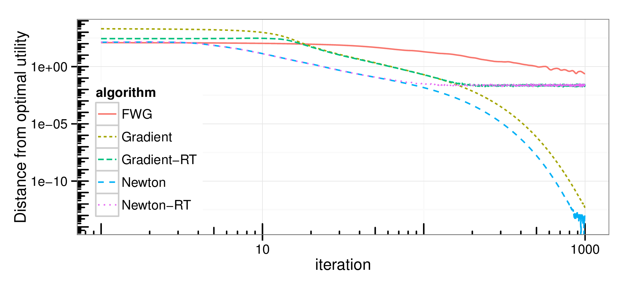
“Off-line” mode

Slide 40
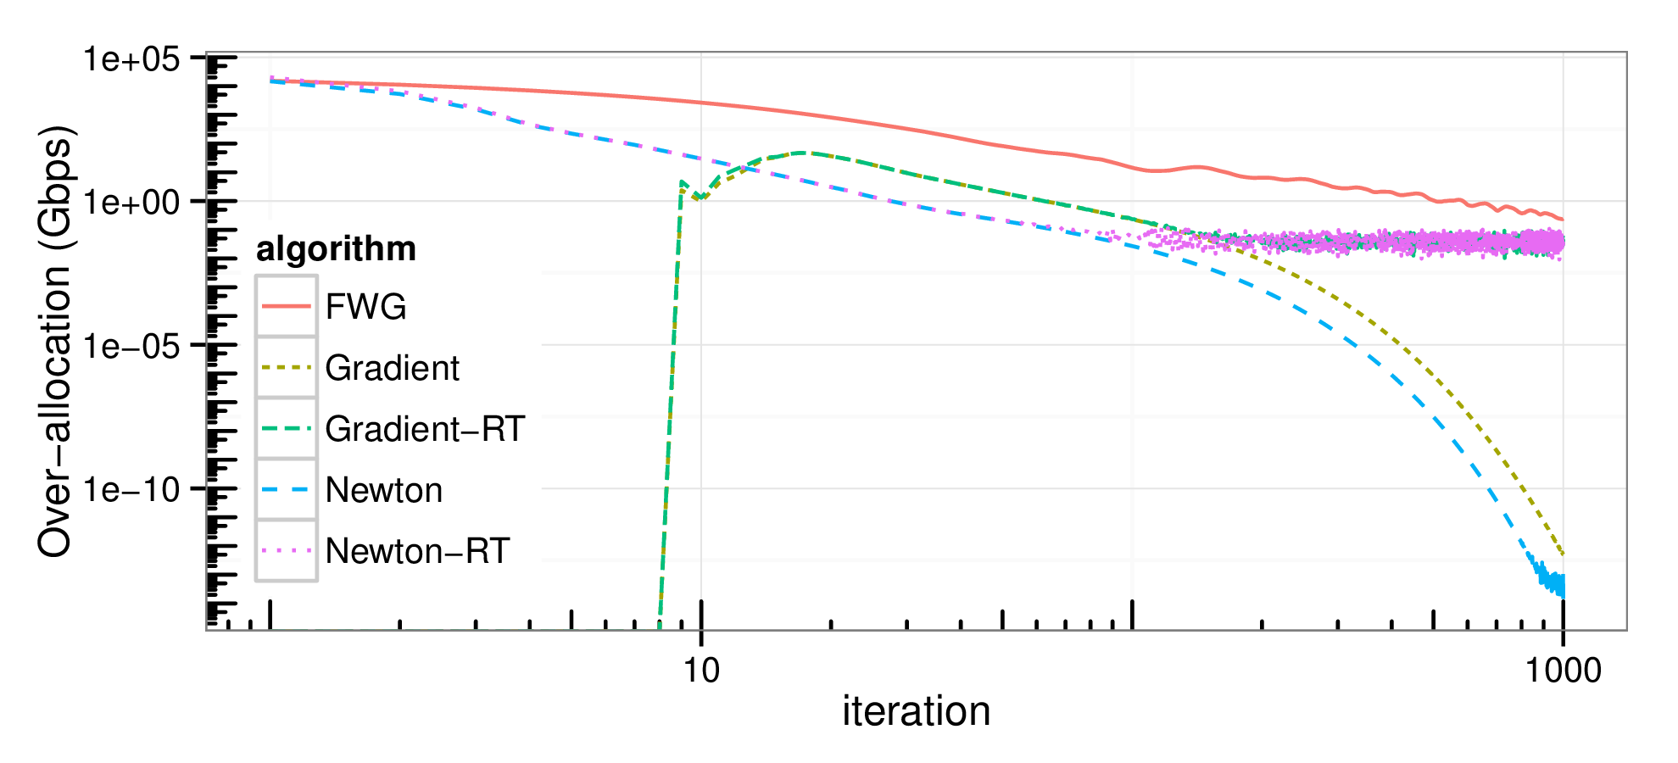
“On-line” – overallocation problem

