Slide 1
Data Center Network Topologies II
Hakim Weatherspoon
Associate Professor, Dept of Computer Science
CS 5413: High Performance Systems and Networking
April 10, 2017 March 31, 2017

Slide 2
Agenda for semester
Project
Continue to make progress.
BOOM proposal due TODAY, Mar 31.
Spring break next week! Week of April 2nd
Intermediate project report 2 due Wednesday, April 12th.
BOOM, Wednesday, April 19
End of Semester presentations/demo, Wednesday, May 10
Check website for updated schedule

Slide 3
Where are we in the semester?
Overview and Basics
Overview
Basic Switch and Queuing (today)
Low-latency and congestion avoidance (DCTCP)
Data Center Networks
Data Center Network Topologies
Software defined networking
Software control plane (SDN)
Programmable data plane (hardware [P4] and software [Netmap])
Rack-scale computers and networks
Disaggregated datacenters
Alternative Switching Technologies
Data Center Transport
Virtualizing Networks
Middleboxes
Advanced topics

Slide 4
Where are we in the semester?
Interested Topics:
SDN and programmable data planes
Disaggregated datacenters and rack-scale computers
Alternative switch technologies
Datacenter topologies
Datacenter transports
Advanced topics

Slide 5
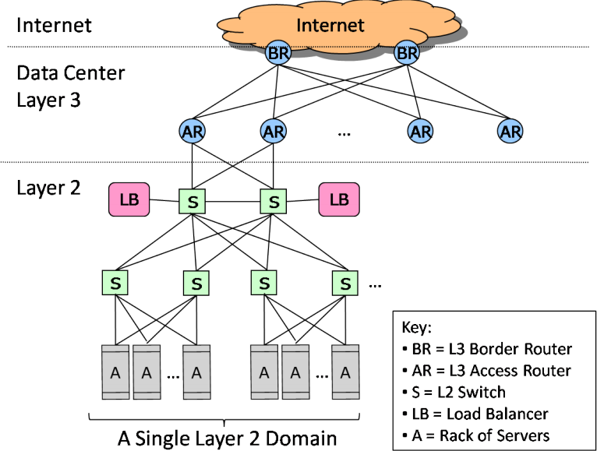
Architecture of Data Center Networks (DCN)

Slide 6
Conventional DCN Problems
CR
CR
1:240
AR
AR
AR
AR
S
S
S
S
I have spare ones,
but…
I want more
1:80
S
S
S
S
. . .
S
S
S
S
1:5
A
A
…
A
A
A
…
A
A
A
…
A
A
A
…
A
Static network assignment
Fragmentation of resource
Poor server to server connectivity
Traffics affects each other
Poor reliability and utilization

Slide 7
Objectives:
Uniform high capacity:
Maximum rate of server to server traffic flow should be limited only by capacity on network cards
Assigning servers to service should be independent of network topology
Performance isolation:
Traffic of one service should not be affected by traffic of other services
Layer-2 semantics:
Easily assign any server to any service
Configure server with whatever IP address the service expects
VM keeps the same IP address even after migration
Discuss Today

Slide 8
Virtual Layer 2 Switch (VL2)
The Illusion of a Huge L2 Switch
CR
1. L2 semantics
CR
. . .
AR
AR
AR
AR
2. Uniform high capacity
3. Performance isolation
S
S
S
S
S
S
S
S
. . .
S
S
S
S
A
A
A
…
A
A
…
A
A
A
A
A
A
A
A
A
A
A
A
A
A
A
A
A
…
A
A
…
A
A
A
A
A
A
A
A
A
A
A
A
A

Slide 9
Approach
A Scalable, Commodity Data Center Network Architecture
M. Al-Fares, A. Loukissas, A. Vahdat. ACM SIGCOMM Computer Communication Review (CCR), Volume 38, Issue 4 (October 2008), pages 63-74.
Main Goal: address the limits of data center network arch
single point of failure
oversubscription of links higher up in the topology
trade-offs between cost and providing
Key Design Considerations/Goals
Allows host communication at line speed
no matter where they are located!
Backwards compatible with existing infrastructure
no changes in application & support of layer 2 (Ethernet)
Cost effective
cheap infrastructure
and low power consumption & heat emission

Slide 10
Approach Background
Internet
Data Center
Core
Layer-3 router
Aggregation
Layer-2/3 switch
Access
Layer-2 switch
Servers

Slide 11
Approach Background
Oversubscription:
Ratio of the worst-case achievable aggregate bandwidth among the end hosts to the total bisection bandwidth of a particular communication topology
Lower the total cost of the design
Typical designs: factor of 2:5:1 (4 Gbps) to 8:1(1.25 Gbps)
Cost:
Edge: $7,000 for each 48-port 10 GigE switch
Aggregation and core: $700,000 for 64-port 100GigE switches
Cabling costs are not considered!

Slide 12
Research Questions
What topology to use in data centers?
Reducing wiring complexity
Achieving high bisection bandwidth
Exploiting capabilities of optics and wireless
Routing architecture?
Flat layer-2 network vs. hybrid switch/router
Flat vs. hierarchical addressing
How to perform traffic engineering?
Over-engineering vs. adapting to load
Server selection, VM placement, or optimizing routing
Virtualization of NICs, servers, switches, …

Slide 13
Properties of the solution
Backwards compatible with existing infrastructure
No changes in application
Support of layer 2 (Ethernet)
Cost effective
Low power consumption & heat emission
Cheap infrastructure
Allows host communication at line speed

Slide 14
Clos Networks/Fat-Trees
Adopt a special instance of a Clos topology
Similar trends in telephone switches led to designing a topology with high bandwidth by interconnecting smaller commodity switches.

Slide 15
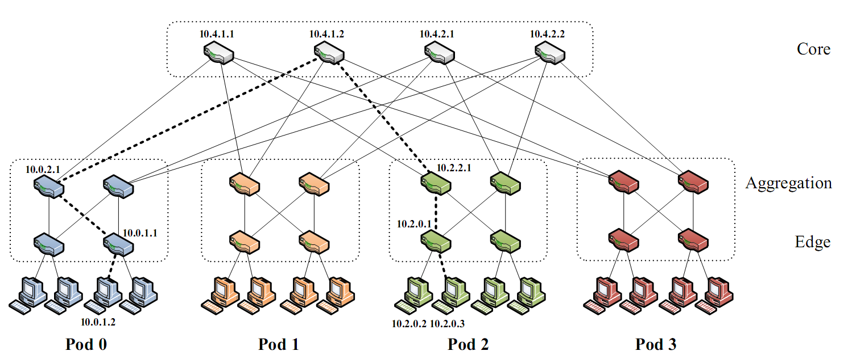
FatTree-based DC Architecture
Inter-connect racks (of servers) using a fat-tree topology
K-ary fat tree: three-layer topology (edge, aggregation and core)
each pod consists of (k/2)² servers & 2 layers of k/2 k-port switches
each edge switch connects to k/2 servers & k/2 aggr. switches
each aggr. switch connects to k/2 edge & k/2 core switches
(k/2)² core switches: each connects to k pods
Fat-tree with K=4

Slide 16
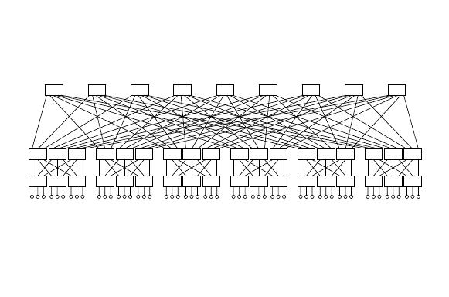
FatTree-based DC Architecture
Why Fat-Tree?
Fat tree has identical bandwidth at any bisections
Each layer has the same aggregated bandwidth
Can be built using cheap devices with uniform capacity
Each port supports same speed as end host
All devices can transmit at line speed if packets are distributed uniform along available paths
Great scalability: k-port switch supports k³/4 servers
Fat tree network with K = 6 supporting 54 hosts

Slide 17
Clos Network Topology
Offer huge aggr capacity & multi paths at modest cost
VL2
Int
. . .
D (# of 10G ports) | Max DC size (# of Servers)
48 | 11,520
96 | 46,080
144 | 103,680
Aggr
. . .
K aggr switches with D ports
. . .
. . . . . .
TOR
. . .
. . . . . . . .
20 Servers
20*(DK/4) Servers
Notes:
D/2 ports facing up, and D/2 ports facing down…

Slide 18
FatTree Topology is great, But…
Does using fat-tree topology to inter-connect racks of servers in itself sufficient?
What routing protocols should we run on these switches?
Layer 2 switch algorithm: data plane flooding!
Layer 3 IP routing:
shortest path IP routing will typically use only one path despite the path diversity in the topology
if using equal-cost multi-path routing at each switch independently and blindly, packet re-ordering may occur; further load may not necessarily be well-balanced
Aside: control plane flooding!

Slide 19
Problems with Fat-tree
Layer 3 will only use one of the existing equal cost paths
Bottlenecks up and down the fat-tree
Simple extension to IP forwarding
Packet re-ordering occurs if layer 3 blindly takes advantage of path diversity ; further load may not necessarily be well-balanced
Wiring complexity in large networks
Packing and placement technique

Slide 20
FatTree Modified
Enforce a special (IP) addressing scheme in DC
unused.PodNumber.switchnumber.Endhost
Allows host attached to same switch to route only through switch
Allows inter-pod traffic to stay within pod

Slide 21
FatTree Modified
Diffusion Optimizations (routing options)
1. Flow classification, Denote a flow as a sequence of packets; pod switches forward subsequent packets of the same flow to same outgoing port. And periodically reassign a minimal number of output ports
Eliminates local congestion
Assign traffic to ports on a per-flow basis instead of a per-host basis, Ensure fair distribution on flows

Slide 22
FatTree Modified
2. Flow scheduling, Pay attention to routing large flows, edge switches detect any outgoing flow whose size grows above a predefined threshold, and then send notification to a central scheduler. The central scheduler tries to assign non-conflicting paths for these large flows.
Eliminates global congestion
Prevent long lived flows from sharing the same links
Assign long lived flows to different links

Slide 23
Fault Tolerance
In this scheme, each switch in the network maintains a BFD (Bidirectional Forwarding Detection) session with each of its neighbors to determine when a link or neighboring switch fails
Failure between upper layer and core switches
Outgoing inter-pod traffic, local routing table marks the affected link as unavailable and chooses another core switch
Incoming inter-pod traffic, core switch broadcasts a tag to upper switches directly connected signifying its inability to carry traffic to that entire pod, then upper switches avoid that core switch when assigning flows destined to that pod

Slide 24
Fault Tolerance
Failure between lower and upper layer switches
Outgoing inter- and intra pod traffic from lower-layer,
the local flow classifier sets the cost to infinity and does not assign it any new flows, chooses another upper layer switch
Intra-pod traffic using upper layer switch as intermediary
Switch broadcasts a tag notifying all lower level switches, these would check when assigning new flows and avoid it
Inter-pod traffic coming into upper layer switch
Tag to all its core switches signifying its ability to carry traffic, core switches mirror this tag to all upper layer switches, then upper switches avoid affected core switch when assigning new flaws

Slide 25
Packing
Increased wiring overhead is inherent to the fat-tree topology
Each pod consists of 12 racks with 48 machines each, and 48 individual 48-port GigE switches
Place the 48 switches in a centralized rack
Cables moves in sets of 12 from pod to pod and in sets of 48 from racks to pod switches opens additional opportunities for packing to reduce wiring complexity
Minimize total cable length by placing racks around the pod switch in two dimensions

Slide 26
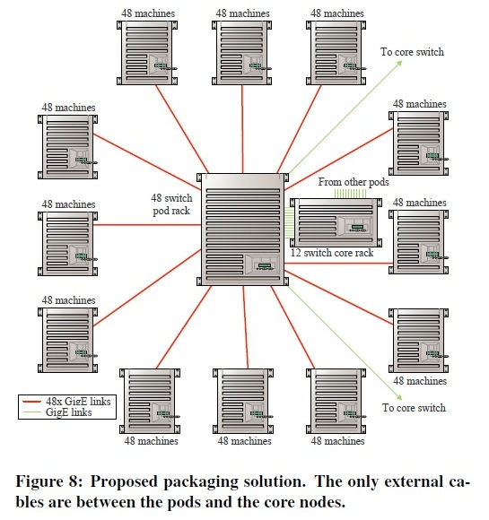
Packing

Slide 27
Perspective
Bandwidth is the scalability bottleneck in large scale clusters
Existing solutions are expensive and limit cluster size
Fat-tree topology with scalable routing and backward compatibility with TCP/IP and Ethernet
Large number of commodity switches have the potential of displacing high end switches in DC the same way clusters of commodity PCs have displaced supercomputers for high end computing environments

Slide 28
Other Data Center Architectures
A Scalable, Commodity Data Center Network Architecture
a new Fat-tree “inter-connection” structure (topology) to increases “bi-section” bandwidth
needs “new” addressing, forwarding/routing
VL2: A Scalable and Flexible Data Center Network
consolidate layer-2/layer-3 into a “virtual layer 2”
separating “naming” and “addressing”, also deal with dynamic load-balancing issues
Other Approaches:
PortLand: A Scalable Fault-Tolerant Layer 2 Data Center Network Fabric
BCube: A High-Performance, Server-centric Network Architecture for Modular Data Centers

Slide 29
Agenda for semester
Project
Continue to make progress.
BOOM proposal due TODAY, Mar 31.
Spring break next week! Week of April 2nd
Intermediate project report 2 due Wednesday, April 12th.
BOOM, Wednesday, April 19
End of Semester presentations/demo, Wednesday, May 10
Check website for updated schedule

