Slide 1

哈希学习
王秋里

Slide 2
SHA-1 1993
MD2 1989
MD4 1990
MD5 1991
Semantic Hashing 2007
CNN Hashing 2014
LSH 2004
Spectral Hashing 2009
ALSH 2014
Notes:
MD5的作用是让大容量信息在用数字签名软件签署私人密钥前被"压缩"成一种保密的格式（就是把一个任意长度的字节串变换成一定长的十六进制数字串）。除了MD5以外，其中比较有名的还有sha-1、RIPEMD以及Haval等。

Slide 3
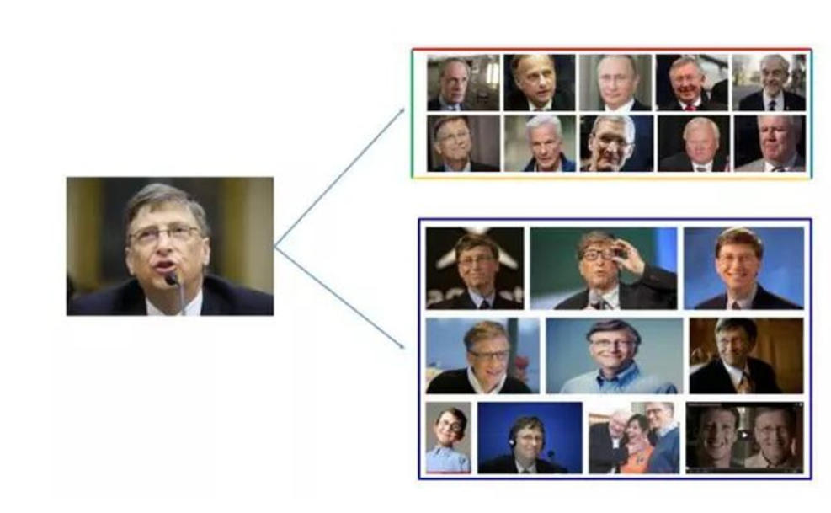
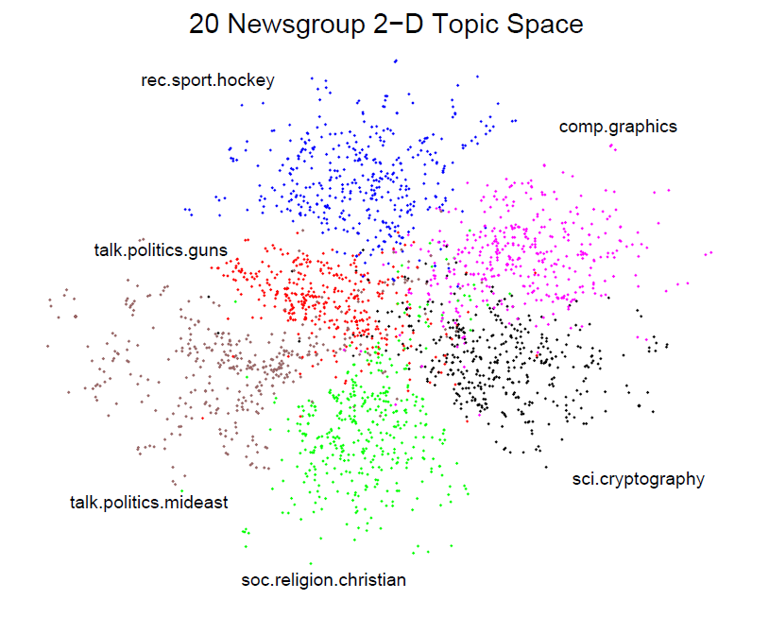
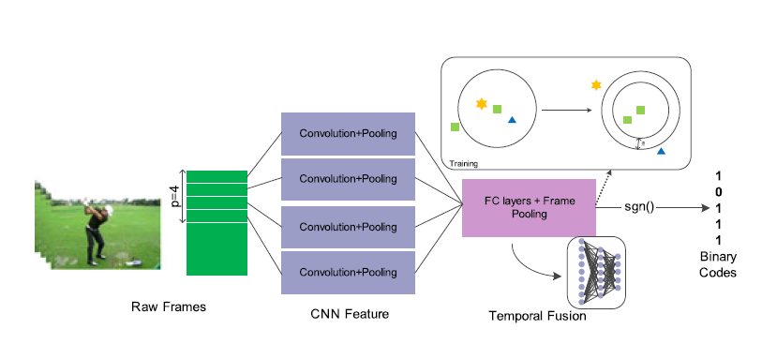
图像搜索
信息检索
计算机视觉

Slide 4
A.哈希学习
B.data-independent hashing
C.data-dependent hashing

Slide 5
哈希学习

Slide 6
A
哈希学习
Hash，一般翻译做“散列”，也有直接音译为“哈希”的，就是把任意长度的输入，通过散列算法，变换成固定长度的输出，该输出就是散列值。
简单的说就是一种将任意长度的消息压缩到某一固定长度的消息摘要的函数。

Slide 7
A
哈希学习
哈希表：
哈希表主要是构造一个映射函数，该函数以数据元素为自变量，函数值即为数据元素在内存中的存储位置。通常把这样的映射函数称为哈希函数h(x)。
常用的哈希函数构造方法：
1 除留余数法
2 直接定址法
3 数字分析法

Slide 8
A
哈希学习
将序列[3, 15, 22, 24, 25]放到编号为0到4，表长为5的哈希表中
哈希函数H(k) = k % 5;
0 | 1 | 2 | 3 | 4
15
22
3
24
25
如果没有内存限制，那么可以直接将键作为数组的索引。那么所有的查找时间复杂度为O(1)

Slide 9
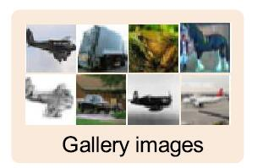
A
哈希学习
Similarity search -> the curse of dimensionality
2 0 1 … 5 4
0 1 7 … 3 5
8 0 1 … 1 4
…
…
4 2 1 … 0 1
[2 0 1 0 6 9 …… 5 7 0 1]
1 x N²
N x N

Slide 10
A
哈希学习
Hashing based approximate nearest neighbor(ANN)
2 0 1 … 5 4
0 1 7 … 3 5
8 0 1 … 1 4
…
…
4 2 1 … 0 1
h(x)
[2 0 1 0 6 9 …… 5 7 0 1]
[1 1 0 1 …… 0 1]
1 x N²
1 x K
N x N
Notes:
Basic idea:
construct a series of hash functions to map each visual object into a binary feature vector so that visually similar samples are mapped into similar binary codes

Slide 11
A
哈希学习
1. data-independent
locality sensitive hashing (LSH) and its kernelized or discriminative extensions
2. data-dependent
spectral hashing, binary reconstructive embedding (BRE), iterative quantization (ITQ), K-means hashing (KMH), minimal loss
hashing (MLH), and sequential projection learning hashing (SPLH).

Slide 12
data-independent hashing

Slide 13

B
data-independent
locality sensitive hashing(LSH)
—— ϵ-NNS problem
1+ϵ
Notes:
Given a set P of points in a normed space 𝑙_𝑝^𝑑, preprocess P so as to efficiently return a point p ∈ P for any given query point q, such that d(q, p) ≤ (1+ϵ) d(q, P), where d(q, P) is the distance of q to the its closest point in P.

Slide 14
B
data-independent
locality sensitive hashing(LSH)
embedding
1 2 1 4
3 2 1 3
3 1 2 2
4 3 2 1
1000 1100 1000 1111
1110 1100 1000 1110
1110 1000 1100 1100
1111 1110 1100 1000
C = 4
the largest coordinate in all points
the embedding preserves the distances between the points

Slide 15
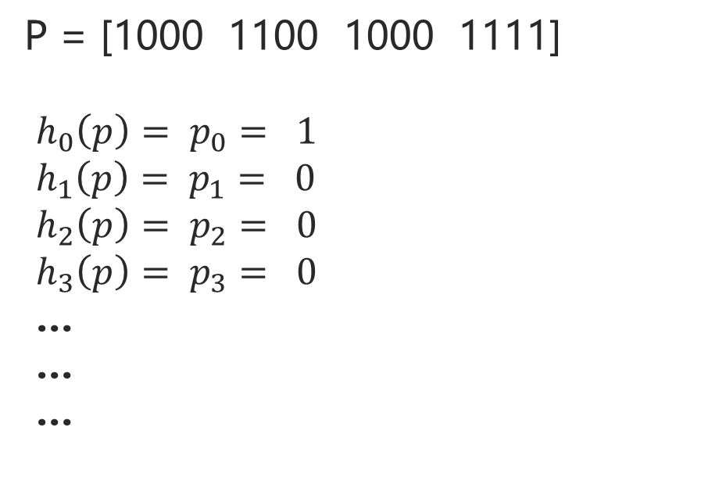

B
data-independent
locality sensitive hashing(LSH)
Origin LSH hash functions: $h_{i}\left(p\right)= p_{i}$
P = [1000 1100 1000 1111]
$h_{0}\left(p\right)= p_{0}= 1$
$h_{1}\left(p\right)= p_{1}= 0$
$h_{2}\left(p\right)= p_{2}= 0$
$h_{3}\left(p\right)= p_{3}= 0$
…
…
…
1000 1100 1000 1111
1110 1100 1000 1110
1110 1000 1100 1100
1111 1110 1100 1000

Slide 16


B
data-independent
locality sensitive hashing(LSH)
Origin LSH hash functions: $h_{i}\left(p\right)= p_{i}$
then we have Cd hash functions
P = [1000 1100 … 1000 1111]
P | G
[1010…1101]
$$g_{i}=(h_{i1}\left(p\right),h_{i2}\left(p\right),…,h_{ik}\left(p\right))$$
Notes:
select k functions:
𝑔_𝑖=(ℎ_𝑖1 (𝑝),ℎ_𝑖2 (𝑝) 〖,ℎ〗_𝑖3 (𝑝) 〖,ℎ〗_𝑖4 (𝑝),…,ℎ_𝑖𝑘 (𝑝))

Slide 17
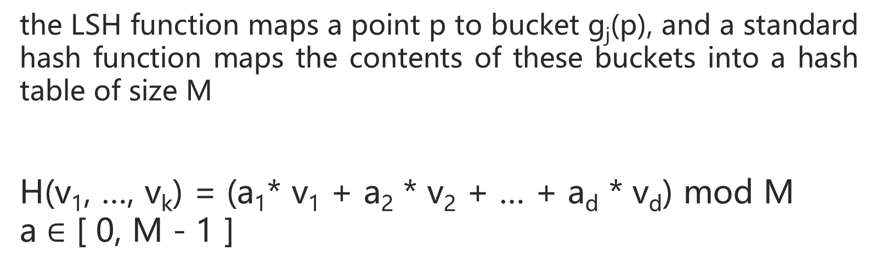
B
data-independent
locality sensitive hashing(LSH)
the LSH function maps a point p to bucket g_{j}(p), and a standard hash function maps the contents of these buckets into a hash table of size M
H(v₁, …, v_{k}) = (a₁* v₁ + a₂ * v₂ + … + a_{d} * v_{d}) mod M
a $∈$ [ 0, M - 1 ]

Slide 18
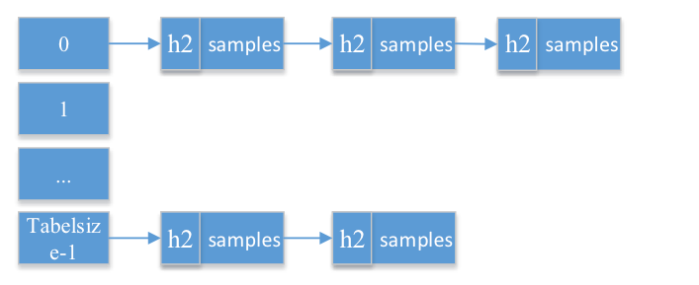
B
data-independent
locality sensitive hashing(LSH)

Slide 19
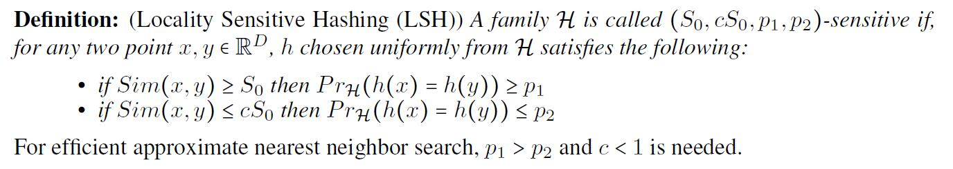
B
data-independent
locality sensitive hashing(LSH)

Slide 20
B
data-independent
Asymmetric locality sensitive hashing(ALSH)
LSH maps data into Hamming space
1000 1100 1000 1111
1110 1100 1000 1110
1110 1000 1100 1100
1111 1110 1100 1000
Sim(x, y) = y^{T} x ?

Slide 21
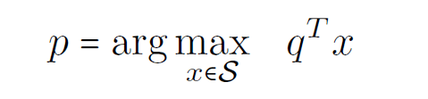
B
data-independent
Asymmetric locality sensitive hashing(ALSH)
—— Maximum Inner Product Search (MIPS)
given a giant data vector collection S of size N, where S ∈ R^{D}, and a given query point q ∈ R^{D} searching for p ∈ S which maximizes (or approximately maximizes) the inner product

Slide 22
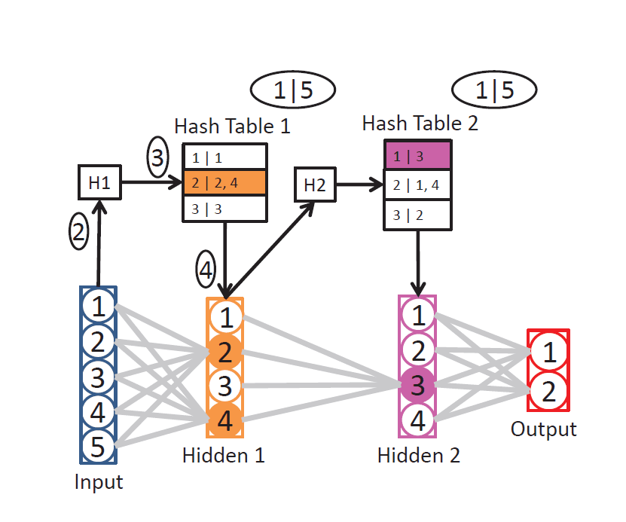
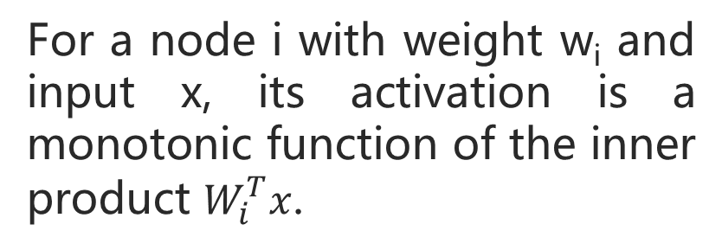
B
data-independent
For a node i with weight w_{i} and input x, its activation is a monotonic function of the inner product $W_{i}^{T}x$.
Scalable and Sustainable Deep Learning
via Randomized Hashing

Slide 23
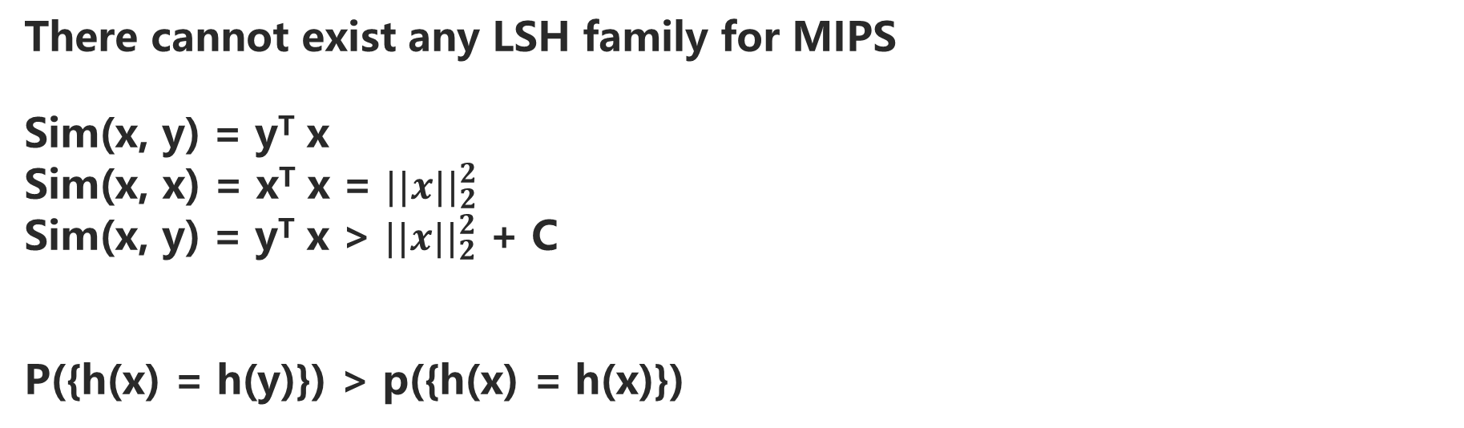
B
data-independent
Asymmetric locality sensitive hashing(ALSH)
There cannot exist any LSH family for MIPS
Sim(x, y) = y^{T} x
Sim(x, x) = x^{T} x = ${||x||}_{2}^{2}$
Sim(x, y) = y^{T} x > ${||x||}_{2}^{2}$ + C
P({h(x) = h(y)}) > p({h(x) = h(x)})

Slide 24
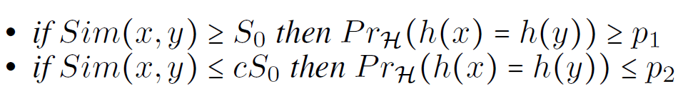
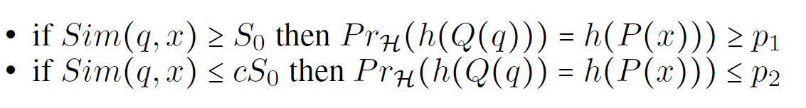
B
data-independent
Asymmetric locality sensitive hashing(ALSH)

Slide 25
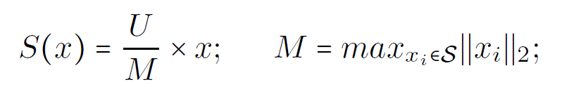
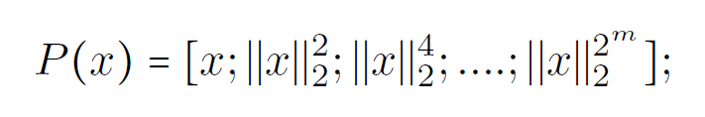
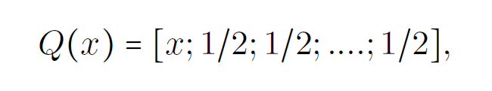
B
data-independent
Asymmetric locality sensitive hashing(ALSH)
Notes:
谱范数

Slide 26
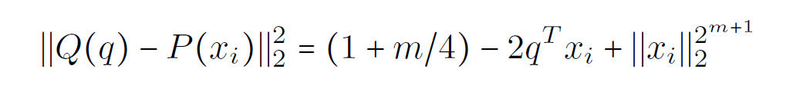
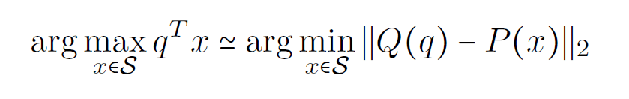
B
data-independent
Asymmetric locality sensitive hashing(ALSH)

Slide 27
data-dependent hashing

Slide 28

C
data-dependent
spectral hashing(谱哈希)
谱哈希将编码过程视为图分割过程
. . . . . . . .
. . . . . . . .
. . . . . . . .
8 x 8

Slide 29

C
data-dependent
spectral hashing(谱哈希)
拉普拉斯降维：如果两个数据实例i和j很相似，那么i和j在降维后目标子空间中应该尽量接近。
实例数目：n
目标子空间维度：m
定义Y，大小为n x m
其中每一个行向量${ y}_{i}^{T}$ 是数据实例 i 在目标 m 维子空间中的向量表示

Slide 30
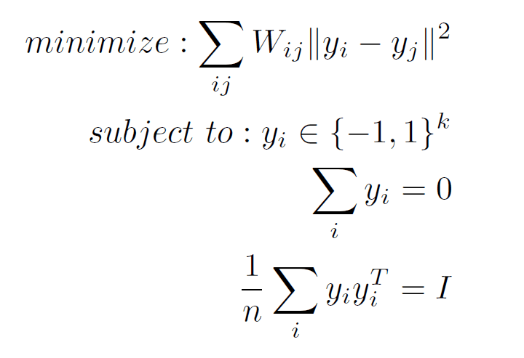
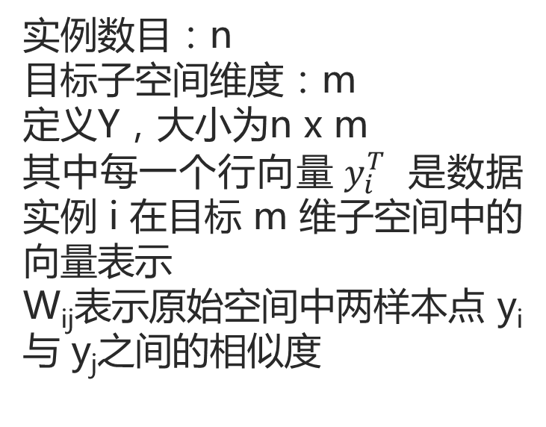
C
data-dependent
spectral hashing(谱哈希)
实例数目：n
目标子空间维度：m
定义Y，大小为n x m
其中每一个行向量${ y}_{i}^{T}$ 是数据实例 i 在目标 m 维子空间中的向量表示
W_{ij}表示原始空间中两样本点 y_{i}与 y_{j}之间的相似度

Slide 31

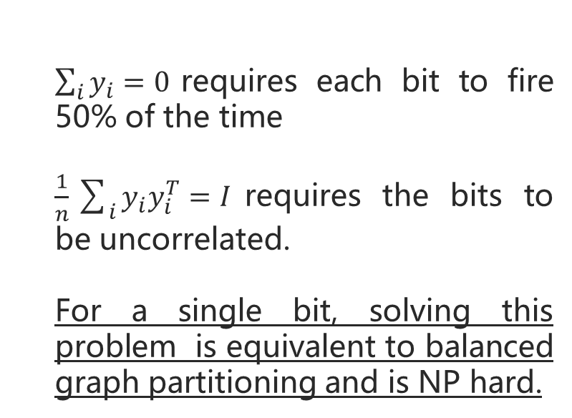
C
data-dependent
spectral hashing(谱哈希)
$\sum_{i}{y_{i}}=0$requires each bit to fire 50% of the time
$\frac{1}{n}\sum_{i}{y_{i}y_{i}^{T}}=I$requires the bits to be uncorrelated.
For a single bit, solving this problem is equivalent to balanced graph partitioning and is NP hard.

Slide 32
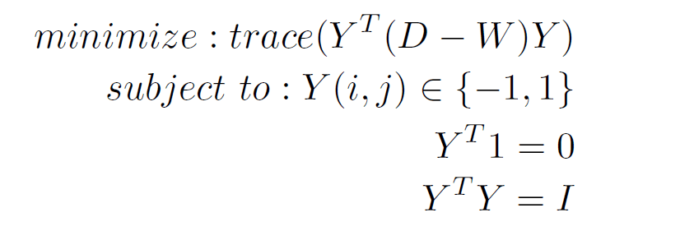
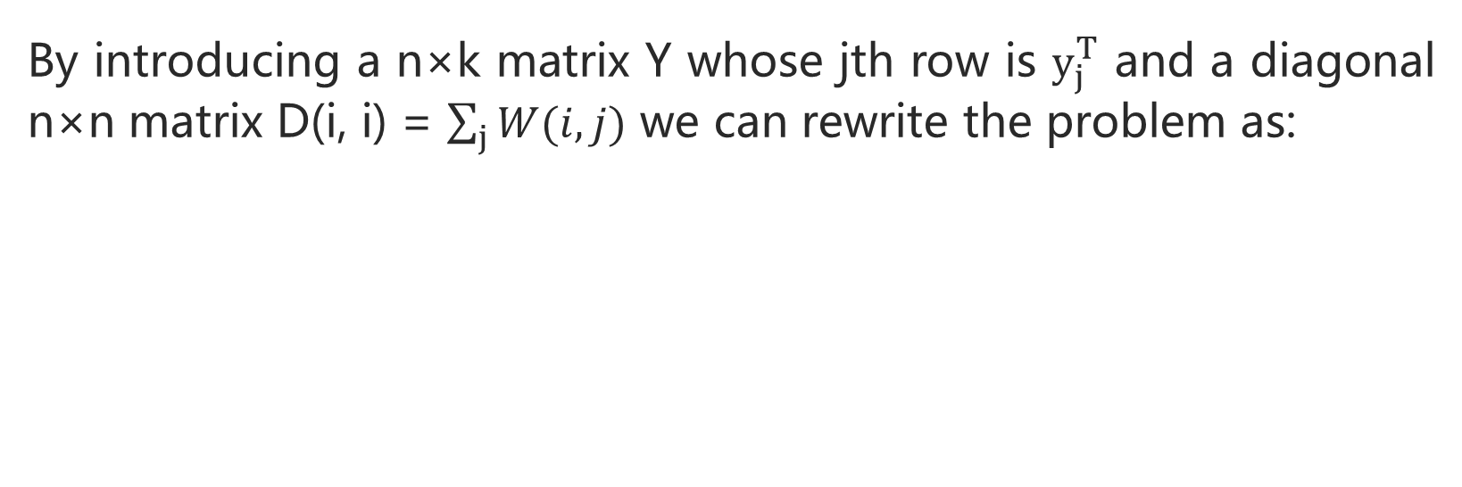
C
data-dependent
spectral hashing(谱哈希)
By introducing a n×k matrix Y whose jth row is $y_{j}^{T}$ and a diagonal n×n matrix D(i, i) = $\sum_{j}{W(i, j)}$ we can rewrite the problem as:
Thresholding ->binary code words

Slide 33
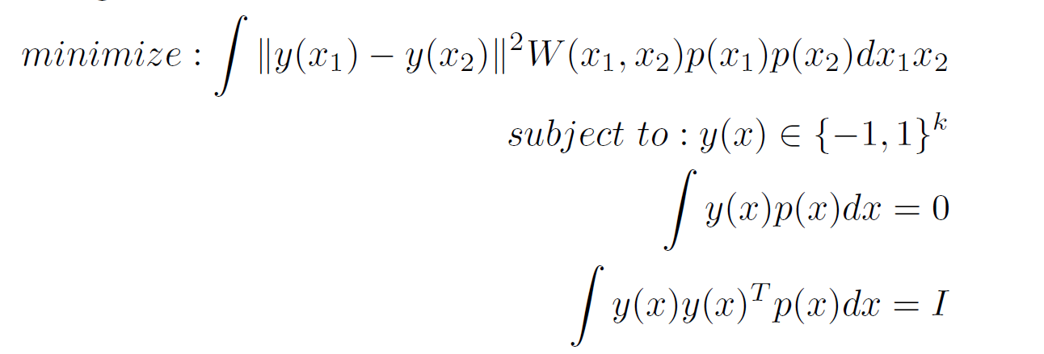
C
data-dependent
spectral hashing(谱哈希)
Out of Sample Extension

Slide 34
结论
what makes a good code:
(1) Easily computed for a novel input
(2) Requires a small number of bits to code the full dataset
(3) Maps similar items to similar binary code words

Slide 35
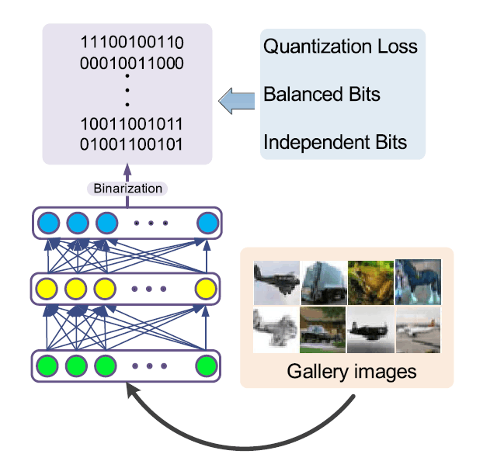
结论
LSH：
简单，有效，不稳定
谱哈希：
哈希函数更稳定，运算更复杂
相似度检测，近邻搜索，分类

Slide 36
参考
Spring R, Shrivastava A. Scalable and Sustainable Deep Learning via Randomized Hashing[J]. 2016.
Weiss Y, Torralba A, Fergus R. Spectral Hashing[C]// Conference on Neural Information Processing Systems, Vancouver, British Columbia, Canada, December. DBLP, 2008:1753-1760.
Shrivastava A, Li P. Asymmetric LSH (ALSH) for sublinear time Maximum Inner Product Search (MIPS)[J]. Advances in Neural Information Processing Systems, 2014, 3:2321-2329.
Gionis A, Indyk P, Motwani R. Similarity Search in High Dimensions via Hashing[C]// International Conference on Very Large Data Bases. Morgan Kaufmann Publishers Inc. 1997:518--529.

Slide 37
END
THANKS

