Slide 1

Achieving Accuracy and Scalability
Simultaneously in Detecting Application Clones
on Android Markets
王秋里

Slide 2
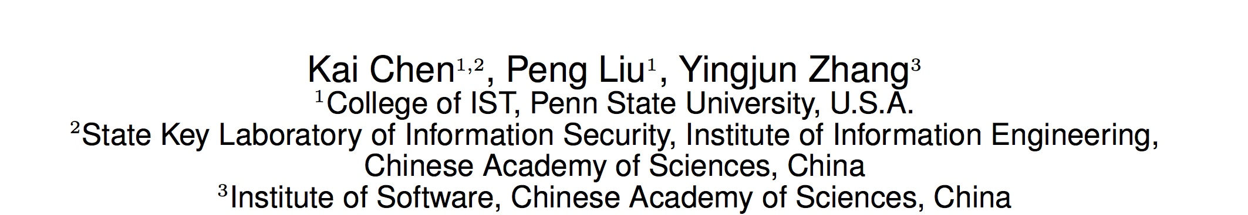
ICSE 2014

Slide 3
Content
1. Overview
2. Centroid of CFGs
3. Method-Level Similarity
4. Evaluation

Slide 4
Overview

Slide 5



A
Overview
Code clones, or similar fragments of source code, bring unwanted problems such as inconsistencies, potential bugs and code smells.
Developers lost advertising revenue and users
Malware prefers to use clones as carriers

Slide 6
A
Overview
Four types of clones
Identical code fragments
Syntactically identical code fragments
Copied code fragments with further modifications
Code fragments that perform the similar computation but implemented through different syntactic variants

Slide 7
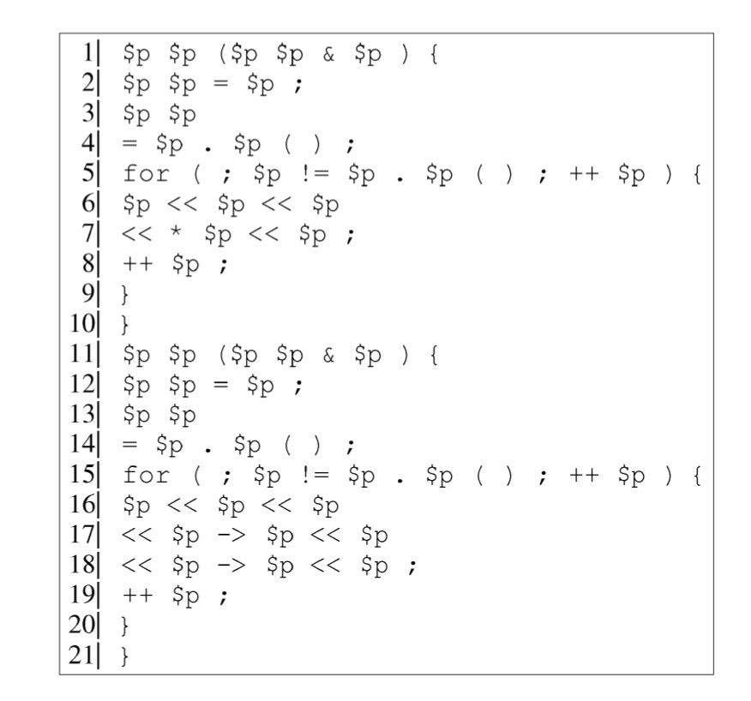
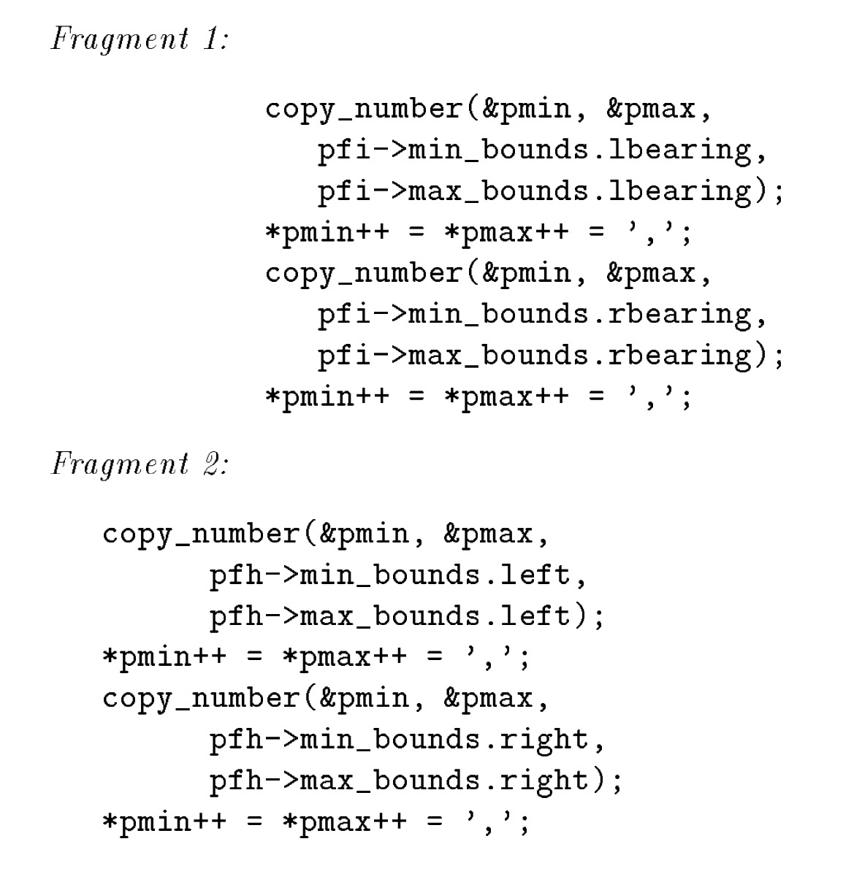
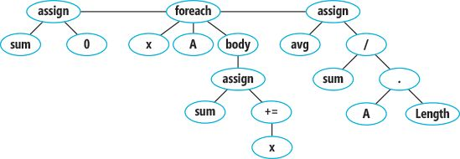
A
Overview
Prior work:
String-based
Token-based
AST-based
PDG-based
…

Slide 8
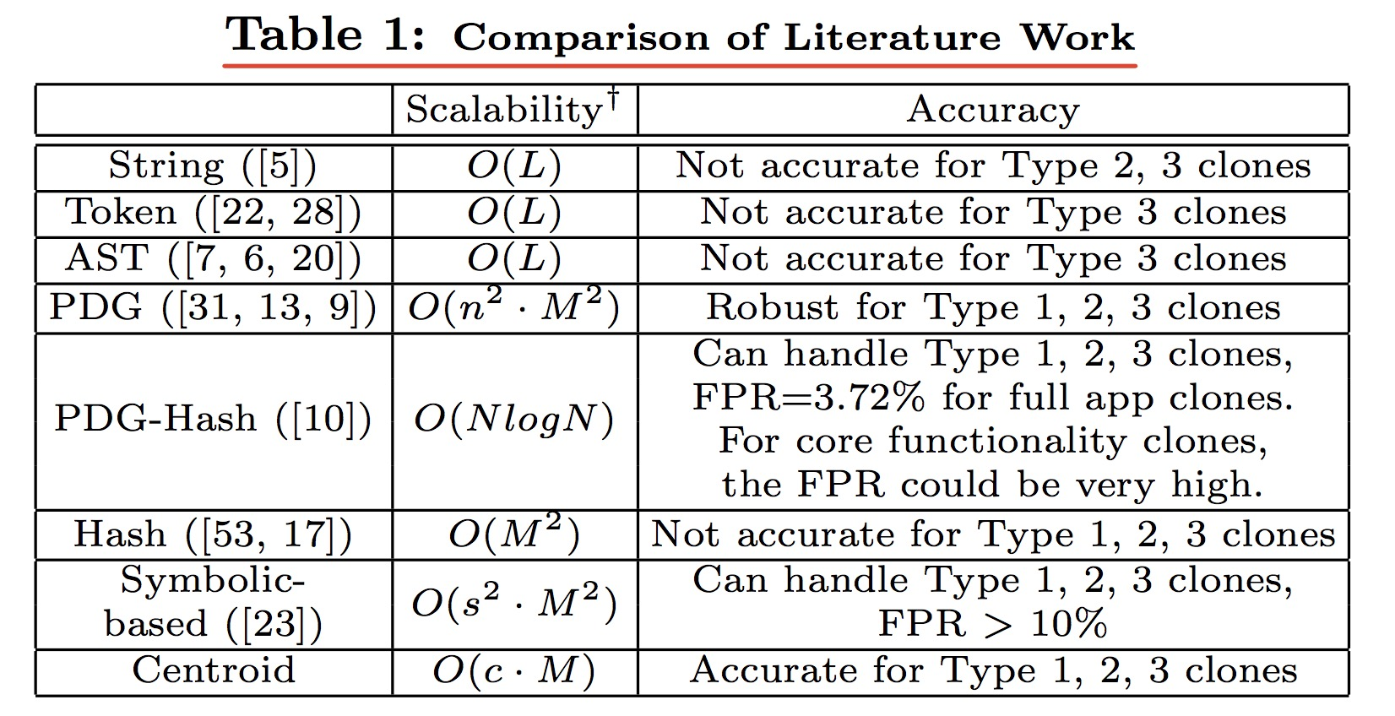
A
Overview
FPR: False Positive Rate

Slide 9
A
Overview
Unique Characteristics of App Clones:
A billion opcode problem
Gap between code fragment clones and app clones
Type 2 and type 3 are prevalent on Android markets

Slide 10
Approach

Slide 11
B
Approach
Step 1: Geometry-characteristic-based encoding of dependency graph.
Step 2: Localized global comparison.
Step 3: Core-functionality- based grouping.

Slide 12
B
Approach
CFG is the control flow graph of a method.
Node
A basic block in the method
Edge
Jumps in the control flow
A
B
C
E
D
F

Slide 13
B
Approach
Centroid (Physical Model) 质心
The “mass” center of an object. 质量中心
When two objects are identical, their centroids are also the same.
Notes:
Given a set P of points in a normed space 𝑙_𝑝^𝑑, preprocess P so as to efficiently return a point p ∈ P for any given query point q, such that d(q, p) ≤ (1+ϵ) d(q, P), where d(q, P) is the distance of q to the its closest point in P.

Slide 14
B
Approach
3D-CFG
A 3D-CFG is a CFG in which each node has a unique coordinate. The coordinate is a vector < x, y, z >.
x is the sequence number in the CFG.
y is the number of outgoing edges of the node.
z is the depth of loop of the node.
Notes:
Given a set P of points in a normed space 𝑙_𝑝^𝑑, preprocess P so as to efficiently return a point p ∈ P for any given query point q, such that d(q, p) ≤ (1+ϵ) d(q, P), where d(q, P) is the distance of q to the its closest point in P.

Slide 15
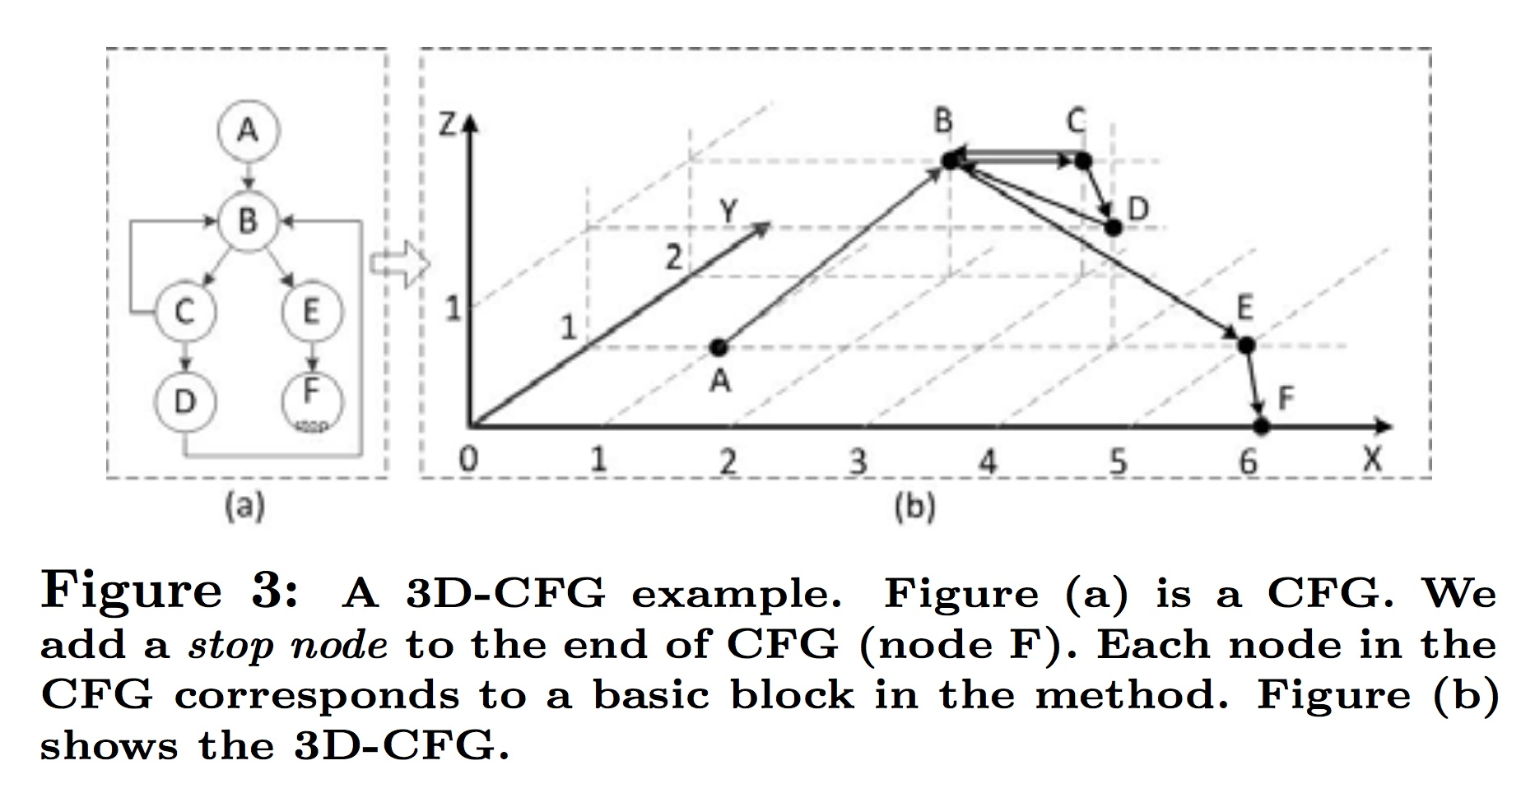
B
Approach
3D CFG

Slide 16
B
Approach
Centroid of 3D-CFG
Notes:
In the equation, e(p, q) is an edge in the 3D-CFG. This edge connects two nodes p and q. < xp, yp, zp > is the coordinate of node p. πp is the number of statements in the basic block of p.

Slide 17
B
Approach
Centroid of 3D-CFG
A
5
π=(5+3)+(3+4)+(3+1)+(4+3)+(4+2)+(2+3)+(1+0)
= 38
3
B
C
4
E
1
Cx=(5×1+3×2×5+4×3×3+2×4×2+1×5×2)/38
= 2.5526
D
2
F
0
c =< 2.5526, 1.7105, 0.8158, 38 >.

Slide 18
B
Approach
Centroid of 3D-CFG
P1) Two same methods have the same centroid.
P2) When a method changes a little, its centroid will not change a lot.

Slide 19

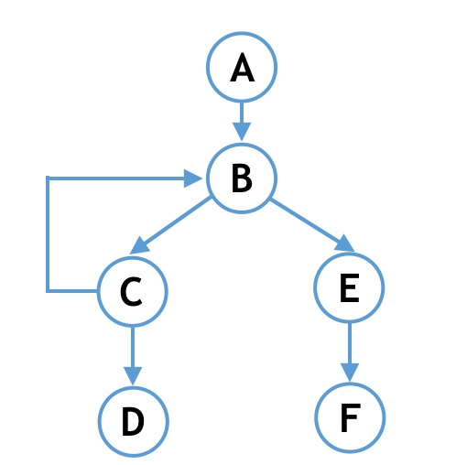
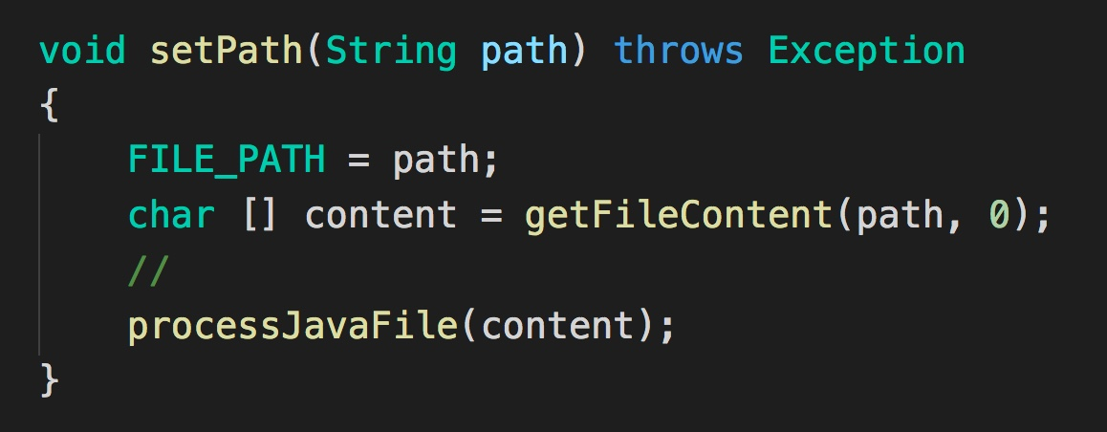
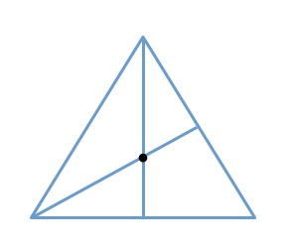
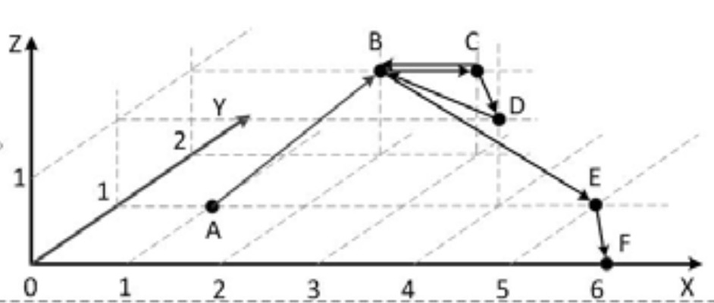
B
Approach
APK files
Java code
2D CFG
Get centroids
3D CFG

Slide 20
Method-Level Similarity

Slide 21
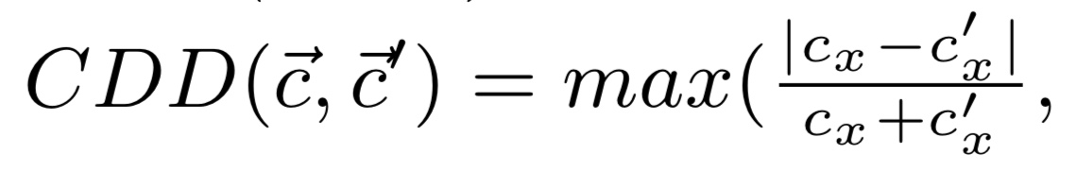
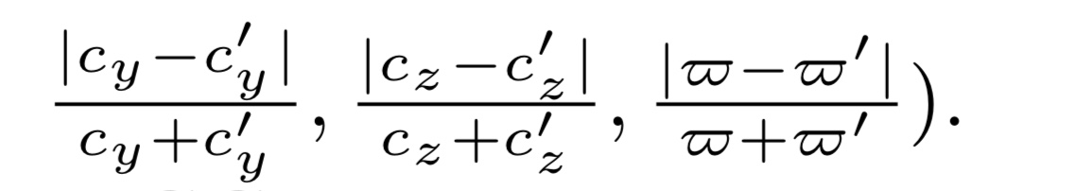


C
Method-Level Similarity
Centroid Difference Degree (CDD)
Methods Difference Degree MDD

Slide 22
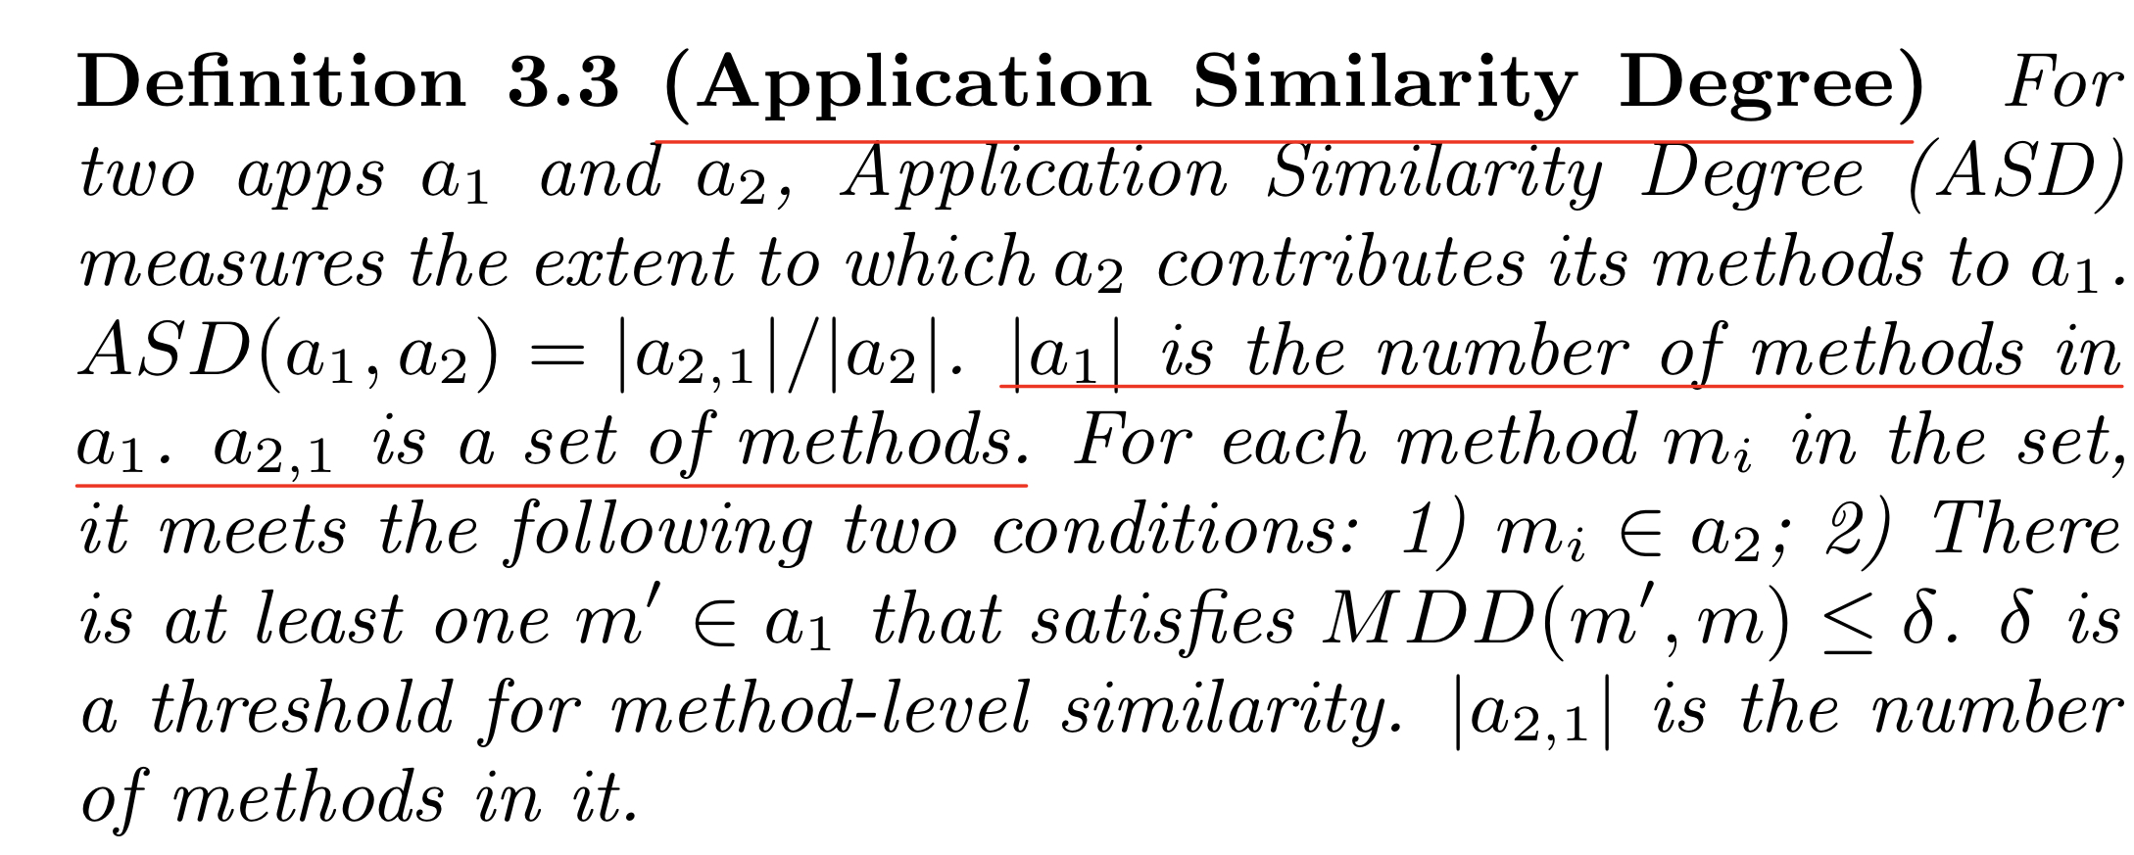
C
Method-Level Similarity
Application Similarity Degree (ASD)

Slide 23
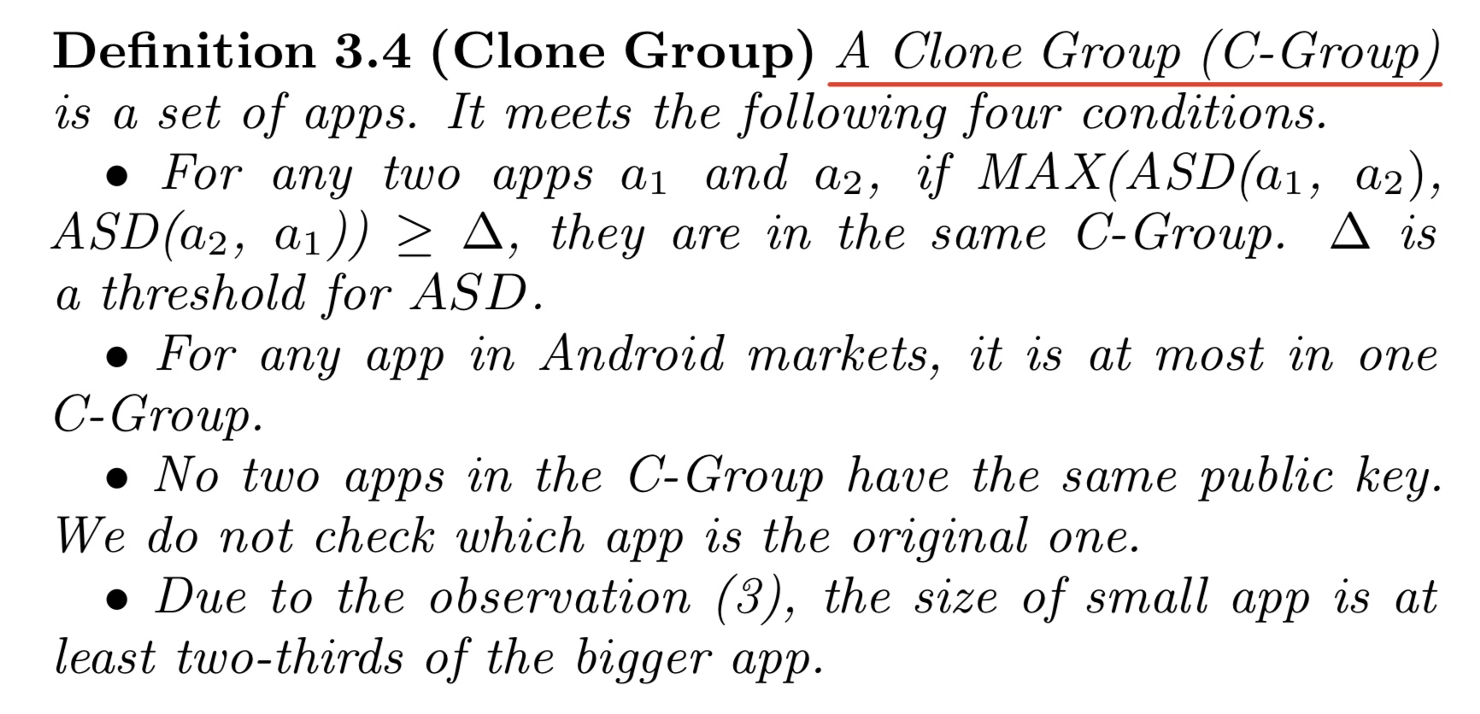
C
Method-Level Similarity
Clone Group (C-Group)

Slide 24
C
Method-Level Similarity
Implementation
(1) use a python script to download apps (APK files) from 5 Android markets
(2) transform APK files to SMALL code using the tool called baksmali
(3) parse the SMALL code and generate 3D-CFGs
(4) give coordinates to the nodes in 3D-CDGs and compute the centroids and put centroids into database

Slide 25
Evaluation

Slide 26
D
Evaluation
Among the 20292 apps
1416 apps from the Pandaapp market
2022 apps from the Slideme market
9850 apps from the Anzhi market
4268 apps from the Dangle market
2736 apps from the Opera market

Slide 27
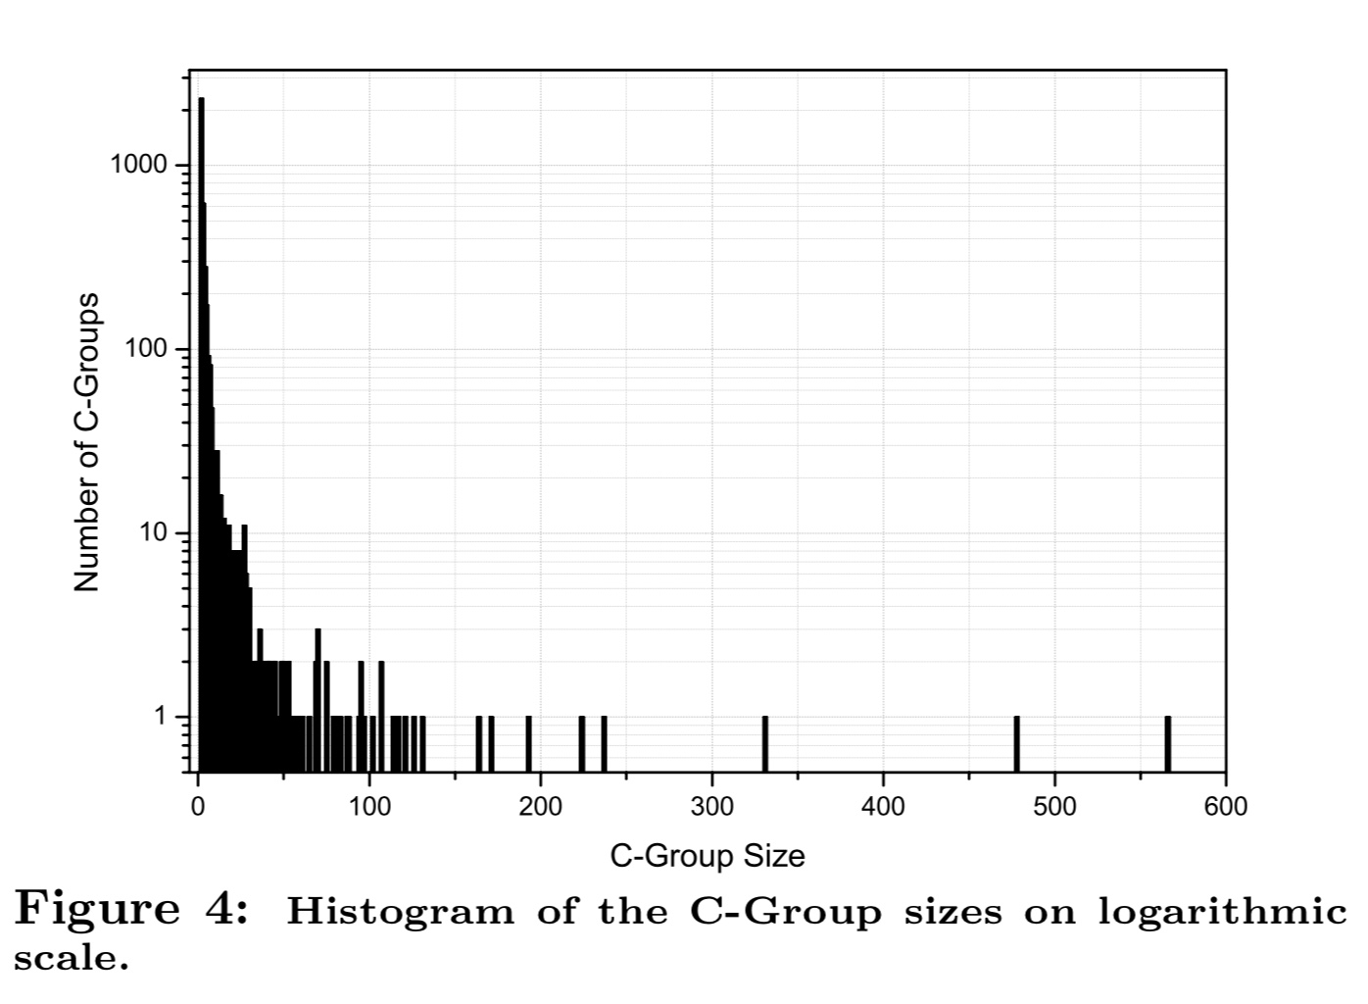
D
Evaluation

Slide 28
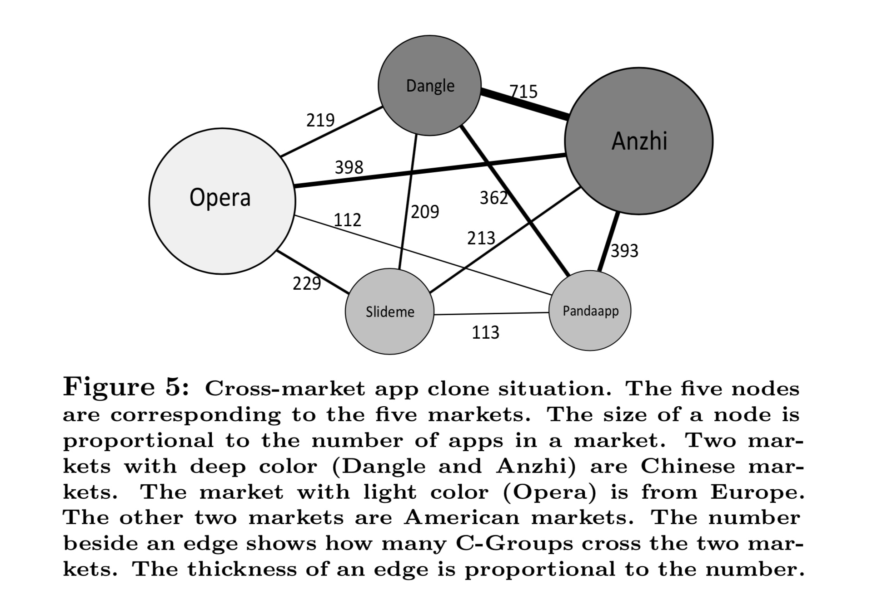
D
Evaluation

Slide 29
D
Evaluation
Limitation
It may not be effective to detect Type 4 clones
Adding one node in small CFGs (with less than 4 nodes) may change the centroids a lot
An app clone could be evade detection by only cloning a small number of methods in the original app
If an app clone has far more opcodes than the original app, we may bot detect it

Slide 30
REF
Achieving Accuracy and Scalability Simultaneously in Detecting Application Clones on Android Markets
On Finding Duplication and Near-Duplication in Large Software System
CCFinder: A Multilinguistic Token-Based Code Clone Detection System for Large Scale Source Code

Slide 31
END
THANKS

