Slide 1

Achieving Accuracy and Scalability
Simultaneously in Detecting Application Clones
on Android Markets
王秋里

Slide 2
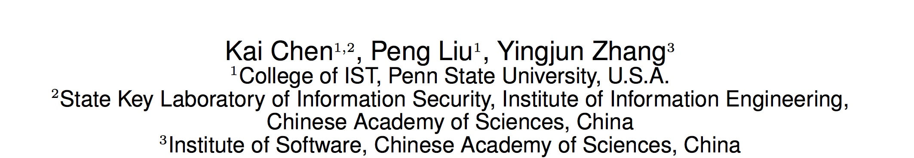
ICSE 2014

Slide 3
Content
1. Overview
2. Centroid of CFGs
3. Method-Level Similarity
4. Evaluation

Slide 4
Overview

Slide 5



A
Overview
Code clones, or similar fragments of source code, bring unwanted problems such as inconsistencies, potential bugs and code smells.
Developers lost advertising revenue and users
Malware prefers to use clones as carriers

Slide 6
A
Overview
Four types of clones
Identical code fragments
Syntactically identical code fragments
Copied code fragments with further modifications
Code fragments that perform the similar computation but implemented through different syntactic variants

Slide 7
A
Overview
Type 1
if (a >= b) {
c = d + b; // Comment1
d = d + 1;}
else
c = d - a; //Comment2
if (a>=b) {
// Comment1'
c=d+b;
d=d+1;}
else // Comment2'
c=d-a;

Slide 8
A
Overview
Type 2
if (a >= b) {
c = d + b; // Comment1
d = d + 1;
}
else
c = d - a; //Comment2
if (m >= n)
{ // Comment1'
y = x + n;
x = x + 5; //Comment3
}
else
y = x - m; //Comment2'

Slide 9
A
Overview
Type 3
if (a >= b) {
c = d + b; // Comment1
d = d + 1;}
else
c = d - a; //Comment2
if (a >= b) {
c = d + b; // Comment1
e = 1; // This statement is added
d = d + 1; }
else
c = d - a; //Comment2

Slide 10
A
Overview
Type 4
int i, j=1;
for (i=1; i<=VALUE; i++)
j=j*i;
int factorial(int n) {
if (n == 0) return 1 ;
else return n * factorial(n-1) ;
}

Slide 11
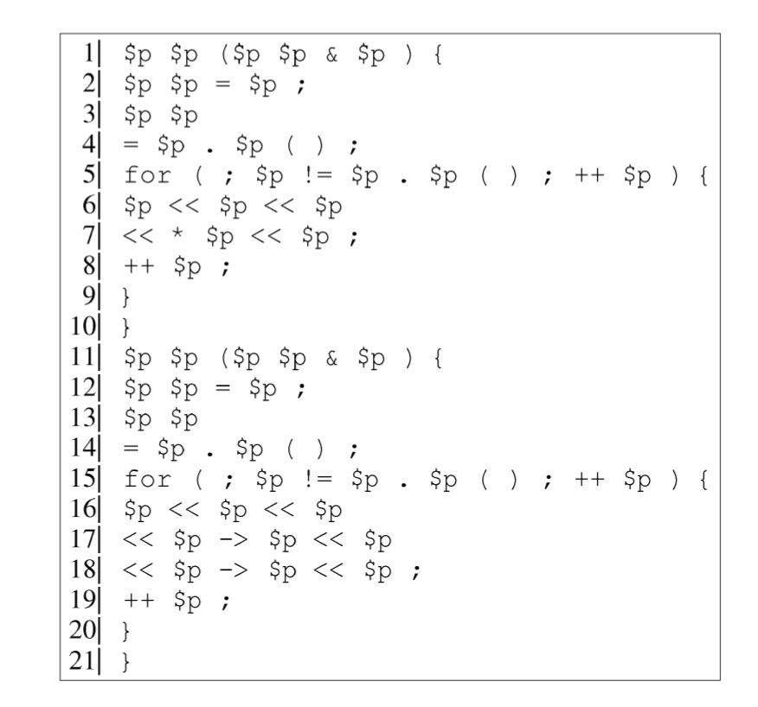
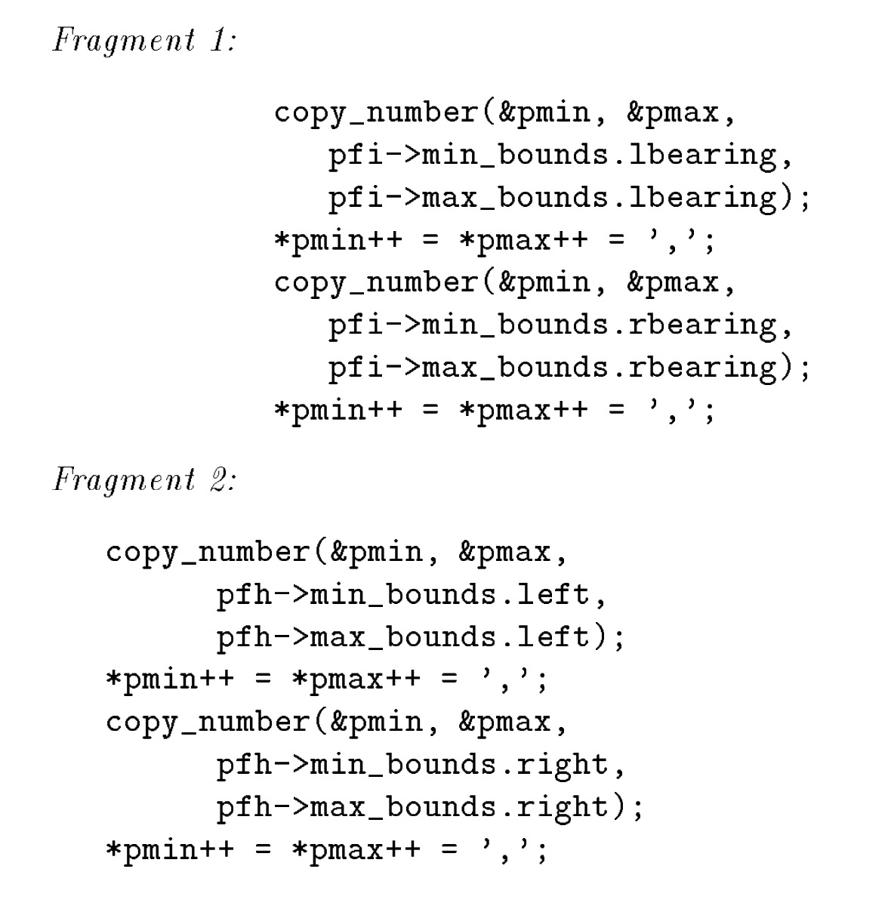
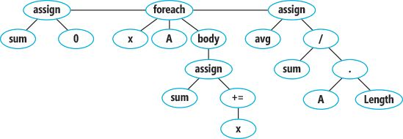
A
Overview
Prior work:
String-based
Token-based
AST-based
PDG-based
…

Slide 12
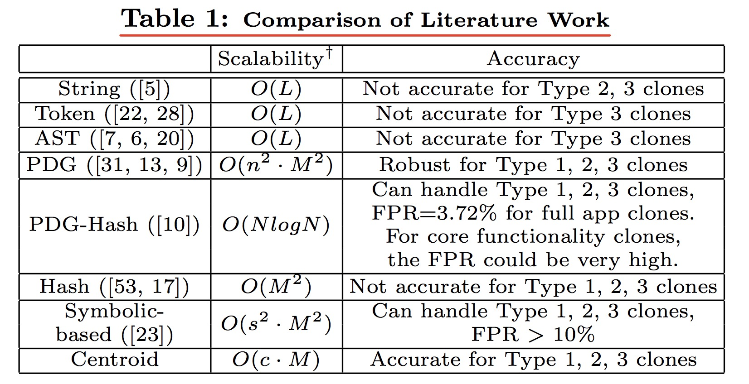
A
Overview
FPR: False Positive Rate
Notes:
Different implementations may have different time complexity. We show the
minimum one. L: the number of statements in all apps. M: the number of
methods in all apps. N: the number of apps. n: the number of PDGnodes. s:
the number of memory states. c: a small number (c <<M. Based on our
evaluation, c ≈ 7.9). FPR: False Positive Rate.

Slide 13
Centroid of CFG

Slide 14
B
Centroid of CFG
CFG is the control flow graph of a method.
Node
A basic block in the method
Edge
Jumps in the control flow
A
B
C
E
D
F

Slide 15
B
Centroid of CFG
Centroid (Physical Model) 质心
The “mass” center of an object. 质量中心
When two objects are identical, their centroids are also the same.

Slide 16
B
Centroid of CFG
3D-CFG
A 3D-CFG is a CFG in which each node has a unique coordinate. The coordinate is a vector < x, y, z >.
x is the sequence number in the CFG.
y is the number of outgoing edges of the node.
z is the depth of loop of the node.

Slide 17
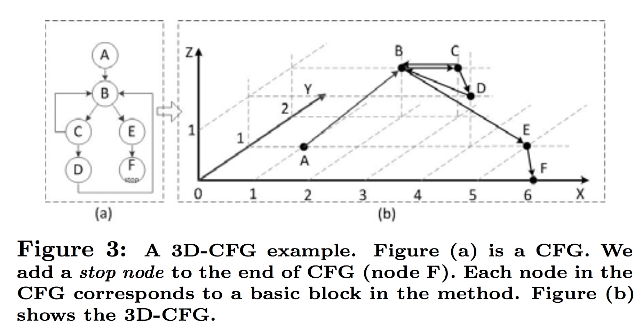
B
Centroid of CFG
3D CFG

Slide 18
B
Centroid of CFG
Centroid of 3D-CFG
Notes:
In the equation, e(p, q) is an edge in the 3D-CFG. This edge connects two nodes p and q. < xp, yp, zp > is the coordinate of node p. πp is the number of statements in the basic block of p.

Slide 19
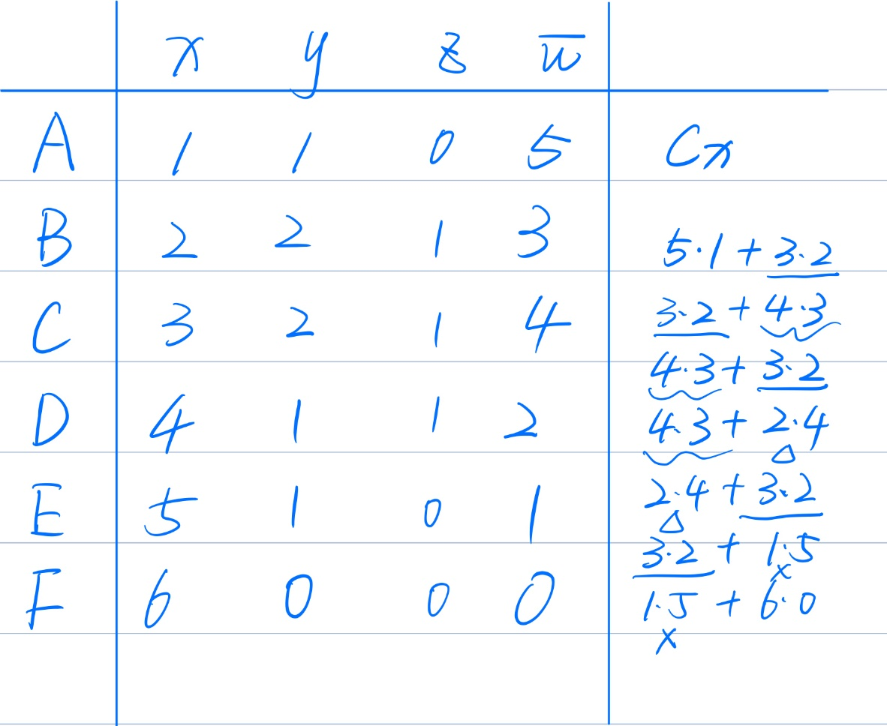
B
Centroid of CFG
Centroid of 3D-CFG
A
5
3
B
C
4
E
1
D
2
F
0

Slide 20
B
Centroid of CFG
Centroid of 3D-CFG
A
5
π=(5+3)+(3+4)+(3+1)+(4+3)+(4+2)+(2+3)+(1+0)
= 38
3
B
C
4
E
1
Cx=(5×1+3×2×5+4×3×3+2×4×2+1×5×2)/38
= 2.5526
D
2
F
0
c =< 2.5526, 1.7105, 0.8158, 38 >.

Slide 21
B
Centroid of CFG
Centroid of 3D-CFG
P1) Two same methods have the same centroid.
P2) When a method changes a little, its centroid will not change a lot.

Slide 22

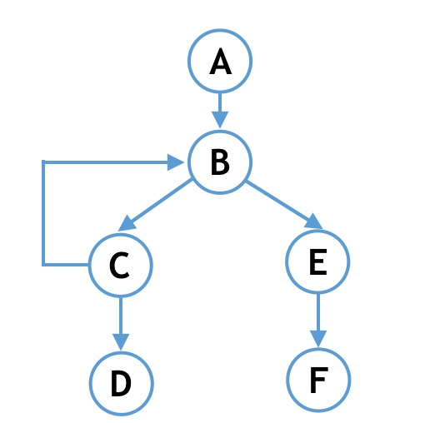
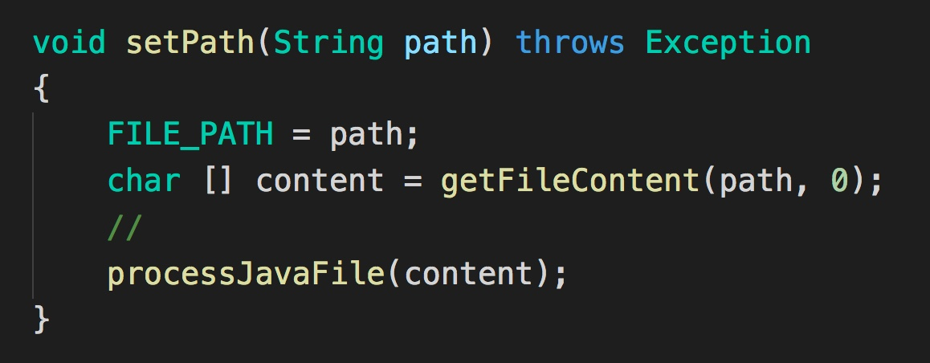
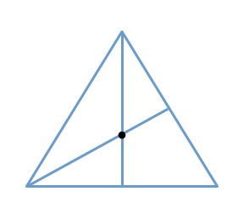
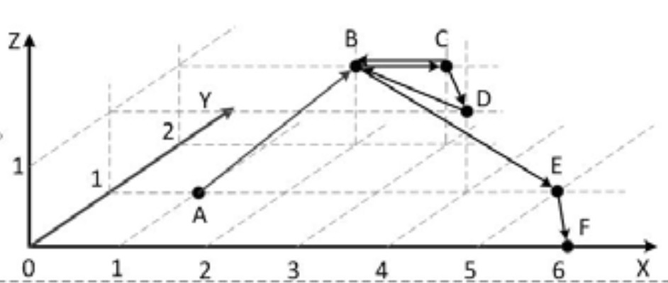
B
Centroid of CFG
APK files
Java code
2D CFG
Get centroids
3D CFG

Slide 23
Method-Level Similarity

Slide 24
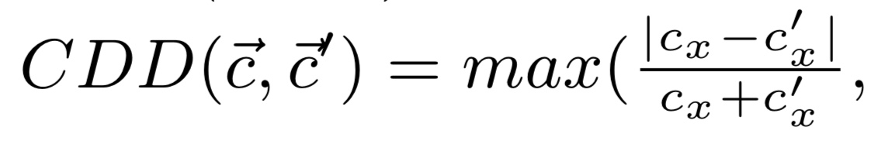
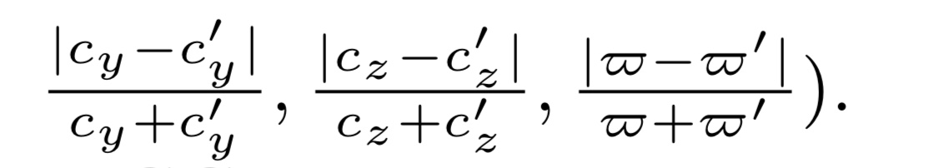


C
Method-Level Similarity
Centroid Difference Degree (CDD)
Methods Difference Degree MDD

Slide 25
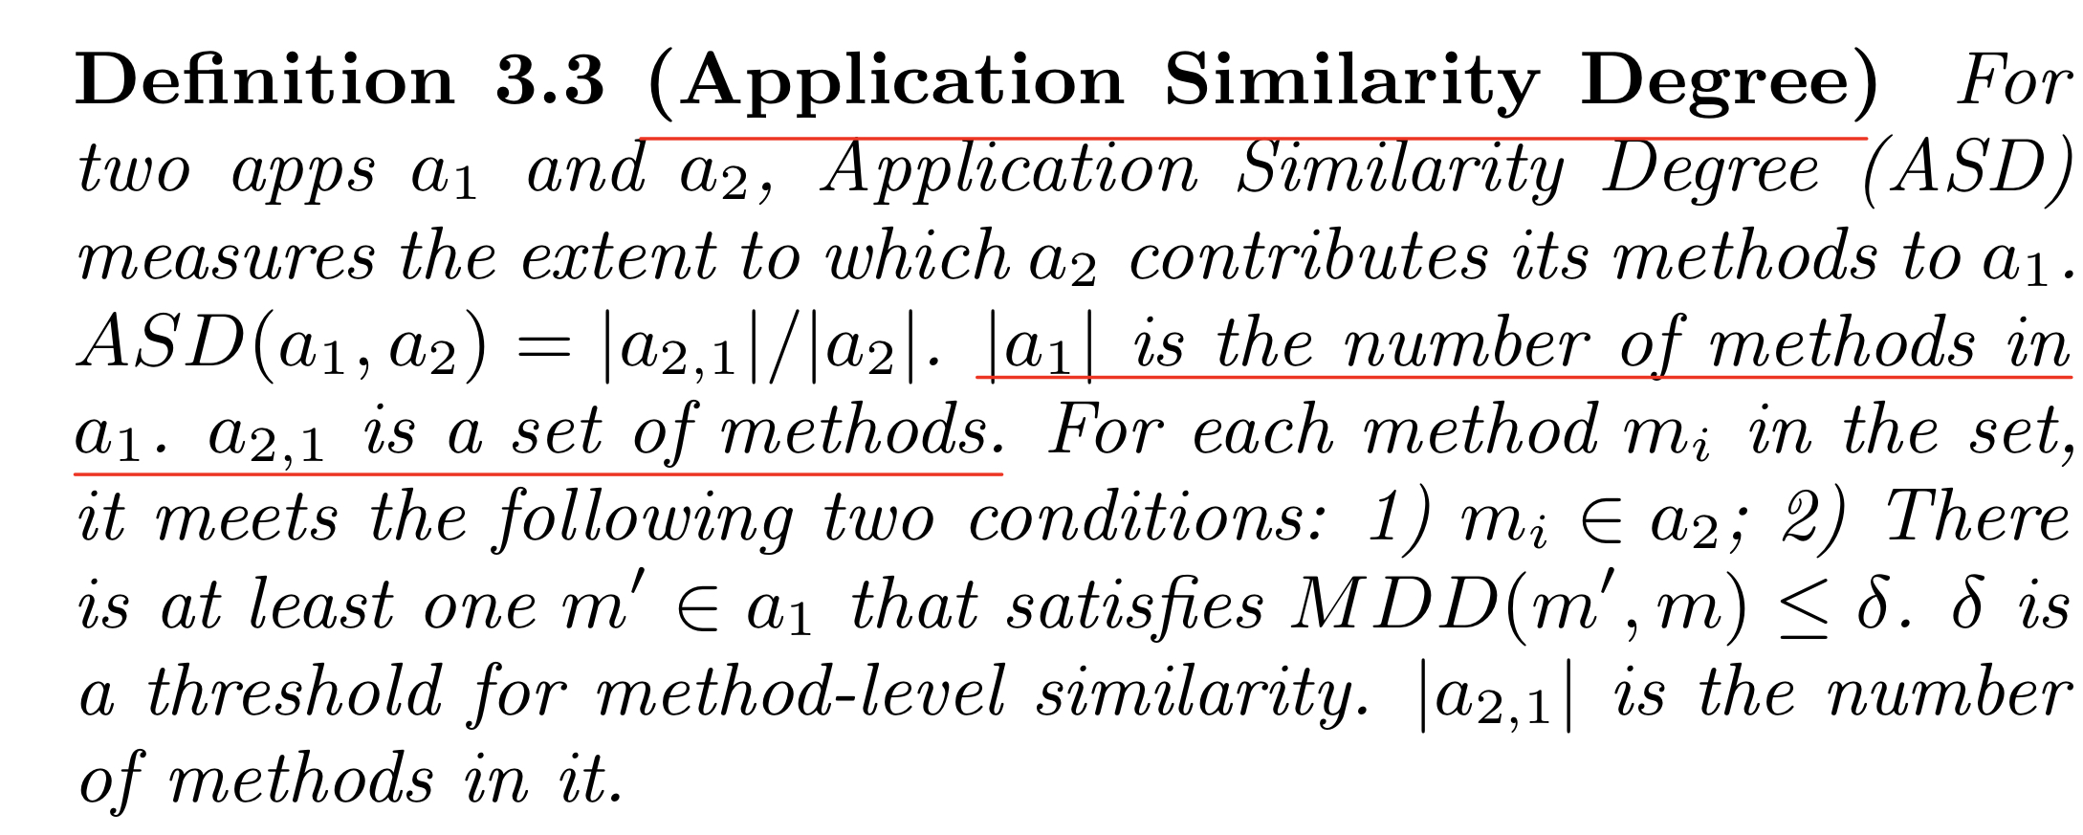
C
Method-Level Similarity
Application Similarity Degree (ASD)

Slide 26
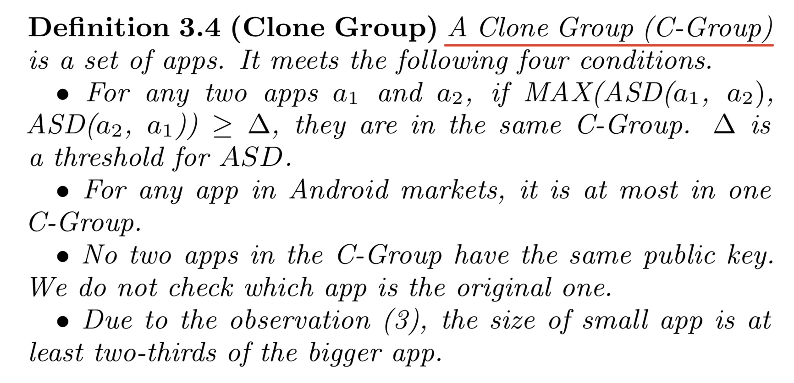
C
Method-Level Similarity
Clone Group (C-Group)

Slide 27
C
Method-Level Similarity
Implementation
(1) use a python script to download apps (APK files) from 5 Android markets
(2) transform APK files to SMALL code using the tool called baksmali
(3) parse the SMALL code and generate 3D-CFGs
(4) give coordinates to the nodes in 3D-CDGs and compute the centroids and put centroids into database

Slide 28
Evaluation

Slide 29
D
Evaluation
Among the 20292 apps
1416 apps from the Pandaapp market
2022 apps from the Slideme market
9850 apps from the Anzhi market
4268 apps from the Dangle market
2736 apps from the Opera market

Slide 30
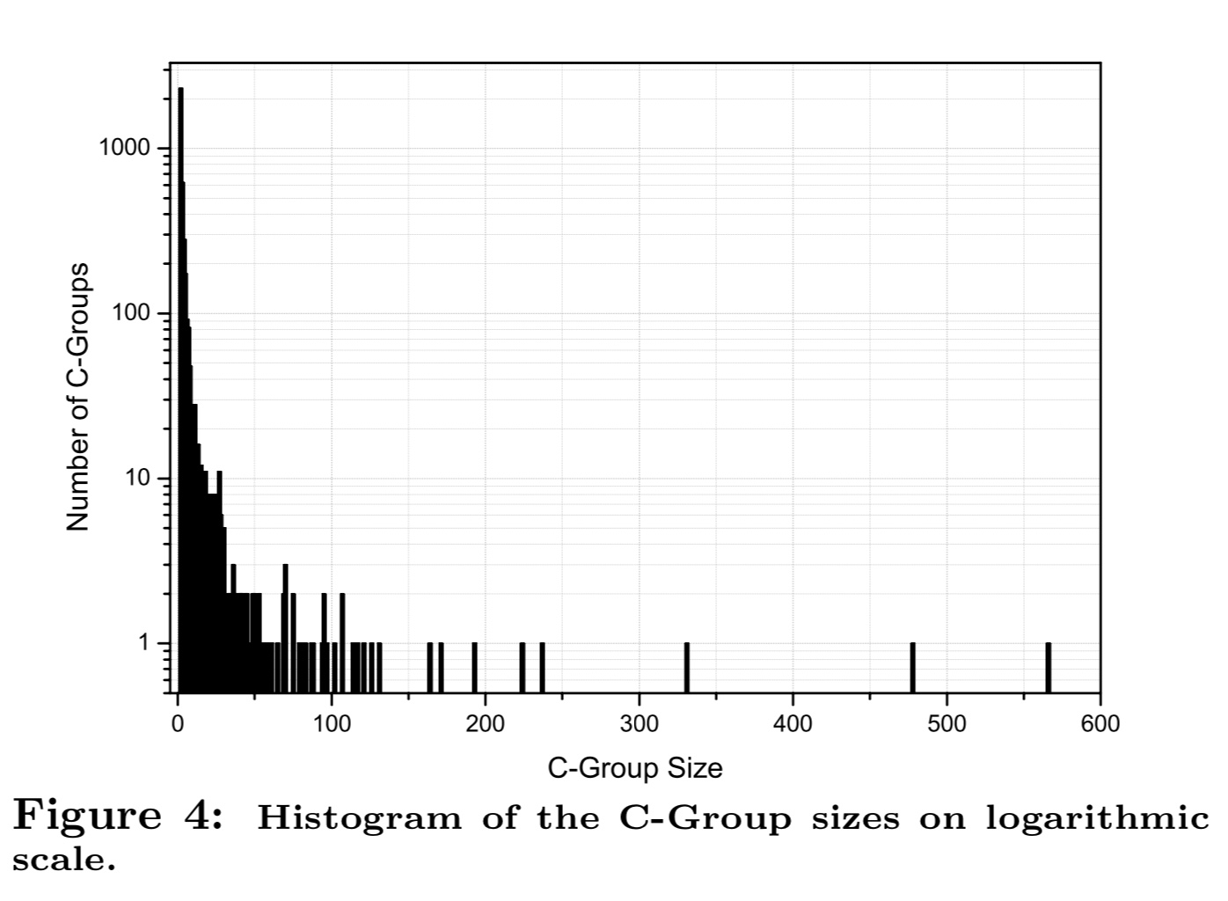
D
Evaluation

Slide 31
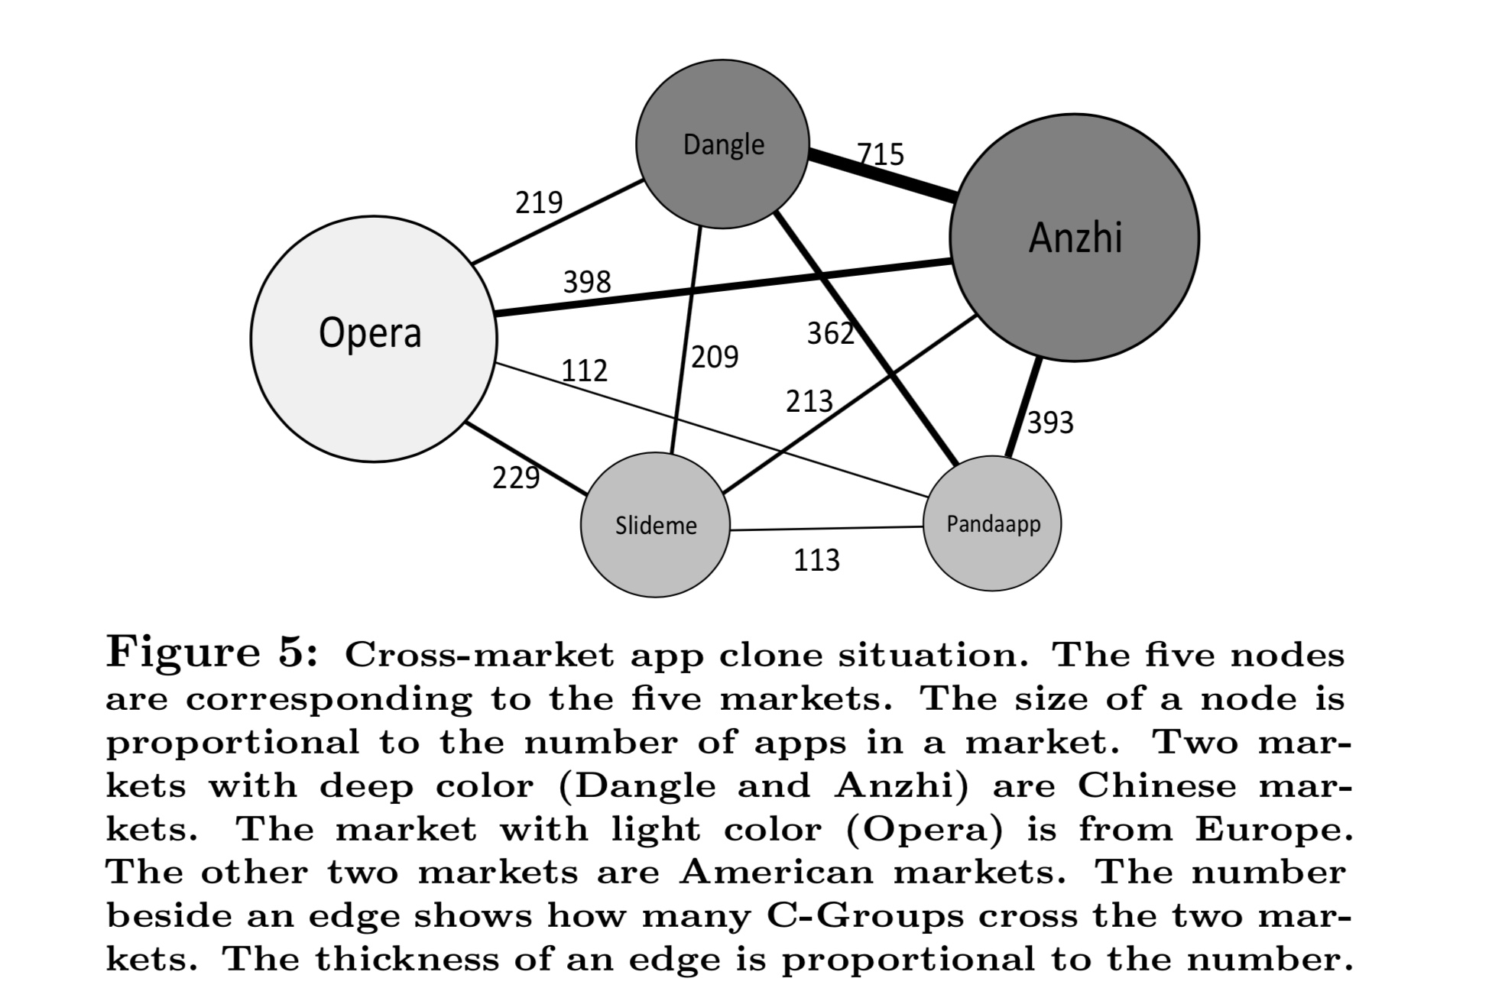
D
Evaluation

Slide 32
D
Evaluation
Limitation
It may not be effective to detect Type 4 clones
Adding one node in small CFGs (with less than 4 nodes) may change the centroids a lot
An app clone could be evade detection by only cloning a small number of methods in the original app
If an app clone has far more opcodes than the original app, we may bot detect it

Slide 33
实验
1. Android APK文件的反编译
2. APK文件的爬取

Slide 34
实验
1. Android APK文件的反编译
APK文件
dex文件
jar文件
apktool解压
dex2jar2
7zip
.java文件
.class文件
JAD

Slide 35


实验
Android APK文件的反编译
apktool d test.apk
d2j-dex2jar.bat classes.dex
7zip解压
jad -o -r -sjava -dsrc tree/**/*.class

Slide 36
实验
2. APK文件的爬取
https://github.com/QyMars/APKSpider
APKSpider 使用Python实现对于小米商城中的APK进行爬取，实现自动化爬取功能

Slide 37
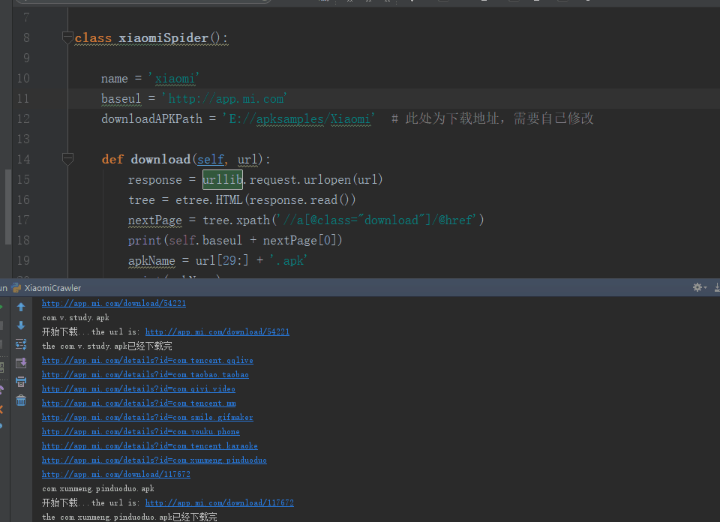
2. APK文件的爬取

Slide 38
REF
Achieving Accuracy and Scalability Simultaneously in Detecting Application Clones on Android Markets
On Finding Duplication and Near-Duplication in Large Software System
CCFinder: A Multilinguistic Token-Based Code Clone Detection System for Large Scale Source Code

Slide 39
END
THANKS

