Slide 1
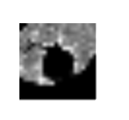
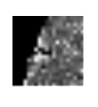


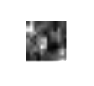




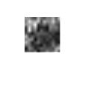
1
1193
550
2254
subtlety
lobulation
spiculation

Slide 2


















input
subtlety
lobulation
spiculation
malignancy

Slide 3
input
subtlety
lobulation
spiculation
malignancy

