Slide 1
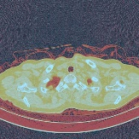
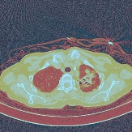
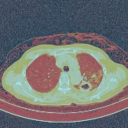
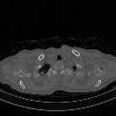
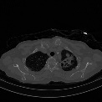
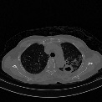
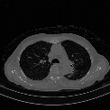
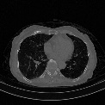
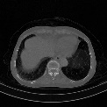
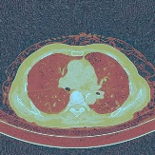
Age, Gender
Loss2
ResNet
Dropout
000000001
男
1999/10/29
咳嗽发热、畏寒、活动后气促伴心悸20余天。
Image
slices
ResNet
Loss1
ResNet
Dropout
LSTM
ResNet
Dropout
Complants
Concatenation
Word2vec
LSTM
$$Loss=\left(1−ω\right)loss1+ωloss2$$
Feature Learning
Prediction

