Slide 1
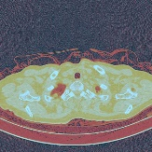
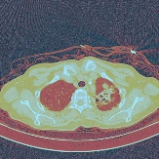
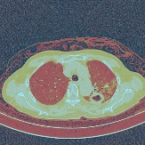
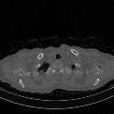
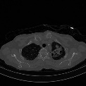
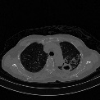
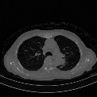
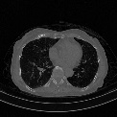
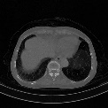
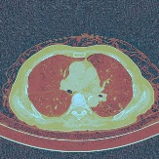

Age, Gender
Φ2
ResNet
Dropout
000000001
男
1999/10/29
咳嗽发热、畏寒、活动后气促伴心悸20余天。
Image
slices
ResNet
Φ1
ResNet
Dropout
LSTM
ResNet
Dropout
Complants
Concatenation
Word2vec
LSTM
$$Loss=\left(1−ω\right)\text{Φ}\text{1}+ω\text{Φ}\text{2}$$
Feature Learning
Prediction

Slide 2
Age, Gender
Φ2
000000001 男
1999/10/29
咳嗽发热、畏寒、活动后气促伴心悸20余天。
Complants
Dropout
Φ1
Word2vec
LSTM
ResNet
Dropout
Image
slices
Dropout
ResNet
ResNet
Concatenation
LSTM
ResNet
$$Loss=\left(1−ω\right)\text{Φ}\text{1}+ω\text{Φ}\text{2}$$
Feature Learning
Prediction

