Slide 1
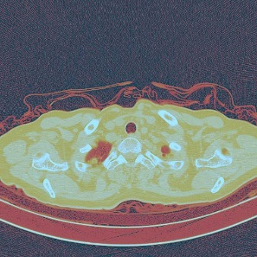
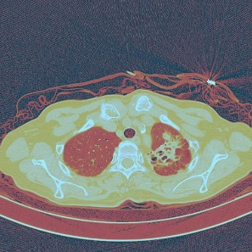
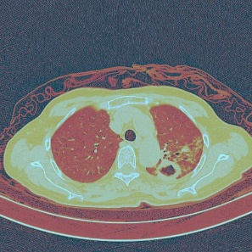
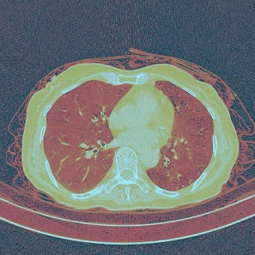
CNN
CNN
CNN
CNN
……
Global average pooling
Global average pooling
Global average pooling
Global average pooling
Fully Connected Layer
Fully Connected Layer
Fully Connected Layer
Fully Connected Layer
LSTM
Fully Connected Layer
Fully Connected Layer
Outputs

