Slide 1
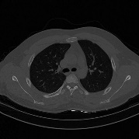
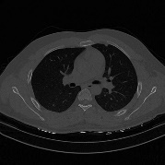
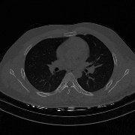
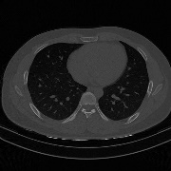
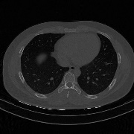
CT
slices
Visual Features
Sequence Learning
Lung window
CNN1
Concat
RNN
Output
Chest window
CNN2
Lung window
CNN1
Concat
RNN
Output
Chest window
CNN2
Lung window
CNN1
Concat
RNN
Output
Ignored
Chest window
CNN2
…
…
…
…
…
…
Lung window
CNN1
Concat
RNN
Output
Chest window
CNN2
Lung window
CNN1
Pneumonia
Concat
RNN
FC
Chest window
CNN2
Healthy

