Slide 1
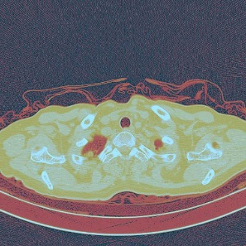
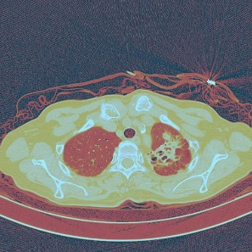
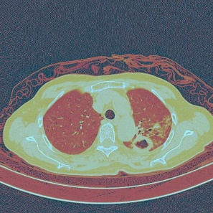
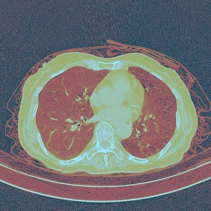
512 x 512
ResNet50
ResNet50
ResNet50
ResNet50
14 x 14 x 2048
……
Global average pooling
Global average pooling
Global average pooling
Global average pooling
1 x 2048
Fully Connected Layer
Fully Connected Layer
Fully Connected Layer
Fully Connected Layer
1 x 256
1 x 256
LSTM
1 x 256
Fully Connected Layer
1 x 2
Fully Connected Layer
Outputs

