Slide 1
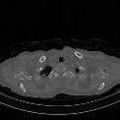
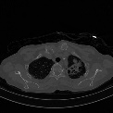
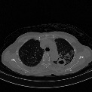
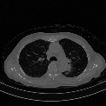
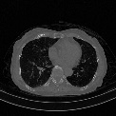
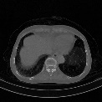
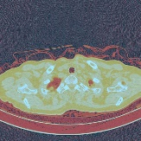
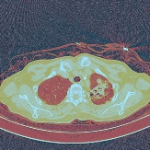
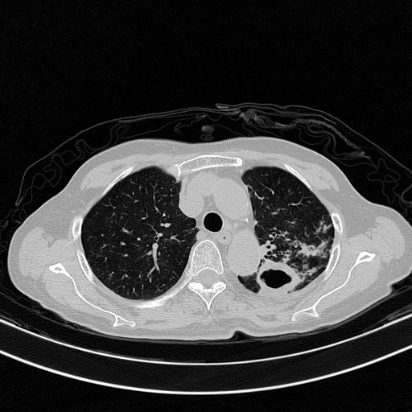
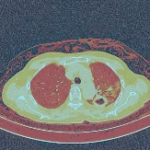
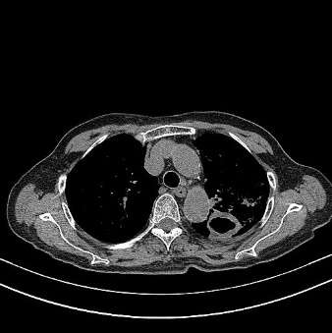
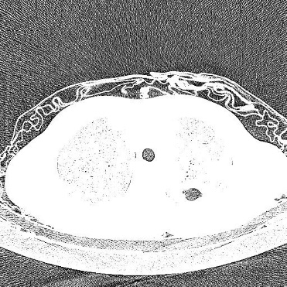
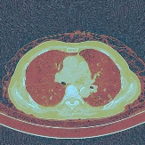

Age, Gender
Pneumonia
Further Treatment
Priori Information
Complants
Diagnosis
Location, Symptoms…
CT(Lung Window)
Healthy
Lung General Visual Features
CT(Mediastinal Window)
Supplement Visual Features
Age, Gender
Φ2
000000001 男
1999/10/29
咳嗽发热、畏寒、活动后气促伴心悸20余天。
Complants
Dropout
Φ1
Word2vec
LSTM
ResNet
Dropout
Image
slices
Dropout
ResNet
LW
Concatenation
HA
ResNet
LA
ResNet
LSTM
$$Loss=\left(1−ω\right)\text{Φ}\text{1}+ω\text{Φ}\text{2}$$
Feature Learning
Prediction

