Slide 1
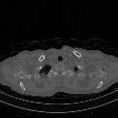
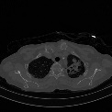
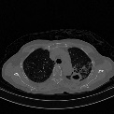
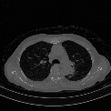
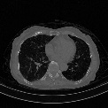
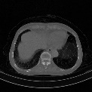
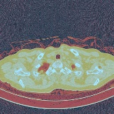
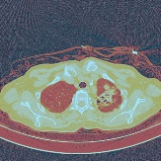
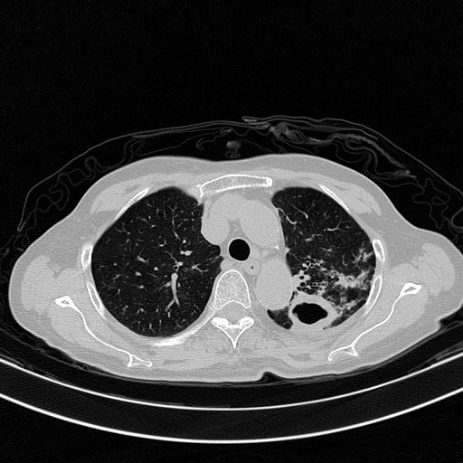
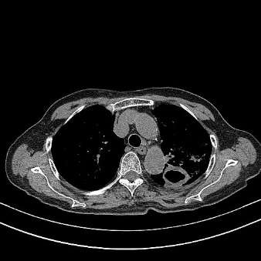
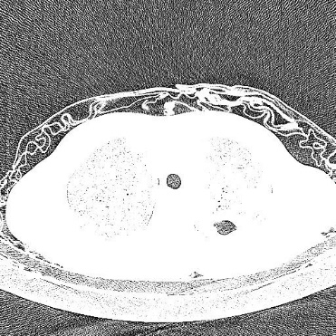
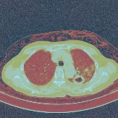
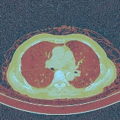

Age, Gender
Auxiliary Loss
Φ2
Dropout
000000001 男
1999/10/29
咳嗽发热、畏寒、活动后气促伴心悸20余天。
Complaints
Detection Loss
Φ1
Word2vec
LSTM
Dropout
ResNet
Dropout
Image
Slices
LW
ResNet
HA
LA
ResNet
Concatenation
Three-Channel
Transform
LSTM
ResNet
$$Loss=\left(1−ω\right)\text{Φ}\text{1}+ω\text{Φ}\text{2}$$
Feature Learning
Regression

