Slide 1
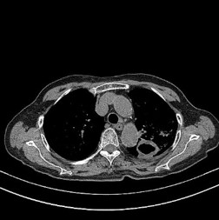
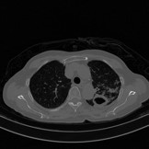

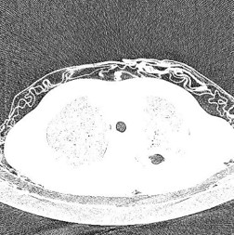
Clinical
Information
High Attenuation Information
Chief complaints
Lung Window
Information
Multimodal Regression Network
Detection Results
Original CT Images
Low Attenuation Information
Age, Gender
Demographic
Information
CT Image
Visual Features

