Slide 1
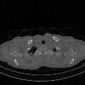
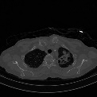
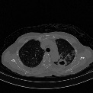
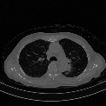
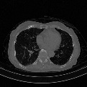
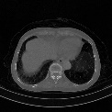
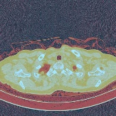
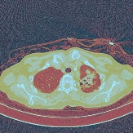
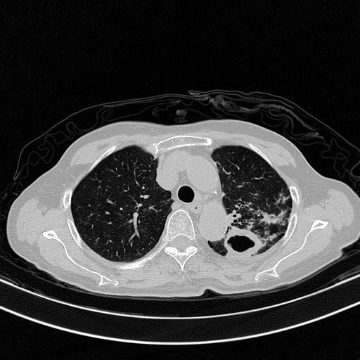
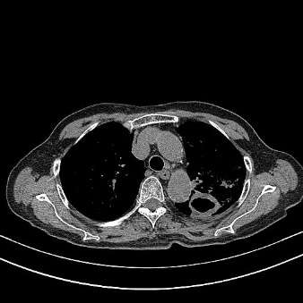
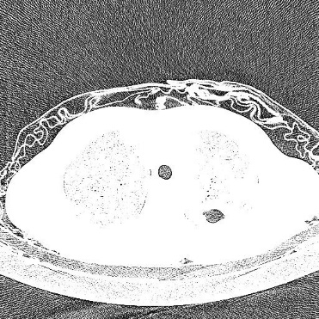
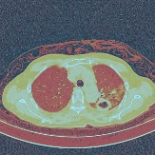
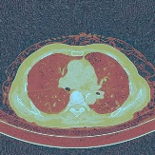
Age, Gender
Concatenation
Confounding Factors
1
Complaints
Detection Loss
000000001 男
1999/10/29
咳嗽发热、畏寒、活动后气促伴心悸20余天。
Φ
Word2vec
Dropout
2
LSTM
Dropout
ResNet
Regression
Image
Slices
LW
ResNet
HA
LA
ResNet
LW : Lung Window
HA : High Attenuation Window
LA : Low Attenuation Window
Three-Channel
Transform
LSTM
ResNet
3
Feature Learning

